Slide 1
Risk Ratios, Odds Ratios, and Logistic Regression
February 23, 2025

Slide 2
Introduction
Logistic regression is used when the dependent variable is qualitative (e.g., Yes/No)
Recall
A qualitative variable (also known as categorical) is not numerical, and its values fit into categories. It is also divided into two types:
Nominal: no ordering is possible or implied in the categories (for example sex at birth);
Ordinal: an order is implied in the categories (for example the health status, such as poor/reasonable/good, a Likert scale)
A binary variable, also known as dichotomous, is a special case of a qualitative nominal variable when there are only two categories.

Slide 3
Research Questions & Methodological Approaches
Medicine
Estimate the risk factors associated with a disease or a harmful condition
Predict the risk of developing a disease based on a patient’s medical history
Determine the most “important” biological factors associated with a specific disease or condition
Economics/Business
Estimate a debtor’s likelihood to default on a loan based on creditworthiness
Model a customer’s propensity to buy a certain product or service given a demographic profile
Psychology/Social Work
Estimate the probability of developing PTSD following trauma
Political Science
A question I examined ad nauseum in graduate school: What predicts voting behavior?

Slide 4
Generalized Linear Models
Two categories
Binary logistic regression is used when the goal is to estimate the relationship between a binary dependent variable (= two outcomes), and one or more independent variables (of any type)
More than two categories
Multinomial logistic regression is used when the goal is to estimate the relationship between a nominal dependent variable with three or more unordered outcomes, and one or more independent variables (of any type).
More than two ordered categories
Ordinal logistic regression is used when the goal is to estimate the relationship between an ordinal dependent variable with three or more ordered outcomes, and one or more independent variables (of any type).
Categorical regressions (i.e., of the logistic family) (and Poisson regression) are both part of a broader type of model called generalized linear models (abbreviated as GLM).

Slide 5
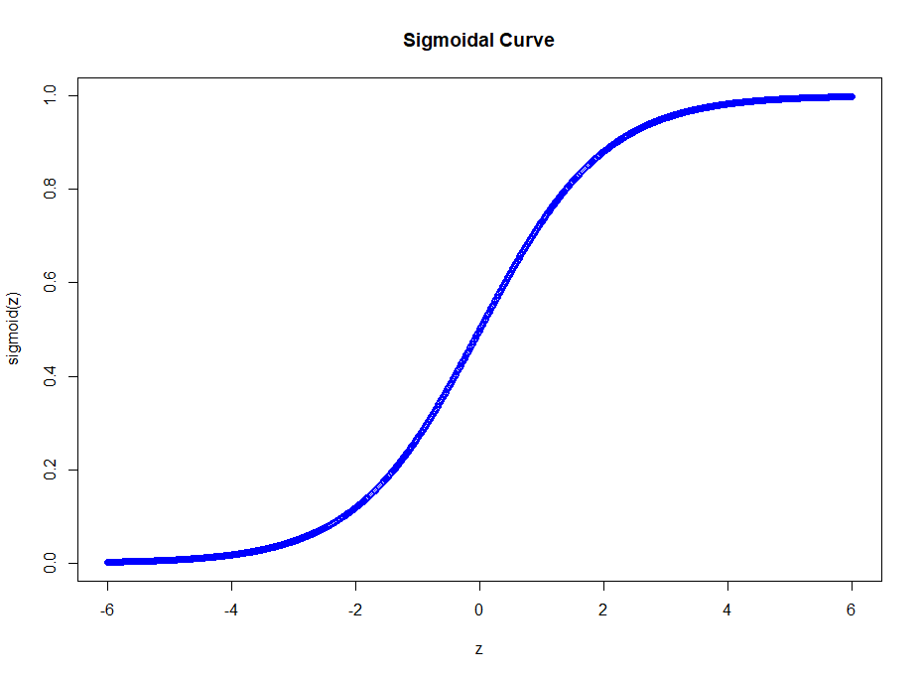
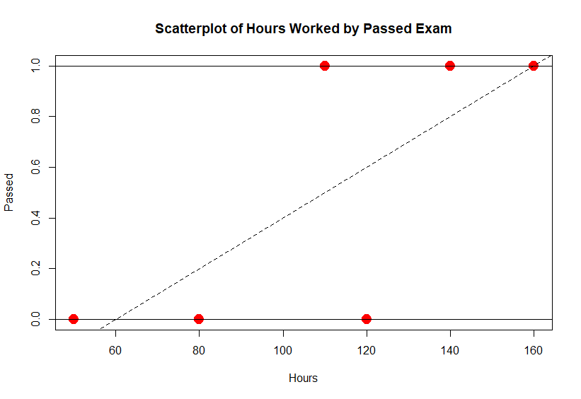

The sigmoidal function models the probability that Y = 1 conditional on X (i.e., values falling along the x-axis); using the logit function ensures that the Y values will be between 0 and 1 for all values of X (i.e., no matter the range of X)
Linear vs. Logistic Regression
Notes:
Logistic
The model is nonlinear (aka sigmoidal)

Slide 6
Univariate versus multivariate logistic regression
Univariate binary logistic regression includes one independent variable
Multivariate binary logistic regression includes two or more independent variables
Variables can be quantitative or qualitative

Slide 7
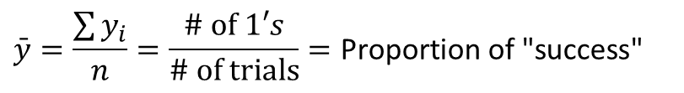
Mechanics of Logistic Regression
A regression where the dependent variable is measured 0/1 (pass/fail; vote/didn’t vote, etc.)
In ordinary regression the model predicts the mean of Y for any combination of predictors
Goal of logistic regression: Predict the “true” proportion of success, p, at any value of the predictor.
What’s the “mean” of a 0/1 indicator variable?
$$\bar{y}=\frac{\sum{y_{i}}}{n}=\frac{\# \text{of} 1′s}{\# \text{of} \text{trials}}=\text{Proportion} \text{of}\text{ "}\text{success}\text{"}$$
p = Proportion of “Success”

Slide 8
From Odds to Probability and Back Again
Binary logistic regression models the probability that Y = 1.
For example, if Y = 1 if the student passed, and 0 otherwise, we are modeling the likelihood that the student passes or not (conditional on the independent variables in the model)
This likelihood will be framed as a probability

Slide 9
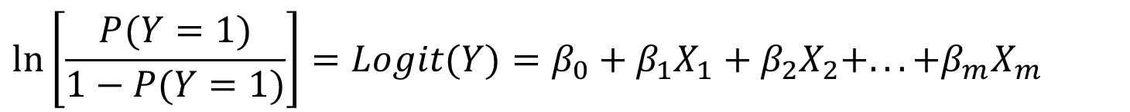
Recall the relation between odds and probability
Odds and logit (or log odds)
In logistic regression, we model the probability P(Y = 1) as a function of the independent variables, X.
Instead of modeling the variables as a function of X’s directly (which are bounded between 0 and 1) we transform it into odds. Then to make the relationship linear, we take the natural logarithm of the odds (log-odds). The transformation is called the logit function. Taking the log of the odds transforms the scale further into an unbounded linear range
$$Y=β_{0}+β_{1}X_{1}+β_{2}X_{2}+...+β_{m}X_{m}$$
$$\ln\left[\frac{P(Y=1)}{1−P(Y=1)}\right]=Logit(Y)=β_{0}+β_{1}X_{1}+β_{2}X_{2}+...+β_{m}X_{m}$$

Slide 11
Linear Regression WILL NOT work
If we were to model the probability of an event occurring given X, this would be problematic because a linear model can predict values outside of the interval [0,1]
If we used OLS, we would run into other issues
Non-linearity: the relationship between X’s and P(Y=1) is often S-shaped rather than strictly linear; and
OLS assumptions will be violated
To overcome these issues, we take the log of odds, i.e., logit, transformation

Slide 12
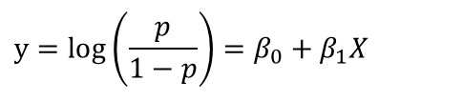
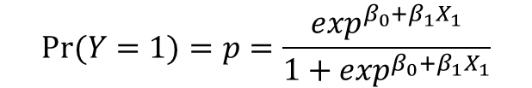
Equivalent forms of the logistic regression model
Y = Binary response
X = Quantitative predictor
Logit form
Probability form
$$y=log\left(\frac{p}{1−p}\right)=β_{0}+β_{1}X$$
$$Pr⁡(Y=1)=p=\frac{\exp^{β_{0}+β_{1}X_{1}}}{1+\exp^{β_{0}+β_{1}X_{1}}}$$
This is natural log (aka “ln”)
p = proportion of 1’s (yes, success) at any X
Log Odds
Probability
Notes:
where π (0≤π≤1) is the probability of an event happening (success) and denoted π=P(success). We find the estimates for β0, β1, …, βp, using the maximum likelihood method. This method is one of several methods used in statistics to estimate parameters of a mathematical model. The goal of the estimator is to estimate the parameters β0, β1, …, βp which maximize the log likelihood function.

Slide 13
Mechanics of Logistic Regression
Logit of Y equation interpretation: For each one-unit change in the independent variable, the log odds of Y increases (decreases) by the beta coefficient
Problem: nobody knows what log odds are!
Exponentiate the logit (Y) (i.e., the outcome of the logistic regression equation), to convert it back to the odds
Interpret the independent variables as affecting the odds (rather than log odds) of the outcome
Convert odds to probability: Probability values close to one indicate increased likelihood of occurrence
Much more intuitive

Slide 14
Model fit
Overall logistic regression model determines the extent to which the predicted values accurately represent the observed values (Xie, Pendergast, & Clarke, 2008)
Change in log likelihood
Hosmer and Lemeshow goodness-of-fit test
Pseudo-variance explained
Predicted group membership
Significance tests: Beta coefficients
Each logistic regression coefficient determines if the individual coefficients are statistically significantly different from zero

Slide 15
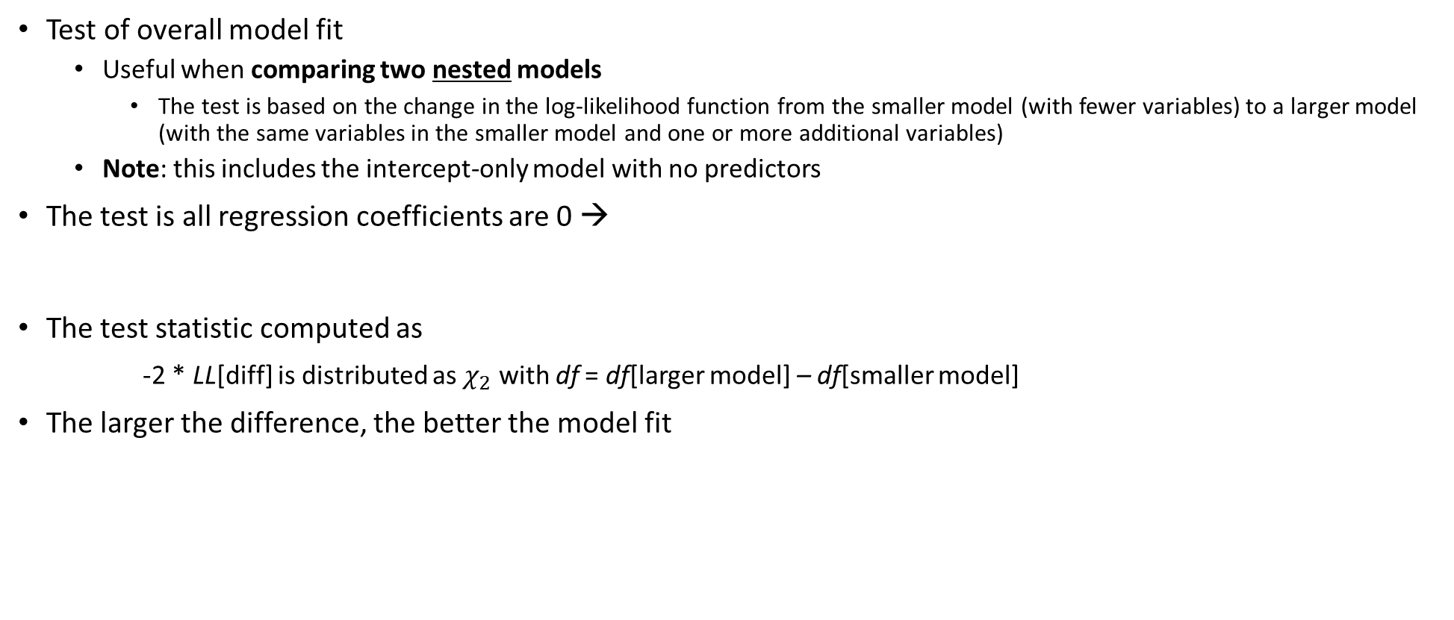


Change in Log Likelihood test for model fit (1)
Test of overall model fit
Useful when comparing two nested models
The test is based on the change in the log-likelihood function from the smaller model (with fewer variables) to a larger model (with the same variables in the smaller model and one or more additional variables)
Note: this includes the intercept-only model with no predictors
The test is all regression coefficients are 0 →
The test statistic computed as
-2 * LL[diff] is distributed as $χ_{2}$ with df = df[larger model] – df[smaller model]
The larger the difference, the better the model fit
$H_{0}:β_{1}=β_{2}…$ $β_{m}=0$
$$H_{1}:at least one β ≠0$$

Slide 16
Predicted Group Membership for determining model fit (2)
If the predicted probability is above a cutoff (usually .5) assign 1, otherwise 0
A crosstab table of predicted to observed probabilities provides the frequency and percentage of cases correctly classified
A perfect model produces 100% correctly classified cases
A model that classifies no better than chance would provide 50% correctly classified cases.

Slide 17
Terminology for Predicted Group Membership table (1)
Sensitivity is the probability that the dependent variable was coded as a “1” and our model predicted a “1” i.e., it was classified correctly
The percentage of correct predictions of the cases that are coded as 1 for the dependent variable
Example: You have the disease and we said you did
Specificity is the probability that a case-coded dependent variable was coded as a “0” and our model predicted a “0” i.e., it was classified correctly
The percentage of correct predictions of the cases that are coded as 0 for the dependent variable
Example: You don’t have the disease and we said you didn’t

Slide 18
Terminology for Predicted Group Membership table (2)
False positive rate is the probability that a negative case (Y = 0 actually) is incorrectly classified.
The model wrongly predicts the presence of an outcome when its absent
Example: you do not have the disease, but we said you do
False negative rate is the probability that a positive case (Y = 1 actually) is incorrectly classified as negative, or absent.
In other words, the model misses the outcome being present
Example: you have the disease, but you we said you do not

Slide 19


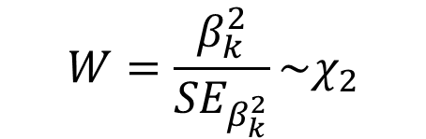
Test of Significance of the Logistic Regression Coefficients
The second test in logistic regression is the test of the statistical significance of each regression coefficient, b_{k}
The test statistic is called a Wald test computed as
$$H_{0}:β_{k}=0$$
$$H_{1}:β_{k}≠0$$
$$W=\frac{β_{k}^{2}}{{SE}_{β_{k}^{2}}}\sim χ_{2}$$

Slide 20
What Logistic Regression Is and How It Works: Assumptions
Noncollinearity
Linearity
Independence of errors
Values of X are fixed
Conditions
Nonzero cell counts
Nonseparation of data
Lack of influential points
Sufficient sample size

Slide 21

Recall the model
Y = $\left\{\begin{aligned}0 \\ 1\end{aligned}\right.$
$$p\left(X\right)=P[Y=1|X=x]=\frac{\exp^{(β_{0}+β_{1}X)}}{1+\exp^{(β_{0}+β_{1}X)}}$$
If the condition is false
If the condition is true
Our goal is to estimate the unknown parameters, ${\hat{β}}_{0}$, ${\hat{β}}_{1}$

Slide 22
What Logistic Regression Is and How It Works: Sample Size
Logistic regression is a large sample procedure
Samples of size 100 or greater are needed to accurately conduct tests of significance for logistic regression coefficients

Slide 23
What Logistic Regression Is and How It Works: Effect Size
Multiple R² pseudo-variance explained values
Odds Ratio

Slide 24




Review Algebra
Properties of exponents
Properties of logarithms
$$e^{x}×e^{y}=e^{x+y}$$
$e^{(x+y)}=e^{x}$ + $e^{y}$
$${ln⁡(e}^{x}) =x$$
$$e^{ln⁡(x)}=x$$
$$e^{0}=1$$

Slide 25



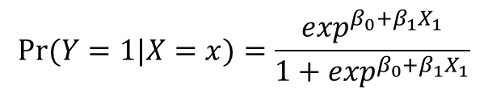

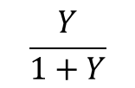

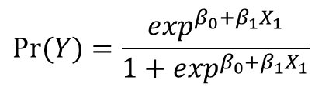


Mathematical Snapshot
$$Logit(Y)=β_{0}+β_{1}X_{1}+β_{2}X_{2}+...+β_{m}X_{m}$$
$β_{0}, β_{1}$ is interpreted as “log odds of Y”
$$Logit(Y)=β_{0}+β_{1}X_{1}$$
Take the exponent of each side
$$\exp^{Logit(Y)}=\exp^{β_{0}+β_{1}X_{1}}$$
This follows because
$$e^{ln⁡(x)}=x$$
$$Y=\exp^{β_{0}+β_{1}X_{1}}$$
$\exp\left(β_{0}\right), exp⁡(β_{1})$is interpreted as the “odds of Y”
$$Pr⁡(Y)=\frac{\exp^{β_{0}+β_{1}X_{1}}}{1+\exp^{β_{0}+β_{1}X_{1}}}$$
$$\frac{Odds}{1+Odds}$$
$$\frac{Y}{1+Y}$$
is a probability
This follows because
so that
$$Pr⁡(Y=1|X=x)=\frac{\exp^{β_{0}+β_{1}X_{1}}}{1+\exp^{β_{0}+β_{1}X_{1}}}$$
This is interpreted as a ‘conditional’ probability

Slide 26
Binary Logistic Regression in JASP
Use the file gpa-college-enroll.JASP/gpa-college-enroll.sav
Analyze → Regression → Binary Logistic
In this example we have
Y = college enrollment
X₁ = undergraduate GPA

Slide 27
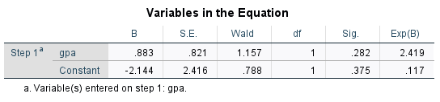

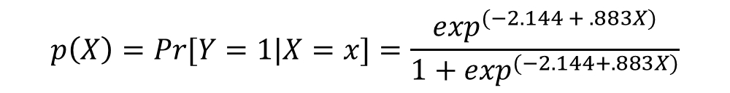
Focus on the results first
$$logit\left(Y\right)=−2.144+.833GPA$$
$$p\left(X\right)=Pr[Y=1|X=x]=\frac{\exp^{(−2.144 + .883X)}}{1+\exp^{(−2.144+.883X)}}$$
Probability of enrolling in
college ‘conditional on’ values
of one’s grade point average
The Wald test is the test statistic for the logistic regression model
The sig. is the p-value
EXP(B) is the odds ratio – the interpretation is: the odds of enrolling in college are about 2.5 times greater for each one unit increase in undergraduate gpa, but the result is not statistically significant

Slide 28

Computing probabilities
The most useful part of logistic regression is the ability to predict the conditional probability of Y given values of the independent variables
For example: what is the probability of college enrollment given that your gpa is 1.0, 2.0, 3.0 and 4.0?
$$Pr⁡(Y=1)=p=\frac{e^{β_{0}+β_{1}X_{1}}}{1+e^{β_{0}+β_{1}X_{1}}}$$
$Pr⁡(Y=1|X=1)=\frac{e^{−2.144+.883(1)}}{1+e^{−2.144+.883(1)}}$ =$\frac{e^{−2.144+.883}}{1+e^{−2.144+.883}}$= $\frac{e^{−1.261}}{1+e^{−1.261}}$= $\frac{.283371}{1+.283371}$=.221
$Pr⁡(Y=1|X=2)=\frac{e^{−2.144+.883(2)}}{1+e^{−2.144+.883(2)}}$ =$\frac{e^{−2.144+1.766}}{1+e^{−2.144+1.766}}$= $\frac{e^{−.378}}{1+e^{−.378}}$= $\frac{.283371}{1+.283371}$=.407

Slide 29
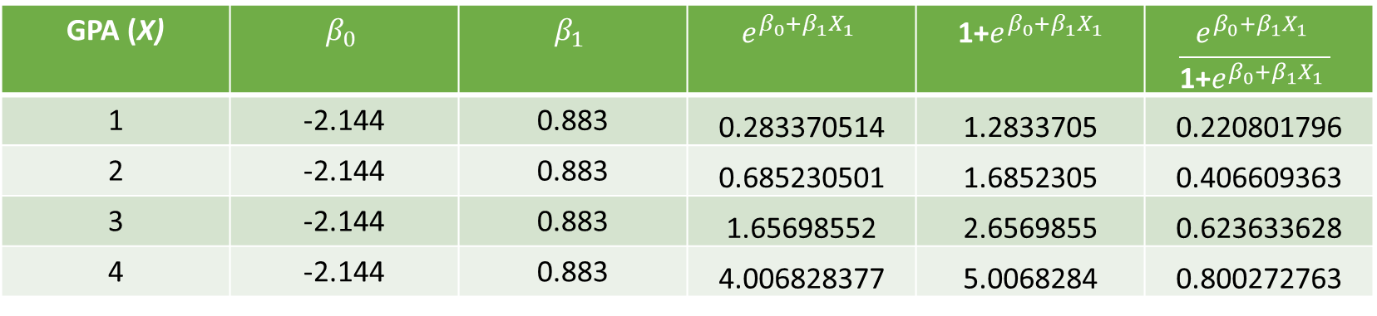
Table of predicted probabilities
GPA (X) | $$β_{0}$$ | $$β_{1}$$ | $$e^{β_{0}+β_{1}X_{1}}$$ | 1+$e^{β_{0}+β_{1}X_{1}}$ | $$\frac{e^{β_{0}+β_{1}X_{1}} }{\text{1+}e^{β_{0}+β_{1}X_{1}} }$$
1 | -2.144 | 0.883 | 0.283370514 | 1.2833705 | 0.220801796
2 | -2.144 | 0.883 | 0.685230501 | 1.6852305 | 0.406609363
3 | -2.144 | 0.883 | 1.65698552 | 2.6569855 | 0.623633628
4 | -2.144 | 0.883 | 4.006828377 | 5.0068284 | 0.800272763
See excel file gpa_college_enrollment_example.xlsx

Slide 30
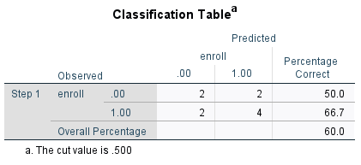
Model Summary & Classification
The classification table is provided. Here we correctly classify 60% of enrollments, better than chance (not much better)
Using the 50% cutoff, when the observed Y was the student did not enroll in college, we predicted enrollment correctly 1/2 of the time
Similarly, using the same cutoff, when the student did enroll, we were correct 4 of 6 times (2/3)
Specificity
Sensitivity
(2 + 4)/(2+2+2+4) = 60%
Notes:
Specificity is the percentage of correct predictions of the cases that are coded as 0 for the dependent variable 50
sensitivity is the percentage of correct predictions of the cases that are coded as 1 for the dependent variable 66.7
false negative rate the percentage of cases in error where the dependent variable is predicted to be 0 50
false positive rate the percentage of cases in error where the dependent variable is predicted to be 1 33.3

Slide 31
More on classifications and correctly predicted observations
Your observed outcome in logistic regression can ONLY be 0 or 1
The predicted probabilities from the model can take on all possible values between 0 and 1
So, for a given observation, the predicted probability from the model may have been 0.51 (51% probability of success), but your observation was actually a 0 (not a success)
By default, SPSS uses a classification of 50/50 → if the probability is .51 or greater, the case is coded as “1” (i.e., a success) and if it is <= .50 it’s coded as “0” (i.e., a fail)
The next slide shows how we can add the probabilities and classifications to our dataset for additional intuition

Slide 32
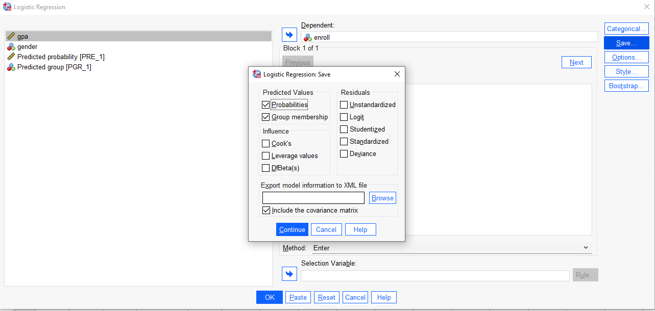

Slide 33
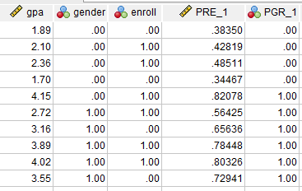

Slide 34
Improving classification
We can change the default value from .5 to something else
Example: Let’s change the default to .4 and see how this ‘improves’ our classification

Slide 35
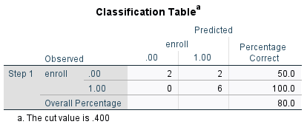
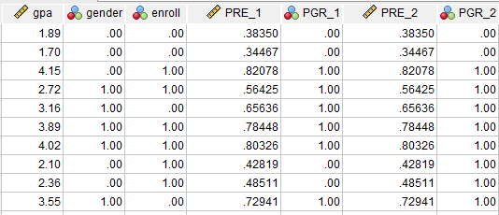
Default = .5
Default = .4
When we changed
the default value from .5
to .4, what changed?

Slide 36
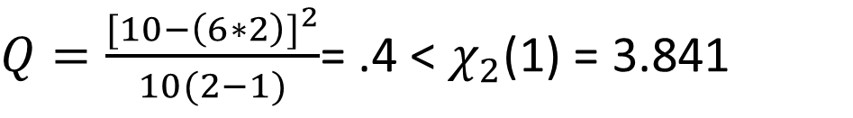
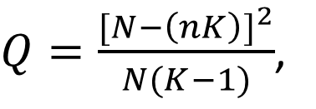
You may want to report…
Is the 60% correctly predicted rate better than chance (i.e., 50%)
You can report Press’s Q, which is distributed as
$Q=\frac{{[N−\left(nK\right)]}^{2}}{N(K−1)}$,
N is the total sample size,
n represents the number of cases that were correctly classified
K equals the number of groups
$Q=\frac{{[10−\left(6∗2\right)]}^{2}}{10(2−1)}$= .4 < $χ_{2}$(1) = 3.841
In this case, the results are no better than chance

Slide 37
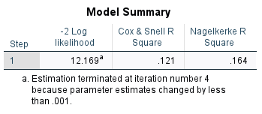
Log-Likelihood
The model summary information is provided only as a method of comparison
Let’s compare this model with a model that includes student gender (next slide)

Slide 38
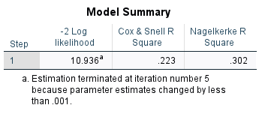
Does the addition of gender improve the model fit?
$χ^{2}(1)$= 2(${LL}_{m2}−{LL}_{m1})=−(10.936−12.169)=1.233$
m2 = model with additional predictors, it is also called the unrestricted model
m1 = model with fewer predictors, it is nested in m2, it is also called the restricted model
There is one parameter difference between the models, and one degree of freedom
The critical value is greater than the calculated statistic and hence there is no statistically significant difference between these models!

Slide 39
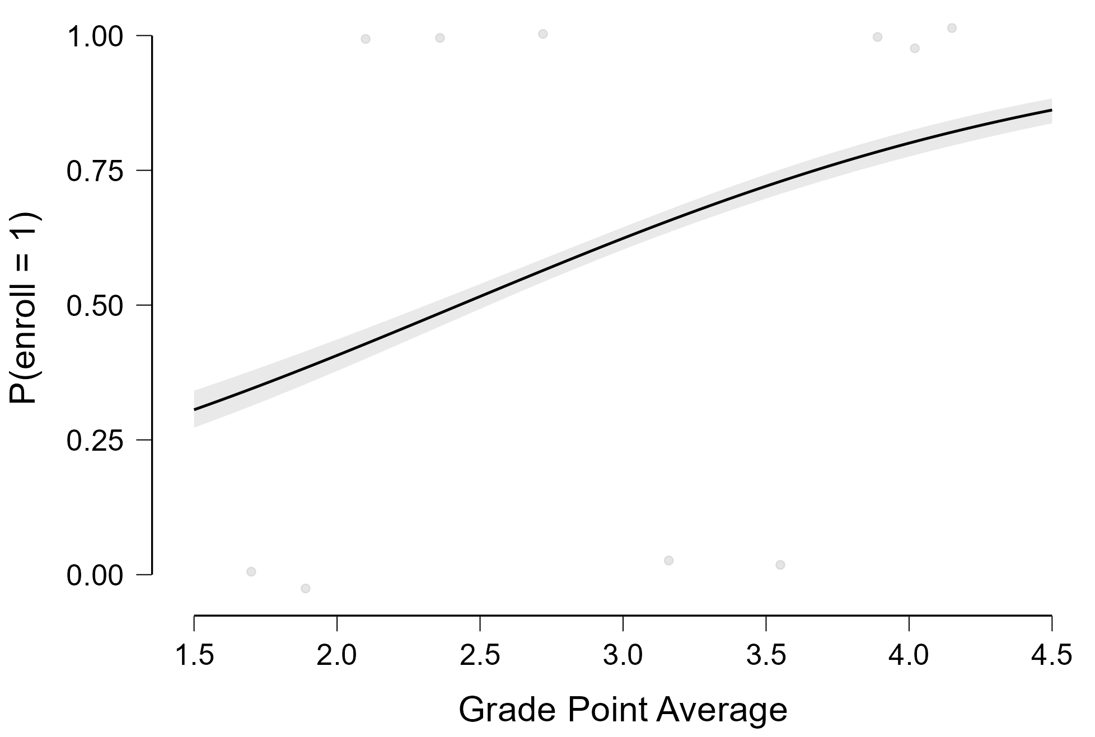
Probability of enrolling in college conditional on high school gpa
As gpa increases the probability of enrolling increases
The probability is about .30 for a gpa = 1.5 but increases to about .9 for a gpa = 4.5

Slide 40
Let’s do this in JASP

Slide 41
Your turn
Open the SPSS file passing.sav
The data has three made-up variables:
Passed a statistics test
Hours of study
Gender (1 = male, 0 = female)
Run a binary logistic regression of passed on hours
Write out the regression equation
Predict the probability of passing for 0, 50, 100, 150,200 and 250 hours of studying
Add gender into the model and interpret the coefficient in terms of odds and percent change in odds
Does adding gender improve the model fit?
Compute the probability of passing for males and females for 100 study hours

Slide 42
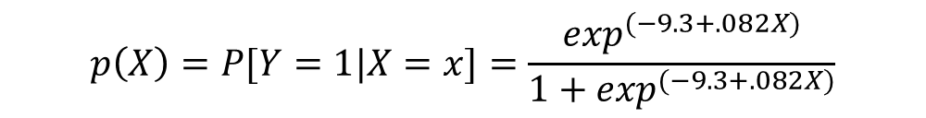

Model & Interpretation
$$logit\left(Y\right)=−9.3+.082X$$
$$p\left(X\right)=P[Y=1|X=x]=\frac{\exp^{(−9.3+.082X)}}{1+\exp^{(−9.3+.082X)}}$$
Check: What is the Probability of passing when hours = X
Note: exp(.082) = 1.085
Table 1. Predicted probability of Passing Conditional on Hours Studying | Table 1. Predicted probability of Passing Conditional on Hours Studying
X | 0 | 50 | 100 | 150 | 200 | 250
P(Y|x=X) | 0.0055 | 0.0603 | 0.4286 | 0.6298 | 0.8975 | 0.9783
Each additional hour spent working increases the odds of passing by [exp(.082)-1 *100] percent
Each additional hour spent working increases the odds of passing by about 8.5 percent
The odds of passing are 1.085 times higher for each additional hour spent studying

Slide 43
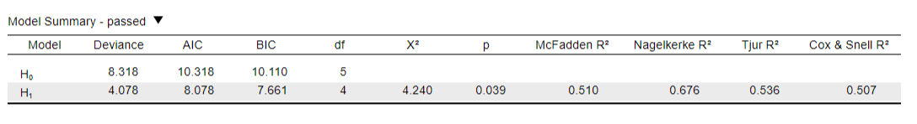
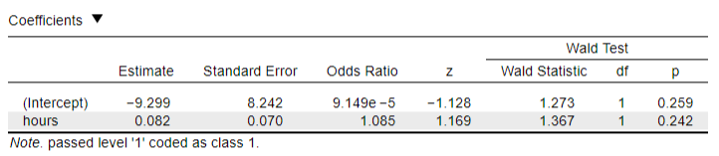
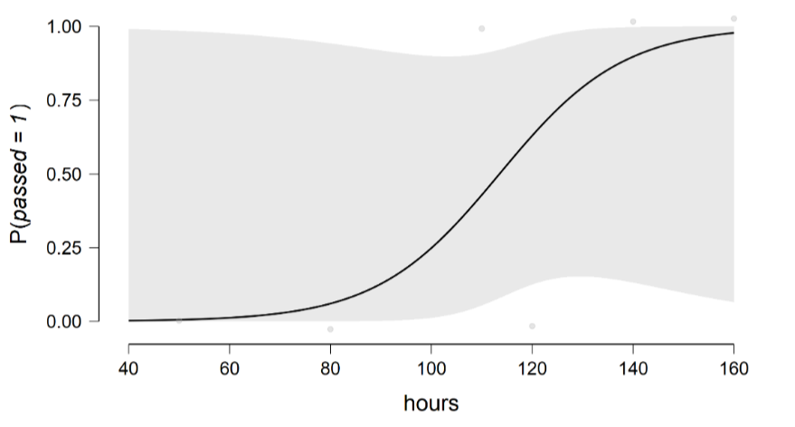
Jasp Output

Slide 44
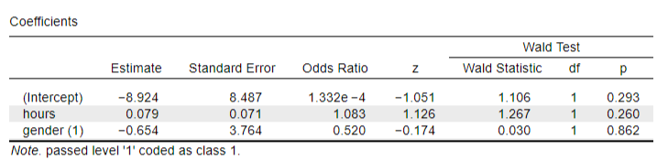
Let’s add a binary variable, gender, to the equation
The odds of passing for males are [exp(-.654)-1 *100] percent lower compared to females
The odds of passing for males are 48.01% lower compared to females
The odds of passing are .5100 (exp(-.654)) times lower for males compared to females
The file probability of passing by gender.xlsx has the probability of passing for males and females given 100
hours of study time

Slide 45
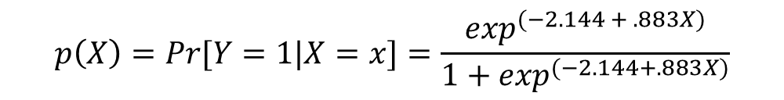

$$logit\left(Y\right)=−2.144+.833GPA$$
$$p\left(X\right)=Pr[Y=1|X=x]=\frac{\exp^{(−2.144 + .883X)}}{1+\exp^{(−2.144+.883X)}}$$
Probability of enrolling in
college ‘conditional on’ values
of one’s grade point average
Coefficients
 |  |  |  |  |  |  |  | Wald Test
 |  | Estimate |  | Standard Error |  | z |  | Wald Statistic |  | df |  | p
(Intercept) |  | -2.144 |  | 2.416 |  | -0.888 |  | 0.788 |  | 1 |  | 0.375
gpa |  | 0.883 |  | 0.821 |  | 1.076 |  | 1.157 |  | 1 |  | 0.282
Note. enroll level '1' coded as class 1.
The Wald test is the test statistic for the logistic regression model
The sig. is the p-value
EXP(B) is the odds ratio – the interpretation is: the odds of enrolling in college are about 2.5 times greater for each one unit increase in undergraduate gpa, but the result is not statistically significant

Slide 46
Your turn
Open the file passing.JASP in JASP
The data has three made-up variables:
Passed a statistics test
Hours of study
Gender (1 = male, 0 = female)
Run a binary logistic regression of passed on hours
Write out the regression equation
Predict the probability of passing for 0, 50, 100, 150,200 and 250 hours of studying
Add gender into the model and interpret the coefficient in terms of odds and percent change in odds
Does adding gender improve the model fit?
Compute the probability of passing for males and females for 100 study hours

Slide 47
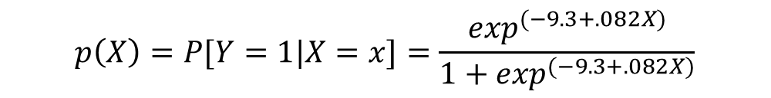

Model & Interpretation
$$logit\left(Y\right)=−9.3+.082X$$
$$p\left(X\right)=P[Y=1|X=x]=\frac{\exp^{(−9.3+.082X)}}{1+\exp^{(−9.3+.082X)}}$$
Check: What is the Probability of passing when hours = X
Note: exp(.082) = 1.085
Table 1. Predicted probability of Passing Conditional on Hours Studying | Table 1. Predicted probability of Passing Conditional on Hours Studying
X | 0 | 50 | 100 | 150 | 200 | 250
P(Y|x=X) | 0.0055 | 0.0603 | 0.4286 | 0.6298 | 0.8975 | 0.9783
Each additional hour spent working increases the odds of passing by [exp(.082)-1 *100] percent
Each additional hour spent working increases the odds of passing by about 8.5 percent
The odds of passing are 1.085 times higher for each additional hour spent studying

Slide 48
Full example in R
See example logistic.R

