Slide 1
Week 5
Review
Introduction to Multiple Linear Regression
Hypothesis Testing and Decomposition of Effects

Slide 2
Data application
Data Makeover Challenge: Reimagine data using effective storytelling
Are there differences in infant mortality by race?

Slide 3
What model do I choose? Basic Statistical Analysis
Outcome Variable | Are the observations independent or correlated? |  | Alternatives if the normality assumption is violated (and small sample size):
 | independent | correlated
Continuous (e.g. pain scale, cognitive function) | T-test: compares means between two independent groups ANOVA: compares means between more than two independent groups Pearson’s correlation coefficient (linear correlation): shows linear correlation between two continuous variables Linear regression: multivariate regression technique used when the outcome is continuous; gives slopes | Paired ttest: compares means between two related groups (e.g., the same subjects before and after) Repeated-measures ANOVA: compares changes over time in the means of two or more groups (repeated measurements) Mixed models/GEE modeling: multivariate regression techniques to compare changes over time between two or more groups; gives rate of change over time | Non-parametric statistics Wilcoxon sign-rank test: non-parametric alternative to the paired ttest Wilcoxon sum-rank test (=Mann-Whitney U test): non-parametric alternative to the ttest Kruskal-Wallis test: non-parametric alternative to ANOVA Spearman rank correlation coefficient: non-parametric alternative to Pearson’s correlation coefficient

Slide 4
Linear regression –Terminology
Outcome, Y
Dependent variable
Response variable
Consequent
Explanatory variable (predictor), X
Independent variable
Covariate
Control
Exposure
Antecedent

Slide 5
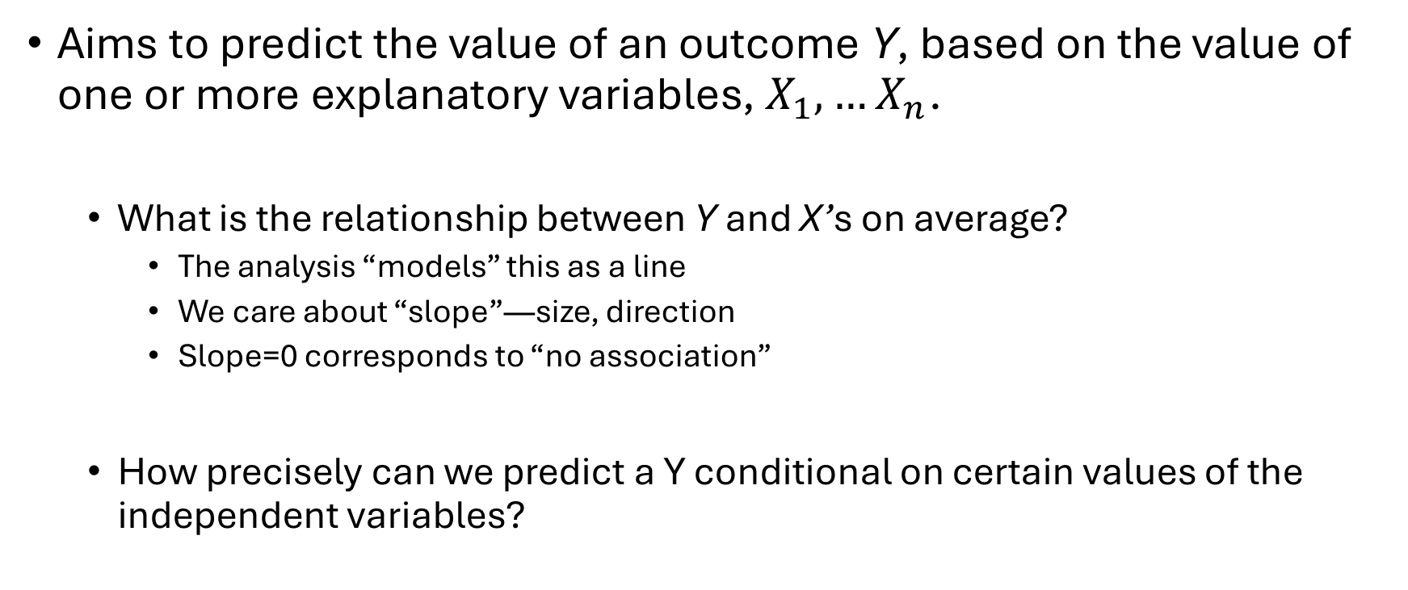
Introduction Linear Regression
Aims to predict the value of an outcome Y, based on the value of one or more explanatory variables, $X_{1}, …X_{n}$.
What is the relationship between Y and X’s on average?
The analysis “models” this as a line
We care about “slope”—size, direction
Slope=0 corresponds to “no association”
How precisely can we predict a Y conditional on certain values of the independent variables?

Slide 6
Deterministic Relationship between 2 variables
A functional relation between two variables is expressed by a mathematical formula
If X denotes the independent variable and Y the dependent variable, a functional relation is: Y = f(X)
→ given a value of X, the function f(X) indicates the value of Y
Example: Y = 200X (?)
Age | ACEs | Test Score
5 | 7 | 1400
10 | 1 | 200
20 | 3 | 600
Notes:
-- the slope is known not estimated
-- there is no variability around the line, there is no probability distribution for the mean of Y
-- all points fall on the line with no error

Slide 7
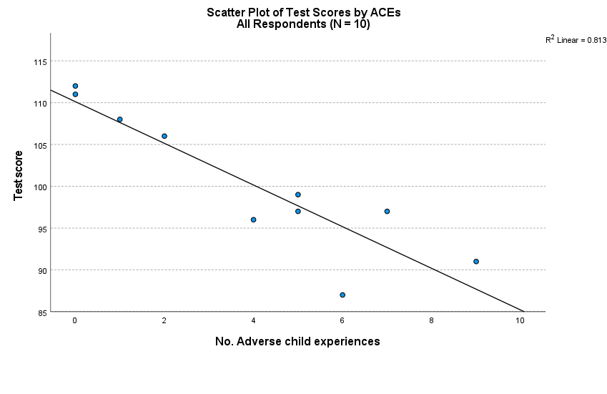
Statistical Relationship between 2 Variables
A statistical relation, unlike a functional relation, is not a perfect one
The observations for a statistical relation do not fall directly on-the curve of relationship
Notes:
Note that most of the points do not fall directly on the line of statistical relationship.
This scattering of points around the line represents variation in test scores that is not associated with ACEs and that is usually considered to be of a random nature.

Slide 8
β₀ and β₁ are unknown population parameters, therefore are estimated from the data.
The first order linear model
Y = dependent variable
X = independent variable
β₀ = Y-intercept
β₁ = slope of the line
ε = error variable
Y
β₁ = Rise/Run
Rise
β₀
Run
X

Slide 9
Estimating the Coefficients
The coefficients are determined by
Drawing a sample from the population of interest,
Calculating sample statistics.
Estimating a straight line that cuts into the data.
Question: What should be considered a good line?
Y
w
w
w
w
w
w w w w
w
w w
w w
w
X

Slide 10
The Least Squares Regression Slope Where should we draw the line
A good line is one that minimizes the sum of squared differences between the points and the line.

Slide 11
Sum of squared differences =
(2 - 1)² +
(4 - 2)² +
(1.5 - 3)² +
(3.2 - 4)² = 6.89
Sum of squared differences =
(2 -2.5)² +
(4 - 2.5)² +
(1.5 - 2.5)² +
(3.2 - 2.5)² = 3.99
4
(2,4)
w
3
w
(4,3.2)
The smaller the sum of
squared differences
the better the “fit” of the
line to the data (?)
2.5
2
w
(1,2)
(3,1.5)
w
1
1
2
3
4

Slide 12
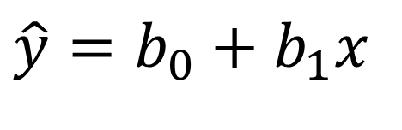
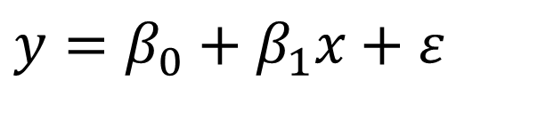
Simple Linear Regression
Assumption: a linear relationship between X & Y exists
Observed Y values can be expressed as:
Use data to estimate that linear relationship with a straight line:
$$y=β_{0}+β_{1}x+ε$$
Deviation from the line
The straight line (average)
$$\hat{y}=b_{0}+b_{1}x$$

Slide 13
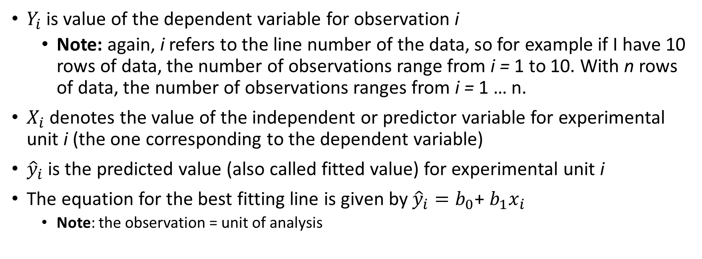
Notation
$Y_{i}$ is value of the dependent variable for observation i
Note: again, i refers to the line number of the data, so for example if I have 10 rows of data, the number of observations range from i = 1 to 10. With n rows of data, the number of observations ranges from i = 1 … n.
$X_{i}$ denotes the value of the independent or predictor variable for experimental unit i (the one corresponding to the dependent variable)
${\hat{y}}_{i}$ is the predicted value (also called fitted value) for experimental unit i
The equation for the best fitting line is given by ${\hat{y}}_{i}=b_{0}$+ $b_{1}x_{i}$
Note: the observation = unit of analysis

Slide 14

Inference from Regression
We want to use our regression equation to make predictions for our dependent variable based on the linear combination of independent variables. To do this we need assumptions on how the data is made!
We imagined that in the population, the values of Y really are generated from the linear probabilistic model
where ε is an error term normally distributed with mean 0 and variance σ²
For our linear regression inference, we will always assume ε has a normal distribution, N(0, σ²)
$$y=β_{0}+β_{1}x+ε$$

Slide 15






The full model
The standard assumption is that the error term is normally distributed
The model you are to use for SLR (which will be extended to the multivariate case) is:
β₁ > 0 ⇒ Positive Association
β₁ < 0 ⇒ Negative Association
β₁ = 0 ⇒ No Association
$$Y_{i}=β_{0}+β_{1}X_{i}+ε_{i}$$
$$Y_{i}$$
The observed response for the ith trial (or row of data)
$$X_{i}$$
A known constant, the level of the predictor in the ith trial
$β_{0}$, $β_{1}$
Unknown regression parameters
$$ε_{i}$$
Error term, independently and normally distributed, N(0, $σ^{2}$)
$$i$$
The index for the total number of cases in your data, i = 1, … N
Notes:
Independent means the outcome of any one trial has no effect on the error term for any other trial
The regression is simple, linear in the parameters and linear in the predictor
Explanatory and Response Variables are Numeric
Relationship between the mean of the response variable and the level of the explanatory variable assumed to be approximately linear (straight line)

Slide 16

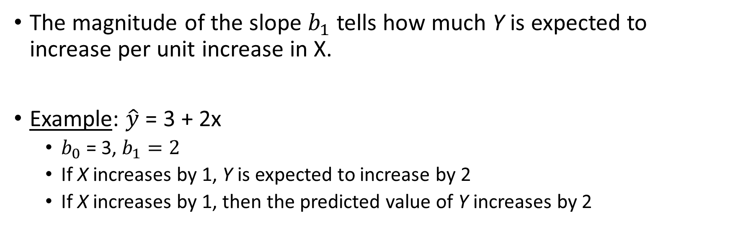
Interpretation of Regression Equation
$$\hat{y}=b_{0}+b_{1}x$$
The magnitude of the slope $b_{1}$ tells how much Y is expected to increase per unit increase in X.
Example: $\hat{y}$ = 3 + 2x
$b_{0}$ = 3, $b_{1}=2$
If X increases by 1, Y is expected to increase by 2
If X increases by 1, then the predicted value of Y increases by 2

Slide 17

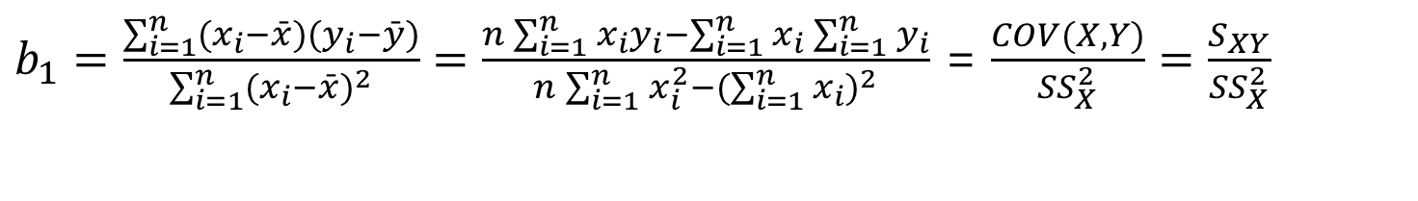

BLUE: Best Linear Unbiased Estimators**
Mathematically, we obtain estimating formulas:
or
$b_{1}=\frac{\sum_{i=1}^{n}{(x_{i}−\bar{x})(y_{i}−\bar{y})}}{\sum_{i=1}^{n}{(x_{i}−\bar{x})^{2}}}=\frac{n\sum_{i=1}^{n}{x_{i}y_{i}−\sum_{i=1}^{n}{x_{i}\sum_{i=1}^{n}{y_{i}}}}}{n\sum_{i=1}^{n}{x_{i}^{2}−(\sum_{i=1}^{n}{x_{i})^{2}}}}$ = $\frac{COV(X,Y)}{{SS}_{X}^{2}}=\frac{S_{XY}}{{SS}_{X}^{2}}$
$$b_{1}=r\frac{S_{y}}{S_{x}}$$
$$b_{0}=\bar{y}−b_{1}\bar{x}$$

Slide 18
The Estimated Coefficients
The regression equation that estimates the first order linear model is:
To calculate the estimates of the line coefficients that minimize the differences between the data points and the line, use the formulas:

Slide 19


What do the regression parameters estimate?
$μ_{Y}=E\left(Y\right)=β_{0}$+ $β_{1}X$
Solid line = sample
Dotted line = population
$\hat{y}=b_{0}$+ $b_{1}x$
Notes:
We take a sample of children because we cannot collect data on the population
Every time we take a sample we will get a different line, different estimates
Ultimately we want to learn about the population parameters and we will do so by looking at the sample estimates for the intercept and slope
Of course, this is where our error comes in

Slide 20
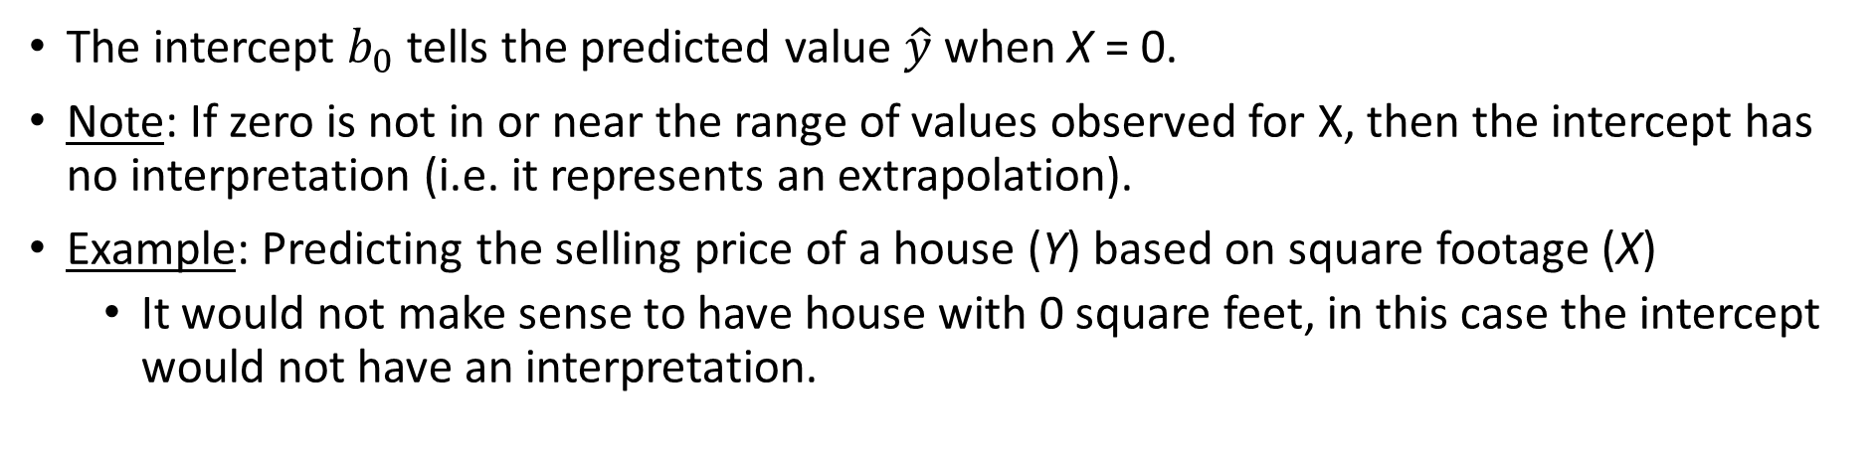
The Intercept
The intercept $b_{0}$ tells the predicted value $\hat{y}$ when X = 0.
Note: If zero is not in or near the range of values observed for X, then the intercept has no interpretation (i.e. it represents an extrapolation).
Example: Predicting the selling price of a house (Y) based on square footage (X)
It would not make sense to have house with 0 square feet, in this case the intercept would not have an interpretation.
Notes:
20

Slide 21
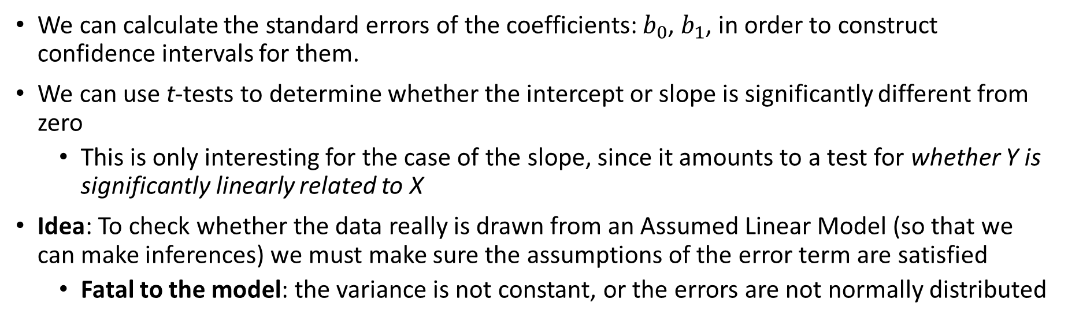
Sampling Distributions & Inference
We can calculate the standard errors of the coefficients: $b_{0}$, $b_{1}$, in order to construct confidence intervals for them.
We can use t-tests to determine whether the intercept or slope is significantly different from zero
This is only interesting for the case of the slope, since it amounts to a test for whether Y is significantly linearly related to X
Idea: To check whether the data really is drawn from an Assumed Linear Model (so that we can make inferences) we must make sure the assumptions of the error term are satisfied
Fatal to the model: the variance is not constant, or the errors are not normally distributed

Slide 22
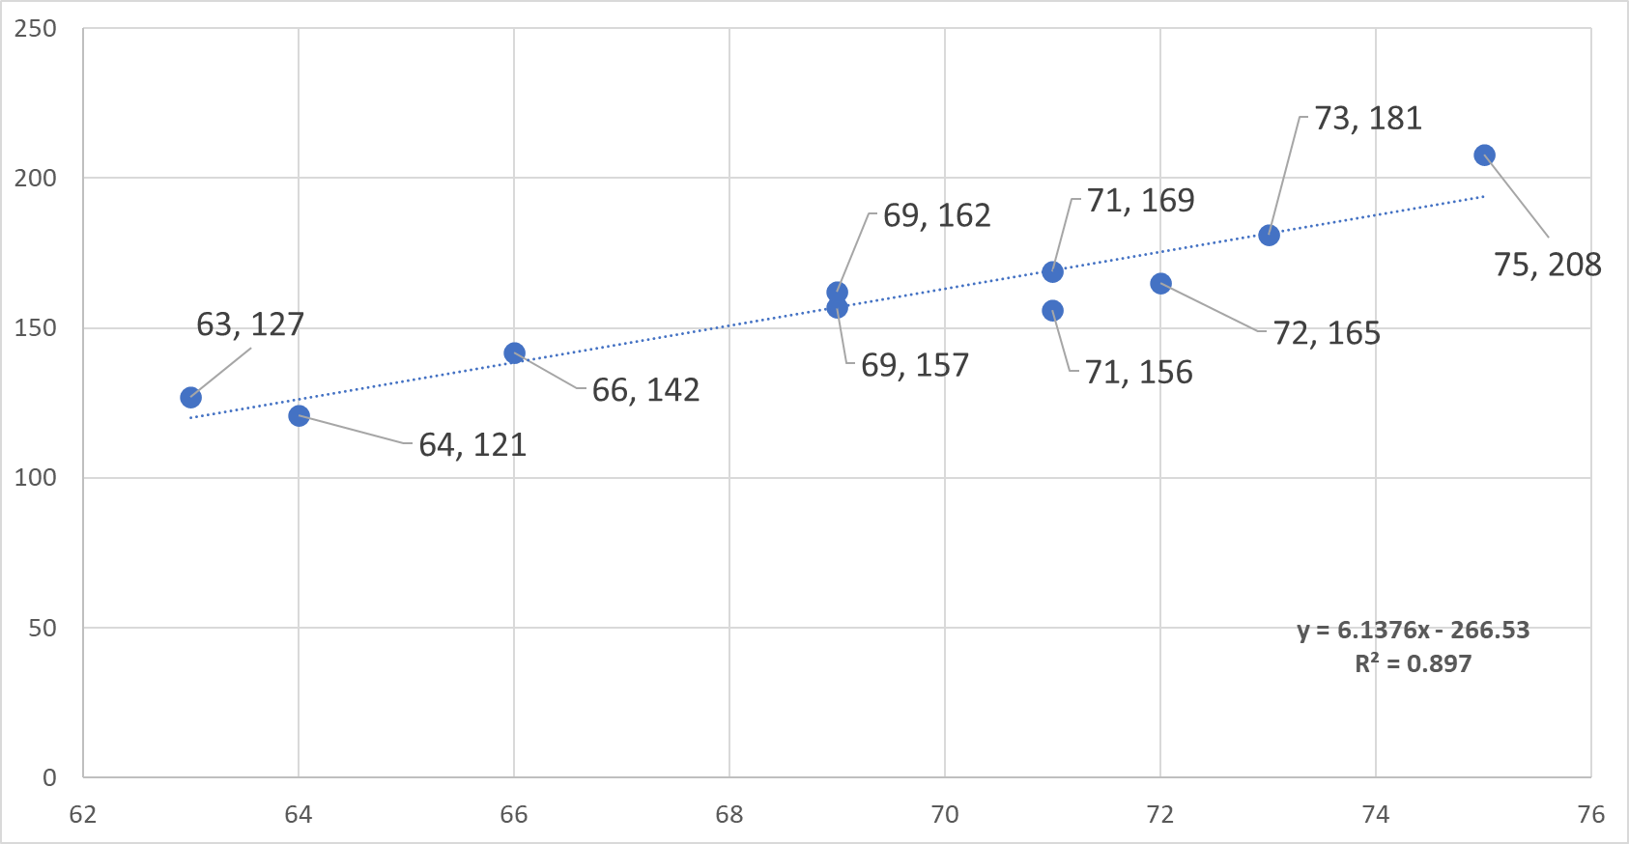
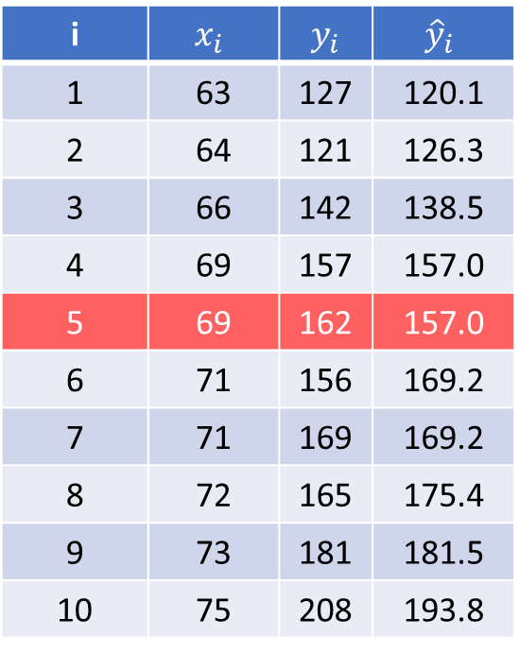
More about the best fitting line: minimizing the sum of squared errors
If we did know the value for observation 5 the equation line would predict it to be 157. The actual value for
observation 5 is 162, hence the prediction error is 162 – 157 = 5. What is the general equation for the error?
i | $$x_{i}$$ | $y_{i}$ | $${\hat{y}}_{i}$$
1 | 63 | 127 | 120.1
2 | 64 | 121 | 126.3
3 | 66 | 142 | 138.5
4 | 69 | 157 | 157.0
5 | 69 | 162 | 157.0
6 | 71 | 156 | 169.2
7 | 71 | 169 | 169.2
8 | 72 | 165 | 175.4
9 | 73 | 181 | 181.5
10 | 75 | 208 | 193.8
Note: begin to practice visualizing data, you should be able to make this chart in excel, jasp or spss

Slide 23
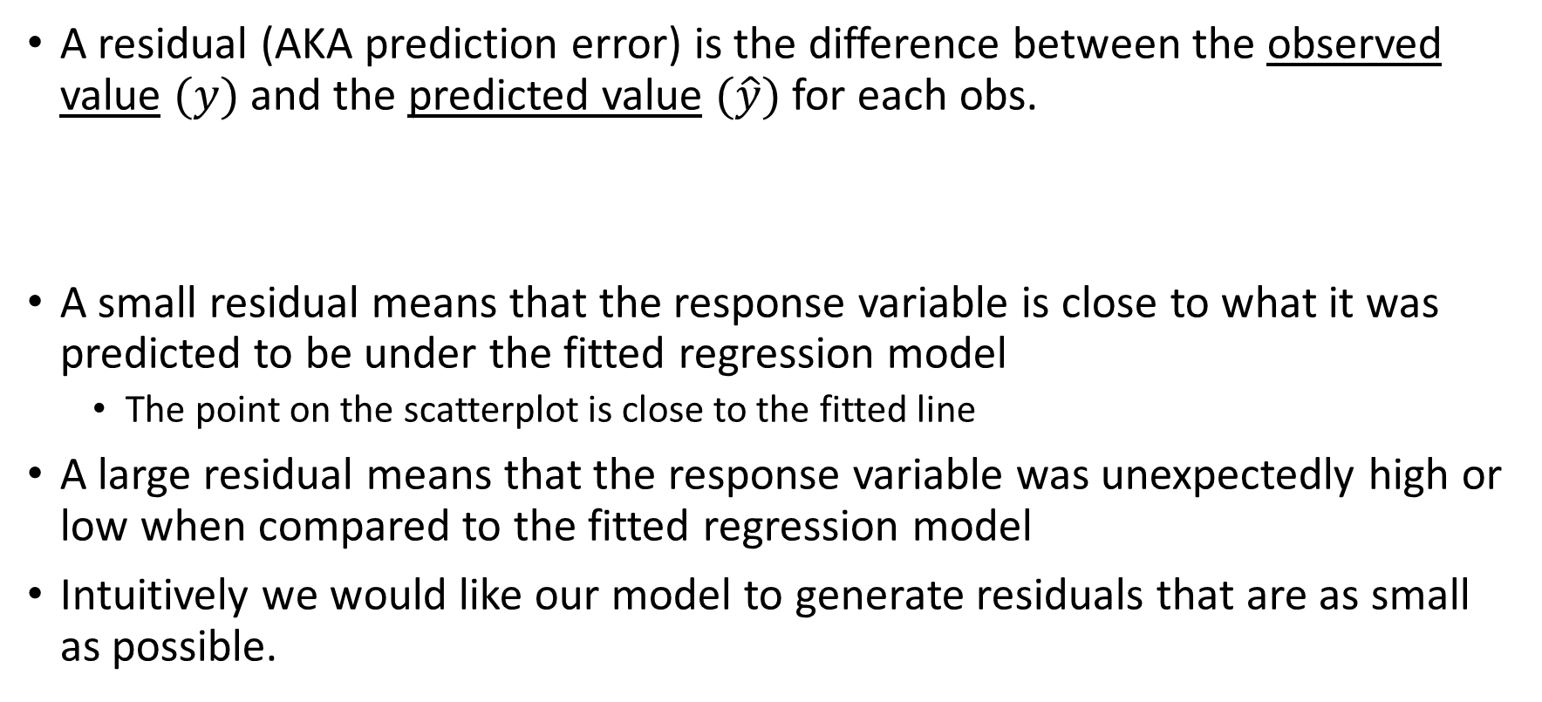
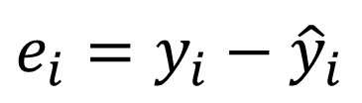
Residuals of Linear Model
A residual (AKA prediction error) is the difference between the observed value $(y)$ and the predicted value $(\hat{y})$ for each obs.
A small residual means that the response variable is close to what it was predicted to be under the fitted regression model
The point on the scatterplot is close to the fitted line
A large residual means that the response variable was unexpectedly high or low when compared to the fitted regression model
Intuitively we would like our model to generate residuals that are as small as possible.
$$e_{i}=y_{i}−{\hat{y}}_{i}$$
Notes:
23

Slide 24

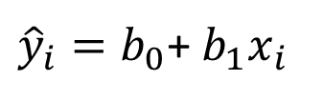
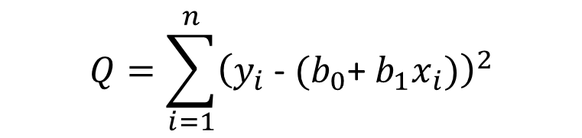

More about the best fitting line
To minimize the SSE, we find the values for $b_{0}$, $b_{1}$ which make the sum of the squared prediction errors the smallest they can be. So, we find these values so that the following equation is minimized
Since
$$Q=\sum_{i=1}^{n}{{\left(y_{i}\text{ − }{\hat{y}}_{i}\right)}^{2}}$$
$$Q=\sum_{i=1}^{n}{{\left(y_{i}\text{ − }(b_{0}\text{+ }b_{1}x_{i})\right)}^{2}}$$
${\hat{y}}_{i}=b_{0}$+ $b_{1}x_{i}$
$$e_{i}=y_{i}\text{ − }{\hat{y}}_{i}$$

Slide 25
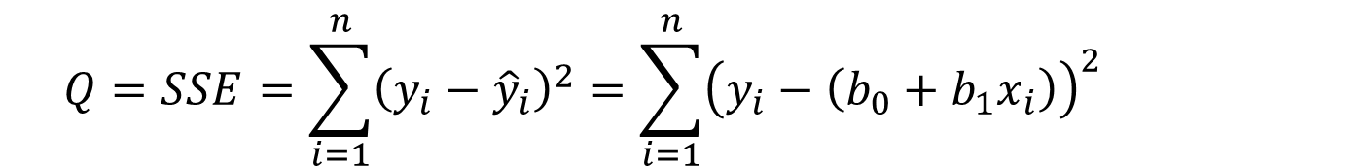
Least Squares Estimation of β₀, β₁
β₀ → Mean response when X = 0 (y-intercept)
β₁ → Change in mean response when X increases by 1 unit (slope)
β₀, β₁ are unknown parameters (like μ)
β₀+β₁x → Mean response when explanatory variable takes on the value x
Goal: Choose values (estimates) that minimize the sum of squared errors (SSE) of observed values to the straight-line:
$$Q=SSE=\sum_{i=1}^{n}{{\left(y_{i}−{\hat{y}}_{i}\right)}^{2}}=\sum_{i=1}^{n}{{\left(y_{i}−\left(b_{0}+b_{1}x_{i}\right)\right)}^{2}}$$

Slide 26
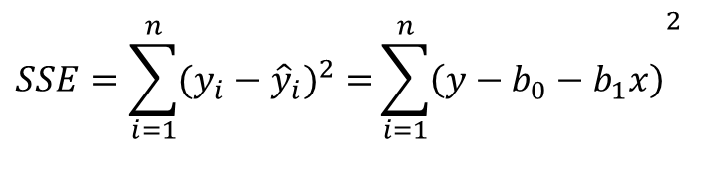
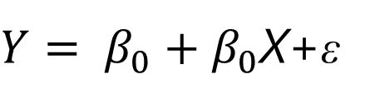
Intuition
We will write an estimated regression line based on sample data as
The method of least squares chooses the values for b₀ and b₁ to minimize the sum of squared errors
$Y= β_{0}+β_{0}$X+ε
$$SSE=\sum_{i=1}^{n}{(y_{i}−{\hat{y}}_{i})^{2}=}{\sum_{i=1}^{n}{\left(y−b_{0}−b_{1}x\right)}}^{2}$$

Slide 27


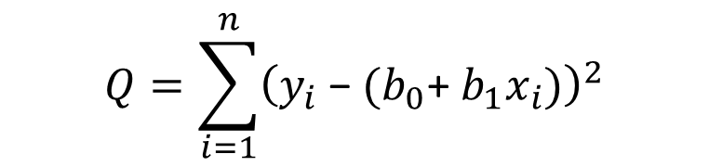
Method of least -Squares
To find "good" estimators of the regression parameters $β_{0}$ and $β_{1}$, we employ the method of least squares.
The method of least squares considers the deviation of Yi from its expected value
In particular, the method of least squares requires that we consider the sum of the n squared deviations.
This criterion is denoted by Q:
$$Q=\sum_{i=1}^{n}{{\left(y_{i}\text{ − }{\hat{y}}_{i}\right)}^{2}}$$
$$Q=\sum_{i=1}^{n}{{\left(y_{i}\text{ − }(b_{0}\text{+ }b_{1}x_{i})\right)}^{2}}$$

Slide 28
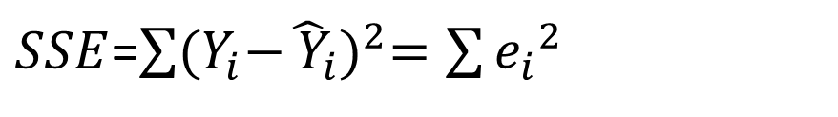
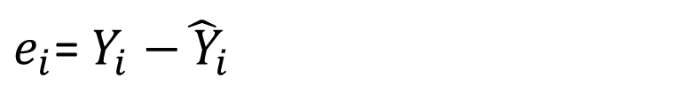
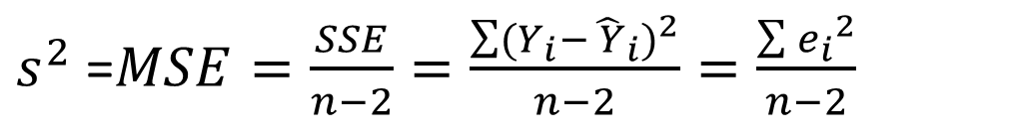
Regression Model
The deviation of an observation is calculated around its estimated mean, hence the deviations are the residuals
$e_{i}$= $Y_{i}{−\hat{ Y}}_{i}$
$SSE$=$\sum{{(Y_{i}{−\hat{ Y}}_{i})}^{2}=\sum{{e_{i}}^{2}}}$
Residual sum of squares
$s^{2}$ =$MSE=\frac{SSE}{n−2}=\frac{\sum{{(Y_{i}{−\hat{ Y}}_{i})}^{2}}}{n−2}=\frac{\sum{{e_{i}}^{2}}}{n−2}$
Mean square error

Slide 29

Summary
In general, when we use ${\hat{y}}_{i}=b_{0}$+ $b_{1}x_{i}$ to predict the actual response $y_{i}$ we make a prediction, or residual error, equal to
$ε_{i}=y_{i}$ - ${\hat{y}}_{i}$
The best fitting line makes all prediction errors as small as possible
The best fitting line minimizes the sum of the squared prediction errors → the least squares criterion
Note: why do we need to square the prediction errors?
Prediction error for data point i

Slide 30
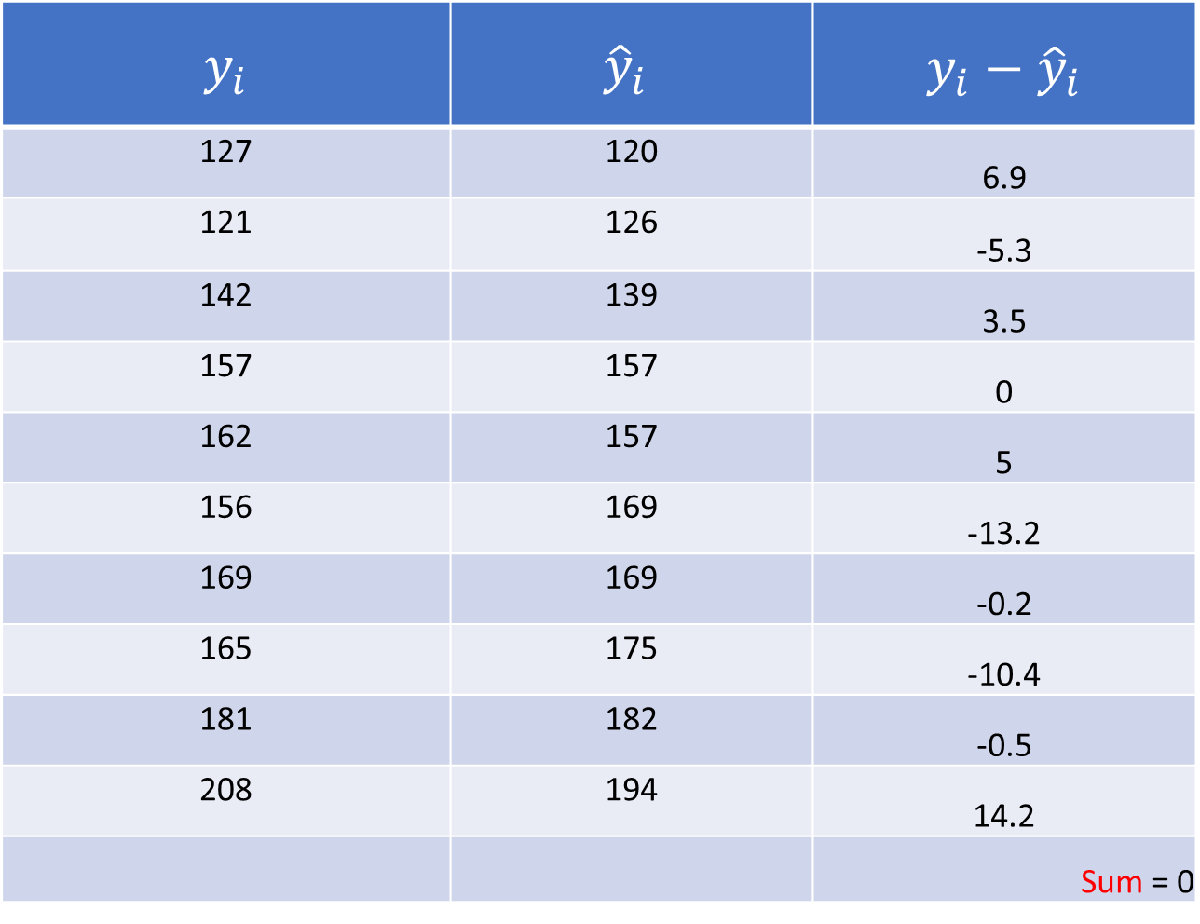
$y_{i}$ | $${\hat{y}}_{i}$$ | $$y_{i}−{\hat{y}}_{i}$$
127 | 120 | 6.9
121 | 126 | -5.3
142 | 139 | 3.5
157 | 157 | 0
162 | 157 | 5
156 | 169 | -13.2
169 | 169 | -0.2
165 | 175 | -10.4
181 | 182 | -0.5
208 | 194 | 14.2
 |  | Sum = 0

Slide 31
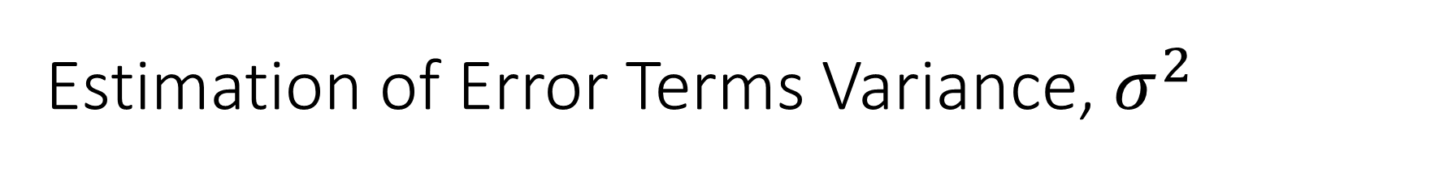

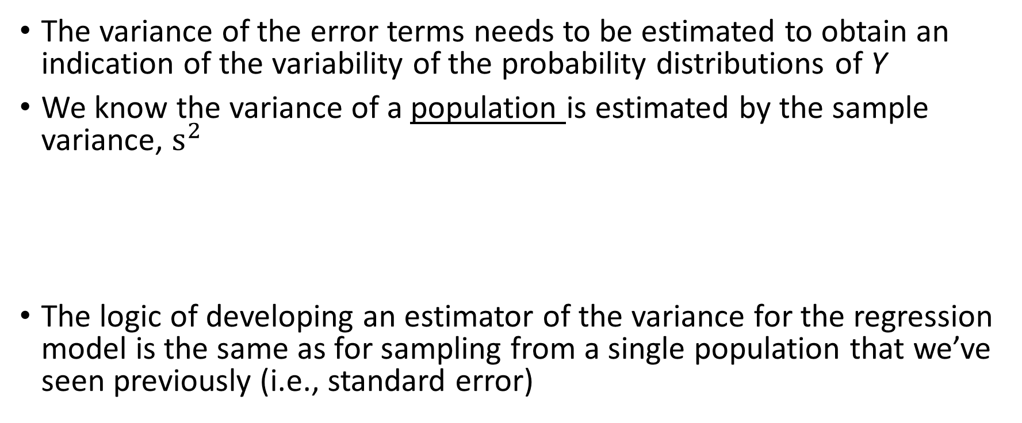
Estimation of Error Terms Variance, $σ^{2}$
The variance of the error terms needs to be estimated to obtain an indication of the variability of the probability distributions of Y
We know the variance of a population is estimated by the sample variance, $s^{2}$
The logic of developing an estimator of the variance for the regression model is the same as for sampling from a single population that we’ve seen previously (i.e., standard error)
Sum of squares
$$s^{2}=\frac{\sum{{(Y_{i}−\hat{Y_{i}})}^{2}}}{n−1}$$
Mean square
df

Slide 32
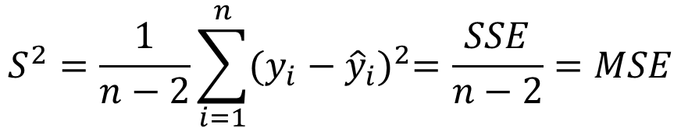

The variance of deviations
The variance of the deviation ($ε_{i}$) is denoted $σ^{2}$ and is estimated using the average squared residual that we have seen before!
$$S^{2}=\frac{1}{n−2}\sum_{i=1}^{n}{{(y_{i}−{\hat{y}}_{i})}^{2}=\frac{SSE}{n−2}=MSE}$$
Note: to make inferences about the model parameters (i.e., hypothesis test) we also need to assume that the deviations $ε_{i}$ are normally distributed

Slide 33
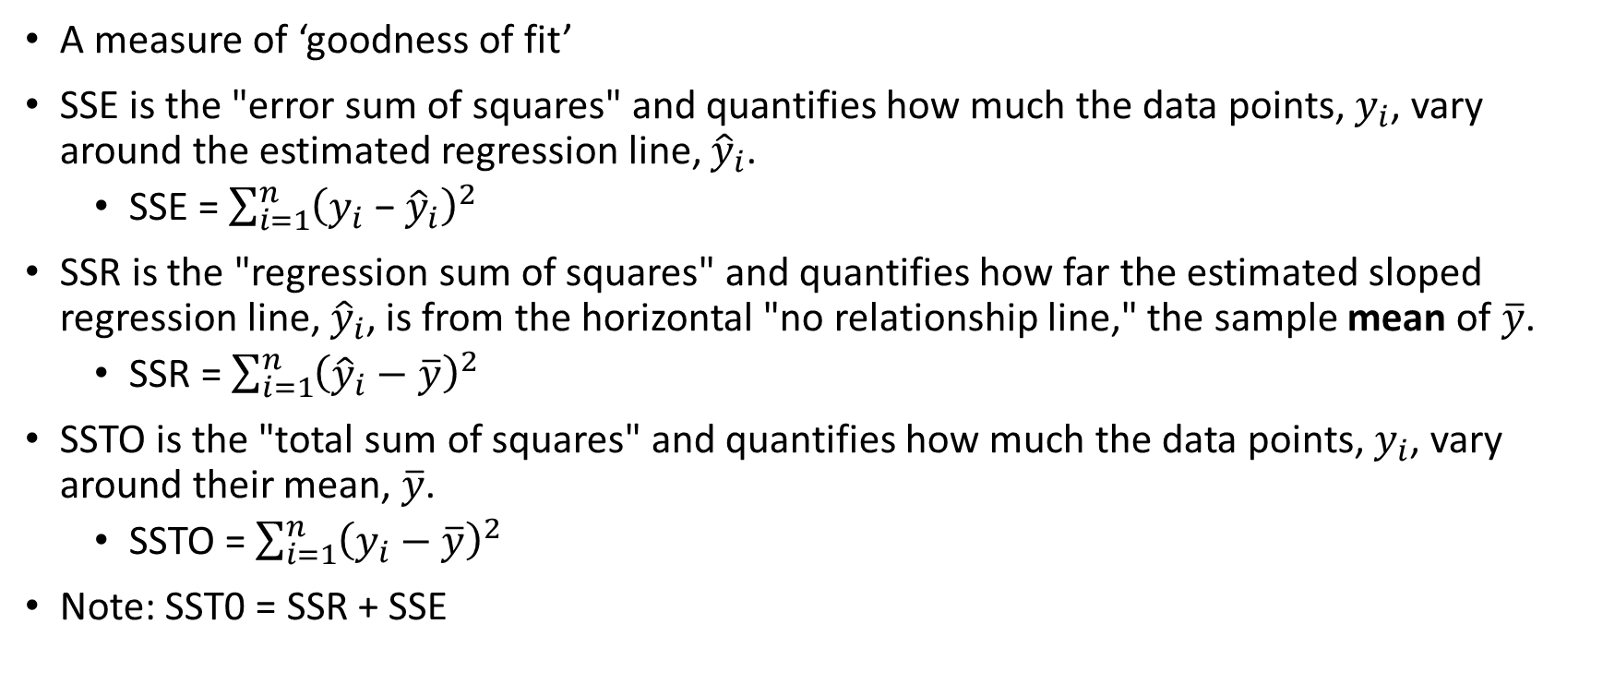
Analysis of Variance for SLR
A measure of ‘goodness of fit’
SSE is the "error sum of squares" and quantifies how much the data points, $y_{i}$, vary around the estimated regression line, ${\hat{y}}_{i}$.
SSE = $\sum_{i=1}^{n}{{\left(y_{i}\text{ − }{\hat{y}}_{i}\right)}^{2}}$
SSR is the "regression sum of squares" and quantifies how far the estimated sloped regression line, ${\hat{y}}_{i}$, is from the horizontal "no relationship line," the sample mean of $\overline{y}$.
SSR = $\sum_{i=1}^{n}{{\left({\hat{y}}_{i}−\overline{y}\right)}^{2}}$
SSTO is the "total sum of squares" and quantifies how much the data points, $y_{i}$, vary around their mean, $\overline{y}$.
SSTO = $\sum_{i=1}^{n}{{\left(y_{i}−\overline{y}\right)}^{2}}$
Note: SST0 = SSR + SSE

Slide 34

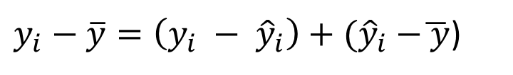
Analysis of Variance in Regression
Goal: partition the total variation in Y into variation “explained” by X and random variation
The total variation in an observed response about its mean can be written as a sum of two parts – (a) its deviation from the fitted value plus (b) the deviation of the fitted value from the mean response
$y_{i}−\overline{y}=\left(y_{i} − {\hat{y}}_{i}\right)+{(\hat{y}}_{i} −\overline{ y}$)
$${(y_{i}−\overline{y})}^{2}={\left(y_{i} − {\hat{y}}_{i}\right)}^{2}+{{(\hat{y}}_{i} −\overline{ y}\text{)}}^{2}$$
SST
SSE
SSR
Note: go back to last week’s lecture introducing SLR

Slide 35


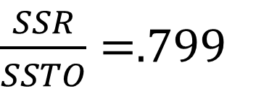
The Coefficient of Determination $R^{2}$
Question: how much of the total variation in the response Y is due to the regression of Y on X as opposed to random error?
EXAMPLE: SSE = 1708.5; SSR = 6679.3; SSTO = 8487.8
We can see that most of the total variation (SSTO) is accounted for by the regression (SSR). That is,
$R^{2}=\frac{SSR}{SSTO}→$ $1 − \frac{SSE}{SSTO}$
Explained
Not Explained
$\frac{SSR}{SSTO}=$.799

Slide 36
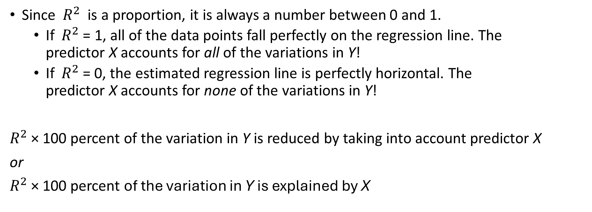

Interpretation $R^{2}$
Since $R^{2}$ is a proportion, it is always a number between 0 and 1.
If $R^{2}$ = 1, all of the data points fall perfectly on the regression line. The predictor X accounts for all of the variations in Y!
If $R^{2}$= 0, the estimated regression line is perfectly horizontal. The predictor X accounts for none of the variations in Y!
$R^{2}$ × 100 percent of the variation in Y is reduced by taking into account predictor X
or
$R^{2}$ × 100 percent of the variation in Y is explained by X

Slide 37
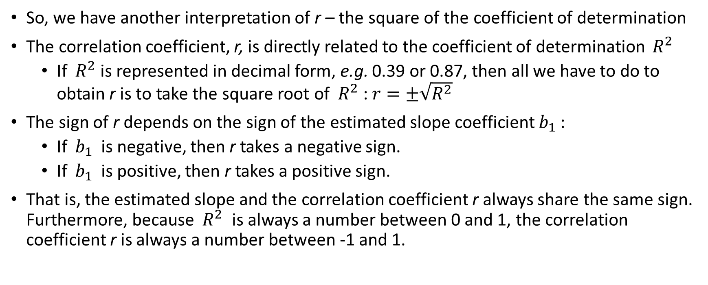

Pearson Correlation, r & $R^{2}$!!
So, we have another interpretation of r – the square of the coefficient of determination
The correlation coefficient, r, is directly related to the coefficient of determination $R^{2}$
If $R^{2}$is represented in decimal form, e.g. 0.39 or 0.87, then all we have to do to obtain r is to take the square root of $R^{2}$: $r=±\sqrt{R^{2}}$
The sign of r depends on the sign of the estimated slope coefficient $b_{1}$ :
If $b_{1}$ is negative, then r takes a negative sign.
If $b_{1}$ is positive, then r takes a positive sign.
That is, the estimated slope and the correlation coefficient r always share the same sign. Furthermore, because $R^{2}$ is always a number between 0 and 1, the correlation coefficient r is always a number between -1 and 1.

Slide 38



Note: with $R^{2}$ and SST we can calculate
and
$$SSR= R^{2}SST$$
$$SSE= {(1 −R}^{2})SST$$

Slide 39
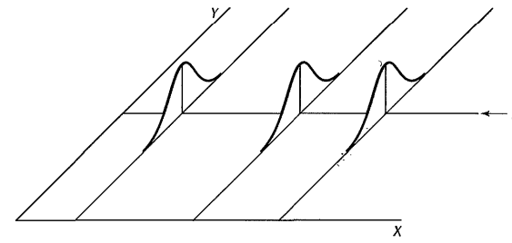
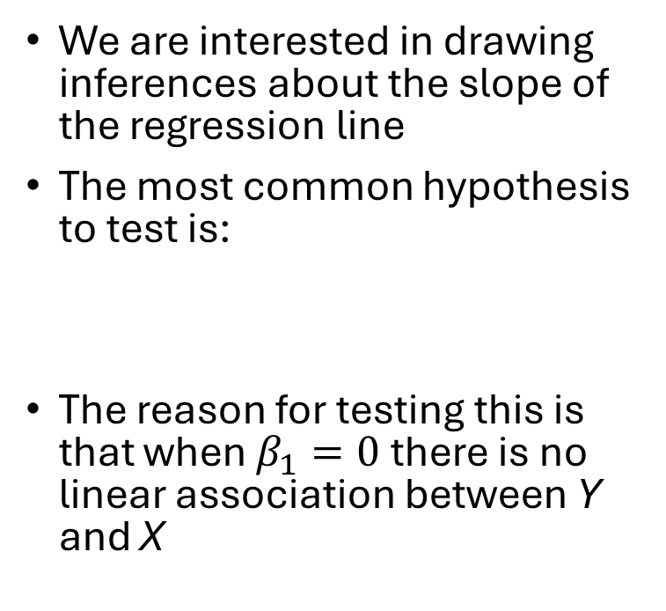



Inferences for point estimates
We are interested in drawing inferences about the slope of the regression line
The most common hypothesis to test is:
The reason for testing this is that when $β_{1}=0$there is no linear association between Y and X
$$β_{0}$$
$$H_{0}:β_{1}=0 vs.H_{0}:β_{1}≠0$$
Mean(Y$)=β_{0}+0X$ = $β_{0}$
Notes:
The probability distributions of Y are identical when the slope is 0 → there is no relationship between X and Y

Slide 40
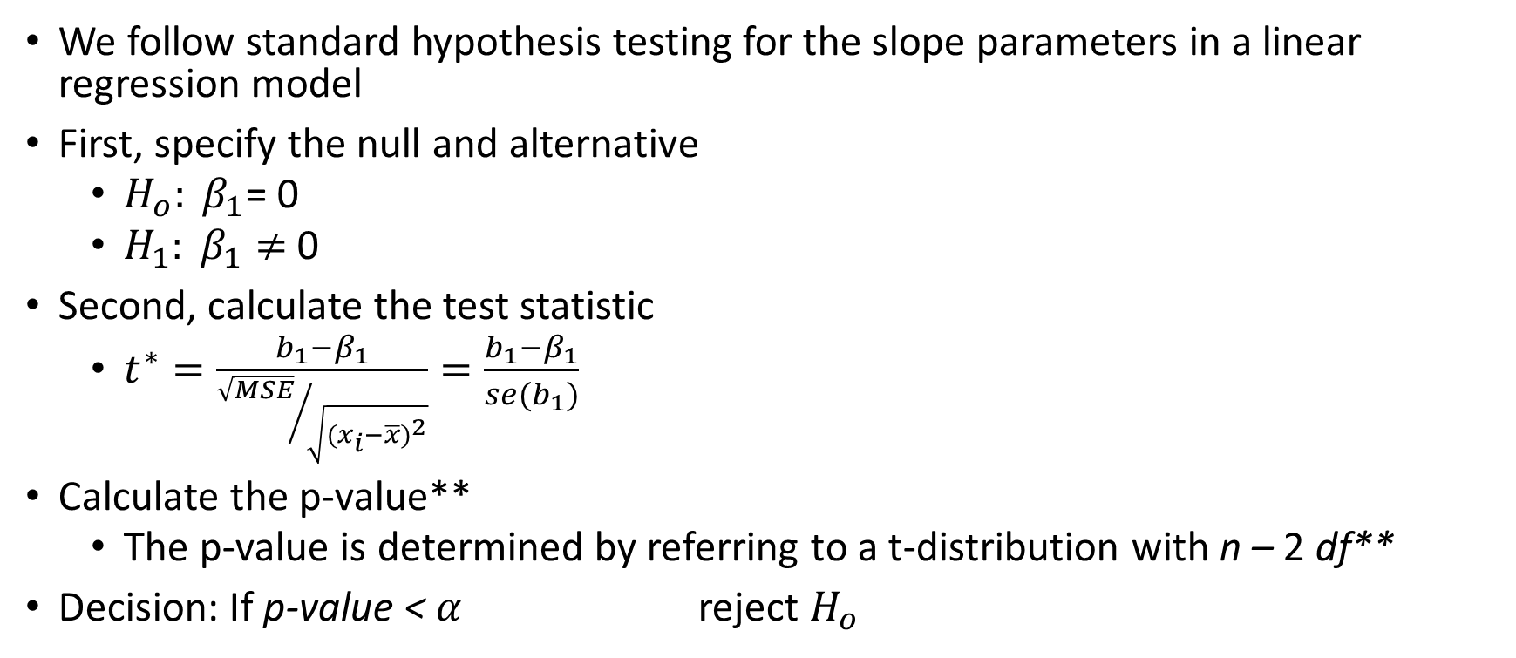
Hypothesis testing of coefficients
We follow standard hypothesis testing for the slope parameters in a linear regression model
First, specify the null and alternative
$H_{o}: β_{1}$= 0
$H_{1}: β_{1}≠$0
Second, calculate the test statistic
$t^{∗}=\frac{b_{1}−β_{1}}{{\sqrt{MSE}}/{\sqrt{{(x_{i}−\overline{x})}^{2}}}}=\frac{b_{1}−β_{1}}{se(b_{1})}$
Calculate the p-value**
The p-value is determined by referring to a t-distribution with n – 2 df**
Decision: If p-value < $α$ reject $H_{o}$

Slide 41
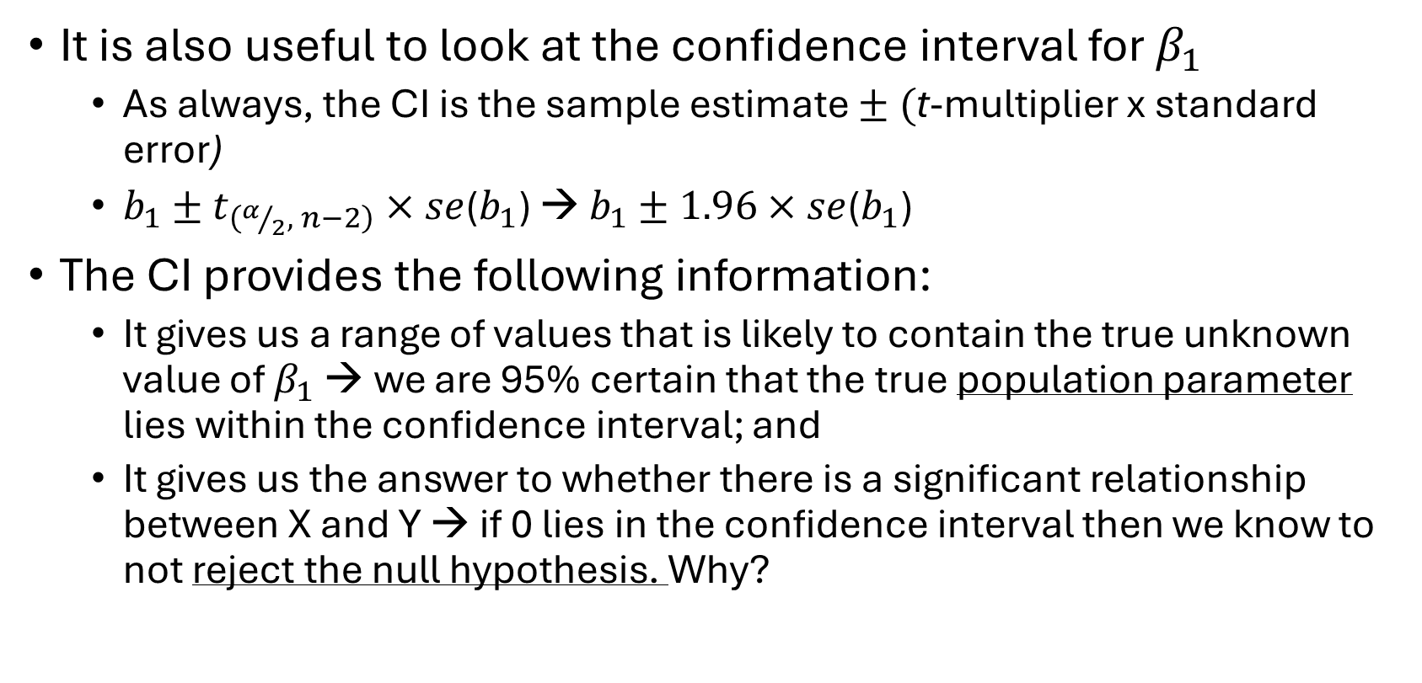
Confidence intervals as hypothesis testing
It is also useful to look at the confidence interval for $β_{1}$
As always, the CI is the sample estimate $± ($t-multiplier x standard error)
$b_{1}±t_{\left(α/2, n−2\right)}×se$($b_{1}$) → $b_{1}±1.96×se$($b_{1}$)
The CI provides the following information:
It gives us a range of values that is likely to contain the true unknown value of $β_{1}$ → we are 95% certain that the true population parameter lies within the confidence interval; and
It gives us the answer to whether there is a significant relationship between X and Y → if 0 lies in the confidence interval then we know to not reject the null hypothesis. Why?

Slide 42
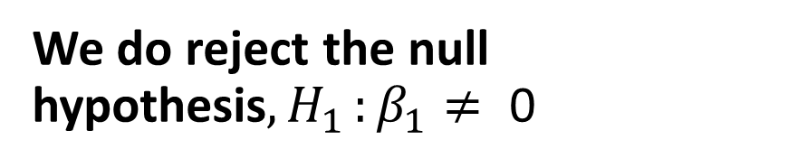
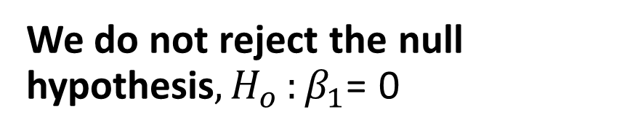
Critical: Inference, Error and Associations
We do not reject the null hypothesis${, H}_{o}:β_{1}$= 0
We do reject the null hypothesis${, H}_{1}:β_{1}≠ \text{0}$
We committed a Type II error
There really is not much of a linear relationship between x and y
There is a relationship between x and y — it is just not linear
We committed a Type I error
The relationship between x and y is indeed linear.
A linear function fits the data, okay, but a curved ("curvilinear") function would fit the data even better (i.e., the model is mis- specified)

Slide 43
Introduction to Multiple Linear Regression
What is it and how it works

Slide 44
Key Questions
Is the overall model (regression equation) useful? i.e. are any of the fitted coeff. significant?
Which features are “significant” and what does that mean?
Are the various features positively or negatively related to the response? How do we interpret them?
How much of the variability in the response variable is explained by the model?
Are the OLS assumptions satisfactory?

Slide 45
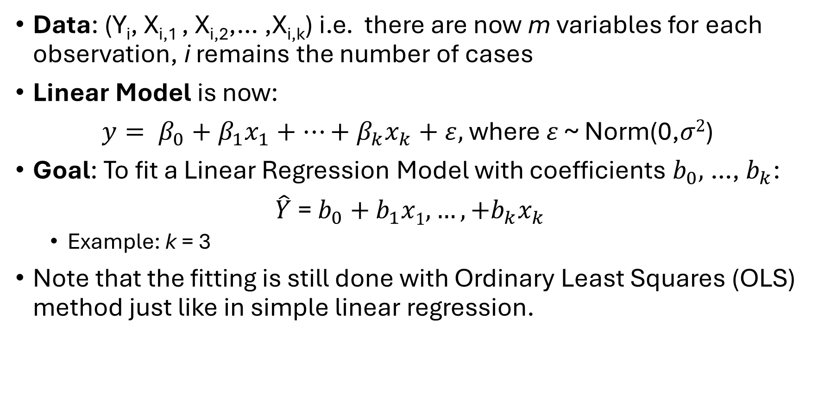
Multiple Linear Regression
Data: (Y_{i}, X_{i,1} , X_{i,2},… ,X_{i,k}) i.e. there are now m variables for each observation, i remains the number of cases
Linear Model is now:
$y= β_{0}+β_{1}x_{1}+…+β_{k}x_{k}+ε,$ where $ε$ ~ Norm(0,$σ2$)
Goal: To fit a Linear Regression Model with coefficients $b_{0},$…, $b_{k}$:
$\hat{Y}$ = $b_{0}\text{ +} b_{1}x1, …,+b_{k}x_{k}$
Example: k = 3
Note that the fitting is still done with Ordinary Least Squares (OLS) method just like in simple linear regression.
${Q=min}_{b_{0}\text{, }b_{1}, …,b_{k}}\sum_{i}{(y_{i} −b_{0}\text{ +} b_{1}x1, …,+b_{k}x_{k})}$²

Slide 46
Similarities/Differences between MLR and SLR
F-test (ANOVA table): Tells us whether any indep. vars are significant
H₀: β_{i} = 0 for all i or H₀: β₁ = β₂ ₌ β_{3 …} β_{k} = 0 (None of the X variables have linear relationships with Y)
H₁: β_{i} ≠ 0 for some i (At least one X variable has a linear relationship with Y)
Intercept: β₀ is the expected value of Y when all predictors are zero
Slope(s): β_{i} is the expected change in response (Y) for every 1 unit increase in X_{i}, while holding all other predictors constant.
Individual t-tests for each coefficient are reported in summary
R²: Proportion of variance in Y that is explained by all independent vars
Use adjusted R-sq because it adjusts for number of predictors (same interpretation) as opposed to regular R² which always increases in # predictors

Slide 47
Example: Regression with two independent/explanatory variables
Question: How is math SAT score related to verbal SAT score and class size?
“Regress math SAT score on verbal SAT score and class size” What is your intuition about the nature of the relationships in this model and why?
Intuition: higher verbal scores should mean higher math scores because students who work hard at math probably work hard at other courses
Intuition: bigger class size means lower math SAT scores because students have less opportunity to interact with teachers, etc.
Intuition: Also though, verbal SAT scores should mean larger classes as well, for the same reason.
Let’s fit a linear model to find out the relationships (if any!).

Slide 48
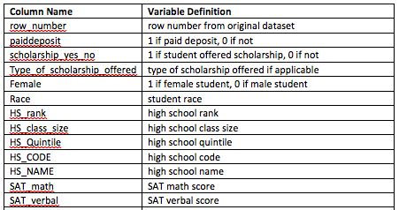
Variable definitions in the school admissions dataset: admissions.sav
…

Slide 49
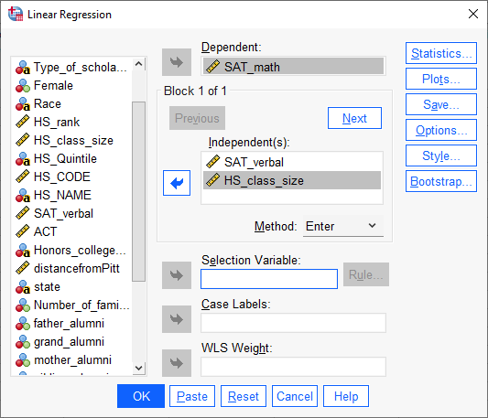
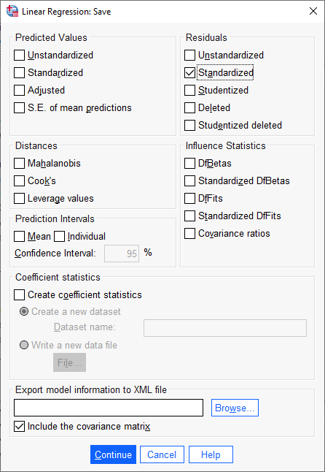
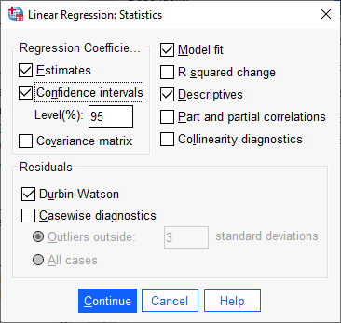

Analyze → Regression

Slide 50


What you already know…Descriptive Statistics & Relationships
Note: the correlation between SAT math
score and SAT verbal score is .450.

Slide 51


What you already know…
22.7% of the variation in MATH SAT scores is explained
by the independent variables (Class size and Verbal SAT)
This means about 87% remains unexplained (an indication that
there are variables omitted from the model that are important
to explain MATH SAT scores)
The independent variables are
moderately to highly correlated with
the dependent variable r = .476
Small p-value → the model is
significant

Slide 52

What’s new …
The more predictors you have in the model the lower the sum of squared residuals, the higher R², indicating the better prediction
The Adjusted R2 accounts for the number of parameters in the model (incurs a penalty for each additional variable)
Durbin-Watson = 2 meaning
the error term may be independent
Small p-value → the model is
significant
$H_{o}: β_{1}$ and $β_{2}$= 0
$$H_{1}:at least one β is not 0$$
We conclude that at least one of
the slopes is not equal to 0
Notes:
Use the Durbin-Watson statistic to test for the presence of autocorrelation in the errors of a regression model. Autocorrelation means that the errors of adjacent observations are correlated. If the errors are correlated, then least-squares regression can underestimate the standard error of the coefficients. Underestimated standard errors can make your predictors seem to be significant when they are not.
Durbin Watson ranges from 0-4, a statistic around 2 is what you are looing for…

Slide 53



What is new…
This is the standardized beta coefficient. This statistic puts the coefficients on the same
“footing” and hence it can be used to compare the strength of the coefficients, indicating which variable
is more meaningfully related to the dependent variable.
Recall the model is:
$$y= β_{0}+β_{1}x_{1}+…+β_{k}x_{k}+ε$$
Here, k = 2 →
$$y= β_{0}+β_{1}x_{1}+β_{2}x_{2}+ε$$
MATH SAT Score = 314.147 + .449VERBAL_SAT(X₁) + .060CLASS_SIZE(X₂ )
Confidence intervals
for the coefficients

Slide 54


What is new…
Notice there are now multiple
independent variables in the model.
This means that the effect of one variable on Y needs to be interpreted slightly different. The slope of a variable now represents the effect
after all other variables in the model are controlled.
Every 1 unit increase in SAT verbal score increases the MATH verbal score by .449 holding class size constant at its mean
Note: the relationship (i.e., correlation) between SAT math score and SAT verbal score is .449 after controlling for class size. That is, after the effect of class size is removed from the relationship between SAT and MATH score.
Recall the model is:
$$y= β_{0}+β_{1}x_{1}+…+β_{k}x_{k}+ε$$
Here, k = 2 →
$$y= β_{0}+β_{1}x_{1}+β_{2}x_{2}+ε$$
MATH SAT Score = 314.147 + .449VERBAL_SAT(X₁) + .060CLASS_SIZE(X₂ )
Notes:
Predict math score for a 410 verbal score and a class size of 35

Slide 55



What is new…
Linear + Constant Variance – Check Residuals v Fitted
Normality of Errors – qqplot of residuals
Data is very close to line that represents a normal distribution
Normality assumption satisfied
No funnel shape (increasing variance)
Not much of a curvilinear pattern
➔ Linearity and Equal Variance assumptions are reasonably satisfied

Slide 56
(aside): part and partial correlation
Partial correlation: the correlation between an independent variable and a dependent variable after controlling for the influence of other variables on both the independent and dependent variable
Example: regress MATH SAT score on VERBAL SAT score and class size – the partial correlation the influence of class size on both MATH and VERBAL SAT score is taken into consideration. This means that the partial correlation between VERBAL SAT score and MATH SAT score takes into account the impact of class size on both VERBAL and MATH SAT score
This is the idea of ‘partialing’ out in regression
Part correlation: the correlation between an independent and dependent variable after controlling for the influence of other variables only on the independent variable
Example: the part correlation above only considers the impact of class size on VERBAL SAT score
This is nice if you want to assess how much unique variance CLASS SIZE explains in relation to the total variance in MATH SAT score

Slide 57

Partial Correlation, i.e. ‘partialling out’ AKA ‘controlling for’… (this is the relationship that holds for all values of class size)

Slide 58
What is MLR and how does it work?
Two or more predictor variables and one criterion variable
Additional variables are incorporated via partial and semipartial correlations
Partial correlation
As a three-variable example, represents the linear relationship between X₁ and X₂ independent of the linear influence of X₃
Semipartial (part) correlation
Linear relationship between X₁ and X₂ after that portion of X₂ that can be linearly predicted from X₃ has been removed from X₂

Slide 59
Partial correlation Intuition
Think of partial correlation as measuring the direct relationship between two variables (X₁ and X₂) while removing the influence of a third variable (X₃) from both
Example: What is the relationship between study time and exam scores?
You find a positive correlation between them using Pearson’s r.
Another variable, X₃ may affect both variables, i.e., say IQ score (?)

Slide 60
Semipartial correlation Intuition
Think of semipartial correlation as measuring the relationship between two variables after removing the effect of a third variable from only one of them
Example:
We still want to see how study time (X₁) and exam scores (X₂) are related, but we only remove the effect of IQ (X₃) from exam scores (X₂)
Study time (X₁) remains unchanged.
This tells us how much study time predicts exam scores after “controlling for” the portion of exam scores that can be explained by IQ

Slide 61
Connection to MLR
Connection to Multiple Regression
In multiple linear regression, you often include multiple predictors to isolate the unique contribution of each predictor to the outcome
Partial correlation (What is the true relationship between X₁ and X₂)
Partial correlation examines the relationship between two variables while statistically holding others constant—just like controlling for confounders in a regression model
"What is the relationship between X₁ and X₂ once the influence of X₃ has been removed from both?"
Semipartial (How much additional variance in X₂ does X₁ explain beyond X₃?)
In multiple regression, the semipartial correlation squared (sr²) represents the unique contribution of a predictor (X₁) to the outcome (X₂) over and above other predictors.
It answers: “If I add this predictor to the model, how much additional variance does it explain?”

Slide 62
Summary
The key difference between partial and semipartial correlation is in how they adjust for the third variable (X₃) and what they tell us about prediction
Type | What It Controls For | Meaning
Partial Correlation | Removes the effect of X₃ from both X₁ and X₂ | Examines the "pure" relationship between X₁ and X₂ with X₃’s influence removed from both | Similar to the standardized beta coefficient (β) in multiple regression
Semipartial (Part) Correlation | Removes the effect of X₃ from only X₂ (or X₁) | Examines how much X₁ contributes to X₂ after adjusting X₂ for X₃, but not adjusting X₁ | Similar to the unique R² contribution of a predictor in multiple regression

Slide 63
What Multiple Linear Regression Is and How It Works: Characteristics
Unstandardized regression model
Sample multiple linear regression model
Y_{i} = b₁ X_{1i} + b₂ X_{2i} + ... + b_{m} X_{mi} + a + e_{i}
Y is the criterion variable
X_{k}’s are the predictor (or independent) variables where k = 1, ..., m
b_{k} is the sample partial slope of the regression line for Y as predicted by X_{k}
a is the sample intercept of the regression line for Y as predicted by the set of X_{k}’s
e_{i} are the residuals or errors of prediction (the part of Y not predictable from the X_{k}’s)
i represents an index for an individual or object
Sample prediction model is
Y'_{i} = b₁ X_{1i} + b₂ X_{2i} + ... + b_{m} X_{mi} + a
Difference in the models:
Regression model explicitly includes prediction error as e_{i}
Prediction model includes prediction error implicitly as part of the predicted score Y'_{i} (i.e., there is some error in the predicted values)

Slide 64


What Multiple Linear Regression Is and How It Works: Characteristics
Standardized regression model
Sample standardized linear prediction model
= sample standardized partial slope
no intercept term is necessary as the mean of the z scores for all variables is 0
Unstandardized or standardized model?
Standardized model is not stable from sample to sample
$$z(Y_{i}^{′})=b_{1}^{∗}z_{1i}+b_{2}^{∗}z_{2i}+...+b_{m}^{∗}z_{mi}$$
$$z(Y_{i}^{′})=b_{1}^{∗}z_{1i}+b_{2}^{∗}z_{2i}+...+b_{m}^{∗}z_{mi}$$

Slide 65
What Multiple Linear Regression Is and How It Works: Characteristics
Coefficient of multiple determination and multiple correlation
Tells the proportion of total variation in the dependent variable Y that is explained by the set of predictor variables
R-squared = .45 → 45% of the variation in Y is explained by Xs
Example: if we predict GGPA from UGPA and our R-squared is .45
1 – R-squared

Slide 66
What Multiple Linear Regression Is and How It Works: Characteristics
Significance tests
Overall: Test of significance of the overall regression model, or alternatively the test of significance of the coefficient of multiple determination
If H₀ is rejected, then one or more of the individual regression coefficients is statistically significantly different from zero
Ceteris paribus: Test of the statistical significance of each individual partial slope or regression coefficient, b_{k}

Slide 67
What Multiple Linear Regression Is and How It Works: Characteristics
Methods of entering predictors
Simultaneous
Backward elimination
Forward selection
Stepwise selection
All possible subsets regression
Hierarchical regression

Slide 68
What Multiple Linear Regression Is and How It Works: Characteristics
Nonlinear relationships
Polynomial models
First degree polynomial (simple linear regression)
Second degree polynomial (quadratic)
Third degree polynomial (cubic)
Example: entering age (first degree), age-squared (quadratic) or age-cubed (3rd degree)

Slide 69
What Multiple Linear Regression Is and How It Works: Characteristics
Interactions
An interaction can be defined as occurring when the relationship between Y and X₁ depends on the level of X₂
In other words, X₂ is a moderator variable

Slide 70
What Multiple Linear Regression Is and How It Works: Characteristics
Categorical predictors
Dummy coding
When there are more than two categories to the categorical predictor, multiple dummy coded variables must be created—specifically one minus the number of levels or categories of the categorical variable

Slide 71
What Multiple Linear Regression Is and How It Works: Sample Size
Sample size considerations differ depending on the research goal—testing a hypothesis test estimating a parameter (Algina & Olejnik, 2000; Maxwell, 2000)
Larger sample sizes needed for estimation (e.g., Pedhazur, 1997)
Sample size increases as the squared multiple correlation coefficient diminishes (Knofszynski, 2008)
Recommendation: estimate power using power software and to consult current advances based on simulation research such as Knofszynski (2008)

Slide 72
What Multiple Linear Regression Is and How It Works: Power
In multiple regression, power is a function
sample size
number of predictors
level of significance
size of the population effect
Recommendation: consult power table or power software

Slide 73
What Multiple Linear Regression Is and How It Works: Effect Size
Coefficient of multiple determination or multiple correlation coefficient
Squared multiple correlation coefficient which can be used to compute a globalized f²

Slide 74
Mathematical Introduction Snapshot
Example: Can I predict your graduate GPA based on your undergraduate GPA & score on the GRE
Note: Be very very careful about what you CLAIM after the analysis. Your conclusions and policy recommendations can be very detrimental particularly to historically marginalized populations!
You should also ask yourself: Who Cares?

Slide 75
Your turn
Can I predict your graduate GPA based on your undergraduate GPA & score on the GRE
gre_example.sav
Process
Look at descriptive statistics
Calculate the zero order and partial correlations between the variables
Run regression analysis
Interpret coefficients
Evaluate overall model for assumptions and fit

Slide 76
GRE-GPA Example Data
Student | GRE-Total (X₁) | Undergraduate GPA (X₂) | Graduate GPA(Y)
1 | 145 | 3.2 | 4.0
2 | 120 | 3.7 | 3.9
3 | 125 | 3.6 | 3.8
4 | 130 | 2.9 | 3.7
5 | 110 | 3.5 | 3.6
6 | 100 | 3.3 | 3.5
7 | 95 | 3.0 | 3.4
8 | 115 | 2.7 | 3.3
9 | 105 | 3.1 | 3.2
10 | 90 | 2.8 | 3.1
11 | 105 | 2.4 | 3.0

Slide 77




$$b_{1}=\frac{(r_{Y.X1}−r_{Y.X2}r_{12})s_{Y}}{(1−r_{12}^{2})s_{X1}}$$
Y = GPA in graduate school
X1 = GRE score
X2 = Undergraduate GPA
$$b_{1}=\frac{(r_{Y.X1}−r_{Y.X2}r_{12})s_{Y}}{(1−r_{12}^{2})s_{X1}}=\frac{\left(r_{Y.X1}−r_{Y.X2}r_{12}\right).3312}{\left(1−r_{12}^{2}\right).4011}$$

Slide 78







Zero order (the Pearson
you already know)
Partial correlation (the correlation after one variable has been partialed out)
Y = GPA in graduate school
X1 = GRE score
X2 = Undergraduate GPA
$$b_{1}=\frac{(r_{Y1.X1}−r_{Y.X2}r_{12})s_{Y}}{(1−r_{12}^{2})s_{X1}}=\frac{[.784−(.752)(.301)].332}{(1−.301^{2})16.33}$$
$$r_{Y.X1}=.784$$
The correlation between GRE and Graduate GPA
$$r_{Y.X2}=.752$$
The correlation between Graduate GPA and Undergrad GPA
$$b_{2}=\frac{(r_{Y.X2}−r_{Y.X1}r_{12})s_{Y}}{(1−r_{12}^{2})s_{X2}}=\frac{[.7516−(.784)(.301)].332}{(1−.301^{2}).401}$$
$$r_{12}=.301$$
The correlation between GRE and Undergraduate GPA

Slide 79


Sample Partial Slope and Intercept
$$b_{1}=\frac{(r_{Y1}−r_{Y2}r_{12})s_{Y}}{(1−r_{12}^{2})s_{X1}}=\frac{[.7845−(.7516)(.3011)].3317}{(1−.3011^{2})16.3346}=.0125$$
$$b_{2}=\frac{(r_{Y.X2}−r_{Y.X1}r_{12})s_{Y}}{(1−r_{12}^{2})s_{X2}}=\frac{[.7516−(.7845)(.3011)].3317}{(1−.3011^{2}).4011}=.4687$$
$$b_{0}=\bar{Y}−b_{1}{\bar{X}}_{1}−b_{2}{\bar{X}}_{2}=3.5000−(.0125)(112.7273)−(.4687)(3.1091)=.6337$$

Slide 80

Sample Multiple Linear Regression Model
Y_{i} = $b_{0}$+ $b_{1}X_{1}+b_{2}X_{2}$+ e_{i}
$\hat{Y\text{i}}$= .6337 + .0125 X₁ + .4687 X₂ + e_{i}
If your score on the GRETOT was 130 and your UGPA was 3.5, then your predicted score on the GGPA would be computed as:
$\hat{Y\text{i}}$ = .0125 (130) + .4687 (3.5000) + .6337 = 3.8992
Run the MLR of grad school GPA on undergraduate GPA and GRE using gre_example.SAV

Slide 81

Overall F Test Statistic
$$F=\frac{SS_{reg}/df_{reg}}{SS_{res}/df_{res}}=\frac{0.9998/2}{.1002/8}=39.9122$$
The null: all slopes equal 0
The critical value, at the .05 level of significance, is _{.05} F _{2,8} = 4.46
Test statistic exceeds the critical value, so we reject H₀ and conclude that not all the partial slopes are equal to zero at the .05 level of significance, i.e., at least one is significant

Slide 82
Example - Pharmacodynamics of LSD
Math Score (y) | LSD Conc (x)
78.93 | 1.17
58.20 | 2.97
67.47 | 3.26
37.47 | 4.69
45.65 | 5.83
32.92 | 6.00
29.97 | 6.41
Response (Y) - Math score (mean among 5 volunteers)
Predictor (X) - LSD tissue concentration (mean of 5 volunteers)
Make scatterplot of data in SPSS
USE LSD.SAV – a made up example of LSD concentration in blood and math score on a test

Slide 83
Homework
Do practice problems in folder for this week and submit to me by next Friday on canvas
Run through the next example yourself and make sure you can replicate the results (LSD.sav, LSD.jasp)

Slide 84


From SPSS

Slide 85


From SPSS
Put score on Y axis and LSD on X axis
Before we customize the plot it will look like this
Let’s take some time making the chart look prettier

Slide 86

Revised Scatterplot
As LSD concentration increases, math score decreases
Looks like a strong, linear relationship
Let’s do a SLR to get the nature of the relationship

Slide 87

Least Squares Computations
$S_{xx}=\sum{{(X−\overline{X})}^{2}}$
$S_{yy}=\sum{{(Y−\overline{Y})}^{2}}$
$S_{xy}=\sum{{(X−\overline{X})(Y−\overline{Y}) }^{ }}$
$b_{1}=\frac{\sum{{(X−\overline{X})(Y−\overline{Y}) }^{ }}}{\sum{{(X−\overline{X})}^{2}}}$=$\frac{S_{xy}}{S_{xx}}$
$b_{0}=$ $\overline{Y}$ ${−b}_{1}\overline{X}$
$s^{2}$ =$\frac{\sum{{(Y−\hat{Y})}^{2}}}{n−2}$ = $\frac{SSE}{n−2}$

Slide 88


Example -Pharmacodynamics of LSD
Score (Y) | LSD Conc (X) | $$X−\overline{X}$$ | $$Y−\overline{Y}$$ | $$S_{xx}$$ | $$S_{xy}$$ | $$S_{yy}$$
78.93 | 1.17 | -3.16 | 28.84 | 10.00 | -91.23 | 831.92
58.20 | 2.97 | -1.36 | 8.11 | 1.86 | -11.06 | 65.82
67.47 | 3.26 | -1.07 | 17.38 | 1.15 | -18.65 | 302.17
37.47 | 4.69 | 0.36 | -12.62 | 0.13 | -4.50 | 159.19
45.65 | 5.83 | 1.50 | -4.44 | 2.24 | -6.64 | 19.69
32.92 | 6.00 | 1.67 | -17.17 | 2.78 | -28.62 | 294.71
29.97 | 6.41 | 2.08 | -20.12 | 4.31 | -41.78 | 404.69
350.61 | 30.33 | 0.00 | 0.00 | 22.47 | -202.49 | 2078.18
Column totals are in red
Verify
$\overline{Y}$ = 50.087
$\overline{X}$ = 4.333
$b_{1}$= -202.49/ 22.47=-9.01
$b_{0}=$ 50.09 – (-9.01 x 4.33) = 89.10
$\hat{Y}$= 89.10-9.01X
$s^{2}$ = 50.72
Let’s do it in SPSS

Slide 89




Slide 90



$$Score=89.125 −9.009LSD$$

Slide 91


Example -Pharmacodynamics of LSD
$H_{o}: β_{1}$= 0 vs $H_{1}: β_{1}≠$0
n = 7; ${ b}_{1}$= -9.01; $s=\sqrt{50.72}=7.12;$ Sxx – 22.475; se($b_{1}$) = 7.12/22.475 = 1.50
Testing
t* = -9.01 / 1.50 = -6.01 → p = .002 → reject Null
Note, the t equals the Z only when N is large

Slide 92



Example -Pharmacodynamics of LSD
n = 7
$b_{1}$=-9.01
se($b_{1}$) = 7.12/22.475 = 1.50
95% CI
-9.01 $±$ 2.57(1.50) → -9.01$±3.86$ → (-12.87, -5.15)
From this confidence interval, do you reject the Null?

Slide 93


Example
$$S_{xx}=22.475 S_{xy}=−202.487 S_{yy}=2078.183 SSE=253.89$$
$$r=\frac{−202.487}{\sqrt{(22.475)(2078.183)}}=−0.94$$
$$R^{2}=\frac{2078.183−253.89}{2078.183}=0.88=(−0.94)^{2}$$
$R^{2}×100$ =
% of variation in the dependent variable explained by the independent variable(s) in the mode

Slide 94



Example

Slide 95
ANOVA F-test
Analysis of Variance F-test
Tests the significance of the overall model including ALL independent variables
For SLR, the F-test is the same as the t-test for b1
F = t²
Source of Variation | Sum of Squares | Degrees of Freedom | Mean Square | F
Model | SSR | 1 | MSR = SSR/1 | F = MSR/MSE
Error | SSE | n-2 | MSE = SSE/(n-2)
Total | S_{yy} | n-1

Slide 96

ANOVA F-test for SLR
Analysis of Variance F-test
$H_{o}: β_{1}$= 0
$H_{1}: β_{1}≠$0
F* = $\frac{MSR}{MSE}$ > $F_{α, df=1, n−2}$→ reject null
Source of Variation | Sum of Squares | Degrees of Freedom | Mean Square | F
Model | SSR | 1 | MSR = SSR/1 | F = MSR/MSE
Error | SSE | n-2 | MSE = SSE/(n-2)
Total | S_{yy} | n-1

Slide 97
Example - Pharmacodynamics of LSD
Total Sum of squares:
Error Sum of squares:
Model Sum of Squares:

Slide 98


Example - Pharmacodynamics of LSD
Source of Variation | Sum of Squares | Degrees of Freedom | Mean Square | F
Model | 1824.293 | 1 | 1824.293 | 35.93
Error | 253.890 | 5 | 50.778
Total | 2078.183 | 6
Analysis of Variance - F-test
H₀: all betas equal 0 vs H_{A}: at least one beta is 0
H₀: β₁ = 0 vs H_{A}: β₁ ≠ 0
$F=\frac{MSR}{MSE}=35.928>F_{α, df=1, n−2}$ = 6.61→
Reject Null

Slide 99




Fitted Values & Residuals
Fitted values for the sample cases are obtained by substituting the appropriate X values into the estimated regression function.
The residual is the difference between the observed value Yi and the fitted value ${\hat{Y}}_{i}$. The residual is denoted by $e_{i}$and is defined as
For the case above
Score (Y) | LSD Conc (X)
78.93 | 1.17
58.20 | 2.97
67.47 | 3.26
37.47 | 4.69
45.65 | 5.83
32.92 | 6.00
29.97 | 6.41
350.61 | 30.33
$Score=89.125 −9.009(4.69$)=46.87279
$e_{i}$= $Y_{i}{−\hat{ Y}}_{i}$
$e_{4}$= $Y_{4}{−\hat{ Y}}_{4}=37.47$- 46.87 = -9.4

Slide 100

Factors affecting the width of the CI: Making the interval as narrow as possible
As the confidence level decreases, the width of the interval decreases
Compare $b_{1}±1.96×se$($b_{1}$) with $b_{1}±1.56×se$($b_{1}$)
Note: the wider interval makes it less likely we reject the null that $β_{1}$= 0, i.e. that 0 will be contained in the CI
As the regression error (MSE) decreases, the width of the interval decreases
Less error means we are more confident about rejecting the null
Look at formula as MSE increases, t-statistic decreases
The more spread out the predictor x values, the narrower the interval
Look at formula, more variation means t-statistic increases because the denominator will be smaller
As the sample size increases, the width of the interval decreases, i.e. it will be more narrow
Larger n means more variation

