Slide 1
Factor Analysis
Week 13
March 31, 2025

Slide 2
What is Factor analysis (FA)?
FA is a tool for analyzing the structure of the interrelationships among a large number of variables by defining sets of variables that are highly interrelated
Social workers use different measures to capture different underlying constructs (?)
To be representative of the underlying construct, the variables should ‘cluster’ together around that construct
The construct is called a latent variable and is represented by a ‘factor’
Note: in Latent Class Analysis (next) the latent variable is referred to as a ‘class’
The factors are assumed to represent dimensions within the data structure
The dimensions can guide the creation of new composite measures
Example: five items represent 1 latent variable called depression, or several items of neighborhood disinvestment represent ‘sustained disinvestment’ (see below)
The dimensions have meaning for what they actually represent if there is a conceptual basis for understanding the relations between the variables

Slide 3
What is a ‘latent variable’
Latent variables are unobserved (hidden) variables that are inferred from patterns in observed data
In factor analysis, latent variables (also called factors) help explain the underlying structure among a set of measured variables (like survey items or test scores)
Example: You might measure things like "feeling sad," "trouble sleeping," and "loss of interest.“
These observed variables are indicators of a latent variable like "Depression."
Latent variables are not measured directly—they are statistical constructs that help us make sense of correlated behaviors or responses
In structural equation modeling (SEM), which builds upon factor analysis, the model is typically divided into two parts:
The Measurement Model: specifies how observed variables (survey items, indicators) reflect or "load onto" latent variables (unmeasured constructs like depression, disinvestment, or social vulnerability)
The Structural Model: This shows how latent variables are related to one another—representing the causal or correlational paths between unmeasured constructs

Slide 4
Factor analysis versus Principal Components Analysis (PCA)
Underlying Assumptions
PCA - the goal is to reduce the number of observed variables into components that account for maximum variance – i.e., to summarize the data
FA – the goal is to understand the hidden structure in the data
In factor analysis, latent variables (also called factors) help explain the underlying structure among a set of measured variables (like survey items or test scores)
Assumption: the latent constructs (factors) cause the observed correlations between variables
Example: You might measure things like "feeling sad," "trouble sleeping," and "loss of interest.“
These observed variables are indicators of a latent variable like "Depression."

Slide 5
Factor analysis versus Principal Components Analysis (PCA)
PCA is not testable
Use PCA when you're interested in data reduction (e.g., building indices or simplifying predictors), and FA when you want to model the underlying structure of the data (e.g., psychological traits, constructs)
You can't really test whether you included the “right” variables in PCA—there's no underlying theory being tested.
PCA is just mathematically rotating your variables into components that capture variance—it doesn't care why the variables are related
If the goal is to estimate underlying factors and attach some meaning, then EFA should be used (Theory)
Do not use PCA

Slide 6
Example: Five indicators of an underlying latent construct we call depression
Let’s say you have 5 questions like:
"I felt sad“
"I couldn’t sleep“
"I felt tired“
"I cried often“
"I had trouble concentrating"
If you conducted a FA:
You’re assuming these 5 items are caused by an underlying factor, like depression
You believe that depression is a latent variable that explains the shared variance (covariance) between these items
Then you test whether this model fits your data (e.g., using model fit statistics). If the model fits well, you have evidence that depression is a valid latent construct
If you conducted a PCA:
PCA examines the total variance of the 5 items and finds components that best summarize the data
You simply want to mathematically combine the items into a weighted average (component) that explains as much variance as possible
There’s no underlying assumption that a real, hidden thing like “depression” exists or is driving the items. It’s just a data summary, not a testable theory

Slide 7
Intuition
PCA
It takes all the variance from all five variables — both shared and unique
Then it creates components (linear combinations of the variables) that explain as much total variance as possible
So even if one variable doesn’t share variance with others (i.e., it doesn’t correlate well), PCA still includes it — it just might load weakly on the first few components
FA
FA focuses only on the shared variance (called common variance) between variables
It assumes there’s some underlying latent factor (like depression) that’s causing the correlation
FA removes unique variance and error variance from the factor model
Example
Let’s say one item (“I felt tired”) is not very correlated with the other 4
PCA still uses it in calculating components
FA might give it a low loading or treat its variance as mostly unique/error rather than useful in explaining the latent construct
Bottom line:
PCA uses all variables and all their variance, shared or not
FA uses only the shared variance to model an underlying latent structure

Slide 8
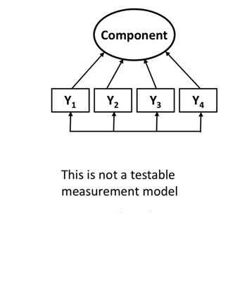
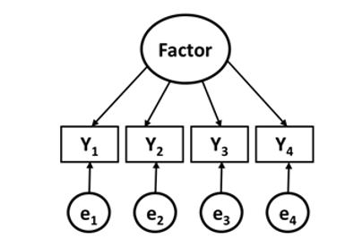
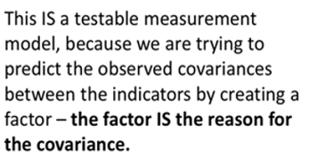
Factor analysis versus Principal Components Analysis (PCA)
In PCA, the indicators drive the component and the Ys covary in some way
Exploratory factor analysis examines all the pairwise relationships between individual variables (e.g., items on a scale) and seeks to extract latent factors from the measured variables.
In FA some underlying factors are driving the variables (plus error)

Slide 9
EFA
The main applications of factor analytic techniques are:
Data reduction. To reduce the number of variables into factors based on shared variance; and
Data classification. To detect structure (or underlying processes) in the relationships between variables, that is, to classify variables
Assumption
Variables that correlate with each other do so because they are measuring the same thing—a common domain
This is important because sometimes composite variables are used from assessments, psychological or otherwise, without concern for the process underlying that construction
RQ: What is the underlying factor structure (i.e., a latent variable) for a set of measures?
EFA is a statistical procedure that allows us to cluster variables together into constructs or ‘latent variables’
Example: Is intelligence a unitary or multidimensional construct (as in multiple forms of intelligence)?

Slide 10
Data Reduction
Reducing the number of variables
The underlying task is to find common variance and eliminate unique variance that is not of interest
It is like a reverse form of ‘partialling out’
Examples
A survey may have 100 items, but the survey was designed to measure 12 components or factors
You have 50 different variables about an individual, but some of those variables are overlapping… are they essentially measuring the same underlying (unobservable, latent) construct?

Slide 11
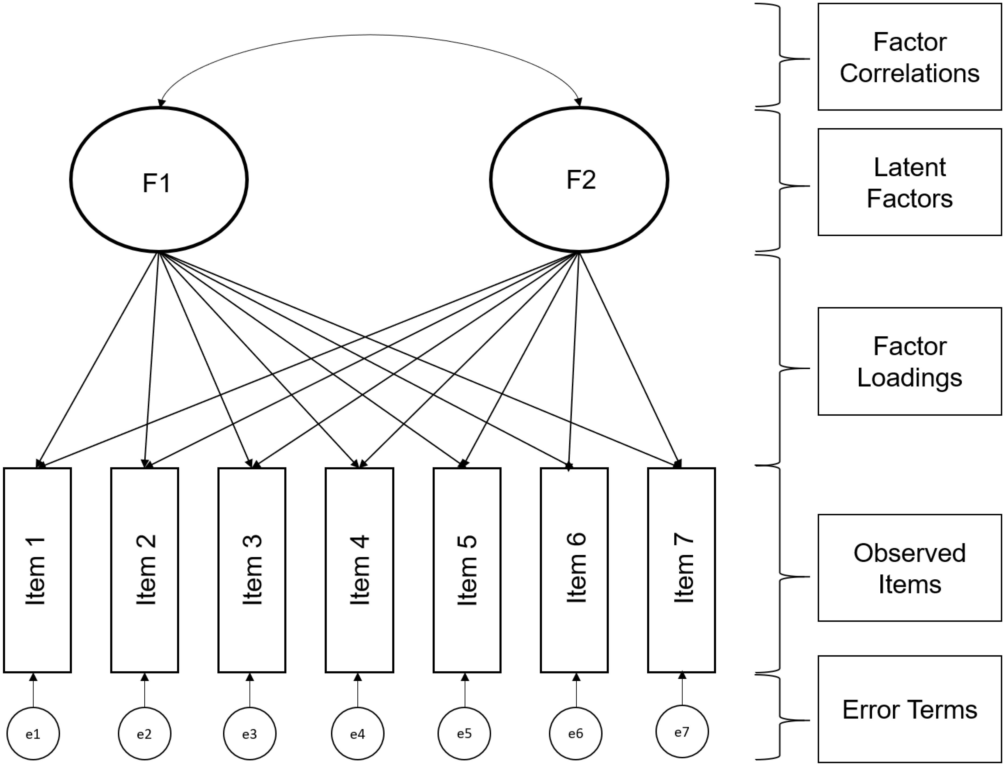
The Statistical Model
EFA does not presuppose a theoretical structure
Useful as a starting point for understanding empirical structures or identifying problems with existing scales
Correlations between items are used to infer the presence of an underlying variable (latent)
Cross loadings: One important consideration is that all items are allowed to load on any factor (compare CFA)

Slide 12
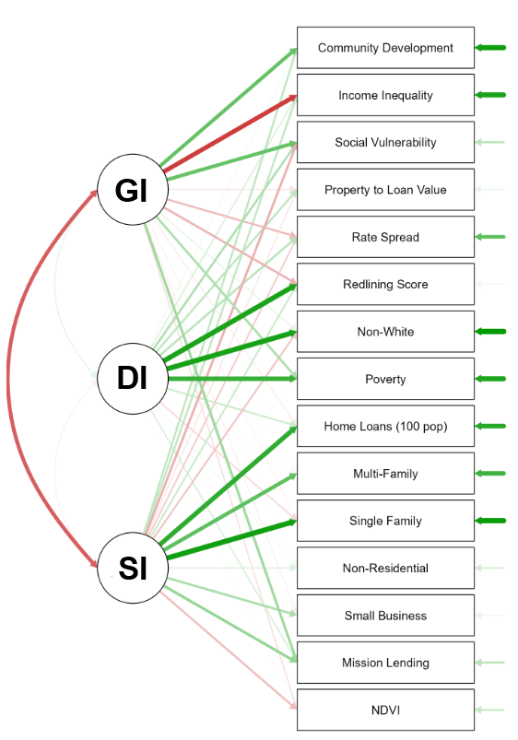
Example
Circles represent latent variables—unobserved constructs identified through factor analysis.
GI = Growing Investment
DI = Disinvestment
SI = Sustained Investment
Researchers assigned these labels based on patterns in the measured data
Boxes represent observed/measured items—real-world variables used to estimate the latent factors (e.g., "Income Inequality," "Home Loans")
Green lines show positive factor loadings:
Thicker green lines indicate stronger relationships, meaning that the item is a good indicator of the latent variable
Red lines show negative relationships or inverse loadings:
These items are negatively associated with the latent variable, meaning they represent an opposite trend or reduce the strength of that factor

Slide 13
Research Questions
How many reliable and interpretable factors/components are there in a set of variables?
How many factors/components should be extracted?
How much variance in a set of variables is accounted for by the retained factors/components?
How are the factors/components interpreted? (Note: this is subjective)

Slide 14
Illustration
Pretend we have gathered information on 9 factors that affected individual choices about whether to patronize certain stores
One question of interest is whether the items can be grouped into some more general areas of focus, i.e., how do the 9 variables group together?
Visual inspection is not helpful in revealing patterns, but factor analysis is… as shown in the next two slides

Slide 15
Correlations (what factor(s) might Cause the relationships?)
Part I Original Correlation Matrix
 | V1 | V2 | V3 | V4 | V5 | V6 | V7 | V8 | V9
V1 Price Level | 1.00
V2 Store Personnel | .427 | 1.00
V3 Return Policy | .302 | .771 | 1.00
V4 Product Availability | .470 | .497 | .427 | 1.00
V5 Product Quality | .765 | .406 | .307 | .427 | 1.00
V6 Assortment Depth | .281 | .445 | .423 | .713 | .325 | 1.00
V7 Assortment Width | .345 | .490 | .471 | .719 | .378 | .724 | 1.00
V8 In-store Service | .242 | .719 | .733 | .428 | .240 | .311 | .435 | 1.00
V9 Store Atmosphere | .372 | .737 | .774 | .479 | .326 | .429 | .466 | .710 | 1.00

Slide 16
Factor Structure
Part II Correlation Matrix After Grouping According to Factor Analysis
 | V3 | V8 | V9 | V2 | V6 | V7 | V4 | V1 | V5
V3 Return Policy | 1.00
V8 In-store Service | .773 | 1.00
V9 Store Atmosphere | .774 | .710 | 1.00
V2 Store Personnel | .771 | .719 | .737 | 1.00
V6 Assortment Depth | .423 | .311 | .429 | .445 | 1.00
V7 Assortment Width | .471 | .435 | .466 | .490 | .724 | 1.00
V4 Product Availability | .427 | .428 | .479 | .497 | .713 | .719 | 1.00
V1 Price Level | .302 | .242 | .372 | .427 | .281 | .354 | .470 | 1.00
V5 Product Quality | .307 | .240 | .326 | .406 | .325 | .378 | .427 | .765 | 1.00

Slide 17
Is factor analysis appropriate?
Conceptual issues (later)
Statistical issues (look at correlations between variables)
Ensure that the data matrix has sufficient correlations to justify the application of FA
If all correlations are low don’t use (<.30)
Look for low partial correlations → a pattern of high partial correlations means that a variable is not correlated with a large number of other variables → no factors exist in the data
Partial correlations > .7 are high
Bartlett’s test of sphericity should be significant
Kaiser-Meyer-Olkin Measure of sampling adequacy (MSA) should be high
Notes:
any partial correlation between any two observed variables is zero once the factor is partialed out
The MSA is a statistic that indicates the proportion of variance in your variables that might be caused by underlying factors.
High values (close to 1.0) generally indicate that a factor analysis may be useful with your data.

Slide 18
Initial factorability assessment (Summary)
Correlation coefficient values
Should be > .30
Bartlett’s test of sphericity
The null hypothesis is the variance-covariance matrix equals the identity matrix
Here we want to reject the null hypothesis because we want overlapping variance between variables to reduce them into latent factors
Anti-image correlation matrix
Kaiser-Meyer-Olkin measure of sampling adequacy (MSA)
An index of shared variance in the variables: the proportion of variance in your variables that might be “caused” by underlying factors
Compares the magnitude of the observed to partial correlation coefficients
Ranges from 0 to 1 and larger values mean more factorability (look for significance)
Notes:
is that the partial correlations should be relatively small if we are to get distinct factors from the analysis
If KMO MSA is significant data are appropriate for factor analysis

Slide 19
Identity matrix v. Covariance matrix
 | Var1 | Var2 | Var3
Var1 | 1 | 0 | 0
Var2 | 0 | 1 | 0
Var3 | 0 | 0 | 1
 | Var1 | Var2 | Var3
Var1 | 1 | 0.6 | 0.4
Var2 | 0.6 | 1 | 0.5
Var3 | 0.4 | 0.5 | 1

Slide 20
Extracting a set of factors from the correlation matrix
Recall: Variance tells us how spread out a variable’s values are around its average
When two variables are correlated, they share some of that variance. The amount they share is the squared correlation
Example: A correlation of 0.5 means 25% of the variance is shared
In FA, variables that are highly correlated are grouped together —meaning they move together and share a lot of variance
It's important to know how much of a variable’s variance is shared with others in its group (factor), and how much is unique or due to error
Total variance = Shared (common) variance + Unique variance + Error

Slide 21
Understanding Variance in Factor Analysis
Common Variance (Shared)
The variance that is shared across variables
Explained by the underlying latent factor (e.g., depression, disinvestment)
This is what we use to group variables into factors
Example: If multiple questions ask about sadness, sleep, and energy, their shared variance may reflect the latent factor "Depression”
Unique Variance
Specific to one variable only
Not shared or explained by the factor
Still meaningful, but only pertains to that item
Example: A question about sleep may reflect not just depression, but unique aspects of sleep itself
Error Variance
Random noise or measurement inaccuracy
Unrelated to any factor or meaningful content

Slide 22
Important concepts
Factor load
Correlation between a variable and a factor (How high is the correlation between two variables?)
Loading a variable to a factor
Eigenvalue
The variance explained by a factor (How much variance can be explained by the factor?)
Sum of the squared factor charges
Communalities
Variance of the variables, which is explained by all factors (How much of the variance of all variables is explained by the factor?)
Sum of the squared factor charges of a variable

Slide 23
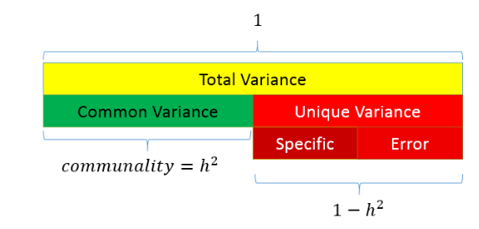
Partitioning the variance in factor analysis
Common variance is the amount of variance that is shared among the variables
Unique variance is the portion of variance that is not common
Specific
Error
Total variance = common + unique
You want communality to be high and uniqueness to be low
Ranges from 0 to 1
Higher values = the common factor
explain more of the variance of an individual
item

Slide 24
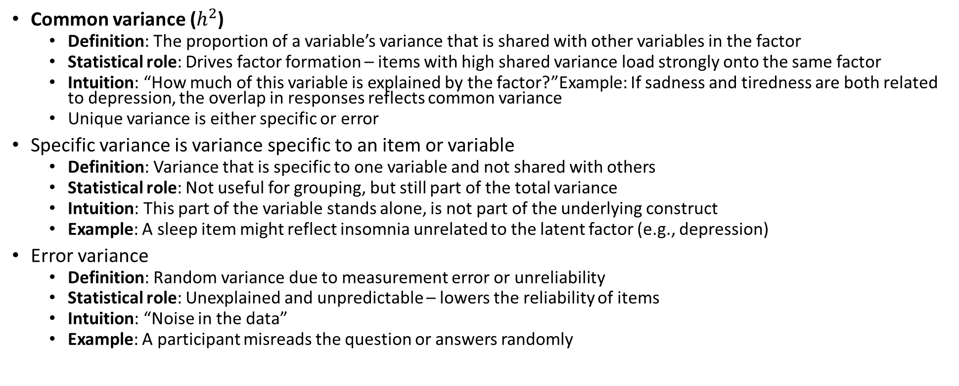
Extracting a set of factors from the correlation matrix
Common variance ($h^{2}$)
Definition: The proportion of a variable’s variance that is shared with other variables in the factor
Statistical role: Drives factor formation – items with high shared variance load strongly onto the same factor
Intuition: “How much of this variable is explained by the factor?”Example: If sadness and tiredness are both related to depression, the overlap in responses reflects common variance
Unique variance is either specific or error
Specific variance is variance specific to an item or variable
Definition: Variance that is specific to one variable and not shared with others
Statistical role: Not useful for grouping, but still part of the total variance
Intuition: This part of the variable stands alone, is not part of the underlying construct
Example: A sleep item might reflect insomnia unrelated to the latent factor (e.g., depression)
Error variance
Definition: Random variance due to measurement error or unreliability
Statistical role: Unexplained and unpredictable – lowers the reliability of items
Intuition: “Noise in the data”
Example: A participant misreads the question or answers randomly

Slide 25
Exploratory Factor Analysis Specification Conditions & Decisions
Factor retention: once the variables are factored, we need to determine how many factors to retain
This is a “crucial decision”
Notes:
If too few factors are retained, then important information is lost and important factors may be neglected
Remember the goal is parsimony

Slide 26
Full Set of Criteria for number of factors
Note: some of these are statistical, some require common sense judgment
Selecting the factor(s)
A priori criterion
Scree plots
Kaiser’s rule (eigenvalues greater than one)
Parallel analysis
Number of variables per factor
Heterogeneity of the respondents

Slide 27
Kaiser’s rule (eigenvalues greater than one)
Eigenvalues measure the amount of variance in the total sample that is accounted for by each factor
Retain only those eigenvalues that are greater than 1 and drop the rest
Why? Any value greater than one represents a factor that explains a higher-than-average amount of variance

Slide 28
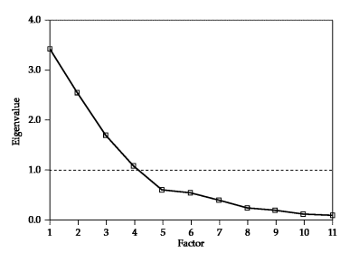
Scree plot
Look to see where the ‘elbow’ bends in the plot – that is how many factors to retain
To do this look for the clearest delineation of where the line goes from being diagonal to horizontal
Then count the number of lines
This is a matter of judgment I would look at 4, 5 and 6 and the use theory to guide
Better than Kaiser’s rule (eigenvalues greater than one)

Slide 29
Parallel Analysis**
Compare the eigenvalues from the original data to the eigenvalues generated from a Monte Carlo simulated matrix created from randomly generated data of the same sample size
Factors are retained when the i^{th} eigenvalue from the observed data is greater than the i^{th} eigenvalue from the random data
Superior to both previous methods
SPSS doesn’t provide this – do it in JASP

Slide 30
Interpreting the factors
An iterative process
Begins with estimating the factor matrix
First, the initial unrotated factor matrix is computed, containing the factor loadings
This is the first solution the software calculates
It finds factors that explain the maximum variance in the data
But: this solution is often hard to interpret, because each variable may load on multiple factors
It gives you the structure, but it's like looking at a blurry picture
Rotated factor loadings are the correlation of each variable and the factor
Rotation is a mathematical adjustment to make the factor structure more interpretable
After rotation, variables usually load more strongly on one factor, and weakly on others
This makes it easier to name the factors based on the items that group together
You typically use rotated loadings to interpret the factors

Slide 31
Example:
Imagine you're doing factor analysis on 10 survey items
Unrotated loadings might show every item loading a little on all factors (messy!)
Rotated loadings will try to "clean this up" so:
Items 1–5 load strongly on Factor 1 → You might label this "Anxiety“
Items 6–10 load strongly on Factor 2 → You might label this "Depression“
→ focus on the rotated loadings

Slide 32
Factor Rotation
Rotation simply means turning the axes (factors) to a new angle to make the factor structure easier to interpret
It doesn’t change the underlying math, but helps us see which variables load clearly onto which factors
Why Rotate?
Rotation helps clarify the factor loadings, making it easier to assign meaning to each factor
It spreads the loadings out more cleanly, so that each variable “belongs” more strongly to one factor instead of multiple
Use oblique rotation (e.g., Promax or Oblimin) in social science research, because factors like "depression" and "anxiety" or "trauma" and "risk-taking" are rarely unrelated in the real world
Type | Factors Are... | Use When...
Orthogonal | Uncorrelated | You assume the factors are independent (rare).
Oblique | Correlated | More realistic for psychology/social sciences.
Notes:
Increases the difficulty in attaching meaning because it will yield an increased number of cross-loadings where some variables will have similar factor loadings for multiple factors

Slide 33
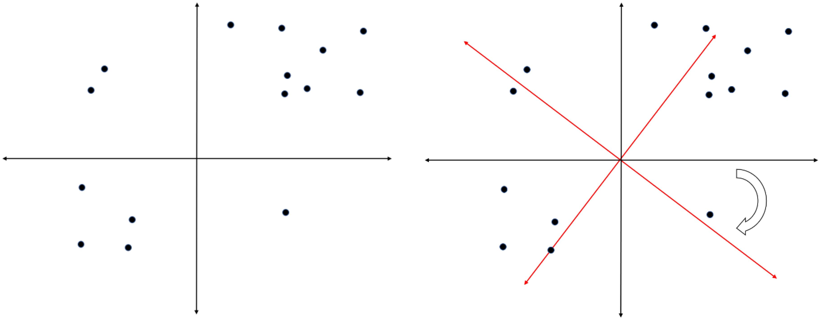
Rotation (Cont’D)
When more than one variable loads highly on a factor, the interpretation becomes difficult (as we will see)
It is a good idea to find an appropriate rotation that makes the factors more interpretable
The best way to understand this is by a scatterplot matrix of the factor loadings – the goal is to find a rotation such that each of the variables has a high loading on only one factor

Slide 34
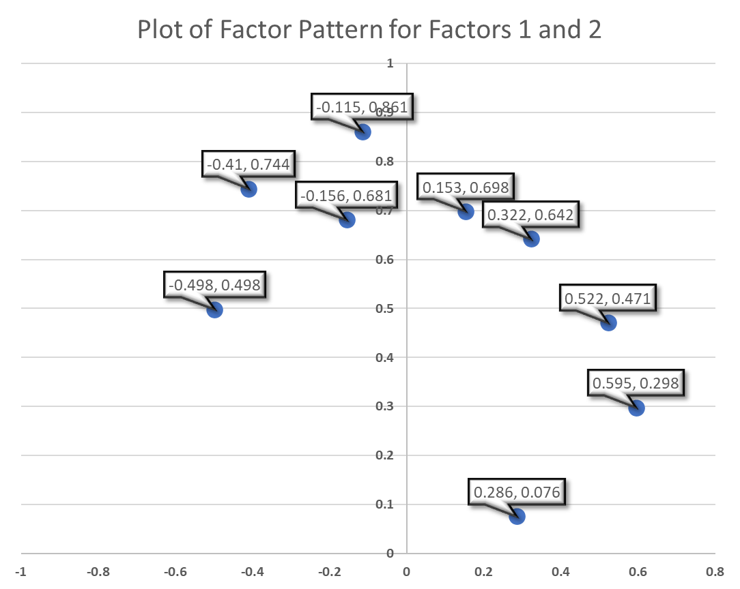
Example
Factor
Variable | 1 | 2 | 3
Climate | 0.286 | 0.076 | 0.841
Housing | 0.698 | 0.153 | 0.084
Health | 0.744 | -0.41 | -0.02
Crime | 0.471 | 0.522 | 0.135
Transportation | 0.681 | -0.156 | -0.148
Education | 0.498 | -0.498 | -0.253
Arts | 0.861 | -0.115 | 0.011
Recreation | 0.642 | 0.322 | 0.044
Economics | 0.298 | 0.595 | -0.533
Notes:
Ideally, each variable appears in only one column
Rotation involves defining new coordinate systems so that when we rotate everything, the points fall close to the vertices (end points) of the new axes.

Slide 35
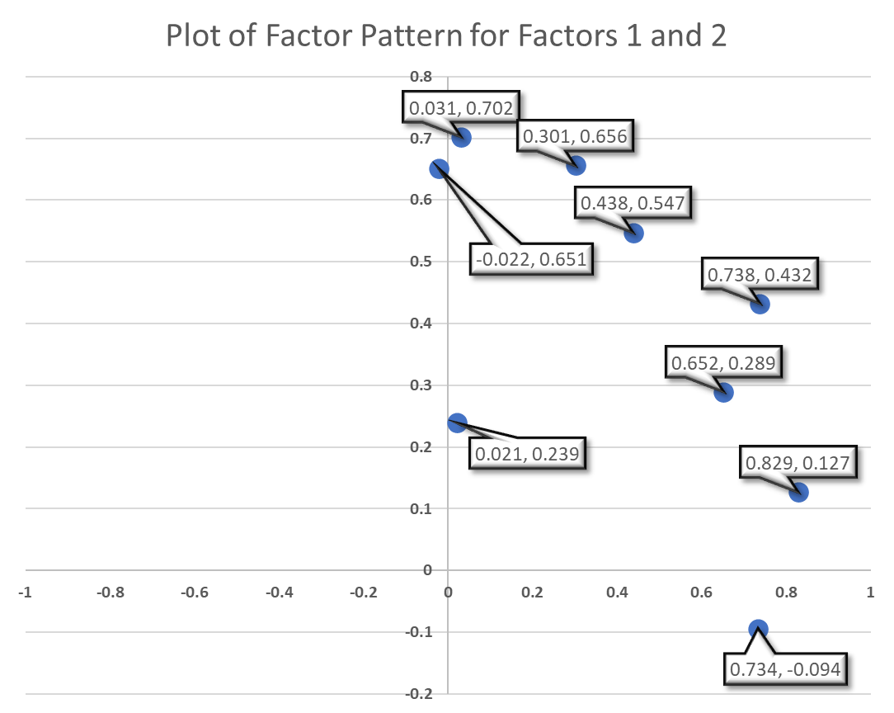
Example
Factor
Variable | 1 | 2 | 3
Climate | 0.021 | 0.239 | 0.859
Housing | 0.438 | 0.547 | 0.166
Health | 0.829 | 0.127 | 0.137
Crime | 0.031 | 0.702 | 0.139
Transportation | 0.652 | 0.289 | -0.028
Education | 0.734 | -0.094 | -0.117
Arts | 0.738 | 0.432 | 0.15
Recreation | 0.301 | 0.656 | 0.099
Economics | -0.022 | 0.651 | -0.551
Notes:
Ideally, each variable appears in only one column
Rotation involves defining new coordinate systems so that when we rotate everything, the points fall close to the vertices (end points) of the new axes.

Slide 36
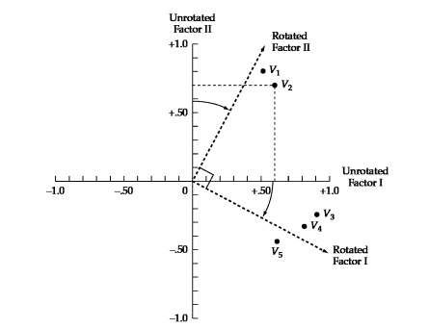
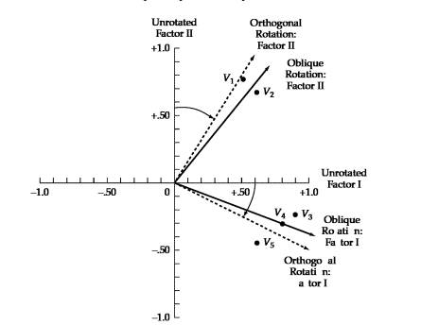
This has the effect of
making the factor loading pattern much clearer
Orthogonal rotates 90º
Comparison Between Rotated and Unrotated Factor Loadings
 | Unrotated Factor Loadings |  | Rotated Factor Loadings
Variables | I | II | I | II
V1 | .50 | .80 | .03 | .94
V2 | .60 | .70 | .16 | .90
V3 | .90 | -.25 | .95 | .24
V4 | .80 | -.30 | .84 | .15
V5 | .60 | -.50 | .76 | -.13
Oblique
Notes:
Factor rotation means that the axes are being rotated so that the clusters of items fall as closely as possible to them.
Imagine rotating the axes so that they intersect the centroid of each cluster variables to get the essence of rotation.
Rotation means that the reference axes of the factors are turned about the origin until some other position has been reached
The effect is to redistribute the variance from earlier factors to later ones to achieve simpler and more meaningful factor pattern
The simplest case is orthogonal factor rotation where the axes are maintained at 90 degrees
When not constrained to being orothogonal the rotation procedure is called oblique
following rotation of the axes, the items now fall closer to each axis line
You can see that after rotating the factor axes, variables 3,4 and 5 load high on factor I and 1 and 2 load high on factor II
Notice too that the oblique factor rotation represents the clustering of variables more accurately because each rotated axis is now closer to the respective group or variables

Slide 37
Factor loadings
The factor loading provides information on the relative contribution that an individual variable makes to a factor
Should be >=.3 preferably >=.4, closer to 1 is better
The factor loading squared is the percentage of common variance of the factor that is accounted for by that variable
In a perfect world, a variable will have a large coordinate on one factor and low on all others – never happens
Negative factor loadings are possible (may want to recode)
Bipolar factors: factors defined by both positive and negative loadings
Notes:
Try: the % of variance in all the variables accounted for by each factor is computed as the sum of the squared factor loadings for that factor divided by the number of variables – which is also the same as dividing the eigenvalue of a factor by the number of variables in the model

Slide 38
Judging the significance of the factors
Ensuring the practical significance
The larger the more important, using practical reasoning
+/- .30 to +/- .40 meet minimum level for interpreting factor structure
Loadings of .50 or higher are practically significant
Loadings > .70 are indicative of well-defined structure

Slide 39
Identify Significant loadings and assess communalities
Once the significance of loadings has been identified, look for any variables that are not adequately accounted for by the factor solution
We do this by looking at communalities → variables with communalities less than .50 do not have sufficient explanation
If low communalities are identified, remove the variable and repeat the analysis
Then label the factors

Slide 40
Interpreting a factor Matrix
Find distinctive variables for each factor and look for correspondence to the conceptual foundation
Note: if an oblique rotation has been used two matrices of factor loadings are provided
The factor pattern matrix contains loadings representing the unique contribution of each variable to the factor
The factor structure matrix contains loadings with both unique variance between variables and factors and the correlation among factors

Slide 41
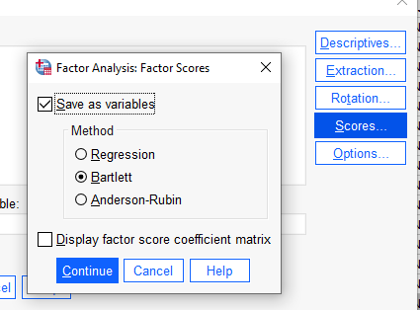
Generating factor scores: A Composite Measure
Sometimes you would like to use the factor scores as a predictor in another analysis
This can be done in SPSS
SPSS will append variables to your dataset for each factor
For oblique rotations, use regression method
This variable can be used in a different analysis
The scores are standardized, mean = 0, var = 1

Slide 42
Considerations
Guidelines
high communalities (approximately .8 to .9)
low model error (which is likely evidenced in situations where communalities are high; RMSR = .00 to .06) (Preacher & MacCallum, 2002)
factors with four or more variables with factor loadings of .60 or greater are interpretable regardless of the sample size
solutions with lower factor loadings (.40) can still be interpreted if the number of cases is at least 200 and the number of variables per factor is larger (=> 10)

Slide 43
Assumptions
Assumption | Effect when violated
Independence | Influences standard errors and hypothesis tests
Linearity | Reduces interpretability of the FA solution
Absence of outlying cases and variables | Exerts undue influence on and distorts the FA solution
Lack of extreme multicollinearity | Reduces ability to separate effects of variables
Multivariate normality | Minimal effect except when MLE is used and when samples size is small
10 observations per variable/n >= 200
Homogeneity of the sample** | Failure to consider groupings
Notes:
Measurement scale
Assumption: a correlation matrix can be calculated from the variables
This matrix is a Pearson matrix (i.e. a linear relationship exists)
Only use ordinal items if they meet the assumption of linearity
This will mostly be never → use LCA/LPA
Sample Size
Minimum of 10 observations per variable
At least 200 cases
Homogeneity of the sample in relation to the underlying factor structure
The sample must be homogenous with respect to the underlying factor structure
Example
If the sample differs on some known characteristic, on the variables you are analyzing then perform separate groups analysis
Example: 20 ratings gauging individual attitudes towards police, do group analysis using race/ethnicity as the grouping variable

Slide 44
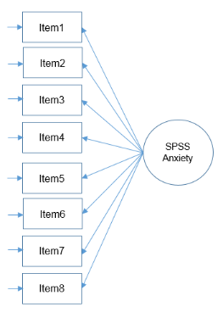
Example: Statistics anxiety
Statistics makes me cry
My friends will think I’m stupid for not being able to cope with SPSS
Standard deviations excite me
I dream that Pearson is attacking me with correlation coefficients
I don’t understand statistics
I have little experience of computers
All computers hate me
I have never been good at mathematics
Stats Anxiety
Question: What constitutes the systematic and random error for item 3?
Notes:
In FA we are assuming that the underlying factor called “stats anxiety” is driving the variables (plus error)
Notice the arrow points from the factor to the variable

Slide 45
Factor Analysis in SPSS
Factor analysis in spss.doc
We will use data from the Program for the International Assessment of Adult Competencies (PIAAC) located here Data - PIAAC, the OECD's programme of assessment and analysis of adult skills
The subsetted spss file is called sub_prgusap1_2017.sav

Slide 46
Cross Cultural Invariance Testing
Most questionnaires were developed in a Western context
But how do we know that the questionnaire measures the same thing across different groups?
Invariance across groups: does the test measure the latent variable in the same way across groups?

Slide 47
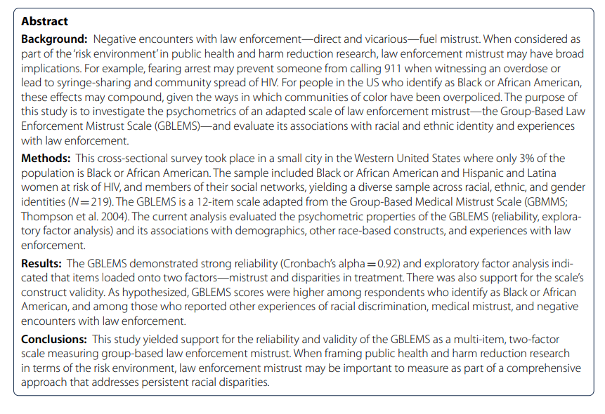
Johnson, L. M., Devereux, P. G., & Wagner, K. D. (2022). The group-based law enforcement mistrust scale: psychometric properties of an adapted scale and implications for public health and harm reduction research. Harm Reduction Journal, 19(1), 1-13.

Slide 48
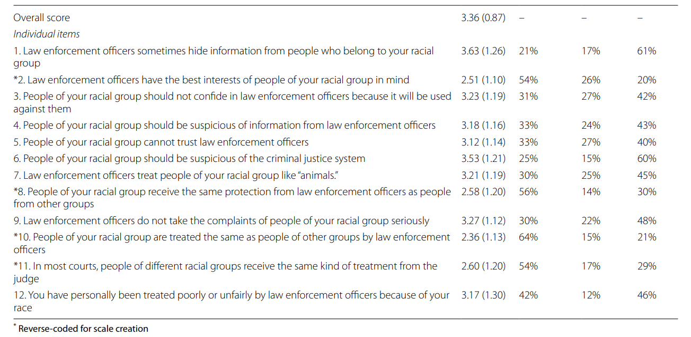
Disagree
Neutral
Agree

Slide 49
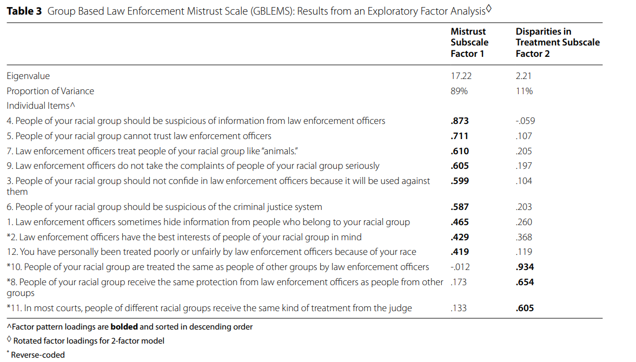

Slide 50
In class assignment
In class assignment.doc
We are going to explore the racial identity scale using data from Generations: A Study of the Life and Health of LGB People in a Changing Society, United States, 2016-2019 (ICPSR 37166)
The file is ‘life and health of lgbt people study.sav’

Slide 51
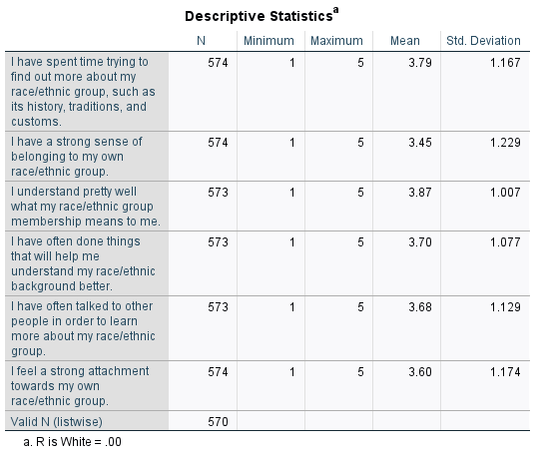
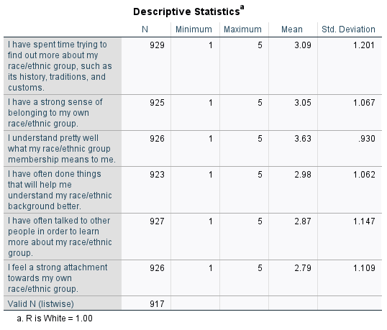

Slide 52
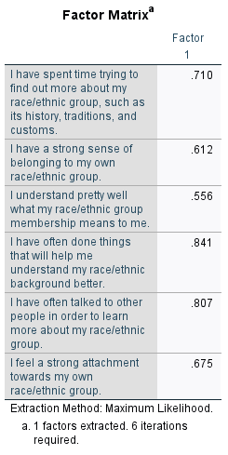

Slide 53
Use the saved factor scale in analyses
Let’s test differences across race
Let’s examine how the factor predicts depressive symptoms, controlling for family social support

