Slide 1
Hierarchical Regression & Dummy Variables
February 17, 2025

Slide 2
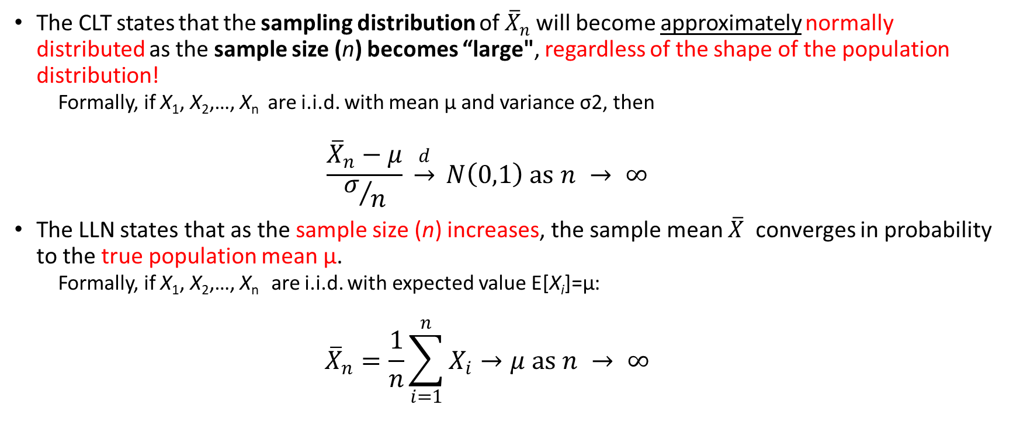
Central Limit Theorem (CLT) & the Law of Large Numbers (LLN)
The CLT states that the sampling distribution of ${\overline{X}}_{n}$ will become approximately normally distributed as the sample size (n) becomes “large", regardless of the shape of the population distribution!
Formally, if X₁, X₂,…, X_{n​} ​ are i.i.d. with mean μ and variance σ2, then
$$\frac{{\overline{X}}_{n}−μ}{σ/n} \underset{→}{d} Ν\left(0,1\right) as n → ∞$$
The LLN states that as the sample size (n) increases, the sample mean $\overline{X}$ converges in probability to the true population mean μ.
Formally, if X₁, X₂,…, X_{n​} ​ ​ are i.i.d. with expected value E[X_{i}]=μ:
$${\overline{X}}_{n}=\frac{1}{n}\sum_{i=1}^{n}{X_{i}}→μ as n → ∞$$

Slide 3
Central Limit Theorem (CLT)
The CLT tells us that the distribution of the sample mean is centered around the true mean
The variance of the sample mean decreases as n increases
With normality approximation of the sampling distribution, we can perform interval estimation around the population mean
The Central Limit Theorem (CLT) has profound implications for confidence intervals and sampling distributions in statistics

Slide 4
Implications for Sampling Distributions
The CLT states that, for a sufficiently large sample size, the sampling distribution of the sample mean will be approximately normal, regardless of the shape of the population distribution.
This allows us to make statistical inferences even when the original population distribution is skewed, bimodal, or non-normal.
The larger the sample size, the closer the sampling distribution will be to normality.

Slide 5
Implications for Confidence Intervals
Confidence intervals (CIs) rely on the assumption that the sampling distribution of the mean is normal
Because of the CLT, we can use the normal distribution (Z-distribution, t-distribution) to compute confidence intervals for population parameters, even if the underlying population is non-normal
As sample size increases:
The standard error (𝜎/𝑛) decreases, leading to narrower confidence intervals (greater precision)
The sampling distribution becomes more normal, making parametric inference more reliable

Slide 6
Practical Considerations
Small Sample Sizes (𝑛<30): If the population is normal, the sampling distribution is also normal, and confidence intervals can be computed using the t-distribution
Large Sample Sizes (𝑛≥30): The CLT ensures that the sampling distribution is approximately normal, even if the population is not (?)
Skewed or Heavy-Tailed Distributions: A larger sample size is needed (e.g., 𝑛≥50 or more) for the CLT to take effect

Slide 7
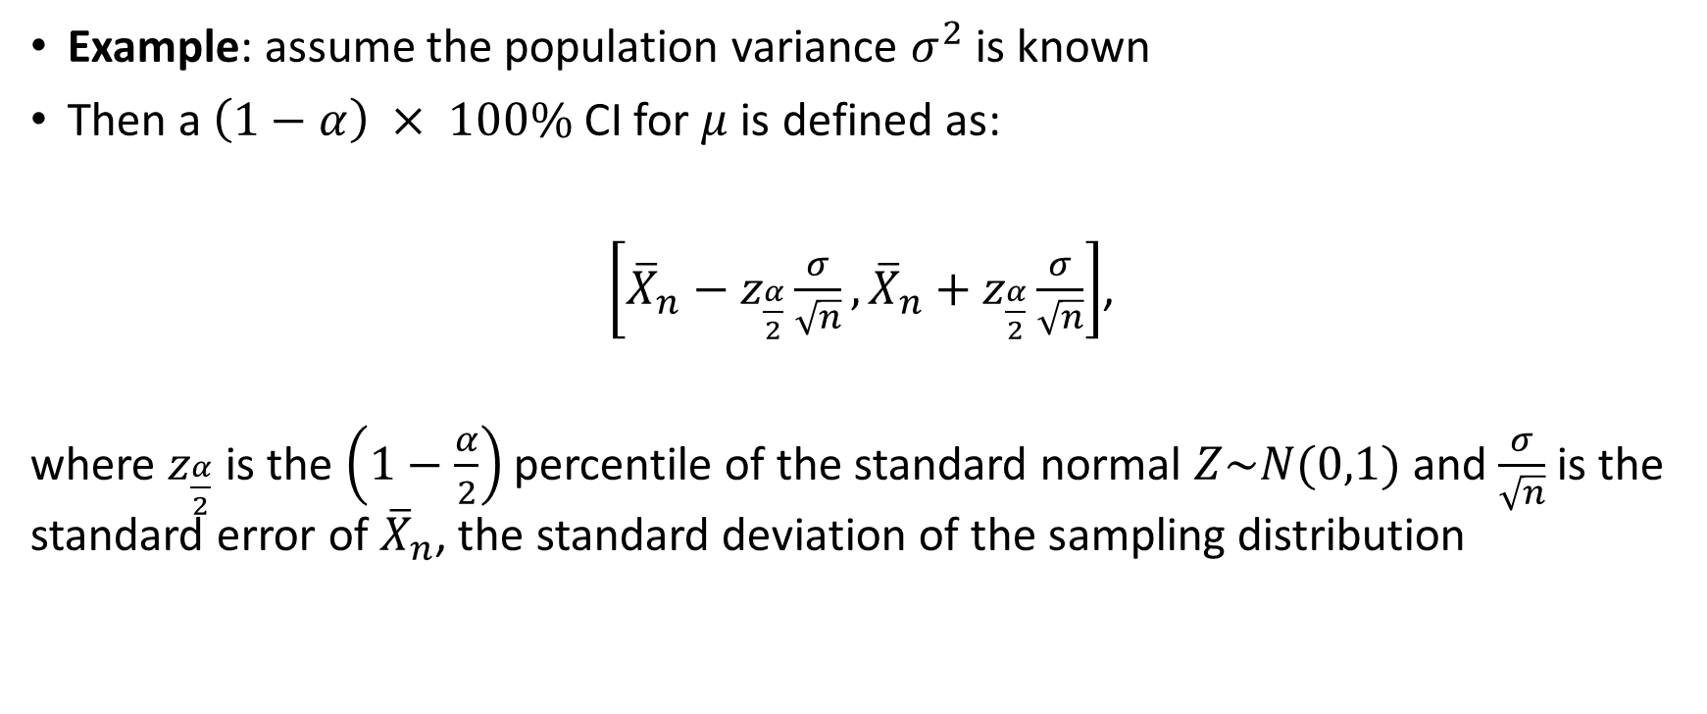
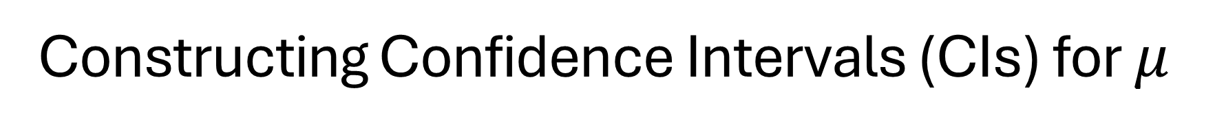
Constructing Confidence Intervals (CIs) for $μ$
Example: assume the population variance $σ^{2}$is known
Then a $\left(1−α\right) × 100\%$ CI for $μ$ is defined as:
$\left[{\overline{X}}_{n}−z_{\frac{α}{2}}\frac{σ}{\sqrt{n}},{\overline{X}}_{n}+z_{\frac{α}{2}}\frac{σ}{\sqrt{n}}\right]$,
where $z_{\frac{α}{2}}$ is the $\left(1−\frac{α}{2}\right)$percentile of the standard normal $Z\sim N(0,1)$ and $\frac{σ}{\sqrt{n}}$ is the standard error of ${\overline{X}}_{n}$, the standard deviation of the sampling distribution

Slide 8
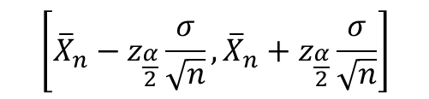
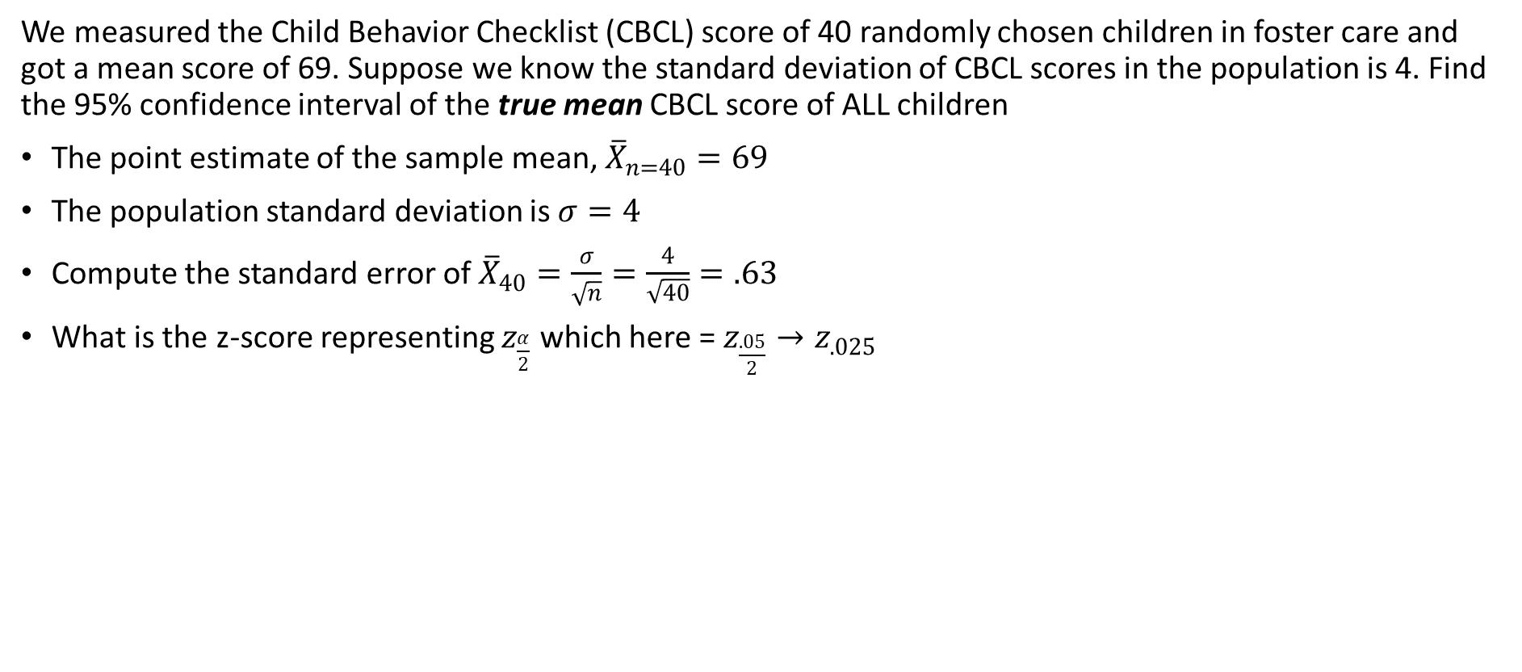


Example
We measured the Child Behavior Checklist (CBCL) score of 40 randomly chosen children in foster care and got a mean score of 69. Suppose we know the standard deviation of CBCL scores in the population is 4. Find the 95% confidence interval of the true mean CBCL score of ALL children
The point estimate of the sample mean, ${\overline{X}}_{n=40}=69$
The population standard deviation is $σ=4$
Compute the standard error of ${\overline{X}}_{40}=\frac{σ}{\sqrt{n}}=\frac{4}{\sqrt{40}}=.63$
What is the z-score representing $z_{\frac{α}{2}}$ which here = $z_{\frac{.05}{2}}{→z}_{.025}$
$$\left[{\overline{X}}_{n}−z_{\frac{α}{2}}\frac{σ}{\sqrt{n}},{\overline{X}}_{n}+z_{\frac{α}{2}}\frac{σ}{\sqrt{n}}\right]$$
$$\left[69−1.96(.63),69+1.96(.63) \right]$$
$$\left[67.77, 70.23\right]$$
Reflects the uncertainty of our estimate

Slide 9
How do we interpret the CI?
In general, If we were to take many random samples then (1 −𝛼 )% of these confidence intervals will contain the true population mean, 𝜇
[67.77, 70.23] (?)
This means that we are 95% confident that the true population mean lies in the interval [67.77, 70.23]
Recall: there is a relationship between the confidence interval and hypothesis testing
Any value outside the confidence interval is in our rejection region
So, the confidence interval represents the outermost limits of statistical significance
A CBCL score of 65 is too unlikely to occur by chance and is significantly different from the population mean of 69
What about a score of 70?

Slide 10
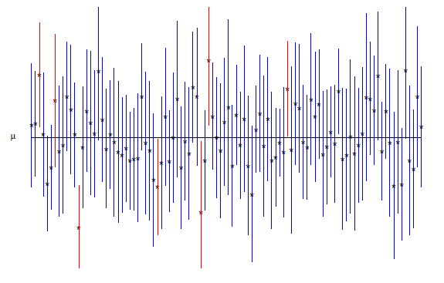
Conceptual Understanding of CIs
The vertical lines (error bars) represent confidence intervals around the estimated means.
The small dots at the center of each line are the point estimates (e.g., means or effect sizes).
The red lines are significantly above the mean, the blue lines overlap
The blue lines indicate estimates that contain the reference value (μ).
The red lines indicate confidence intervals that do not include μ, suggesting statistical significance

Slide 11

Central Limit Theorem (CLT) - Redux
The sampling distribution of ${\overline{X}}_{n}$ will become approximately normally distributed as the sample size (n) becomes “large", regardless of the shape of the population distribution!

Slide 12
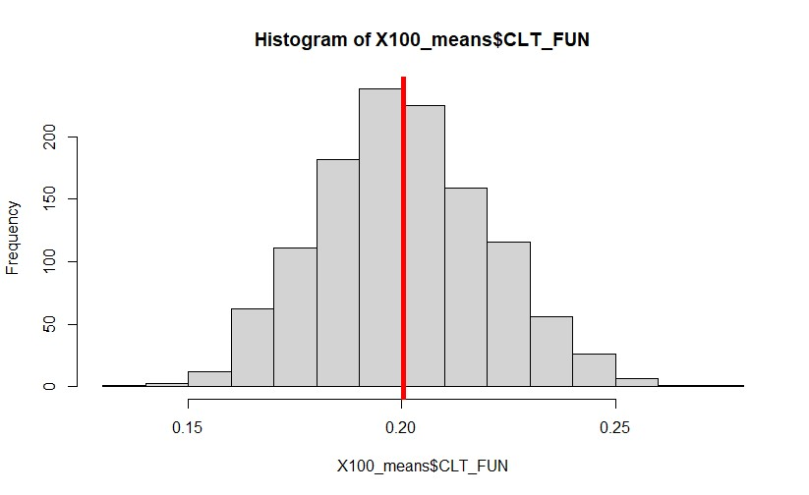
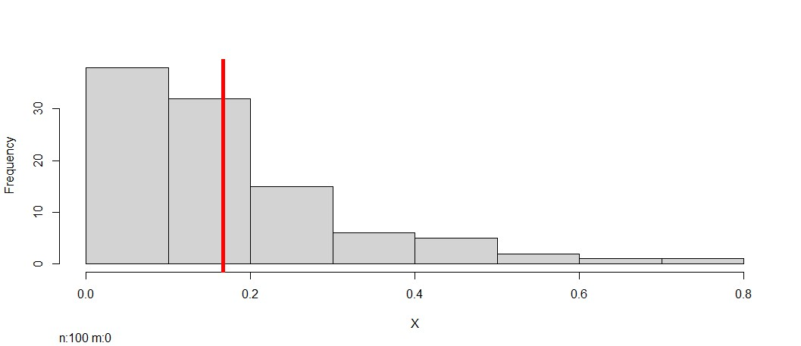
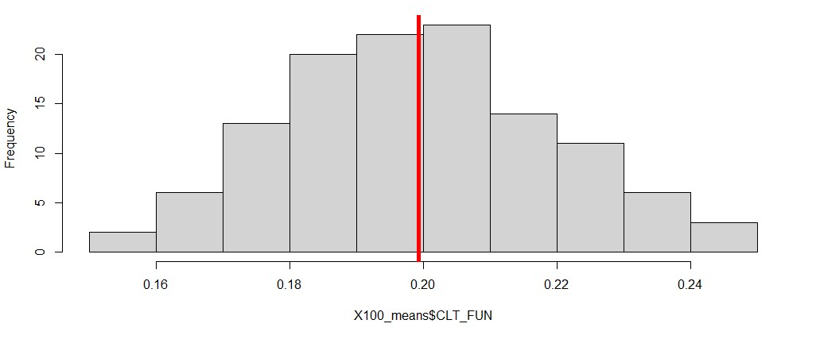
From exponential to normal?
I took n = 100 observations from an exponential distribution with mean = .20 and plotted it (to the left)
Then I repeated this process 120 times (took 120 samples of n = 100 observations) and plotted the mean of each sample – according to the CLT this plot of the means should look normal ☺
Mean of 120 samples of n = 100 observations from
an exponential distribution
Exponential Distribution (n = 100 observations)
Try increasing the number of samples from 120 to 1200

Slide 13

“Sharpton took to X/Twitter to call out the jury selection process after only four Black people were selected as possible jurors for the New Yorker’s case, writing: “It has been brought to my attention by the [his civil rights organisation] National Action Network’s Los Angeles office that out of 106 people called to potentially sit as jurors in A$AP Rocky’s trial in Los Angeles, there are only four Black people.”
Al Sharpton says "ridiculous" jury selection process may "deprive A$AP Rocky of a fair trial"

Slide 14
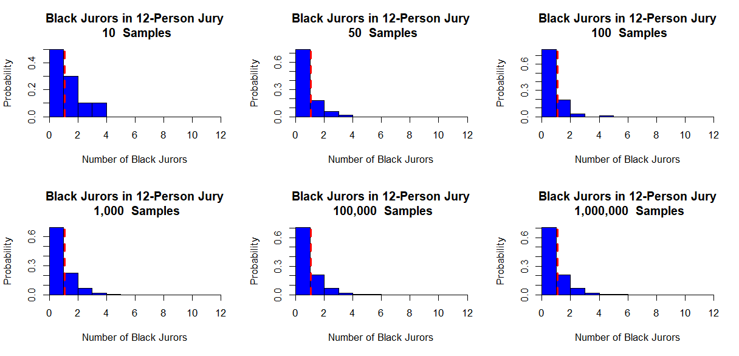
Why is the distribution not converging to normal?
See my write-up on A$AP Rocky

Slide 15
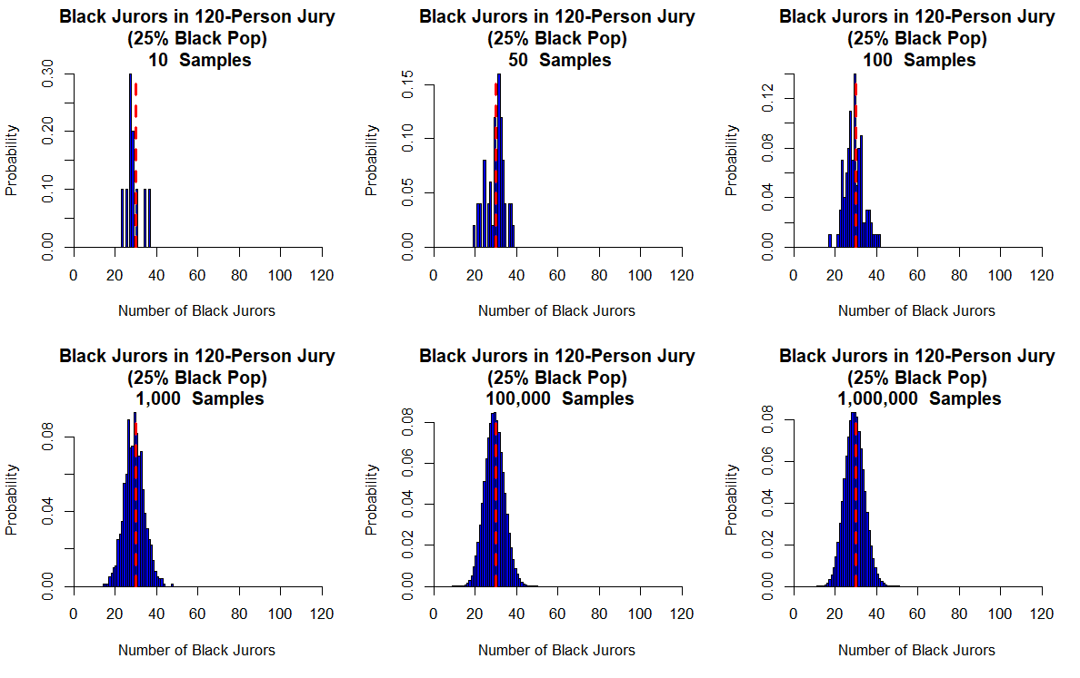
Low precision
Low confidence
Higher precision
More confidence

Slide 16
Multicollinearity
One of the assumptions of the linear regression model is that there is no exact linear relationship among the regressors
Perfect collinearity: A perfect linear relationship between the two variables exists.
Imperfect collinearity: The regressors are highly (but not perfectly) collinear
Multicollinearity is when the predictors in the regression equation are correlated with each other
Why care?
Even though some regression coefficients are statistically insignificant, the R² value may be very high
One may conclude (misleadingly) that the true values of these coefficients are not different from zero

Slide 17
Multicollinearity
As the number of predictors increases, multiple regression modeling can become very complicated
Example: Suppose you use educational attainment and job type as predictors to model income. These two variables are highly correlated—higher education often leads to better job opportunities. If both variables are included in the regression model:
The improvement in 𝑅2 (the proportion of variance explained) by adding job type on top of education may be minimal (?)
If true, the model suggests that education is not significant but job type is, one might mistakenly conclude that education does not matter for income, which is incorrect.
Education influences income through job type, making it an indirect effect rather than a negligible one.
Notes:
because much of job type’s effect is already captured by education (this is where semi-partial correlation comes in)

Slide 18
What to do if you find multicollinearity?
If two variables are highly correlated, using both in the regression equation is probably not a good idea. Why?
Many correlated variables hurts the Adjusted R²
We generally prefer smaller models
Smaller models are much easier to interpret
Recall: multiple regression models describe the effect of one variable on another after partiallypartialling out the effects of all other variables in the model
Regarding MC, this means that if two variables are highly correlated, once one of them is partialed out, there is much less variation left in the other variable for the model to “explain”
Check the partial correlation coefficients and zero-order coefficients before including variables!

Slide 19
Takeaways
If variables are conceptually distinct but highly correlated, consider whether both should be included or if one should be treated as a mediator or moderator rather than a direct predictor
Simply relying on statistical significance without theoretical justification can lead to misinterpretation of results
Multicollinearity does not necessarily mean a variable is unimportant—it may just indicate conceptual overlap

Slide 20
What is confounding?
This challenge of distinguishing between overlapping predictors is closely related to the issue of confounding, where an omitted variable influences both the predictor and the outcome, leading to biased estimates
Just as multicollinearity can obscure the unique contribution of each variable, failing to account for confounders can distort causal interpretations in regression models
Confounding occurs when the relationship between a given exposure and a specific disease/outcome is distorted (confused) by the influence of a third variable or group of variables (confounders)

Slide 21
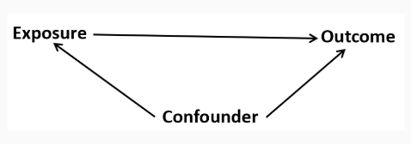
What is confounding?
To be a confounding factor, two conditions must be met:
The confounding variable must be associated with the exposure (but not a consequence of the exposure)
The confounding variable must be associated with the outcome Independently of exposure
The confounding variable cannot be an intermediary step in the causal pathway from the exposure of interest to the outcome of interest.

Slide 22
What is confounding?
By controlling for confounding, we can obtain an unbiased estimate of the causal relationship between exposure and outcome
Two ways to deal with confounding
The study design phase (by randomization, restriction, and matching)
During data analysis (by stratification, propensity score matching, and multivariate analysis - MRL)

Slide 23
First Application in Our Research (SSRW Example)
In our study, we encountered a similar issue when including an index of redlining, concentrated disadvantage, and concentrated affluence in the same model. The key challenge was:
Theoretical vs. Statistical Distinction:
Redlining and concentrated disadvantage are closely linked because historical housing discrimination shaped patterns of economic and social deprivation
However, concentrated affluence is not simply the opposite of concentrated disadvantage—wealthier areas are not just areas without disadvantages; they have unique social, economic, and political advantages

Slide 24
The next four slides are from our paper titled , “Redlining, Reinvestment, and Racial Segregation: A Bayesian Spatial Analysis of Mortgage Lending Trajectories and Firearm-Related Violence” forthcoming in Injury Epidemiology
Second Application in Our Research

Slide 25
Fun Example
Study Objective: Examining the relationship between lending trajectory (historical and contemporary housing discrimination) and firearm-related homicide victimization
Key Variables: Lending Trajectory (Main Exposure): Sustained Disinvestment, Disinvestment, Growing Investment, High Investment
Firearm-Related Homicide (Outcome)
Possible confounders
Area Deprivation Index (ADI): Measure of socioeconomic disadvantage
Racial Segregation: Degree of racial isolation within neighborhoods
Argue in favor of including ADI and racial segregation in the model

Slide 26
Conceptual Issues in Adjusting for ADI and Racial Segregation
Omitting ADI and Racial Segregation:
Risks omitted variable bias, leading to an overestimated or misattributed effect of lending trajectory on firearm-related homicide.
Fails to account for structural conditions that shape firearm violence risk.
Including ADI and Racial Segregation as Covariates:
For: If ADI and segregation are confounders, their inclusion helps isolate the true effect of lending trajectory
Against: risks over-adjustment if these variables are actually part of the causal pathway (i.e., mediators – after break).

Slide 27
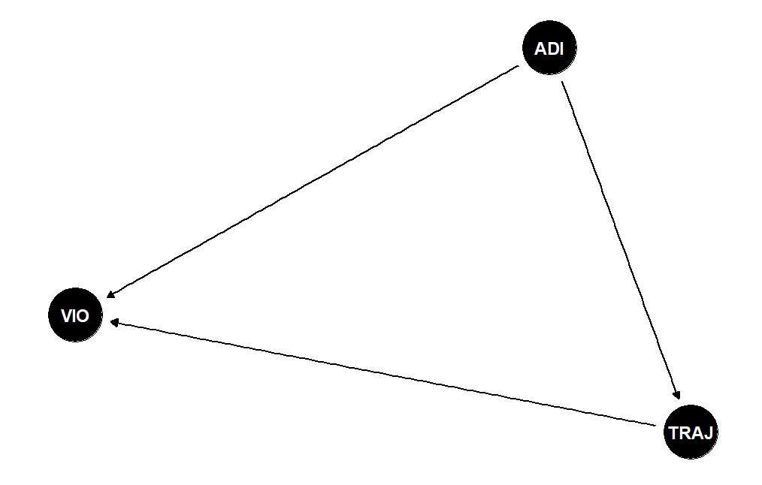
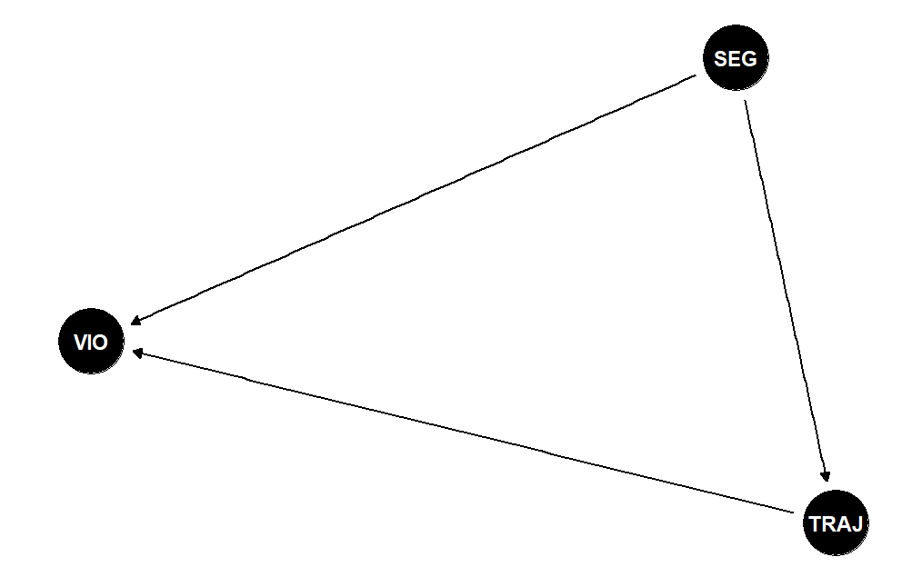
Simple confounding
dag_ex.R

Slide 28
Multicollinearity and Partial Correlation
Multicollinearity:
High correlation between ADI, racial segregation, and lending trajectory can inflate standard errors, making it harder to detect true effects.
Can result in unstable coefficient estimates in regression models.
Variance Inflation Factor (VIF) (below) can assess the severity of multicollinearity.
Partial Correlation:
Examines the relationship between lending trajectory and firearm-related homicide, controlling for ADI and segregation.
If the correlation weakens significantly when controlling for ADI and racial segregation → suggests that these factors mediate the effect.
If the correlation remains strong → suggests that ADI and segregation act as confounders rather than mediators.

Slide 29
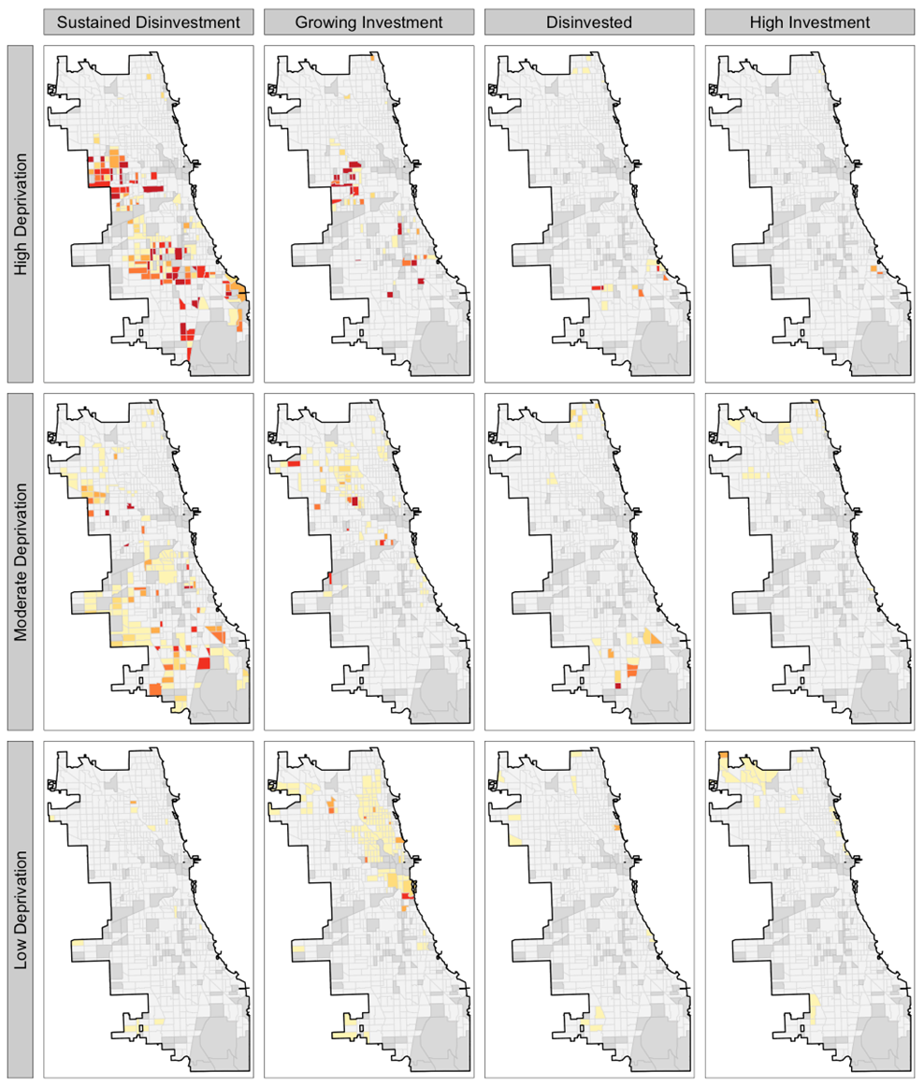
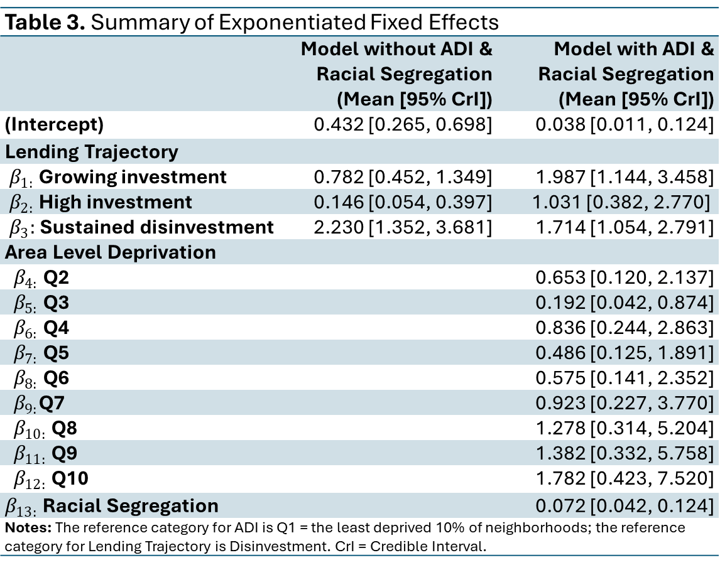
Table 3. Summary of Exponentiated Fixed Effects
 | Model without ADI & Racial Segregation (Mean [95% CrI]) | Model with ADI & Racial Segregation (Mean [95% CrI])
(Intercept) | 0.432 [0.265, 0.698] | 0.038 [0.011, 0.124]
Lending Trajectory
$β_{1:}$ Growing investment | 0.782 [0.452, 1.349] | 1.987 [1.144, 3.458]
$β_{2:}$High investment | 0.146 [0.054, 0.397] | 1.031 [0.382, 2.770]
$β_{3}:$Sustained disinvestment | 2.230 [1.352, 3.681] | 1.714 [1.054, 2.791]
Area Level Deprivation
$β_{4:}$Q2 |  | 0.653 [0.120, 2.137]
$β_{5:}$Q3 |  | 0.192 [0.042, 0.874]
$β_{6:}$Q4 |  | 0.836 [0.244, 2.863]
$β_{7:}$Q5 |  | 0.486 [0.125, 1.891]
$β_{8:}$Q6 |  | 0.575 [0.141, 2.352]
$β_{9:}$Q7 |  | 0.923 [0.227, 3.770]
$β_{10:}$Q8 |  | 1.278 [0.314, 5.204]
$β_{11:}$Q9 |  | 1.382 [0.332, 5.758]
$β_{12:}$Q10 |  | 1.782 [0.423, 7.520]
$β_{13:}$Racial Segregation |  | 0.072 [0.042, 0.124]
Notes: The reference category for ADI is Q1 = the least deprived 10% of neighborhoods; the reference category for Lending Trajectory is Disinvestment. CrI = Credible Interval.

Slide 30
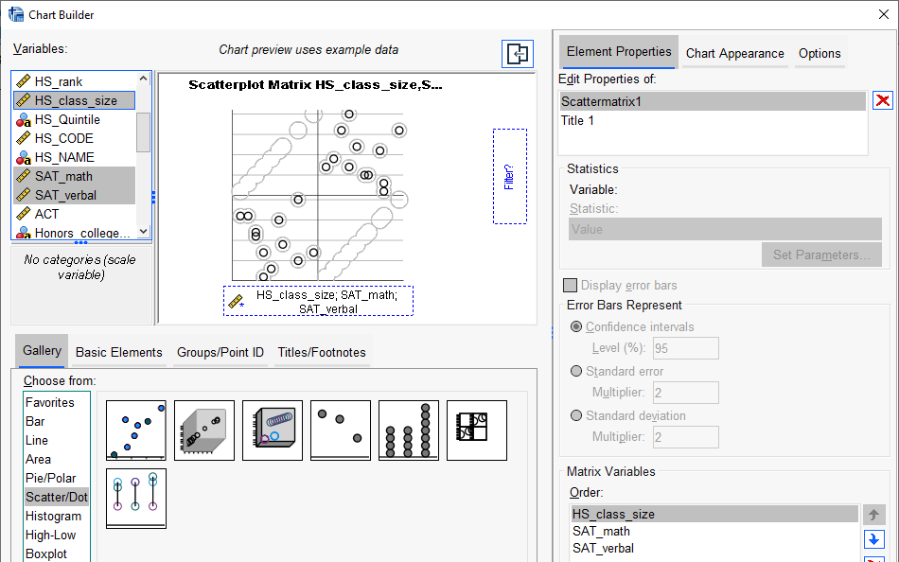
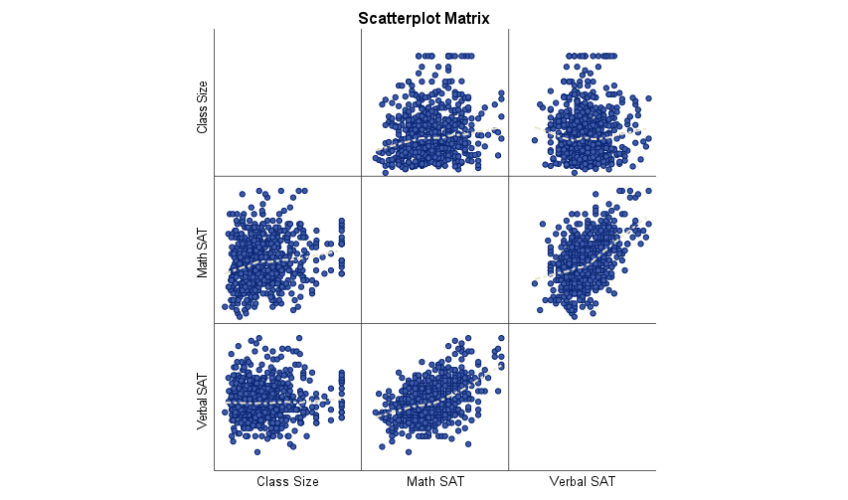
How to check for multicollinearity?
Scatterplots, Scatterplot Matrix
A scatterplot matrix is a matrix of scatterplots, one plot for each pair of variables.
Note: To read it, pick a plot in the matrix. Look in the column for the X variable and the row for the Y variable
Graph → Chart Builder → Scatter/Dot (drag variables into chart area)
GPA data.sav

Slide 31
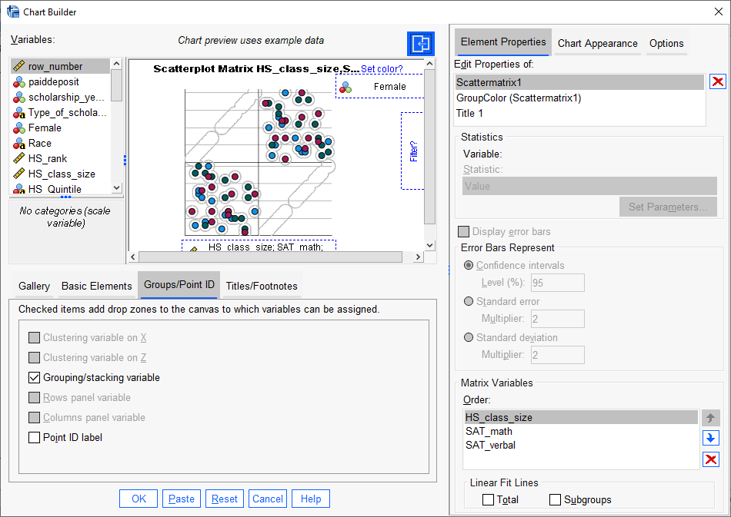
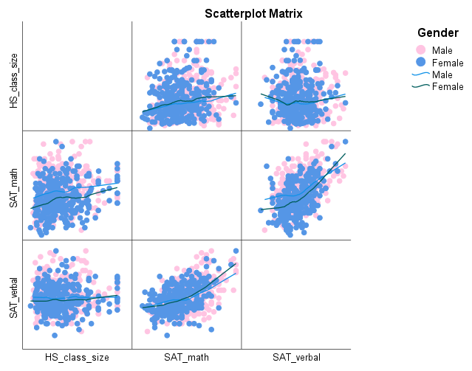
Scatterplots by Grouping Variable
Can color code a scatterplot by a categorical variable to get a sense of how the distribution of variables is heterogeneous across groups

Slide 32
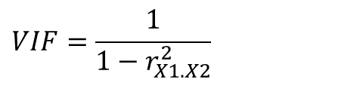
Variance Inflation Factor
$$Y_{i}=β_{0}+β_{1}X_{1i}+β_{2}X_{2i}+u_{i}$$
$$VIF=\frac{1}{1−r_{X1.X2}^{2}}$$
VIF is a measure of the degree to which the variance of the OLS estimator is inflated because of collinearity.

Slide 33
Clues that MC is a problem
High R² but few significant t ratios
High pair-wise correlations among explanatory variables or regressors
High partial correlation coefficients
High Variance Inflation Factor (VIF) and low Tolerance Factor (TOL, the inverse of VIF)

Slide 34
What should we do if we detect multicollinearity?
Nothing, for we often have no control over the data and our model is driven by theory
Redefine the model by excluding variables may attenuate the problem, provided we do not omit relevant variables
Principal components analysis (this is something we will cover later)

Slide 35
Outliers and Leverage Points
Outlier: A data point where the response variable 𝑦 does not follow the general trend of the rest of the data.
Outliers are often identified using the interquartile range (IQR) rule: a point is considered an outlier if it falls beyond 1.5 times the IQR (i.e., 1.5×(𝑄3−𝑄1)) above the third quartile (Q3) or below the first quartile (Q1).
High Leverage Point: A data point with an extreme value for one or more predictor variables (X).
In a single predictor model, a high leverage point is simply one with a particularly high or low X value.
In a multiple predictor model, a point may have high leverage if it has an extreme value on one or more predictors, even if individual predictor values do not appear extreme.
Example of High Leverage in Multiple Predictors:
Suppose X1​ and X2 are strongly positively correlated (e.g., r = +0.90), meaning that as X1​ increases, X2 also tends to increase
A case where X1​ is very high but X2​ is very low would be an unusual observation, potentially influencing the regression model due to its high leverage
Notes:
or may be "unusual" combinations of predictor values

Slide 36



Who’s the problem? Influencers, Leverag-ors and Outliers
Trendsetters: Some people are influential, they change the trend
Influencers with no influence: Some people have high leverage, i.e., lots of followers but no real impact
Bizarre: Some people are outliers, they are strange but don’t really affect anything

Slide 37
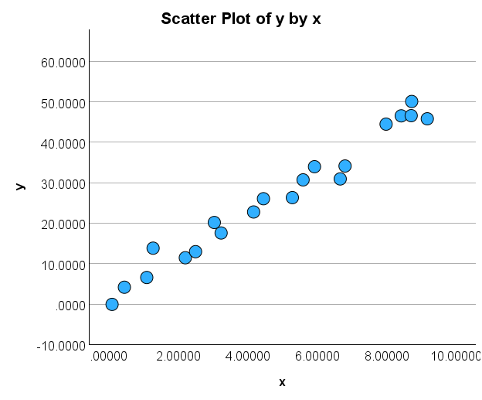
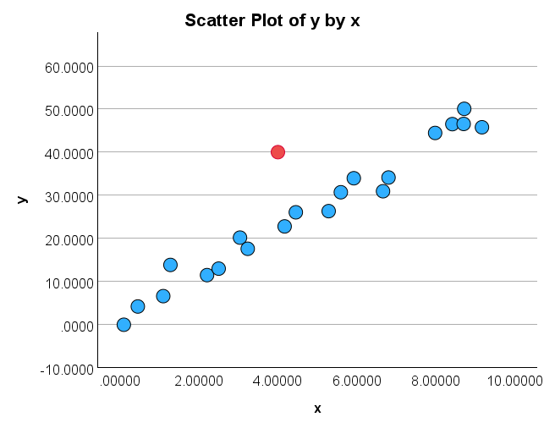
Outliers and Leverage Points
Influence1.sav
A
Does anything look unusual or different about plot A?
B
Does anything look unusual or different about plot B?
Influence1.sav
Notes:
The red point in B is not an extreme x value, so it does not have high leverage.
Is the red data point influential? An easy way to determine if the data point is influential is to find the best fitting line twice — once with the red data point included and once with the red data point excluded. Then note any glaring differences or inconsistencies

Slide 38
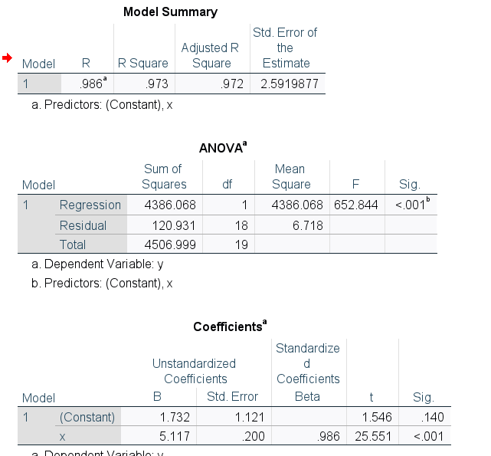
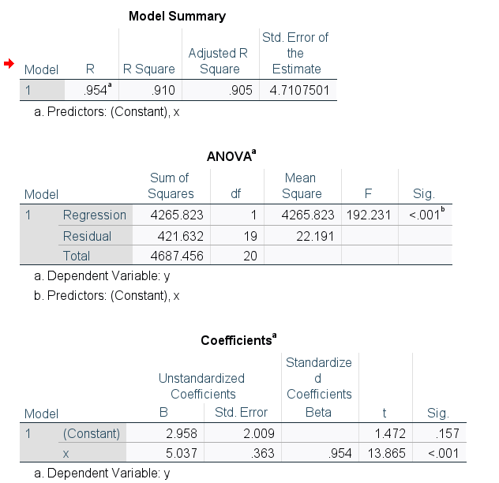
Regression output
Compare the two regressions, any differences?
A
B
Why is the standard error bigger?
Notes:
The R² value has decreased slightly, but the relationship between y and x would still be deemed strong.
The standard error of b₁, which is used in calculating our confidence interval for β₁, is larger when the red data point is included, thereby increasing the width of our confidence interval. You may recall that the standard error of b₁ depends on the mean squared error MSE, which quantifies the difference between the observed and predicted responses. It is because the red data point is an outlier — in the y direction — that the standard error of b₁ increases, not because the data point is influential in any way.
In each case, the P-value for testing H₀: β₁ = 0 is less than 0.001. In either case, we can conclude that there is sufficient evidence at the 0.05 level to conclude that, in the population, x is related to y.

Slide 39
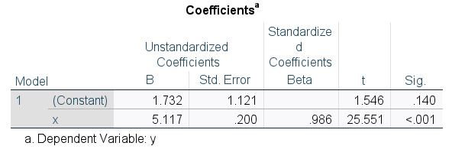
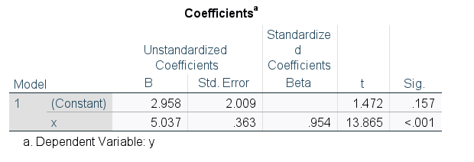
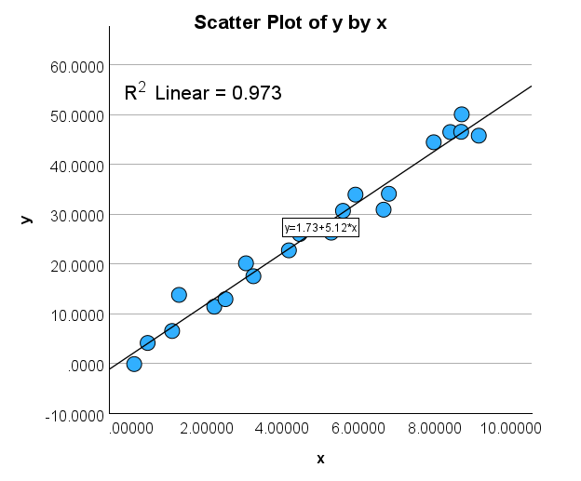
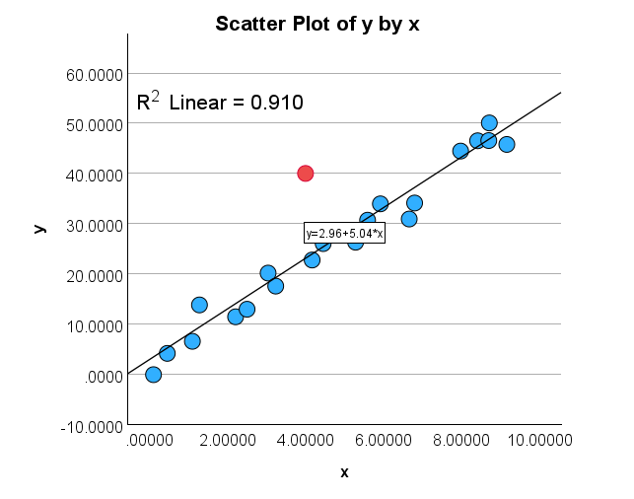
Compare & Intuit
Lines are fairly similar BUT
More error & less confidence → smaller t-value, bigger standard errors, wider confidence interval

Slide 40
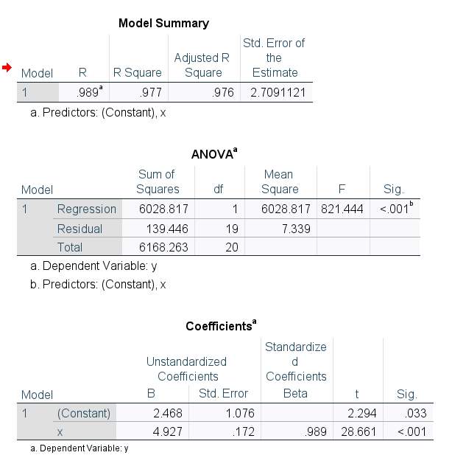
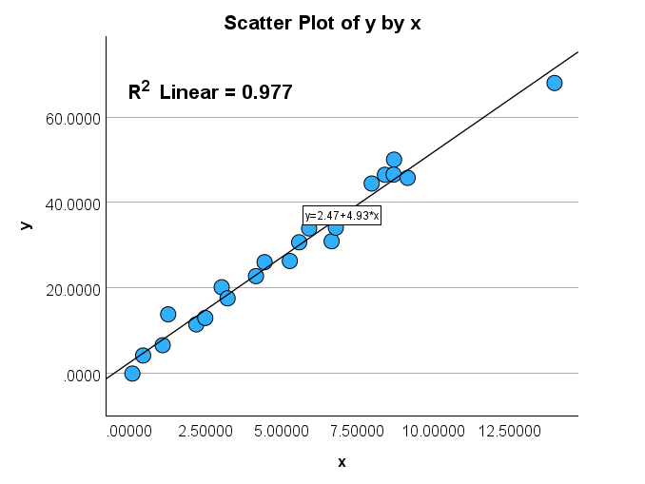
Influence3.sav
From above
Notes:
The R² value has hardly changed at all, increasing only slightly from 97.3% to 97.7%. In either case, the relationship between y and x is deemed strong.
The standard error of b₁ is about the same in each case — 0.172 when the red data point is included, and 0.200 when the red data point is excluded. Therefore, the width of the confidence intervals for β₁ would largely remain unaffected by the existence of the red data point. You might take note that this is because the data point is not an outlier heavily impacting MSE.
In each case, the P-value for testing H₀: β₁ = 0 is less than 0.001. In either case, we can conclude that there is sufficient evidence at the 0.05 level to conclude that, in the population, x is related to y.

Slide 41
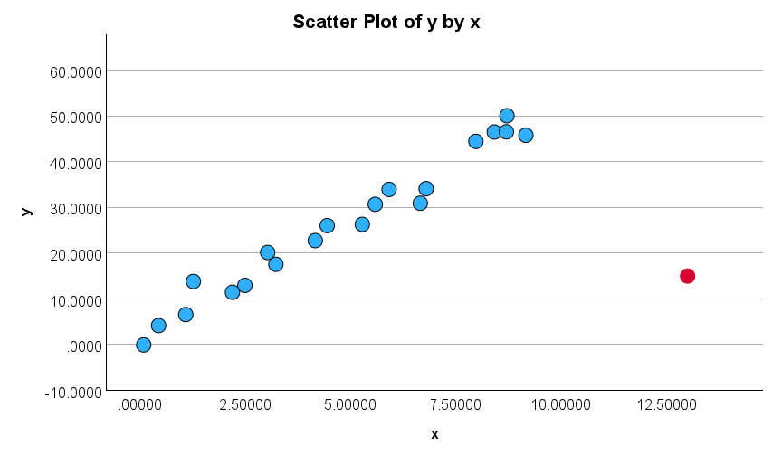
Unusual values and influential points
Does anything look unusual or different about this plot?

Slide 42
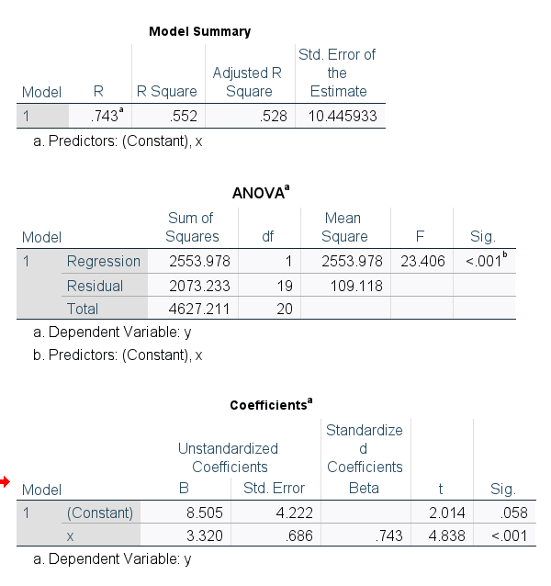
Unusual values and influential points
B

Slide 43
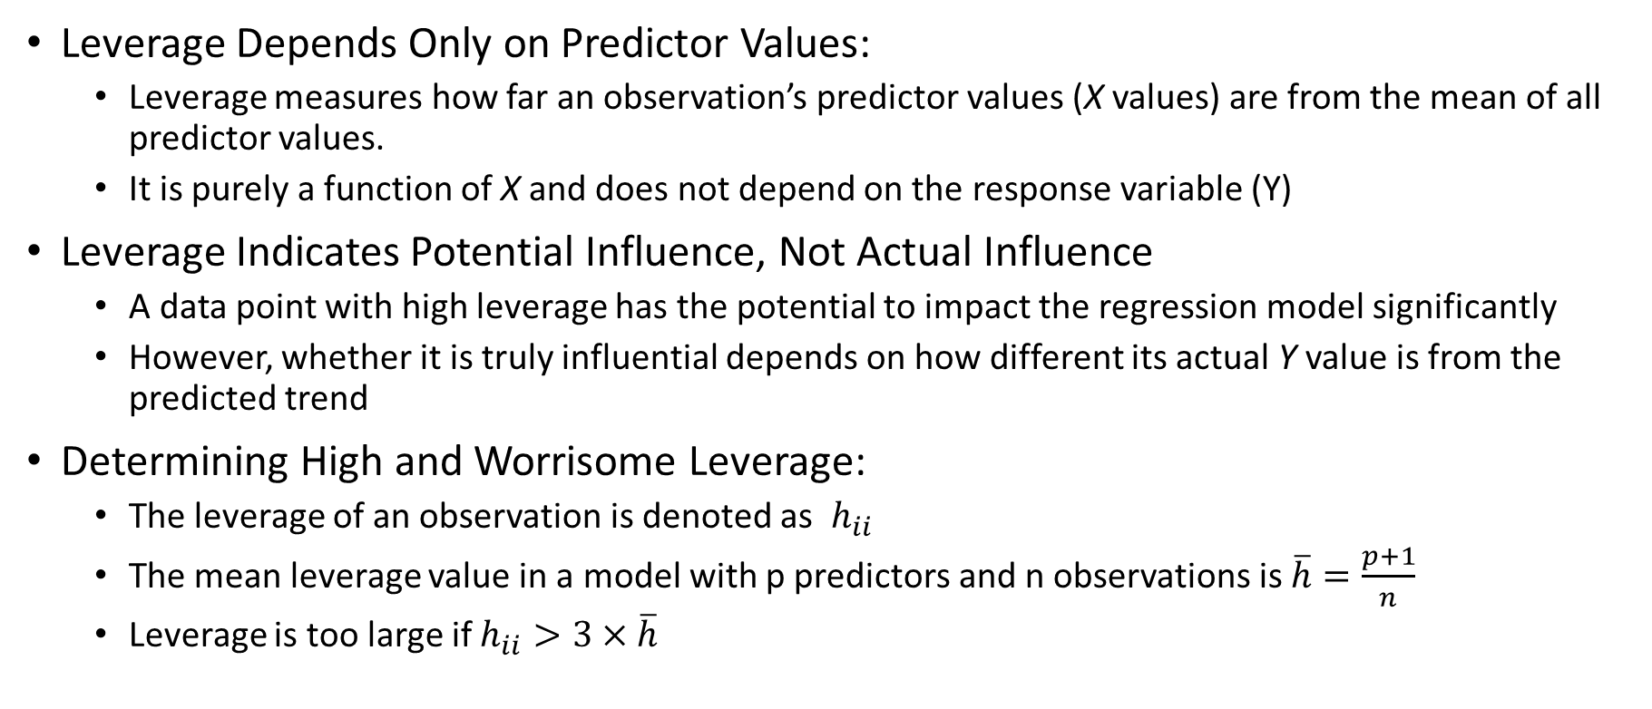
Leverage and Influence in Regression Analysis
Leverage Depends Only on Predictor Values:
Leverage measures how far an observation’s predictor values (X values) are from the mean of all predictor values.
It is purely a function of X and does not depend on the response variable (Y)
Leverage Indicates Potential Influence, Not Actual Influence
A data point with high leverage has the potential to impact the regression model significantly
However, whether it is truly influential depends on how different its actual Y value is from the predicted trend
Determining High and Worrisome Leverage:
The leverage of an observation is denoted as ​ $h_{ii}$
The mean leverage value in a model with p predictors and n observations is $\overline{h}=\frac{p+1}{n}$
Leverage is too large if $h_{ii}>3×\overline{h}$

Slide 44
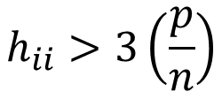
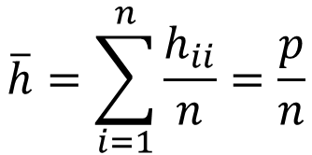
Calculating Leverage
$$\overline{h}=\sum_{i=1}^{n}{\frac{h_{ii}}{n}}=\frac{p}{n}$$
p = # of parameters in the model and n = the number of observations
Then flag the observations as unusual → X is an observation whose value gives it large leverage for the regression analysis
$$h_{ii}>3\left(\frac{p}{n}\right)$$

Slide 45
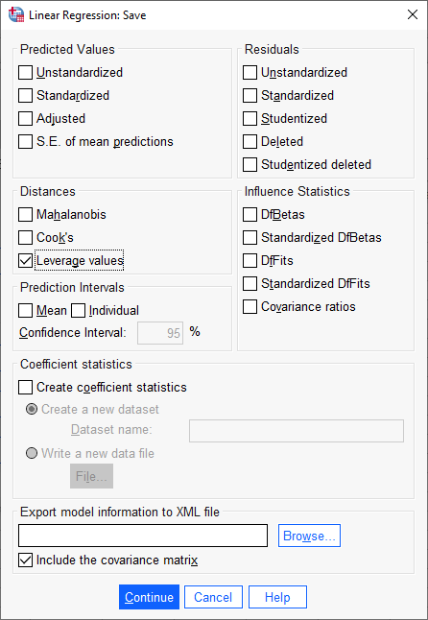
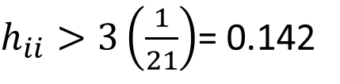
Example
You perform a SLR with n = 21 cases. What is the leverage cutoff value that gives you some reason to be concerned?
→ p = 1, n = 21
$h_{ii}>3\left(\frac{1}{21}\right)$= 0.142
Influence3.sav

Slide 46
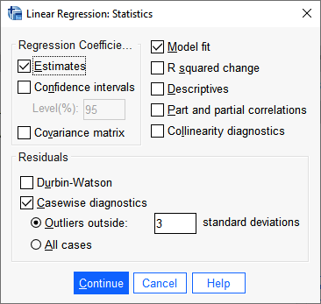
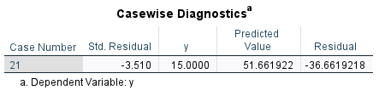
Can have SPSS provide outliers

Slide 47
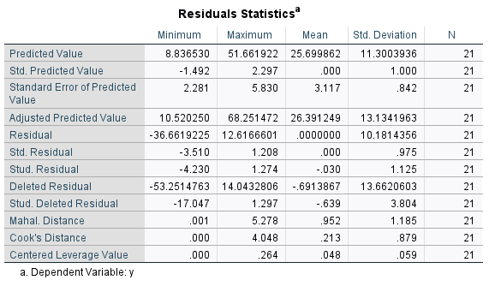
Recall the mean leverage is p/n. If all the observations have roughly equivalent influence on the estimated value of the coefficients, the leverages would be close to

Slide 48
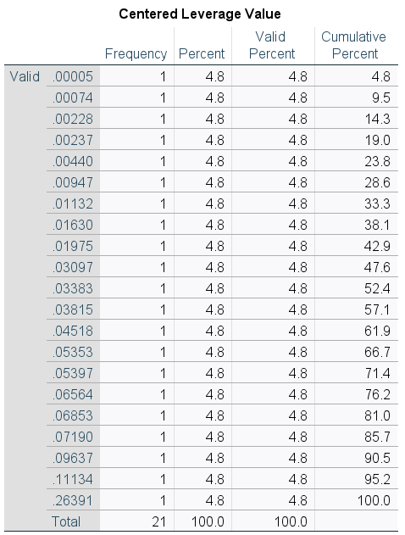
Notes:
The R² value has decreased substantially from 97.32% to 55.19%.
The standard error of b₁ is almost 3.5 times larger when the red data point is included — increasing from 0.200 to 0.686. This increase would have a substantial effect on the width of our confidence interval for β₁
the t-statistic decreases dramatically from 25.55 to 4.84 but is still statistically significant

Slide 49
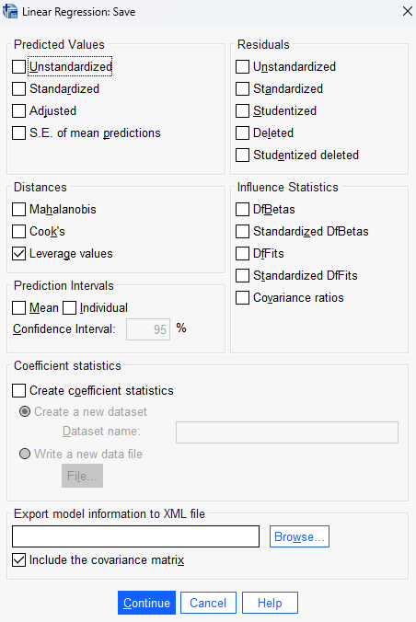
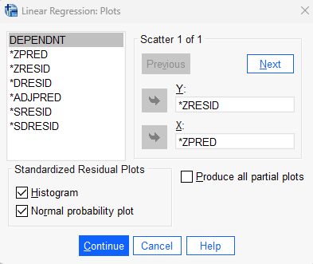
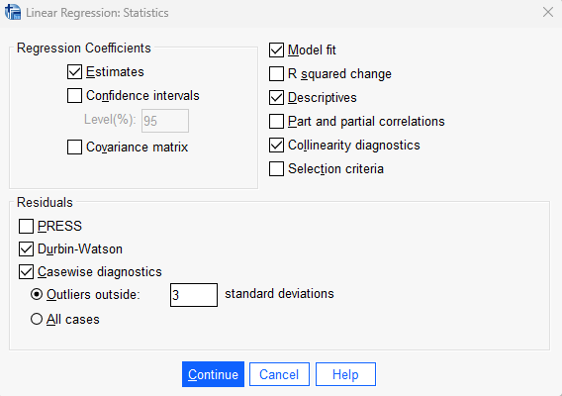

Slide 50
Note: we have already covered predicted values,
and standardized predicted values so you should know
what those are.
Statistic | Meaning | Cutoffs | Example from above
Residual | The difference between observed and predicted values (Y - Y-hat). | Values far from 0 indicate poor model fit; extreme values suggest outliers. | Min: -36.6619 (Potential extreme residual)
Standardized Residual | Residual divided by its standard deviation, helping detect outliers. | Greater than ±2 suggests a possible outlier; greater than ±3 is a likely outlier. | Min: -3.510 (Likely outlier)
Studentized Residual | Similar to standardized residual but adjusted for variance, used for identifying influential cases. | Greater than ±2 suggests a possible outlier; greater than ±3 is a likely outlier. | Min: -4.230 (Highly influential outlier)
Deleted Residual | Residual recalculated after removing the observation, helping assess influence. | No strict cutoff, but large deviations suggest influence on the model. | Min: -53.2515 (Extreme case)
Studentized Deleted Residual | Deleted residual standardized to assess the impact of omitting an observation. | Greater than ±3 suggests a highly influential data point. | Min: -17.047 (Highly influential)
Mahalanobis Distance | Measures how far an observation is from the mean in predictor space. | Values greater than 15 in small samples may indicate an outlier. | Max: 5.278 (Moderate distance from center)
Cook’s Distance | Measures the influence of a single case on the regression model. | Values greater than 1 indicate highly influential points. | Max: 4.048 (high influence)
Centered Leverage Value | Indicates the extent to which an observation’s predictor values are extreme. | Concern if > 3(p/n) (where p = predictors, n = obs.) | Max: 0.264 (max = .264 exceeds)

Slide 51
Beyond Numeric Features
Thus far we’ve seen regressions characterized by:
Numeric response (Y) variable
Example: SAT Verbal Score
Numeric explanatory (X) variable(s)
Example: SAT Math Score, ACT Score, Class Rank
Idea: Explanatory variables are not just limited to numeric variables! We can incorporate categorical and higher-order variables into the regression equation with (almost) no additional work.

Slide 52
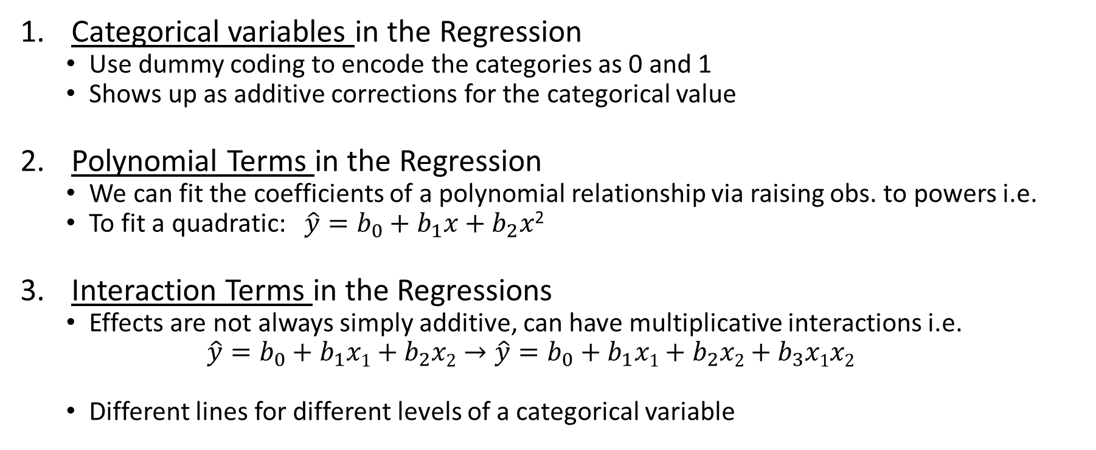
Advanced Topic: Heterogeneous Variable Types
Categorical variables in the Regression
Use dummy coding to encode the categories as 0 and 1
Shows up as additive corrections for the categorical value
Polynomial Terms in the Regression
We can fit the coefficients of a polynomial relationship via raising obs. to powers i.e.
To fit a quadratic: $\hat{y}=b_{0}+b_{1}x+b_{2}x$²
Interaction Terms in the Regressions
Effects are not always simply additive, can have multiplicative interactions i.e.
$$\hat{y}=b_{0}+b_{1}x1+b_{2}x2→\hat{y}=b_{0}+b_{1}x1+b_{2}x2+b_{3}x1x2$$
Different lines for different levels of a categorical variable
New variable, simply the square of the x
New variable, product of x₁ and x₂

Slide 53
Models with Dummy Variables
Some models have both numeric and categorical explanatory variables (e.g., gender or race)
If a categorical variable has k levels, need to create k-1 dummy variables that take on the values 1 if the level of interest is present and 0 otherwise.
The baseline level of the categorical variable for which all k-1 dummy variables are set to 0
The regression coefficient corresponding to a dummy variable is the difference between the mean for that level and the mean for the baseline group, controlling for all numeric predictors

Slide 54
Interpreting Dummy Variables
Can add categorical variables to the regression model, but first need to create dummy codes
If k categories, you only need k-1 dummy variables
Other category acts as the reference group; absorbed into intercept
Each dummy variable acts as an indicator of whether the observation is in that category
Each dummy coefficient can be interpreted as the average difference in Y between the dummy category and the reference group.
Specifically, the dummy coefficients are the linear correction in the model for that level relative to the reference group.

Slide 55
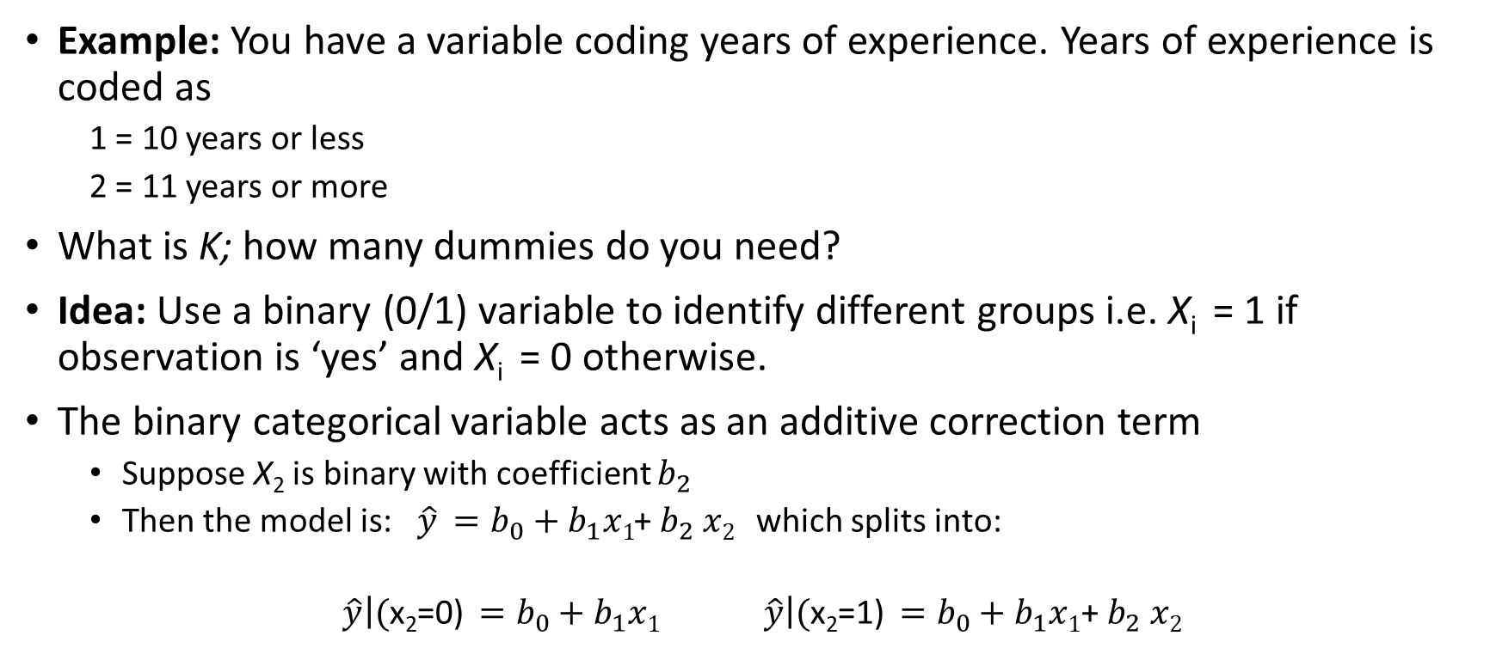
Categorical Variables and Dummies
Example: You have a variable coding years of experience. Years of experience is coded as
1 = 10 years or less
2 = 11 years or more
What is K; how many dummies do you need?
Idea: Use a binary (0/1) variable to identify different groups i.e. X_{i} = 1 if observation is ‘yes’ and X_{i} = 0 otherwise.
The binary categorical variable acts as an additive correction term
Suppose X₂ is binary with coefficient $b_{2}$
Then the model is: $\hat{y} =b_{0}+b_{1}x1$+ $b_{2} x2$ which splits into:
$\hat{y}\left|\text{(}\text{x}\text{2}\text{=0)} =b_{0}+b_{1}x1 \hat{y}\right|\text{(}\text{x}\text{2}\text{=1)} =b_{0}+b_{1}x1\text{+} b_{2} x2$
Additive Correction

Slide 56
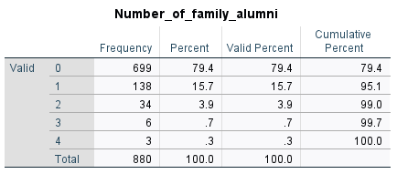
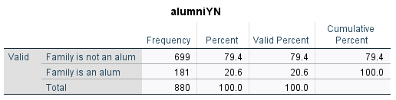
Example: Recoding dummy variables
Use the school admissions data variable (gre_example.sav) for whether a student has a family member that is an alumni (Number_of_family_alumni) and recode it as a simple binary variable (Y/N).
Label the groups with no alum family 0, else 1
The “0” group is called the reference group, no additive correction present here
We will use it in a multiple linear regression where the “slope” for the binary categorical variable we create will represent the difference in the intercepts between of the two groups

Slide 57

Example
Run a multiple linear regression of HS class rank on Math SAT score and the dummy variable coding the effect of having a family member as an alum (=1) or not (=0)
With only two groups,
the dummy variable represents
the average difference in HS rank between students who have family members who are alumni and those who do not.
Note: this is not really any different, an increase in X means going from 0 to 1
Interpretation: the estimated difference in HS rank between students who have family that are alumnus and those who do not is -2.604. Students who have one or more family members who are alums have a HS rank that is 2.604 points lower, on average, holding SAT math score constant at its mean.
Regression Equation:
Rank = 68.89 + .007*SAT_math – 2.6*(IF ALUM)

Slide 58

The correction
Then the model is: $\hat{y} ={\hat{β}}_{0}+{\hat{β}}_{1}x1$+ ${\hat{β}}_{2}$ $x2$ which splits into:
$\hat{y}\left|\text{(}\text{x}\text{2}\text{=0)} ={\hat{β}}_{0}+{\hat{β}}_{1}x1 \hat{y}\right|\text{(}\text{x}\text{2}\text{=}\text{1}\text{)} ={\hat{β}}_{0}+{\hat{β}}_{1}x1$+ ${\hat{β}}_{2}$
Regression Equation:
Rank = 68.89 + .007*SAT_math – 2.6*(IF ALUM)
Regression Equation:
Rank|Alum = 0: 68.89 + .007*SAT_math
Regression Equation:
Rank|Alum = 1: = 68.89 + .007*SAT_math – 2.6*(1)

Slide 59
SAT Math | Family is Alumni | Predicted Class Rank
100 | 0 | 69.59
100 | 1 | 66.99
500 | 0 | 72.39
500 | 1 | 69.79

Slide 60


Quadratic Terms
Problem: What if, before running our multiple linear regression we look at paired scatter plots and observe that the relationship between independent and response is not simply a straight line?
One Solution: Use X² to model a curvilinear relationship:
$\hat{y}={\hat{β}}_{0}+{\hat{β}}_{1}x1+{\hat{β}}_{2}x1$²
x₁² is treated as another predictor, data is generated by simply squaring the features value for each observation!
(Barely) Linear Scatterplot
Rel.
Nonlinear Scatterplot Rel.

Slide 61
Quadratic Terms
A quadratic term is an interaction of a variable with itself; sometimes, we suspect these relationships even without seeing the scatter plot.
Example: Modeling the effect of increasing the distance from Pitt on SAT score might also be dependent on the current distance from Pitt, thus requiring a quadratic term
Warning: Adding quadratic terms increases the number of variables in your model like anything else and thus hurts the model R² unless this relationship is strongly present
It’s also an easy way to overfit your data, which can lead to bizarre predictions!

Slide 62
Quadratic Terms
A quadratic term is the variable multiplied with itself (i.e., squared
Example: Age and crime?
Consistent with life course theory

Slide 63

Interaction Terms
More generally than just quadratic terms, sometimes the effect of one variable depends on the value of another variable
Can include interactions of 2 or more variables
Model is of the form: $\hat{y}={\hat{β}}_{0}+{\hat{β}}_{1}x1+{\hat{β}}_{2}x2+{\hat{β}}_{3}x1x2$
Note that these sorts of interactions are hard to pick up from scatterplots. In this class, they will come most often from data-driven hypotheses
Natural Interpretation when interactions include categorical variables!
Variables of the form x₁x₂ where x₁ is binary and x₂ is numeric, model linear corrections instead of additive corrections. That is, they are corrections to the slope of the coefficient on the numeric variable.

Slide 64


Interaction Terms
What do you eat? What condiments do you put on your food? How much enjoyment do you get from each food you commonly eat? Hypotheses: There is a significant interaction between food type and condiment type on enjoyment. Specifically, the effect of a condiment on enjoyment depends on the type of food it is paired with.
While mustard enhances the enjoyment of hot dogs but decreases the enjoyment of ice cream, chocolate sauce increases the enjoyment of ice cream but decreases the enjoyment of hot dogs. Therefore, the hypothesis is supported

Slide 65

Do children removed from home have higher levels of post-traumatic stress?
This data is from NASCW on youth in the child welfare system
The variables are as follows:
EV severe violence exposure
Child is in out-of-home care (dummy, removed or not)
Child gender (dummy; 0 = male, 1 = female)
Child Age in Years
Child experienced physical abuse (1 = yes, 0 = no)
Child experienced sexual abuse (1 = yes, 0 = no)
Child is Non-Hispanic White (1 = yes, 0 = no)
nscaw_sample.jasp

Slide 66
Testable Hypotheses
Older children with higher levels of violence exposure have more PTS symptoms compared to younger children
Children who are sexually abused with higher levels of violence exposure have more PTS symptoms compared children who have experienced other forms of abuse
Children who have more depressive symptoms and higher levels of violence exposure have more PTS symptoms compared to children with less depressive symptoms
Note: this is the same hypothesis as: Children who have higher levels of violence exposure and more depressive symptoms have more PTS symptoms compared to children with less violence exposure
Note: we will cover this thoroughly after the break
Notes:
How might depressive symptoms be related to PTS symptoms?
More depressive symptoms → more PTS symptoms

