Slide 1
Hive

Slide 2
What is Hive?
Hive is a data warehouse infrastructure tool to process structured data in Hadoop. It resides on top of Hadoop to summarize Big Data, and makes querying and analyzing easy.
Hive was developed by Facebook, later the Apache Software Foundation took it up and developed it further as an open source under the name Apache Hive.

Slide 3
Hive is not
A relational database
A design for OnLine Transaction Processing (OLTP)
A language for real-time queries and row-level updates

Slide 4
Features of Hive
It stores schema in a database and processed data into HDFS.
It is designed for OLAP.
It provides SQL type language for querying called HiveQL or HQL.
It is familiar, fast, scalable, and extensible.

Slide 5
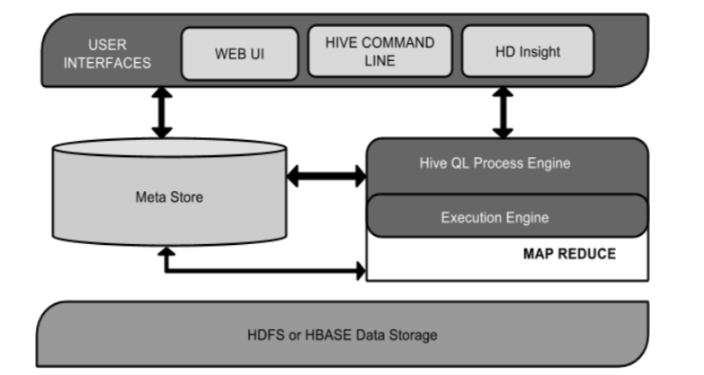
Architecture of Hive

Slide 6
Architecture
User Interface - Hive is a data warehouse infrastructure software that can create interaction between user and HDFS. The user interfaces that Hive supports are Hive Web UI, Hive command line, and Hive HD Insight (In Windows server).
Meta Store - Hive chooses respective database servers to store the schema or Metadata of tables, databases, columns in a table, their data types, and HDFS mapping.

Slide 7
Architecture
HiveQL Process Engine - HiveQL is similar to SQL for querying on schema info on the Metastore. It is one of the replacements of traditional approach for MapReduce program. Instead of writing MapReduce program in Java, we can write a query for MapReduce job and process it.
Execution Engine - The conjunction part of HiveQL process Engine and MapReduce is Hive Execution Engine.
HDFS - HBASE Hadoop distributed file system for storage

Slide 8
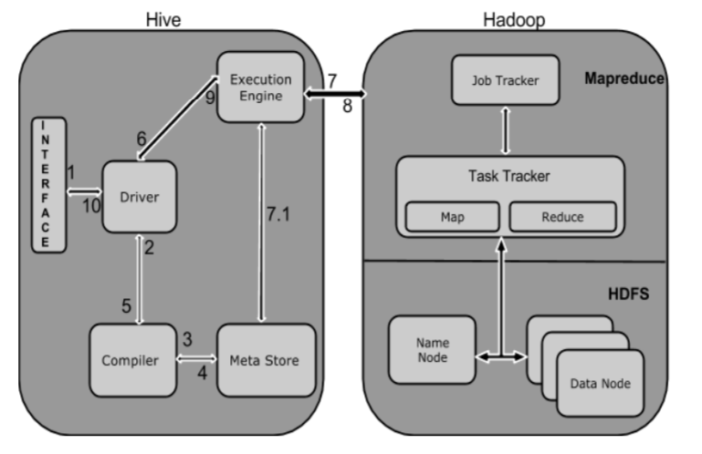
Working of Hive

Slide 9
Operations
Execute Query - The Hive interface such as Command Line or Web UI sends query to Driver (any database driver such as JDBC, ODBC, etc.) to execute.
Get Plan - The driver takes the help of query compiler that parses the query to check the syntax and query plan or the requirement of query.
Get Metadata - The compiler sends metadata request to Metastore (any database).

Slide 10
Operations
Send Metadata - Metastore sends metadata as a response to the compiler
Send Plan - The compiler checks the requirement and resends the plan to the driver. Up to here, the parsing and compiling of a query is complete.
Execute Plan - The driver sends the execute plan to the execution engine.
Execute Job - Internally, the process of execution job is a MapReduce job. The execution engine sends the job to JobTracker, which is in Name node and it assigns this job to TaskTracker, which is in Data node. Here, the query executes MapReduce job.

Slide 11
Operations
Metadata Ops - Meanwhile in execution, the execution engine can execute metadata operations with Metastore.
Fetch Result - The execution engine receives the results from Data nodes.
Send Results - The execution engine sends those resultant values to the driver
The driver sends the results to Hive Interfaces.

Slide 12
Database
Syntax: CREATE DATABASE|SCHEMA [IF NOT EXISTS] ;
Ex: CREATE DATABASE [IF NOT EXISTS] userdb;
SHOW DATABASES;
Syntax: DROP DATABASE StatementDROP (DATABASE|SCHEMA) [IF EXISTS] database_name [RESTRICT|CASCADE];
DROP DATABASE IF EXISTS userdb;

Slide 13
Data Types
Types are associated with the columns in the tables. The following Primitive types are supported:
Integers
TINYINT—1 byte integer
SMALLINT—2 byte integer
INT—4 byte integer
BIGINT—8 byte integer
Boolean type
BOOLEAN—TRUE/FALSE
Floating point numbers
FLOAT—single precision
DOUBLE—Double precision
Fixed point numbers
DECIMAL—a fixed point value of user defined scale and precision
String types
STRING—sequence of characters in a specified character set
VARCHAR—sequence of characters in a specified character set with a maximum length
CHAR—sequence of characters in a specified character set with a defined length
Date and time types
TIMESTAMP— a specific point in time, up to nanosecond precision
DATE—a date
Binary types
BINARY—a sequence of bytes

Slide 14
Create Table
CREATE [EXTERNAL] TABLE [IF NOT EXISTS] [db_name.]table_name [(col_name data_type [COMMENT col_comment], ...)]
[COMMENT table_comment]
[PARTITIONED BY (col_name data_type [COMMENT col_comment], ...)]
[CLUSTERED BY (col_name, col_name, ...) [SORTED BY (col_name [ASC|DESC], ...)] INTO num_buckets BUCKETS]
ON ((col_value, col_value, ...), (col_value, col_value, ...), ...)
[STORED AS DIRECTORIES]
[
[ROW FORMAT row_format]
[STORED AS file_format]
| STORED BY 'storage.handler.class.name' [WITH SERDEPROPERTIES (...)]
]
[LOCATION hdfs_path]
[TBLPROPERTIES (property_name=property_value, ...)] [AS select_statement];

Slide 15
Demo

Slide 16
Alter table
ALTER TABLE name RENAME TO new_name
ALTER TABLE name ADD COLUMNS (col_spec[, col_spec ...])
ALTER TABLE name DROP [COLUMN] column_name
ALTER TABLE name CHANGE column_name new_name new_type
ALTER TABLE name REPLACE COLUMNS (col_spec[, col_spec ...])
ALTER TABLE employee RENAME TO emp;

Slide 17
Demo

Slide 18
Partitions & Buckets
Hive organizes tables into partitions. It is a way of dividing a table into related parts based on the values of partitioned columns such as date, city, and department. Using partition, it is easy to query a portion of the data
Tables or partitions are sub-divided into buckets, to provide extra structure to the data that may be used for more efficient querying. Bucketing works based on the value of hash function of some column of a table.

Slide 19
Partitions
Partitions
Each table can be broken into partitions
Partitions determine distribution of data within subdirectories
Example -
CREATE_TABLE Sales (sale_id INT, amount FLOAT)
PARTITIONED BY (country STRING, year INT, month INT)
So each partition will be split out into different folders like
Sales/country=US/year=2012/month=12

Slide 20
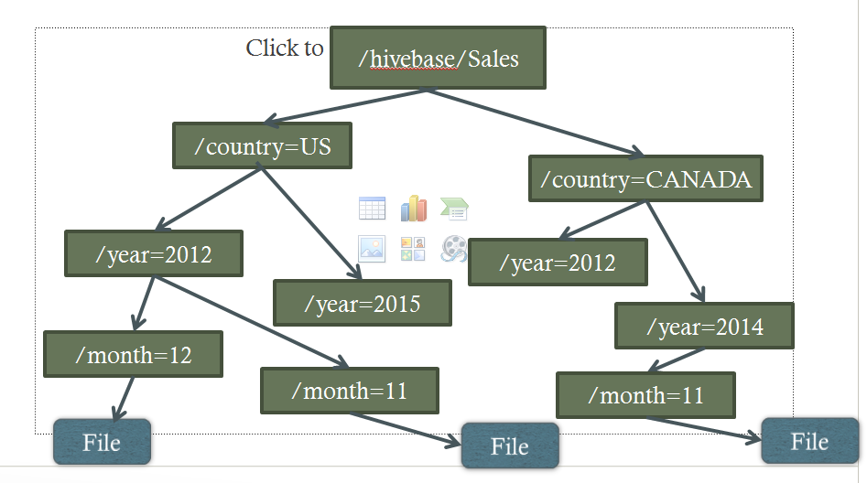
Partitions

Slide 21
Buckets
Data in each partition divided into buckets
Based on a hash function of the column
H(column) mod NumBuckets = bucket number
Each bucket is stored as a file in partition directory
Helps improve load performance, sampling performance, join performance

Slide 22
Buckets
Hive Buckets is a technique of decomposing data or decreasing the data into more manageable parts or equal parts
For example we have table with columns like date,employee_name,employee_id,salary,leaves etc . In this table just use date column as the top-level partition and the employee_id as the second-level partition leads to too many small partitions.
So here employee table is partition by date and bucketing by employee_id.The value of this column will be hashed by a user-defined number into buckets. Records with the same employee_id will always be stored in the same bucket.

Slide 23
Buckets
CREATE TABLE order
( username STRING,
orderdate STRING,
amount DOUBLE,
tax DOUBLE)
PARTITIONED BY (company STRING) CLUSTERED BY (username) INTO 25 BUCKETS;
set map.reduce.tasks = 25
set hive.enforce.bucketing = true

Slide 24
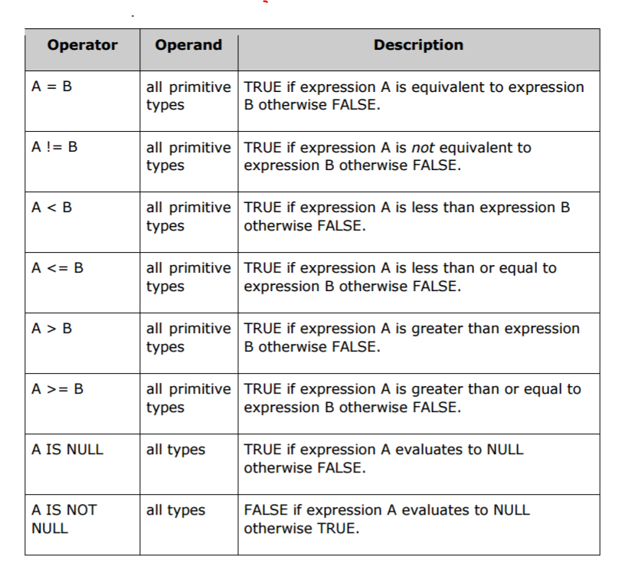
Relational Operators

Slide 25
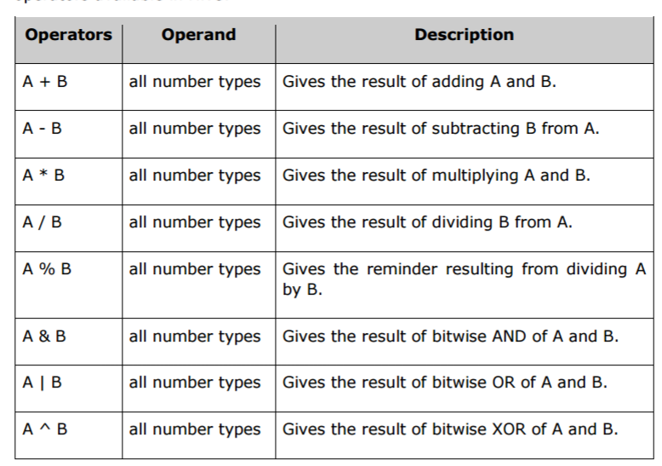
Arithmetic Operators

Slide 26
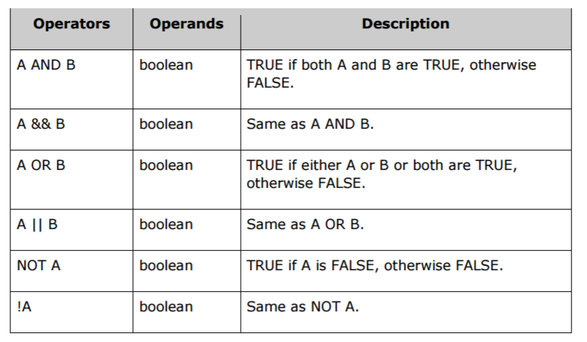
Logical Operators

Slide 27
Queries
Select
Limit
Functions
Where clause
Group By and having clause
Join Statements
Order by and Sort By
Distribute by and Sort by
Cluster by
Union all

Slide 28
Tuning Parameters
Skew Merge Bucket Joins | set hive.optimize.skewjoin = true; set hive.skewjoin.key = skew_key_threshold
Sort Merge Bucket Map Join | set hive.optimize.bucketmapjoin = true;
 | set hive.optimize.bucketmapjoin.sortedmerge = true;
 | set hive.input.format=org.apache.hadoop.hive.ql.io.BucketizedHiveInputFormat;
Bucket Map Join | set hive.optimize.bucketmapjoin = true;
Prevent MapJoins for Large Tables | set hive.auto.convert.join=false;
Controlling the CombinedHiveInputFormat Size | set mapred.max.split.size=268435456;
 | set mapred.min.split.size=
 | set mapreduce.input.fileinputformat.split.maxsize=
 | set mapreduce.input.fileinputformat.split.minsize=
 | set hive.input.format=org.apache.hadoop.hive.ql.io.CombineHiveInputFormat
Dynamic Partition Creation | set hive.exec.dynamic.partition.mode=nonstrict;
 | set hive.exec.max.dynamic.partitions=10000;
 | set hive.exec.max.dynamic.partitions.pernode=500;
 | set hive.auto.convert.join.noconditionaltask = true;
 | set hive.auto.convert.join.noconditionaltask.size = 10000;
Control the Output Compression | set hive.exec.compress.output=true
Control the Intermediate | set hive.exec.compress.intermediate=true
 | set io.sort.mb=400
 | set hive.limit.pushdown.memory.usage=0.1f
 | set hive.optimize.correlation=true;
Notes:
https://streever.atlassian.net/wiki/display/HADOOP/Hive+Performance+Tips

Slide 29
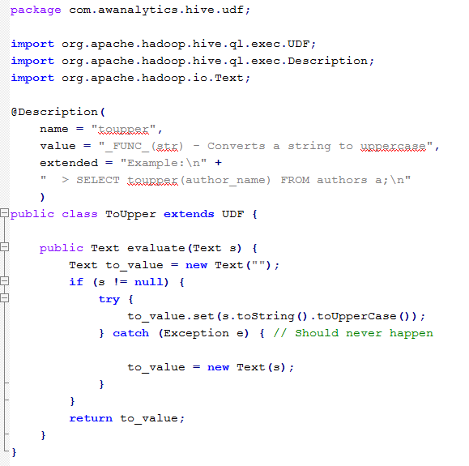
Hive UDF

Slide 30
Usage
> add jar /path/to/HiveSwarm.jar;
> create temporary function to_upper as 'com.awanalytics.hive.udf.ToUpper';
> SELECT toupper(author_name) FROM authors a;

