Slide 1


Triaging Performance Issues in EBS
Oracle OnDemand Training
Lester Gutierrez
E-business Suite Applications Performance Group

Slide 2
R12 Apps Basic Layers / Products
OC4J
JVM1
App1
App2
JVM2
App3
App2
Apache
Listener
Oracle Forms
Browser
mod_oc4j
Ext. procs
mod_proxy
Repository
Concurrent Processor, Manager
RAC Database
+ db Listener
mod_plsql
oc4j_security
IdM
mod_osso
OAM
LDAP
OID

Slide 3
R12 Apps Basic Layers / Products
OC4J
JVM1
App1
App2
JVM2
App3
App2
Apache
Listener
Oracle Forms
Browser
mod_oc4j
Ext. procs
mod_proxy
Repository
Concurrent Processor, Manager
RAC Database
+ db Listener
mod_plsql
oc4j_security
IdM
mod_osso
OAM
LDAP
OID

Slide 4
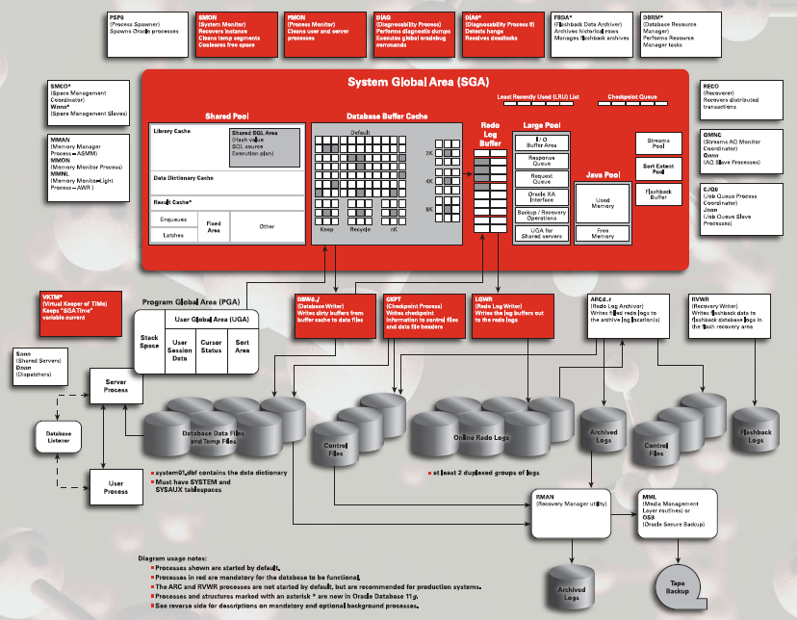
R12 Apps Basic Layers / Products

Slide 5
Topics
How to Approach a Performance Issue
Where is the time going ? Get the right diagnostics
  Where? What? Why?
Time outside of SQL Execution
Time in SQL Execution
Analysis & Workarounds
Extras
Q&A

Slide 6
What is Performance?
Notes:
Time it takes to execute a (business) task.
Response Time: time per task
Throughput: count of task executions within specified time interval

Slide 7
The fastest way to do something is not to do it at all
- Cary Millsap

Slide 8
How to Approach a Performance Issue
DEFINE the problem clearly
GATHER the right data to analyze the issue
Identify the ROOT CAUSE of the problem, possibly gather additional data
Search for a KNOWN SOLUTION or workaround that addresses the root cause of the problem
If it is a product issue, PASS ON the right information to support/dev through the regular channels
Try to identify a TEMPORARY WORKAROUND to alleviate the issue while you get a product fix

Slide 9
Define the problem
Get a clear understanding of the performance issue
  What
  Where
  When
  Why
  How
Notes:
What is slow ?
Single process or screen or user(s)
Everything in a module
Entire instance
Where is it slow ?
Test / Dev / Production / All
When is it slow ?
Is it slow at particular times of the day ?
Is it slow when there are only a few users on the system or only why the system is loaded ?
Since when is this slow ? What could have changed since the last time it ran ok ?
Patches,Gather stats,,Change in Data Volumes, etc
Why is it slow ?
Why do you think it is slow? May be customer will tell they have applied patch, or recent load etc
How ?
How to reproduce the issue?

Slide 10
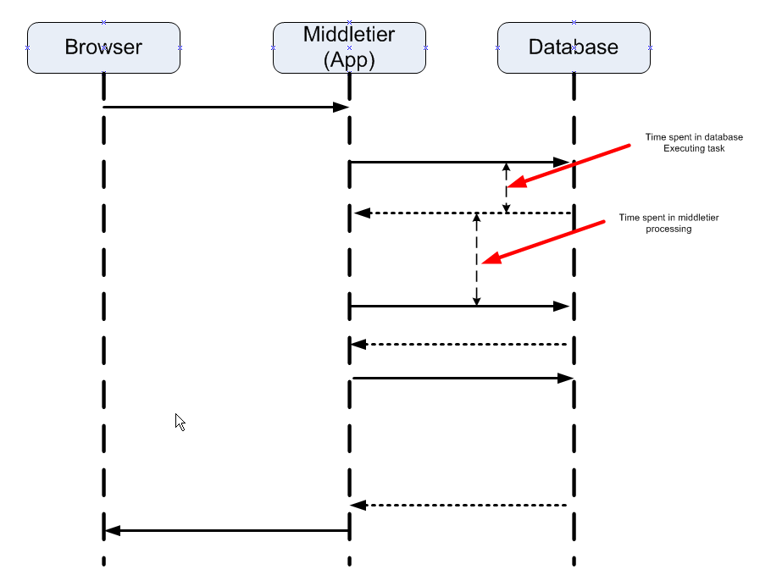
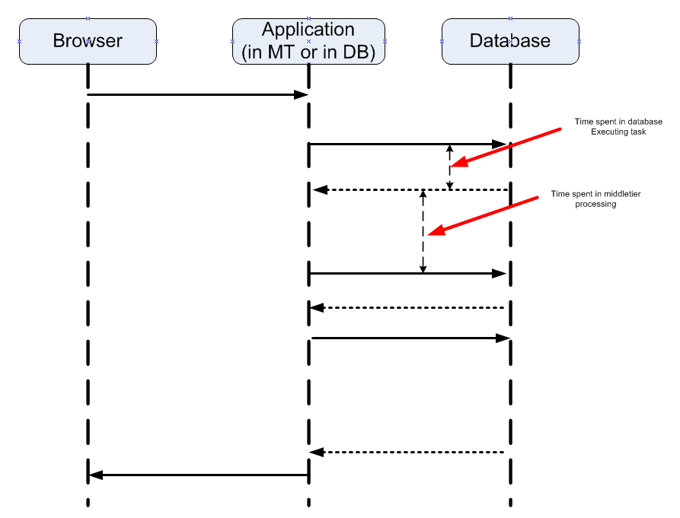
Define the problem
Sequence Diagram
Notes:
What is slow ?
Single process or screen or user(s)
Everything in a module
Entire instance
Where is it slow ?
Test / Dev / Production / All
When is it slow ?
Is it slow at particular times of the day ?
Is it slow when there are only a few users on the system or only why the system is loaded ?
Since when is this slow ? What could have changed since the last time it ran ok ?
Patches,Gather stats,,Change in Data Volumes, etc
Why is it slow ?
Why do you think it is slow? May be customer will tell they have applied patch, or recent load etc
How ?
How to reproduce the issue?

Slide 11
Define the problem
Take the time to read all the history of the issue
  SR
  BDE performance bug template
  Bug
Check if the problem is reproducible internally or in a test instance
Analyze the problem first before applying patches

Slide 12
Gather data
Product Logs with debug info
Trace files
SQLT output (note: 215187.1)
Trace Analyzer (note: 224270.1)
PL/SQL Profiler (note: 808005.1)
Automatic Workload Repository (AWR) report (note: 748642.1)
ADDM report (note: 250655.1)
Automated Session History (ASH) Report
11g SQL Monitoring
Forms Tracing (note: 373548.1)
JVM Logs
LTOM output (note: 352363.1)
OSWatcher (note: 301137.1)
….
Notes:
Trace File
set max_dump_file_size = unlimited AND statistics_level = all
Verify row source
Verify total time
Compare time reported in trace vs customer reported time
For parallel queries, pick files from udump AND from *bdump* directory
Interpreting Raw SQL_TRACE: Note 39817.1
SQLT (note 215187.1)
set statistics_level = all
methods with order of preference:
..sqltxecute.sql
..sqltxtract.sql - use sql_id
verify row counts
if run while query is running SQL Tuning Advisor is invoked. In 11g, SQL Monitoring report will be produced.
..sqltxplain.sql
AWR Report (748642.1)
create snapshots...dbms_workload_repository.create_snapshot()
generate report: $ORACLE_HOME/rdbms/admin/awrrpt.sql
AWR sql report: awrsqrpt.sql
ASH Report
get using $OH/rdbms/admin/ashrpt.sql or ashrpti.sql
ADDM Report (250655.1)
create awr snapshots
$ORACLE_HOME/rdbms/admin/addmrpt.sql
Trace Analyzer
if trace file is not too big
PL/SQL Profiler
https://webiv.oraclecorp.com/cgi-bin/webiv/do.pl/Get?WwwID=note:808005.1
Events
alter system set events '4030 trace name errorstack level 3';
Dumps
"System state: alter session set events 'immediate trace name SYSTEMSTATE level 10';
-- for hang issue ST support asked us to produce with level 266"
Process state: alter session set events 'immediate trace name PROCESSSTATE level 10';
Solaris...truss -a -e -f -rall -wall -o /tmp/truss.out -p <UNIX pid>
Linux...strace -p <UNIX pid>
11g Real Time SQL Monitoring
http://structureddata.org/2008/01/06/oracle-11g-real-time-sql-monitoring-using-dbms_sqltunereport_sql_monitor/
OSWatcher: 301137.1
Forms Trace:

Slide 13
Gather data
SQL Tuning
  Trace files
  SQLT output (note: 215187.1)
  Trace Analyzer (note: 224270.1)
  AWR Report (note: 748642.1)
  AWR SQL Report (awrsqrpt.sql)
  11g SQL Monitoring
  SQL Tuning Advisor
PL/SQL Tuning
  Product logs
  PL/SQL Profiler (note: 808005.1)
Forms Tuning
  Forms Tracing (note: 373548.1)
  FRD Log (note: 445166.1)
  - Generic note: 438652.1
Reports Tracing
  note: 111311.1
Database Tuning
  AWR Report (note: 748642.1)
  ADDM report (note: 250655.1)
  Automated Session History (ASH) Report
  LTOM output (note: 352363.1)
Middletier Tuning
  JVM Logs
OS
  OSWatcher (note: 301137.1)
Notes:
Trace File
set max_dump_file_size = unlimited AND statistics_level = all
Verify row source
Verify total time
Compare time reported in trace vs customer reported time
For parallel queries, pick files from udump AND from *bdump* directory
Interpreting Raw SQL_TRACE: Note 39817.1
SQLT (note 215187.1)
set statistics_level = all
methods with order of preference:
..sqltxecute.sql
..sqltxtract.sql - use sql_id
verify row counts
if run while query is running SQL Tuning Advisor is invoked. In 11g, SQL Monitoring report will be produced.
..sqltxplain.sql
AWR Report (748642.1)
create snapshots...dbms_workload_repository.create_snapshot()
generate report: $ORACLE_HOME/rdbms/admin/awrrpt.sql
AWR sql report: awrsqrpt.sql
ASH Report
get using $OH/rdbms/admin/ashrpt.sql or ashrpti.sql
ADDM Report (250655.1)
create awr snapshots
$ORACLE_HOME/rdbms/admin/addmrpt.sql
Trace Analyzer
if trace file is not too big
PL/SQL Profiler
https://webiv.oraclecorp.com/cgi-bin/webiv/do.pl/Get?WwwID=note:808005.1
Events
alter system set events '4030 trace name errorstack level 3';
Dumps
"System state: alter session set events 'immediate trace name SYSTEMSTATE level 10';
-- for hang issue ST support asked us to produce with level 266"
Process state: alter session set events 'immediate trace name PROCESSSTATE level 10';
Solaris...truss -a -e -f -rall -wall -o /tmp/truss.out -p <UNIX pid>
Linux...strace -p <UNIX pid>
11g Real Time SQL Monitoring
http://structureddata.org/2008/01/06/oracle-11g-real-time-sql-monitoring-using-dbms_sqltune.report_sql_monitor/
OSWatcher: 301137.1
Forms FRD log and Forms Trace location: $FORMS_TRACE_DIR
Frd log file: collect_<pid>
Forms trace file: forms_<pid>.trc
Performance Tuning Assistant: http://unique.us.oracle.com:7777/PTAv3/

Slide 14
Root Cause Analysis: Check the basics
Version levels
Required Configuration
  Init.ora : Notes 396009.1 (R12) & 216205.1 (11i)
AWR, ADDM & OS Stats
Latest patch levels
Recommended Patch lists
  Note “Recommended Performance Patches for the Oracle E-Business Suite”, 244040.1
  Also check for product specific notes
Available Fixes
Best Practices in Performance for EBS
  http://blogs.oracle.com/stevenChan/2009/11/ebs_tuning_oow09.html

Slide 15
Root Cause Analysis
Where is the time going?
Who is consuming time?
Why?
Notes:
Where…in which component
Who…SQL, PL/SQL, waits or unaccounted waits…further drilldown to objects
Why…5 whys concept

Slide 16
Where is the time going ? Get the right diagnostics
Identify the components that do the processing
  Refer to the architecture
    which tier(s) play a part ?
    which components within a tier come into play ?
Follow a plan …

Slide 17
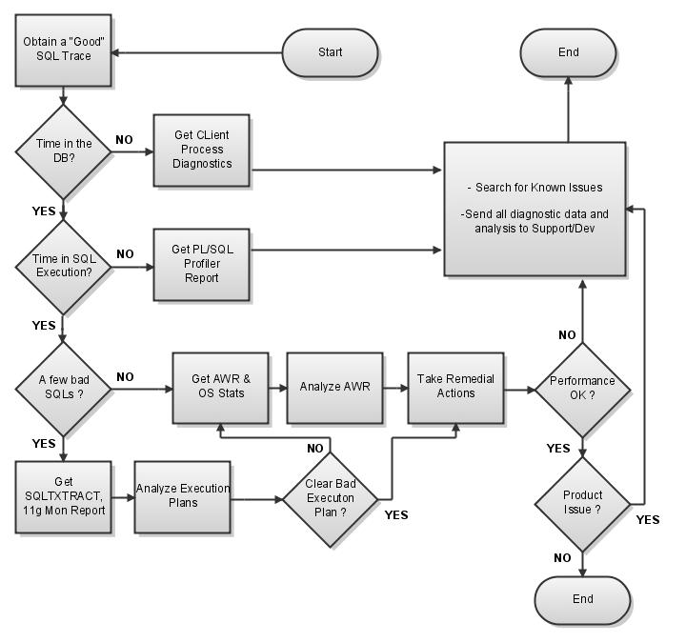

Slide 18
Where is the time going ? Get the right diagnostics
Starting with the SQL Trace/TKPROF file
  Look at “Overall Totals” > Parse+Execute+Fetch
Can you account for user reported response time ?
  If yes, which would be in most of the cases, you have identified the issue to be SQL/PLSQL related
  If no, check if the raw trace file is truncated
  If that is not the case, then the issue is probably because of other non-database processing being done by the program
    Forms, Reports, Java, etc

Slide 19
Where is the time going ? Get the right diagnostics
If non-database (client side) processing occurs within the flow that was traced, you may see wait events like
  SQL*Net Message%
  TCP Socket%
  PLSQL Lock Timer
Tkprof mistakenly assigns these to the nearest SQL cursor
Other useful data in identifying where time is spent
  Raw sql trace file
  Product logs
  App server logs such as http logs
  Client process cpu consumption from OS (for example ps)

Slide 20
Where is the time going ? Get the right diagnostics
If time is spent in the client process get ….
  Process CPU consumption,
  App server OS stats
  For FORMS, get a Forms Runtime Diagnostic Trace
    See “Extras” section
  For REPORTS, get a Reports Trace (aka Reports Profiler)
    See “Extras” section
  For Java/OA FWK
    See complementary presentation on mid-tier performance analysis for EBS
In case of a concurrent program, make sure to check the Actual Start Date and Actual Completion Date to get the exact run time (FND_CONCURENT_REQUESTS)

Slide 21
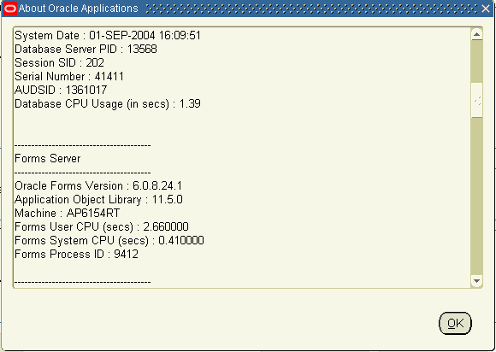
Where is the time going ? Get the right diagnostics
Client Process CPU Consumption
  Help -> Oracle Applications
  Forms and Database process id & CPU Time

Slide 22
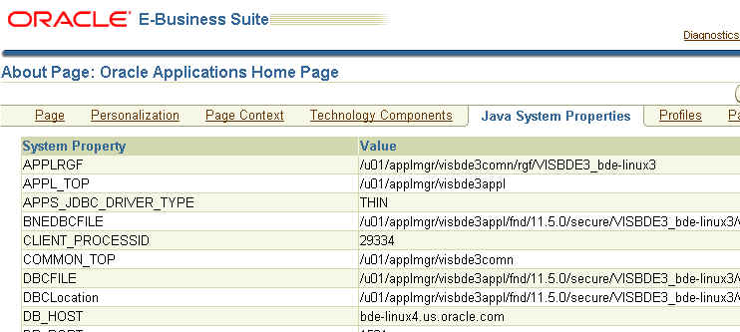
OA Fwk : JVM Process ID
Client Process CPU Consumption
  OA FWK – JVM Process ID
  The “About” link is at the bottom of each page
    Requires FND_DIAGNOSTICS profile set to
Process ID of the JVM handling your session

Slide 23
Where is the time going ? Get the right diagnostics
SQL Trace & PL/SQL Profiler EBS Features
  TRACEFILE_IDENTIFIER set by default to Sign-on username. For concurrent requests, it is set to username_CR<request_id>.
  Forms: Help -> About Oracle Applications
  PL/SQL Profiler Forms
  PL/SQL Profiler OA FWK
  Request submission level Debug option for Concurrent Programs (includes sql trace, plsql profiler, reports trace, java Xprof output)
  PLSQL Profiler Report concurrent program

Slide 24
SQL Trace - Introduction
It is a diagnostic/debugging facility that provides runtime performance statistics for individual SQL statements that your application runs.
It also records the execution plan that was used to execute each SQL statement.
In most cases, enabled at the session level.
It is a text file, but raw.

Slide 25
SQL Trace - What information does it provide
Provides the following information for each statement.
Parse, execute, and fetch counts
CPU and elapsed times
Physical reads and logical reads
Number of rows processed
Misses on the library cache
Each commit and rollback
Runtime Execution Plan
Execution Plan row counts and row source stats ***

Slide 26
SQL Trace - Levels
Level 1 - Standard Sql Trace
Level 4 - Level 1 PLUS Bind values
  BINDS #1:
  bind 0: dty=2 mxl=22(22) mal=00 scl=00 pre=00 oacflg=03 oacfl2=0 size=24 offset=0
  bfp=80000001000cbc78 bln=22 avl=04 flg=05
  value=144867
Level 8 - Level 1 PLUS Wait Statistics
  WAIT #1: nam='file open' ela= 0 p1=0 p2=0 p3=0
  WAIT #1: nam='db file sequential read' ela= 2 p1=330 p2=121062 p3=1
Level 12 - Level 1 PLUS Bind values and Wait Statistics
In most cases, level 8 is good enough

Slide 27
SQL Trace – What it looks like
PARSING IN CURSOR #1 len=53 dep=0 uid=33 oct=3 lid=33 tim=4181264358 hv=3778312068 ad='350e5c48'
select party_name from hz_parties where party_id=:b1
END OF STMT
PARSE #1:c=1,e=1,p=0,cr=2,cu=0,mis=1,r=0,dep=0,og=0,tim=4181264358
BINDS #1:
bind 0: dty=2 mxl=22(22) mal=00 scl=00 pre=00 oacflg=03 oacfl2=0 size=24 offset=0
bfp=80000001000cbc78 bln=22 avl=04 flg=05
value=144867
EXEC #1:c=0,e=0,p=0,cr=0,cu=0,mis=0,r=9223372041149743104,dep=0,og=4,tim=4181264358
WAIT #1: nam='SQL*Net message to client' ela= 0 p1=1650815232 p2=1 p3=0
WAIT #1: nam='db file sequential read' ela= 1 p1=328 p2=129038 p3=1
WAIT #1: nam='file open' ela= 1 p1=0 p2=0 p3=0
WAIT #1: nam='db file sequential read' ela= 3 p1=327 p2=128915 p3=1
WAIT #1: nam='file open' ela= 0 p1=0 p2=0 p3=0
WAIT #1: nam='db file sequential read' ela= 2 p1=330 p2=121062 p3=1
FETCH #1:c=0,e=6,p=3,cr=4,cu=0,mis=0,r=9223376430606319617,dep=0,og=4,tim=4181264364
WAIT #1: nam='SQL*Net message from client' ela= 0 p1=1650815232 p2=1 p3=0
FETCH #1:c=0,e=0,p=0,cr=0,cu=0,mis=0,r=9223376430606319616,dep=0,og=0,tim=4181264364
WAIT #1: nam='SQL*Net message to client' ela= 0 p1=1650815232 p2=1 p3=0
WAIT #1: nam='SQL*Net message from client' ela= 999 p1=1650815232 p2=1 p3=0
STAT #1 id=1 cnt=1 pid=0 pos=0 obj=20595 op='TABLE ACCESS BY INDEX ROWID HZ_PARTIES '
STAT #1 id=2 cnt=1 pid=1 pos=1 obj=34093 op='INDEX UNIQUE SCAN '
Notes:
Interpreting Raw SQL_TRACE and DBMS_SUPPORT.START_TRACE : Note 39817.1
Have sample of RPC call and commit/rollback

Slide 28
SQL Trace – init.ora parameters
sql_trace=false
  Enables sql tracing for the entire instance
timed_statistics=true
  Enables collection of CPU and elapsed times
max_dump_file_size=val [K|M]|unlimited
  Specifies max size of the trace file
user_dump_dest=<directory>
  Specifies location where trace files should be written
background_dump_dest=<directory>
  Trace files of background processes like parallel query slaves
tracefile_identifier=‘string’
  Creates trace files with the name sid_ora_pid_string.trc
_trace_files_public=true
  Creates trace files with mode 644 instead of 600

Slide 29
Enabling Trace - SQL Plus/PL/SQL
Enabling trace for the current session
  alter session set sql_trace=true;
  alter session set events ‘10046 trace name context forever, level <x>’;
  dbms_session.set_sql_trace(true);
  dbms_support.start_trace(waits=>true,binds=>true);
Enabling trace for a different session
  dbms_system.set_sql_trace_in_session (SID,SERIAL#,TRUE);
  DBMS_SUPPORT.START_TRACE_IN_SESSION( SID , SERIAL#, waits=>TRUE, binds=>TRUE )
Notes:
Trace for a session id:
select ses.sid, ses.serial#, proc.spid, proc.*
from v$session ses, v$process proc
where proc.addr = ses.paddr(+)
--and ses.sid = 22700
;

Slide 30
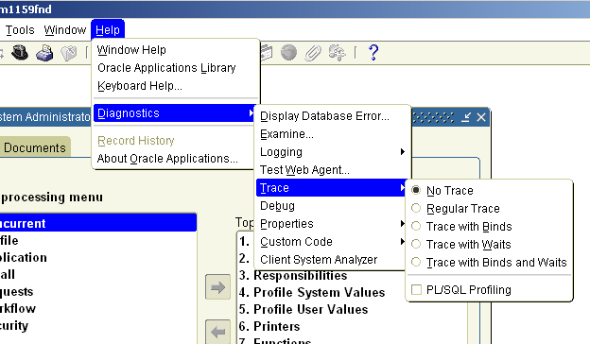
Enabling Trace - Forms
Note: Set profile option Utilities:Diagnostics to Yes in order to supress Apps password prompt.

Slide 31
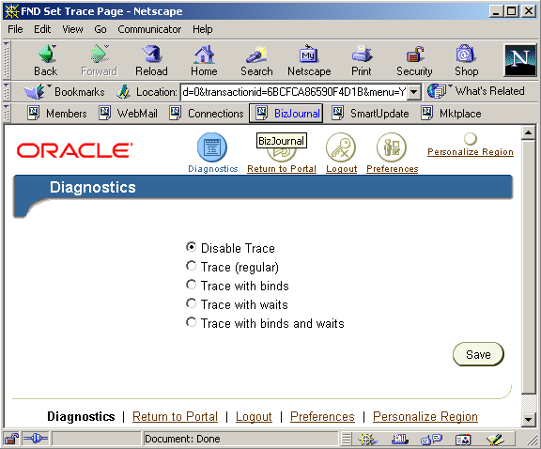
Enabling Trace – OA FWK
Notes:
- Set profile FND : Diagnostics to Yes at user level
- Login to Self Service as the above user
- Click on Diagnostics icon at the top of page
- Select ‘Set Trace Level’ and click Go
- Select the desired trace level and click Save
- Perform the activity that you want to trace
Exit application, without disabling trace

Slide 32
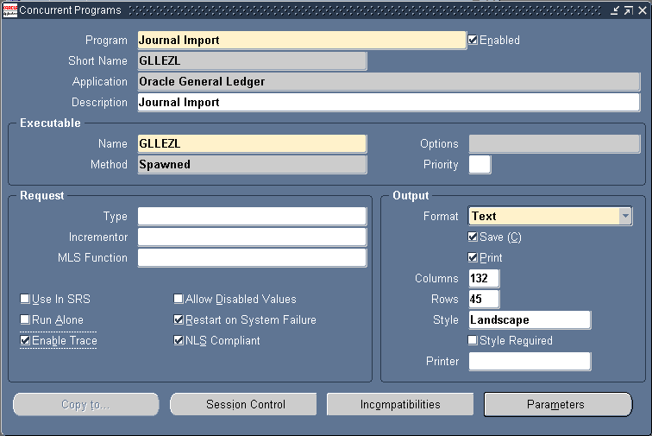
Enabling Trace – Concurrent Program

Slide 33
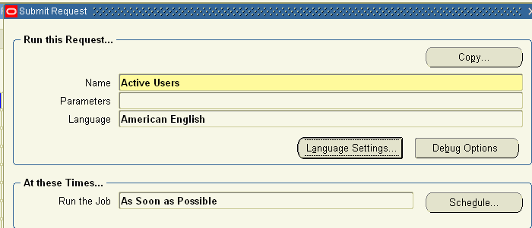
SQL Trace – Concurrent Request
Set Profile option Concurrent: Allow Debugging to Yes
OAM minipack H + rollup 1 or later is required.

Slide 34
11g SQL Tracing Enhancements
  PLAN_STAT – first_execution | all_executions
  Connection pool problem to get row source stats is solved
  Pursuing tkprof enhancement to aggregate row source stats for all_executions case
  Expect up to double trace size
  Turn trace on for just 1 or a list of sql_id’s..very cool, combined with real-time row source stats monitoring from v$sql_plan_stats – no more waiting hours for a complete trace to get the right trace data
  Timing issues fixed in bugs 7522002 and 7168259
  Expanded event syntax :
  - alter session set events ’sql_trace [sql:a5ks9fhw2v9s1|56bs32ukywdsq] …
  - sql_trace wait=true | false, bind=true | false,planstat=never | first_execution | all_executionss|level = 1| 4| 8| 12 | 16

Slide 35
Enabling Trace – Generic Method for Oracle Apps
Set the profile ‘Initialization SQL Statement – Custom’ at user level to the following value
  BEGIN FND_CTL.FND_SESS_CTL('','','TRUE','TRUE','','ALTER SESSION SET TRACEFILE_IDENTIFIER=''APPSPERF'' STATISTICS_LEVEL = ALL EVENTS=''10046 TRACE NAME CONTEXT FOREVER, LEVEL 8''');END;
This will trace all the sessions of that user at level <x>
The trace file name will be of the format :
  sid_ora_spid_CLASSXX.trc
Notes:
Check behavior for conc programs submitted by this user, My tests show NO
Initialization SQL Statement – Custom’ or Initialization SQL Statement - Oracle
11g:
BEGIN FND_CTL.FND_SESS_CTL ('','','TRUE','TRUE','LOG', 'alter session set tracefile_identifier ="appsperf" events=''sql_trace wait=true, plan_stat=first_execution'''); END;
-- you can also use all_executions
10g:
BEGIN FND_CTL.FND_SESS_CTL('','','TRUE','TRUE','','ALTER SESSION SET TRACEFILE_IDENTIFIER=''APPSPERF'' STATISTICS_LEVEL = ALL EVENTS=''10046 TRACE NAME CONTEXT FOREVER, LEVEL 8''');END;

Slide 36
TKPROF
Contains the following information
  The text of the SQL statement.
  The SQL trace statistics in tabular form.
  The number of library cache misses for the parsing and execution of the statement.
  The user initially parsing the statement.
  Runtime Execution Plan, listed under ‘Row Source Operation’
  The execution plan generated by EXPLAIN PLAN.
  Wait Statistics ( 9i onwards )
There are many parameters, with more added each version, however for most cases, it is still advisable to produce 2 versions
  1 unsorted and 1 sorted (prsela,exela,fchela)
Notes:
Tabular Statistics
Each row corresponds to one of the three phases of SQL processing
Parse
Execute
Fetch
The columns display the statistic value for each phase
Count
The number of times each statement was parsed, executed or fetched
CPU
Total CPU time in seconds for all parse, execute, or fetch calls for the statement
Elapsed
Total elapsed time in seconds for all parse, execute, or fetch calls for the statement
Disk
Total number of data blocks physically read from the datafiles on disk for all parse, execute, or fetch calls
Query
Total number of buffers retrieved in consistent mode (i.e., When “finding” the rows to modify) for all parse, execute, or fetch calls
Current
Total number of buffers retrieved in current mode i.e., When getting the block as it exists now to actually update the row of interest.
+ undo segment block to begin transaction
+
Rows
Total number of rows processed by the SQL statement
Does not include the rows processed by the sub-queries of the SQL statement
The last row displays the totals

Slide 37
TKPROF – Sample Output
select party_name
from
hz_parties where party_id=:b1
call count cpu elapsed disk query current rows
------- ------ -------- ---------- ---------- ---------- ---------- ----------
Parse 1 0.00 0.01 0 0 0 0
Execute 1 0.00 0.00 0 0 0 0
Fetch 2 0.00 0.06 3 4 0 1
------- ------ -------- ---------- ---------- ---------- ---------- ----------
total 4 0.00 0.07 3 4 0 1
Misses in library cache during parse: 1
Optimizer goal: CHOOSE
Parsing user id: 33 (APPS)

Slide 38
TKPROF – Sample Output
OVERALL TOTALS FOR ALL NON-RECURSIVE STATEMENTS
call count cpu elapsed disk query current rows
------- ------ -------- ---------- ---------- ---------- ---------- ----------
Parse 538 0.70 0.95 1 670 0 0
Execute 560 4.11 6.20 0 44942 45 224
Fetch 363 0.44 4.34 278 3401 52 1157
------- ------ -------- ---------- ---------- ---------- ---------- ----------
total 1461 5.25 11.49 279 49013 97 1381
Misses in library cache during parse: 60
OVERALL TOTALS FOR ALL RECURSIVE STATEMENTS
call count cpu elapsed disk query current rows
------- ------ -------- ---------- ---------- ---------- ---------- ----------
Parse 4578 4.30 4.71 2 38 3 0
Execute 10944 2.47 3.19 109 1365 3048 580
Fetch 29021 6.49 34.64 2583 287337 1902 29597
------- ------ -------- ---------- ---------- ---------- ---------- ----------
total 44543 13.26 42.54 2694 288740 4953 30177

Slide 39
TKPROF – Good vs. Bad
To get full value from tracing & tkprof you must have
  A complete, non-truncated trace file
  From before the user action began
  To the point the DB session ends**
Summarized per SQL execution, trace Totals and Wait stats are important and sufficient in some cases, however …
In most cases, 1 or more SQLs long runtimes are the culprits, and to answer the question of what is wrong with them one MUST
  Runtime Execution Plans
  Row Counts & Row Source Stats
Run Time Execution Plan = Row Source Operation
Row Source Counts
  Row source counts are displayed when the cursor is closed
  Do not call sql_trace=false, otherwise the cursors will not be closed. Instead, exit from the session.

Slide 40
TKPROF – Sample Output
Runtime Plan+Row Counts & Stats
call count cpu elapsed disk query current rows
------- ------ -------- ---------- ---------- ---------- ---------- ----------
Parse 1 0.00 0.00 0 0 0 0
Execute 7674758 780.79 728.70 0 1 0 0
Fetch 7674758 6328.78 6757.80 225987 153846532 0 7674758
------- -------- -------- ---------- ---------- ---------- ---------- ----------
total 15349517 7009.58 7486.52 225987 153846533 0 7674758
Misses in library cache during parse: 1
Misses in library cache during execute: 1
Optimizer mode: ALL_ROWS
Parsing user id: 173 (recursive depth: 2)
Rows Row Source Operation
------- ---------------------------------------------------
7674758 SORT AGGREGATE (cr=153846532 pr=225987 pw=0 time=7174772779 us)
7675089 NESTED LOOPS (cr=153846532 pr=225987 pw=0 time=6919378560 us)
7675089 SORT UNIQUE (cr=123146176 pr=162809 pw=0 time=6083080435 us)
55878643 TABLE ACCESS BY INDEX ROWID AR_TRX_COGS_GT (cr=123146176 pr=162809 pw=0 time=5577872837 us)
136390387 INDEX RANGE SCAN AR_TRX_COGS_N1 (cr=23439707 pr=37706 pw=0 time=2136416980 us)(object id..
7675089 TABLE ACCESS BY INDEX ROWID RA_CUSTOMER_TRX_LINES_ALL (cr=30700356 pr=63178 pw=0 time=539908369 us)
7675089 INDEX UNIQUE SCAN RA_CUSTOMER_TRX_LINES_U1 (cr=23025267 pr=2820 pw=0 time=196155435 us)(object ..

Slide 41
TKPROF – Sample Output
Runtime Plan+Row Counts & Stats…Waits
call count cpu elapsed disk query current rows
------- ------ -------- ---------- ---------- ---------- ---------- ----------
Parse 1 0.00 0.00 0 0 0 0
Execute 7674758 780.79 728.70 0 1 0 0
Fetch 7674758 6328.78 6757.80 225987 153846532 0 7674758
------- -------- -------- ---------- ---------- ---------- ---------- ----------
total 15349517 7009.58 7486.52 225987 153846533 0 7674758
Elapsed times include waiting on following events:
Event waited on Times Max. Wait Total Waited
---------------------------------------- Waited ---------- ------------
db file sequential read 32 0.03 366.38
SQL*Net message to client 2 0.00 0.00
SQL*Net message from client 2 0.00 0.00
Waits = elapsed – cpu
= 7486.52 – 7009.58 =~ 477 seconds
UnAccount Waits = (elapsed – cpu) - reported waits =~ 100 seconds
= indicates CPU Contention or uninstrumented code
!=

Slide 42
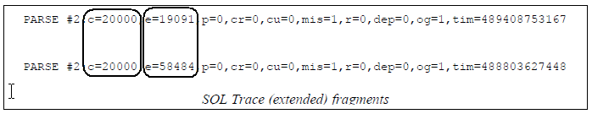
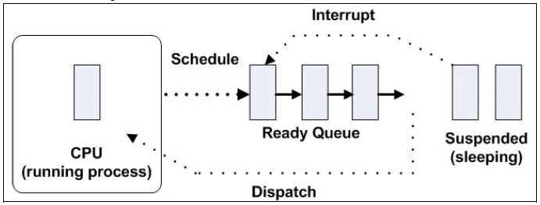
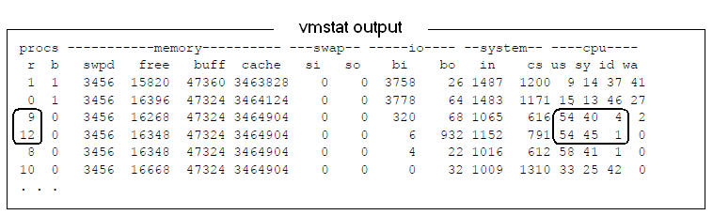
TKPROF – Sample Output
UnAccounted Waits
CPU is not consumed
Run queue i.e., waiting for CPU

Slide 43
TKPROF Issues/Tips
A truncated trace file will provide incomplete information. Go to the end of the trace file and check for the following line.
*** DUMP FILE SIZE IS LIMITED TO 12345 BYTES***
Use a TKPROF of the same version of the database, else timing data may be messed up due to changing timing units across db versions
Still can’t get row counts/rowsource stats ?
  Common with connection pooling situations
  May need to manually run/trace from sqlplus with session setting of statistics_level=ALL and declaring and assigning bind variables and/or using hint /*+ gather_plan_statistics */
Check the last line of the tkprof for total time captured (10g+ )
Notes:
Still can’t get row counts/rowsource stats ?
Common with connection pooling situations
Always set statistics_level=ALL while tracing…reset it back to TYPICAL
OA/Forms: exit apps, and if possible, bounce middletier
See whether any truncate or stats gathering is happening…these operations will wipe out plans from memory
Show my script

Slide 44
TKPROF – When to look at raw trace
Bind information
Specific execution, instead of aggregates
RPC procedure (server side) calls from Forms
Identification & placement of client side processing

Slide 45
Live Review
Raw Trace Viewer & Tkprof

Slide 46
Where is the time going ? Get the right diagnostics – PL/SQL
Totals for recursive and non-recursive statements in tkprof will not always add up due to accounting issues with deep call stacks
Time is likely spent in the PL/SQL layer if
  If the reported response or run time is accounted for in the SQL trace/Tkprof
  SQL execution does not add up to this time
  Client processing wait events does not add up to this time
In this case, you should produce a PL/SQL Profiler report, enable the profiler by
  Forms : Help-> Diagnostics -> Trace -> PL/SQL profiler
  OA FWK : Diagnostics Link
Notes:
PL/SQL Profiler for Ebiz: 808005.1
PL/SQL Profiler 243755.1

Slide 47
PLSQL Profiler - Forms

Slide 48
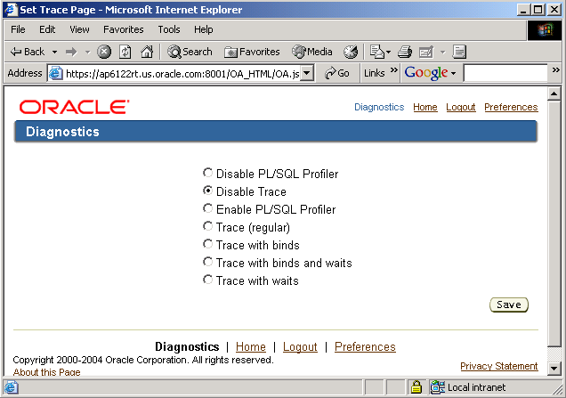
PLSQL Profiler – OA FWK

Slide 49
Producing the PLSQL Profiler Data
Click checkbox to Enable (in Forms or OA Fwk)
Perform the user action
When done, click checkbox to disable.
Exit from the application
You will get a message that a concurrent report has been submitted.
Login back again and view the output for this concurrent request.
Output is a hyperlinked profiler report will summary and detail sections.
Notes:
If report is not submitted, you can submit manually by running Concurrent Request “PL/SQL Profiler Report” from Sysadmin responsibility.
Tables involved:
Plsql_profiler_runs
Plsql_profiler_units
Plsql_profiler_data

Slide 50
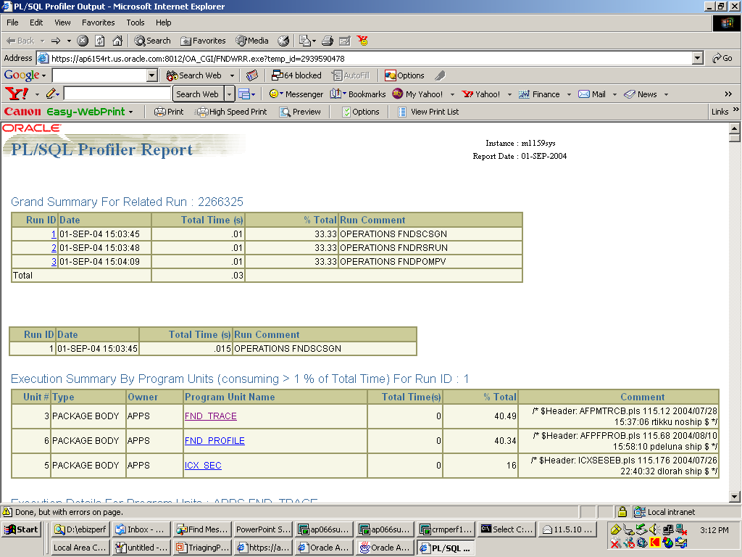
PLSQL Profiler Report – Sample

Slide 51
I know where the time is going, now what ?
OK, so you got a good trace and tkprof capturing all the flow with rowsource counts and stats & waits for all expensive statements…now what ?
For client or pl/sql processing ..re-check knowledge base for known issue/fixes and send mentioned diagnostic info to support/development
For SQL Execution Issues
  Good trace & tkprof will have told us …
    What SQLs are the issue
    What part of the execution plans are most expensive
    What database waits are causing the issue
Next step ?

Slide 52
SQL Execution Issues
We still need to answer the “why” question…
Depending on whether the main issue is to do with a bad execution plan or with contention related database waits, we will need…
  AWR & ASH Reports ( awrrpt.sql / awrsqrpt.sql )
  SQLT Reports for expensive SQLs with bad executions plans
  11g SQL Monitor Report

Slide 53
SQLT
Tool that gathers in one hyperlinked report most data needed to analyze why CBO chose a particular execution plan
Always use latest version from Note 215187.1
Best method is XECUTE
  but Dev team has to provide sql script
Preferred method is XTRACT
  Prereq: statistics_level = all
  Gets actual execution statistics in memory and/or AWR
  Focuses on runtime execution plans
  Alternative option (XPLAIN) may result in displaying a different execution plan than the one chosen at runtime
  Ideally, run report shortly after SQL has finished executing

Slide 54
SQLT – XTRACT
Requisites
  SQL_ID or HASH_VALUE of SQL to be analyzed must be known before hand
  SQL must be in memory and/or in AWR
Steps
  Connect to SQL*Plus as the application user for given SQL
  Execute script sqlt/run/sqltxtract.sql
  Provide as input parameter SQL_ID or HASH_VALUE
      # cd sqlt/run
      # sqlplus qtune/qtune
      SQL> START sqltxtract.sql cqkrws8pvc493

Slide 55
11g SQL Monitoring Report
Automatically on for parallel SQL or SQL running >5s
Can monitor details SQL and Execution Plan line level stats while the statement is running
Can query V$SQL_MONITOR for top level stats
Detailed, html report, highlighting where the time and resource consumption is happening
    select
    DBMS_SQLTUNE.REPORT_SQL_MONITOR(
    session_id=>sys_context('userenv','sid'),
    report_level=>'ALL') as report
    from dual;

Slide 56
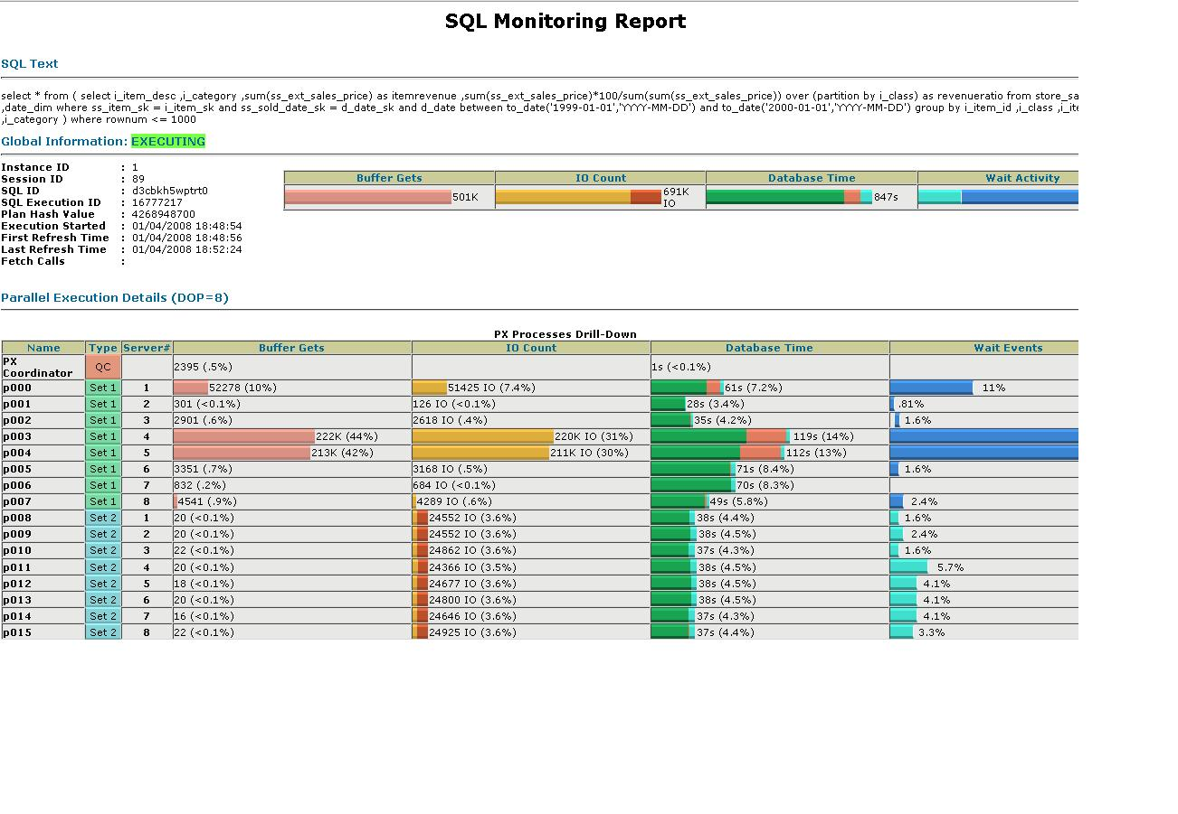
11g Automatic SQL Monitoring & Tuning
Almost as good as SQL trace in terms of diagnostic data, but always on for expensive SQL
Better than trace in terms of data presentation, ease of analysis
Intelligent, pragmatic tuning tests result in recommendations proven to work for you

Slide 57
Live Review
SQLT & SQL Monitoring Report

Slide 58
Analysis and Workarounds –
SQL Execution
OK, got all the right diagnostics collected ..now what ?
  In parallel…
    Send to support/dev
    Conduct your own analysis to identify possible workarounds/solutions

Slide 59
Analysis and Workarounds –
Basic Execution Plan Analysis
First, educate yourself on the basics
  Key Concepts
    Cost
    Cardinality & Selectivity
    Access Paths
    Efficient Indexing
    Join Methods
    Other Common Plan Rowsources
  Learn to interpret execution ORDER ( sqlt has it too )

Slide 60
Analysis and Workarounds –
Basic Execution Plan Analysis
Some Key Concepts
  Cost
    Relative index as to the amount of resources needed to execute a particular SQL statement. Primary components are # of physical IO operations and CPU cycles
  Cardinality
    Number of rows expected for a given row source.
  Selectivity
    # between 0 and 1 which reflects the ratio of returned rows, usually referenced in terms of where clause predicate(s), column(s) and index(es)
  All these are estimates, they can be wrong …

Slide 61
Analysis and Workarounds –
Basic Execution Plan Analysis
Some Key Concepts
  Most Common Access Paths
    Index .. Scan
      Unique – no problem!
      Range – It depends ..How selective ? Throw-away later ?
    Table Access By Index Rowid
      Single block IO ... db file sequential read waits
      Very IO intensive IF following an unselective range scan, otherwise generally OK
    Table Access Full
      Root of all evil ? …Not necessarily
      Multi – Block IO … db file scattered reads
      Can be optimal for small tables and/or when selecting significant % of the table data

Slide 62
Analysis and Workarounds –
Basic Execution Plan Analysis
Some Key Concepts
  Efficient Indexing
    Most often equals selective indexing, but this depends not only on column selectivity, but also on SQL where clauses available
    Must measure index selectivity on which columns are used as access predicates in index access row source
      Missing or Range predicates on indexed columns such as <, <, LIKE, BETWEEN prevent subsequent index column predicates from being used as access predicates
    Filter predicates won’t help much the index access step, but can help sub-sequent table access by index rowid

Slide 63
Analysis and Workarounds –
Basic Execution Plan Analysis
Some Key Concepts
  Common Join Methods
    Cartesian Join (Merge Join Cartesian)
      No join conditions exist or single row table.
    Hash Join
      build and probe: build in-memory hash table with top-most rowsource, then read the bottom most rowsource and probe the hash table for a match
    Nested Loops Join
      for each outer row (driving table), scan the inner table using the correlated outer row as the join input
  Under what conditions can one method cost more than another ?

Slide 64
Analysis and Workarounds –
Basic Execution Plan Analysis
Execution Order
  Critical step in execution plan analysis, allows you to correctly follow-the-plan in conjunction with the access & filter predicate information
  SQLT & OEM have it
  Manual Method
    Find Driving Step = Rightmost, Uppermost ACCESS rowsource (index or table) without a child rowsource
    From here, recursively follow the tree structure of the plan..accessing sibling rowsources or query blocks, then then the parent and so forth ..

Slide 65
Analysis and Workarounds –
Basic Execution Plan Analysis
The Process…What? How? Why?
  Read/understand query, functionality and identify main filters –these are usually the key to an efficient or inefficient plan
  Use Runtime plan only, ideally with rowsource counts & stats
  Get access/filter predicate dump ( sqlt, dbms_xplan, etc)
  “WHAT is the problem with this plan ?” A: Locate expensive rowsources and/or row throw-away, cross check with wait information & access/filter predicates
  Understand HOW it is happening by “following the plan”
  Look to cardinality and cost estimates to understand WHY CBO Chose this plan – where is the mistake ?
  Know you know the root cause, think of possible remedies..

Slide 66
Analysis and Workarounds –
Poor SQL Execution Plan
Non representative (or missing) statistics lead to
Poor cardinality estimates which leads to
Poor access path selection which leads to
Poor join method selection which leads to
Poor join order selection which leads to
Poor SQL execution times

Slide 67
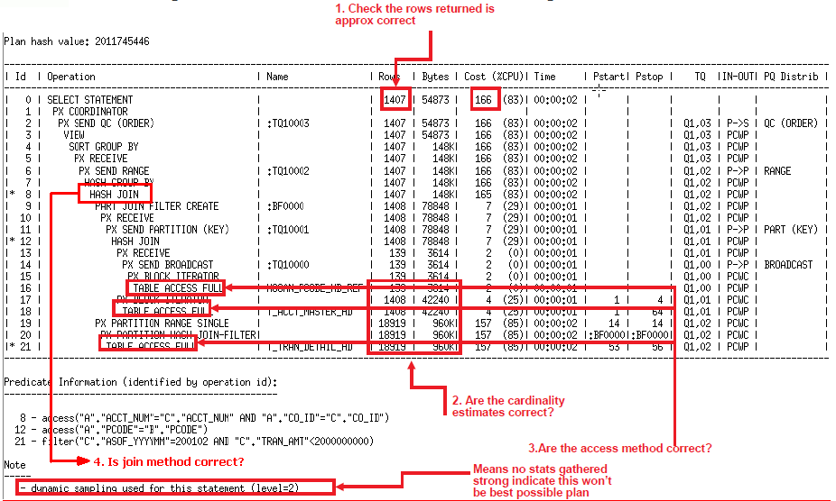

Analysis and Workarounds –

Slide 68
Live Review
Lets revisit the SQLT & Analyze the execution plan…

Slide 69
Analysis and Workarounds – Statistics
Check for any out of date stats
GTT table & indexes should have no stats
If you suspect cardinality estimates to be the cause of a poor execution plan
  Try re-gathering stats at a higher % (30,100)
  Is it skew related ? Consider a new histogram
  Is it underestimation due to predicate correlation ? Consider 11g extended stats (CREATE_EXTENDED_STATS)
Setting fake stats (SET_TABLE_STATS/SET_INDEX_STATS)
  This is dangerous if not done correctly and can affect other code, so should be done with help/blessing from dev
  Rarely done, usually reserved for very intra-process volatile data (rows and/or columns) for which it is difficult to get good stats

Slide 70
Analysis and Workarounds – Statistics
Remember the best practices for Statistics Management
  Do not gather statistics excessively such as nightly or weekly
  Use the GATHER_AUTO option to gather incrementally
  Use only FND_STATS or Gather Schema Concurrent Program
  Due to data skew, some products/tables benefit from higher sampling %
    Analyze all schemas at 10%, then specific objects at x%
  Disable the 10g/11g automatic job to gather stats

Slide 71
Analysis and Workarounds – Statistics
Gathering Statistics
  Consider locking stats for very volatile tables once a representative set is gathered
    Some Interface tables
    Other examples: ap_selected_invoices, wsh_pr_workers
    FND_STATS patch 6079369 recommended for using GATHER_SCHEMA_STATS with locked stats
  Review the table and index statistics for the objects which appear in the top SQL section of AWR
    FND_STATS.VERIFY_STATS or
    SQLT reports

Slide 72
Analysis and Workarounds – Custom Indexing
Use with care
  Over-indexing heavily transacted tables can slow down other activity
  Can also cause execution plan changes elsewhere
2 Main cases to consider
  Original (New index on previously un-indexed columns)–
    Consider when main/most-selective access or join predicate in SQL is not indexed– expensive full scan or hash joins with significant throw-away usually seen in execution plan
  Expanded (New index with previously indexed cols + new ones)-
    Consider when significant throw-away AND time is seen in table access by index rowid row source
Should follow up with development to see if a product solution can be provided allowing you to drop the custom index

Slide 73
Analysis and Workarounds –
Locking down an execution plan
As a temporary WORKAROUND, you can use SQL Profiles (doesn’t lock) or SQL Plan Baselines (locks a plan )to
  Import a “good” execution plan from one system to another and force it to be used for future executions
  Lock in a “good” execution plan you temporarily obtain by changing session parameters to be used by all future executions
    Example : optimizer_features_enable
    Other Tricks to try (on a test system) to get the plan you want temporarily ..
      Setting stats, drop indexes or make them invisible(11g), alter other session optimizer related parameters, etc..
  Support/Dev should in most cases, come back with a permanent solution

Slide 74
Analysis and Workarounds –
SQL Profiles
  The SQL Profile is not "locking a plan in place", but rather giving the optimizer yet more bits of information it can use to get the right plan.
  it is just like gathering statistics for a query, it stores additional information (like cardinality information, first rows optimization) in the dictionary which the optimizer uses at optimization time to determine the correct plan.
  looks at the entire query - cross table, column, whatever and does partial executes on it (try out the data in your database) and remember that in the dictionary as extended statistics.
  the profiles have as great a probabiliy of going stale as any other statistic does.

Slide 75
Analysis and Workarounds –
SQL Profiles
Tell the database to always use a specific execution plan for a specific SQL statement
Uses DBMS_SQLTUNE Package
  Import_Sql_Profile API
coe_xfr_sql_profile.sql
  Available as part of SQLT (sqlt/utl directory)
  Easy to use, takes a sql_id or hash_value and a plan_hash_value and creates a script to create a SQL Profile for that sql & execution plan
  Can be run on a different system if needed

Slide 76
Analysis and Workarounds – 11g SQL Baselines (Lock Plans)
Use DBMS_SQLTUNE and DBMS_SPM to capture, optionally export, and accept a profile for future use
Method 1 -- Process..
  At a session level, make necessary adjustments to get the execution plan desired (cbo parameter, setting stats, setting an index invisible, etc)
  Use DBMS_SQLTUNE apis to
    Create and load plans into a SQL Tuning Set
      CREATE_SQLSET & CAPTURE_CURSOR_CACHE_SQLSET
      Can be done from 10g or 11g env
    Pack / Unpack a staging table with the desired profiles if you need to export into another database
  Use DBMS_SPM apis to Load and Accept profiles
      LOAD_PLANS_FROM_SQLSET & LOAD_PLANS_FROM_CURSOR_CACHE
      Can use parameter : basic_filter => ‘sql_id=“b62q7nc33gzwx”’
      Use the ENABLED parameter to YES to use profiles

Slide 77
Analysis and Workarounds – 11g SQL Baselines
Method 2 – Associate hinted plan with app sql
  Problem
    SQL coming from an app where the SQL can't be changed
    SQL needs hints to run with a good execution plan
Action Plan (using DBMS_SPM) …
  Capture sql plan baseline for the original SQL
  Execute the hinted SQL & identify its sql_id & plan_hash_value
  Verify original SQL baseline exist, get sql_handle
  Associate the hinted execution plan to the original sql_handle
  Drop or disable old baseline
  Verify the new baseline was added and used

Slide 78
Analysis and Workarounds – 11g SQL Baselines
Examples & Additional details in the following notes
  456518.1:SQL Plan Management
  789888.1:HOW TO LOAD SQL PLANS INTO SPM FROM AWR
  801033.1:HOW TO MOVE 10gR2 EXECUTION PLANS AND LOAD ..11g SPM
  790039.1:HOW TO DROP PLANS FROM SPM REPOSITRY
  787692.1: Loading Hinted Execution Plans into SQL Plan Baseline

Slide 79
Live Review
SQL Profiles & Baselines

Slide 80
Analysis and Workarounds – Execution Plan is fine, but…
If bad performance persists even with an optimal execution plan, next step …
  Reduce waits as reported in the diagnostic data collected for the flow
    Analyze AWR data

Slide 81
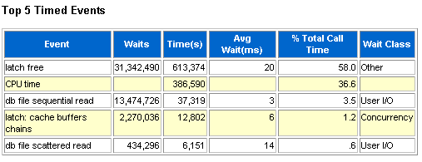
AWR Report
AWR
  Review Automatic Workload Repository(AWR) data
  Establish AWR baselines for different workloads and use AWR diff reports
  Review Top 5 Timed Events section to determine utilization & bottlenecks and review relevant detailed sections for these
Notes:
Here we see an example of a system with a “little” contention !

Slide 82
AWR Report
AWR continued
  For latch (serialization device) related waits
    Latch contention is often a symptom due to a legitimate problem such as non-sharable SQL, sub-optimal SQL which performs full table or full index scans, dynamic object creation/removal, etc.
    Review the latch Statistics section to determine the hot latches
    Trace some waiter and holder sessions to determine actual cause & SQL statements
  For I/O related waits
    Review SQL sections by Logical/Physical reads and the Segment Statistics sections by I/O
  For enqueue related or buffer busy waits
    Review the following sections: enqueue, segment statistics by buffer busy waits, row lock & ITL waits

Slide 83
AWR Report
Link AWR with ASH data
  Map sessions & SQL to main bottlenecks
  Query Active Session History (ASH) data
  Enable tracing for a few of the sessions with heavy waits determine the actual cause and SQL statements.
    For CM, OA and Forms, Trace file identifier is automatically set to the Applications user name: prod11i_ora_2738_BASMITH.trc
  Review the Advisory statistics sections in AWR to fine tune your memory pools
    Buffer cache, Shared Pool, PGA Target, Java, Streams
  Correlate top SQL in AWR to business flows
  Produce and review SQL AWR reports for top SQLs (awrsqrpt.sql)
  Monitor OS Stats (included in 11g AWR)
    CPU and Memory Utilization & Paging, I/O statistics & response times
Notes:
SQL Identification
New SQL_ID is used in place of SQL hash value to uniquely identify SQL statements
Preserved across releases
Allows SQL statement statistics to be easily compared across upgrades.

Slide 84
Common corrective actions to maximize scalability
If bottleneck is IO related...
(db file sequential read, db file scattered read, log file sync, free buffer waits, etc...)
  Tune Top SQL is always the first step
  Maximize Memory availability , allocate generously to buffer cache, review AWR advisories & monitor swapping & paging
  Use ASM or alternatively use the SAME methodology for db files
  IO Sub-system:
    HW RAID 10 still preferred most often for high end requirements Ideal avg. response times of < 10ms.
  Check for excessive/redundant indexing
  Configure async IO, use quick IO technologies

Slide 85
Common corrective actions to maximize scalability
If the bottleneck is concurrency related ...
(enq%, latch%, buffer busy waits, etc )
  Use 10g global hash-partitioned indexes to reduce common index concurrency issues. Start with PK/UK/sequence driven indexes, and identify others via AWR "Top logical IOs by Segment"
  These waits could again be caused by bad SQL execution plans for example :latch: cache buffer chains is many times seen as a result of this..so again, this should be covered first.
  Make sure to use ASSM and OATM tablespace model.
  Increase INITRANS to alleviate ITL contention
  Increase sequence caches
  Work with support and consulting to evaluate if further table/index partitioning will help your specific situation.
  If the program allows, more frequent commits can help by reducing the CR (consistent read) work required

Slide 86
Common corrective actions to maximize scalability
If the bottleneck is RAC related ...
(gc%, global%, etc...)
  First do all the steps mentioned previously...
  Check interconnect configuration -- make sure private network is being used (gv$cluster_interconnects) and use ping/traceroute to validate optimal latency. Use Jumbo frames.
  Do not use parallel query/dml accross nodes (instance_groups & parallel_instance_groups settings)
  Use Parallel Concurrent Processing, using CM rules to minimize the execution of high volume/high frequency DMLs on the same objects concurrently across nodes.
  This would include constraining child requests of a single parent to run in 1 node, as well as grouping heavy dml programs by node based on Application or DML activity to large transaction tables

Slide 87
AWR Reports
Automatic Workload Repository Collects, processes and maintains performance statistics.
Automatically generates snapshots every hour (default)
Results are stored in tables
  Each snap is Identified by a Snapshot_id
Just run the report for the desired time periods
  $ORACLE_HOME/rdbms/admin/awrrpt.sql
  Use html format (has complete SQL statements)
Also can generate snapshots manually
    BEGIN
    DBMS_WORKLOAD_REPOSITORY.CREATE_SNAPSHOT ();
    END;
    /
AWR-SQL Reports (awrsqrpt.sql) can also be run on top SQL observed in AWR reports

Slide 88
Live Review
AWR & AWR SQL Reports

Slide 89
Extras
FND_STATS
CBO Trace (event 10053)
11g SQL Test Case Builder
PL/SQL Profiler from SQL*Plus
Forms Runtime Diagnostics & FRD Analyzer
Reports Trace

Slide 90
FND_STATS
It’s a wrapper around dbms_stats that suits most of the E-Business Suite's requirements.
We recommend using fnd_stats over dbms_stats
If the Gather Schema Statistics concurrent program is used fnd_stats does the bookkeeping for the run. Should the run fail for any reason, the next run of the program starts from where the previous run was stopped. This saves lot of time.
We also recommend fnd_stats because of its support for histograms. Histograms are useful when:
  A table's column is used in an equality or equi-join predicate AND there are skews in the column.
  A table's column is used in a range or like predicate AND there are skews in the column.
  Oracle Applications' data distribution is dependent on the functionality of the specific product modules. Based on our benchmarks, a number of columns are useful for histograms. These columns are listed in the FND_HISTOGRAM_COLS table.
  When Gather Schema Statistics is executed, it reads FND_HISTOGRAM_COLS and builds the histograms.

Slide 91
FND_STATS – Histograms
Please use FND_STATS.LOAD_HISTOGRAM_COLS, histograms can be seeded by calling to fnd_stats.load_histogram_cols. FND_STATS Schema/Table stats will take care of the gathering stats on histograms.
select application_id, APPLICATION_SHORT_NAME from fnd_application where APPLICATION_SHORT_NAME=‘APPLICATION’;
exec FND_STATS.LOAD_HISTOGRAM_COLS ('INSERT',<APPLICATION_ID>,‘<TABLE_NAME>', ‘<COLUMN>');
exec fnd_stats.gather_table_stats(‘OWNER', ‘<TABLE_NAME');
once the histogram is seeded, you can check the histogram entry :
select table_name, column_name from fnd_histogram_cols where table_name= ‘<TABLE_NAME>';

Slide 92
FND_STATS – Concurrent Programs
When gathering the statistics for the entire applications database, we must use the Gather Schema Statistics concurrent program. Only the Gather Schema Statistics and Gather Table Statistics should be used.
Do not use the Gather Column Statistics program. It is obsolete.
There is again no hard and fast rule for the interval between gathering statistics. A general rule-of-thumb is is to run the statistics collection after a 10% increase in the database size.
From 11.5.10 onwards, fnd_stats was enhanced to gather only the statistics for those objects, which have undergone a predefined percentage of data increase, or for objects that have no statistics.
The latest versions of fnd_stats identifies STALE and EMPTY statistics and gather the statistics for those objects only. This saves lot of time and allows sysadmins to set flexible statistics gathering intervals.
Use the Gather Schema/Table Statistics concurrent program regularly. The GATHER AUTO option can be of great help here.

Slide 93
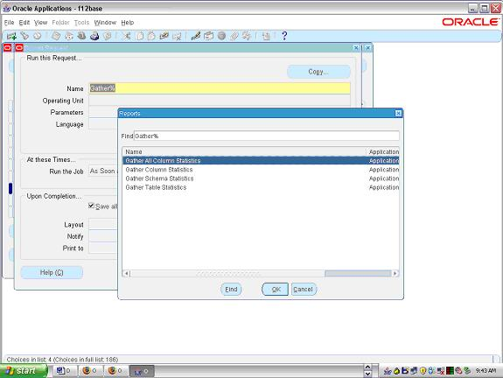

Slide 94
CBO Trace
Details the choices made by the CBO in evaluating the execution path for a query
Shows the costing for each choice considered
Useful when you want to understand why the optimizer made a particular choice
Enabled by setting event 10053 for the session
  alter session set events '10053 trace name context forever, level 1';
SQLT generates this trace for you by default.
NO NEED TO ASK CUSTOMERS TO PROVIDE THIS TRACE UNLESS REQUESTED BY THE PERFORMANCE TEAM

Slide 95
11g SQL Test Case Builder
Usually only needed after it is verified/proven the root cause to be a CBO bug
Will export all dependent objects (not data) and stats, allowing CBO development to import and reproduce the issue internally.
Some outstanding bugs exist, so it is best to simplify the sql as much as possible,while still showing the issue
      sqlplus APPS/APPS
      declare
      tco clob;
      begin
      dbms_sqldiag.export_sql_testcase(directory=>'TCB_DIR_EXP',
      sql_id=>'__SQL_ID__',
      exportData=>FALSE,
      testcase => tco);
      end;

Slide 96
PL/SQL Profiler - Setting it up
Create the DBMS_PROFILER package
  Run $ORACLE_HOME/rdbms/admin/profload.sql in the APPS schema
Create the run-time PL/SQL profiler tables
  Run $ORACLE_HOME/rdbms/admin/proftab.sql in the schema running the application, in our case APPS
  Profiler Tables
    PLSQL_PROFILER_RUNS
    PLSQL_PROFILER_UNITS
    PLSQL_PROFILER_DATA

Slide 97
PL/SQL Profiler - Running the Profiler (Manual)
Execute dbms_profiler.start_profiler(‘<run name>’);
  Starts profiler data collection in session
Execute PL/SQL code to be profiled
Execute dbms_profiler.stop_profiler;
  Flushes data into profiler tables and stops profiler data collection
  Exiting session does not save data automatically
  Profiler data is stored in memory. You can call dbms_profiler.flush_data at various points in your code save incremental data and free memory, if you expect a lot of data to be generated
Notes:
declare
Profiler_Return BINARY_INTEGER;
l_cmt varchar2(100);
l_runid number;
begin
l_cmt := 'opmBatchLayers-'|| &&batch_id1;
Profiler_Return := sys.dbms_profiler.start_profiler(l_cmt);
select max(runid) into l_runid
from PLSQL_PROFILER_RUNS
where RUN_COMMENT = l_cmt;
dbms_output.put_line('PL/SQL Profiler runid: ' || l_runid || '. Use this runid to submit PL/SQL Profiler concurrent program');
REBUILD_11iBATCH_LAYERS.rebuild_layers_main(&&batch_id);
Profiler_Return := sys.dbms_profiler.stop_profiler;
end;
/
undefine batch_id1
undefine batch_id

Slide 98
PL/SQL Profiler – Querying Profiler Data (Manual)
Scripts available at www-apps/performance/utils/profiler
  profsum.sql
    Gives a summary of all the plsql units called in the run
  profdetail.sql
    Gives timing information for each line executed
You can also refer the customer to a script available on Metalink. Refer to Note 243755.1 for details.

Slide 99
PL/SQL Profiler – Sample Output
Unit Owner Name Type Timestamp Total Time¹ Text Header
1 SYS DBMS_PROFILER PACKAGE 25-APR-07 16:48:20 0.00
Body
2 APPS CSD_OM_INTERFACE_PVT Package 25-APR-07 18:11:27 1178.77
body /* $Header: /fluke/CVS.repo/ora_apps/11i/csd/admin/flk_csdvomtb.pls,v 1.1 2005/02/02 06:24:21 eheyman Exp $ */
Line Total Times Executed Text
Time
=============================================
266^{T1} 1176.32 3 FOR C1 in Get_rcv_lines
(p_inventory_org_id, p_subinventory_name
267 LOOP
268 BEGIN

Slide 100
PL/SQL Profiler – Output
Use the profsum.sql to find out the expensive plsql units that were called
Run profdetail.sql for each expensive program unit reported by profsum.sql
Check which lines show high timings and number of executions
If it is unnecessary code, remove it. Otherwise think of cheaper ways of doing the same thing

Slide 101
Forms Runtime Diagnostics
Forms Runtime Diagnostics (FRD) is a runtime event-based logging system intended to aid in the debugging of Forms applications
FRD is enabled at runtime on a user by user basis
Trace file contains chronological representation of external user events and internal Forms processing events
FRD generates extensive output useful for analysis and debugging, and it is therefore recommended FRD be utilized as a logging mechanism only when specific issues are encountered.

Slide 102
Forms Runtime Diagnostics
Events traced by FRD
  Navigation
  Trigger Firing: includes name and location
  Built-in execution (includes name and IN and OUT parameter types and values)
  All external user events
  Messages
  FMX/MMX file opens
  Unhandled exceptions

Slide 103
Forms Runtime Diagnostics
How to enable (R12)
  Refer to Note : 438652.1
  Can use profiles (at user level) :
    “ICX:Forms Launcher”: append : ?record=collect
    “Forms Runtime Parameters” : record=collect
Reproduce the steps that you wish to trace
Exit from the Application completely
Retrieve the trace file from the application server
  Environment variable $FORMS_TRACE_DIR
Analyze the trace file

Slide 104
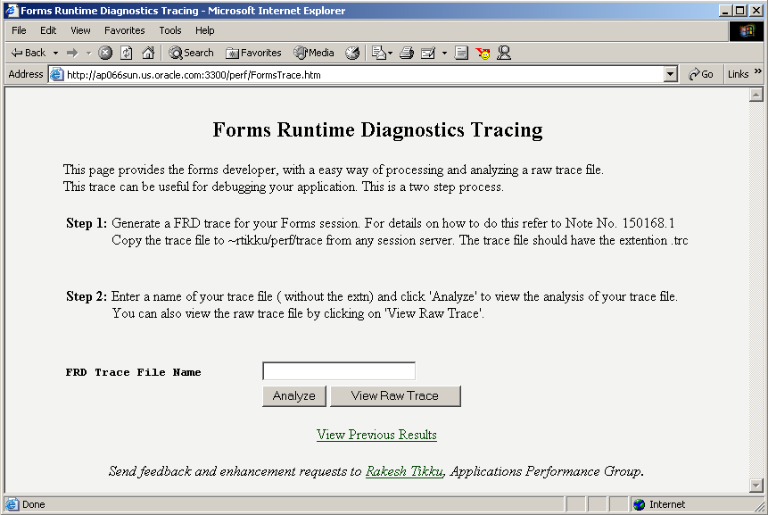
FRD Analyzer
URL : http://perftools.us.oracle.com

Slide 105
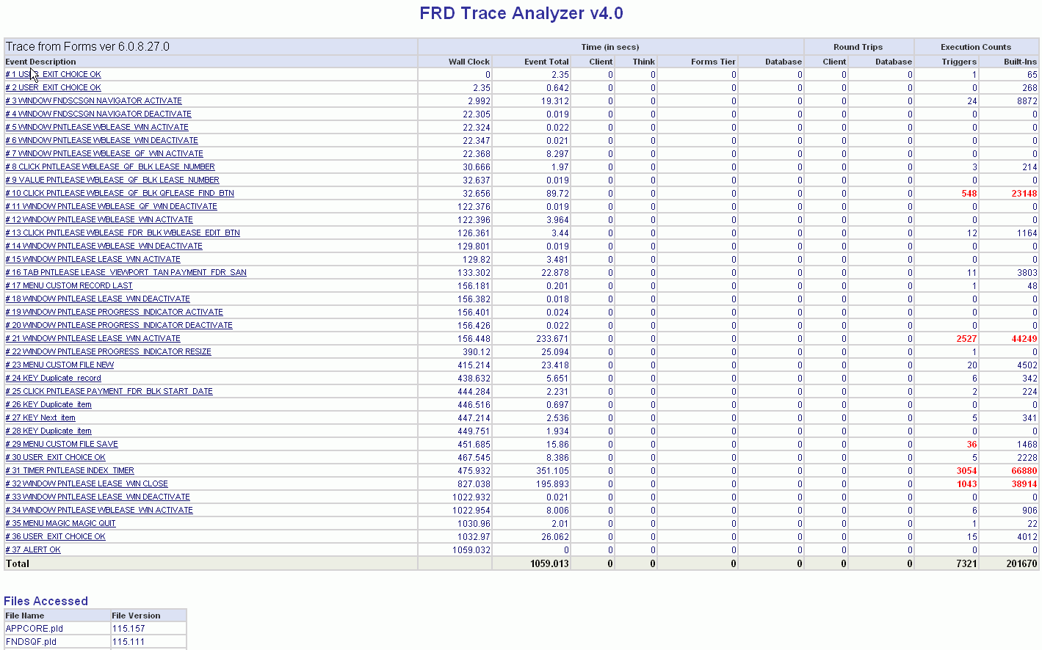
FRD Analyzer

Slide 106
FRD Analyzer
Gives you a list of Internal Forms and User events
Shows the total number of Triggers and Built-ins called
Gives a count of Triggers and Built-ins called during each event
Provides a list of the Triggers and the levels at which they were fired for each event
Provides a list of Built-ins and their input/output arguments for each event
Lets you view the raw trace file too

Slide 107
Reports Tracing
Enabled by appending tracing parameters to command line
  ar60run … … TRACEFILE=<file> TRACE_OPTS=(<trace options>) TRACEMODE=trace_replace|trace_append
  Where trace options can be one or more of the following :
  TRACE_ALL : log all possible trace information in the trace file. (DEFAULT)
  TRACE_APP : log trace information on all the report objects in the trace file.
  TRACE_BRK : list breakpoints in the trace file.
  TRACE_ERR : list error messages and warnings in the trace file.
  TRACE_PLS : log trace information on all the PL/SQL objects in the trace file.
  TRACE_PRF : log performance statistics in the trace file.
  TRACE_SQL : log trace information on all the SQL in the trace file.
  TRACE_TMS : enter a timestamp for each entry in the trace file.
Notes:
Webiv note: 111311.1

Slide 108
Enabling Reports Trace in Apps
Sign-on to Apps with System Administrator responsibility
Go to Concurrent -> Program -> Define
Query up your Reports concurrent program
Locate the “Options” field and enter the following values :
  TRACEOPTS=<trace option> TRACEFILE=<path/file>
Save the concurrent program
Running the concurrent program now will generate the reports trace file as specified by TRACEFILE
Caution : should be performed on the test instance when no other user is Since this involves changes at the report definition level, this operation running this report.

Slide 109
Reports Tracing – Sample Output
LOG :
Report: /u01/CRMPERF/appl/fnd/11.5.0/reports/US/FNDSCURS.rdf
Logged onto server:
Username:
. . . . . . . .
23:59:57 APP ... ( Generic Graphical Object B_SECURITY_GROUP_NAME1
23:59:57 APP ... ) Generic Graphical Object B_SECURITY_GROUP_NAME1
23:59:57 APP ... ( Generic Graphical Object B_USER_NAME1
. . . . . . . .
+-------------------------------------+
| Report Builder Profiler statistics |
+-------------------------------------+
TOTAL ELAPSED Time: 2243.04 seconds
Reports Time: 1196.62 seconds (53.34% of TOTAL)
ORACLE Time: 1046.41 seconds (46.65% of TOTAL)
UPI: 1046.00 seconds
SQL: 0.40 seconds
TOTAL CPU Time used by process: 904.71 seconds

Slide 110
Reports Tracing – Interpretation
From the profile output, it is possible to see :
Execution time (total elapsed time) for the report
Time that was spent on formatting the data (Reports Time)
Time spent in running Reports Triggers, Formula columns, etc.
Time spent for the data to be retrieved (Oracle Time).
UPI time is the time spent in establishing the database connection and parsing and executing the SQL.
The SQL time is the time spent on fetching the data by the database server (percent of time spent executing SRW.DO_SQL() statements, EXEC_SQL statements, PL/SQL Cursors, etc.).

Slide 111
Metalink Note References
216205.1
  Database Initialization Parameters for Oracle Applications 11i
396009.1
  Database Initialization Parameters for Oracle Applications Release 12
174605.1
  bde_chk_cbo.sql - Reports Database Initialization Parameters related to an Apps 12 or 11i instance
244040.1
  Oracle E-Business Suite Recommended Performance Patches
392782.1
  Oracle E-Business Suite System Survey
215187.1
  SQLT

Slide 112
More Tools…
CoE Team:
  http://coe.oraclecorp.com/pls/prod/coe.engineering
Performance Tuning Assistant
  http://unique.us.oracle.com:7777/PTAv3/
Nmon Analyzer
Vmstat Analyzer
Look for other tools in the accompanying ZIP file

Slide 113
Q & A

Slide 114


