Slide 1
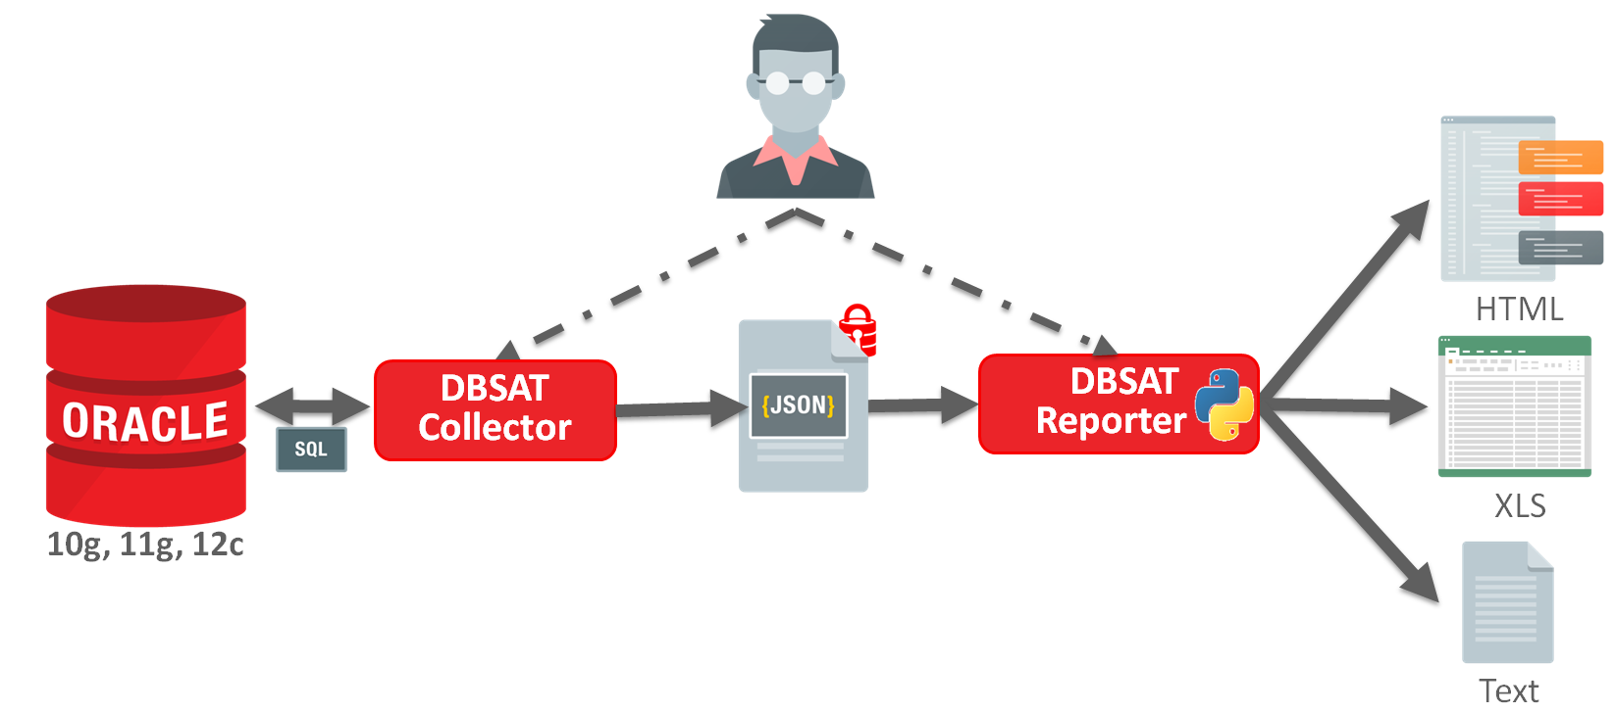
How to get DBSAT and the limited of OS/DB version
Download the dbsat.zip from My Oracle Support
- Doc ID 2138254.1 Oracle Database Security Assessment Tool (DBSAT)
Unzip the file via oracle user
- eg. Linux
1. mkdir –p /home/oracle/dbsat
2. unzip dbsat.zip –d /home/oracle/dbsat
3. cd /home/oracle/dbsat
Exectute DBSAT
- dbsat collect [DBUser/Password] [outputfile]
※output will be compressed into zip file.
OS:
Solaris x64, Solaris SPARC
Linux x86-64
Windows x64
HP UX IA(64bit)
IBM AIX, zSeries Based Linux
Database
Oracle Database 10.2.0.5 above
※The data is get via SQL and host OS commands and Only SQL is required in Windows.

