Slide 2
RWP*Load Simulator
Simulating Load – The RWP way
Bjørn Kisbye Engsig
Oracle Real World Performance Team

Slide 3
Overview
Yet another load simulator?
A small scott/tiger example
Background
What is it?
Typical usage and requirements
Complete examples
Next steps

Slide 4
Yet another load simulator?
Lots of people have ”their own”
Rarely general purpose
Mine was ”spaghetti in C” (rather than ”rapsody in blue”….)
”Real” benchmarking tools are very expensive
Running the full application is mostly not an option
SQL*Plus is too simple

Slide 5
Comparison to similar tools
Swingbench
Does something similar
Is more heavy
Java based
Includes graphical output
Requires Java programming for new ”transactions”
SLOB
Is not general purpose
Focuses on I/O

Slide 6
Small example
Using scott/tiger
Print employees in some department
Example contains basic rwloadsim elements
Declarations of database connection, variables and SQL
Executable code
Calling rwloadsim

Slide 7
A scott/tiger example - declarations
database scott username "scott" password "tiger" default;
integer empno, deptno:=10, numemps:=0;
string ename;
sql selemps
select empno, ename from emp where deptno=:1;
define 1 empno, 2 ename;
bind 1 deptno;
array 10;
end;
Database connection
Some variables
An SQL statement with bind, define, array size

Slide 8
Executable statements
for selemps loop
printline empno, ename;
numemps += 1;
end loop;
if numemps=0 then
printline "No employees in department", deptno;
end if;
Cursor loop
Procedural statements
Conditional code

Slide 9
Calling it
Banner and connect message inspired by SQL*Plus
$ rwloadsim emp.rwl
RWP*Load Simulator Release 2.0.2.75 Beta on Mon Aug 20 01:10:31 2018
Connected scott to:
Oracle Database 12c Enterprise Edition Release 12.2.0.1.0
7782 CLARK
7839 KING
7934 MILLER
$ rwloadsim –q -i deptno:=42 emp.rwl
No employees in department 42
Use a different value for some variable

Slide 10
Background
Benchmarks, POC, etc require repetitive work
Combinations of sql, bash, etc are often OK for D/W
SQL*Plus becomes difficult for oltp (-ish)
Similar issues for BUG triage
Use of session pools requires programming, e.g. Java
High lead time from ”simulate this mix of SQL” until simulation actually works
Non-trivial to inspect and/or plot execution time results

Slide 11
What is RWP*Load Simulator
A tool that supplements sqlplus
Designed for UNIX scripting
Ready to use with scalability tests (1, 2, 4, …. )
Closely does SQL the way Oracle does (e.g. bind variables)
Inherently multi-threaded and with session pool support
Programmable in the ”rwl” language (pronounced ”rawl”)
Contains mix of procedural and declarative logic
Saves execution time results in database tables
Think of it as allowing OCI programming without writing C

Slide 12
What is RWP*Load Simulator NOT?
It is NOT a general programming tool
Is has very limitied input facilities
GUI is neither included nor planned
Output is limited to what is useful in scripting such as:
Gnuplot data files
Excel
Further scripting
Other limitations imposed
Uses OCI, but surely doesn’t have everything

Slide 13
Typical use for e.g. benchmark
A number of SQL scripts to create schema, etc
A number of RWL files that define ”business logic”
This is where most preparation time is likely to be spent
Effectively implements a simplified core application
Some helper RWL files for e.g. awr gathering
Mostly just adoption of exisisting files/scripts
One (or maybe few) shell scripts that run everything
Shell/RWL script(s) to present data as html
Use gnuplot for graphing

Slide 14
Typical requirements
Database systems under test
Preferably separate database for rwloadsim repository
Oracle client environment (11, 12, 18 currently supported) on Linux
Can very well be the same as the database
Rwloasim CPU usage is NOT neglible
Gnuplot is strongly recommended
So X-Windows is needed, but vncserver is absolutely fine
Httpd is strongly recommended to show results

Slide 15
Example 1
Based on the ”connection demo” workload
Shell script with parameters such as
Process count
Thread count
Session pool size
Shell script calls rwloadsim
Little real programming required

Slide 16
Core of shell script
Specify some input parameters
while test $procnumber -le $proccount
do
rwloadsim -i procnumber:=$procnumber \
-i clothreads:=$clothreads -i proccount:=$proccount \
-i poolsize:=$poolsize -i runperiod:=$runperiod \
system.rwl cpustat.rwl \
resultsdb.rwl clouser.rwl clodecl.rwl clorun.rwl &
procnumber=`expr $procnumber + 1`
done
wait
Specify some input files
Start several in background, wait

Slide 17
Core of rwloadsim execution (clorun.rwl)
How many threads?
run
threads threadcount
loop stop runperiod
every runseconds<runperiod/2 ?erlang2(0.2):erlang2(0.1);
doclo();
end loop;
end threads;
end run;
Repeat until when?
At which frequency?
What this really means:
If current timestamp is less than half of the total runtime, execute on average every 0.2s
Otherwise execute on average every 0.1s
Effectively, this implemenens a workload surge halfway through
Do what?

Slide 18
Exctract of declarations; variables, SQL (clodecl.rwl – part 1)
Scalar variables
integer s_sesid;
double g_val, b_val, d_val;
string(100) s_rowid;
sql sel_ses_sql
select rowid from closes where sesid=:1 for update
/
bind 1 s_sesid;
define 1 s_rowid;
end;
SQL text
Binds and defines

Slide 19
Exctract of the procedure (part 2)
Calculate some values
procedure doclo()
s_sesid := tno * pcount + pnum-1 + pcount * tcount
*uniform(1,maxses/(pcount*tcount)-1);
d_seqid := 100000000*(tno * pcount + pnum) + my_loop;
sel_ses_sql;
d_fill := "abc" || uniform(0.0,123456789.0) || "efg";
d_val := erlang2(1.0);
d_sesid := s_sesid;
ins_det_sql;
. . .
Execute some SQL
Some more values and another SQL execution

Slide 20
Exctract of the procedure (part 3)
Conditional execution
. . .
commit;
# do bonus in 10% of the cases
if uniform(0.0,1.0) < bonuspct / 100.0 then
g_sesid := s_sesid;
g_seqid := d_seqid;
g_fill := erlang(1000000.0) || "aaaaa";
g_val := erlang2(25.0);
ins_gam_sql;
. . .
end;
. . .
end; # of doclo
Some more values and another SQL execution

Slide 21
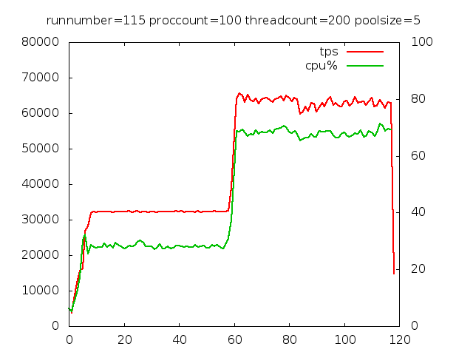
Let’s run it!
Execute the shell script
Starts rwloadsim in loop
Gathers some data
Produces plot
Saves statistics in repository
The small pool deals with the surge
tps
cpu%
Surge happens

Slide 22
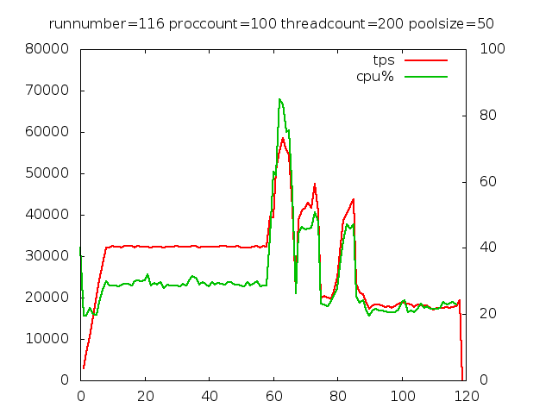
Another run
Surge happens
Ten times larger session pool
As expected, much worse performance after the workload surge with the large pool

Slide 23
Let’s run it!
Execute the shell script
Starts rwloadsim in loop
Gathers some data
Produces plot
Saves statistics in repository
The small pool deals with the surge
tps
cpu
Surge happens

Slide 24
Another run
Ten times larger session pool
As expected, much worse performance after the workload surge with the large pool
Surge happens

Slide 25
Procedural elements of rwloadsim
Integer, double and string data types, some CLOB support
Files for writing output
Here used for data files for gnuplot
Can also be used to create awr reports
Expressions include elements from C (e.g. ? : ) and SQL (between , ||, is null)
Data types can be mixed in expressions (e.g. 2||”abc”)
Several ways to generate random data: uniform, erlang, etc

Slide 26
Procedures and functions
Procedures and function can be delcared
Can take arguments
Can have local variables
Stack allowing recursive calls
Typical procedural logic
if/then/else, while
for .. loops like PL/SQL
cursor loops
Control loops simulating e.g. random arrival time

Slide 27
SQL processing
Bind and/or define very similar to OCI or DBMS_SQL
Supports queries, dml, ddl and PL/SQL blocks
Parse/execute and cursor cache can be controlled
Array fetch via OCI
Automatic array dml without programming
Direct connections, session pools, DRCP
Ramp up possible to avoid connection storms

Slide 28
Statistics repository
Gathered statistics
Overall counts and times for each procedure
Per second execution counts; flushable to support progress bars
Histograms of execution times
Possible use
Plotting via gnuplot or Excel
Queries such as execution time percentiles
Repository database separate from execution database
Repository designed to be shared between many tests

Slide 29
Example 2 – mixed workload
Simulates a very simplified ”order entry” system
Three ”business processes”:
Create an order with a random number of order lines
Select an order and its order lines
Execute a complex SQL statement against a range or orders
A run simulates a certain mix of these three

Slide 30
Exctract of declarations – SQL to insert order head
Declare a SQL statement
sql insordsql
insert into rwl_demo_ord
( ordno, b, pl, c )
values
( rwl_demo_ordno.nextval
, :b, :pl, :c)
returning ordno into :ordno
/
bind ":b" b, ":pl" pl, ":c" c;
bindout ":ordno" ordno ;
end;
Binds can be by name
Use bindout for the returning clause

Slide 31
Exctract of declarations – SQL to insert order line
sql inslinsql
insert into rwl_demo_lin
( ordno, linno, e, pl, refno)
values (:ordno, :linno, :e, :pl, :refno)
/
# binds plus array size
bind ":ordno" ordno;
bind ":pl" pl;
bind ":e" e;
bind ":linno" linno;
bind ":refno" refno ;
array 5;
end;
The array will be implicitly created and used

Slide 32
Exctract of declarations – Procedure to create an order
Fill values and insert the order header
procedure insorder()
b := uniform(0, 100);
. . .
insordsql;
max := uniform(1,10);
for linno := 1 .. max loop
. . .
inslinsql;
end;
commit;
end;
Array implicitly flushed when full
Commit always flushes

Slide 33
Exctract of declarations – Cursor loops
Variable to track execution count
integer threads sum ordcount := 0;
sql selordsql . . . end;
sql sellinsql
select . . from rwl_demo_lin where ordno=:1 order by linno;
bind . . . ; define . . . ;
array 10;
end;
procedure selorder()
ordcount:=ordcount+1;
selordsql;
for sellinsql loop
lincount:=lincount+1;
end;
end;
Cursor loop with array fetch

Slide 34
Core of rwloadsim execution
Pick a random procedure with some probability
random procedure array doeither
( insorder 25, selorder 65, qcomplex 10);
run
# Start a number of real worker threads
threads thrcount at demouser # Use this database
loop doeither() # executing this
every erlang2(0.05)
stop totaltime;
doeither();
end loop;
end threads;
end run;
Random execution

Slide 35
Running it all…
rwloadsim -sss awr.rwl rwloadsim.rwl demouser.rwl \ insertdemo.rwl querydemo.rwl runsimulation.rwl
RWP*Load Simulator Release 1.0.2 Beta on Oct 9 14:10 2017
Created demouser as session pool to:
Oracle Database 12c EE Extreme Perf Release 12.1.0.2.0
created 1513 orders with 8262 order lines in total
selected 3728 orders with 20436 order lines in total
runnumber: 120
Very useful debug output

Slide 36
Thread handling
Worker threads are fully independent
No mutex taken (except by OCI itself)
Variables are local to each thread
No race condition risk
Thread summary variables
integer threads sum ordcount:=0;
double threads sum something:=0.0;
These are summed after threads terminate
Very useful for reporting, etc.

Slide 37
Goodies
Supports CLOB (not piecewise)
Support for dealing with multi-process runs as a single execution
Actual start of all threads/processes can be coordinated
Results saved per process; aggregate views available
No inter process communication – hence no race condition risk
Also allows multi host
One results repository fine for completely different tests
Hostname saved
User defined key can e.g. be used for grouping, aggregates

Slide 38
Some more goodies
Graceful and mostly fast CTRL-C termination
Can write to pipelines (like writing to files)
NULL dealt with similar to Oracle
Extensive error handling
Includes an ”RWL-600” for programming errors
Allows modular programming
Global, private, local variables
Include files (like @ in SQL*Plus)

Slide 39
Some repository queries
SQL >select * from runres where runnumber=120;
RUNNUMBER VNAME WTIME ETIME ECOUNT
---------- ---------- ----- ------ ----------
120 insorder 0.03 1.85 1513
120 qcomplex 0.39 11.31 622
120 selorder 0.08 4.40 3749
counts
Total wait time to acquire session
Total database execution time

Slide 40
Some repository queries
SQL >select vname, wtime/ecount avgw
2 , etime/ecount avge
3 from runres where runnumber=120
4 order by vname
5 /
VNAME AVGW AVGE
---------- --------- ---------
insorder 0.000022 0.001222
qcomplex 0.000621 0.018185
selorder 0.000022 0.001174

Slide 41
Some repository queries
select vname,bucktim,bcount from histogram where runnumber=120
VNAME BUCKTIM BCOUNT
---------- --------- ----------
insorder 0.000977 714
insorder 0.001953 772
insorder 0.003906 2
qcomplex 0.000977 13
...
qcomplex 0.125000 16
qcomplex 0.500000 1
selorder 0.000977 1740
selorder 0.001953 2138
selorder 0.500000 4
772 insorder in time interval [0.98ms;1.95ms]
4 selorder in time interval [0.25s;0.50s]

Slide 42
Status, downloads, etc
Current release is 2.0.10 Limited Production
64 bit Linux release thouroughly tested
SPARC Solarais can be made available
Documentation and download
https://confluence.oraclecorp.com/confluence/display/RWP/RWP*Load+Simulator
Immediate next steps:
Much more testing needed
Feedback highly wanted!

Slide 43
How was it done
Evolved from my previous ones:
”loadgen” (single threaded, one database only, 2007-2010)
”loadthr” (multi threaded, multiple databases, pooling, 2010-2017)
Uses ”oracle types” thoughout (ub4, sb2, sb8, etc)
OCI for database access and threading
Lexical scanner written in flex; parser written using bison
Evolved as my side project during the last year or so
Comments in code, but real programming documentation still in its early stages
Currently about 18k source lines plus 5k lines of tests

Slide 44
Some future ideas
Database usage
Currently too static
Sharding support
Data types
More complete CLOB
RAW, BLOB
Programming
string functions (length, substr)
more procedural logic

Slide 45
More future ideas
Smarter input
reading files
Bad behavior simulation
cursor leak
session leak
Improved documentation

Slide 46
Next steps
Where does it go from here?
RWP only?
Oracle?
Public?
Distribution?
Swingbench model?
Public domain, git?

