Slide 1
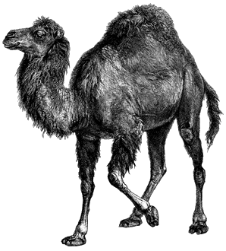
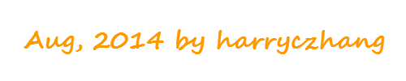
Learn Perl in
2-hours

Slide 2

PREFACE
What
Who

Slide 3


HELLO
VARIABLE
REFERENCE
SCOPE
QUIZ
MORE
AGENDA
REFERENCES

Slide 4
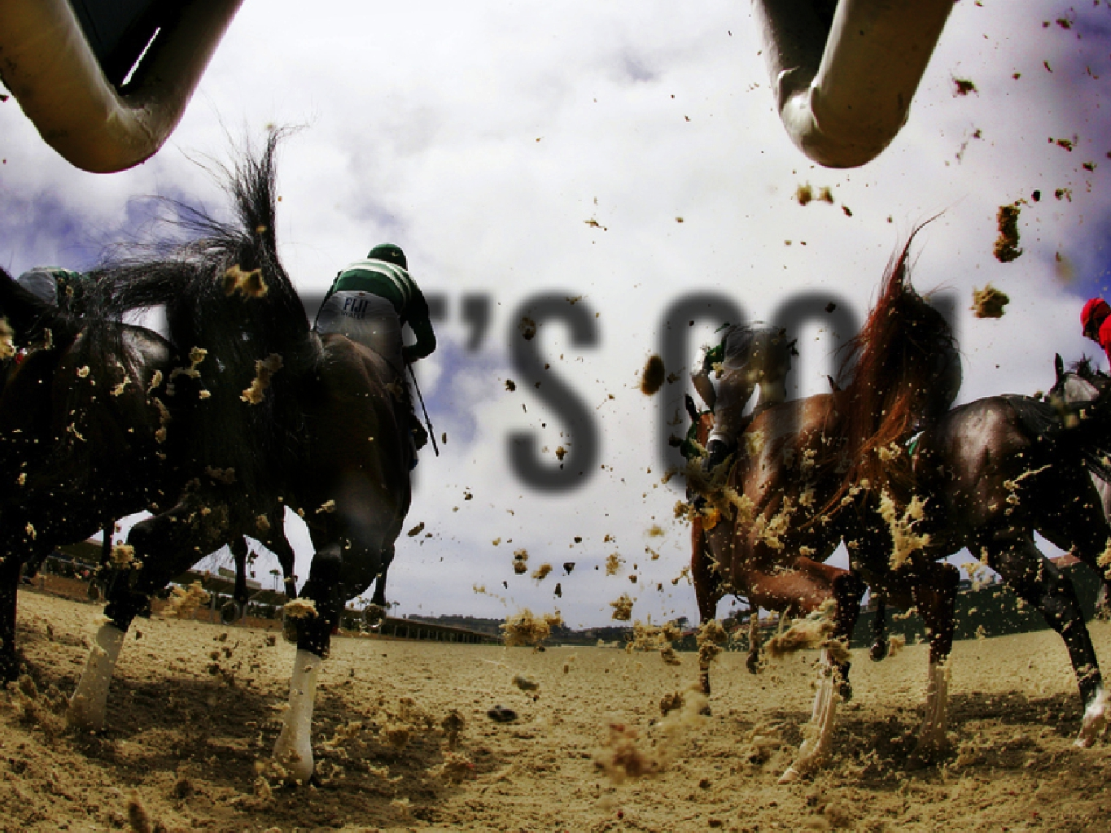

LEt’sgo!

Slide 5
HELLO WORLD? NO!
Fibonacci sequence [1, 1, 2, 3, 5, 8...]
Read input from user, loop until EOF
Do valid check for user input
Print welcome info, as well as fib nums
Encapsulate to functions for re-usage
Analyze complexity and make it visible
Optimize it

Slide 6
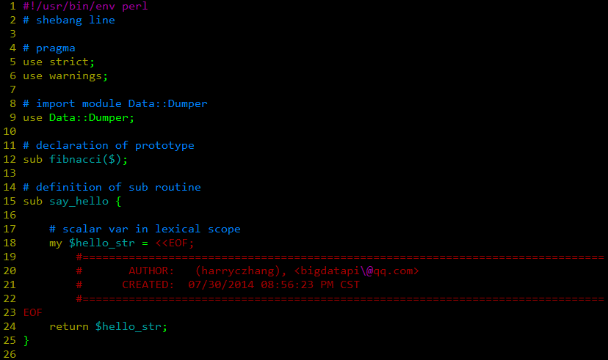

Slide 7
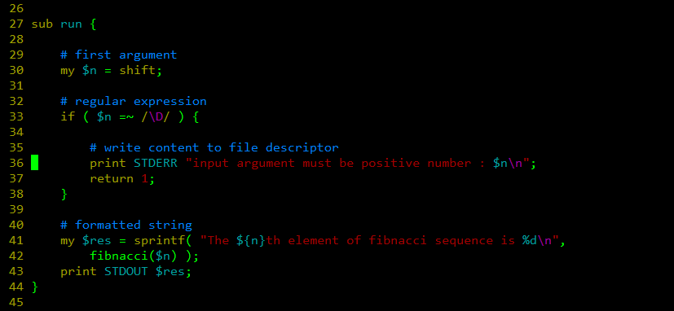

Slide 8
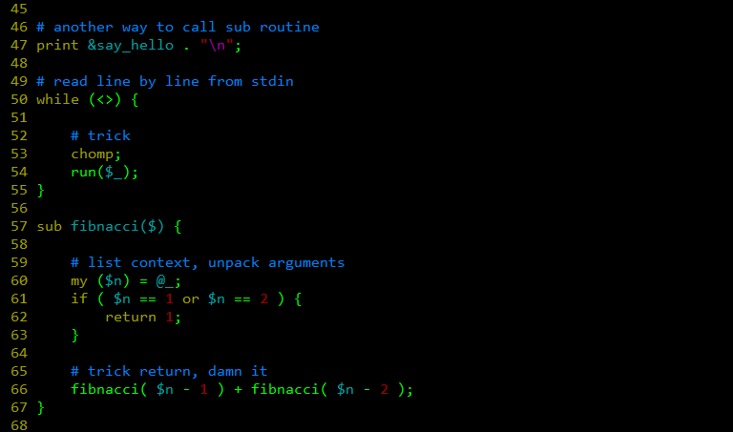

Slide 9
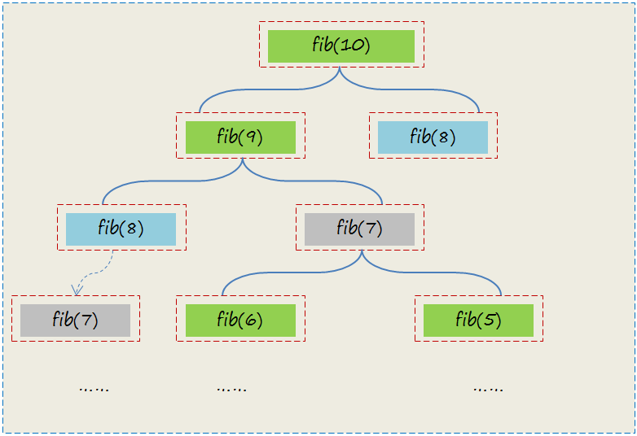

Slide 10
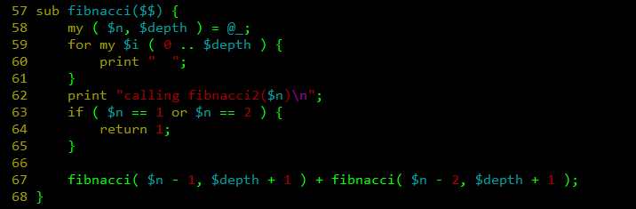
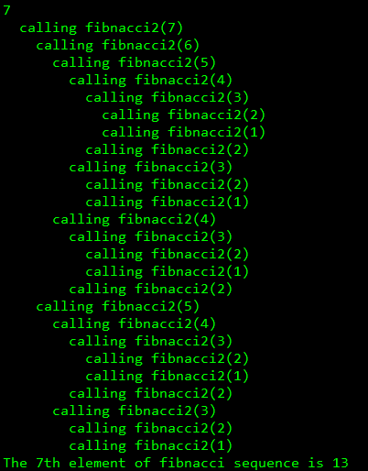

Slide 11
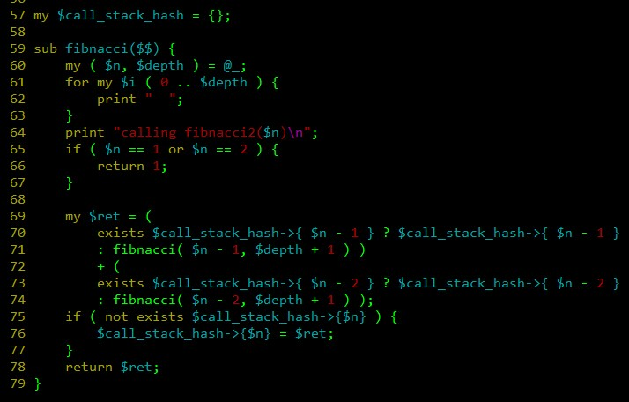
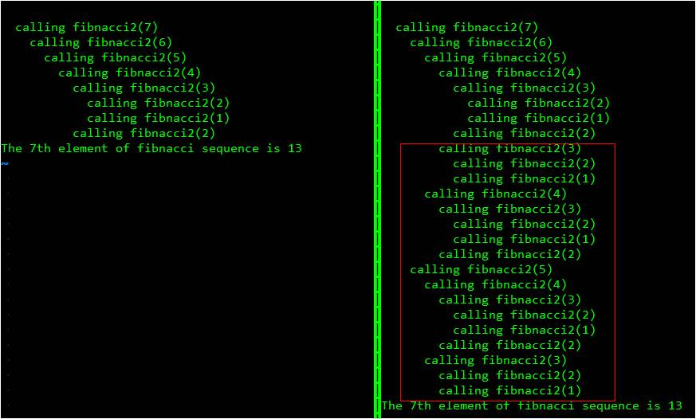

Slide 12
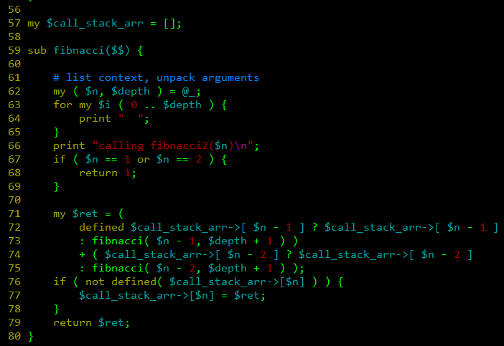

Slide 13

runnable script(shebang/pragma/syntanx)
variable (scalar array hash)
prototype (sub fibnacci($$))
recursion (sub fibnacci)
basic IO (print)
expression
statement
container (hash array)
reference (anonymous array / hash)

Slide 14
VARIABLE
Scalar
Array
Hash
Type Glob

Slide 15
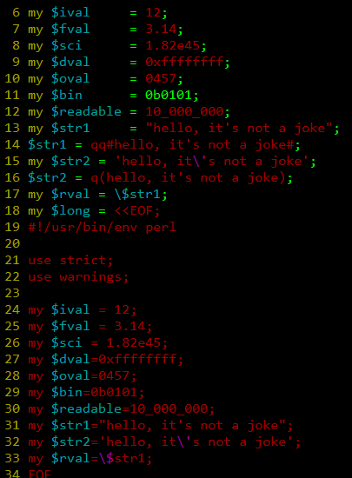
Scalar

Slide 16
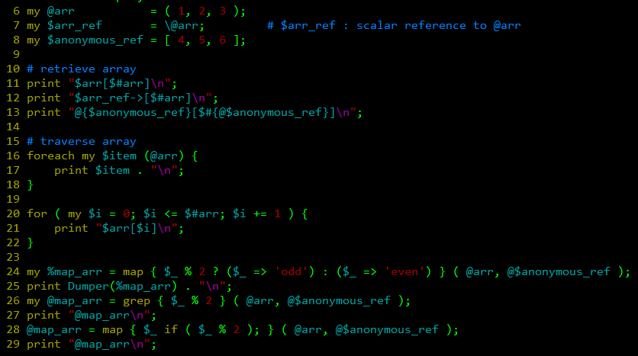
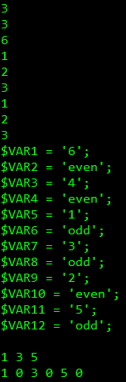
Array

Slide 17
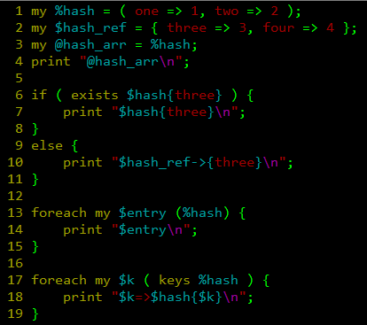
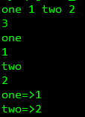
Hash

Slide 18
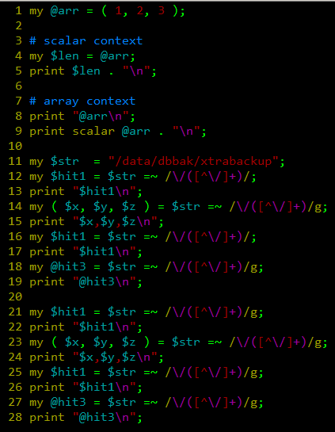
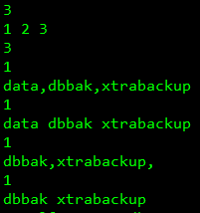
Context

Slide 19
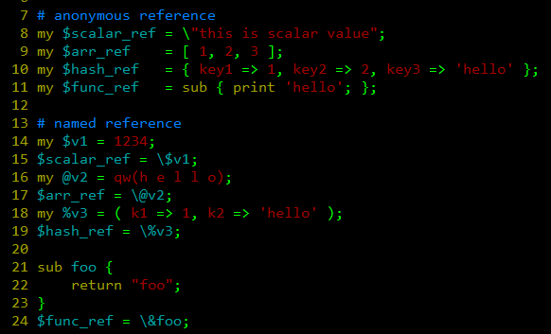
Reference

Slide 20
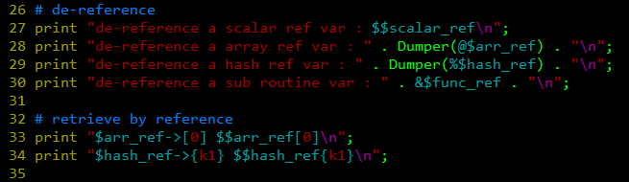
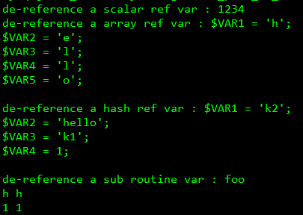
Reference

Slide 21
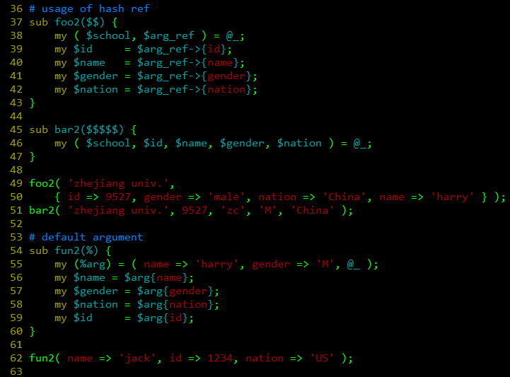
Reference

Slide 22
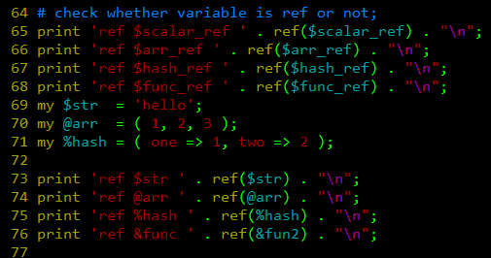
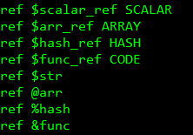
Reference

Slide 23

SCOPE
Symbol Table (%main:: | %::)
Lexical Scoping (my)
Dynamic Scoping (local)
Package Scoping (our)

Slide 24
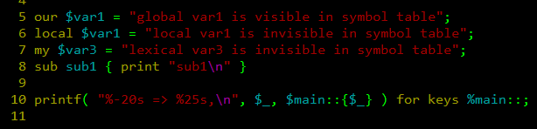
SCOPE

Slide 25
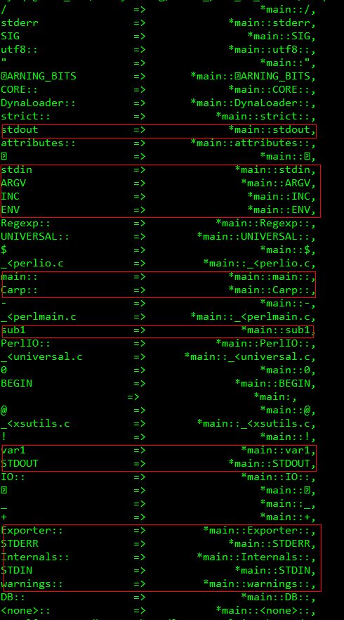
SCOPE

Slide 26
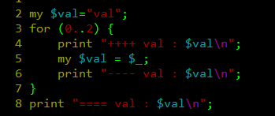
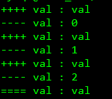
SCOPE

Slide 27
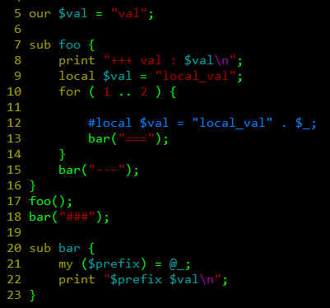
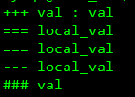
SCOPE

Slide 28
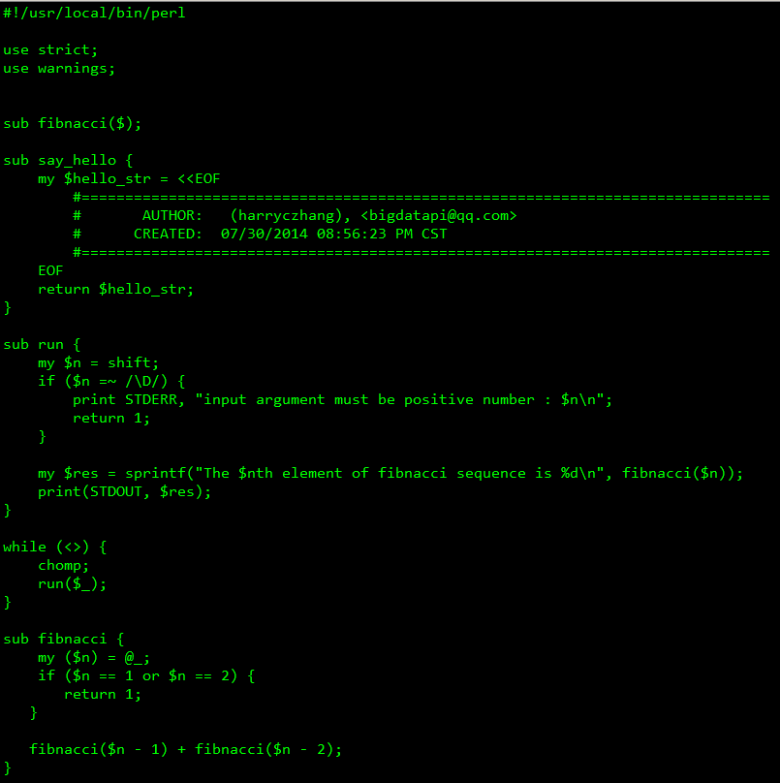
QUIZ

Slide 29
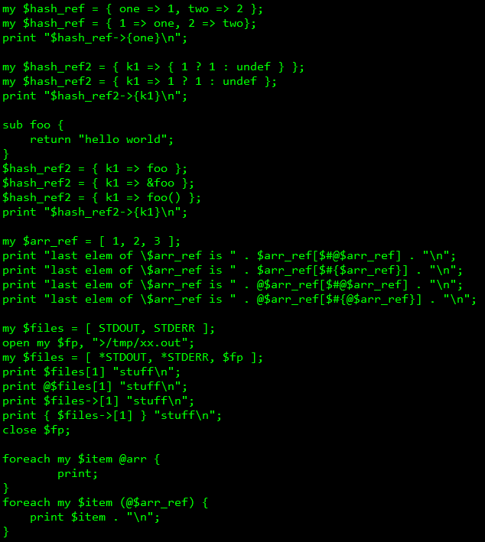
QUIZ

Slide 30
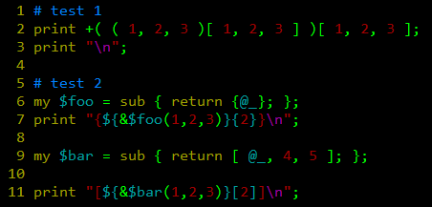

QUIZ

Slide 31
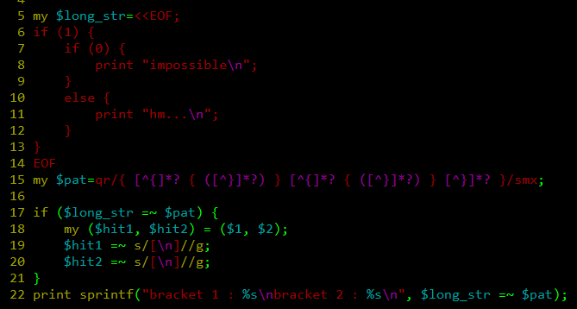
QUIZ

Slide 32

More
Module (.pm)
OOP
Regular Expression
More Lib (CPAN)
Tools (perltidy log4perl perlbrew a2p/s2p find2perl, etc)
Moose
Design Patterns
Web Framework (mojo catalyst dancer, etc)

Slide 33
References
- Learning Perl in 6th Edition by Randal L. Schwartz
Developing Web Applications with Perl, memcached, MySQL and Apache by Patrict Galbraith
http://perlhacks.com/about/

Slide 34


Slide 35
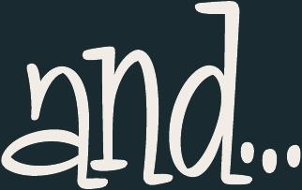

Slide 36



Slide 37
JUSTTRY.

Slide 38

Sources Download Here:
https://github.com/bigdatapi/learn_perl_in_2hours
Contact@Me:
bigdatapi@qq.com
bigdatapi.com

