Slide 1

Session 4
Using external API’s

Slide 2
Session Outline
What is an API?
What is Mailgun?
Getting the grips of Mailgun
Getting data from API's

Slide 3
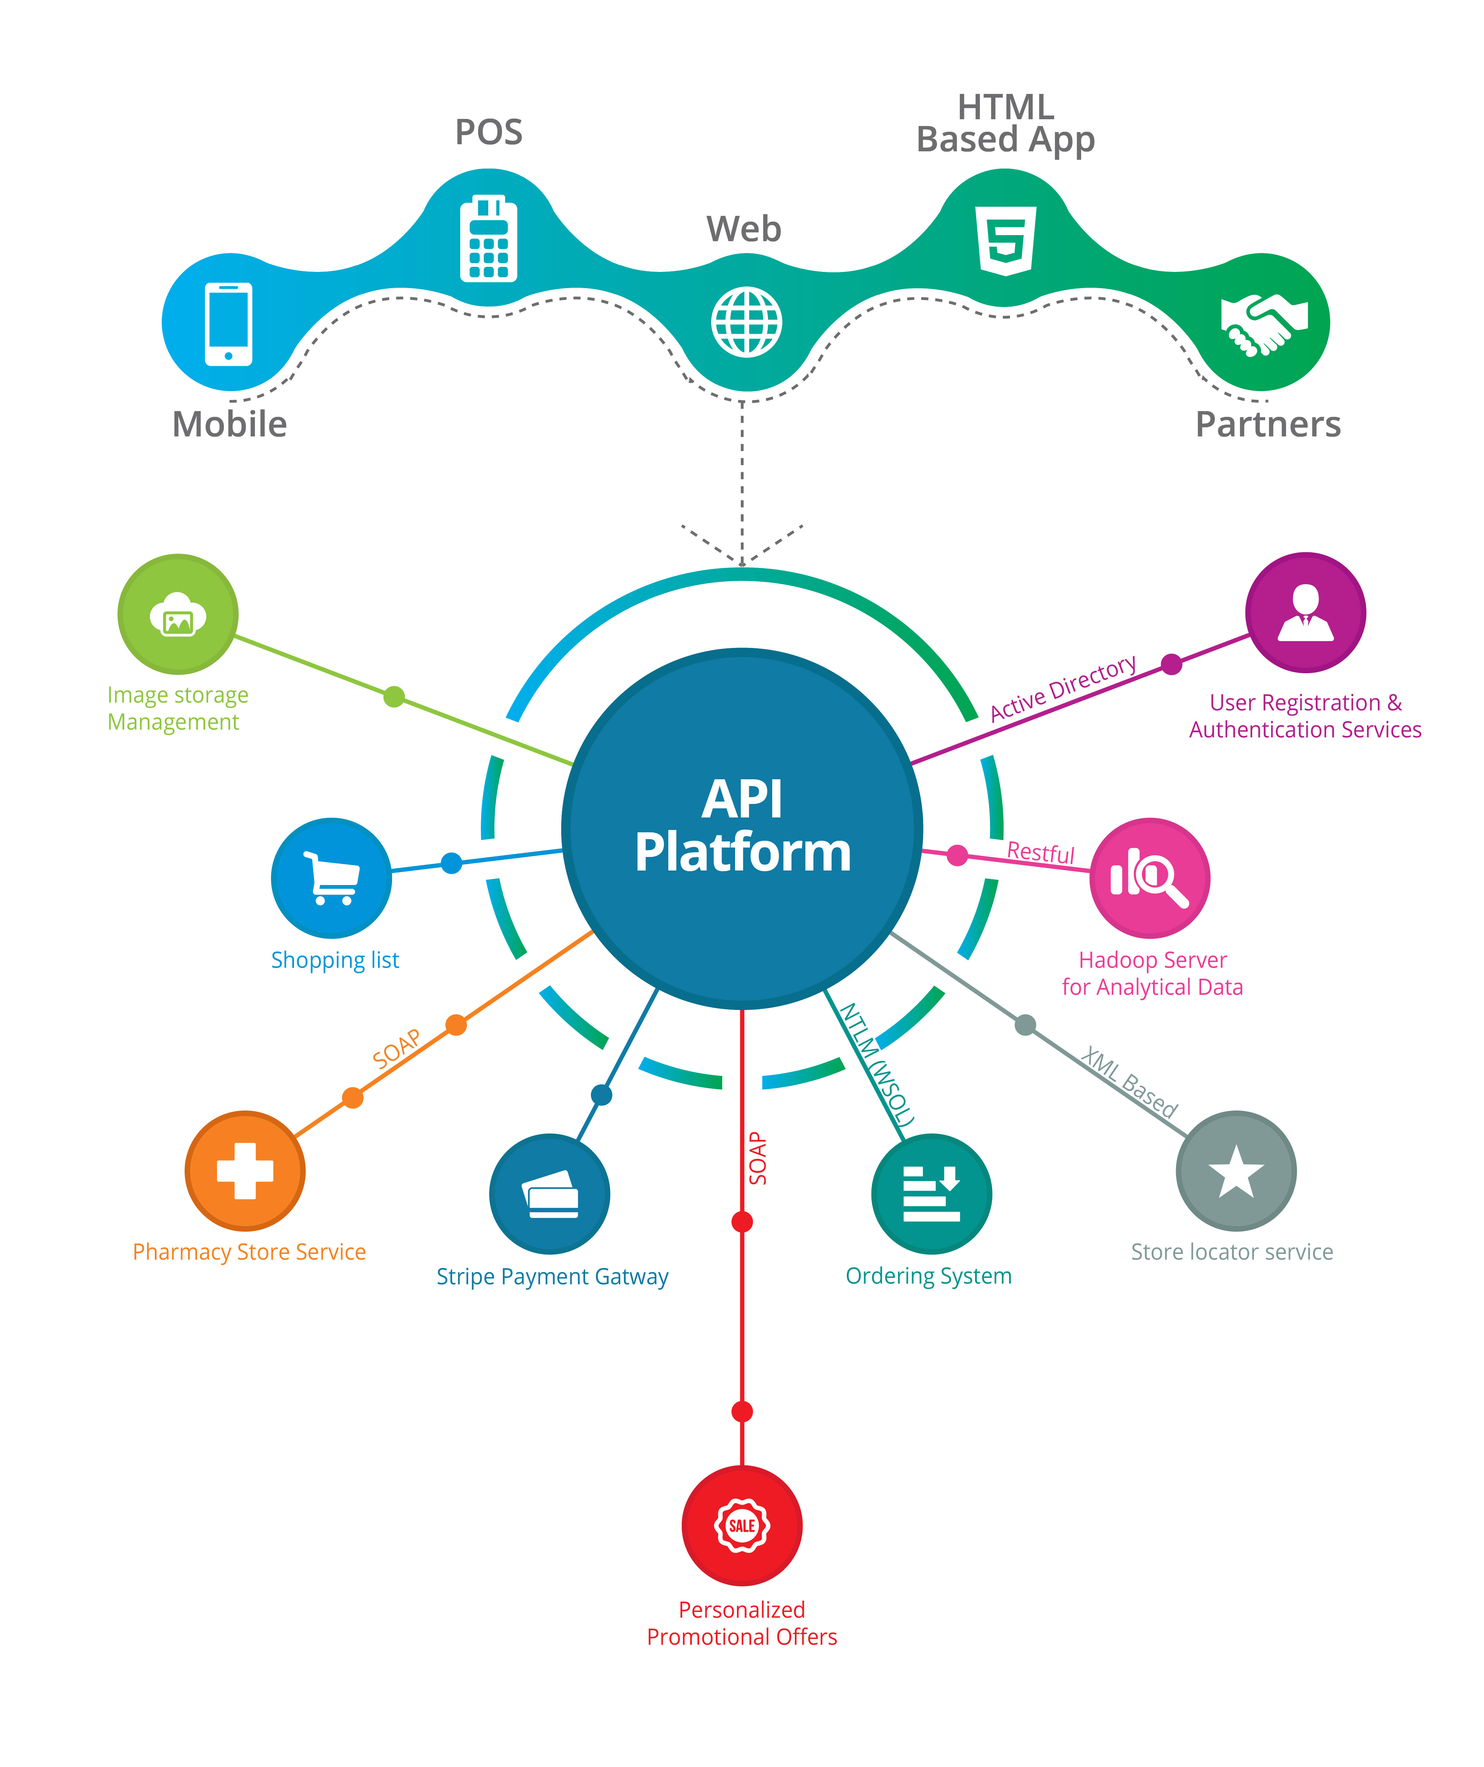
What is an API?
Application Programming Interfaces
But what do they do?
They allow your product or service to talk to another product or service
https://youtu.be/s7wmiS2mSXY

Slide 4
Mailgun
It allows us to receive and track emails
Enables us to send emails programmatically (10 K free emails per month)
How could it be used?
Imagine you build a website you might want to
Capture the emails address of people interested in your product
Communicate with the people
Send monthly/weekly newsletters….

Slide 5
From session 3
Capture a user’s name and email address
Learn GET/POST
In this session
Use the acquired data to send them an e-mail

Slide 6
Getting started
We need to make sure we have the requests library, so from your command line type:
Get a Mailgun account from https://mailgun.com/signup … and activate your account.
Note you will need your phone number to do so!
pip install requests

Slide 7
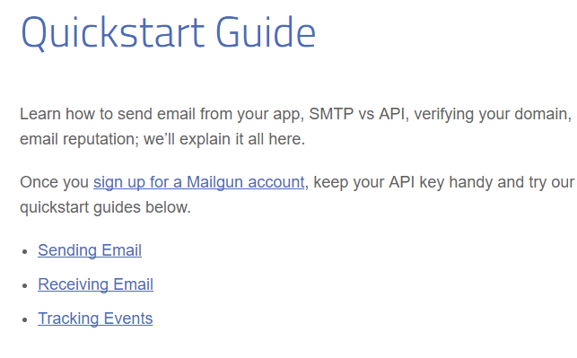
Using MailGun
Documentation page
https://documentation.mailgun.com/
Make sure you select Python

Slide 8
Locate your Key and domain
On your dashboard:
Find and copy your API (starts with sandbox)
Find and copy your key
Create `keys.py` with your details:
key = ‘’
Sandbox = ‘’

Slide 9
Now we will learn to:
Send a basic email
Tracking email delivery
All the material is located in
https://github.com/trallard/CodeFirst-Python_material.git

Slide 10
A few more things!
Go to https://documentation.mailgun.com/api-sending.html#sending
Can you figure out how to:
Send email with HTML content?
Attach files?
Send the email at a specific time (queue)?

Slide 11
Hands on time
Integrate the previous code in the context of your Flask app
Create a form to take the user name and address
Add a POST request to your Flask app and access the submitted values
Use the request library to trigger an e-mail send to that user, set your own email as the sender

Slide 12
Using API's to request data
We will be using the OpenWeatherMap:
http://openweathermap.org/current
You need to create an API key so that you can access the data, for this lesson you can use mine
"84600bca7507293656495e8972aec659"

Slide 13
Requesting data
The basic elements you need:
API ID
City you want the data for
The requests library
# our variables
api_id = "84600bca7507293656495e8972aec659"
city_id= "London" # Search for your city ID here: http://bulk.openweathermap.org/sample/city.list.json.g
mode = "json" #html, json, xml
unit = 'metric' # For Fahrenheit use imperial, for Celsius use metric, and the default is Kelvin.

Slide 14
Enter the following url in your web browser:
api.openweathermap.org/data/2.5/weather?q=London

Slide 15
Hands on
Obtain the weather for different cities using the script provided
Modify the script such that the user can input a city and gets the weather conditions displayed in the terminal
Use your knowledge to use The Giphy API ( https://api.giphy.com) to get the first GIF returned from doing a search for a user's favorite animal

Slide 16
Using Twitter API
Create a twitter account (make sure to add your phone number)
Now create a Twitter developer account at https://dev.twitter.com/index
Make sure you have Tweepy. Type the following in your terminal:
pip install tweepy

Slide 17
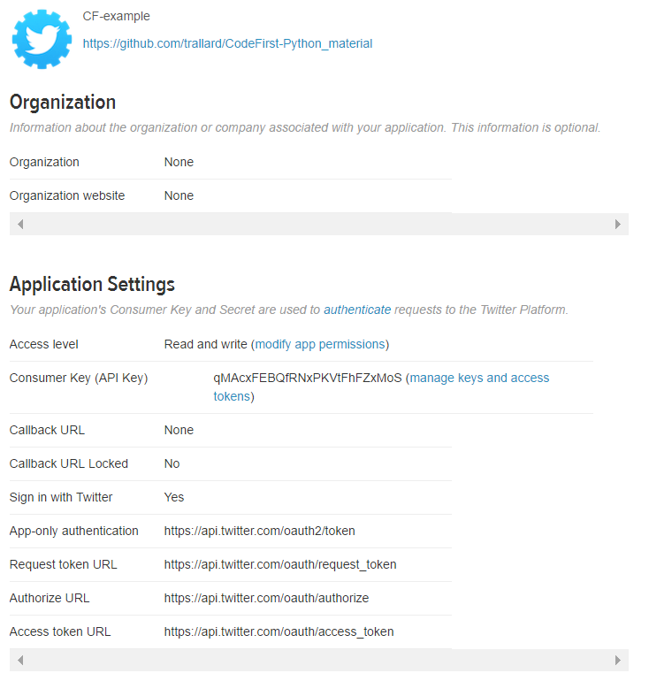
Creating an app
Login to your Twitter developer account and click on My apps then on create a new app
Once created make sure you have write and read permissions
Create your access token

Slide 18
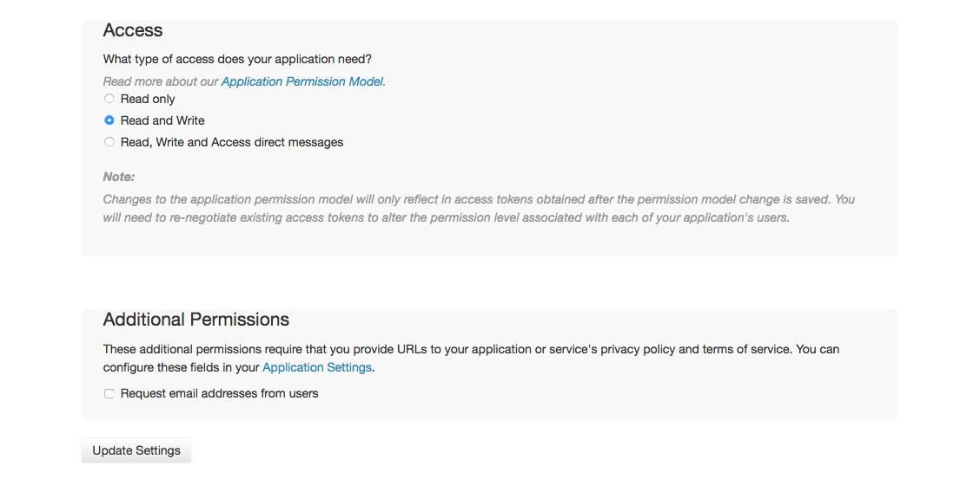
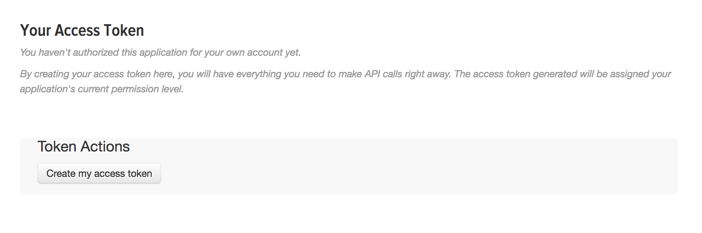

Slide 19
Now let’s create our script
As in the Mailgun examples it might be useful to save your keys in a separate file (e.g. twitter_keys.py)
consumer_key =‘’
consumer_secret =‘’
access_token = ‘’
Access_token_sec =‘’

Slide 20
Look at your local copy of the CF python repository and locate the “Twitter” folder, we will use the base scripts provided to:
Collect tweets from your timeline
Search for tweets containing a key word / hashtag
Tweet using Python
Extras:
Using Python get a list of the Code First girls twitter account

