Slide 1

BSD Packet Filter (PF)
David Liana
dliana@frontiernet.net
http://thelinuxgeek.org

Slide 2
BSD Packet Filter (PF)
“PF (Packet Filter, also written pf) is a BSD licensed stateful packet filter, a central piece of software for firewalling. It is comparable to iptables, ipfw and ipfilter. PF is developed on OpenBSD, but has been ported to many other operating systems including Mac OS 10.7 ‘Lion’, FreeBSD, NetBSD, DragonFly BSD and Debian GNU/kFreeBSD.” -- from Wikipedia

Slide 3
Features
Bandwith Queues
Wireless Authentication (WPA, WEP, user auth)
Network address translation (NAT)
IPv6
DMZ
Fail over / Redundancy
Integration with spam filters

Slide 4
Rules
Rules file: /etc/pf.conf
Pf reads rules top to bottom, the last rule in a rule set that matches a packet or connection is the one that is applied
Macros – a list, improves readability
Tables

Slide 5
Basic Rule Set
tcp_services=”{ domain www https }”
udp_services=”{ domain }”
block all
pass out proto to port $tcp_services
pass proto udp to port $udp_services

Slide 6
NAT Gateway
int_if="re0"
ext_if="re1"
localnet = $int_if:network
match out on $ext_if from $localnet nat-to ($ext_if)
block all
pass out from { lo0, $localnet, $ext_if }
pass in from { lo0, $localnet }

Slide 7
Logging
Syslog
Systat
Pftop
Pfstat
Pflow
Pfflowd
Can set up SNMP

Slide 8
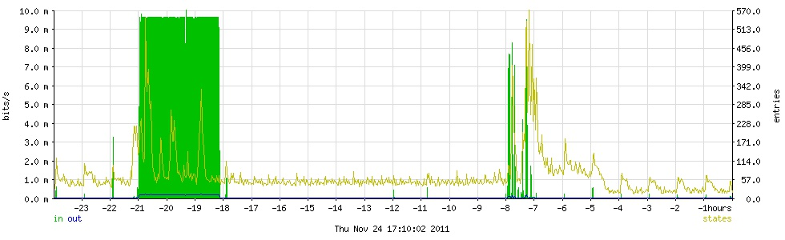
Pfstat Graph

Slide 9
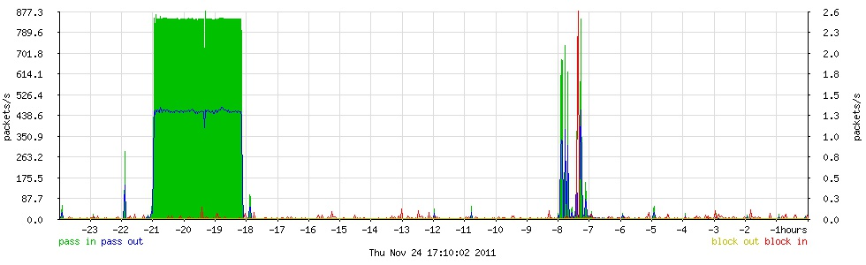
Pfstat Graph

Slide 10
PF Sense
Free BSD
Additional software
Web based interface for configuration

Slide 11
Resources
Book of PF, 2nd Edition by by Peter N.M. Hansteen
PF FAQ: http://www.openbsd.org/faq/pf

Slide 12
Questions?

