Slide 1

Chronic Kidney Disease
Alberto Ramos
Jonathan Gilbert
Hemangi Shah
Priya Balasubramanian

Slide 2
TABLE OF CONTENTS
Introduction Project overview
Data Analysis Data cleaning and preprocessing
Coding Approach
Machine Learning Steps
Conclusion

Slide 3
OVERVIEW
Chronic kidney disease (CKD) is an increasing medical issue that declines the productivity of renal capacities and subsequently damages the kidneys.
The objective of the dataset is to diagnostically predict whether a patient is having chronic kidney disease or not, based on certain diagnostic measurements included in the dataset.
There are 400 rows with 25 features (eg, red blood cell count, white blood cell count, etc). The target is the 'classification', which is either 'ckd' or 'notckd' - ckd=chronic kidney disease.
Logistic regression is a statistical method used to model the relationship between a dependent variable (also known as the target variable) and one or more independent variables (also known as features). The goal of logistic regression is to find the best-fitting straight line (or hyperplane in higher dimensions) that predicts the dependent variable based on the values of the independent variables.
It is widely used in various fields for predictive modeling and is a foundational concept in statistics and machine learning.

Slide 4
DATASET
Size of dataset : 44.58 kB
Content: The data was taken in 2015 over a 2-month period in India with 25 features ( e.g., red blood cell count, white blood cell count, etc). The target is the 'classification', which is either 'ckd' or 'notckd' - ckd=chronic kidney disease.
Number of records: 400 rows
Number of columns: 26 columns
Key Features
This dataset consists of several medical predictor variables and one target variable, Class. Predictor variables includes Blood Pressure(Bp), Albumin(Al), etc.
The datasets consist of several medical predictor (independent) variables and one target (dependent) variable, Class.
Source
https://www.kaggle.com/code/niteshyadav3103/chronic-kidney-disease-prediction-98-accuracy/input

Slide 5
DATA - ANALYSIS

Slide 6
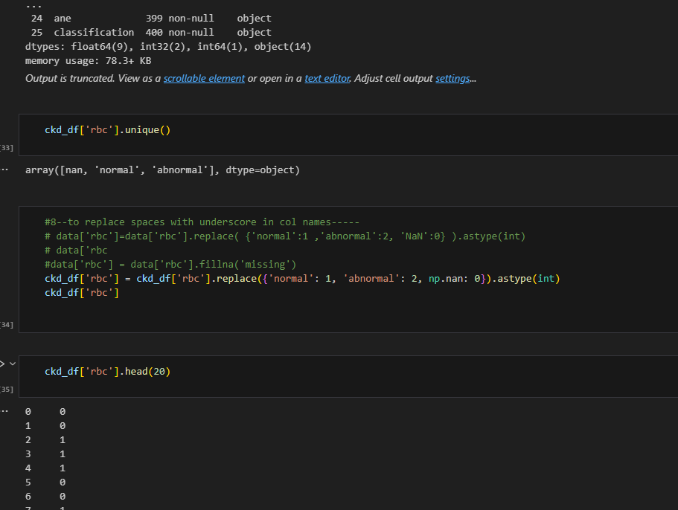
Data Cleaning & Pre Processing
Handling Missing Data: By filling in missing values with the mean of that column and replacing NaN with 0 ensures that the dataset remains intact and usable for further analysis.
Encoding categorical data and facilitating model training :This dataset is intended for predictive modelling encoding categorical variables like ‘rbc’ in to numerical format, which is essential for machine learning algorithms that require numerical input which allows the model to understand and utilize the information effectively.

Slide 7
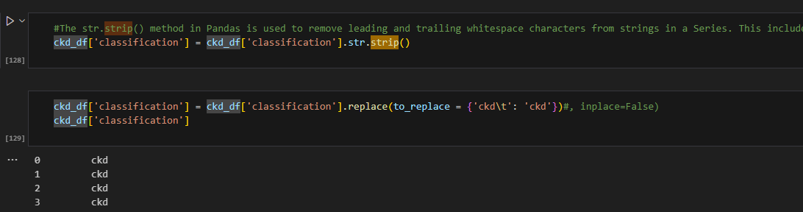
Data Cleaning & Pre Processing
Facilitating Data Operations: .str.strip(): This method removes any leading and trailing whitespace characters from the strings in the 'classification' column.
Cleaned string data allows for more effective operations, such as comparisons, merges, or aggregations, without the risk of errors due to unexpected whitespace.
Data Preparation for Analysis: This transformation prepares the data for further analysis or modelling allowing for easier interpretation and computation of results.

Slide 8
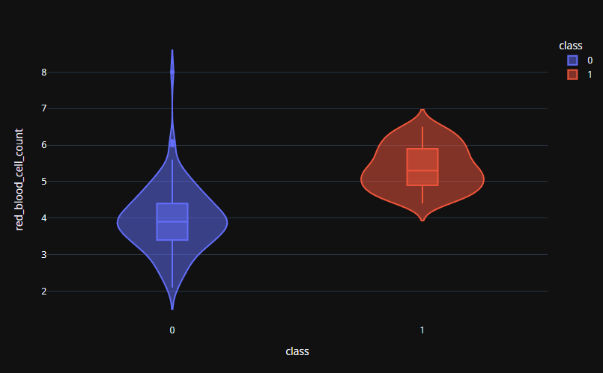
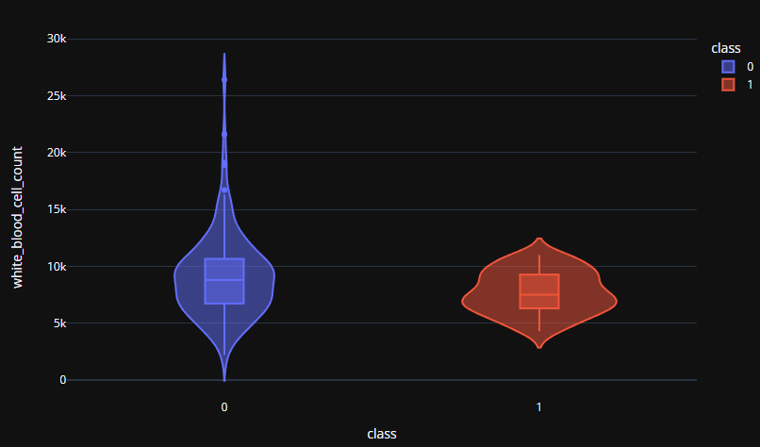
Exploratory Analysis
"First Look" at the data, to attempt to draw any conclusions.
Results...... Inconclusive.

Slide 9
Database Management

Slide 10
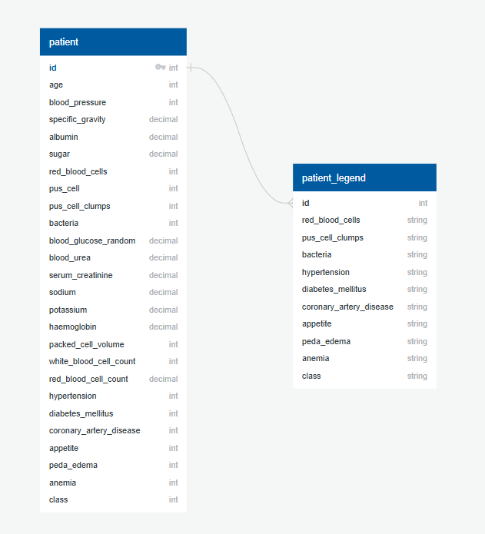
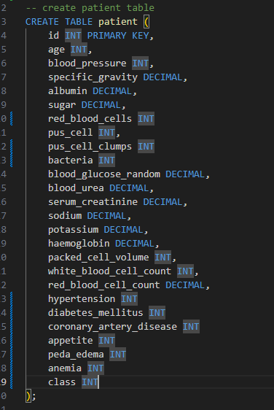

PostgresSQL
SQL utilized to store, retrieve, and manage data in a database
2 Tables
SQL is scalable and memory efficient

Slide 11
Machine Learning Steps

Slide 12
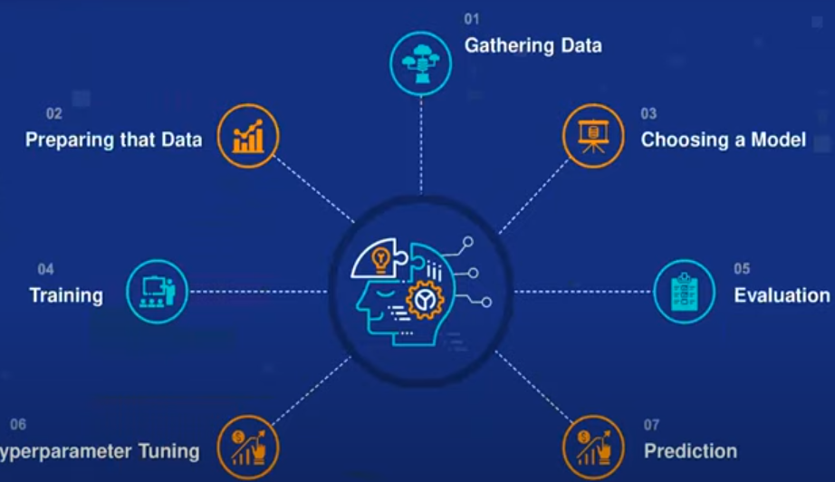


Slide 13
Import Necessary Libraries
from sklearn.model_selection import train_test_split
from sklearn.linear_model import LinearRegression
from sklearn import metrics
from sklearn.metrics import accuracy_score,confusion_matrix, classification_report
Load Your Dataset
Load your dataset into a pandas DataFrame.
1. Data Preparation
The target variable (y) is defined as the 'class' column, while the feature set (x) is created by dropping the 'class’ column from the dataset. This indicates a clear separation between the input features and the outcome we want to predict.
2. Data Splitting
The dataset is split into training and testing sets using train_test_split. By setting a random_state of 1, the results are reproducible. This ensures that the model is trained on a specific portion of the data (80%) and tested on a separate portion (20%), which is crucial for evaluating its performance.

Slide 14
3. Model Training
A logistic regression model is instantiated and fitted to the training data (x_train, y_train). This step is where the model learns the relationship between the features and the target variable.
4. Model Evaluation
The accuracy of the model is calculated for both the training and testing sets.
5. Making Predictions
Predictions are made on both the training set (pred) and the testing set (pred1). This allows for an assessment of how well the model performs on data it has seen (training) versus data it has not seen (testing).
6. Confusion matrix ​
A confusion matrix is generated for the testing data, which shows the number of true positives, true negatives, false positives, and false negatives. This matrix helps to visualize the model's performance in more detail.​

Slide 15

The inference from the confusion matrix can be summarized as follows​
[[33 0]
[ 1 46]]
Model Performance:
The model has a high accuracy since it correctly classified a large number of instances (33 true negatives and 46 true positives) compared to the total number of predictions.
There are very few misclassifications, with only 1 false negative and no false positives.
Class Distribution:
The model is better at identifying positive instances, as indicated by the high number of true positives (46) compared to the single false negative (1). This suggests that the model is effective in predicting the positive class.

Slide 16
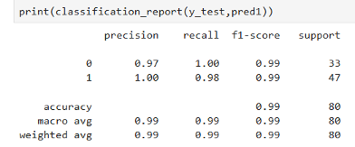
Precision:
For class 0: Precision is 0.97, meaning 97% of the instances predicted as class 0 were correct.
For class 1: Precision is 1.00, meaning 100% of the instances predicted as class 1 were correct.
Recall:
This metric indicates the proportion of true positive predictions among all actual positive instances.
For class 0: Recall is 1.00, meaning the model correctly identified all actual instances of class 0.
For class 1: Recall is 0.98, meaning 98% of the actual instances of class 1 were correctly identified.
F1-Score:
This is the harmonic mean of precision and recall, providing a single score that balances both metrics. It is particularly useful when you need to account for both false positives and false negatives.
For both classes, the F1-score is approximately 0.99, indicating a strong balance between precision and recall.
Accuracy:
This is the overall accuracy of the model, calculated as the ratio of correctly predicted instances to the total instances. Here, the accuracy is 0.99, meaning the model correctly predicted 99% of the instances.
Class 0 Recall is 1.00​
Class 1 Recall is 0.98
For both classes, the F1-score is approximately 0.99, indicating a strong balance between precision and recall.

Slide 17
Inference​

Slide 18
Overall, this classification report indicates that the model performs exceptionally well, with high precision, recall, and F1-scores for both classes.
The model appears to be performing well, particularly in identifying the positive class, with minimal errors. However, it is important to consider the context of the data and the potential consequences of the misclassifications to ensure that the model's performance aligns with the goals of the analysis.

Slide 19
Thank you

