Slide 1
802.11a PHY Digital Back-end Design
Sean Huang, Kunmo Kim, Paul Kwon, Josh Sanz, Meng Wei
Notes:
Sean opens here with introductions

Slide 2
Why do OFDM in Chisel?
Several Verilog/VHDL implementations of WiFi exist
But they’re not flexible
Written to support one standard in particular ^{[1]}
Or wrap several standard specific basebands^{[2]}
And they’re big
880,000 lines of code^{[1]}
172,000 lines of code^{[2]}
[1] J. Shi, “OpenOFDM.” https://github.com/jhshi/openofdm, 2017.
[2] phthinh, “IEEE 802.11 OFDM-based transceiver system.” https://github.com/phthinh/OFDM_802_11
Notes:
Josh talks about this

Slide 3
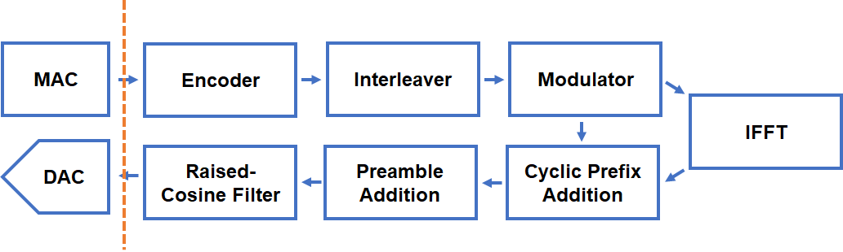
802.11a Transmit Chain

Slide 4
802.11a Tx Encoder
Modulation Ctrl
Data
Convolutional Coding
Puncturing
Interleaver & Modulator
Ctrl
Fully compatible with 802.11a Specification
Puncturing matrix can be modified on the fly
Support programmable convolutional coding matrix

Slide 5
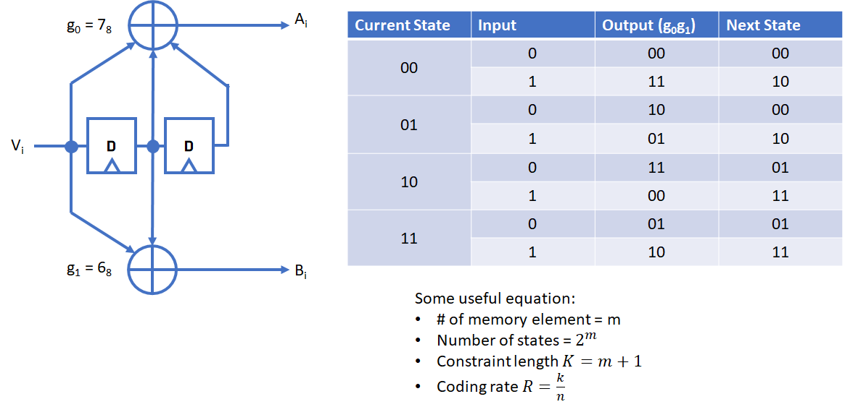
802.11a Tx Encoder - Convolutional Code (7, 6)

Slide 6
802.11a Tx – Convolutional Encoder (802.11a Standard)
g₀ = 133₈
A_{i}
802.11a default coding rate = ½
802.11a default constraint length (K) = 7
(n,k,m) = (2,1,6)
D
D
D
D
D
D
V_{i}
g₁ = 171₈
B_{i}

Slide 7
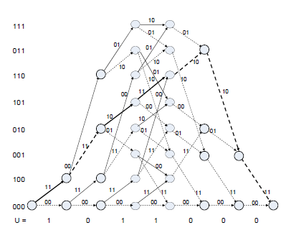
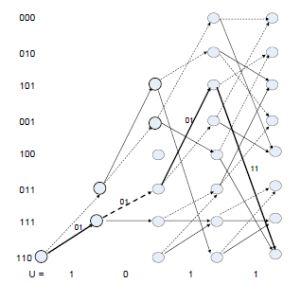
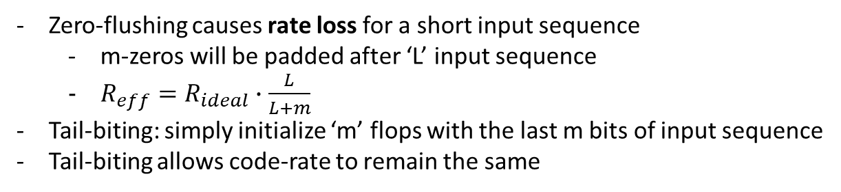
Tail-Biting

Slide 8
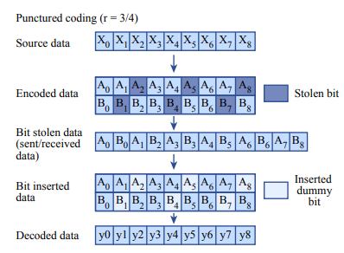
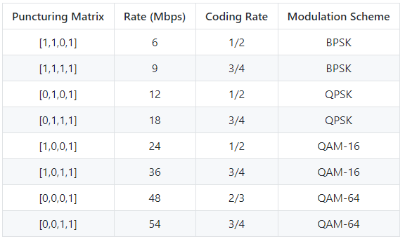
802.11a Tx – Puncturing
Image from [1]

Slide 9
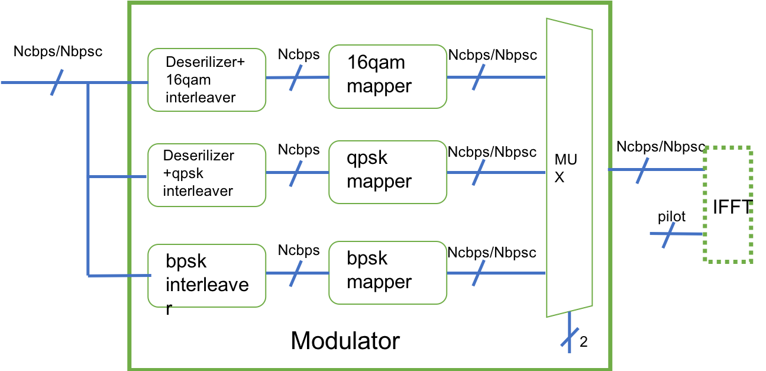
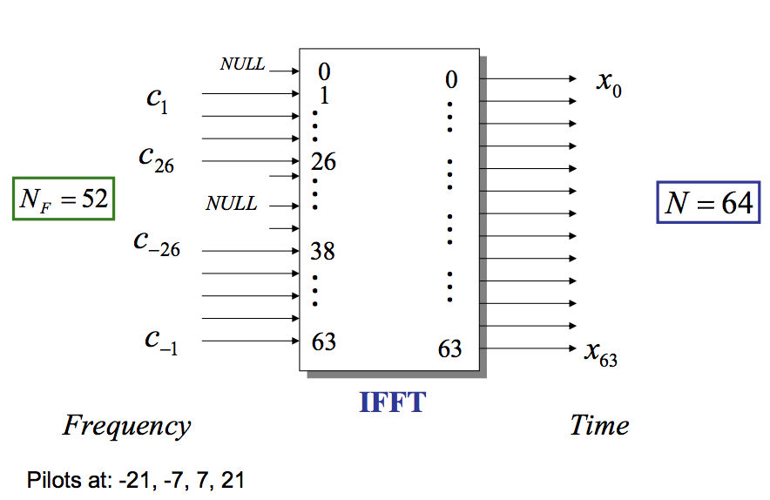
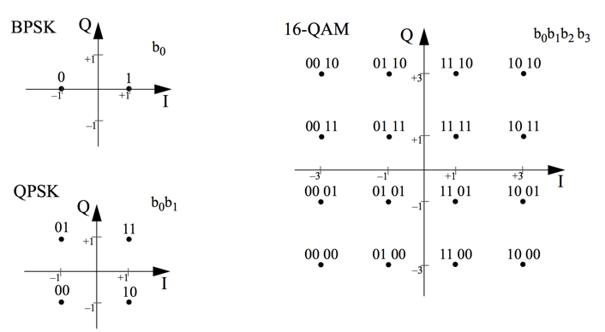
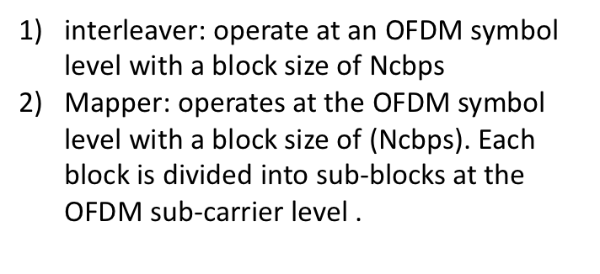
Tx Modulator

Slide 10
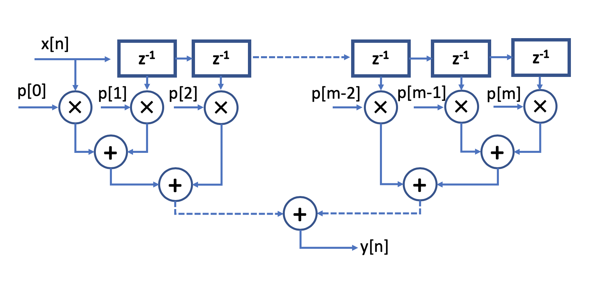
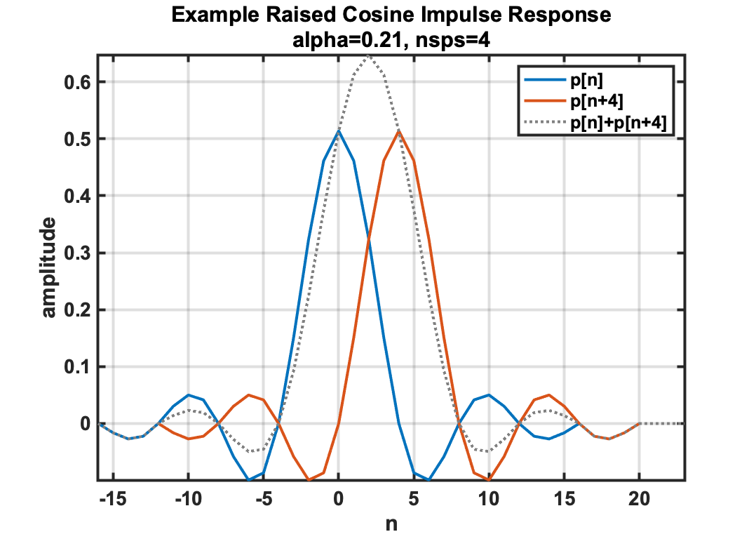
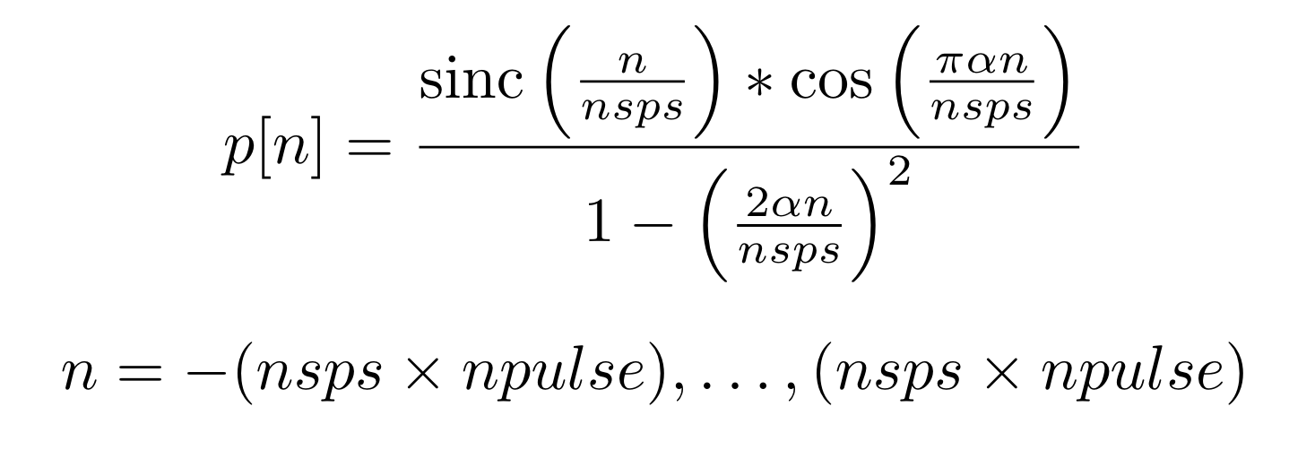
Raised-Cosine Filter
Direct form FIR architecture
TreeReduce addition to reduce critical path delay

Slide 11
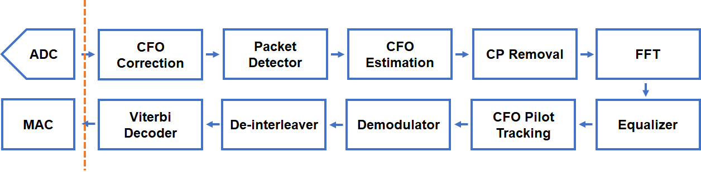
802.11a Receive Chain

Slide 12
802.11a RX CFO Estimation and Correction
Data
Data
CFO Correction
Packet Detector
CFO Estimation
Data arrives in CFO Correction block and is rotated by phase error
Data arrives at Packet Detector and packet start/end flags generated
CFO Estimation gets new phase error estimation and updates correction
E. Sourour, H. El-Ghoroury, and D. McNeill, “Frequency offset estimation and correction in the ieee 802.11a wlan,”
in IEEE 60th Vehicular Technology Conference, 2004. VTC2004-Fall. 2004, vol. 7, pp. 4923–4927 Vol. 7, Sept 2004.

Slide 13
Coarse Offset Estimation
16 samples
16 samples
T₀
T₁
T₂
T₃
T₄
802.11a Short Training Field (STF) has 10 repeating sets of a 16-sample pattern
Every 16 samples the pattern repeats
By averaging the phase difference between all of the corresponding pairs, can extract per-sample phase estimate
CFO Estimation is the last block that uses this field, so this is dropped at this stage
E. Sourour, H. El-Ghoroury, and D. McNeill, “Frequency offset estimation and correction in the ieee 802.11a wlan,”
in IEEE 60th Vehicular Technology Conference, 2004. VTC2004-Fall. 2004, vol. 7, pp. 4923–4927 Vol. 7, Sept 2004.

Slide 14
Fine Offset Estimation
32 samples
64 samples
Guard Interval
T₀
T₁
802.11a Long Training Field (LTF) has 2 repeating sets of a 64-sample pattern
32 sample Guard Interval between STF and LTF
Every 64 samples the pattern repeats
These samples have the coarse correction applied already, so the long fields are required to get the small residual offset still present after the coarse correction
Equalizer also uses LTF, so this field is passed through
E. Sourour, H. El-Ghoroury, and D. McNeill, “Frequency offset estimation and correction in the ieee 802.11a wlan,”
in IEEE 60th Vehicular Technology Conference, 2004. VTC2004-Fall. 2004, vol. 7, pp. 4923–4927 Vol. 7, Sept 2004.

Slide 15
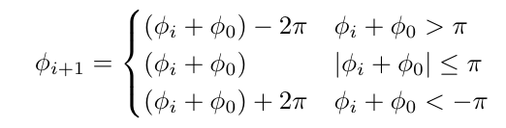
Offset Correction
CORDIC
REAL
REAL
IMAG
IMAG
Phase Correction
Correction is done by CORDIC rotation of input I/Q Vector
Estimation block gives a per-sample phase correction estimate (𝞅₀)
Each new sample requires more rotation as phase error accumulates
The next phase correction follows the piecewise function

Slide 16
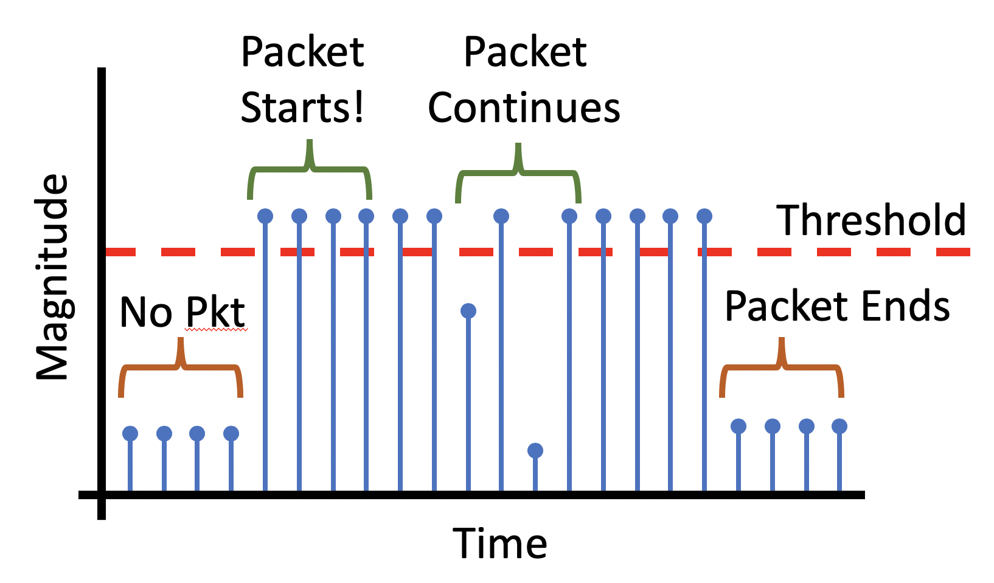
Packet Detector

Slide 17
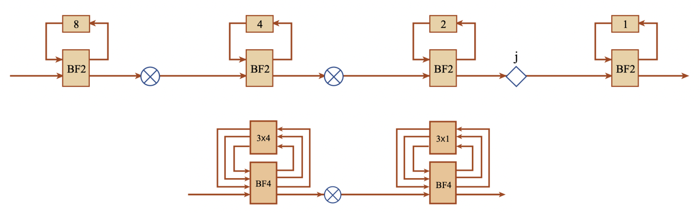
FFT (& IFFT)
Single-path delay feedback architecture
Supports radix-2 and radix-4
FFT sizes: powers of 2
IFFT reuses FFT architecture
SDF Chain
FFT block diagram
Deserializer
Unscrambler
N
N
IFFT block diagram
Re
Re
Re
÷ N
Re
FFT
S. He and M. Torkelson, “A new approach to pipeline FFT processor,” in Proceedings of International Conference on Parallel Processing, pp. 766–770, April 1996.
V. Stojanovic, “Lecture 10: Fast Fourier transform: VLSI architectures,” in 6.973 Communication System Design, 2006. MIT OpenCourseWare.
Im
Im
Im
÷ N
Im

Slide 18
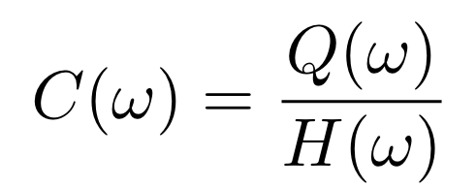
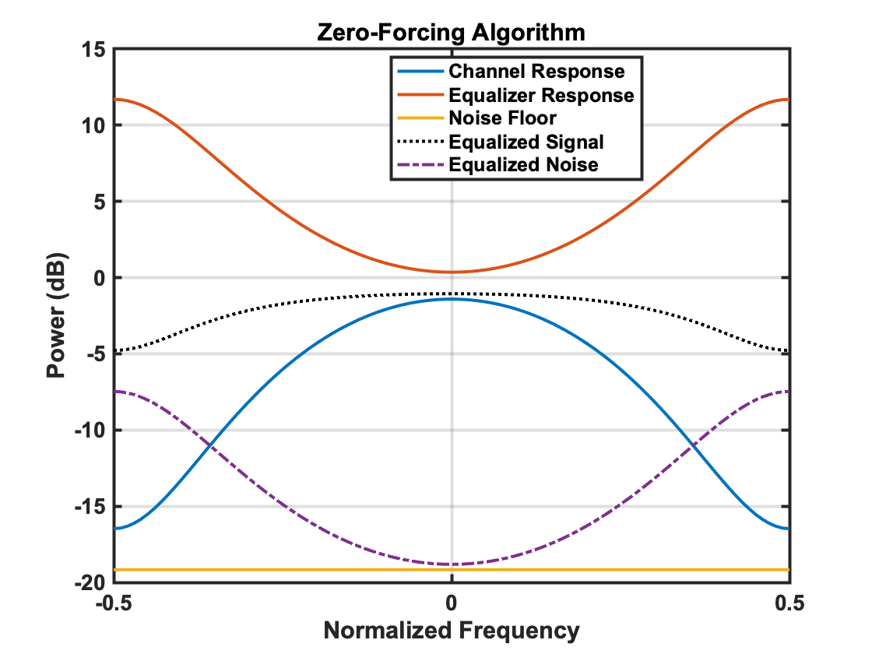
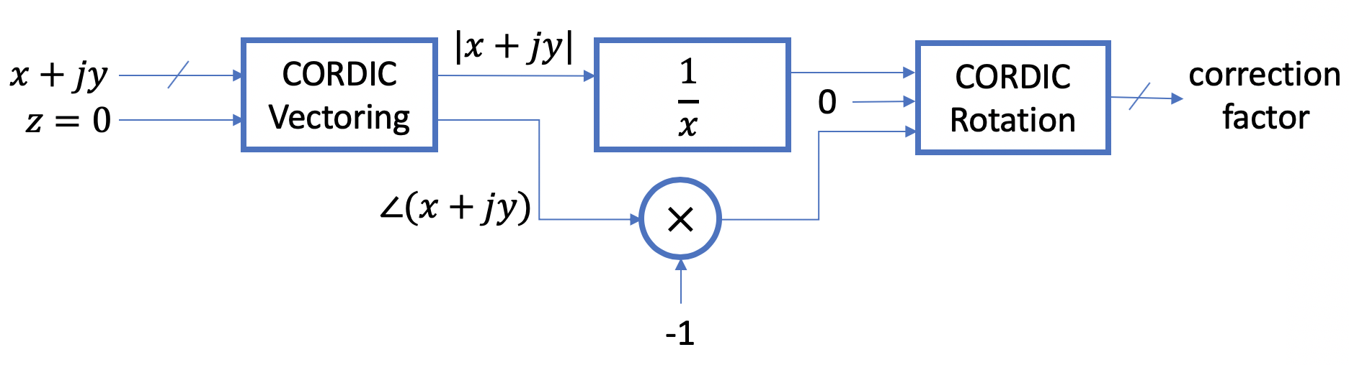
Zero-Forcing Equalizer
Completely eliminates ISI
BUT…
Amplifies noise
Reduces overall SNR
Channel Inversion
J. W. M. Bergmans, Linear Equalization. Springer-Science+Business Media, B.V., 1996.

Slide 19
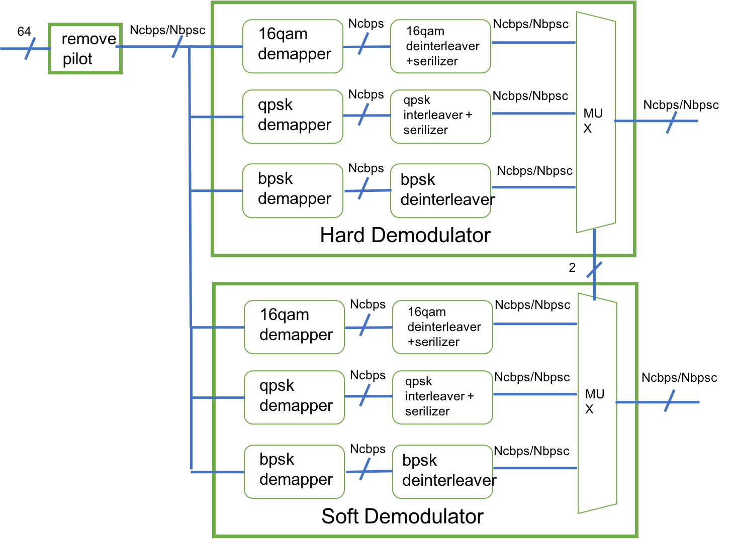
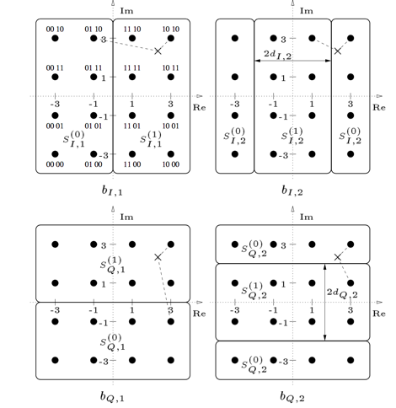

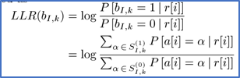


Rx Demodulator
Optimal soft demapping:
-include logarithmic and exponential functions
-not suitable for hardware implementation
Sub-optimal soft demapping
-low complexity
-negligible soft decoding performance loss

Slide 20
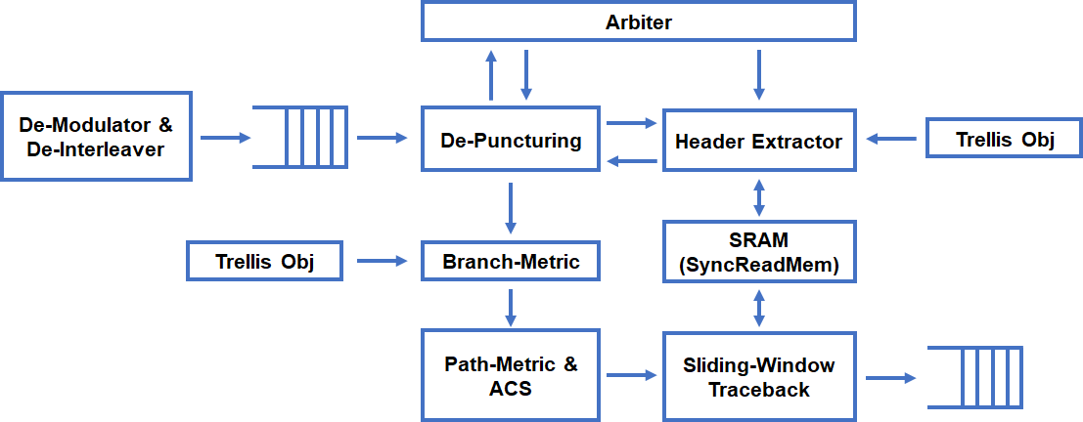
802.11a Rx Decoder
•Support both Hard & Soft decoding
•802.11a requires only hard decoding
•Two Viterbi decoding algorithms are used
•Normal Viterbi Decoding
•Sliding-Window Viterbi Decoding

Slide 21
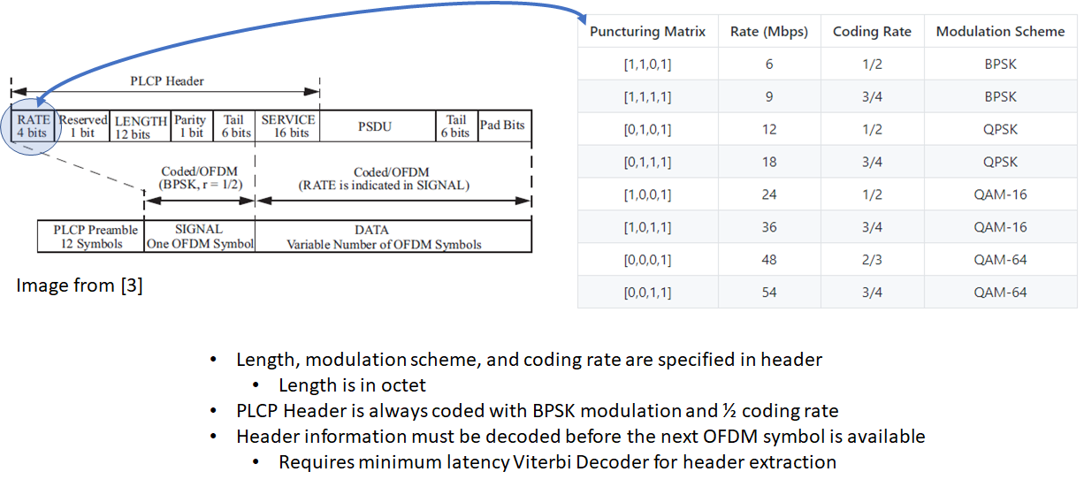
802.11a PPDU Frame Structure

Slide 22
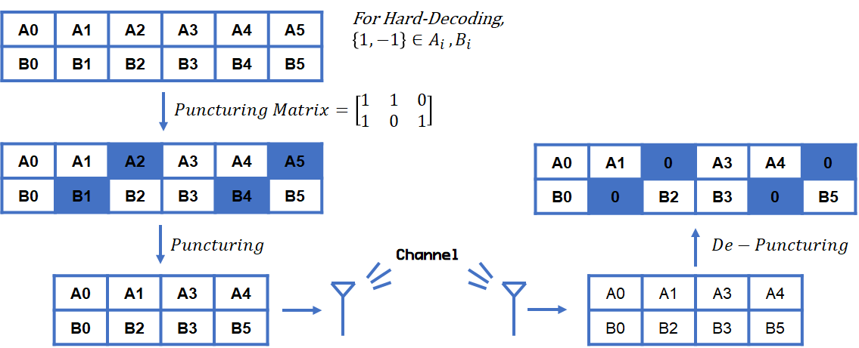
De-Puncturing

Slide 23
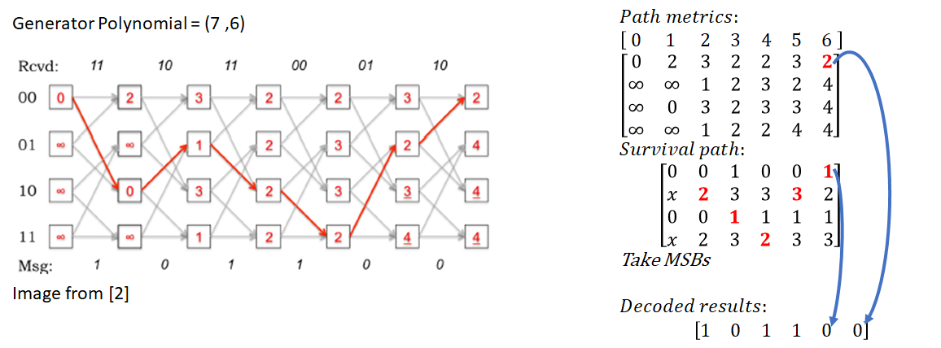
Maximum Likelihood Sequence Estimator

Slide 24
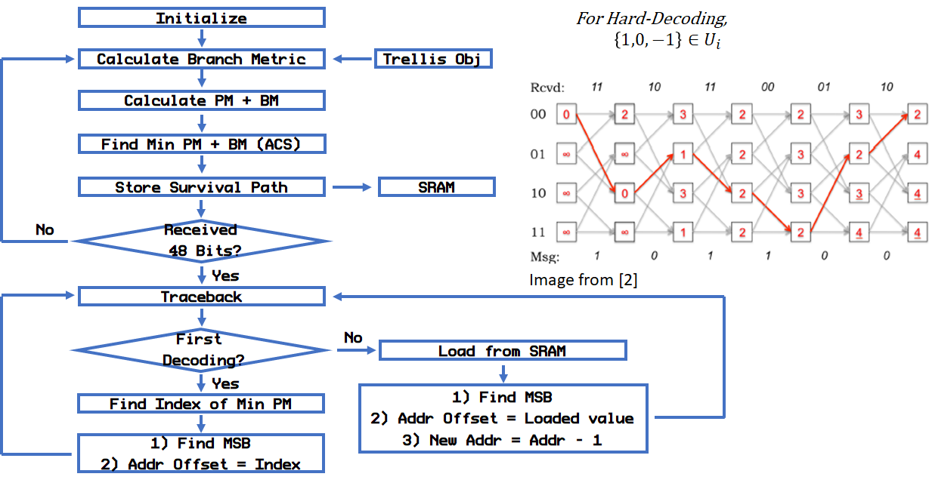
Viterbi Decoder Algorithm Flow Chart

Slide 25
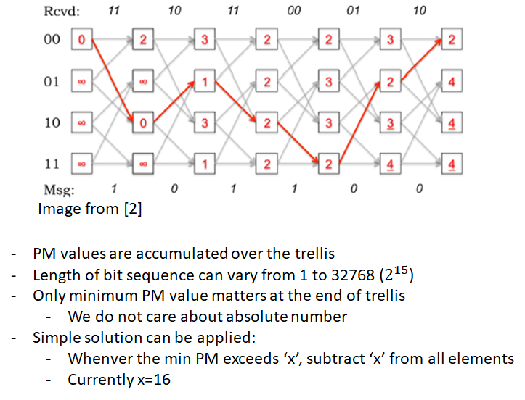
How to determine bit width for PM Register?

Slide 26
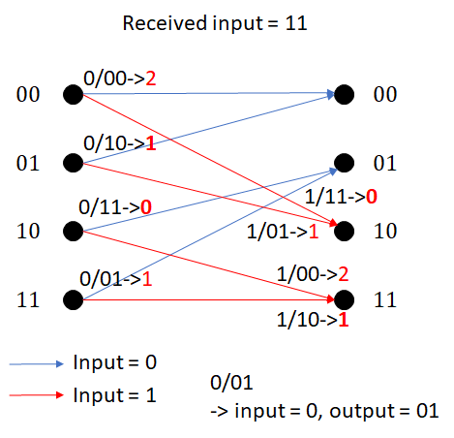
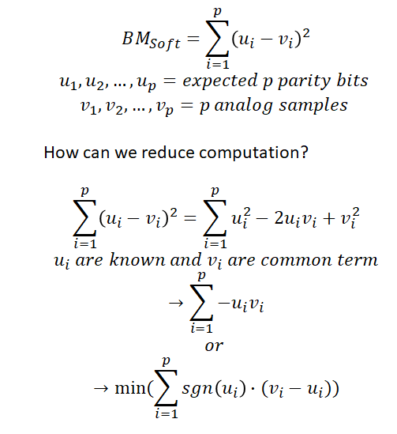
Hard Decoding vs Soft Decoding
Hard Decision = Hamming distance calculation
Type = SInt(2.W)
Soft Decision = Euclidean distance calculation:
Type = FixedPoint(bitWidth, (bitWidth-3).BP)

Slide 27
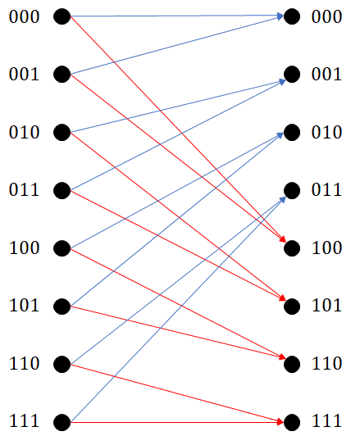

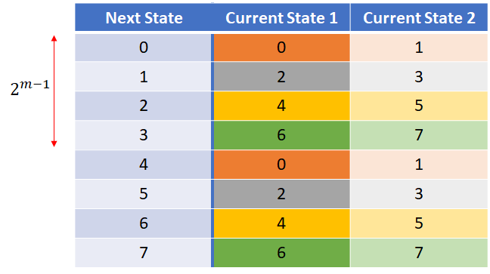
ACS computation

Slide 28
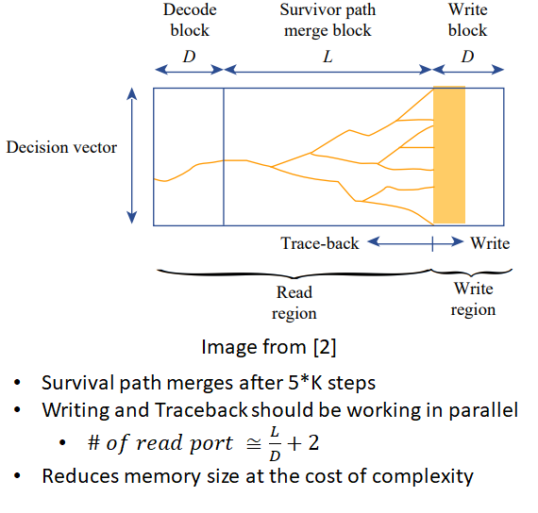
Sliding Window Viterbi Decoder

Slide 29
The Chisel Difference
Concise code
8,700 lines of implementation
8,700 lines of testing
1-2 orders of magnitude less than the Verilog versions
Agile generators
Can reconfigure for arbitrary number of subcarriers
Can reconfigure for arbitrary (convolutional) coding schemes
And more...
Rapid unit testing!

Slide 30
Reference
[1] ISO/IEC/IEEE 8802-11:2012
[2] MIT opencourseware 6.973
[3] Deepthi Ancha, Implementation of Tail-Biting Convolutional codes, 2008

