Slide 1
Lab.07 Pointer & C String
Jack Lin 2017.4.12

Slide 2
Local vs.. PDOGS
編譯參數 -O2 -std=c++11
Initial value …etc

Slide 3
Pointer
Address vs. value
Function Call : Call By Value/ Reference
Dynamic Array
Pointer Operations

Slide 4
Pointer
* and &
Address / identifier / Value

Slide 5
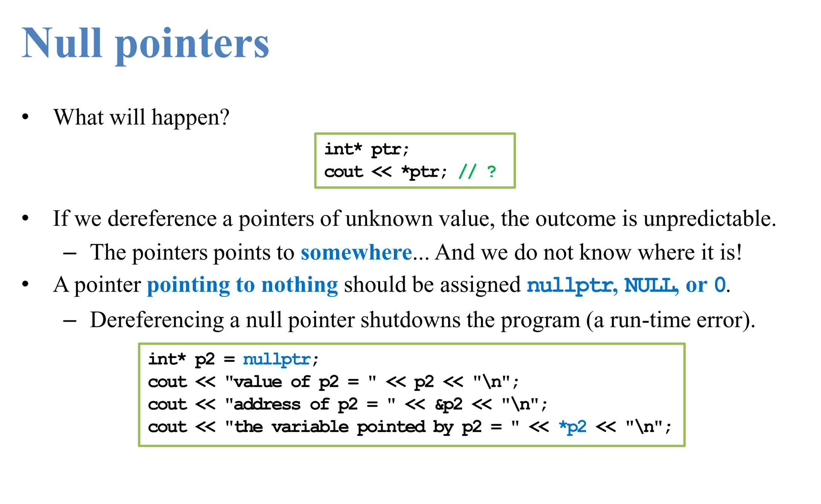
Pointer Initial

Slide 6
Function Call
Call By Value
Call By Reference
Call By Pointer

Slide 7
Dynamic Array
One Dimension Array
data type* array name=new data type[size];
Two Dimension Array
data type** array name=new data type*[size];

Slide 8
Address Differences : Operator -
Use “ - ” to find 間隔 ( Notice No matter the type is !)
You cannot use “ + ” with address and address

Slide 9
C String
Character Array ?
End with \0
Pointer ?
cin vs. getline
atoi and atof

Slide 10
C String library
strstr()
strchr()
strlen()
Example : Pointer of strchr and Character String
char a[100] = “abcd efg” char * b
a = strchr(a,’ ’) + 1 print a ? => Syntax Error
b = strchr(a,’ ’) + 1 print b ?

Slide 11
How to delete a element in Array?
Delete a character in string?

Slide 12
Practice: Delete Dirty Decoding
Delete &$%^* out of string
Input:
Appl$%e
Ora#$%#ng
A$%*&pple
Output:
Apple
Orange
Apple

Slide 13
Practice: Period of String
Input : String
Output : Minimum period length of String
Input:
ababab
abaccc
Output:
2
6

