Slide 1
PermitScope
Know what you signed.
Know what is still open.
Captured ERC-2612 permissions, lifecycle checks,
and an inspectable cancellation outcome.
https://hackathon.pocketplay.win/permitscope/
PermitScope · 3rd-Web-Hack · September 2026
Notes:
Independent hackathon prototype. OpenAI Codex assisted implementation and documentation. No production protection or traction claimed.

Slide 2
Zero allowance can hide a usable signature
A user signs a permit.
It has not been submitted on-chain.
The spender’s current allowance is zero.
The signature can still activate an allowance later.
The user needs the captured signature context as well as current chain state.
PermitScope · 3rd-Web-Hack · September 2026
Notes:
Source: https://eips.ethereum.org/EIPS/eip-2612 ; https://revoke.cash/learn/approvals/what-are-eip2612-permit-signatures

Slide 3
Existing protections and the remaining gap
Revoke.cash: existing permit cancellation
Rabby: existing signature history
Wallet security tools: existing risk detection
Our focus
Keep captured permissions tied to their lifecycle, distinguish signature state from allowance, and verify the outcome by execution.
PermitScope · 3rd-Web-Hack · September 2026
Notes:
Revoke.cash already supports cancellation. Rabby already stores signatures. Inspected Rabby reference commit: 66c312834b2706232adb9a1b1a67b9eb7644f9a8. Sources: https://revoke.cash/learn/approvals/what-are-eip2612-permit-signatures ; https://github.com/RabbyHub/Rabby/blob/66c312834b2706232adb9a1b1a67b9eb7644f9a8/src/background/service/signTextHistory.ts

Slide 4
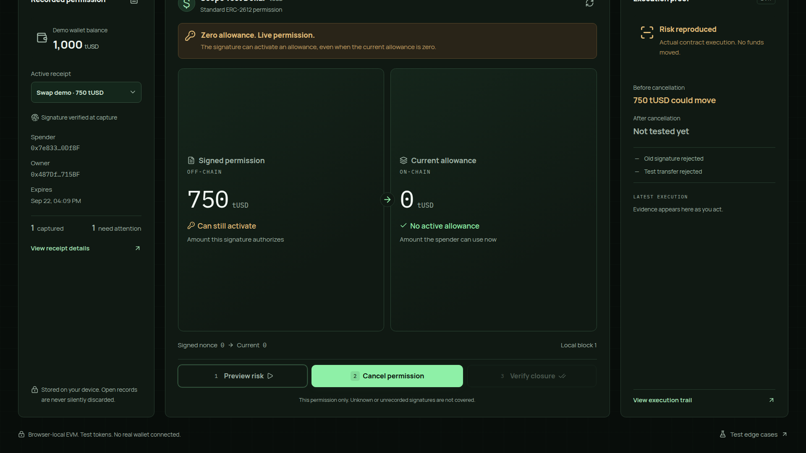
A working permission lifecycle
Capture → inspect → cancel → verify
PermitScope · 3rd-Web-Hack · September 2026
Notes:
Actual prototype screenshot. Real EthereumJS VM execution; isolated browser state and valueless test tokens. No personal wallet is connected.

Slide 5
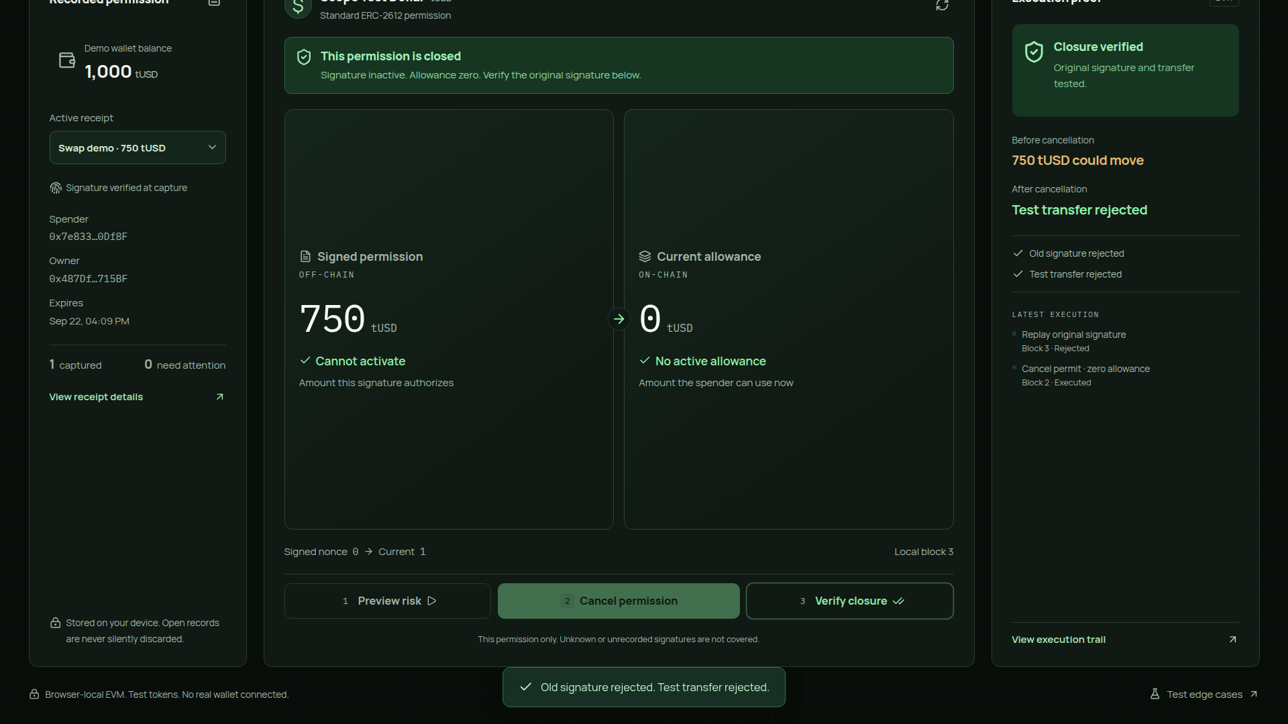
Verified local result: the old signature is rejected
750 tUSD
before
Rejected
after
Test assets
Browser EVM
PermitScope · 3rd-Web-Hack · September 2026
Notes:
Actual prototype screenshot after cancellation. The 750 tUSD is synthetic exposure, not real loss prevented. The original signature and test transfer fail after same-nonce cancellation.

Slide 6
Boundaries and next steps
Current scope
Next validation
Captured standard ERC-2612 permits
Known token implementation
Real execution on an isolated EVM
Wallet recorder integration
Public-network state verification
User comprehension and coverage
Unrecorded signatures remain invisible. No universal protection or recovery of stolen funds is promised.
PermitScope · 3rd-Web-Hack · September 2026
Notes:
No interviews, active-user metrics, business savings or security audit are claimed. Public source: https://github.com/bigerbigernerd/permitscope . OpenAI Codex assisted research, code, tests, UI and docs. OpenZeppelin and EthereumJS provide the core token and execution dependencies.

