Slide 1
多机穿越丛林任务拓展
211220166 王诚昊

Slide 2
目标之一是要尽快到达，不绕弯路
按照原来的奖励设置（每走一步扣一分），不一定能够真的“尽快”到达
是否可以提前规划一条路径（考虑到障碍物位置）然后在这个可行路径上设置一个“领航点”，把无人机与领航点的距离差也加权考虑到reward里面去。
参考一篇论文：Multi-UAV Path Planning and Following Based on Multi-Agent Reinforcement Learning
Drones | Free Full-Text | Multi-UAV Path Planning and Following Based on Multi-Agent Reinforcement Learning (mdpi.com)

Slide 3
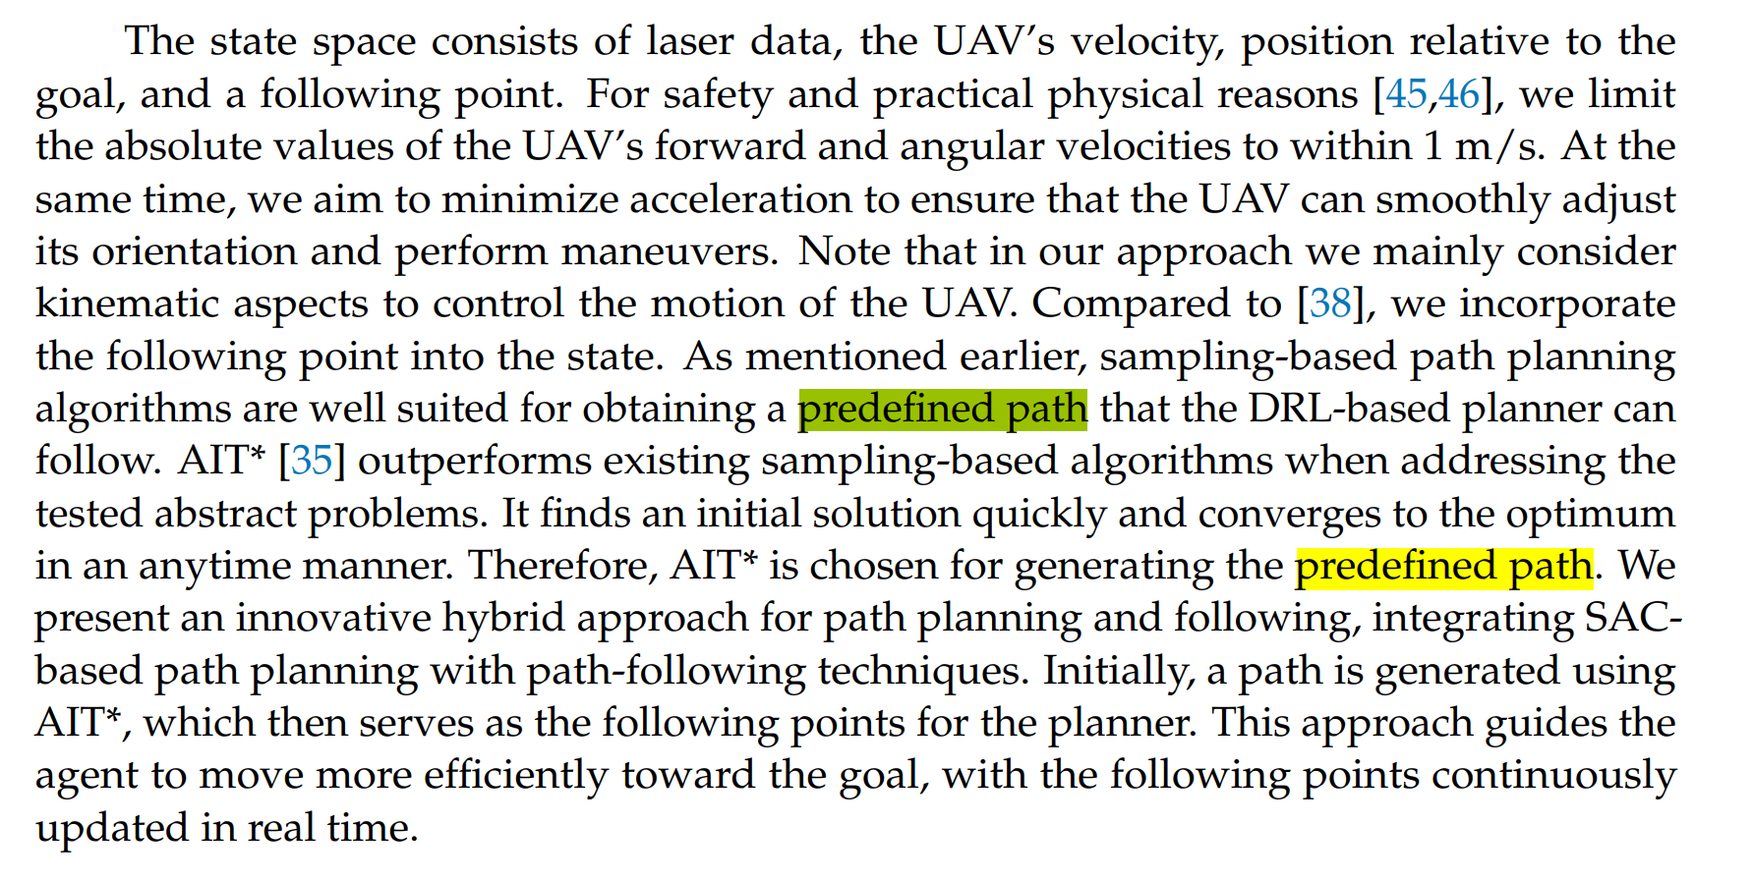

Slide 4
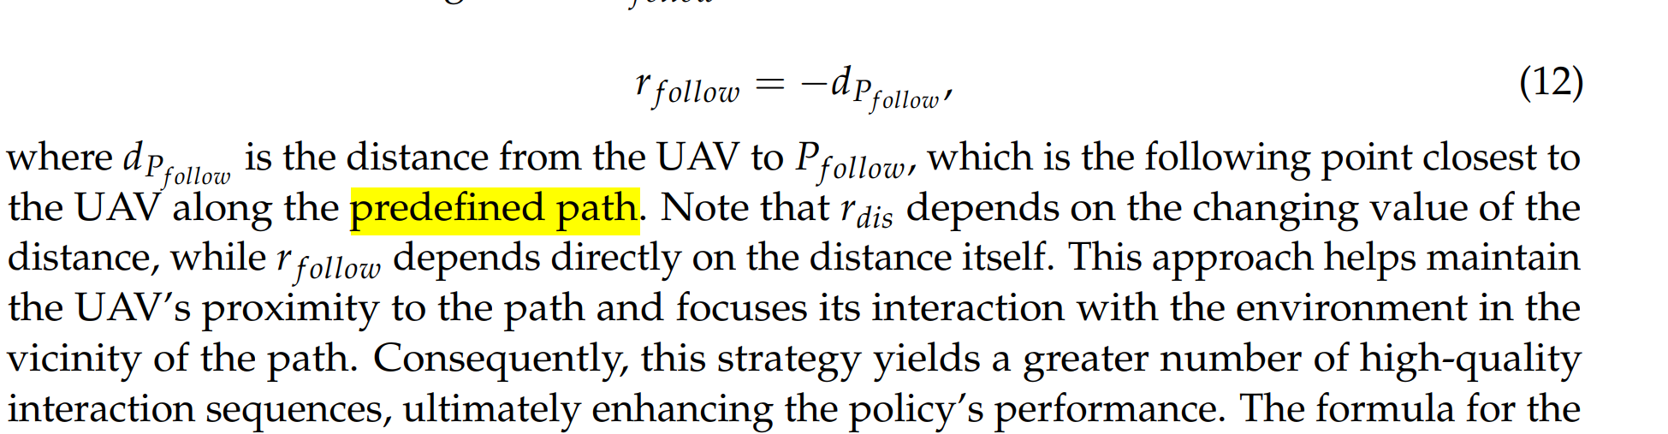

Slide 5
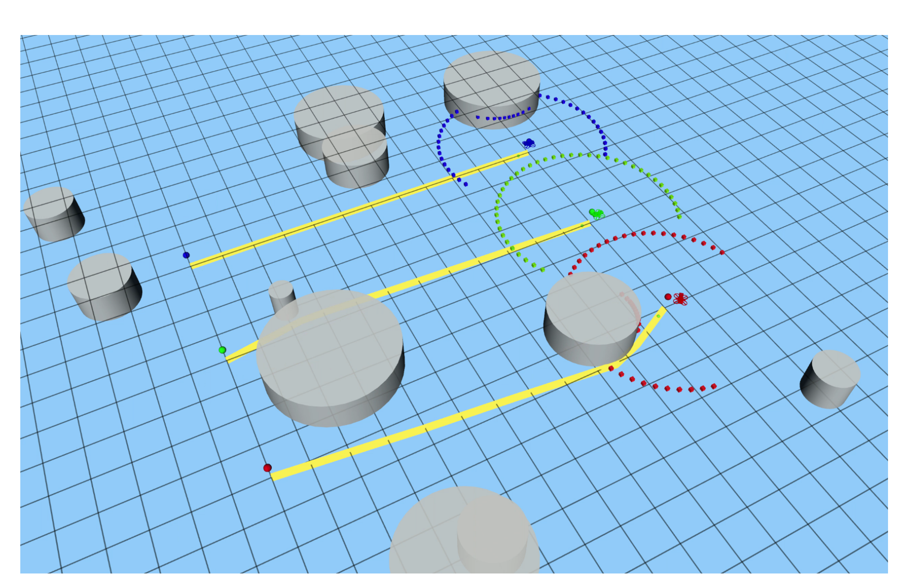

Slide 6
怎么确定predefined path？
文中提到了一种算法：AIT*
. Strub, M.P.; Gammell, J.D. Adaptively Informed Trees (AIT*): Fast Asymptotically Optimal Path Planning through Adaptive Heuristics. In Proceedings of the 2020 IEEE International Conference on Robotics and Automation (ICRA), Paris, France, 31 May–31 August 2020; pp. 3191–3198. [CrossRef]
能够迅速找出可行解，一定时间内收敛到最优解

