Slide 1
Bond Risk Premia
Derivation from Stochastic Discount Factors

Slide 2
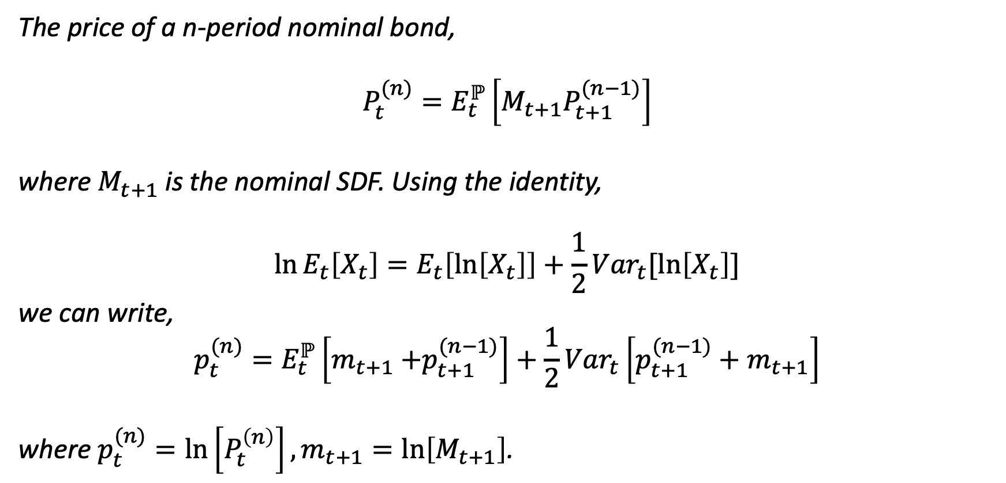

The Long-term Yield $y_{t}^{(n)}$- (I)
The price of a n-period nominal bond,
$$P_{t}^{(n)}=E_{t}^{ℙ}\left[M_{t+1}P_{t+1}^{(n−1)}\right]$$
where $M_{t+1}$is the nominal SDF. Using the identity,
$$\ln{E_{t}\left[X_{t}\right]}=E_{t}\left[\ln\left[X_{t}\right]\right]+\frac{1}{2}{Var}_{t}[\ln\left[X_{t}\right]]$$
we can write,
$$p_{t}^{(n)}=E_{t}^{ℙ}\left[m_{t+1}{+p}_{t+1}^{(n−1)}\right]+\frac{1}{2}{Var}_{t}\left[p_{t+1}^{(n−1)}+m_{t+1}\right]$$
where $p_{t}^{(n)}=\ln\left[P_{t}^{\left(n\right)}\right], m_{t+1}=\ln\left[M_{t+1}\right]$.

Slide 3
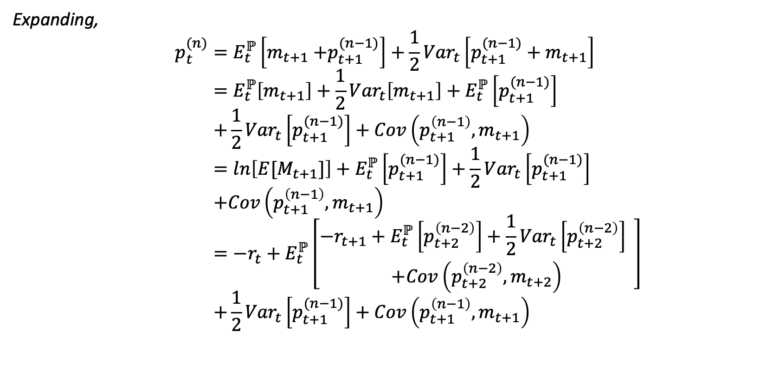

The Long-term Yield $y_{t}^{(n)}$- (II)
Expanding,
$$p_{t}^{(n)}=E_{t}^{ℙ}\left[m_{t+1}{+p}_{t+1}^{(n−1)}\right]+\frac{1}{2}{Var}_{t}\left[p_{t+1}^{(n−1)}+m_{t+1}\right] \\ =E_{t}^{ℙ}\left[m_{t+1}\right]+\frac{1}{2}{Var}_{t}\left[m_{t+1}\right]+E_{t}^{ℙ}\left[p_{t+1}^{(n−1)}\right] \\ +\frac{1}{2}{Var}_{t}\left[p_{t+1}^{(n−1)}\right]+Cov\left(p_{t+1}^{\left(n−1\right)},m_{t+1}\right) \\ =ln\left[E[M_{t+1}]\right]+E_{t}^{ℙ}\left[p_{t+1}^{(n−1)}\right]+\frac{1}{2}{Var}_{t}\left[p_{t+1}^{(n−1)}\right] \\ +Cov\left(p_{t+1}^{\left(n−1\right)},m_{t+1}\right) \\ =−r_{t}+E_{t}^{ℙ}\left[\begin{aligned}{−r}_{t+1}+E_{t}^{ℙ}\left[p_{t+2}^{\left(n−2\right)}\right]+\frac{1}{2}{Var}_{t}\left[p_{t+2}^{\left(n−2\right)}\right] \\ +Cov\left(p_{t+2}^{\left(n−2\right)},m_{t+2}\right)\end{aligned}\right] \\ +\frac{1}{2}{Var}_{t}\left[p_{t+1}^{(n−1)}\right]+Cov\left(p_{t+1}^{\left(n−1\right)},m_{t+1}\right)$$

Slide 4
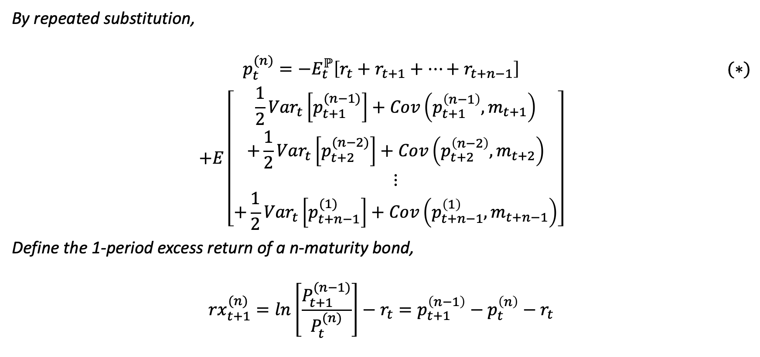

The Long-term Yield $y_{t}^{(n)}$- (III)
By repeated substitution,
$$\begin{aligned}p_{t}^{(n)}={−E}_{t}^{ℙ}\left[r_{t}+r_{t+1}+⋯+r_{t+n−1}\right]\#\#(∗)\end{aligned}$$
$$+E\left[\begin{aligned}\frac{1}{2}{Var}_{t}\left[p_{t+1}^{(n−1)}\right]+Cov\left(p_{t+1}^{\left(n−1\right)},m_{t+1}\right) \\ +\frac{1}{2}{Var}_{t}\left[p_{t+2}^{(n−2)}\right]+Cov\left(p_{t+2}^{\left(n−2\right)},m_{t+2}\right) \\ ⋮ \\ +\frac{1}{2}{Var}_{t}\left[p_{t+n−1}^{(1)}\right]+Cov\left(p_{t+n−1}^{\left(1\right)},m_{t+n−1}\right)\end{aligned}\right]$$ Define the 1-period excess return of a n-maturity bond,
$${rx}_{t+1}^{(n)}=ln\left[\frac{P_{t+1}^{(n−1)}}{P_{t}^{(n)}}\right]−r_{t}=p_{t+1}^{\left(n−1\right)}−p_{t}^{\left(n\right)}−r_{t}$$

Slide 5
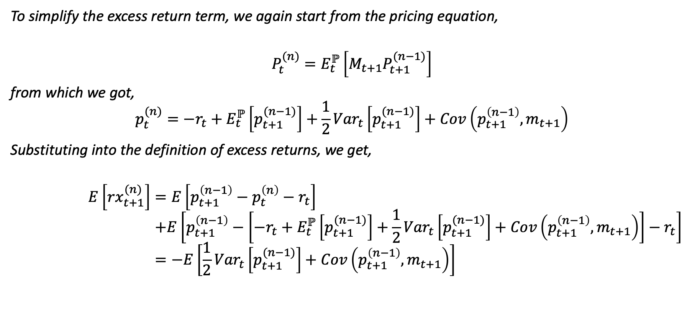

The Long-term Yield $y_{t}^{(n)}$- (IV)
To simplify the excess return term, we again start from the pricing equation,
$$P_{t}^{(n)}=E_{t}^{ℙ}\left[M_{t+1}P_{t+1}^{(n−1)}\right]$$ from which we got,
$$p_{t}^{(n)}=−r_{t}+E_{t}^{ℙ}\left[p_{t+1}^{(n−1)}\right]+\frac{1}{2}{Var}_{t}\left[p_{t+1}^{(n−1)}\right]+Cov\left(p_{t+1}^{\left(n−1\right)},m_{t+1}\right)$$
Substituting into the definition of excess returns, we get,
$$E\left[{rx}_{t+1}^{(n)}\right]=E\left[p_{t+1}^{\left(n−1\right)}−p_{t}^{\left(n\right)}−r_{t}\right] \\ +E\left[p_{t+1}^{\left(n−1\right)}−\left[−r_{t}+E_{t}^{ℙ}\left[p_{t+1}^{(n−1)}\right]+\frac{1}{2}{Var}_{t}\left[p_{t+1}^{(n−1)}\right]+Cov\left(p_{t+1}^{\left(n−1\right)},m_{t+1}\right)\right]−r_{t}\right] \\ =−E\left[\frac{1}{2}{Var}_{t}\left[p_{t+1}^{(n−1)}\right]+Cov\left(p_{t+1}^{\left(n−1\right)},m_{t+1}\right)\right]$$

Slide 6
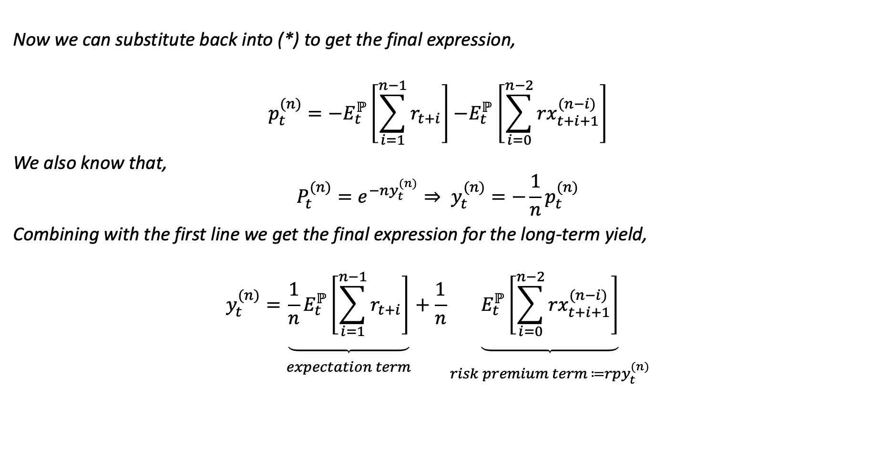

The Long-term Yield $y_{t}^{(n)}$- (V)
Now we can substitute back into (*) to get the final expression,
$$p_{t}^{(n)}={−E}_{t}^{ℙ}\left[\sum_{i=1}^{n−1}{r_{t+i}}\right]{−E}_{t}^{ℙ}\left[\sum_{i=0}^{n−2}{{rx}_{t+i+1}^{(n−i)}}\right]$$
We also know that,
$$P_{t}^{(n)}=e^{−ny_{t}^{(n)}}⇒ y_{t}^{(n)}=−\frac{1}{n}p_{t}^{(n)}$$
Combining with the first line we get the final expression for the long-term yield,
$$y_{t}^{(n)}=\underset{\begin{aligned} \\ expectation term\end{aligned}}{\underbrace{{\frac{1}{n}E}_{t}^{ℙ}\left[\sum_{i=1}^{n−1}{r_{t+i}}\right]}}+\frac{1}{n}\underset{\begin{aligned} \\ risk premium term ≔{rpy}_{t}^{(n)}\end{aligned}}{\underbrace{E_{t}^{ℙ}\left[\sum_{i=0}^{n−2}{{rx}_{t+i+1}^{(n−i)}}\right]}}$$

