Slide 1
Feedback on the Advanced Stock Assessment course ICES – Copenhagen, Dec. 2016
Yves Reecht
BIGFISH, 25/01/2017

Slide 2
General information
Given by Jan Jaap Poos (Wageningen Marine Research – NL) & Richard Hillary (CSIRO – Hobart)
Every second year (alternate with a course focusing on SAM).
Main focus:
Understanding the concepts.
Developing the ability to build your own model

Slide 3
Program
Population dynamics
Structure of stock assessments
Maximum Likelihoods
Gradient searches/optimizers
Uncertainty estimation
Multispecies models?
Reference points
Tagging
Bayesian techniques
Harvest Control Rules?

Slide 4
Different types of models outlined
Structured: explicit separation of contributions to the biomass production (individual growth, recruitment, mortality,…)
E.g. Berverton-Holt: age-structured.
Unstructured:
E.g. Surplus production models of Schaeffer, Pella Tomlinson (1969)

Slide 5
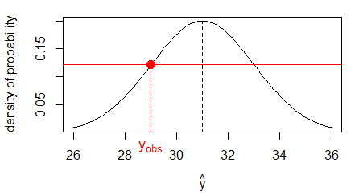

Likelihood
$L(θ|data)$ : expresses how well the data support some parameter value or hypothesis
Practically, for one observation: $p\left(y_{obs} | \hat{y}\right)$ e.g. following a normal distribution
dnorm(yobs, yhat, sigma)

Slide 6
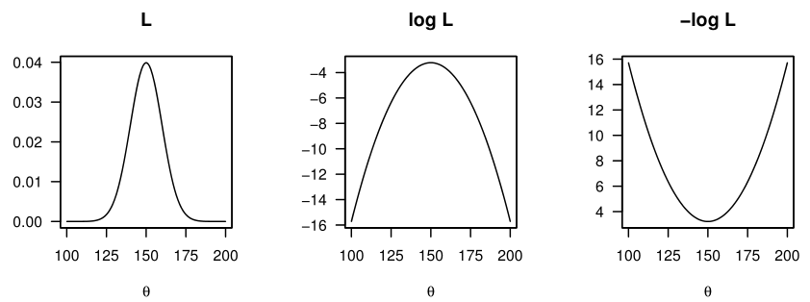
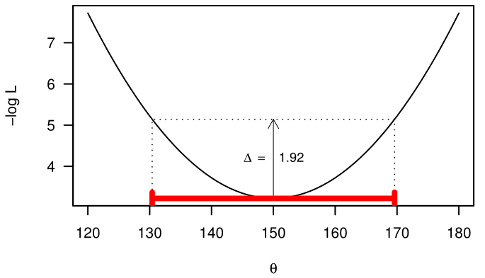

Likelihood
Property: $L=L_{1}×L_{2}×…$
More convenient to work with NLL:
Additive
Steepness of the gradient:
Relative probability: $2\ln{\frac{L_{1}}{L_{2}}}\sim χ_{df}^{2}$
-sum(dnorm(yobs, yhat, sigma, log = TRUE)

Slide 7
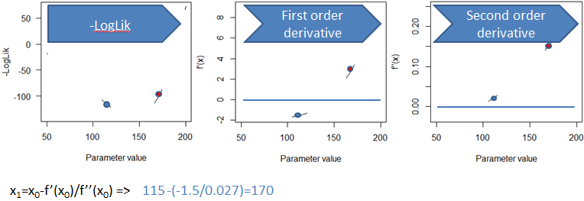
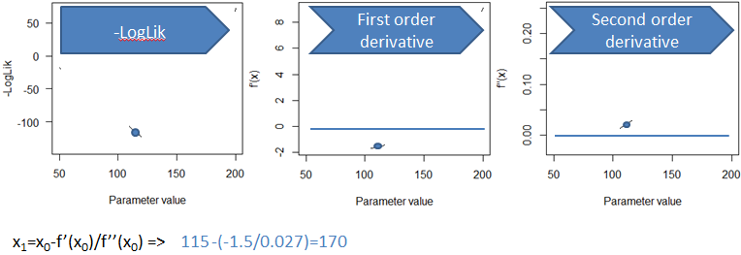
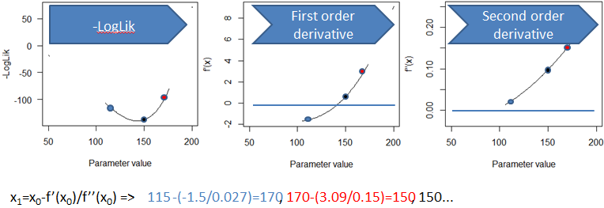
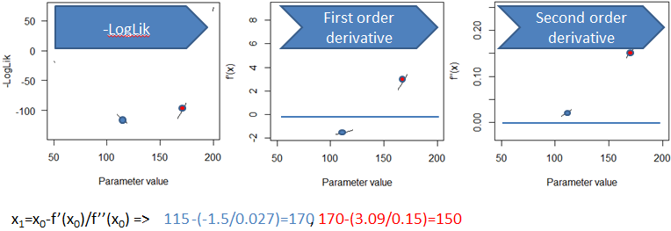
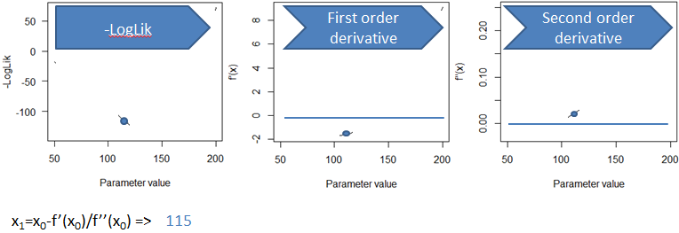
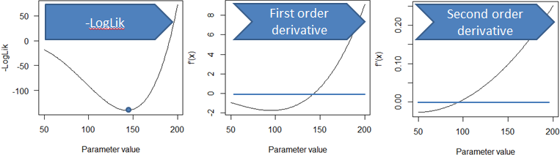
Optimizers/Hessian matrix
Different types but focus on derivative based methods (assumptions about geometry of likelihood surface)

Slide 8
Optimizers/Hessian matrix
Square matrix of second-order partial derivatives of a function!!!
Several uses:
Inverse yield the covariance matrix of parameters
=> used with a multivariate Normal dist. -> CI estimates
Delta method for uncertainty of “derived estimates”
Eigenvalues for diagnostic (all > 0)
solve(res$hessian)
eigen(res$hessian)

Slide 9
Tools used during the course
Most of examples have been implemented both in R and R+TMB
R+TMB steps:
C++ model returning the NLL.
Preparing the data in R.
Compiling and linking the C++ model with R (TMB package).
Running the optimisation using R optim.
Getting additional estimates of parameter/derived estimates variability.
Post processing/plotting in R

Slide 10



Tools used during the course
ADMB/TMB pros & cons
(Much much) faster (C++)
Very good and easy integration with R (TMB).
Autodiff (analytical derivatives when possible)
More accurate gradients => (R) optimizers converge quicker.
Yet another language (C++).
Debugging.

Slide 11
Tools used during the course
R+TMB: example now!
SA structured in age, no SR function, no AC in F…
Data (simulated):
By age/year: maturity, mean indiv weight, catches, survey index
By year: total catch, M
Params:
Selectivity (sigmoid params), max F/year, recruitment/year, Starting N/age, catchability/age (survey, age 1-10), SD for NLL components.

