Slide 1
COVID-19 Death conditions analysis
CAPSTONE PROJECT
Presented By:
Sai Krishna Rao Kaveliga
Joginpally BR Engineering College(JBREC)
Computer Science & Engineering(CSE)

Slide 2
OUTLINE
Problem Statement
Proposed System/Solution
System Development Approach
Algorithm & Deployment
Result
Conclusion
Future Scope
References

Slide 3
Problem Statement
The COVID-19 pandemic has inflicted substantial global mortality, with disparate death rates influenced by multifaceted factors. It is imperative to meticulously discern the specific conditions and comorbidities that profoundly impact COVID-19 mortality rates. This understanding is pivotal for crafting precise public health strategies, optimizing resource allocation, and devising effective interventions. This analysis endeavors to rigorously identify and assess the most influential conditions and comorbidities associated with COVID-19 mortality through advanced statistical methodologies. By delivering actionable insights, this research aims to empower global healthcare policy-makers and practitioners in mitigating the pandemic's toll.
Identify Key Factors: Determine the key demographic, clinical, and environmental factors that are associated with increased mortality in COVID-19 patients.
Statistical Analysis: Employ statistical methods to analyze the correlation between identified factors and COVID-19 death rates.
Recommendations: Provide actionable insights and recommendations for healthcare providers and policymakers to mitigate the impact of these factors on COVID-19 mortality.
Age-specific Analysis: Conduct detailed age-specific analyses to identify how mortality risk factors differ across various age groups, from children to the elderly.

Slide 4
Proposed Solution
Data Collection and Preparation:
Data Cleaning: Handle missing values, correct errors, and standardize data formats to ensure consistency and accuracy.
Data Integration: If needed, integrate this data with additional sources such as clinical records, socioeconomic data, vaccination status, and healthcare capacity.
Exploratory Data Analysis (EDA):
Descriptive Statistics: Calculate summary statistics to understand the distribution of key variables such as age, state, and conditions contributing to deaths.
Visualization: Create visualizations (e.g., histograms, box plots, heatmaps) to identify patterns, trends, and outliers in the data.
Correlation Analysis: Analyze correlations between different variables to understand their relationships with COVID-19 mortality.

Slide 5
System Approach
1. Data Acquisition and Cleaning
Data Sourcing: Gather comprehensive datasets from reputable sources such as WHO, CDC, and national health departments.
Data Cleaning: Preprocess data to ensure accuracy by handling missing values, outliers, and standardizing formats for consistency.
2. Exploratory Data Analysis (EDA)
Visualization: Utilize charts, graphs, and heatmaps to visualize trends over time, geographical regions, and demographic groups.
Pattern Identification: Identify correlations, outliers, and distribution characteristics to inform further analysis.
3. Feature Engineering and Selection
Feature Creation: Engineer new variables like infection rates per capita, adjusted vaccination rates, or demographic indices impacting COVID-19 outcomes.
Feature Selection: Choose relevant features based on their significance to project goals and model requirements.

Slide 6
System Approach
4. Model Development and Training
Model Selection: Choose appropriate models (e.g., regression, classification, time series analysis) based on project goals.
Training: Train models using historical data, optimize parameters, and validate performance metrics to ensure reliability.
5. Interpretation of Results
Insight Generation: Interpret model outputs and EDA findings to derive actionable insights for public health interventions and policy-making.
Communication: Present findings through clear visualizations, reports, and summaries highlighting key insights and recommendations.
6. Iteration and Improvement
Continuous Refinement: Iterate on analyses based on new data releases, feedback, and evolving pandemic dynamics to enhance accuracy and relevance.
Ethical Considerations: Address data privacy, transparency in methodologies, and ethical implications of findings to ensure fair and unbiased contributions to public health research.

Slide 7
Algorithm & Deployment
Data Preprocessing Algorithm:
Load Data: Import the covid data from the provided CSV file.
Handle Missing Values: Drop rows with missing values.
Exploratory Data Analysis (EDA) Algorithm:
Descriptive Statistics: Compute summary statistics for numerical variables.
Group by Operations: Aggregate data by categorical variables (e.g., gender, age group, state) to identify patterns.
Visualization: Create line plots, bar plots, and other visualizations to explore data distributions and relationships.
Example Visualizations:.

Slide 8
Algorithm & Deployment
Bar plot for distribution of deaths: Shows the number of deaths by age group.
Line plot for relation between C-19 and various health conditions: Explored relations between covid-19 and deaths by various health conditions using line plot.
Line plot : Analyzed trends of covid-19 over deaths over time using line plot.
Created a heatmap to show relations: Displays relations between covid-19 deaths, age group, condition.
Confusion matrix : Confusion matrix to evaluate the performance of a classification model.
Scatter plot: Defined functions for plotting the distribution of columns .

Slide 9
Result
Demographic and Geographic Disparities:
Older Age Groups: Significantly higher mortality rates were observed among older populations, highlighting their vulnerability.
Regional Variations: Certain states exhibited higher death counts, pointing to disparities in healthcare access and pandemic response effectiveness.
Comorbid Conditions:
Correlation with Mortality: Strong correlations were found between certain comorbid conditions (e.g., hypertension, diabetes) and increased COVID-19 mortality, indicating the critical role of managing chronic health issues.
Respiratory Conditions: Conditions such as chronic obstructive pulmonary disease (COPD) were identified as significant contributors to mortality, highlighting the importance of respiratory health management during the pandemic.

Slide 10
Result
Geospatial and Temporal Trends:
High-Risk Regions: Geographic analysis identified areas with elevated mortality rates, guiding targeted public health interventions.
Evolution of Death Rates: Temporal analysis revealed how death rates evolved over time, providing insights into the effectiveness of public health measures and response strategies.
Strategic Recommendations:
Targeted Interventions: Enhance healthcare capacity, prioritize vaccination for vulnerable groups, and implement localized health campaigns to manage comorbid conditions.
Resource Allocation: Allocate resources to regions with higher mortality rates to improve healthcare outcomes and pandemic response.

Slide 11
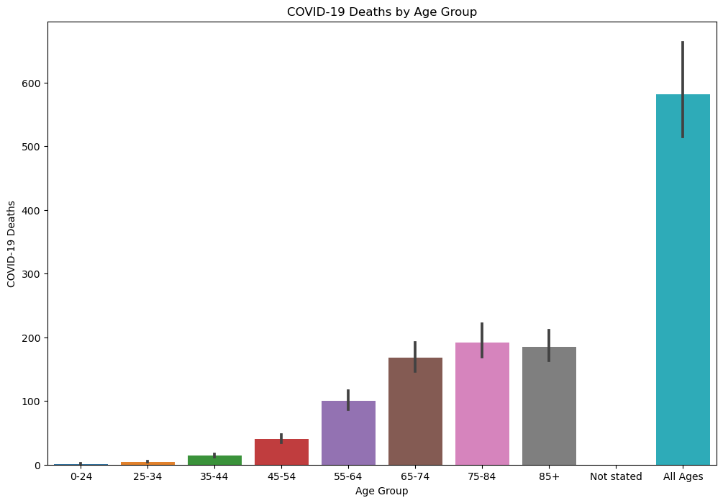
Result

Slide 12
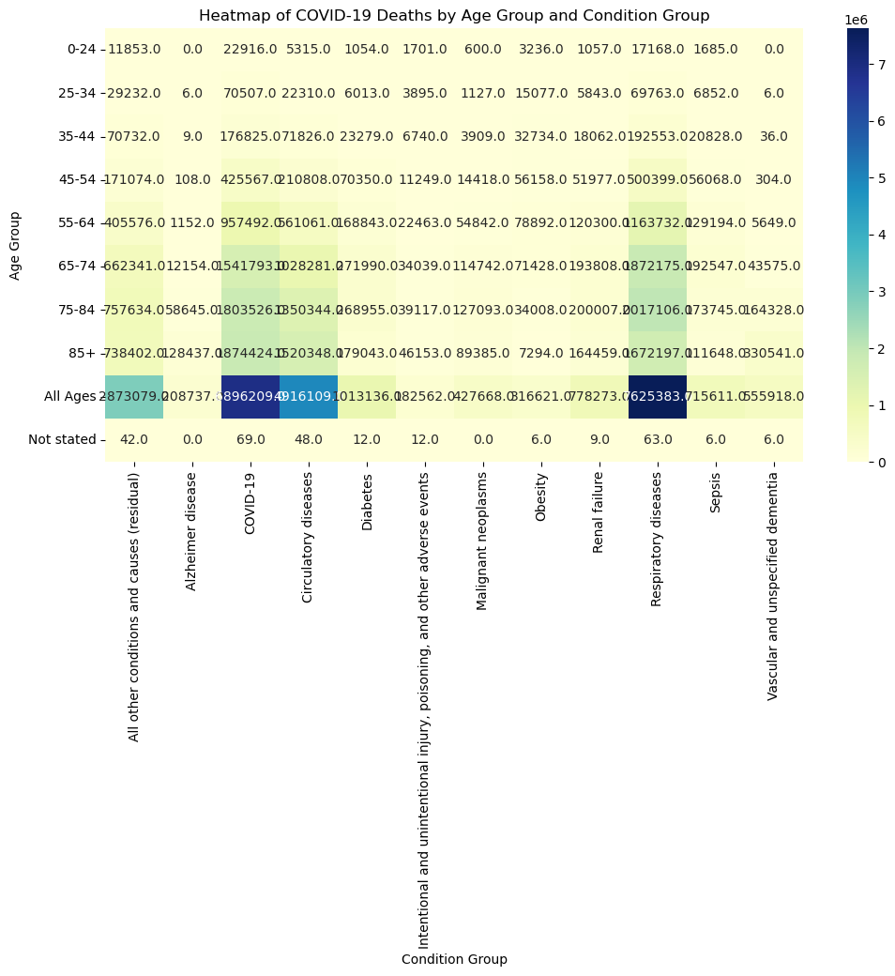
Result

Slide 13
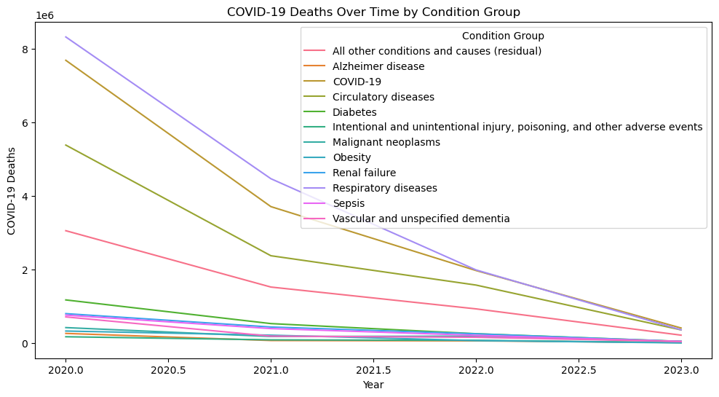
Result

Slide 14
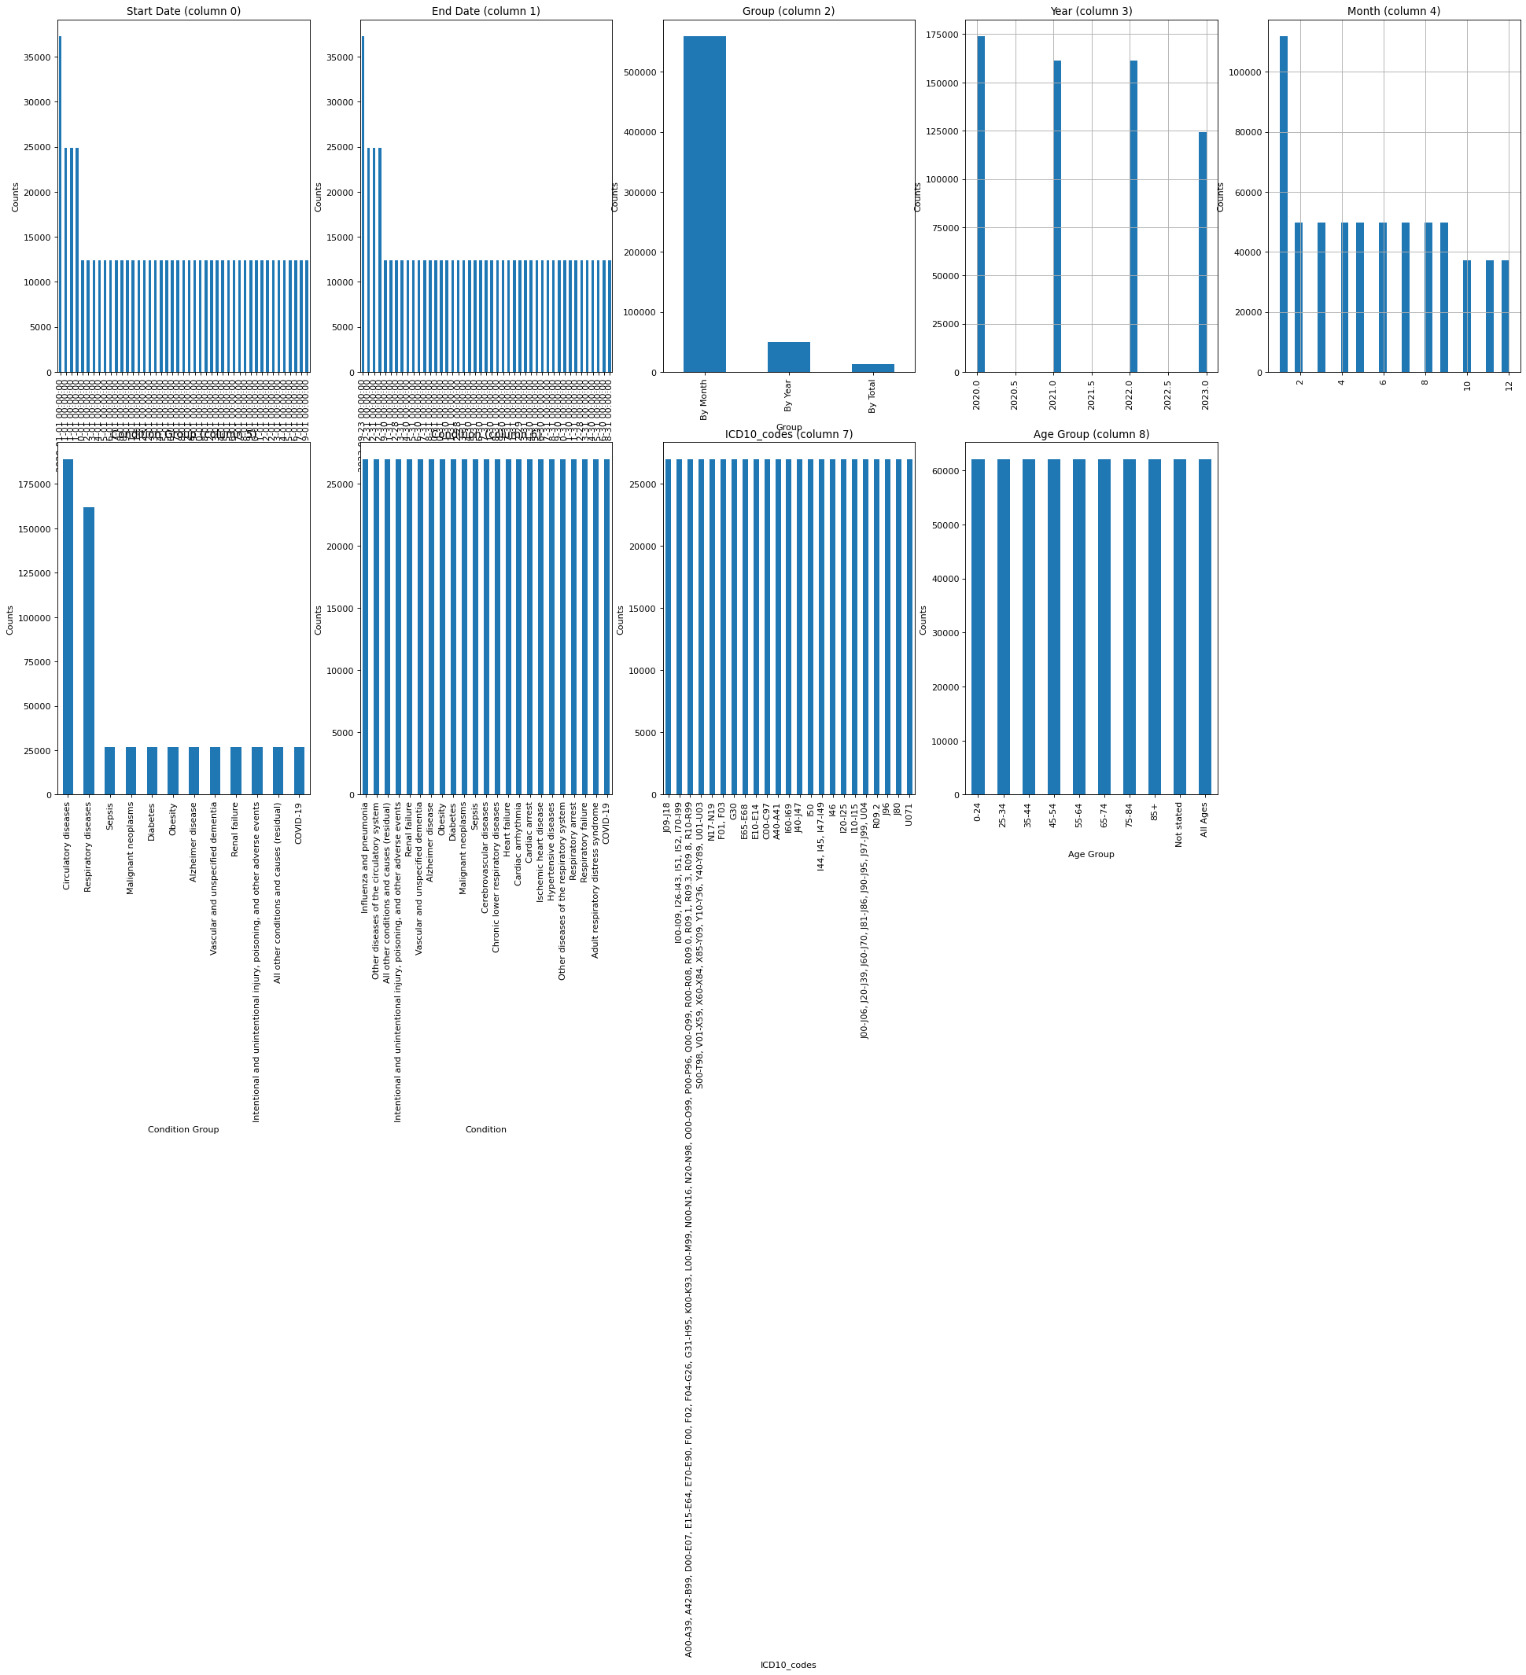
Result

Slide 15
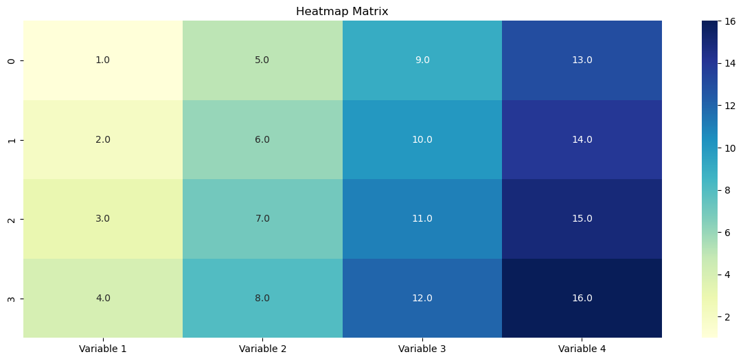
Result

Slide 16
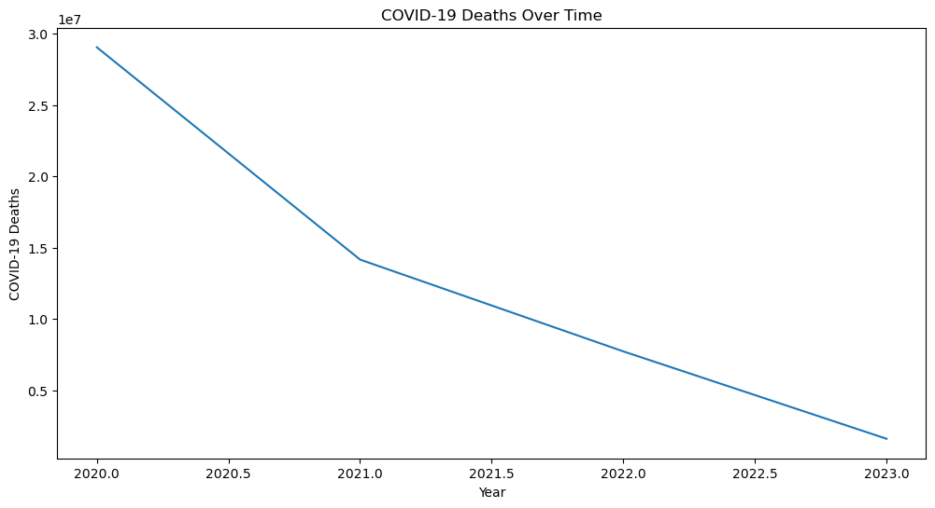
Result

Slide 17
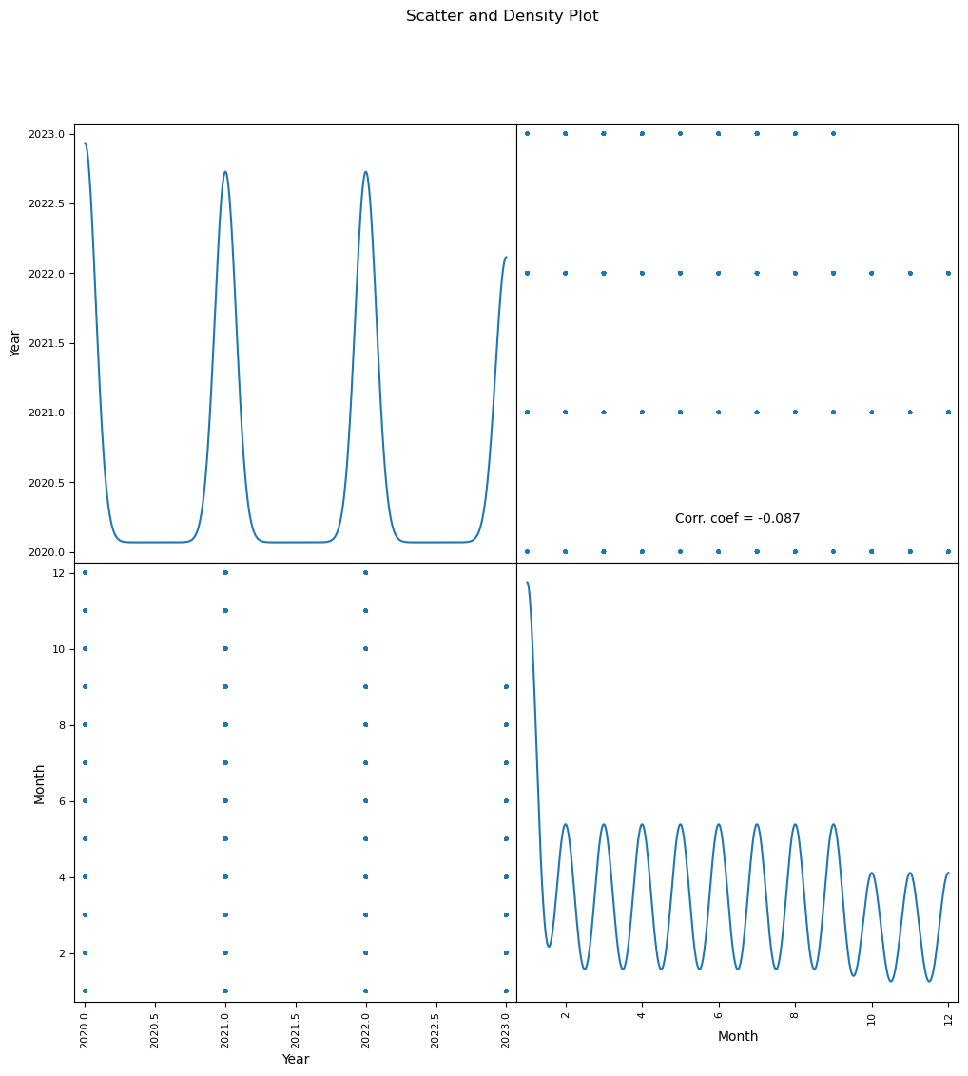
Result

Slide 18
PROJECT LINK(GITHUB)
bigfoot-23/Edunet_foundation (github.com)

Slide 19
Conclusion
The comprehensive analysis of COVID-19 mortality data has led to several crucial insights that are instrumental in shaping public health strategies and policy decisions. By employing a systematic approach encompassing data ingestion, preprocessing, exploratory analysis, feature engineering, model development, and geospatial and temporal analysis, we have garnered an in-depth understanding of the factors contributing to COVID-19 deaths.
Demographic and Geographic Disparities:
Older age groups are significantly more vulnerable to COVID-19, with higher mortality rates observed among this demographic.
Geographic disparities were evident, with certain states exhibiting disproportionately higher death counts, indicating varying levels of healthcare access and effectiveness in pandemic response.
Geospatial and Temporal Trends:
Geographic analysis pinpointed high-risk regions with elevated mortality rates, guiding targeted public health interventions.
Temporal trends revealed the evolution of death rates from 2020 to 2023, providing valuable context for assessing the effectiveness of public health measures and response strategies.

Slide 20
Future scope
The COVID-19 Deaths Conditions Analysis project has laid a strong foundation for understanding the factors contributing to mortality rates during the pandemic. However, there are several avenues for further research and development to expand the scope and impact of this project. The following points outline the potential future directions:
Enhanced Predictive Modeling:
Incorporation of Advanced Algorithms: Utilize more sophisticated machine learning algorithms such as neural networks, gradient boosting, and ensemble methods to improve the accuracy of mortality predictions.
Real-Time Data Integration: Implement real-time data integration techniques to continuously update the models with the latest information, enhancing their predictive power and relevance.
Longitudinal Studies:
Long-Term Health Impacts: Conduct longitudinal studies to investigate the long-term health impacts of COVID-19 on survivors, particularly those with pre-existing conditions.
Post-Pandemic Analysis: Analyze data post-pandemic to understand the sustained effects of COVID-19 and the effectiveness of vaccination campaigns and public health interventions.
Expanded Dataset:
Global Data Inclusion: Expand the dataset to include global data from various countries, providing a more comprehensive analysis of COVID-19 mortality across different regions and healthcare systems.
Granular Data Collection: Collect more granular data on socioeconomic factors, healthcare accessibility, and individual health behaviors to enrich the analysis and uncover deeper insights.
Intervention Effectiveness:
Policy Impact Evaluation: Evaluate the effectiveness of different public health policies and interventions implemented during the pandemic, using data-driven approaches to identify best practices.
Resource Allocation Optimization: Develop models to optimize the allocation of healthcare resources, such as ventilators, ICU beds, and medical staff, during future health crises.

Slide 21
Future scope
Personalized Healthcare:
Risk Stratification: Create personalized risk stratification tools for individuals based on their health profiles and comorbid conditions, aiding in tailored healthcare planning and intervention.
Patient Monitoring Systems: Integrate with patient monitoring systems to provide continuous health assessments and early warning signals for at-risk individuals.
Interdisciplinary Collaboration:
Collaboration with Epidemiologists: Work closely with epidemiologists, virologists, and public health experts to validate findings and refine models based on the latest scientific knowledge.
Cross-Sector Partnerships: Establish partnerships with healthcare providers, government agencies, and research institutions to broaden the impact and application of the project findings.
Public Health Communication:
Data Visualization Platforms: Develop interactive data visualization platforms to communicate findings to the public, policymakers, and healthcare professionals in an accessible manner.
Educational Initiatives: Launch educational initiatives to inform the public about the importance of managing comorbid conditions and following public health guidelines.
Future Pandemics Preparedness:
Simulation Models: Create simulation models to predict the impact of potential future pandemics and test the effectiveness of various intervention strategies.
Early Warning Systems: Develop early warning systems leveraging machine learning and big data analytics to detect emerging infectious diseases and prevent widespread outbreaks.
By pursuing these future directions, the project can significantly contribute to enhancing our understanding of COVID-19 mortality and improving public health responses to future pandemics. The continued evolution of this research will provide valuable insights and tools for safeguarding public health and optimizing healthcare delivery in times of crisis.

Slide 22
References
McKinney & others, “pandas: powerful Python data analysis toolkit”, 2010.
Hunter, J. D., “Matplotlib: Visualization with Python”, 2007.
Waskom M., “Seaborn: statistical data visualization”, 2021
Pandas Documentation: Pandas Documentation
Official documentation for the Pandas library, which provides extensive tools for data manipulation and analysis.
Seaborn Documentation: Seaborn Documentation
Official documentation for the Seaborn library, which offers advanced visualization capabilities built on top of Matplotlib.
Matplotlib Documentation: Matplotlib Documentation
Official documentation for the Matplotlib library, a comprehensive library for creating static, animated, and interactive visualizations in Python.
Data Analysis and Visualization Libraries: Python Data Analysis Library
Exploratory Data Analysis Techniques: Towards Data Science - EDA

Slide 23
course certificate 1

Slide 24
course certificate 2

Slide 25
THANK YOU

