Slide 1
A + B → AB rate constant, k1 = 0.017
Note:
X and Y are phosphatases
A and pB are kinases
We want to follow pC formed
as output
A
AB → A + B rate constant, k2 = 0.225
AB → A + pB rate constant k3 = 0.025
B
pB + X → pBX rate constant k4 = 0.017
pBX → pB + X rate constant k5 = 0.225
C
pBX → B + X rate constant k6 = 0.025
pB + C → pBC rate constant k7 = 0.017
pBC → pB + C rate constant k8 = 0.225
pBC → pB + pC rate constant k9 = 0.025
pC + Y → pCY rate constant k10 = 0.017
pCY → pC + Y rate constant k11 = 0.225
pCY → C + Y rate constant k12 = 0.025
Check the reactions very carefully. These are reversible enzymatic reactions, broken in elementary reactions. Check the units of rate constants. Smoldyn may have specific issues in this type of reaction system

Slide 2
Initial condition:
At t = 0:
  Number of A = 5000
  Number of B = 50000
  Number of AB = 0
  Number of pB = 0
  Number of C = 50000
  Number of pBC = 0
  Number of pC = 0
  Number of X = 25000
  Number of Y = 25000
  Number of pBX = 0
  Number of pCY = 0
Note:
X and Y are phosphatases
A and pB are kinases
We want to follow pC formed as output
Volume of cell: 3000 micro-mt cube
Diffusivity of proteins in cytoplasm: 0.001 to 10 micro-m^2/s (we will vary this to check effect of diffusivity: 0.001, 0.01, 0.1, 1.0, 10.0 )
Total duration of simulation: 20 min
Number of repetitions: 100 to 1000. I will prefer 1000
Be very careful about units

Slide 3
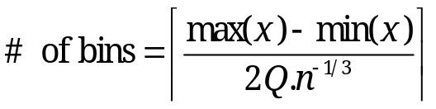
Plot:
A. Mean number of pC (in vertical axes) vs time; For 5 different diffusivity values
(mean pC will be calculated from averaging data of 100 or 1000 repeated runs)
B. Frequency Histograms: Number of pC per cell at 20 min (in horizontal axes) vs frequency
Draw such frequency histograms for simulations with five different diffusivity values
Number of bins in histogram decides shape of histogram How to decide number of bins in histograms? :
Freedman-Diaconis rule
Where x is the data set, Q is the interquartile range of data, Q = Q3-Q1. n is number of data points. That bracket is ceiling.
One can use, histx of MATLAB that will generate histogram with optimum bins.
You can download calcnbins from net and use it to calculate bin numbers using MATLAB

Slide 4
Plot:
Calculate Standard deviation for each histograms from the data.
Calculate coefficient of variation (CV) for each histogram from data.
[CV = std deviation/mean]
C. Plot CV (in vertical axes) vs Diffusivity.
D. Plot Mean (in vertical axes) vs diffusivity
E. Plot CV vs Mean for all five diffusivity cases in one plot.

Slide 5
Page 9 of Smoldyn User manual shows a reversible reaction like ours.
The RED colored line will be crucial
# Chemical reactions
reaction fwd E(front) + S(bsoln) -> ES(front) K_FWD # association reaction
reaction back ES(front) -> E(front) + S(bsoln) K_BACK # dissociation reaction
product_placement back pgemmax 0.2 # for reversible reactions
reaction prod ES(front) -> E(front) + P(bsoln) K_PROD # product formation reaction

Slide 6
Page 27-28 talks about Molecule List. Can this be useful for our wor? Particularly to speedup the simulation?
The only bimolecular reaction possible is between A and B molecules, so there is no need
to check each and every A-A, B-B, A-C, B-C, and C-C molecule pair as well to look for
more possible reactions. In this case, storing A, B, and C molecules in three separate lists means that potential A-B reactions can be checked without having to scan over all of the other combinations too. This is done in the example file S4_molecules/mollist.txt, where it is found that using three molecule lists for A, B, and C leads to a simulation that runs 30% faster than using just one molecule list. With a Michaelis-Menten reaction, the
difference was found to be closer to a 4-fold improvement.

Slide 7
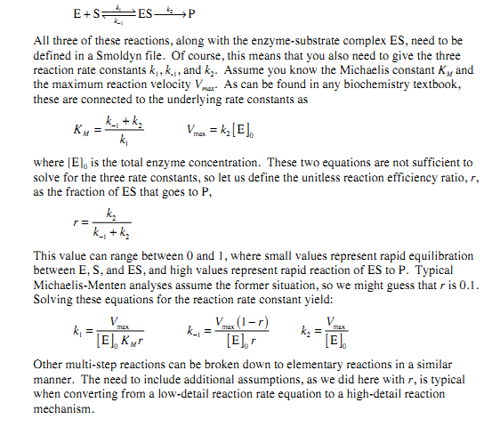
This is for our record only

