Slide 1

XYZ DevOps Transformation
A holistic approach to adopting DevOps concepts and best-practices for XYZ

Slide 2
Outline
Introductions
What is DevOps?
What is a Dojo?
What's Next?

Slide 3

Problem Statement
XYZ has been struggling with environment building, code quality, and the speed in which they are delivering their software.

Slide 4

What is DevOps?

Slide 5
How do you define DevOps?
"Everything you do to overcome the friction created by silos ... All the rest is plain engineering."
Patrick Debois, LinkedIn
Simply, DevOps is the intersection between Software Development and Software Operations.
Notes:
Termed by Patrick Debois in 2009.

Slide 6
Legacy Infrastructure vs Modernized
Legacy
Modern
Long-lived environments
Manual Environment Creation
Manual deployments
Extended downtime for deployments
Managed by AppOps or another team apart from the development team.
Setup and Teardown Environments as needed
Automated and versioned environment creation
Zero downtime environments adopting Blue/Green or rolling deployments
You build it, You own it

Slide 7
Infrastructure as Code
Infrastructure as Code
Automated deployment of resources to multiple providers
Application Infrastructure and hosting is versioned with software code.
Allows for Infra testing and Verification prior to deployment
Allows for elastic infrastructure, scaling environments as needed for
Build One, Deploy Anywhere

Slide 8
So You Want to Join a Dojo?

Slide 9
What is a Dojo?
A Dojo is a high-touch, immersive engagement with coaches built around improving all aspects of value delivery.
Timeline varies, but is generally between 6-10 weeks
Based around the idea of short feedback loops, learning something and applying the concept in the same day

Slide 10
What Can I expect to learn in a Dojo?
Agile Fundamentals
Product Management
Automated Testing
Feature Based development
Git best-practices
Build/Release Pipeline management
Cloud Concepts
Containerization

Slide 11
XYZ Dojo Engagement

Slide 12
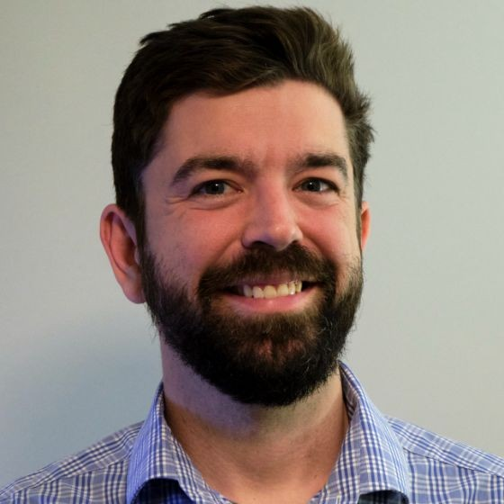
Meet Your Coaches
Ryan Honer
Software Consultant with nearly 15 years of experience in various roles
Began his obsession with DevOps after reading the DevOps handbook

Slide 13
Meet Your Coaches
Coach B
Technical Coach
Focusing on CI/CD and Engineering Mindset
Coach C
Technical Coach
Working on Containers, Kubernetes, and Infrastructure improvements

Slide 14
Weeks 1-2
Focus on Learning and adoption of a Continuous Improvement Mindset
Process Improvements
VSM
Agile
Product
Culture
CI/CD and pipeline improvements

Slide 15
Weeks 3-4
Begin short iterations, between 1-2.5 days
Technical Foundations
Architecture
Unit Testing
Git and Feature Branching
Infrastructure Improvements
Containerization of Apps
Zero Downtime Deployments

Slide 16
Weeks 3-4
Continue to enforce learning. Adopt what the team has been learning
Use repetition of Agile Ceremonies to reinforce muscle memory

Slide 17
Weeks 7+
Congratulations! You have successfully completed your first Dojo!
Moving forward the Coaching team will be focused on another team, but will be checking in with the team at regular intervals to determine if any issues have reared up.

