Slide 1
California Rent
Analysis
Diana Bradberry
Jonathan David
Timothy Wasserman
Brandon Liunoras

Slide 2
Project Background
This project is an exercise in taking a dataset and using it to analyze variables to provide insight into factors influencing the San Fran, California rental market and what we can learn from the data.

Slide 3


Business Q’s
How do rent prices change depending on neighborhood and county?
Does the availability of rentals within a location affect price?
What are the main drivers of rental prices in California?

Slide 4
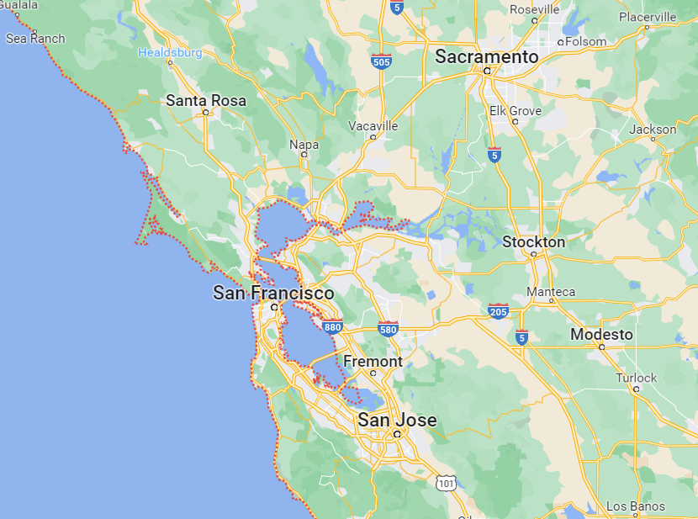

Slide 5
Research Methodology
Publicly available dataset of archived Craigslist rental listings, 2000 - 2018
For workability the dataset was filtered to years 2003, 2008, 2013, and 2018
>14K records with 17 variables; NA values imputed

Slide 6
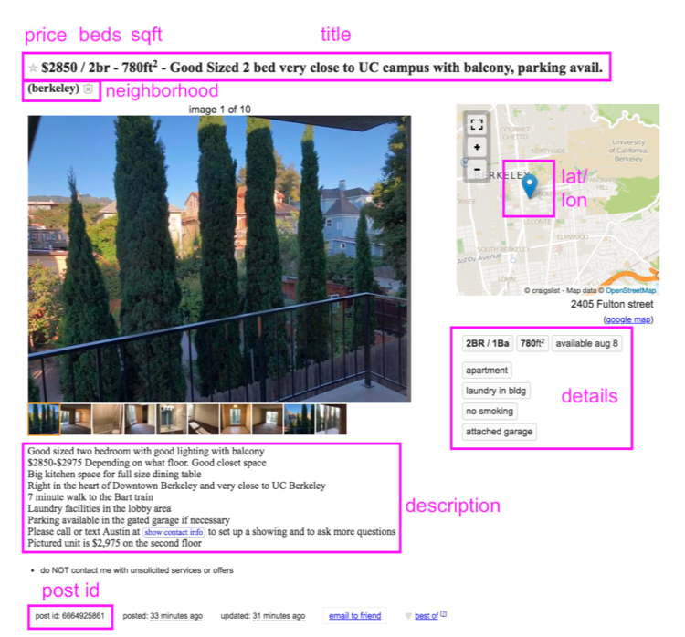

Slide 7
Research Methodology
Individual Regression Modelling
Different variables within the dataset were tested within a linear model against the variable price to see which variables solely affected the rental price.
The code used reads as a summary of a linear model, with price being the variable, and other columns such as “city” as the independent variable.
Multiple Regression Modelling
Across models summary statistics were not sensitive to whether a full, or 75% validation, dataset was used to fit the model.
Models were also very similar after removing predictors identified by the backwards elimination procedure.
Note: This study is subject to several limitations; it utilized data from one geographic location; sourced from only Craiglist posts. Data up to the year 2018; only the price of rentals was available- actual paid rent may have been different from the list price.

Slide 8
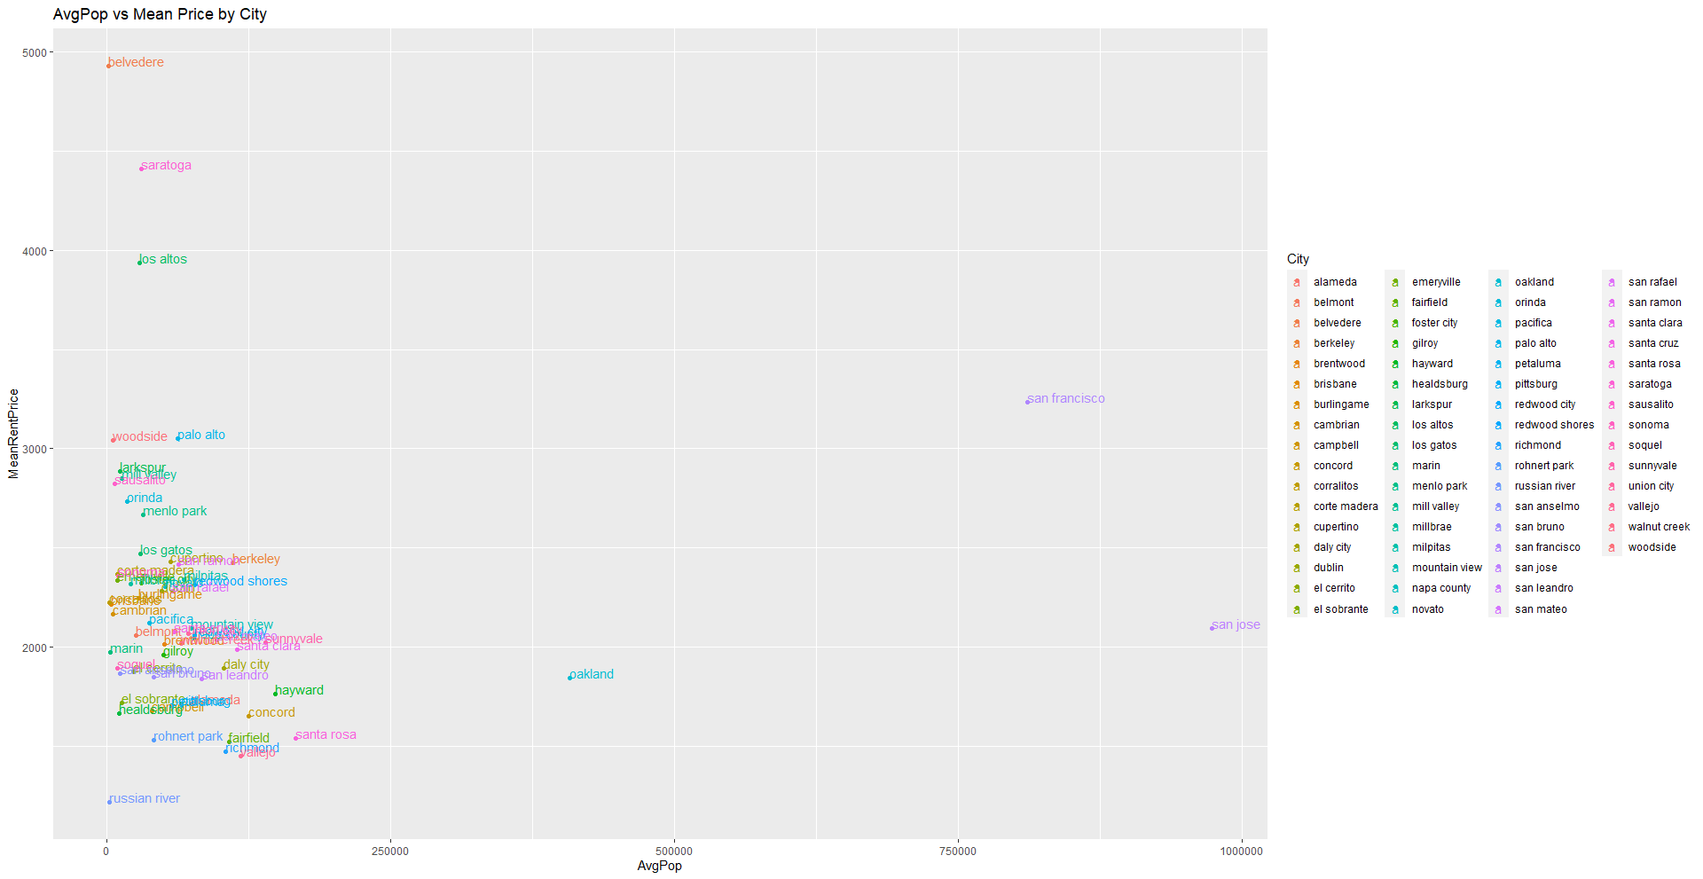

Slide 9
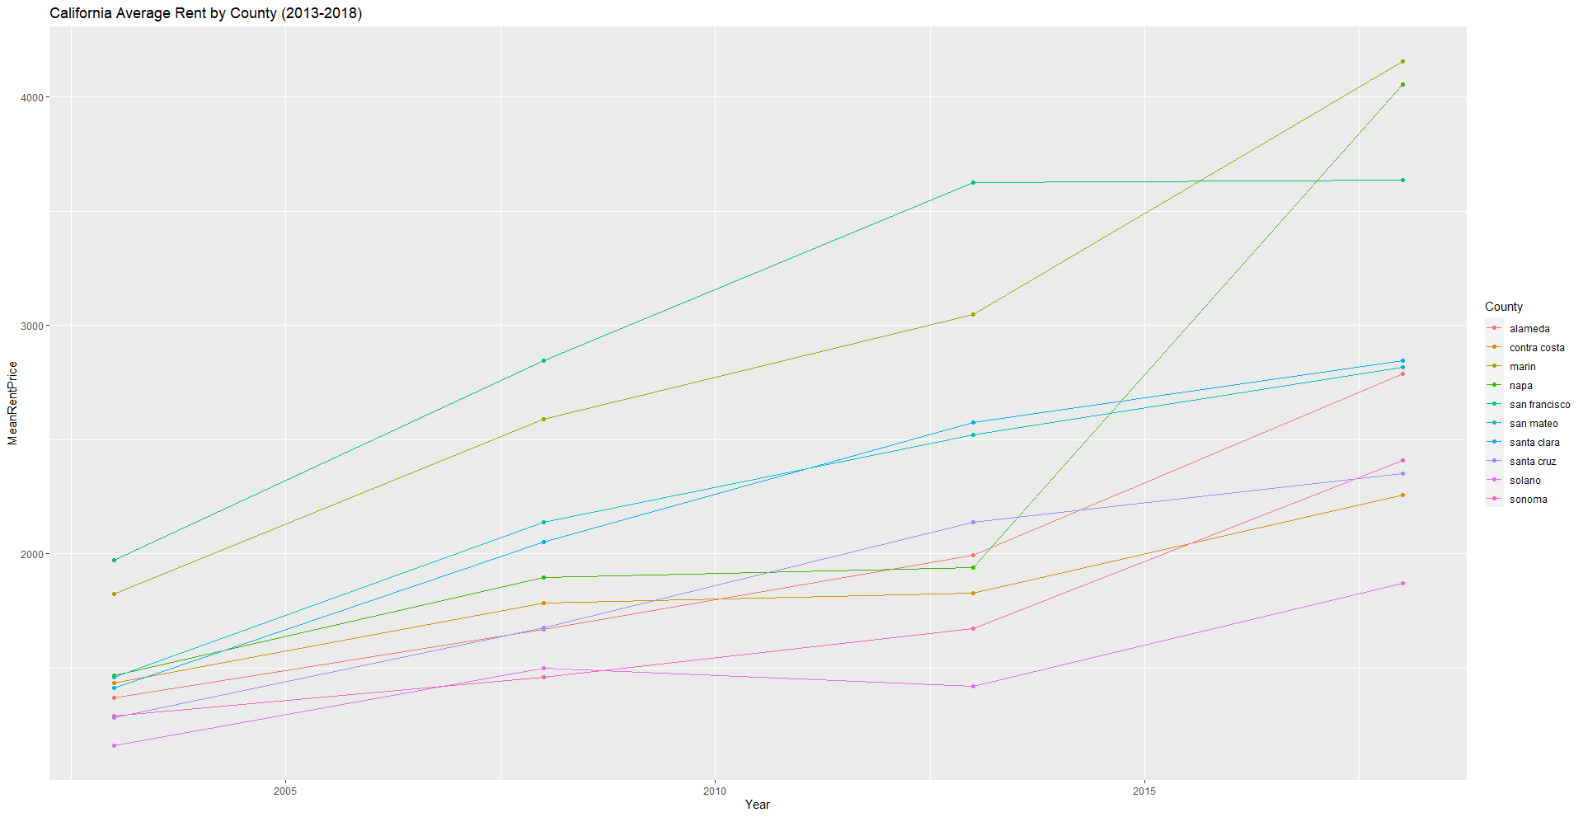

Slide 10
Results
Independent Variable | Adjusted R-Squared
County | 0.1189
City | 0.1538
Neighborhood | 0.2186
Sqft (Square Footage) | 0.02762
Beds | 0.2002
Baths | 0.0177

Slide 11
Results
Model* | Adjusted R-squared | RMS Residual
Full-dataset; all predictors | 0.5895 | $1,030
Full-dataset; predictors remaining after backwards elimination | 0.5886 | $1,031
75% training model; all predictors | 0.5900 | $1,021
75% training model; predictors remaining after backwards elimination (Final Model) | 0.5896 | $1,021

Slide 12
Results (Final Model)
Predictor* | Estimate | Importance (max=100)
Year | $112 | 50
Beds | $725 | 73
Baths | $84 | 5
SQFT | $0.30 | 19
Neighborhood: SOMA South Beach | $2,240 | 37
Neighborhood: Pacific Heights | $2,519 | 33
Neighborhood: Russian Hill | $2,421 | 25
Neighborhood: Marina Cow Hollow | $1,939 | 23
Neighborhood: Nob Hill | $1,269 | 18

Slide 13
Conclusion
Studied Bay Area rental price by location and apartment attributes
The linear model showed that all available predictors- year, beds, baths, square feet, and neighborhood- significantly impacted price
Beds, and neighborhood (location, location, location!), were more important for price than baths and square feet
Results may be useful for policy makers and other audiences interested in the dynamics underlying Bay Area housing prices
This study may also be useful to investors, landlords, and others with an interest in ROI and the factors that command premium rental prices

Slide 14
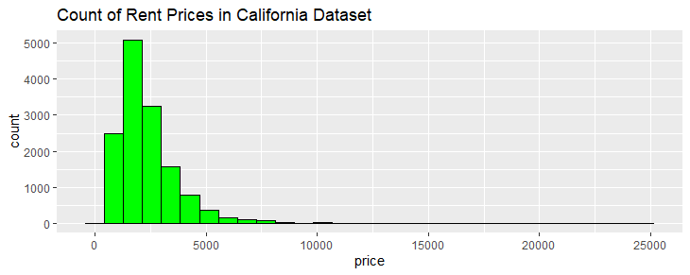
Appendix

Slide 15
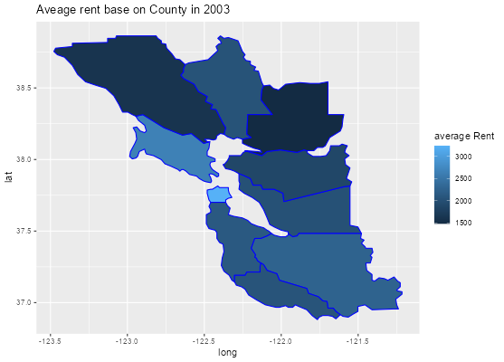
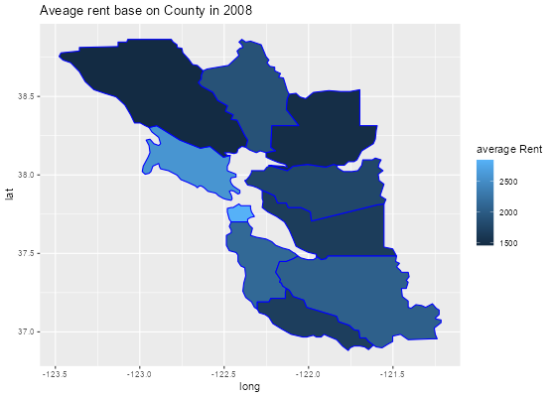


Appendix

Slide 16
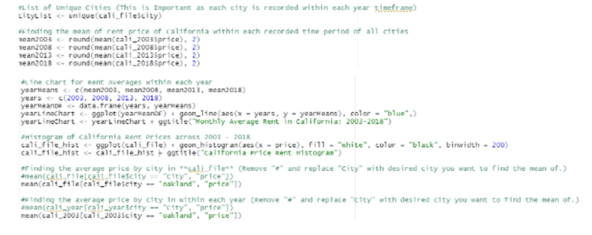
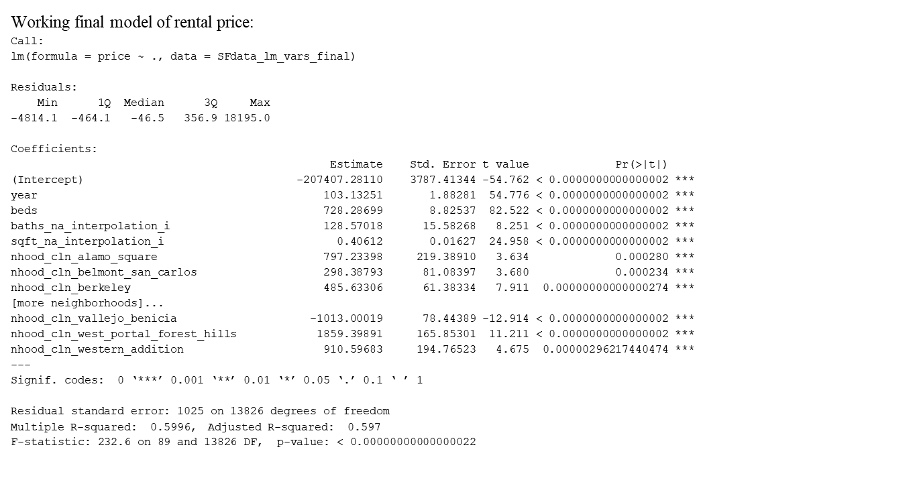
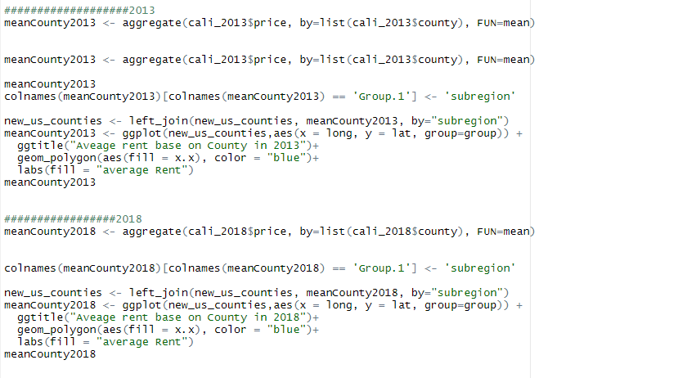
Appendix

Slide 17
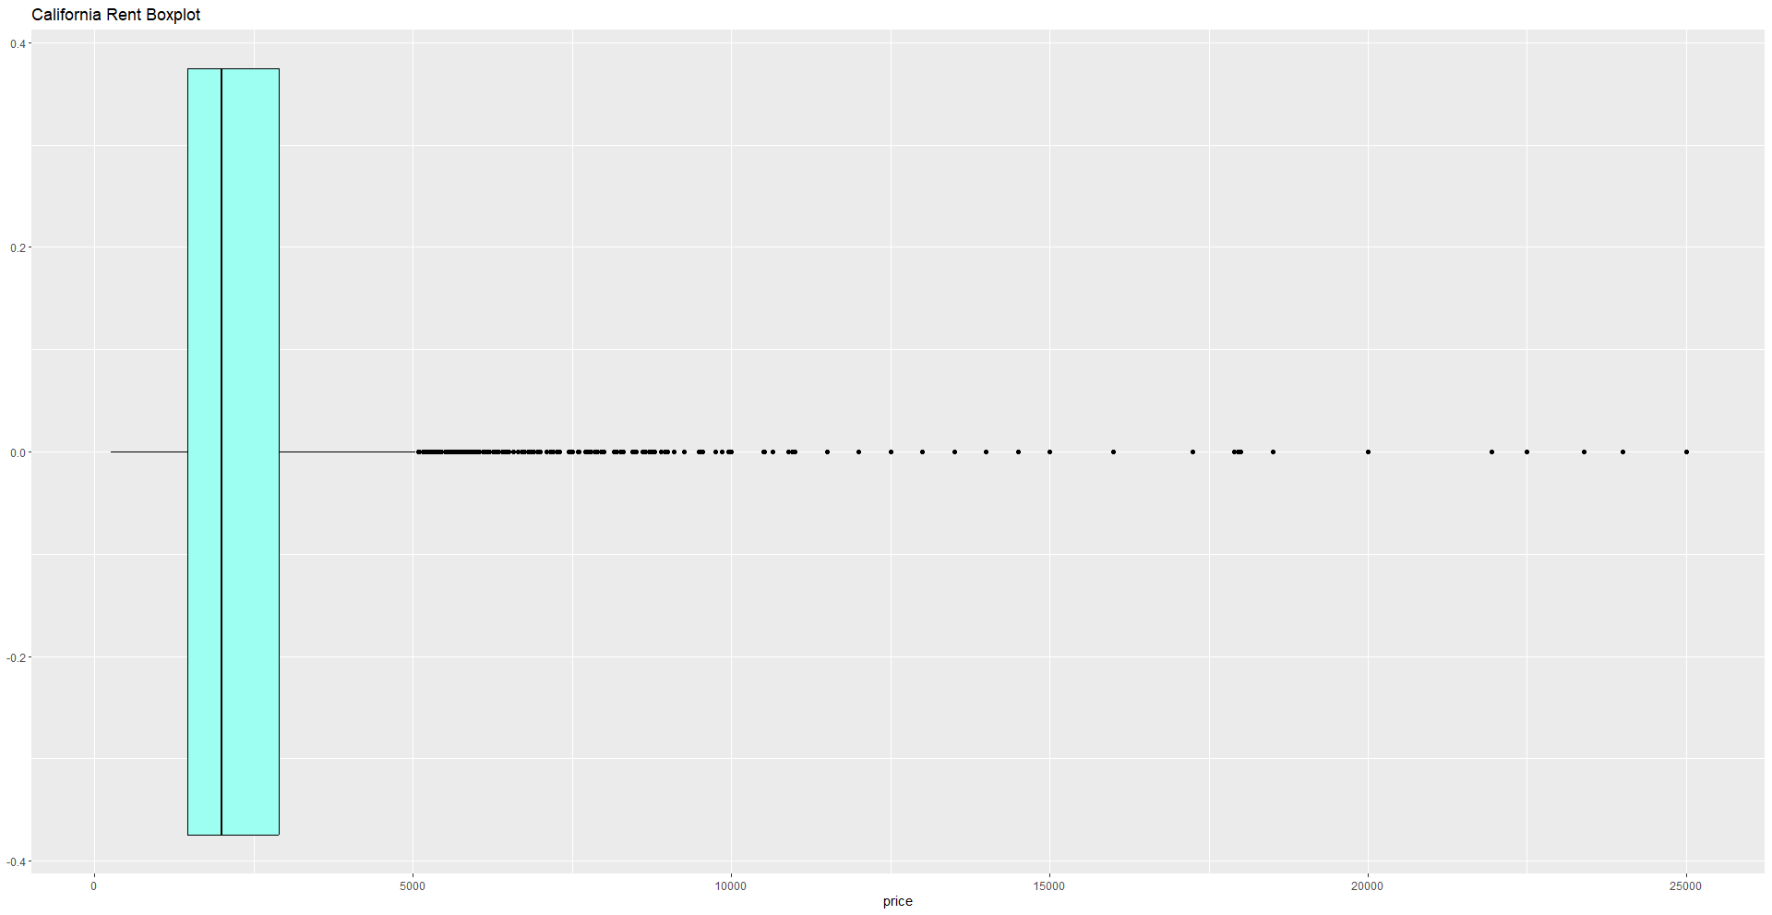
Appendix

Slide 18
Appendix

