Slide 1
Final Project DAtabase
Brandon Liunoras
IST 659

Slide 2
Introduction
This project is the building of a SQL database made in Azure Data Studio and is used in the AdMiner provided at the beginning of the class. The purpose of the database is to manage the data of a fictitious event management company called Brandon’s Hospitality Holdings (BHH).

Slide 3
Tables
bookings
  This table is used to show the different events that are being hosted at Brandon’s Hospitality Holdings (BHH). Key information such as who is hosting, who is coordinating, and other businesses that are used during the event will appear here in this table. This table has the most foreign keys as it holds relationships with all other tables except for two tables. At least one element is present in the table from six of the eight other tables in the database.
registrants
  This table houses all of the clients that want to host an event at BHH. These people are the ones responsible for payment for the event and being present at the event. Each registrant is the point of contact for any changes to the event that they want to host.
coordinators
  This table holds all of the coordinators that work for BHH to execute the event for the registrant. This table has a special relationship with a lookup table to show the job titles of each different coordinator.

Slide 4
Tables
vendors
  This table holds all of the verified vendors that have been vetted and approved to be partner businesses for BHH. This table has a special relationship with a lookup table to show the different types of vendors that are available during an event.
location_lookup
  This lookup table houses the four locations that are available for event use for the registrants at BHH.
vendor_type_lookup
  This lookup table houses the different types of vendors that are available for use at a BHH event. Types of vendors include catering, entertainment, and utility for event management.

Slide 5
Tables
job_title_lookup
  This lookup table houses the different job titles for the many coordinators at BHH.
event_type_lookup
  This lookup table houses the different event types that a registrant can have at BHH. Such event types include weddings, birthdays, business meetings, and other general celebrations.
event_status_lookup
  This lookup table is especially important for the coordinators as this table denotes the different statuses of an event. It tells coordinators if an event has been completed, confirmed, canceled, and other different statuses that event can be attributed.

Slide 6
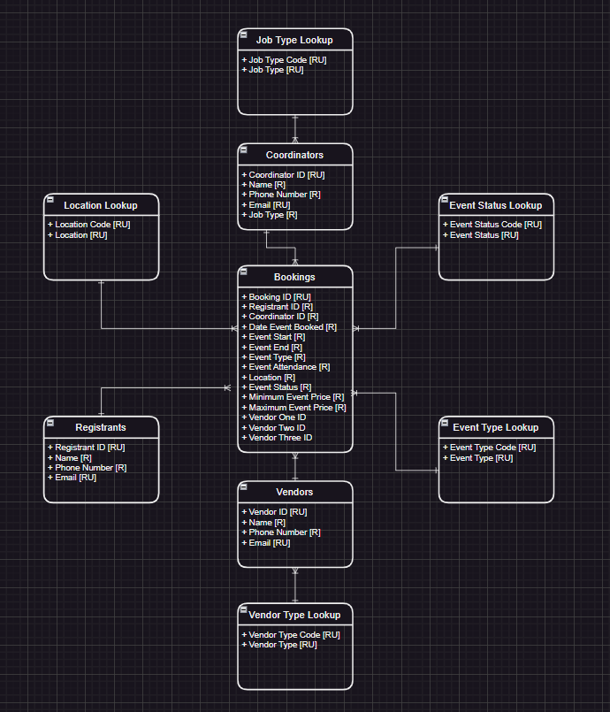
Conceptual Model

Slide 7
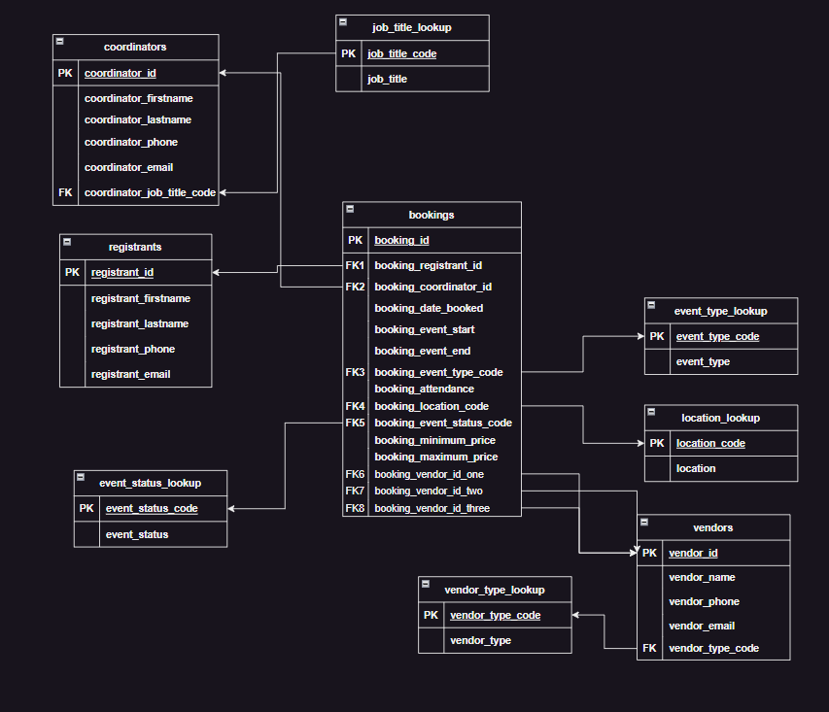
Logical Model

Slide 8
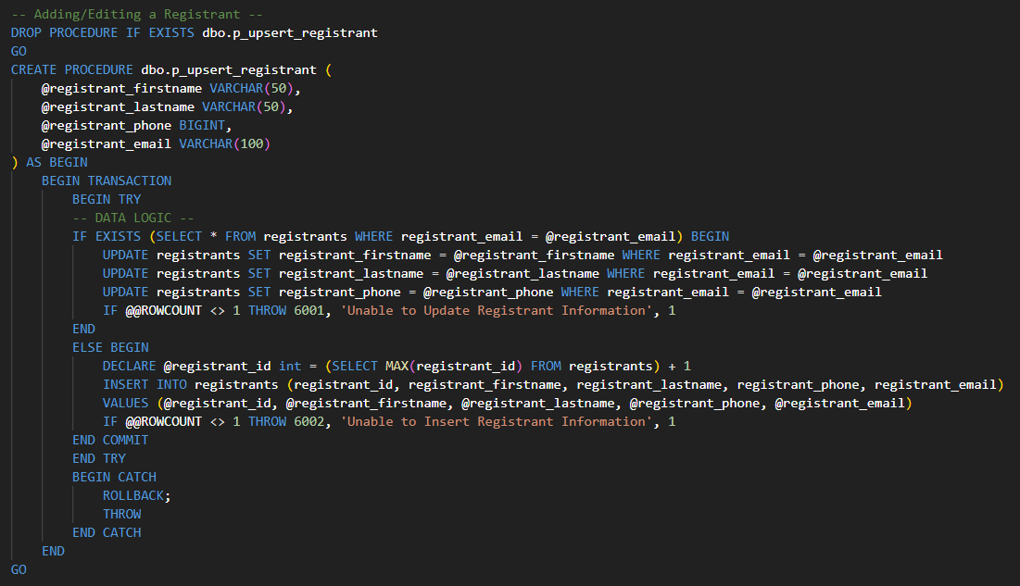
Procedures

Slide 9
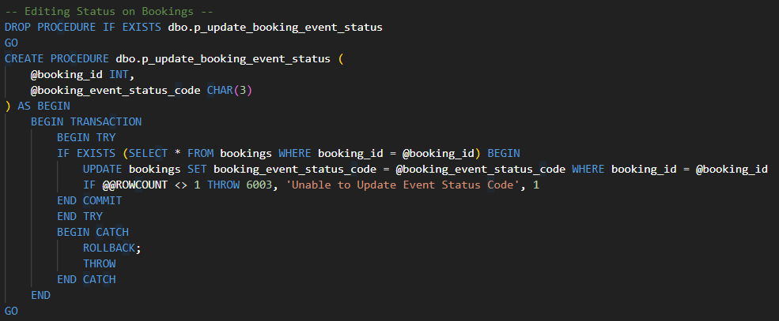
Procedures

Slide 10
Applications
As for real-world applications for the database, this type of database can be used in any scenario that needs either sales, events, or timings of logistics. The organization that this database offers gives streamlined information and can even be put into other formats such as invoice forms, calendars, and memos for invitations, depending on the different situations. The database houses a multitude of information for anything you can you use.

Slide 11
Reflections
Looking at my project, I feel that if I had more time, I would put more effort into the database. I would put in triggers to automatically set up data and times for when each booking is created. I feel that if I had more knowledge in this field, I would set up versioning and locks to ensure that there is more data security.

