Slide 1
Spotify Data Project
Brandon Liunoras
YouTube Link: https://youtu.be/GnYSZbvW0D0

Slide 2
Purpose
The purpose of this project is to move Spotify data into dataframes and then utilize that data for analysis to derive new information and insights about song data. Afterwards, it will be stored into MongoDB for future use.

Slide 3
Programs USed
SPOTIFY API
SPOTIPY
JUPYTER NOTEBOOK
MONGO DB

Slide 4
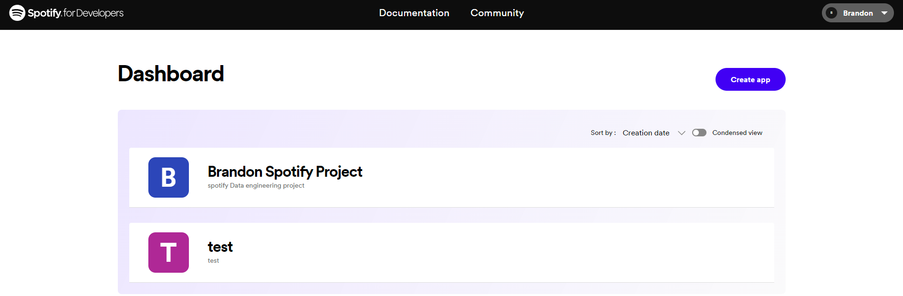
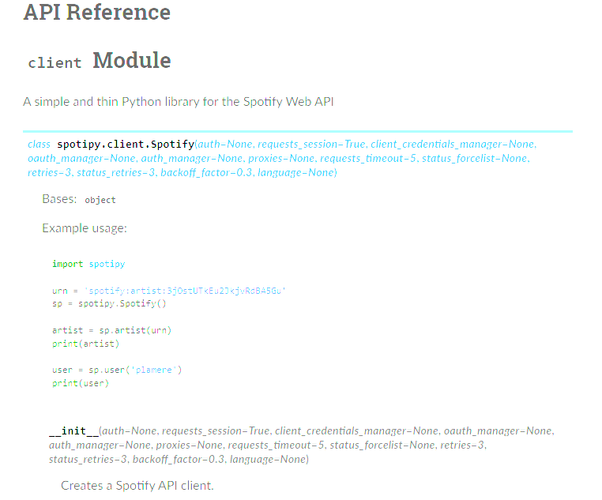
Spotify API
Before anything can work, a Spotify Developer account is needed as well as an authorization to an app. This allows access to a client_id and client_secret.
To perform any commands in Spotipy, it is recommended to go through the reference information on the main website

Slide 5
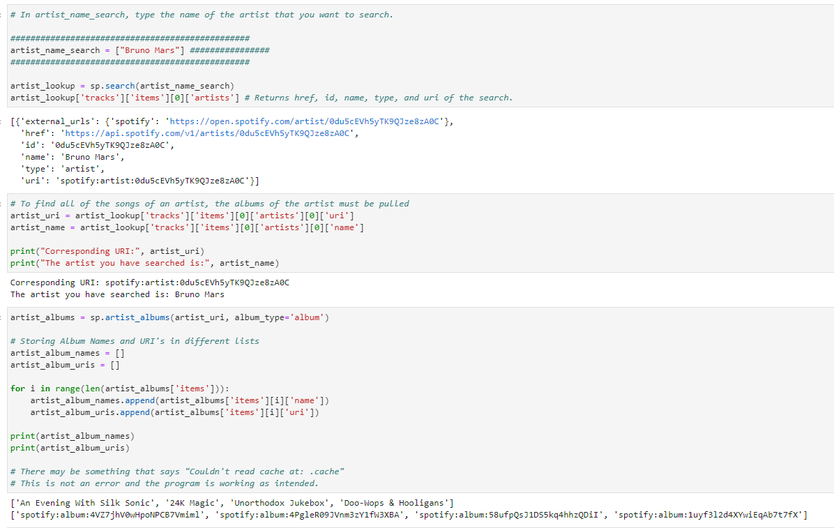
The Architecture
This module is used for API calls using Spotipy. It works by using Spotify Search and API references to seek out different data tags. This then returns
In the module, it works by searching for artist names to return URI and album information. This in turn gives song information.

Slide 6
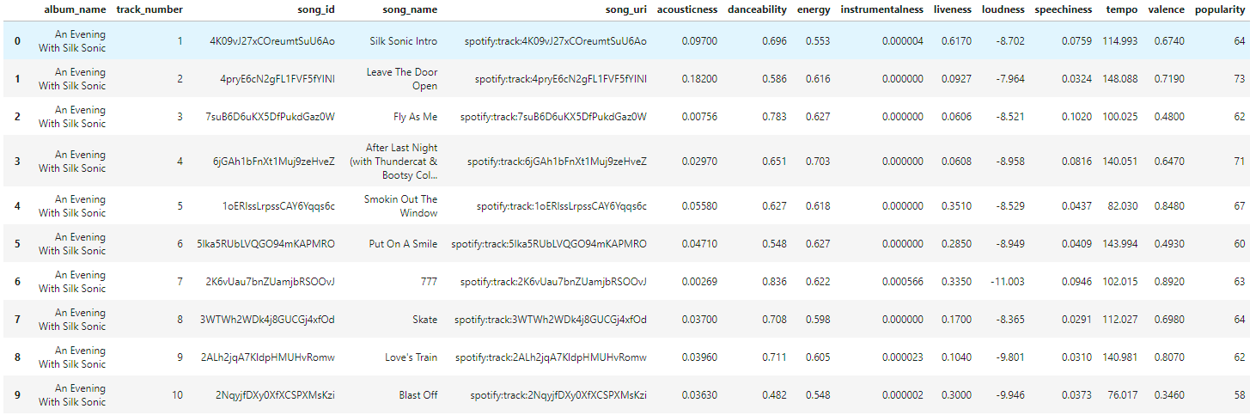
The Data
The data shown is from the API call module. It displays a myriad of song identifiers as well as different attributes about the song such as energy, valence, and tempo.
This data is then used for exploratory analysis and multivariate regression.

Slide 7
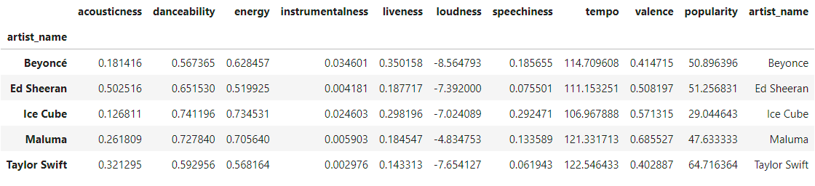

Exploratory Analysis
The figures to the right display averages of the song attributes for each artist.
On the next slide are comparison graphs of the same data. This displays the disparity in popularity in each artist as well as what the average song sounds like for each artist.

Slide 8
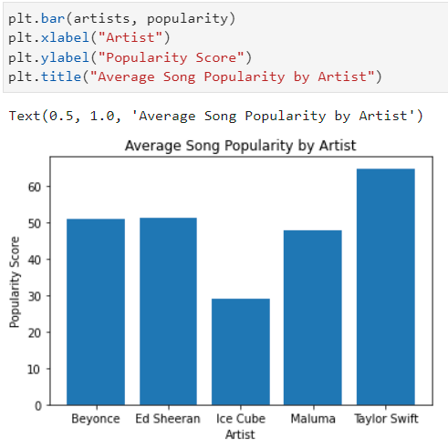
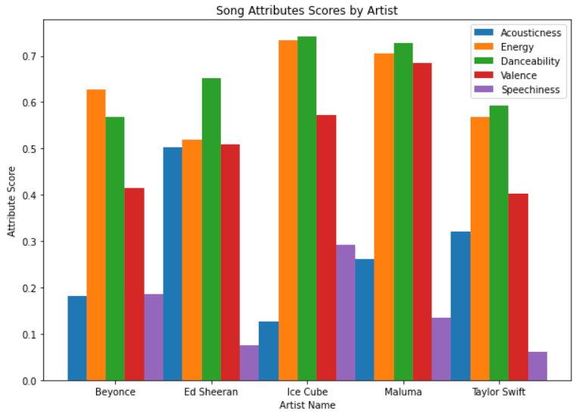
Exploratory Analysis

Slide 9
Regression and More
• Maluma r-squared = 0.09984551515258588
• Taylor Swift r-squared = 0.296912042382258
• Ice Cube r-squared = 0.10339604740270782
• Ed Sheeran r-squared = 0.08344167274465603
• Beyonce r-squared = 0.29099386768949465
These r-squared coefficients display that the song attributes bear little to explain what makes an artist’s song popular.
As for the regression analysis, a multivariate linear regression model was created to see if and what variables could explain a song’s popularity on Spotify.
This process was repeated with each artist. The following results show the r-squared values of each artists’ songs regarding song attributes versus popularity.

Slide 10
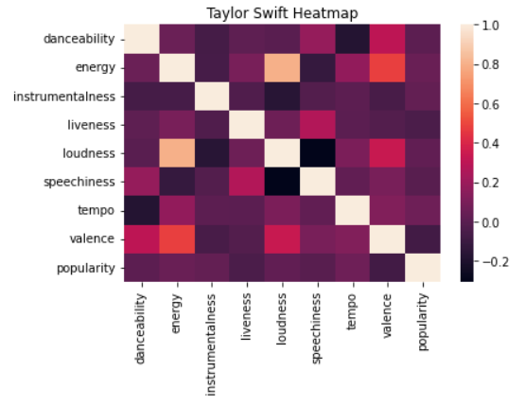
Regression and More
After the regression model was executed, heat maps for each artist were created to show correlations between different attributes of songs. The main attribute observed was popularity and its interactions with the other attributes

Slide 11
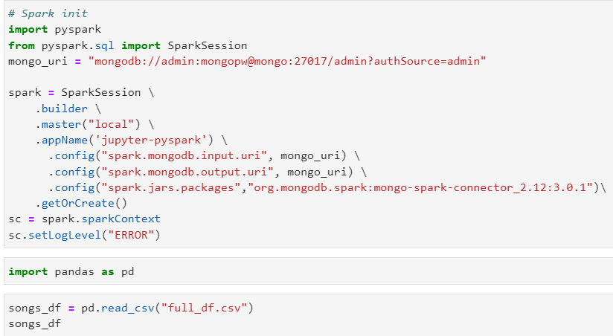
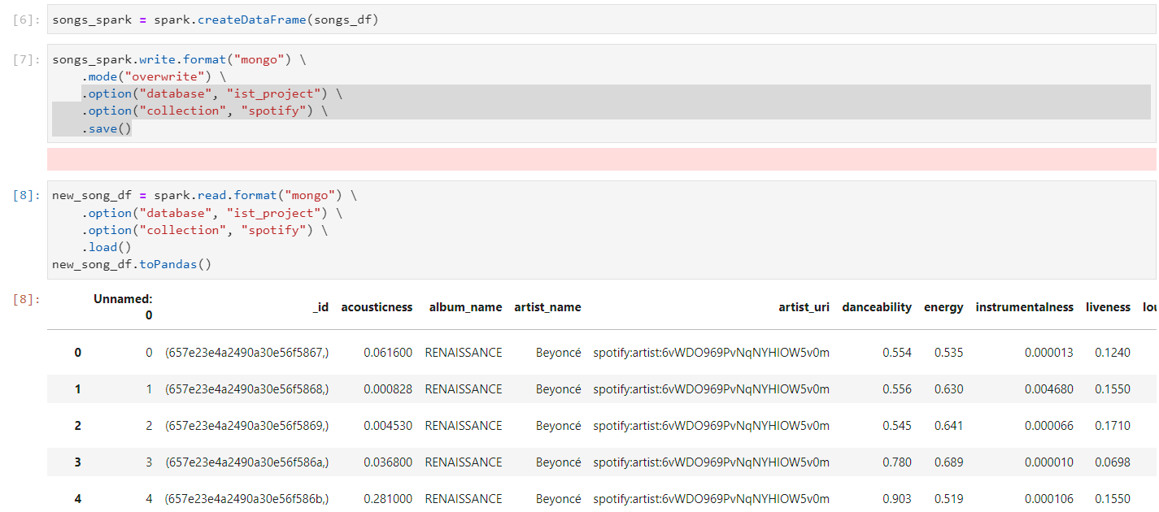
MongoDB Storage
After all analysis is made, a dataframe was created to house all the individual dataframes into one.
The large dataframe was then saved as a csv file and then transferred to a different environment to be converted from a pandas dataframe to a spark dataframe.
From there, the dataframe was loaded into Mongo and then read back out to ensure that it was stored correctly.

Slide 12
SUMMARY
The Spotify data used was insightful when it comes to learning about song data and how users on Spotify perceive songs. This data can be very useful to derive other information such as creating song recommendations, playlist creations, and ad targeting, all based on what songs are listened to and what their attributes are. Overall, I enjoyed using Spotipy and Spotify API to look at song data and derive new insights. I will continue to use this API and MongoDB for future projects.

Slide 13
THANK YOU
Brandon Liunoras​
IST 769
Spotify Data Project
YouTube Link: https://youtu.be/GnYSZbvW0D0

