Slide 1
comments
Much much more context and background
Diagrams of systems and how investigated in general
FERROMAGNETIC RESONANCE – also sweeping the field strength
Illustrate why useful – distinguish from nmr
Field space diagrams

Slide 2
Exploring the Dynamical Behaviour of Spin Waves Through Energy Absorption Interferometry
Felix Biggs

Slide 3
Overview
Introduction, Methodology
Dipole properties & responses
EAI
Further investigation of properties

Slide 4
Introduction
General technique, based on partially coherent energy absorption
Used previously on electric dipoles – here will be applied to magnetic
Spin waves – large static field aligns and smaller time varying excites

Slide 5
EAI
The excitation is caused by phase-locked sources
P(Δϕ) measured → fringe → complex visibility
Source positions varied, EAI then reconstructs modes of system
Requires only P! So widely applicable.

Slide 6
Methodology
I. Discretise system (always possible using DDA)
  Calculate response matrix of given system
  Simulate its response to given sources
II. Use EAI to reconstruct response
III. Investigate system properties further

Slide 7
Implementation
Use MATLAB – highly efficient for matrix manipulation and plotting
Make code modular so changing system is only modifying a few parameters
Investigate `known' properties to check for bugs

Slide 8
Theory of Magnetic Dipoles
Evolve according to Landau-Lifshitz-Gilbert:
For single dipole in strong fixed field, response dyad (similar to tensor):

Slide 9
Discrete Version
Use greens function from sources:
This gives us complex amplitudes at dipoles:
Then apply coupling and scattering to get h(tot)

Slide 10
Power Absorbed
At a dipole, field is sum of ext, coupling and scattered (which destroys information):
Define response matrix:
Can be broken down into terms from scattering and coupling (kappa is scattering):

Slide 11
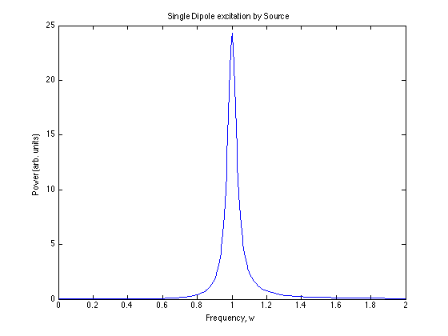
Power Absorption: 1 Dipole, 1 Source
Circularly Polarised source at (1,1). Dipole at (0,0) with w0 = 1, gamma (damping) = 1/16. All constants set to 1 for simplicity.

Slide 12
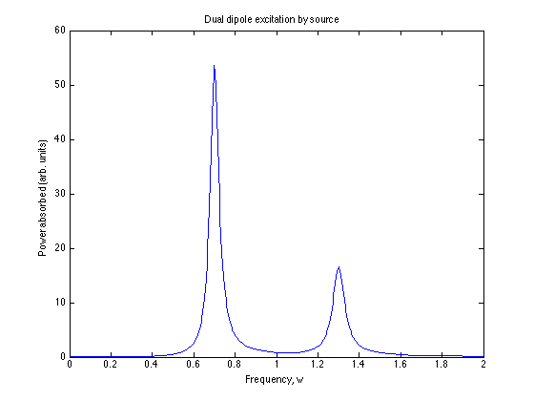
Power Absorption: 2 Dipoles
Same source, same dipole properties but now two, at (0.4,0) and (-0.4,0), directly coupled with coefficient 0.3.

Slide 13
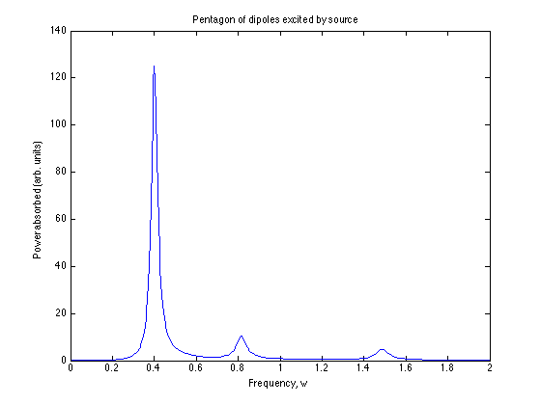
Power Absorption: 5 Dipoles
Same source, same dipole properties. Now 5, at (0.4,0) etc around (0,0), directly coupled with coefficient 0.3. 3 modes, lowest frequency one most easily excited.

Slide 14
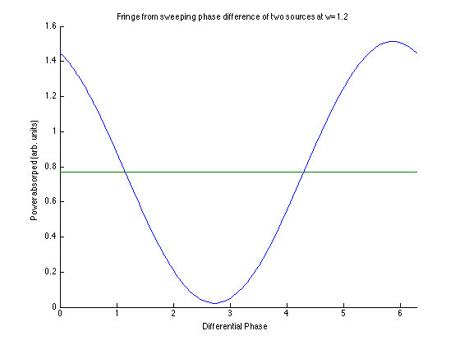
Fringe from 2 sources, 10 dipoles
Green line shows sum of powers of two sources independently

Slide 15
How does this compare with theory?
Lorentzian shape for 1
2 dipoles coupling – 2 modes expected - think about geometry for absorption
5 dipoles – lowest mode most excited
Fringe – as expected

Slide 16
Side note: Positive Power
Looking at equations we see there are solutions giving negative power absorption (opposite direction rotation).
i.e. S has -ve and +ve eigenvalues for w>w_0
However we are manifestly in the steady state regime.

Slide 17
Side note: Positive Power 2
These excitations would be 'damped out' in practice, so we remove them.
This is done simply be decomposing the field at each dipole:
h = a(1,i) + b(1,-i)
Then set h = a(1,i)

Slide 18
Theory of EAI in Brief
For two coherent sources:
Assemble matrix H = [h1,h2,...hn] for n source positions
Rewrite:

Slide 19
EAI 2
However a little maths shows us that:
Where P(ii) is power absorbed by single source i, and P(ij) is power absorbed by both i and j, and phi is the phase difference.
This neatly allows us to populate A, and if we know the source properties, calculate L using the H.
It seems odd that we use our knowledge of source positions but makes sense if we use DDA.

Slide 20
EAI 3: SVD
In general dim(A) != dim(H) so H is not invertible to find the dual.
In this case we use SVD:
We can also plot the complex visibility as a function of position(j) for fixed (i) to look at coherence lengths etc.

Slide 21
Eigenvalues
Once we have reconstructed L, we may diagonalise it.
This gives the eigenvector excitations – i.e. the ways in which we can excite the sample in only one mode.
Some examples are plotted for investigation of the systems – they illustrate that individual modes are simply Lorentzian

Slide 22
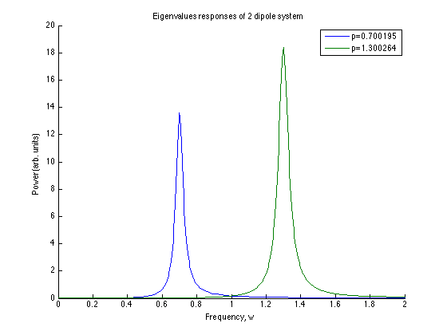
Eigenvalue responses: 2 dipoles
Same 2 dipole configuration as before. Responses due to each of 2 eigenvectors.

Slide 23
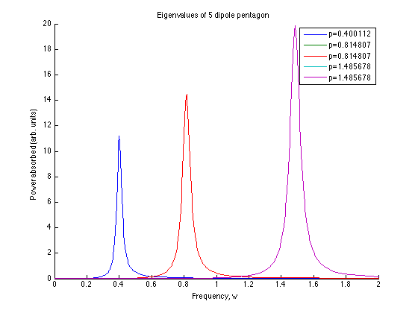
Eigenvalue responses: 5 dipoles
Two sets of degenerate modes, plus lowest freq one

Slide 24
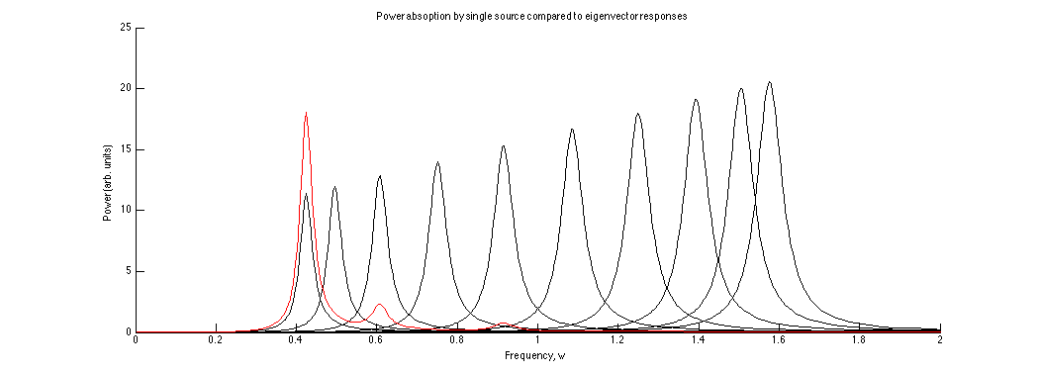
Eigenvalue responses: 10 dipoles
Dipoles in line eigenvalues and excitation by source at (5,5). Most excited modes are 'fundamental', w1, sqrt(2)*w1 and 2*w1. Seems to be shown for other numbers. Interestingly they are also lowest modes available for end coupled version

Slide 25
Longer chains – some properties
End coupling increases favouring of lowest mode excitation
Tend to get multiples of sqrt(2) most excited
Moving source closer excites higher modes more
Quite obvious comparison with string modes

Slide 26
Discussion
Individual eigenvector responses look as expected.
Number of generally modes makes sense
Can see slightly better if look at individual eigenvectors
Interesting responses for linear chains to sources

Slide 27
Conclusions
System gives expected responses
EAI works for recovering those responses
Responses are generally as expected
Other things that I have looked at: coherence volumes, many different systems (especially circular ones), relative dipole orientations (with arrows) and magnetic field throughout space of various modes.

Slide 28
Questions?

