Slide 1
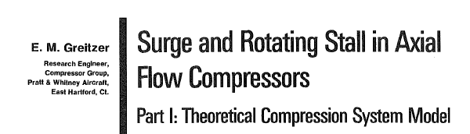
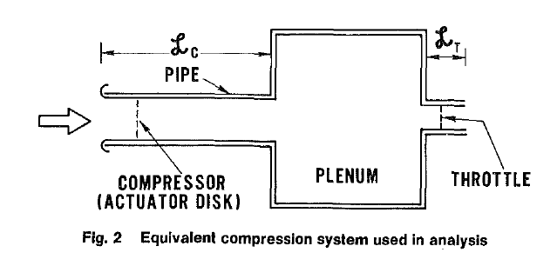
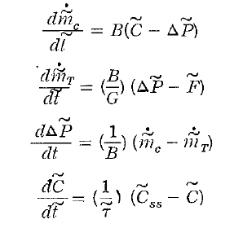
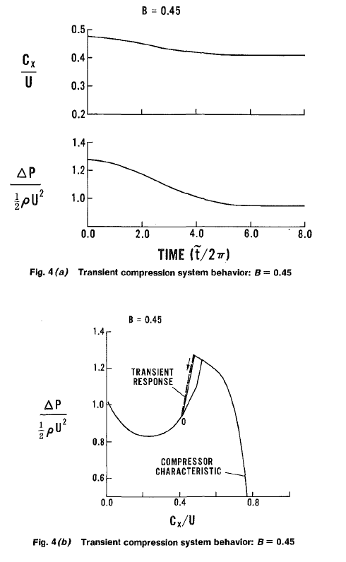
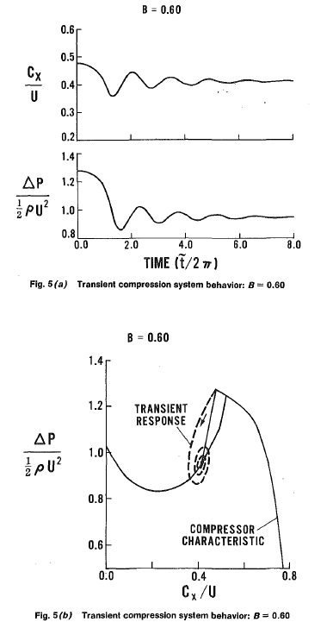
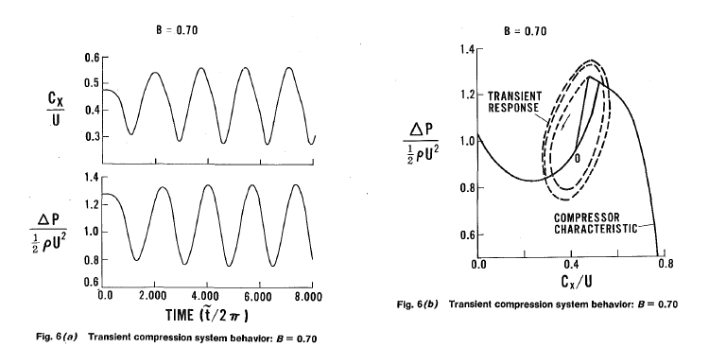
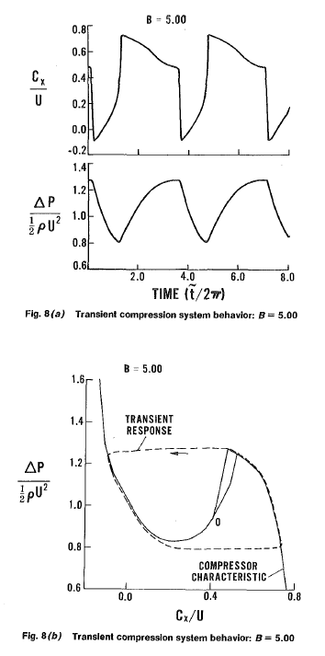
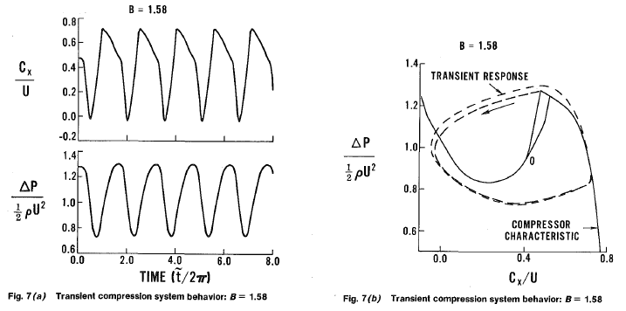
Greitzer EM. Surge and rotating stall in axial flow compressors—Part I: Theoretical compression system model. Journal of Engineering for Power. 1976 Apr 1;98(2):190-198.
物理模型
数学模型
参数研究
B=0.45
B=0.6
surge
B=0.7
B=5.0
rotating stall
rotating stall
surge
B=1.5
surge

Slide 2
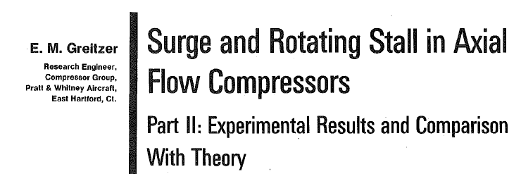
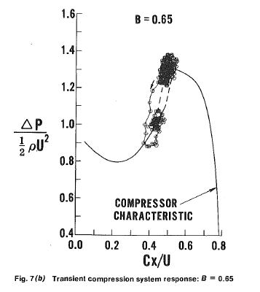
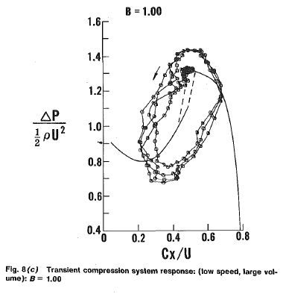
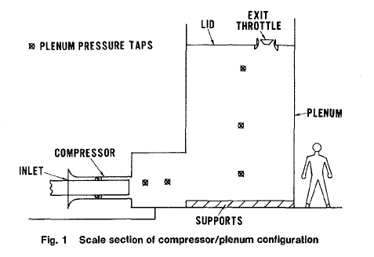
Greitzer EM. Surge and rotating stall in axial flow compressors Part II: experimental results and comparison with theory. J. of Engineering for Power. 1976 Apr 1;98(2):199-211.
实验装置示意图
实验结果验证理论模型
rotating stall
surge

