Slide 2
B
A

Slide 3
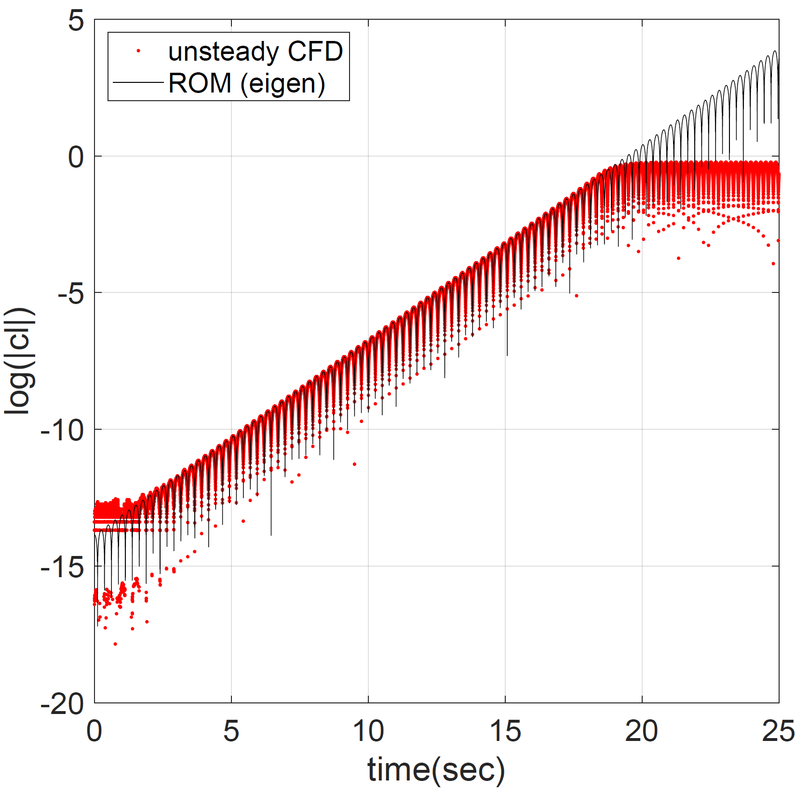
Experiments
with very
long cylinder
B
Oscillation
frequency
same as
that of B
Eigenvalue prediction
usig baseflow
Oscillation frequency
same as that of A
A

Slide 4
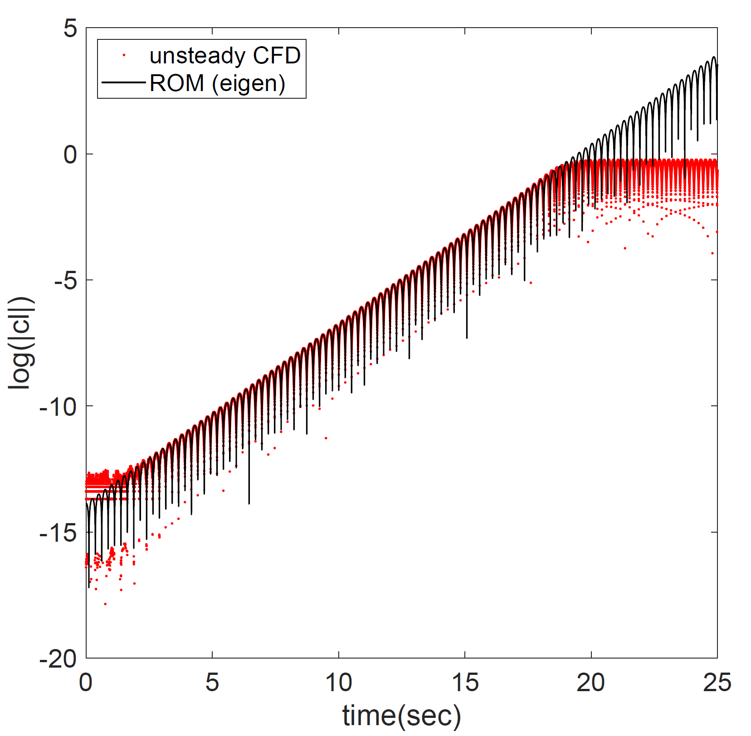
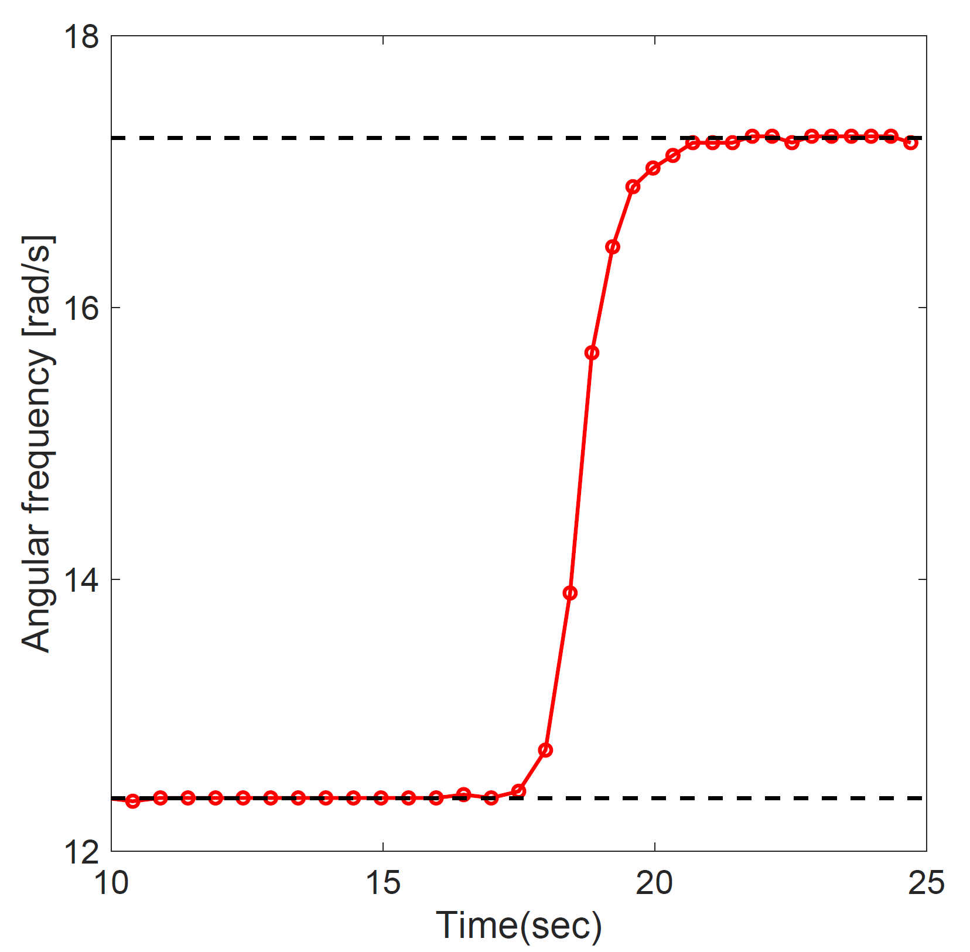
B: ω=17.25 rad/s (St=0.162)
A: ω=12.39 rad/s (St=0.116)

Slide 5
