Slide 1
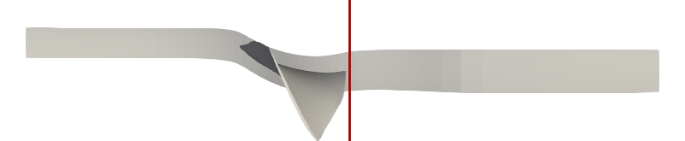
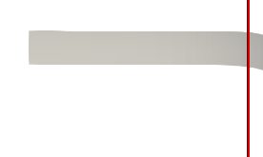
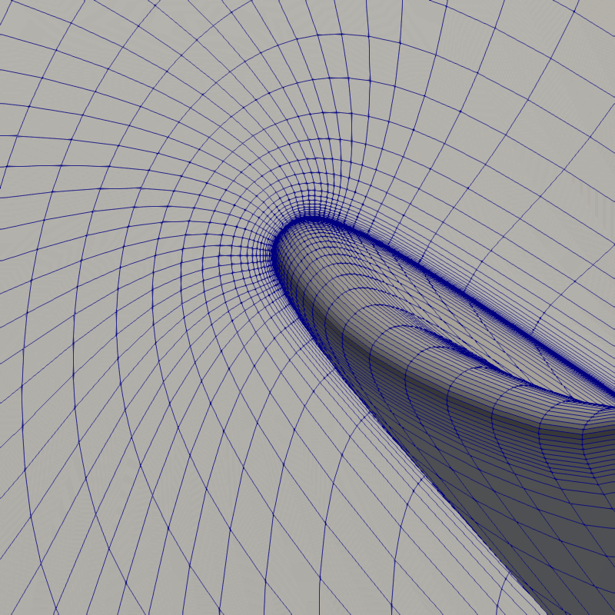
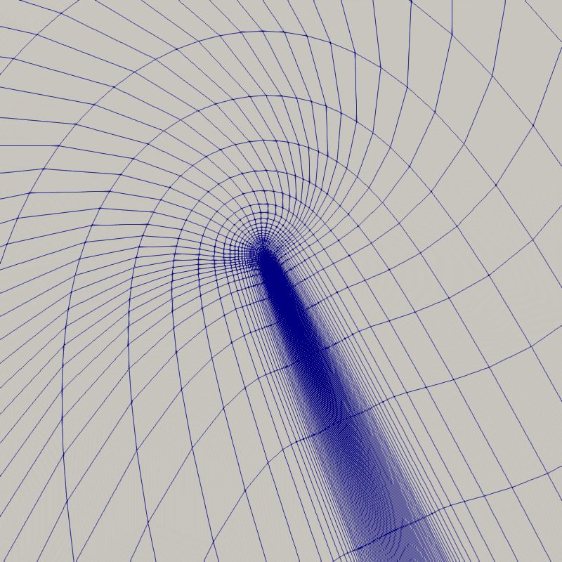
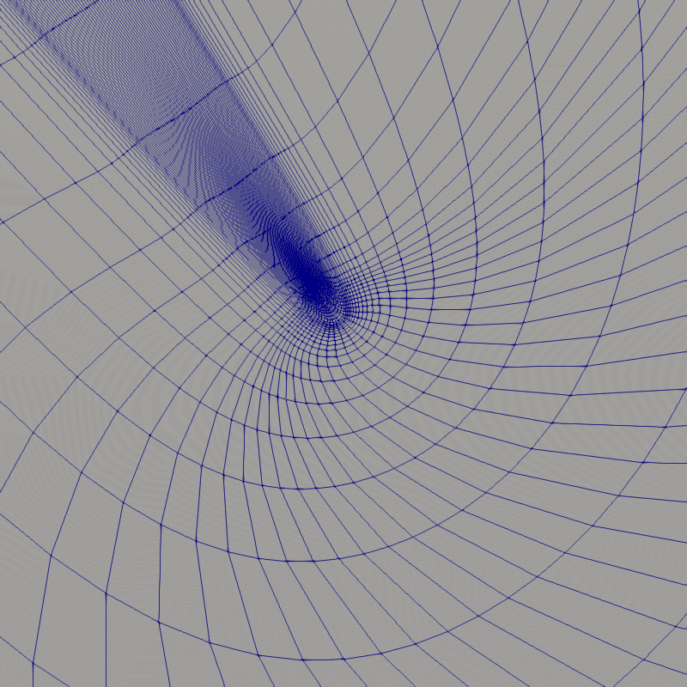
Rotor blade viewed from tip
inlet
outlet
Rotating
Mesh around
leading edge
on hub
Mesh around
leading edge
on shroud
Mesh around
trailing edge
on shroud

