Slide 1
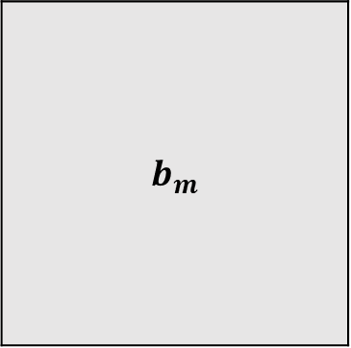

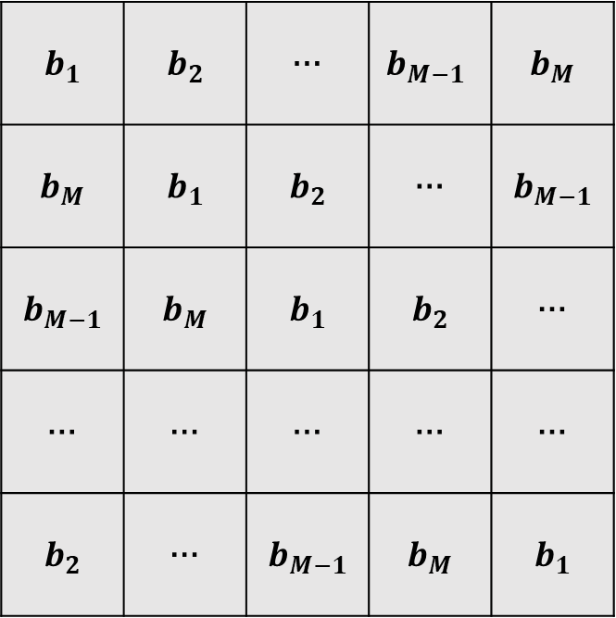



$$b_{1}$$ | $$b_{2}$$ | … | $$b_{M−1}$$ | $$b_{M}$$
$$b_{M}$$ | $$b_{1}$$ | $$b_{2}$$ | … | $$b_{M−1}$$
$$b_{M−1}$$ | $$b_{M}$$ | $$b_{1}$$ | $$b_{2}$$ | …
… | … | … | … | …
$$b_{2}$$ | … | $$b_{M−1}$$ | $$b_{M}$$ | $$b_{1}$$
$$b_{m}$$
$$M×N$$
$$N$$
$$N$$
$$M×N$$

Slide 2

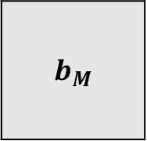

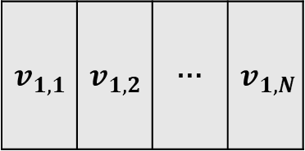
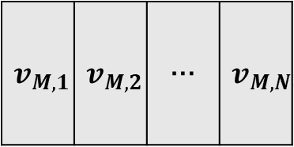
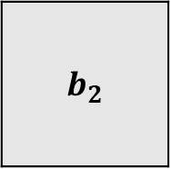

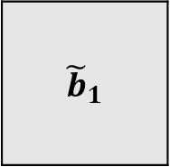
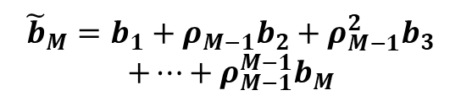
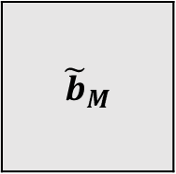
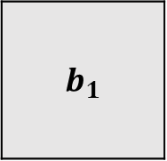
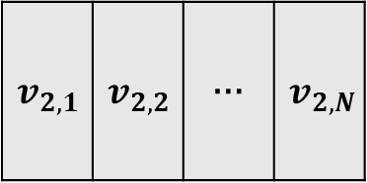
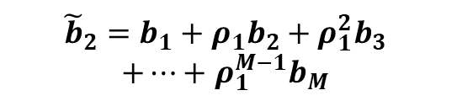


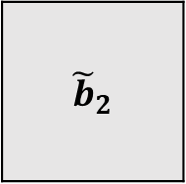


块矩阵
块矩阵
特征值
$$λ_{1,1}$$ | $$λ_{1,2}$$ | … | $$λ_{1,N}$$
$$b_{1}$$
$${\tilde{b}}_{1}$$
特
征
向
量
$$v_{1,1}$$ | $$v_{1,2}$$ | … | $$v_{1,N}$$
${\tilde{b}}_{1}=b_{1}+b_{2}+b_{3}+$ $b_{M}$
$$m=1$$
块矩阵
块矩阵
特征值
$$λ_{2,1}$$ | $$λ_{2,2}$$ | … | $$λ_{2,N}$$
$$b_{2}$$
$${\tilde{b}}_{2}=b_{1}+ρ_{1}b_{2}+ρ_{1}^{2}b_{3}$$
$+…+$ $ρ_{1}^{M−1}b_{M}$
$${\tilde{b}}_{2}$$
$$v_{2,1}$$ | $$v_{2,2}$$ | … | $$v_{2,N}$$
特
征
向
量
$$m=2$$
…
…
…
块矩阵
块矩阵
特征值
$$λ_{M,1}$$ | $$λ_{M,2}$$ | … | $$λ_{M,N}$$
$${\tilde{b}}_{M}=b_{1}+ρ_{M−1}b_{2}+ρ_{M−1}^{2}b_{3}$$
$$+…+ρ_{M−1}^{M−1}b_{M}$$
$$b_{M}$$
$${\tilde{b}}_{M}$$
特
征
向
量
$$v_{M,1}$$ | $$v_{M,2}$$ | … | $$v_{M,N}$$
$$m=M$$

Slide 3


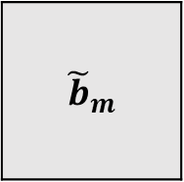
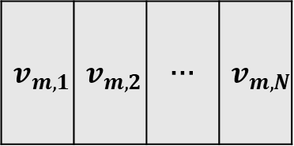


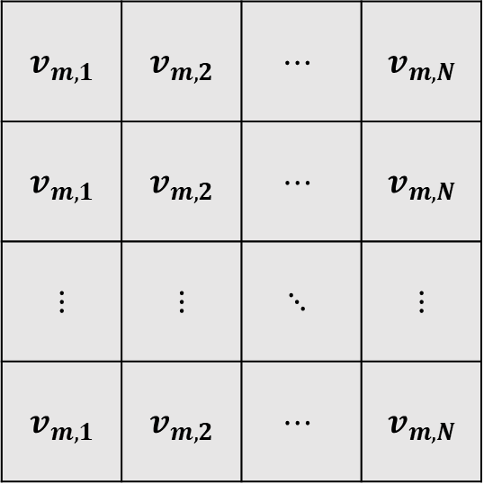

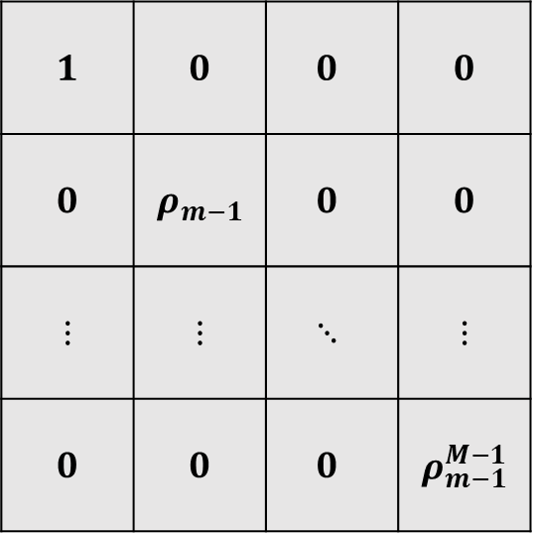
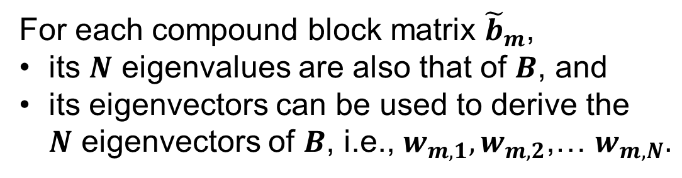
块矩阵
特征值
$$λ_{m,1}$$ | $$λ_{m,2}$$ | … | $$λ_{m,N}$$
For each compound block matrix ${\tilde{b}}_{m}$,
its $N$ eigenvalues are also that of $B$, and
its eigenvectors can be used to derive the $N$ eigenvectors of $B$, i.e., $w_{m,1},w_{m,2}$,… $w_{m,N}.$
$${\tilde{b}}_{m}$$
特
征
向
量
$$v_{m,1}$$ | $$v_{m,2}$$ | … | $$v_{m,N}$$
$$1$$ | $$0$$ | $$0$$ | $$0$$
$$0$$ | $$ρ_{m−1}$$ | $$0$$ | $$0$$
$$⋮$$ | $$⋮$$ | $$⋱$$ | $$⋮$$
$$0$$ | $$0$$ | $$0$$ | $$ρ_{m−1}^{M−1}$$
$$v_{m,1}$$ | $$v_{m,2}$$ | $$⋯$$ | $$v_{m,N}$$
$$v_{m,1}$$ | $$v_{m,2}$$ | $$⋯$$ | $$v_{m,N}$$
$$⋮$$ | $$⋮$$ | $$⋱$$ | $$⋮$$
$$v_{m,1}$$ | $$v_{m,2}$$ | $$⋯$$ | $$v_{m,N}$$
特征值
$$λ_{m,1}$$ | $$λ_{m,2}$$ | … | $$λ_{m,N}$$
特
征
向
量
$$w_{m,1}$$ | $$w_{m,2}$$ | $$⋯$$ | $$w_{m,N}$$
$$=$$
$$×$$

