Slide 1
Eigenvalue analysis for low-Re laminar flow around 2-D circular cylinder and reduced-order-model based on eigenvectors
Shenren Xu
Northwestern Polytechnical University

Slide 2
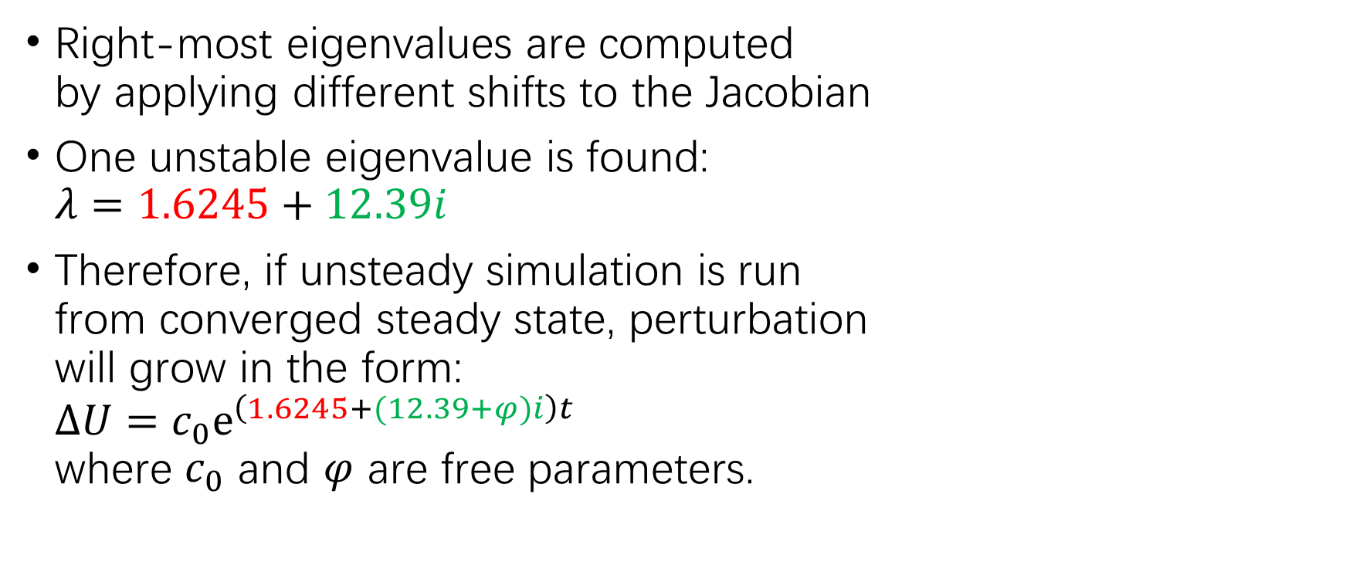
Eigenanalysis for Re=100
Right-most eigenvalues are computed by applying different shifts to the Jacobian
One unstable eigenvalue is found: $λ=1.6245+12.39i$
Therefore, if unsteady simulation is run from converged steady state, perturbation will grow in the form: $∆U=c_{0}e^{\left(1.6245+(12.39+φ)i\right)t}$ where $c_{0}$ and $φ$ are free parameters.
unstable mode

Slide 3
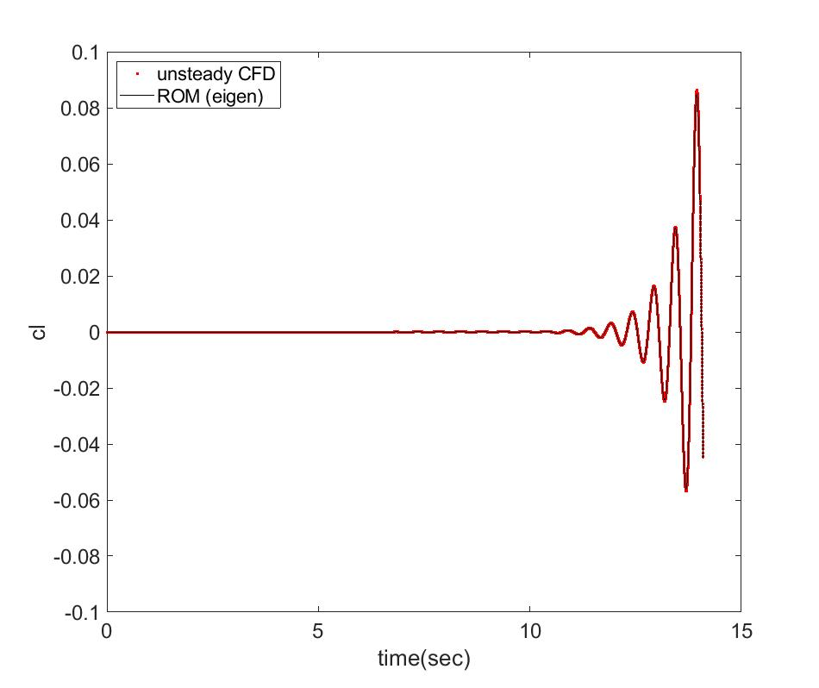
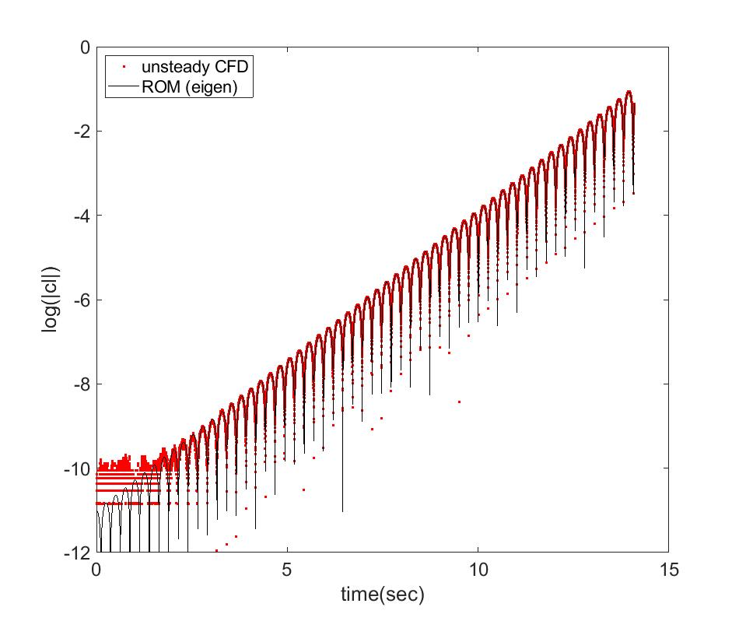
Eigenmode perfectly predicts the initial transient behavior of the destabilized flow
Unsteady solution for Re=100, initialized with converged steady calculation, matches with eigenmode-based ROM.

Slide 4
Eigenmodes do not reproduce LCO
ROM using eigenmodes, although is able to perfectly reproduce the initial transient behaviors, which is essentially a linear growth of the perturbation, is NOT able to predict the LCO, which is essentially a nonlinear behavior.

