Slide 1
Hotel recommendation
Zhihan Wang, Junrui Ye

Slide 2
Project goal
Analyze the impact of different factors in hotel booking
Hotel Booking Prediction
Gross Booking in USD (GBU) Prediction

Slide 3
DatASET
Data Description
Hotel booking information from Expedia (Kaggle)
Data Cleaning
Missing data
Corrupted data
Key Features
Hotel features: Star rating, hotel unit price, review score,
Customer features: Historical booking price of the customer, and search features like length of stay, number of rooms.

Slide 4
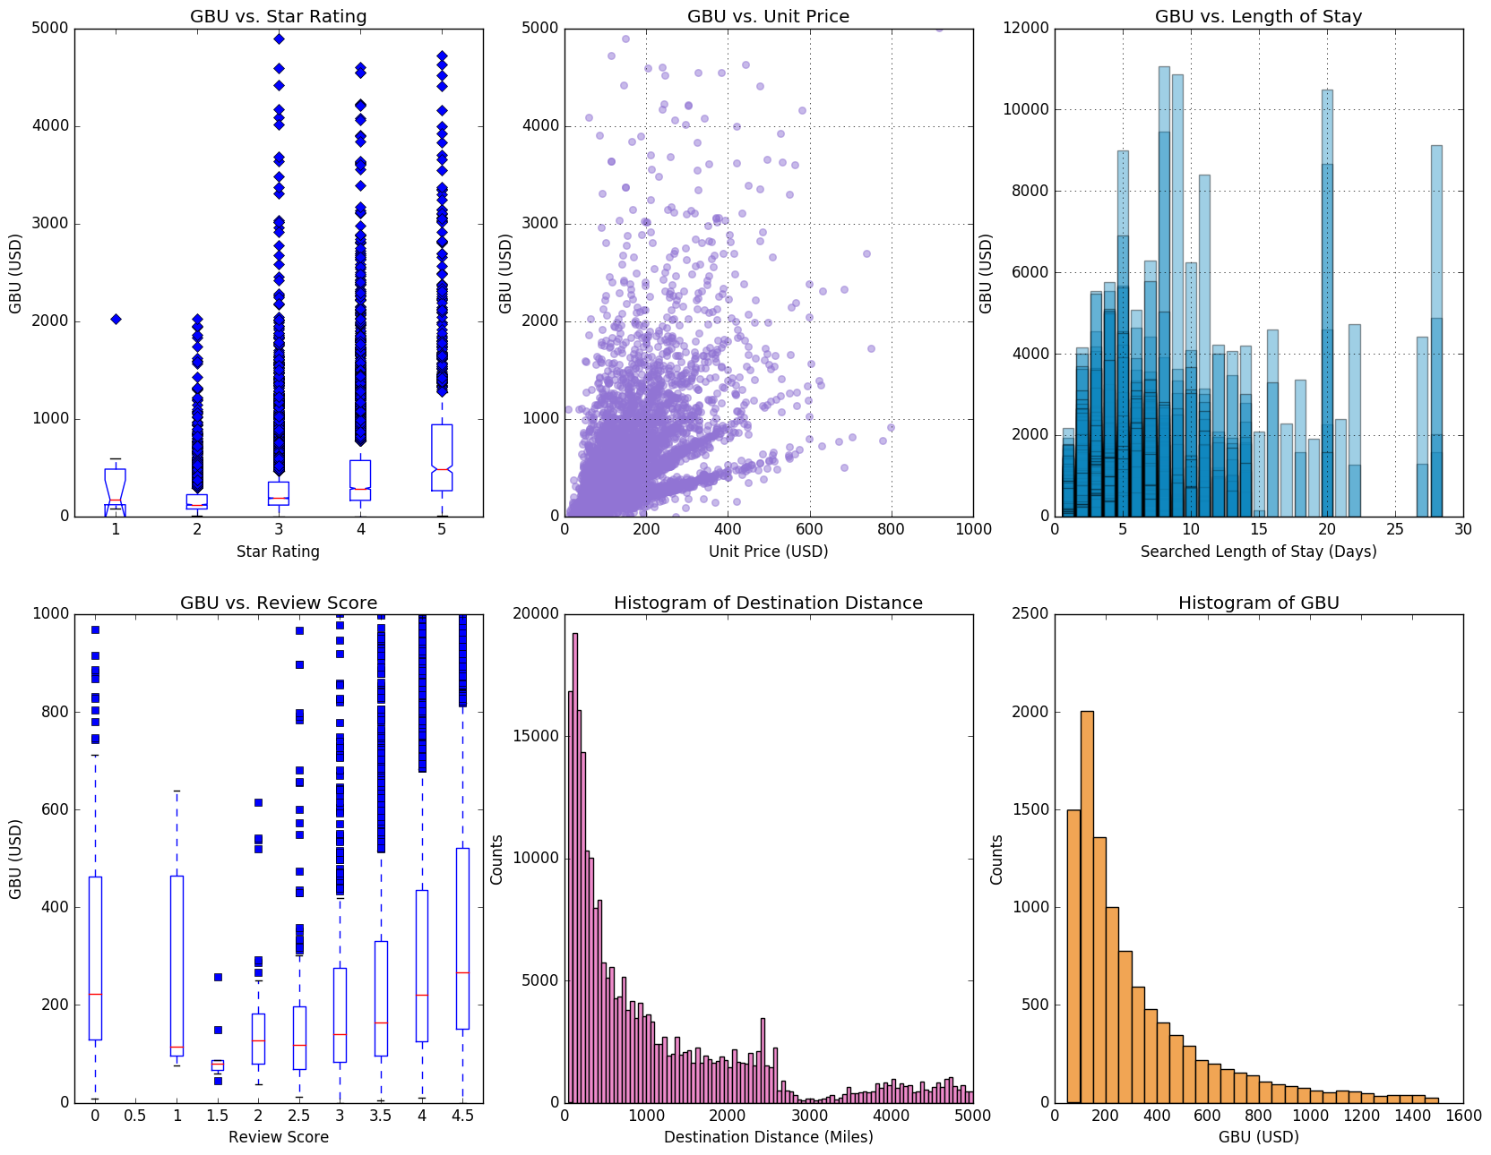
Descriptive statistics
Data Trend and Feature Correlation

Slide 5
Data analysis
Feature Engineering:
Clustering： visitor star rating, visitor historical booking price, property star rating, property review score, property location score, price, booking window, position
Model Picking
Logistic Regression

Slide 6
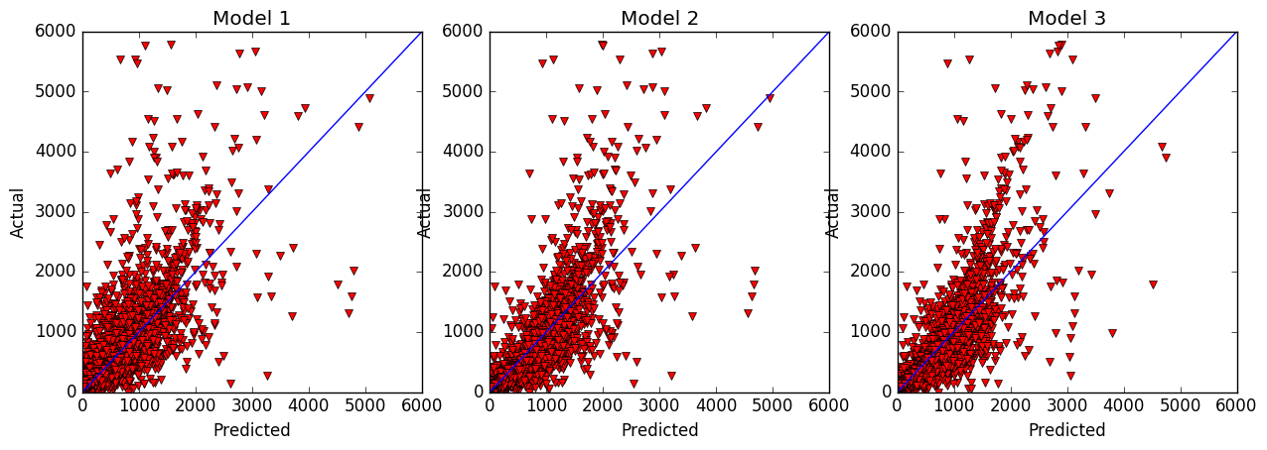
DATA ANALYSIS: GBU PREDICTION

Slide 7
Results and next step
GBU prediction
Further Feature Engineering
Random Forest
Advanced Feature Analysis (further research)
Feature Normalization
Visualization

Slide 8
Thank you!

