Slide 1
Hotel recommendation
Zhihan Wang, Junrui Ye

Slide 2
Project goal
Analyze the impact of different factors in hotel booking
Hotel Booking Prediction
Gross Booking in USD (GBU) Prediction

Slide 3
DatASET
Data Description
Hotel booking information from Expedia (Kaggle)
Data Cleaning
Missing data
Corrupted data
Key Features
Hotel features: Star rating, hotel unit price, review score
Customer features: Historical booking price of the customer, and search features like length of stay, number of rooms.

Slide 4
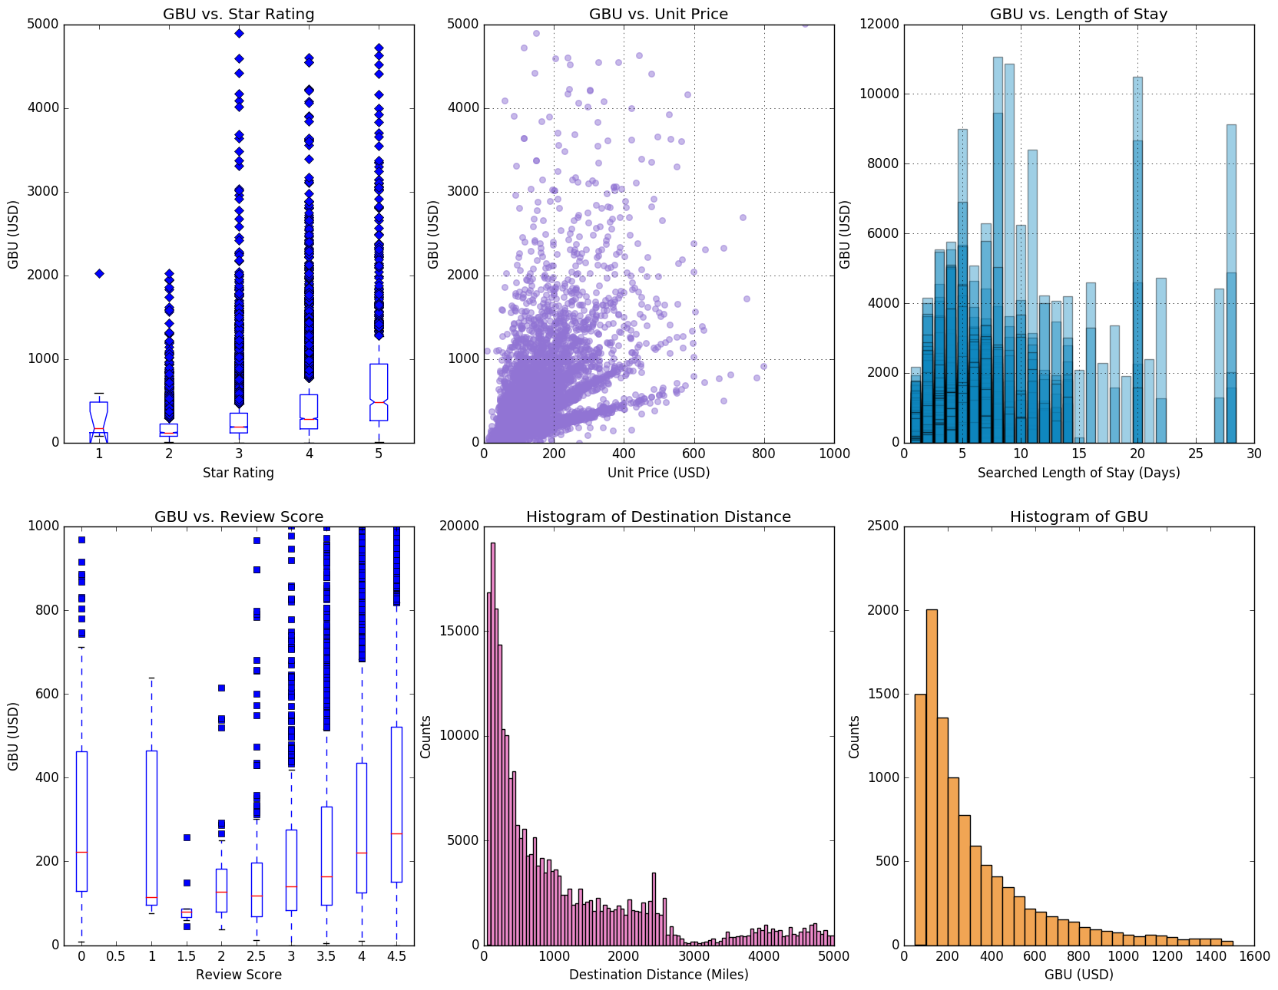
Descriptive statistics
Data Trend and Feature Correlation

Slide 5
Data analysis
Feature Engineering:
Clustering： visitor star rating, visitor historical booking price, property star rating, property review score, property location score, price, booking window, position
Model Picking
Logistic Regression
Create balanced input data set
Cross validation score: avg 0.58.

Slide 6
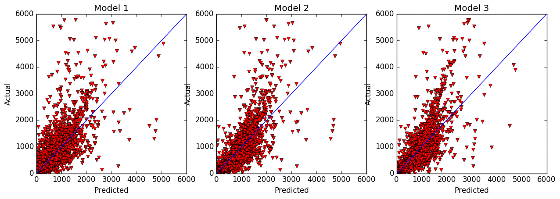
DATA ANALYSIS: GBU PREDICTION

Slide 7
next step
Increase prediction accuracy (for booking prediction and booking value prediction)
Further Feature Selection/Engineering
Advanced Feature Analysis (further research)
Random Forest
Feature Normalization

Slide 8
Thank you!

