Slide 1
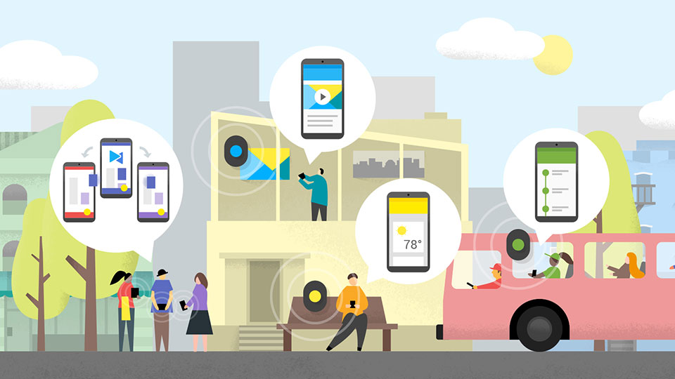
How beacons can add interactivity to a museum. simplified

Slide 2


Museums Using Beacons
The MET, New York
The Guggenheim, New York
Metropolitan Museum of Art, New York
Brooklyn Museum, New York
Grand Rapids Public Museum, Michigan
Seattle Art Museum, Washington
Australian Museum, Australia
Victoria and Albert Museum, Museum of Neons
Canadian Museum of Nature, Canada

Slide 3
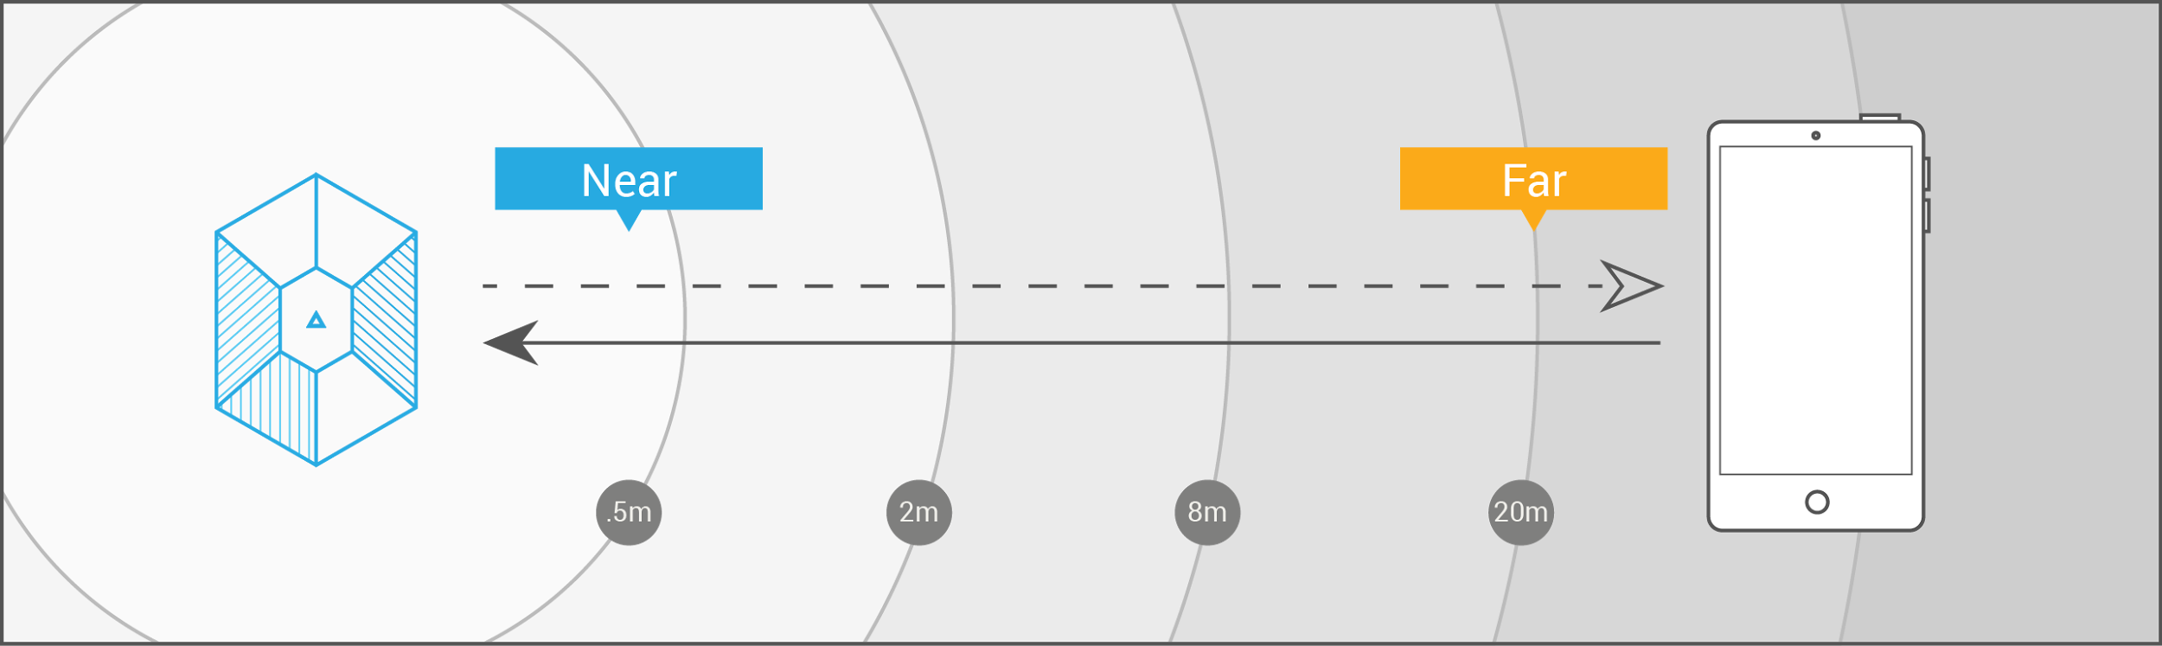
How Beacons Work
Beacons don’t transmit content; they transmit a series of numbers
The transmitted signal allows another device to identify it and determine the device’s proximity to the beacon

Slide 4
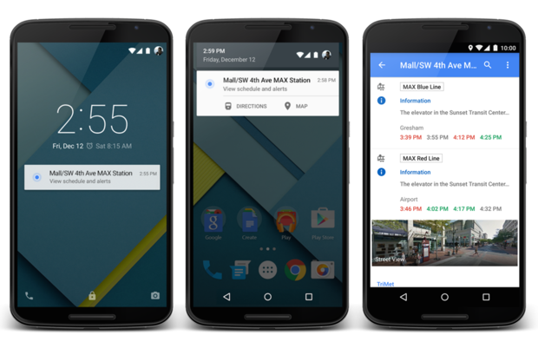
Google Eddystone on Android

Slide 5
Google Eddystone vs. Apple iBeacon
Google Eddystone Apple iBeacon
- Open source, available on GitHub - Proprietary software.
under the Apache v2.0 license.
Cross-platform software - Native only to iOS devices and beacons
Can send messages to all smartphones - Can send messages to all smartphones
meeting the BLE (Bluetooth 4.0) standard. meeting the BLE (Bluetooth 4.0) standard.
Sends messages/data via UUID, URLs and Telemetry. - Sends messages only through UUID.
To receive messages, mobile app is optional. - To receive messages, mobile app is mandatory.
Ephemeral Identifiers (EIDs) change frequently which - No EIDs
only authorized clients can decode.

Slide 6
Google Eddystone – under the hood
Nearby API
Allows Android and iOS devices to communicate with other devices and beacons.
Part of Google Play Services.
For iOS, Google has a Nearby API library that developers can include with their app.
Proximity Beacon API
Lets developers connect semantic location data to beacons. Also works with Places API.
The diagnostics component that allows companies to monitor their beacon fleet.
Identify beacons behaving unusually (i.e. dropped from ceiling or out of battery).

Slide 7
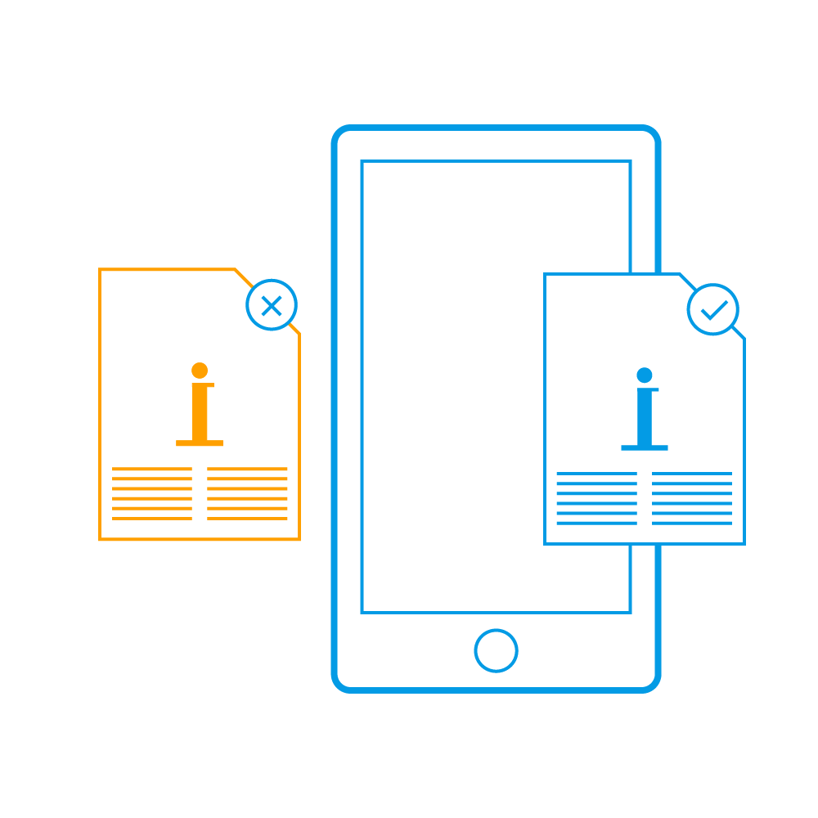

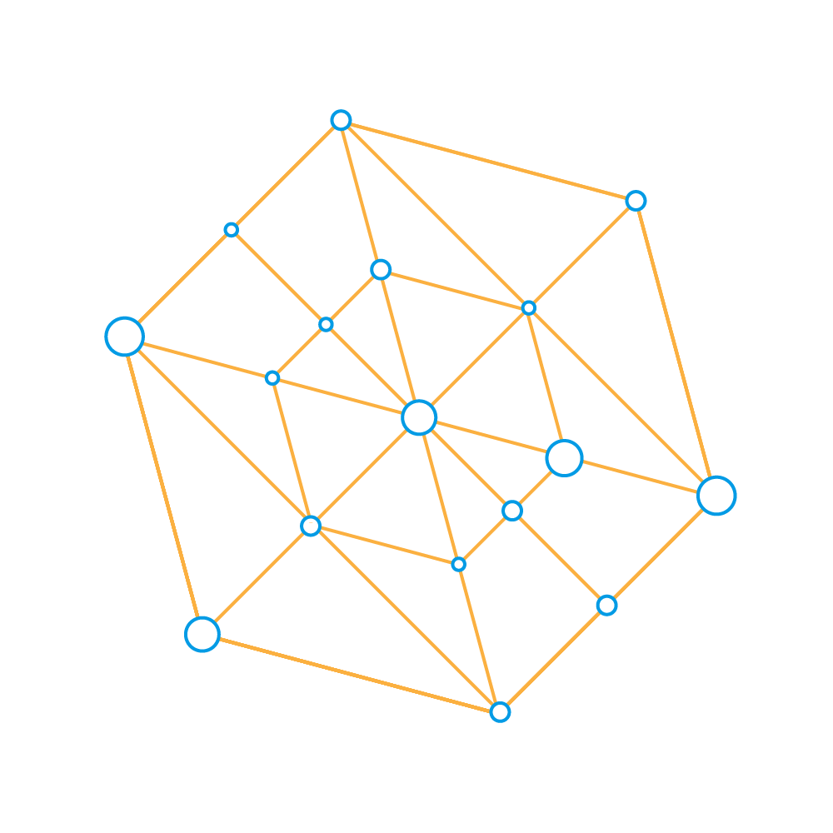
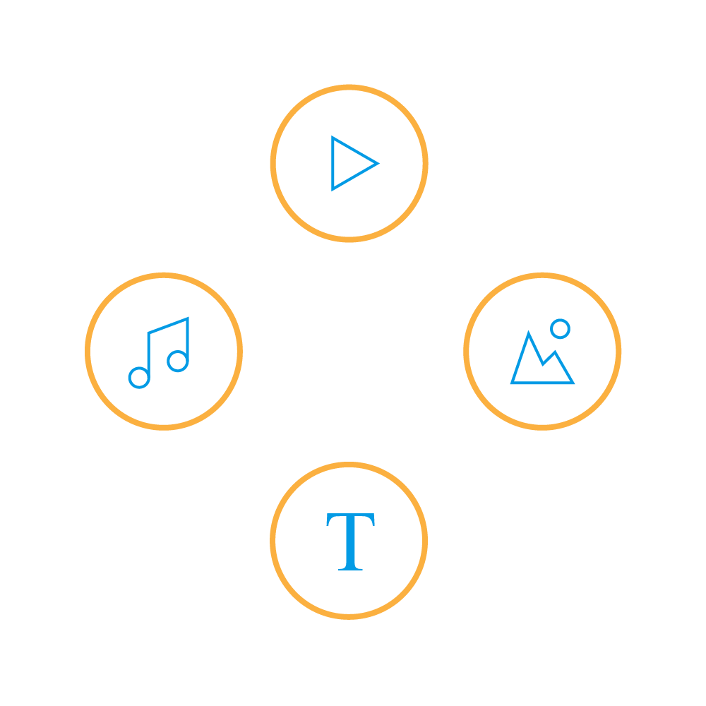
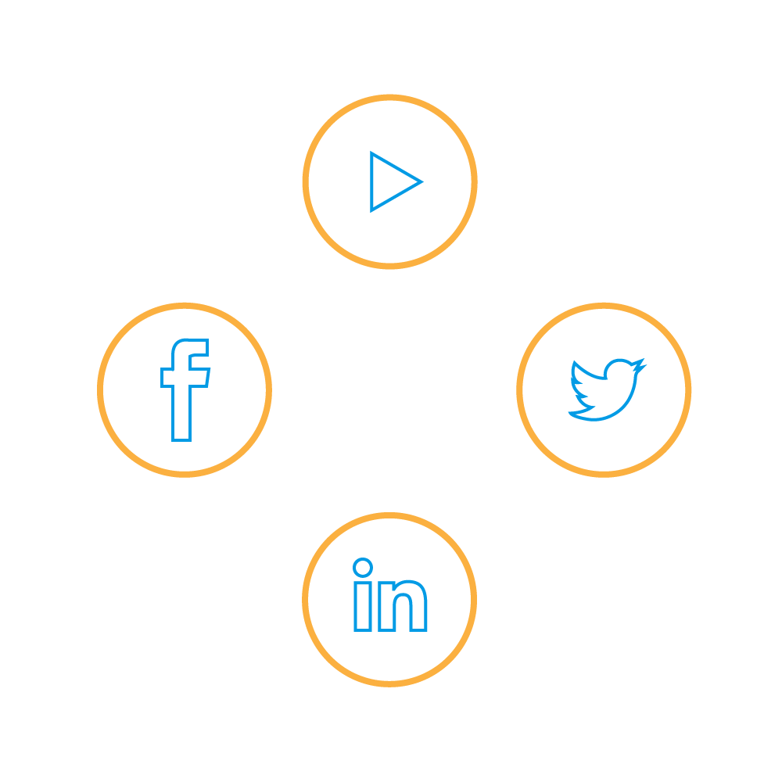
How Beacons Enhance Experience
Deliver contextual information
Individualize Learning Experiences
Gather behavioral data
Enhance
Interactivity beyond audio
Social
media outreach

Slide 8
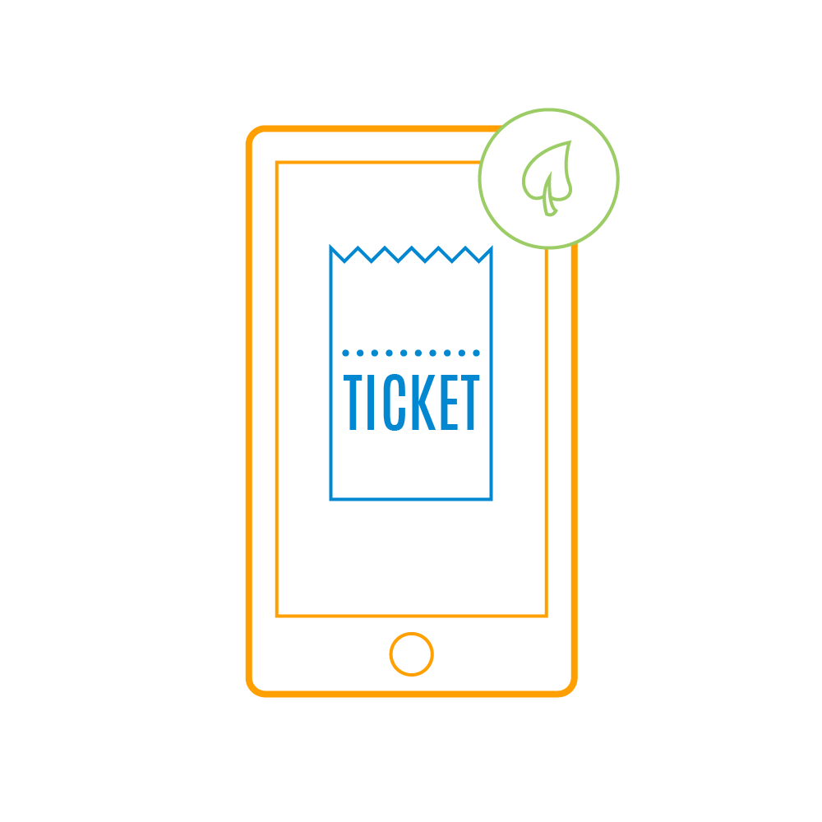

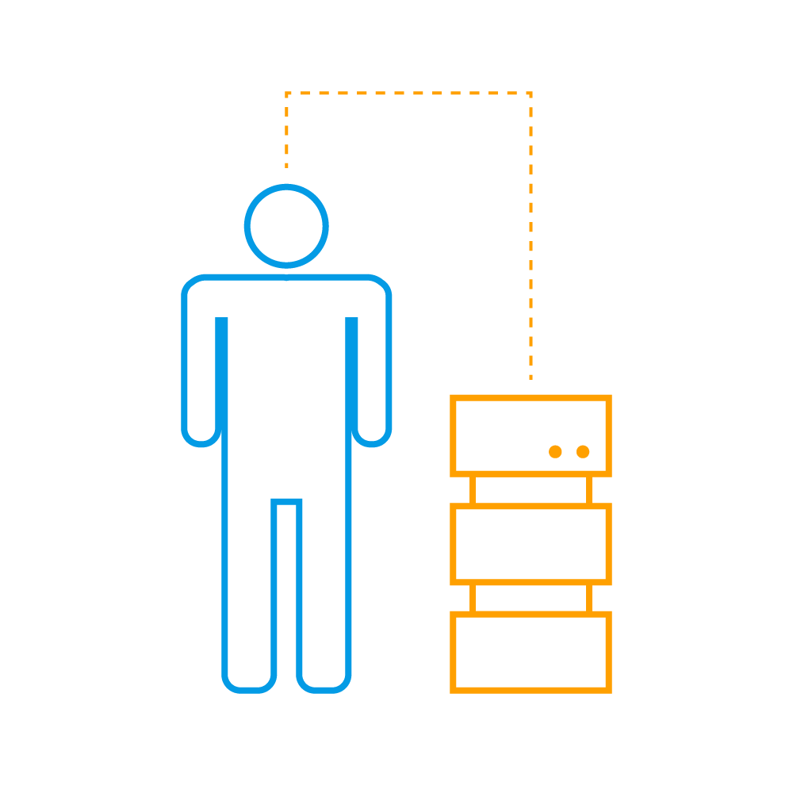
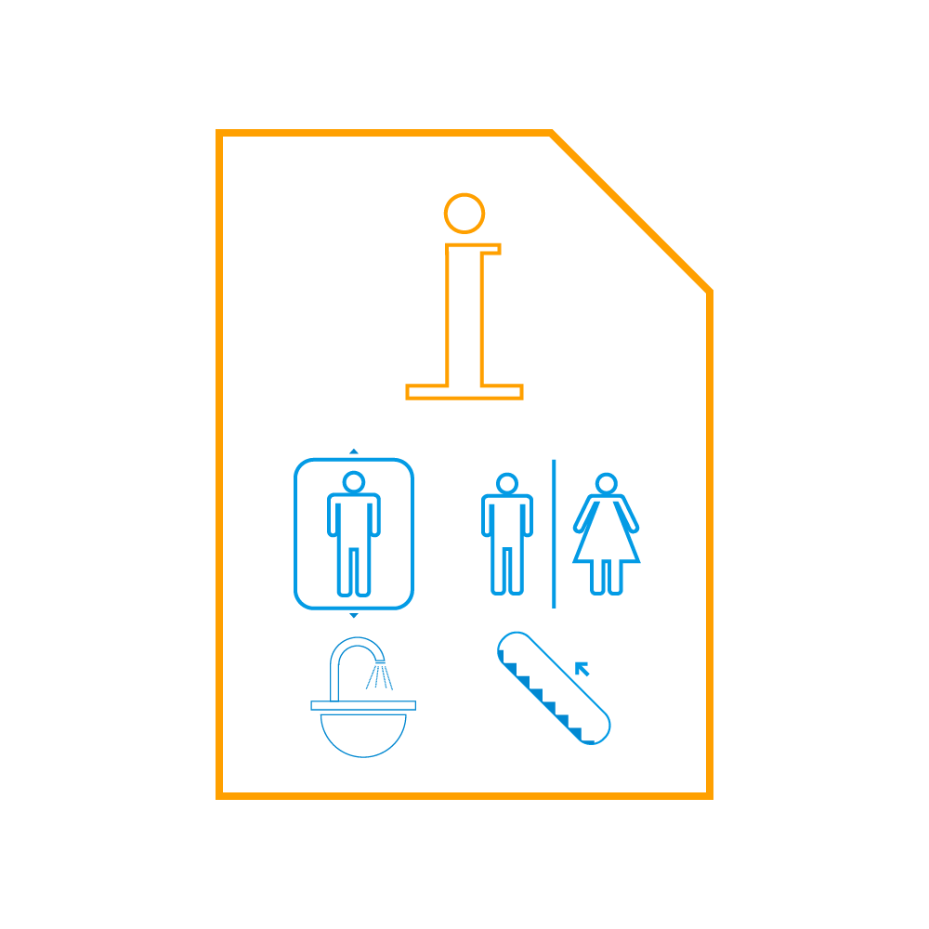
How would it work in my museum?
Ticketless entry
Upsell mementos, gifts from the souvenir shop
Provide Teachers with Student Tour Learning Results
Recommend exhibits
Information about facilities available
Gather visitor data

Slide 9
Things to Keep in Mind
Beacon installation
Purchase beacons - consider color, design, power options
Configure - ‘major’ and ‘minor’ numbers
Placement - must be unobtrusive
Visitor coordinates not really precise
Factor in beacon signal interference
Use proximity, instead of a precise set of coordinates

Slide 10
Things to Keep in Mind
Management and monitoring
Track data coming from multiple beacons
Monitor beacons for battery life and last ping time
Consider using a beacon platform
Security
Change major/minor numbers frequently and encrypt them
Detect unauthorized authentication attempts
Set up a mechanism that sends timely firmware updates and security notifications

Slide 11
Considerations
UX – What experience are you trying to create?
What LMS would you use to create that experience?
How can we integrate existing LMS platforms with beacon analytics?
Density and spacing of beacons
Pilot First – limited educational content and beacon locations (data mine for success using previous year data)

