Slide 1
Title slide: the talk's claim or question as its title
Venue · date
Authors with affiliation marks¹ ²
¹ University · ² Lab

Slide 2
A story title states the takeaway in one sentence
Semibold lead-in: then the point in a few words
Three or four bullets: about 40 words per slide at most
Sources: a superscript number here¹, the reference in the footnote
¹ Author et al. (2025), Venue.

Slide 3
The research question gets its own slide, by slide 3
The question, stated precisely in one or two sentences, on the card
Contribution: what this work adds that prior work does not.

Slide 4
Methods and discussion split into two labeled columns
Design
Outcomes
Data: what and how much
Method: only what the audience needs
Primary: the main measure
Secondary: supporting measures
Full details: Appendix A

Slide 5
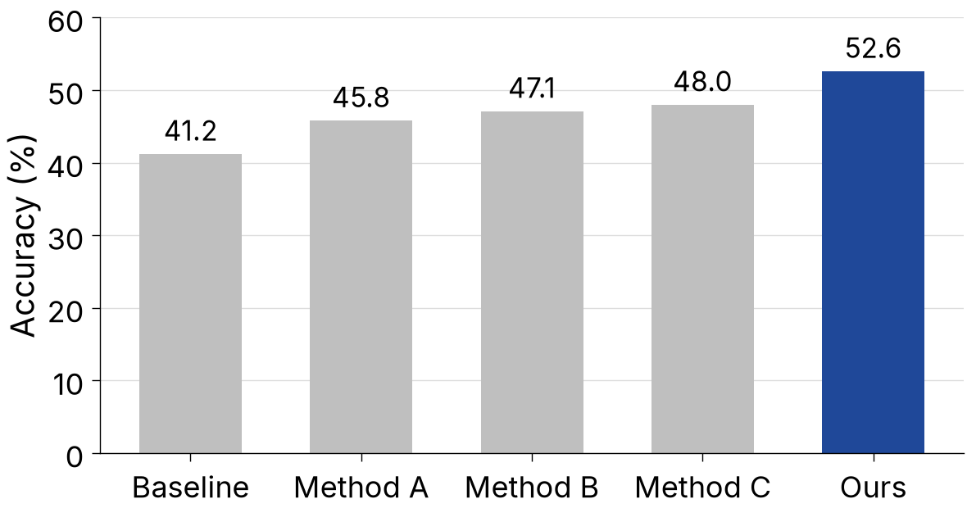
Results: the finding in the title, the figure as evidence
The figure keeps its aspect ratio
Points add what the figure can't show
One finding per slide
Figure: example data.

Slide 6
Section name
Part 2

Slide 7
References
Author, A., et al. (2025). Title of the paper. Venue.
Author, B., and Author, C. (2024). Title of the paper. arXiv:0000.00000.

Slide 8
Title Only: draw anything below the title

