Slide 1
Pretraining on unlabeled speech makes low-resource ASR practical
ICML 2026 · Oral
Jane Kim¹, Min Park¹, Alex Lee² jane.kim@example.edu
¹ Example University · ² Example Lab
Notes:
Showcase: Title

Slide 2
Method
Notes:
Showcase: Section

Slide 3
Supervised ASR needs labels that most languages don't have
Labels are scarce: 5 of 100 languages have over 100 h of transcripts¹
  Transcribing 1 h of speech takes about 8 h of expert time
Audio is not: radio and podcasts exist in every language
Supervised ASR stalls: over 40% WER with 10 h of labels²
  Errors double again on accented and noisy speech
¹ Author et al. (2024), Venue. ² Author et al. (2023), Venue.
Notes:
Showcase: Points

Slide 4
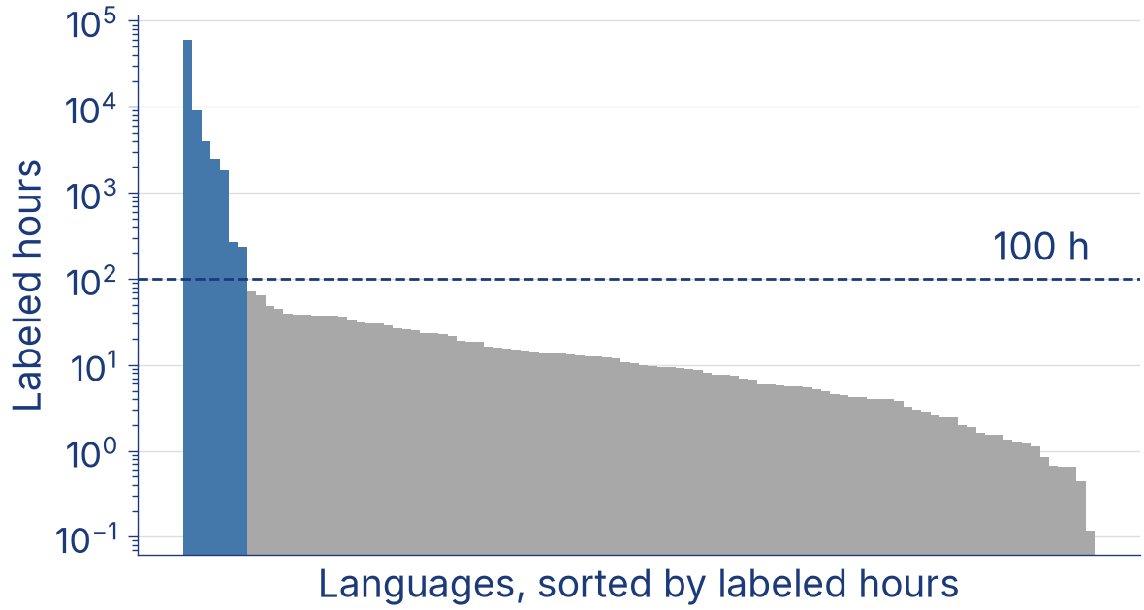
Only a handful of languages have enough labeled speech
5 of 100 languages have over 100 h of transcripts¹
Every language has unlabeled audio, from radio to podcasts
¹ Author et al. (2024), A census of speech corpora, Venue.
Notes:
Showcase: Figure with remarks

Slide 5
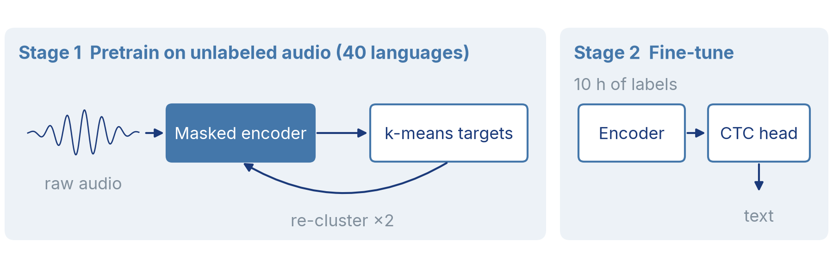
Stage 1 learns from audio alone
Mask: spans of 10 frames, 8% of starts
Predict: each masked frame's cluster
Re-cluster: 100 MFCC clusters, then 500
Notes:
Showcase: Diagram walkthrough

Slide 6
Training runs in four steps, and only the last one uses transcripts
Raw audio
Masked encoder
Discrete targets
CTC fine-tuning
Steps 1 to 3 run once per language family; step 4 per language.
Notes:
Showcase: Flow

Slide 7
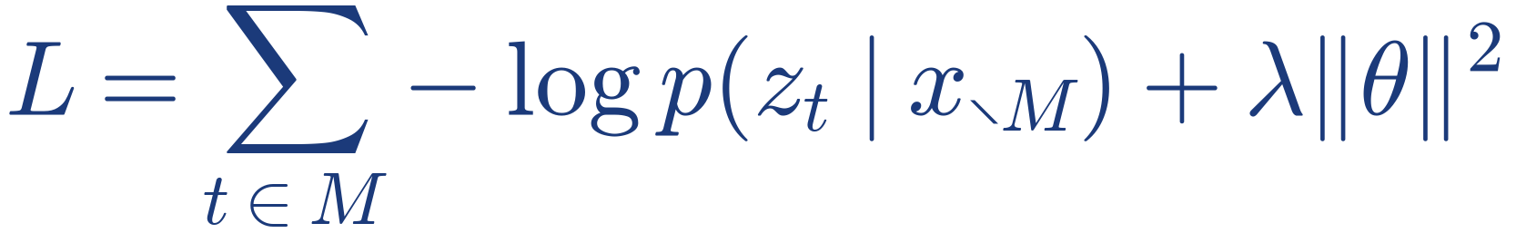
The loss predicts the targets of masked frames from their context
M masked frames (8% of starts, spans of 10)
z_{t} k-means cluster of frame t, from the previous iteration
λ weight decay; 0.01 in all runs
Notes:
Showcase: Equation

Slide 8
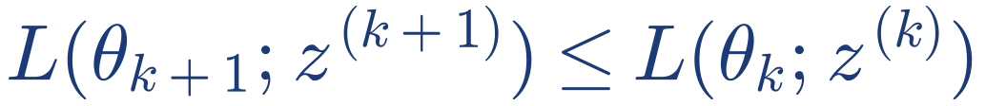
Re-clustering cannot make the targets worse
Proposition 1
If the encoder lowers the masked-prediction loss, re-clustering its features never raises it:
So iterations can only help
Proof in Appendix B
Notes:
Showcase: Theorem

Slide 9
Ours has the lowest WER on three of four test sets
 | LibriSpeech
Method | clean | other | CV | FLEURS
Supervised | 8.4 | 19.2 | 21.7 | 24.1
Contrastive [1] | 4.6 | 10.8 | 17.9 | 19.8
Masked prediction [2] | 3.9 | 9.6 | 16.9 | 18.7
Multilingual fine-tuning [3] | 5.3 | 12.4 | 16.1 | 17.5
Ours | 4.0 | 9.1 | 15.2 | 16.6
WER (%), lower is better; best per column in dark navy. CV: Common Voice.
Notes:
Showcase: Results table

Slide 10
The paper makes three contributions of different kinds
Dataset
8K hours of unlabeled speech in 40 languages, all of it public
Objective
Masked prediction of discrete targets, no negative pairs
Analysis
When and why pretraining helps below 10 hours of labels
Code, data and models: example.com/project
Notes:
Showcase: Contributions

