Slide 1
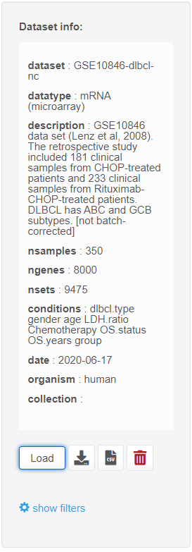
Download
pgx
Delete
Download
csv

