Slide 1

UniShare
Agility
Marvin Fourastié - Corentin Bugnot - Adrien Razurel
Raphaël Lutz - Romain Bigot - Heloy Estevanin
1

Slide 2




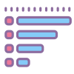
L’application
Ad-service
User-service
Image-service
Search-service
Category-service
2

Slide 3
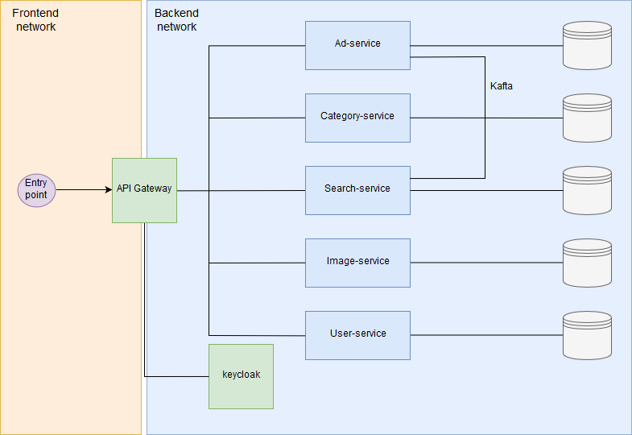
3

Slide 4
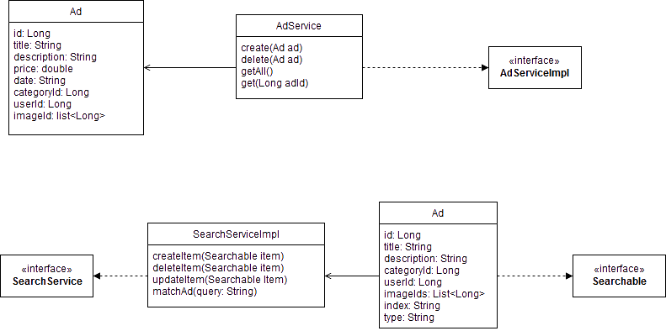
DOM
Ad-service
*
1
Search-service
*
1
4

Slide 5

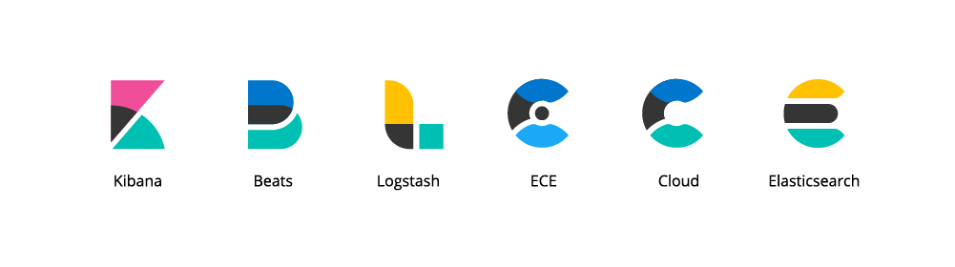




Technologies
Kong
Kafka
Keycloak
Kibana – Elasticsearch
Travis
Sonarcloud
5

Slide 6




Sonarcloud
Github
Travis CI
Docker
6

Slide 7



Features
Poster une annonce
Consulter une annonce
Rechercher une annonce
7

Slide 8
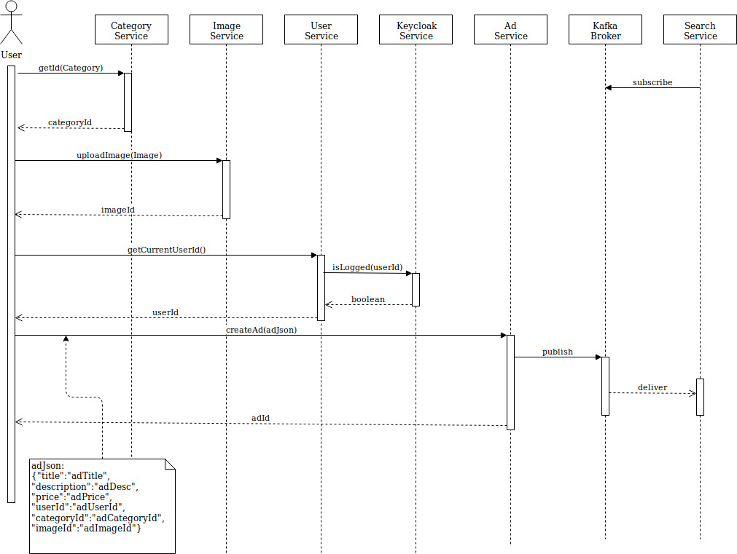
8

Slide 9
Démonstration
9

Slide 10




Risques
Temps
Technologies
Conflits
Maladie
10

Slide 11
Plannification
Mar 5
100%
Mar 29
62 days
Ad-service
Mar 30
98%
Jun 7
50 days
User-service
Apr 17
90%
Jun 7
38 days
Category-service
Apr 17
100%
May 16
22 days
Search-service
Apr 23
95%
Jun 7
34 days
Image-service
May 1
98%
Jun 7
28 days
Chat-service
May 2
10%
Jun 7
27 days
Database
May 10
100%
May 14
3 days
Frontend
Mar 26
50%
Jun 7
54 days
API gateway
May 13
90%
Jun 7
20 days
Keycloak
May 13
50%
Jun 7
20 days
2019
Mar
Apr
May
Jun
2019
Today
2019
11

