Slide 1

Quasi-Periodic Waveform Generative Model with Pitch-dependent Dilated Convolutional Neural Network
2020
Yi-Chiao Wu
Toda Lab, Nagoya University, Japan

Slide 2
Outline
Introduction
Speech signal
Source-filter model
RNN-based speech generation
CNN-based speech generation
PDCNN and QP structure
QPNet and QPPWG
Discussion
Conclusion

Slide 3
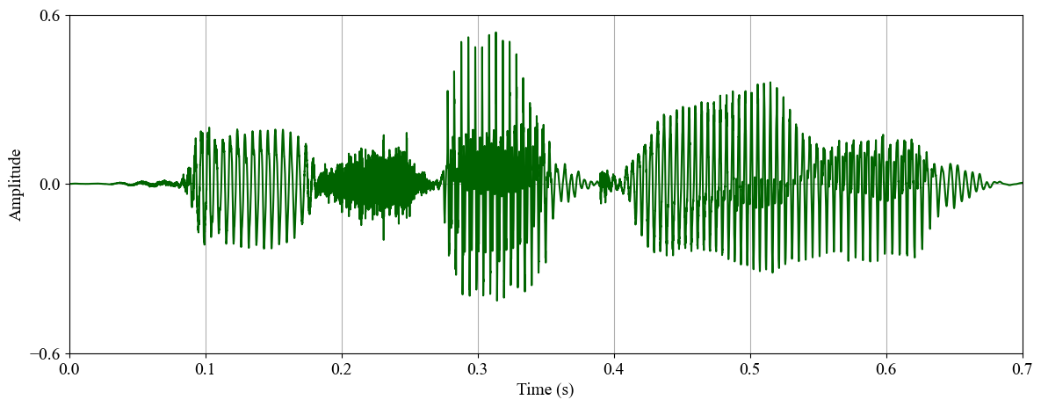
Speech Signal
Sequential signal
Very high temporal resolution (F_{s} >= 16kHz)
Very long-term dependency
Directly modeling speech waveform is challenging

Slide 4
Vocoder [H. Dudley, 1939]
Vocoder: voice coder
Encoder (analyzer)
Encoding speech into acoustic features
Decoder (synthesizer)
Decoding speech from acoustic features

Slide 5
Source-filter Model [R. McAulay+, 1986]
Speech generation is formulated as a convolution of a excitation signal and a spectral filter
Excitation (source) signal
Modeling the glottal waveform generated by the vocal fold movements
Spectral filter
Modeling the vocal tract resonances

Slide 6
Source-filter Vocoder
Mixed excitation vocoder
STRAIGHT [H. Kawahara+, 1999]
WORLD [M. Morise+, 2016]
Lost temporal details and phase information cause speech quality degradation

Slide 7
RNN-based Speech Generation
Speech is a sequential signal ➔ RNN
Speech has a very high temporal resolution
Gradient vanishing/explosion for RNN modeling a signal with a very long term dependency
Generation time is extremely long

Slide 8
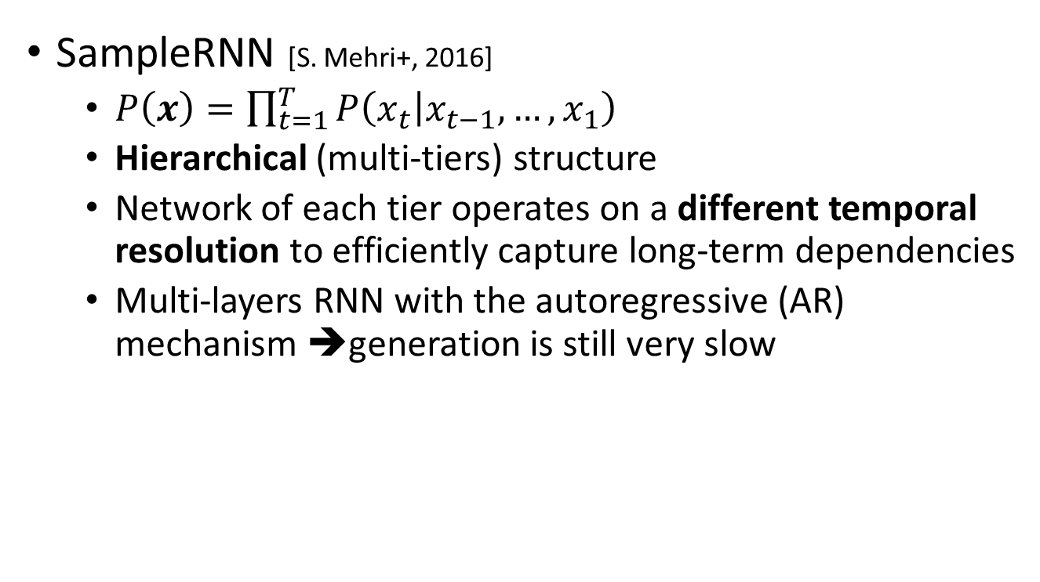
RNN-based Speech Generation
SampleRNN [S. Mehri+, 2016]
$P\left(x\right)=\prod_{t=1}^{T}{P\left(\left.x_{t}\right|x_{t−1},…,x_{1}\right)}$
Hierarchical (multi-tiers) structure
Network of each tier operates on a different temporal resolution to efficiently capture long-term dependencies
Multi-layers RNN with the autoregressive (AR) mechanism ➔generation is still very slow

Slide 9
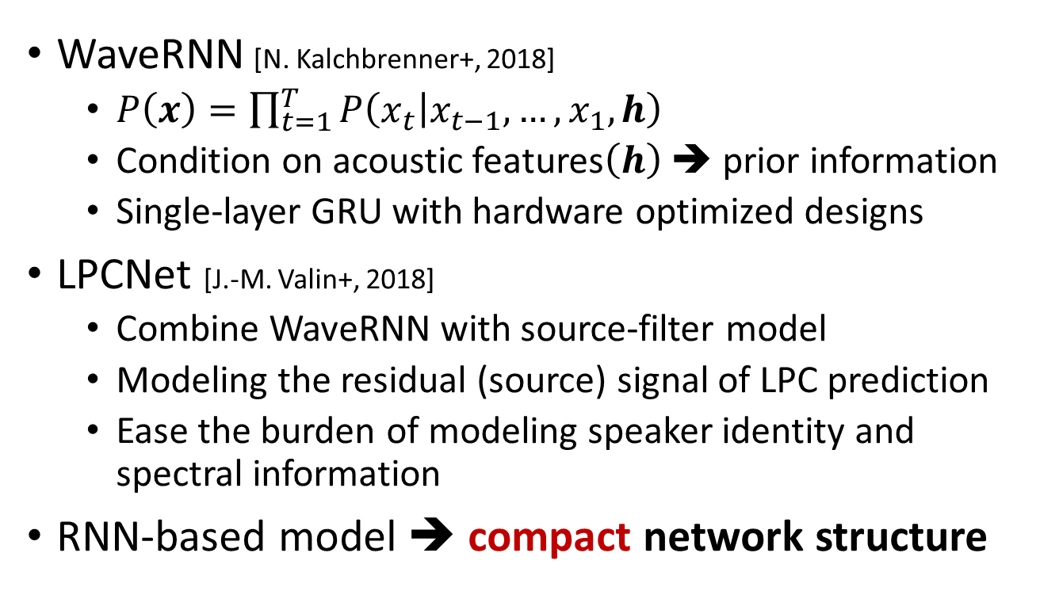
Real-time RNN-based Vocoder
WaveRNN [N. Kalchbrenner+, 2018]
$P\left(x\right)=\prod_{t=1}^{T}{P\left(\left.x_{t}\right|x_{t−1},…,x_{1},h\right)}$
Condition on acoustic features$\left(h\right)$ ➔ prior information
Single-layer GRU with hardware optimized designs
LPCNet [J.-M. Valin+, 2018]
Combine WaveRNN with source-filter model
Modeling the residual (source) signal of LPC prediction
Ease the burden of modeling speaker identity and spectral information
RNN-based model ➔ compact network structure

Slide 10
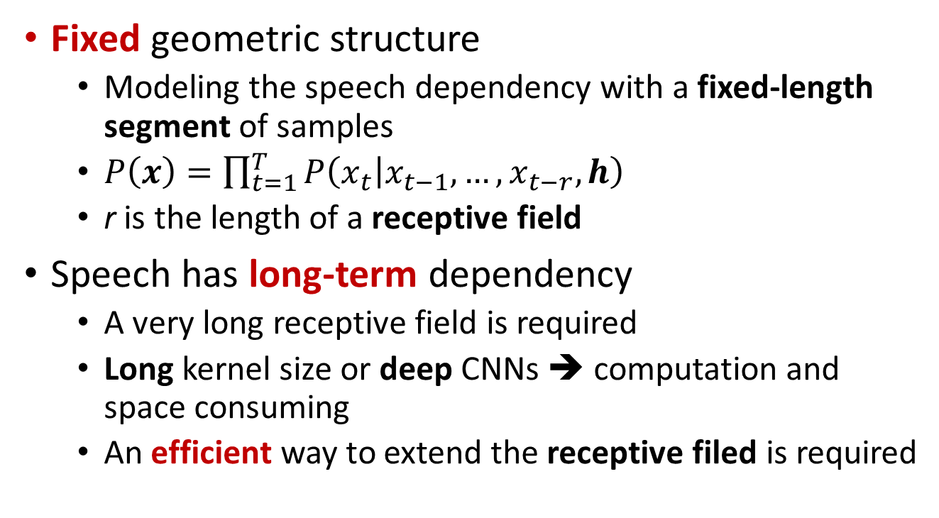
CNN-based Speech Generation
Fixed geometric structure
Modeling the speech dependency with a fixed-length segment of samples
$P\left(x\right)=\prod_{t=1}^{T}{P\left(\left.x_{t}\right|x_{t−1},…,x_{t−r},h\right)}$
r is the length of a receptive field
Speech has long-term dependency
A very long receptive field is required
Long kernel size or deep CNNs ➔ computation and space consuming
An efficient way to extend the receptive filed is required

Slide 11
WaveNet w/ DCNN
Dilated CNN (DCNN) [F. Yu+, 2016]
Convolution with gaps (dilation size)
WaveNet (WN) [A. Oord+, 2016]
Stacked DCNNs to get long receptive fields
Huge network w/ the AR mechanism ➔ slow generation

Slide 12
Non-AR CNN-based Model
Flow-based
Invertible network to transfer a distribution of white noise to the distribution of speech
IAF: parallel WN [A. Oord+, 2017], Clarinet [W. Ping+, 2019]
Glow: WaveGlow [R. Prenger+, 2019], Flowavenet [S. Kim+, 2019]

Slide 13
Non-AR CNN-based Model
GAN-based
Stability of GAN training is a issue
Using multi-STFT losses: parallel WaveGAN (PWG)
[R. Yamamoto+, 2020]
Using multi-discriminators: MelGAN [K. Kumar+, 2019]

Slide 14
Source-filter Vocoder
Vocoder with a source-filter structure

Slide 15
Unified Vocoder
Vocoder modeling source and resonance signals w/ a single model

Slide 16
Problem of Unified Vocoder I: Inefficient speech modeling
Speech signal is a quasi-periodic signal
Periodic part: long-term correlation
Non-periodic part: short-term correlation
Modeling the very long-term dependency
Long receptive field to cover the related samples
huge network is required
Without the prior knowledge of audio periodicity
Fixed network for both periodic and non-periodic parts
Oversampling of periodic part
Receptive field includes many redundant samples

Slide 17

Problem of Unified Vocoder II: Limited pitch controllability
Vocoder conditioned on unseen acoustic features
F₀ is not observed in the range of training data
Unseen feature pair of spectrum and F₀
Original spectral feature with scaled F₀
Difficult to generate speech
Inaccurate pitch of the generated speech
Normal (Natural):
Normal (PWG):
2×F₀ (Expected):
2×F₀ (PWG):

Slide 18

PDCNN
Main drawback of CNN/DCNN is the fixed structure
$y_{t}^{(o)}=W^{(c)}∗y_{t}^{(i)}+W^{(p)}∗y_{t−d}^{(i)}$
Dilation size $d$ is pre-defined and time-invariant
Pitch-dependent DCNN
Dilation size $d′$ is pitch-dependent and time-variant

Slide 19
Quasi-Periodic Structure
Cascaded network of fixed and adaptive blocks
Fixed blocks w/ DCNNs
Model the non-periodic components with the nearest samples (short-term correlations)
Network architecture is fixed
Adaptive blocks w/ PDCNNs
Model the periodic part with prior F₀ knowledge (long-term correlations)
Network architecture is dynamically changed

Slide 20
QPNet [Y.-C. Wu+, 2019]
Apply the QP structure to WaveNet
Difference w/ WaveNet
Cascaded fixed and adaptive blocks
Adaptive block w/ PDCNN
1/2 model size
Drawback
Generation is still slow

Slide 21
QPPWG [Y.-C. Wu+, 2020]
Apply the QP structure to the generator of PWG
Inherit from PWG
Multi-resolution STFT
Discriminator
Differences w/ QPNet
Non-AR
Gaussian noise input
Raw waveform output
1/20 model size

Slide 22
Subjective Evaluation I: QPNet and WaveNet
MOS of speech quality
ABX (preference) of pitch accuracy
X: WORLD-generated reference

Slide 23
Subjective Evaluation II: QPNet, QPPWG, and PWG
MOS of speech quality

Slide 24
Subjective Evaluation II: QPNet, QPPWG, and PWG
ABX of pitch accuracy
X: WORLD-generated reference

Slide 25
Deformable CNN [J. Dai+, 2017]
CNN: fixed sampling grid
DCNN: fixed sampling grid w/ fixed offsets
Deformable CNN: deformable sampling grid w/ input-dependent offsets

Slide 26
PDCNN and Deformable CNN
Input of CNN is indexed feature map
Deformable CNN ➔ Index is predicted by a NN
PDCNN ➔ Index is calculated from F₀ and F_{s}

Slide 27
QPPWG and NSF
NSF [X. Wang+, 2019]
Explicitly model excitation signal and spectral filtering
QPPWG:
Adaptive and fixed macroblocks are analogous to the excitation generation and spectral filtering modules

Slide 28
Conclusion
RNN-based
Pro: Recurrent structure theoretically enable network to model arbitrary length of correlations
Con: Limited model size for real-time generation
Focus: Only modeling minimum essential information
CNN-based
Pro: Parallelized computation for real-time generation
Con: Fixed geometric structure limits memory capacity
Focus: Non-AR modeling algorithm; Adaptive network w/ a free from of sampling grid

Slide 29
Conclusion
PDCNN
Simple and general for any CNN-based model
QP structure
Pitch-dependent adaptive network
Analogous to a source-filter model
QPNet/QPPWG compared with WN/PWG
Smaller model size
Better pitch controllability
Comparable speech quality

Slide 30

Thank you for your attention ! https://bigpon.github.io/QuasiPeriodicWaveNet_demo/ https://bigpon.github.io/QuasiPeriodicParallelWaveGAN_demo/

