Slide 1
Locally Linear Embedding for Exemplar-Based Spectral Conversion
Yi-Chiao Wu ¹, Hsin-Te Hwang¹, Chin-Cheng Hsu¹,
Yu Tsao², Hsin-Min Wang¹
¹ Institute of Information Science, Academia Sinica, Taipei, Taiwan
²Research Center for Information Technology Innovation, Academia Sinica, Taipei, Taiwan
INTERSPEECH 2016, San Francisco
Sep. 10, 2016
Notes:
Good afternoon everyone , I’m Wu Yi Chiao from Academia Sinica, Taipei.
Today, I would like to present the paper entitle “locally linear embedding for exemplar-based spectral conversion”.

Slide 2
Outline
Exemplar-based spectral conversion
Motivation
Proposed method
Experimental results
Conclusions
Notes:
This is my outline.
I’ll start with the motivation and the proposed method of our voice conversion system.
And then I’ll present the experimental results.
In the end, I’ll summarize our work.

Slide 3
Motivation
Manifold learning
Discovering the intrinsic geometry of data in high dimensional spaces and embed them onto low dimensional spaces
Inspired from image super resolution & exemplar-based voice conversion (VC)
VC assumption:
The manifold of source speech is similar to that of target speech
Preserving local geometry of source speech can make converted speech sound more natural
Notes:
Ok, at start, I’d like to talk about the motivation.
The main concept of manifold learning is that discovering the intrinsic geometry of high dimensional data and then embedding them onto low dimensional space.
Additionally, one of the most important manifold learning application is the image super resolution.
Moreover, we inspire from both image super resolution and traditional exemplar-based voice conversion.
As a result, we introduce the manifold learning concept to the exemplar-based voice conversion.
For the voice conversion, we assume that the manifold of source speech is similar to that of target speech, therefore the geometric structure of source can be directly applied to target.
Also, we assume that the input source speech is natural speech, so preserving the local geometry of source to the converted speech can make converted speech sound more natural.

Slide 4
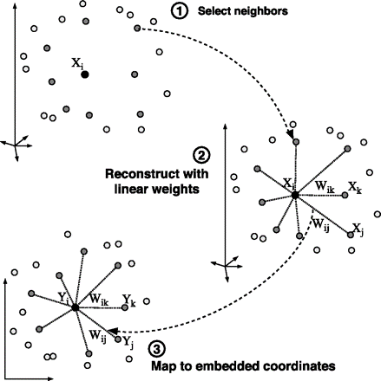
Locally Linear Embedding
LLE algorithm
Finding the high dimensional local path
Linear reconstruction with neighbors
Mapping the structure to the low dimension
Notes:
Ok, now I’m going to present the local linear embedding algorithm.
The LLE algorithm is a manifold learning method that computes the low-dimensional embeddings that best preserve the local geometry of each locally linear patch in the high dimensional space.
Furthermore, LLE includes three steps. First, finding the high dimensional local patch which contains a set of k nearest data points named neighbors.
Second, linear reconstructing the selected data with neighbors in the local patch
The last, applying the reconstruction weight of the step 2 to the low dimensional local patch

Slide 5
Proposed Method (1/3)
Offline stage
Dictionary collection
Target speaker’s statistic parameters
Notes:
Let’s move on to our proposed system.
In our proposed method, we divide system into offline and online stages.
For the offline stage,
We prepare parallel speech corpus and extract spectral features first.
After DTW alignment, we can get the paired source and target dictionaries.
Besides, we also get target’s statistical parameters for postfiltering processing.

Slide 6
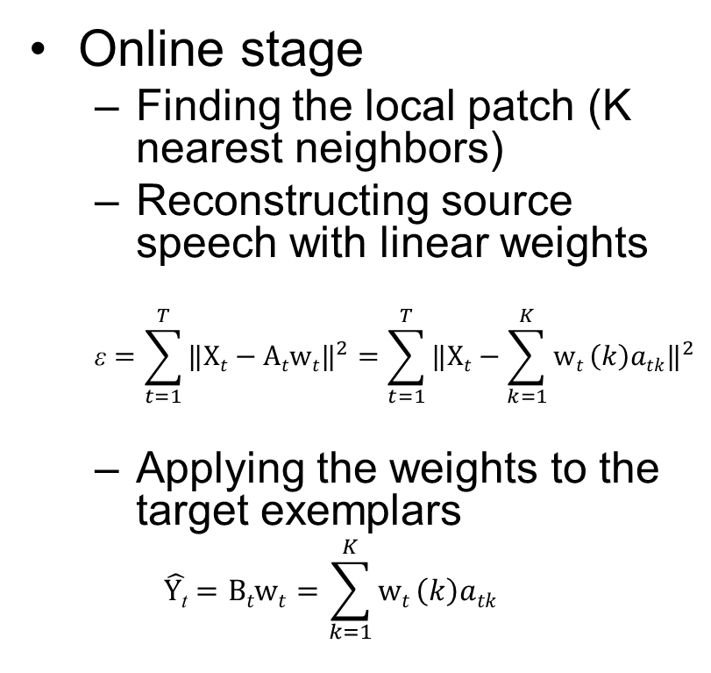
Proposed Method (2/3)
Online stage
Finding the local patch (K nearest neighbors)
Reconstructing source speech with linear weights
$$\text{ε}=\sum_{t=1}^{T}{{‖Xt−Atwt‖}^{2}}=\sum_{t=1}^{T}{{‖Xt−\sum_{k=1}^{K}{wt}\left(k\right)atk‖}^{2}}$$
Applying the weights to the target exemplars
$$\hat{Y\text{t}}=Btwt=\sum_{k=1}^{K}{wt}\left(k\right)atk$$
Notes:
On the other hand,
In the online stage, we also extract the spectral feature first.
And then, we modify the LLE algorithm for speaker voice conversion.
First, we find the input speech ‘s local patch in the source dictionary , and the k nearest exemplars form the sub dictionaries frame by frame.
Secondly, we linearly reconstruct input speech with the sub dictionaries and weight vectors.
Thirdly, we apply the weight to corresponded target sub dictionaries to produce converted speech.

Slide 7
Proposed Method (3/3)
Parameter Generation
MLPG algorithm for tackling the discontinuity problem
GV algorithm for tackling the over-smoothing problem
Notes:
After we get the frame-based converted speech, we use MLPG algorithm to solve frame-based discontinuity problem and global variance algorithm to solve the over-smoothing problem.

Slide 8
Outline
Exemplar-based spectral conversion
Motivation
Proposed method
Experimental results
Conclusions
Notes:
Now let’s turn to the experimental results of our system.

Slide 9
Evaluation Conditions
Dataset
For each of the 25 source-target pairs
162 parallel sentences for constructing the dictionary (no training)
54 sentences for testing
Configuration
513-dimensional spectral features extracted from STRAIGHT
Frame-wise energy normalization and taking logarithm
Static, delta and delta-delta features are used
LLE, K=1024
Notes:
For the dataset,
We used the 2016 voice conversion challenge corpus, and please noted that we did not have training phase.
For the configuration,
We used STRAIGHT to extract 513 dimensions magnitude spectrum.
And then, we did energy normalization of each frame and took log of normalized features.
In the end of speech preprocessing, we got the static, delta and delta-delta features.
Besides, for our system, we set K equal to 1024

Slide 10
Objective Evaluations
Mel-cepstral distance (MCD)
Computed based on 1st -24th Mel-cepstral coefficients (converted from spectral features)
 | F2F | F2M | M2M | M2F | Mean
Source | 8.10 | 8.80 | 7.78 | 8.78 | 8.36
LLE_SC | 5.67 | 5.70 | 5.55 | 5.78 | 5.67
LLE_SC+MLPG | 5.59 | 5.58 | 5.40 | 5.59 | 5.54
LLE_SC+MLPG+GV | 5.87 | 5.82 | 5.63 | 5.85 | 5.79
Not included in the paper
Notes:
For the objective evaluations,
We conducted the mel-cepstral distortion measurements.
The table shows the female to female, female to male, male to male, male to female and the mean of this 4 conditions.
We can find that LLE with MLPG gets the best objective performance.
However, we also find the similar results with other previous papers that MCD will increase after GV is applied.
Moreover, although the MCD will increase after global variance processing, the sound quality still improve.

Slide 11
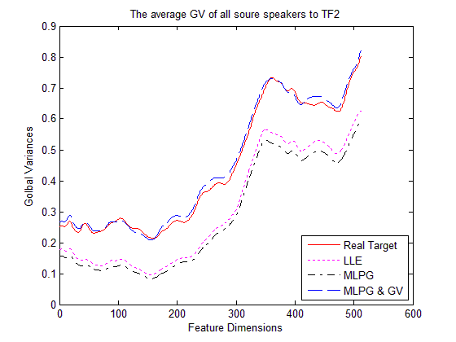
Objective Evaluations
Global variance
Not included in the paper
Notes:
To be more specific,
In this figure, we shows the converted speech and real target speech average global variance from speaker TF2.
The Red line is real target, the Magenta line is LLE, the black line is LLE with MLPG, and the Blue line is the LLE with MLPG and GV
We can find that before GV is applied, the converted speech’s variances of each dimension are not consist with real target.
That is to say, GV can makes the converted speech become more natural.

Slide 12

Subjective Evaluations (1/2)
Internal experiment
Notes:
For the subjective test, we get internal and external evaluations.
In the internal experiment, we conducted an AB test to compare three systems: LLE system, LLE with MLPG, and LLE with MLPG and GV.
The results in this figure shows that LLE with MLPG outperforms LLE, and LLE with MLPG and GV achieves a significant gain over LLE with MLPG only.
That is to say, introducing the MLPG algorithm and postfiltering-based GV compensation method further improves the quality of the converted speech.

Slide 13
Subjective Evaluations (2/2)
2016 Voice conversion challenge
MOS Similarity
Notes:
On the other hand,
In the external evaluation from the 2016 VCC organize,
Our system is B.
For both naturalness and similarity, our system is above the average of the total 18 systems.

Slide 14
Observed Problems
The similarity of M2M and F2M are not good (~53%)
The quality is not good enough (MOS 2.67)
Spectral features not suitable for LLE exemplar-based VC ?
Notes:
However, according to the subjective test,
We find some problems of our system.
First, the similarity of M2M and F2M are not significant better than the baseline system.
Second, the quality is not good enough, because we only get 2.67 MOS score.
As a result, we wonder that magnitude spectral feature used in submit system may not suitable for LLE exemplar-based VC.

Slide 15
Spectral Features vs MCCs (1/2)
Notes:
Additionally, although we just followed the traditional exemplar-based VC to use spectral feature, MCC is still one of the most popular feature in VC task.
Therefore, we also try to use 25 dimensions mcc and it’s dynamic features in our work.
According to this figure, we can find that before GV processing, MCC features achieve better performance than spectral features.
Although after GV is applied, MCC domain gets higher MCD, we know that the MCD will not reflect the real sound quality when GV is applied.

Slide 16
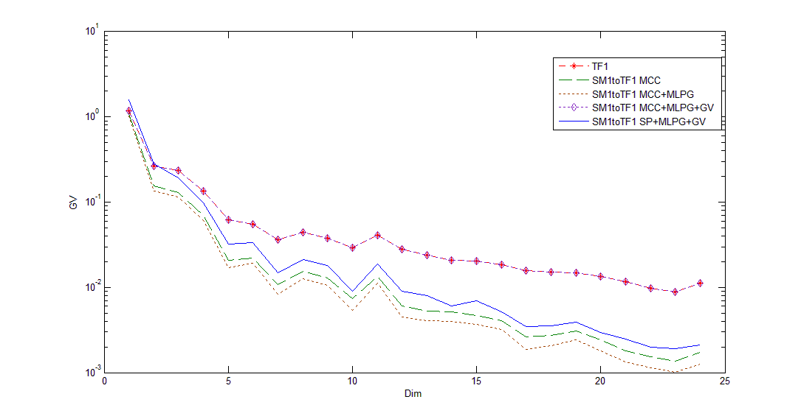
Spectral Features vs MCCs (2/2)
Global variance comparison (MCC domain)
Notes:
Additionally, we plot the GV curves of real target, MCC and spectral features in MCC domain.
We find that MCC with MLPG and GV boost more high order MCC and it will make the sound become more clear.
Moreover, in our internal subjective test, MCC with MLPG and GV also got the highest preference.

Slide 17
Demo Sounds
F2F | F2M | M2F | M2M
SP | SP | SP | SP
MCC | MCC | MCC | MCC
Notes:
Now I would like to demo some speech file to you.

Slide 18
Outline
Exemplar-based spectral conversion
Motivation
Proposed method
Experimental results
Conclusions
Notes:
Now I ‘d like to summarize our work.

Slide 19
Conclusions
We investigated the effectiveness of the LLE algorithm for exemplar-based SC
The proposed system achieved satisfied performance with MLPG and GV algorithms
MCCs might be more suitable for LLE exemplar-based VC than spectral features
Notes:
First, we investigated the effectiveness of the LLE algorithm for the exemplar-based SC
Second, the proposed system achieved satisfied performance with MLPG and GV algorithm
The last, we found that MCC might be more suitable for LLE exempla-based VC than spectral features.

Slide 20
Thank you
Notes:
Thank you and do you have any question?

Slide 21
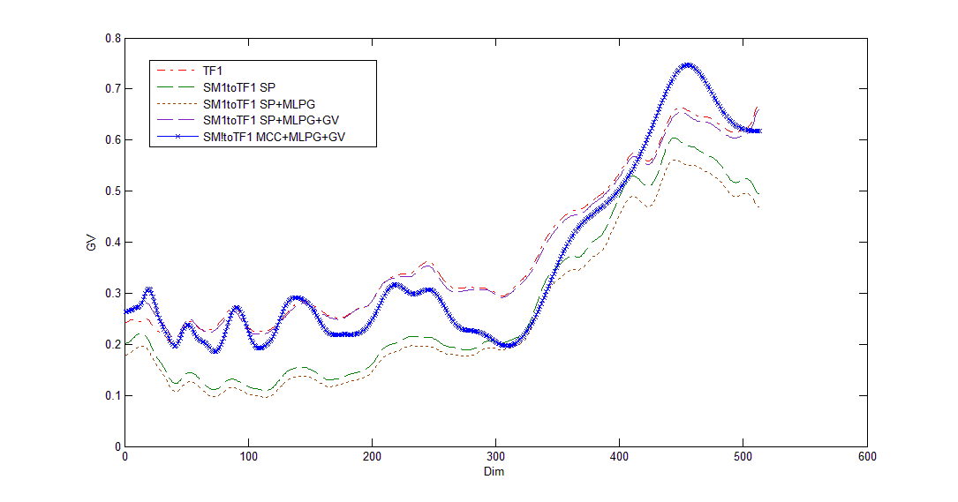
Appendix
Global variance comparison (SP domain)
Notes:
This figure shows the GV comparison in spectrum domain.
We can find that although MCC with MLPG and GV did not match the statistic of real target from spectrum domain, it still boost more high band signal.

Slide 22
Appendix
Notes:
We choose the K by experimental results and the concern of the computation time
We found that when K=1024, it could achieve acceptable quality and computation time

