Slide 1

Quasi-Periodic WaveNet Vocoder: A Pitch Dependent Dilated Convolution Model for Parametric Speech Generation
Monday, September 16th 2019
Yi-Chiao Wu, Tomoki Hayashi, Patrick Lumban Tobing,
Kazuhiro Kobayashi, Tomoki Toda
Toda Lab, Nagoya University, Japan

Slide 2
Outline
Introduction
Problems of WaveNet as a vocoder
QPNet with PDCNN
Speech generation with scaled F₀
Conclusion

Slide 3
Challenges of audio generation
Directly modeling speech waveform is challenging
Speech waveform signals
Very high temporal resolution (>= 16kHz)
Very long-term dependency
Conventional parametric synthesis (Vocoder)
STRAIGHT [H. Kawahara+, 1999] and WORLD [M. Morise+, 2016]
Encode speech into spectral and prosodic features
Decode the acoustic features to speech waveform
Lost temporal details and phase information cause speech quality degradation
Notes:
[challenges]
[straight drawback]
As we know, directly modeling speech waveform is challenging because speech waveform usually has a very high temporal resolution, which means it has a very long-term dependency.
Therefore, conventional parametric synthesis technique such as STRAIGHT and WORLD usually encode speech into low-dimensional spectral and prosodic features and then decode the acoustic features to speech waveform.
However, because of the over-simplified assumption of speech generation mechanism, the lost temporal details and phase information cause significantly speech quality degradation.

Slide 4
WaveNet [A. van den Oord+, 2016]
Autoregressive causal model
Modeling the conditional probability
Receptive filed: a segment of previous samples
Dilated convolution to extend the receptive field
Notes:
[WavNet]
[receptive field]
[DCNN]
As a result, Google proposed WaveNet in 2016, which is an autoregressive causal model directly modeling the probability P given a segment of previous speech samples to predict the distribution of the current sample.
The segment of previous samples is called receptive filed, and WaveNet apply the dilated convolution technique to efficiently extend the size of receptive field.
Dilated convolution is a convolution with skip holes or we can call it dilation size, based on the stacked dilated convolution layers with different size of skip holes or we call it dilation size, the network can catch different levels’ information.

Slide 5
WaveNet Vocoder [A. Tamamori+, 2017]
WaveNet as a vocoder
Input: acoustic features
Output: speech waveform
Conditional WaveNet
Conditional probability
h: auxiliary features (conditional features)
Acoustic features from conventional vocoder as the auxiliary features
Without hand-craft assumptions of speech generation
Recover the lost phase and temporal details information
Notes:
Furthermore, Tamamori applied WaveNet as a Vocodcder in 2017, which makes WaveNet condition on the acoustic feature to generate speech waveform.
Without the hand-craft assumptions of speech generation, WaveNet can recover the lost phase and temporal information caused by the conventional vocoder.

Slide 6
Is WaveNet vocoder suitable for speech generation?
Speech signal is a quasi-periodic signal
Periodic part: long-term correlation
Non-periodic part: short-term correlation
WaveNet
Fixed network architecture
Without prior knowledge of speech signal
Problems of WaveNet as a vocoder
Inefficient speech signal modeling
Limited pitch controllability
Notes:
[quasi-periodic signal]
[issues]
However, speech signal is a quasi-periodic signal which includes periodic and non-periodic parts.
Therefore, the fixed network structure without prior knowledge of speech may cause some problems of WaveNet as a vocoder.
For instance, the inefficient audio signal modeling and limited pitch controllability.

Slide 7
Problem I: Inefficient speech modeling
Modeling the very long-term dependency
Long receptive field to cover the related samples
huge network is required
Without the prior knowledge of audio periodicity
Dilated layers of WaveNet are like downsampling
Fixed network for both periodic and non-periodic parts
Oversampling of periodic part
Receptive field includes many redundant samples
Notes:
[huge network]
[fixed for both periodic and non-periodic]
[redundant]
Specifically, to model the very long-term dependency, a extremely long receptive filed is needed to cover all related past samples, and it means that a huge network is required.
Moreover, as we know, the dilated layers of WaveNet acts like downsampling to catch different levels’ information.
Therefore, the same fixed network structure for both periodic and non-periodic part is not reasonable.
It is like oversampling the periodic part, which means that the receptive field includes many redundant samples.

Slide 8

Problem II: Limited pitch controllability
WaveNet conditioned on unseen acoustic features
F₀ is not observed in the range of training data
Unseen feature pair of spectrum and F₀
Original spectral feature with scaled F₀
Difficult to generate speech
Inaccurate pitch of the generated speech
Normal (Natural):
Normal (WaveNet):
1.5 F₀ (Expected):
1.5 F₀ (WaveNet):
Notes:
Furthermore, based on previous works’ results, we found that it is hard to generate speech with accurate pitch when WaveNet conditioned on the unseen acoustic features.
For example, the natural speech is like that, and WaveNet conditioned on the natural acoustic features is like that, which has good speech quality and accurate pitch.
However, if we scaled the pitch feature to 1.5 pitch, the expected sound is like that, but the WaveNet generated speech is like that, which has much lower pitch.

Slide 9
Quasi-Periodic WaveNet [Y. -C. Wu+, 2019]
Pitch-dependent dilated convolution
Inspired by code-excited-linear-prediction (CELP)
Dynamically change the dilation size
Model the periodic part with prior F₀ knowledge (long-term correlations)
Cascaded network
Fixed modules model the non-periodic part with the nearest samples (short-term correlations)
Adaptive modules for periodic part
Notes:
To solve the mentioned problems, we propose the Quasi-periodic WaveNet vocoder, which introduces a pitch-dependent dilated convolution to model the periodic part and apply a cascaded structure to simultaneously model both periodic and non-periodic parts.

Slide 10
Pitch-dependent dilated convolution
Fixed number of samples in a receptive filed
Determined by the number of network layers
Effective receptive field can be changed with different dilation size
Pitch-dependent
Dilated convolution:
Dilation size d
Vanilla DCNN: time-invariant and constant
Proposed PDCNN: time-variant and pitch-dependent
Notes:
As we know, the number of samples in a receptive field is determined by the network size.
However, the effective receptive field can be changed by different dilation size.
Specifically, dilated convolution can be formulate like that.
The current output Xt(o) can be a weighted sum of the current input and a past sample with dilation size d.
For vanilla dilated CNN the dilation size is a time-invariant constant.
But our proposed pitch-dependent CNN has a time-variant dilation size.

Slide 11
Pitch-dependent dilated convolution (cont.)
Pitch-dependent dilated factor: E_{t} = F_{s}/(F_{0,t} × a)
Notes:
We introduce a pitch-dependent dilated factor Et to control the dilation size to dynamically extend the effective receptive field.
The dilated factor Et is the sampling rate divided by each sample’s pitch and a dense factor.

Slide 12
Dense factor
Dense factor a is the number of samples in one cycle period taken into account
Notes:
Dense factor indicate the number of samples in one cycle period taken into account.
For example, the first we take 8 samples in one cycle, and the last figure we only take 2 samples ion one cycle.

Slide 13
Effective receptive filed
Fixed number of samples in a receptive filed
Fixed number of samples in one cycle
The same number of past cycles in a effective receptive field for arbitrary F₀
Notes:
Here is an example to explain the concept of effective receptive filed with dense factor.
According to the two figures, we find that although the signals have different frequencies, the same dense factor makes the effective receptive fields include the same number of past cycles.

Slide 14
Cascaded networks
Fixed modules for short-term correlations
Fixed dilated convolution (DCNN)
Adaptive modules for long-term correlations
Pitch-dependent dilated convolution (PDCNN)
Notes:
Furthermore, we propose a cascaded structure of the fixed and adaptive modules to simultaneously model the short- and long-term correlations of speech signals.

Slide 15
Experiments setting
Corpus for WaveNet-based vocoder
VCC2018 and patrial CMU ARCTIC
Training (VCC2018): 81 sentences * 12 speakers
Training (ARCTIC): 1034 utterances * 2 speakers
Testing (SPOKE set): 35 utterances / speaker
Models
QPNet: Quasi-Periodic WaveNet (2.4 × 10⁷ parameters)
WNc: compact size WaveNet (2.4 × 10⁷ parameters)
WNf: full size WaveNet (4.4 × 10⁷ parameters)
WORLD
Notes:
We conducted evaluation based on the Voice conversion challenge 2018 and CMU-ARCTIC corpus
We compared the proposed QPNet vocoder with the compact size WaveNet WNc, double size WaveNet WNf, and world vocoders.
Please note that the number of parameters of QPNet is the same as WNc.

Slide 16
Experiments setting
Sampling rate: 22.05kHz
Acoustic features (extracted using WORLD)
34-dim mel-cepstral coefficients (mcep)
2-dim coded aperiodic features
1-dim interpolated continuous F₀
1-dim voice/unvoice binary flag
Scaled F₀
Ratio: unchanged, 1/2, 2/3, 3/4, 4/5, 6/5, 5/4, 4/3, 3/2, 2
MCD, RMSE of log F₀
Notes:
The auxiliary features were extracted by world vocoder.
In order to evaluate the pitch controllability of the vocoders, we test the vocoders with scaled f0.
The 10 different scaling rations are form 0.5 to 2.

Slide 17
Objective evaluation
 | RMSE of log F₀ |  |  |  | MCD
F₀ ratio | WORLD | WNf | WNc | QPNet | WORLD | WNf | WNc | QPNet
Unchanged | 0.09 | 0.14 | 0.26 | 0.13 | 2.52 | 3.58 | 4.34 | 4.08
1/2 | 0.13 | 0.30 | 0.38 | 0.23 | 3.92 | 4.56 | 5.02 | 4.79
2/3 | 0.11 | 0.23 | 0.35 | 0.19 | 3.19 | 4.15 | 4.71 | 4.47
3/4 | 0.10 | 0.20 | 0.32 | 0.17 | 2.93 | 3.95 | 4.58 | 4.34
4/5 | 0.10 | 0.18 | 0.30 | 0.16 | 2.79 | 3.84 | 4.50 | 4.27
6/5 | 0.09 | 0.16 | 0.26 | 0.13 | 2.72 | 3.60 | 4.38 | 4.14
5/4 | 0.09 | 0.17 | 0.26 | 0.14 | 2.76 | 3.62 | 4.39 | 4.16
4/3 | 0.10 | 0.18 | 0.26 | 0.15 | 2.83 | 3.63 | 4.42 | 4.19
3/2 | 0.09 | 0.21 | 0.27 | 0.16 | 3.05 | 3.68 | 4.50 | 4.27
2 | 0.09 | 0.26 | 0.28 | 0.18 | 3.75 | 3.86 | 4.75 | 4.59
Average | 0.10 | 0.20 | 0.29 | 0.16 | 3.04 | 3.84 | 4.56 | 4.33
Notes:
For the objective evaluation, we measure the generated pitch accuracy by rmse of log f0 and the spectrum prediction accuracy by mel-cepstral distortion.
According to the result, among the neural-based vocoders, QPNet achieves the best pitch accuracy.
And QPNet also outperform the same size WaveNet in the MCD measurements.
Which confirm the effectiveness of PDCNN and cascaded structure.

Slide 18
Subjective evaluation
MOS for speech quality
XAB test for pitch accuracy
Notes:
Furthermore, we also conducted subject evaluation to evaluate the speech quality and pitch accuracy.
For speech quality, QPNet significantly outperforms the same size WaveNet and achieves comparable speech quality to double size WaveNet.
For the pitch accuracy QPNet still outperform the double size WaveNet which is consistent with the objective results.

Slide 19
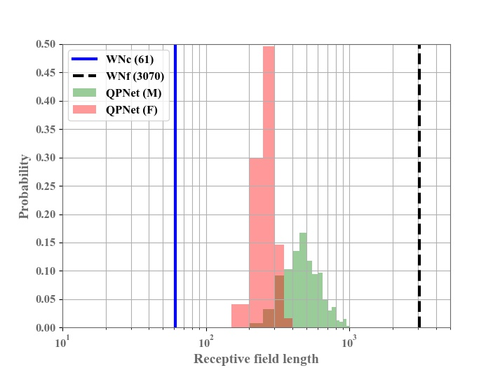
Effective receptive field length
WNf > QPNet(male set) > QPNet(female set) > WNc
Notes:
Because the receptive filed of QPNet is time variant, we also plot the distribution of effective receptive filed of female and male set.
The blue line is the receptive filed size of same size WaveNet, and the black line is the receptive filed size of double size WaveNet
The results show that with PDCNN, QPNet can extend the effective receptive field more efficiently.

Slide 20
Demo
Natural
 | Unchanged | 1/2 F₀ | 3/2 F₀
World
WNc
WNf
QPNet

Slide 21
Conclusion
PDCNN efficiently extends the effective receptive filed and reduces the network size requirement.
Cascaded structure simultaneously models long- and short-term correlation well.
Pitch controllability
QPNet significantly outperforms WNf and WNc
Speech quality
QPNet outperforms same-sized WN (WNc)
QPNet is comparable with double-sized WN (WNf)

Slide 22
Thank you for your attention ! https://bigpon.github.io/QuasiPeriodicWaveNet_demo/

Slide 23
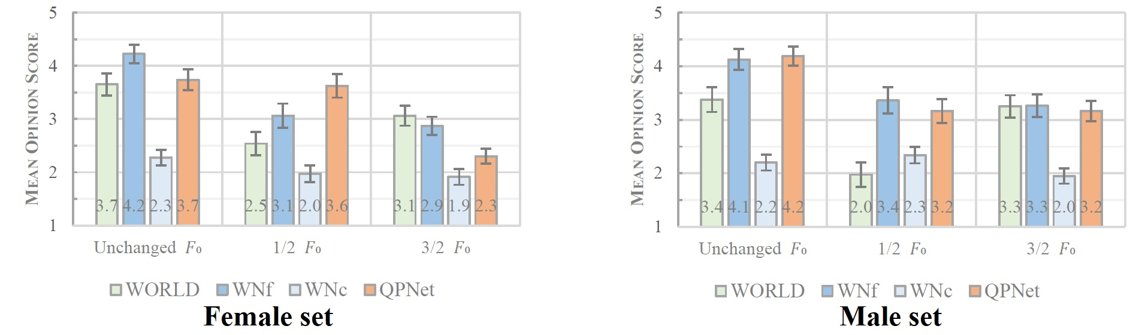
Subjective evaluation
MOS for speech quality

Slide 24
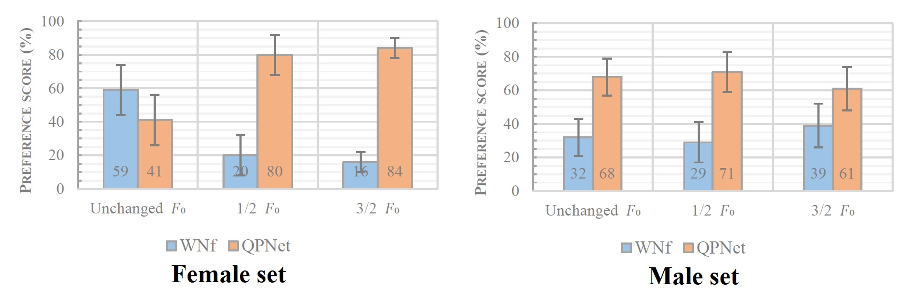
Subjective evaluation
XAB preference test for pitch accuracy

