Slide 1
Music Sheet
LaLa Philharmonic Orchestra
Kim Jin Soo

Slide 2








Slide 3










Slide 4
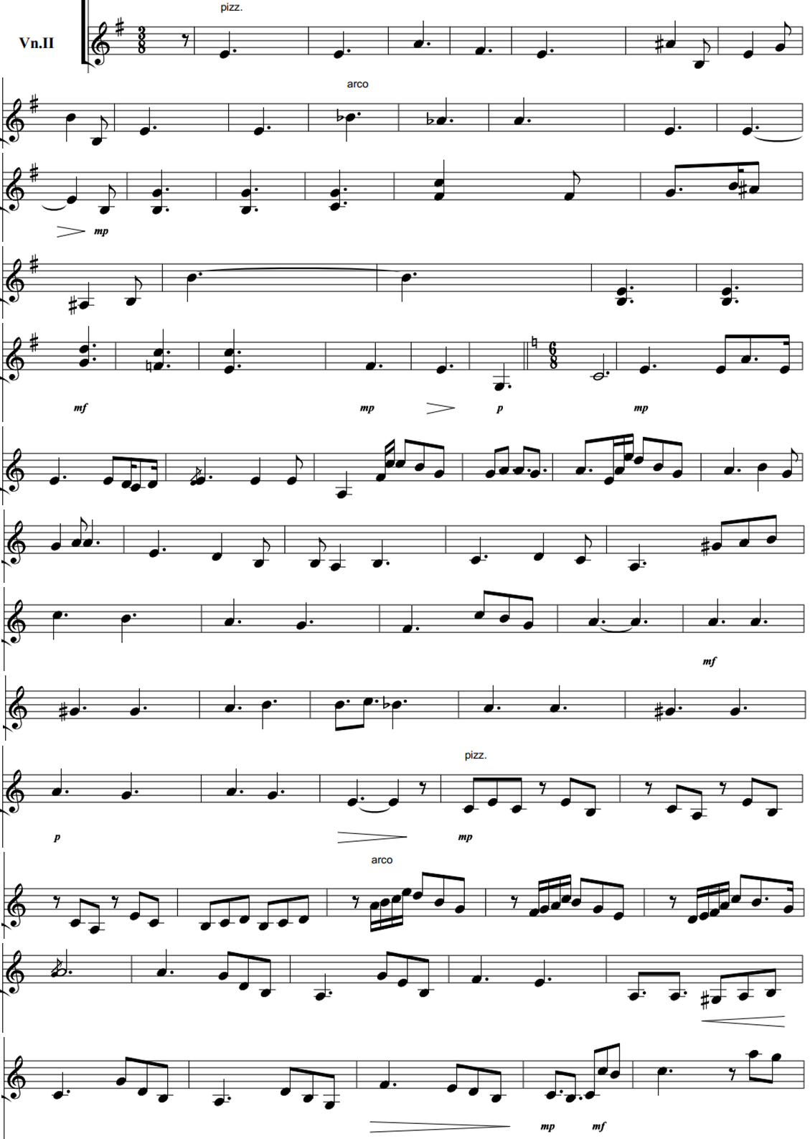

Slide 5
