Slide 1
Dijkstra Algorithm

Slide 2
Link State Properties
Link-state routing protocols are one of the two main classes of routing protocols used in packet switching networks for computer communications
Dijkstra’s algorithm is usually the working principal behind Link State routing protocols, OSPF and IS-IS
The algorithm can be used to find a shortest route from a fixed source node to any other nodes.
It finds the shortest paths from some source vertex to all the other vertices one-by-one
The paths are discovered in the order of their weighted lengths, starting with the shortest, proceeding to the longest
Initially all the tentative distances are "infinity“(ꝏ), except for the source vertex which has tentative distance zero

Slide 3
Example For Finding Shortest Path Using Dijkstra Algorithm
Step - 1
B
11
D
A | B | C | D
0 | ꝏ | ꝏ | ꝏ
5
4
5
A
C
10
As vertex A is source, column A value is 0
Other columns values will be ꝏ
Value in column denotes weight of the shortest path
0 means source Vertex and ꝏ means unexplored vertices
Smallest marked value in row is 0
A | B | C | D
 | ꝏ | ꝏ | ꝏ
0

Slide 4
Step - 2
B
11
D
Now we will look edges that are directly connected with Vertex A (B and C)
Minimum value = min(value of vertex in column, Marked value+ Edge Weight)
D is not directly connected hence so previous value is copied (ꝏ)
4
5
5
A
C
10
A | B | C | D
 | ꝏ | ꝏ | ꝏ
 | Min(ꝏ , 0+5) 5 | Min(ꝏ , 0+10) 10 | ꝏ
0
0

Slide 5
Step - 3
B
11
D
4
Now smallest unmarked value in Second row is 5
Now since 5 is marked vertex B is marked
5
5
A
C
10
A | B | C | D
 | ꝏ | ꝏ | ꝏ
 | Min(ꝏ , 0+5) | Min(ꝏ , 0+10) 10 | ꝏ
0
0
5

Slide 6
Step - 4
11
As B is marked, now look for edges those are directly connected to vertex B
Now smallest unmarked value in Third row is 9
Now since 9 is marked vertex C is marked
B
D
4
5
5
A
C
10
A | B | C | D
 | ꝏ | ꝏ | ꝏ
 | Min(ꝏ , 0+5) | Min(ꝏ , 0+10) 10 | ꝏ
 |  | Min(10, 5+4) | Min(ꝏ, 5+11) 16
0
0
5
0
5
9

Slide 7
Step - 5
11
As C is marked, now look for edges those are directly connected to vertex C
As only one Vertex is remaining, look edge directly connected to Vertex D
Now smallest unmarked value in fourth row is 14
B
D
4
5
5
A
C
10
A | B | C | D
 | ꝏ | ꝏ | ꝏ
 | Min(ꝏ , 0+5) | Min(ꝏ , 0+10) 10 | ꝏ
 |  | Min(10, 5+4) | Min(ꝏ, 5+11) 16
 |  |  | Min(16, 9+5)
0
0
5
0
5
9
0
5
9
14

Slide 8
Backtracking
Step - 1
A | B | C | D
 | ꝏ | ꝏ | ꝏ
 | Min(ꝏ , 0+5) | Min(ꝏ , 0+10) 10 | ꝏ
 |  | Min(10, 5+4) | Min(ꝏ, 5+11) 16
 |  |  | Min(16, 9+5)
0
0
5
0
5
9
0
5
9
14
Move upwards row by row
Stop when find change in value
Start from the final marked value
Here final marked value is 14

Slide 9
Step - 2
A | B | C | D
 | ꝏ | ꝏ | ꝏ
 | Min(ꝏ , 0+5) | Min(ꝏ , 0+10) 10 | ꝏ
 |  | Min(10, 5+4) | Min(ꝏ, 5+11) 16
 |  |  | Min(16, 9+5)
A
0
B
0
5
✓
C
0
5
9
✓
D
0
5
9
14
Tick D as it is the destination Vertex
Check value in Third row
Value is change from 14 to 16
Tick Vertex that was marked in that row
Tick the Vertex is C

Slide 10
Step - 3
A | B | C | D
 | ꝏ | ꝏ | ꝏ
 | Min(ꝏ , 0+5) | Min(ꝏ , 0+10) 10 | ꝏ
 |  | Min(10, 5+4) | Min(ꝏ, 5+11) 16
 |  |  | Min(16, 9+5)
A
0
✓
B
0
5
✓
C
0
5
9
✓
D
0
5
9
14
Move pointer to Vertex C
Move pointer to one row upwards
Check if value has been changed
Value is changed from 9 to 10
Tick Vertex that was marked in that row
Tick the Vertex is B

Slide 11
Step - 4
A | B | C | D
 | ꝏ | ꝏ | ꝏ
 | Min(ꝏ , 0+5) | Min(ꝏ , 0+10) 10 | ꝏ
 |  | Min(10, 5+4) | Min(ꝏ, 5+11) 16
 |  |  | Min(16, 9+5)
✓
A
0
✓
B
0
5
✓
C
0
5
9
✓
D
0
5
9
14
Move pointer to Vertex B
Move pointer to one row upwards
Check if value has been changed
Value is changed from 5 to ꝏ
Tick Vertex that was marked in that row
Tick the Vertex is A

Slide 12
Step - 5
A | B | C | D
 | ꝏ | ꝏ | ꝏ
 | Min(ꝏ , 0+5) | Min(ꝏ , 0+10) 10 | ꝏ
 |  | Min(10, 5+4) | Min(ꝏ, 5+11) 16
 |  |  | Min(16, 9+5)
✓
A
0
✓
B
0
5
✓
C
0
5
9
✓
D
0
5
9
14
Since initial Vertex A is marked stop here
Therefor the required shortest path is
A -----> B -----> C -----> D

Slide 13
TEST CASE TOPOLOGY DIAGRAM
R2
8
R3
7
R4
4
9
2
R1
11
4
R5
R9
14
8
7
6
10
R8
R7
R6
1
2

Slide 14
STEPWISE-FLOW FOR SHORTEST PATH WITH SORCE R1
4
4
4
12
4
12
R2
R2
R2
R3
R2
R3
0
0
0
0
15
R1
R1
R1
R1
R9
R8
R8
R8
R8
R7
8
8
8
8
9
4
12
4
12
R2
R3
R2
R3
0
15
0
15
R1
R9
R1
R9
R8
R7
R6
R8
R7
R6
8
9
11
8
9
11

Slide 15
STEPWISE-FLOW FOR SHORTEST PATH WITH SORCE R1
25
4
12
19
4
12
R4
R2
R3
R4
R2
R3
0
R5
0
15
R5
14
21
R1
R9
R1
R9
21
21
R8
R7
R6
R8
R7
R6
8
9
8
9
11
11
4
12
19
4
12
19
R2
R3
R4
R2
R3
R4
0
R5
0
14
21
14
R5
21
R1
R9
R1
21
21
R9
R8
R7
R6
R8
R7
R6
8
9
11
8
9
11

Slide 16
0
8
15
8
0
7
R2
R3
R4
R2
R3
R4
10
R5
22
2
R5
R1
R9
14
4
21
12
R1
R9
21
R8
R7
R6
R8
R7
R6
11
12
12
7
6
4
SHORTEST PATH TREE WITH SOURCE R2
SHORTEST PATH TREE WITH SOURCE R3
15
7
0
22
14
9
R2
R3
R4
R2
R3
R4
9
R5
16
R5
0
9
R1
R9
19
R1
R9
21
21
21
R8
R7
R6
R8
R7
R6
14
13
11
13
12
10
SHORTEST PATH TREE WITH SOURCE R4
SHORTEST PATH TREE WITH SOURCE R5

Slide 17
12
4
11
12
6
13
R2
R3
R4
R2
R3
R4
6
R5
10
R5
R1
R9
12
11
21
9
R1
6
R9
21
R8
R7
R6
R8
R7
R6
3
2
0
1
0
2
SHORTEST PATH TREE WITH SOURCE R6
SHORTEST PATH TREE WITH SOURCE R7
11
7
14
2
9
10
R2
R3
R4
R3
R4
R2
R5
13
R5
8
R1
7
R9
0
16
21
14
R1
R9
21
R8
R7
R6
R8
R7
R6
0
1
3
7
6
6
SHORTEST PATH TREE WITH SOURCE R8
SHORTEST PATH TREE WITH SOURCE R9

Slide 18
Test cases for five topologies

Slide 19
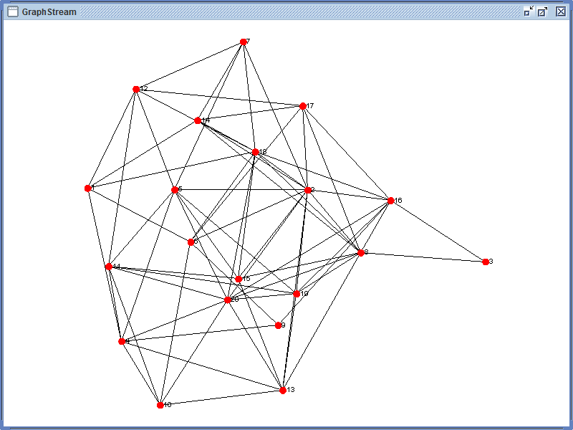
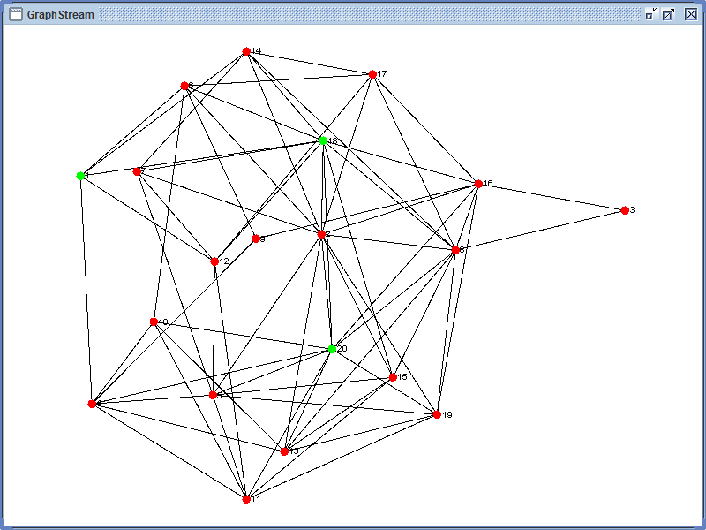
Topology 1
Graph for Topology 1
Path from source 1 to destination 20
for Topology 1
--------------Shortest Path-------------------
1->18->20
1->4->20

Slide 20
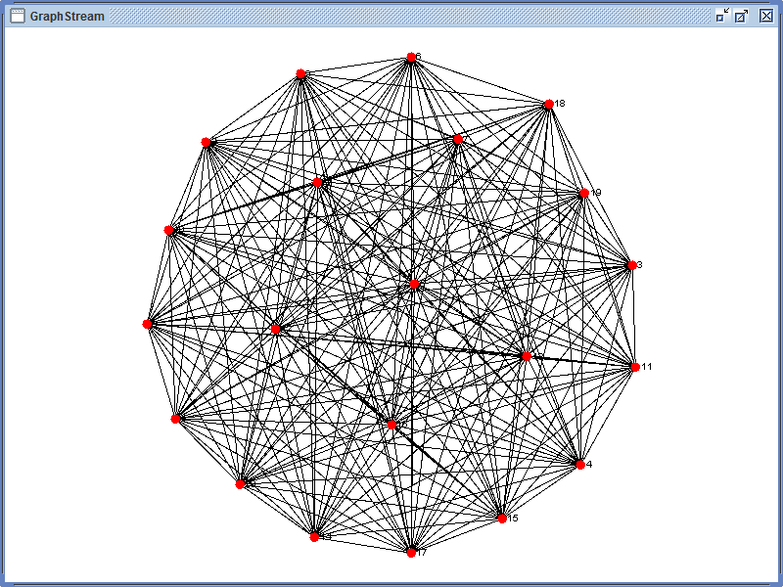
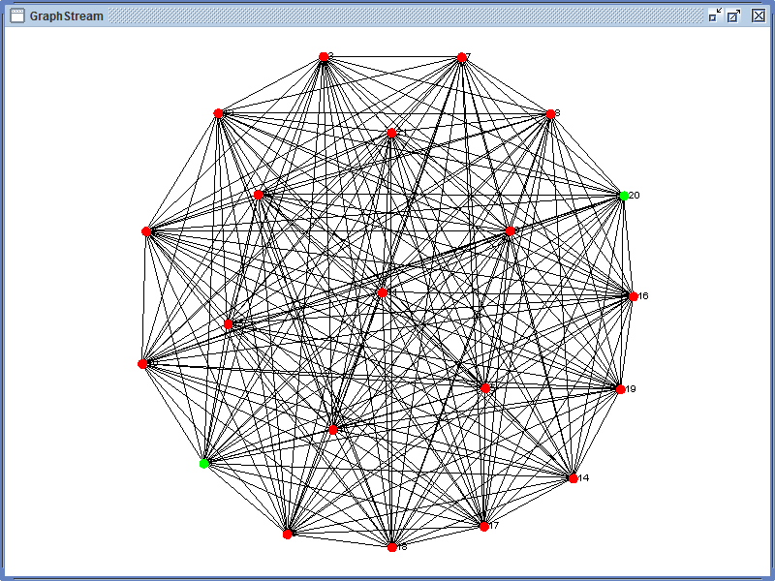
Topology 2
Graph for Topology 2
Path from source 1 to destination 20
for Topology 2
--------------Shortest Path-------------------
1->20

Slide 21
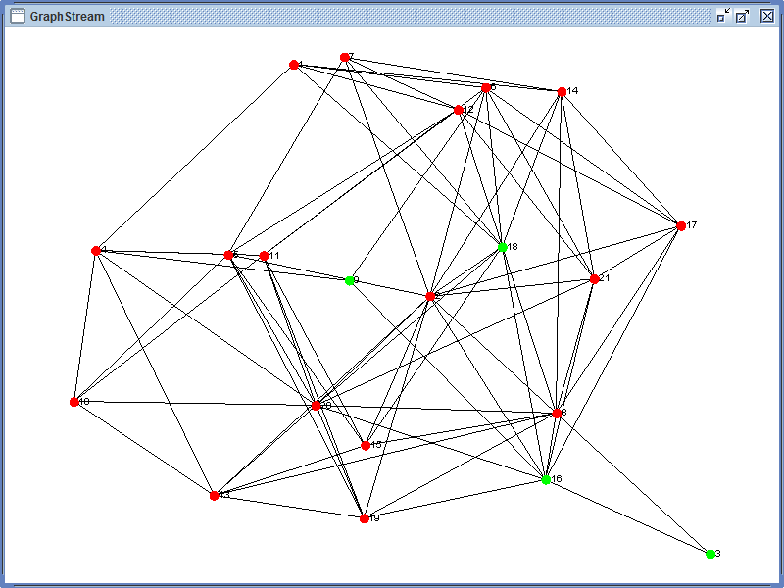
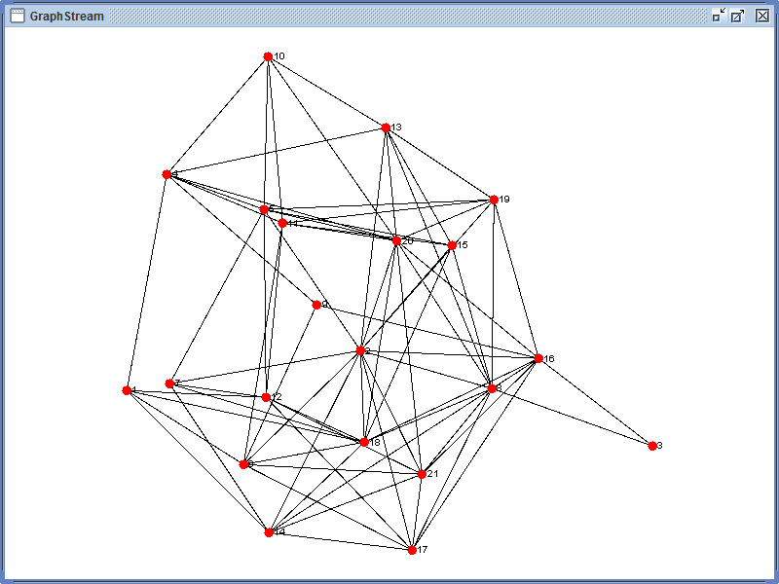
Topology 3
Path from source 3 to destination 9 for Topology 3
-------------Shortest Path--------------
3->16->18->9
3->8->21->9
3->16->6->9
3->8->20->9
3->16->20->9
3->16->14->9
3->8->14->9
3->8->18->9
3->16->21->9
Graph for Topology 3

Slide 22
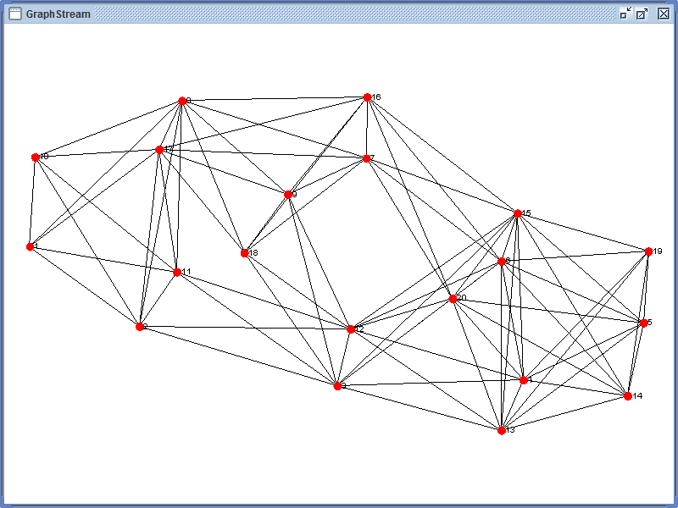
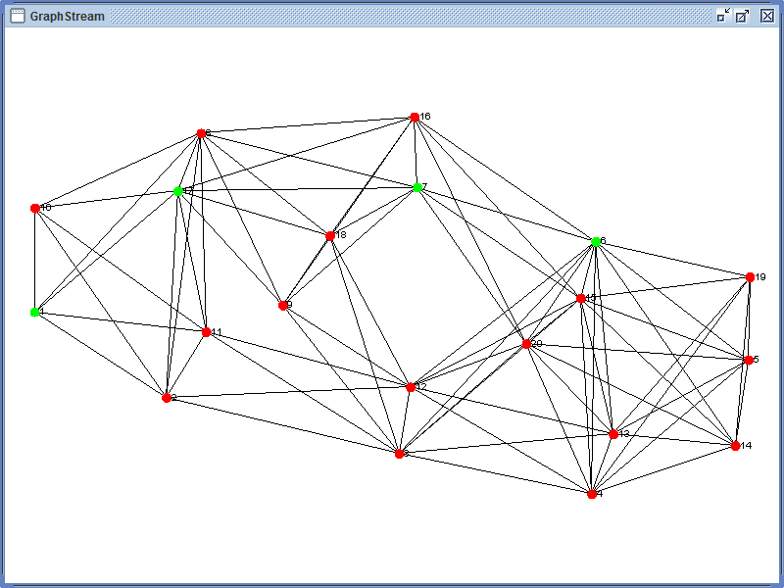
Topology 4
Graph for Topology 4
Path from source 1 to destination 6
for Topology 4
------------Shortest Path----
1->17->7->6
1->17->16->6
1->8->7->6
1->8->16->6

Slide 23
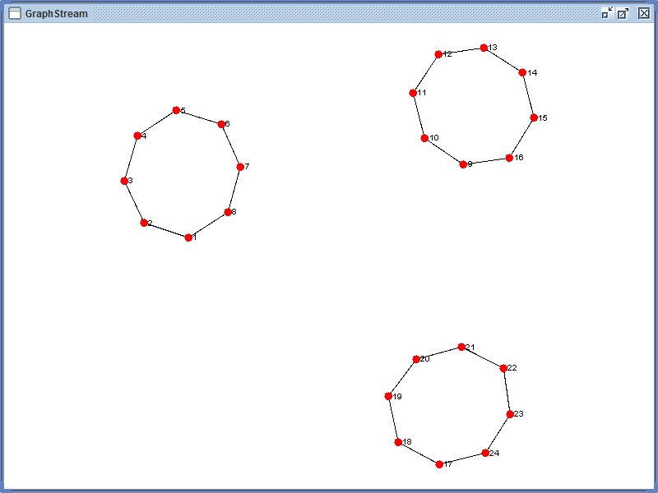
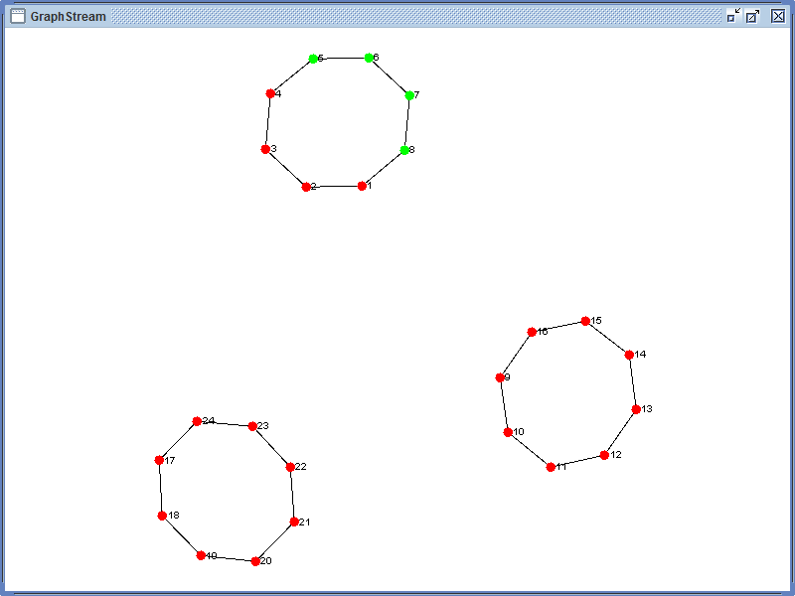
Topology 5
Graph for Topology 5
Path from source 5 to destination 8
for Topology 5
----------Shortest Path------------
5->6->7->8

Slide 24
Assumptions for topology file
Weight of a Node to itself will be “0” i.e., the diagonal of a Matrix should be zero.
A Node may not be directly connected to another Node for which weight will be Positive Infinity and represented by “-1” in Matrix.
An Edge of a Node other than as mentioned in above two points cannot have a zero or a negative weight.
Matrix must be a Square Matrix i.e., number of columns equal to the number of rows
Only single space separated file.
File cannot have any characters other than numbers.

Slide 25



File error handling
The diagonal of a Matrix not “0”
Edge other than diagonal Weight of “0”
Not a Square Matrix
Edge Weight with Negative value other than “-1”
File With more than one space
File With non-number character

Slide 26
External libraries used
Design Grid layout
Graph stream
Gnatt chart
ProjectLibre
reference
Wikepedia - https://en.wikipedia.org/wiki/dijkstra%27s_algorithm

