Slide 1
مدیریت همگام سازی داده چندین سامانه در سیستم عامل لینوکس
محمد گلکار
حامد کلانتری
امیررضا شیرمست

Slide 2
SANMAN
BARC Confronting with SAN Management Need

Slide 3
Why Not Just Buy One?
Interoperability
Vendor Support
Data Security
Licensing

Slide 4
Thus, Let’s Build
Hardware: Off-the-Shelf Commodity Components
Software: Base on Open Source Components

Slide 5
Redundany
Fault Tolerance
High Availability
Removing a Single Point of Failure

Slide 6
Bring DRBD In
I/O Performance
Data Reliability
Logical Volumes

Slide 7
Distributed Replicated Block Device (I)
Mirroring Block Devices Between Hosts
Implemented as a Kernel Module

Slide 8
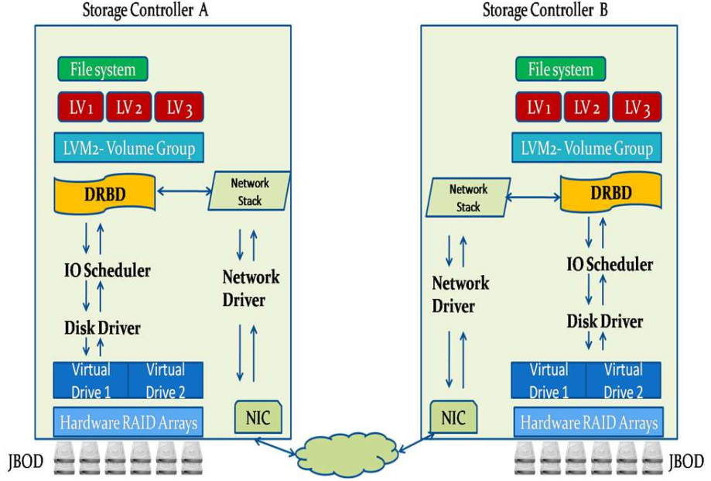
Distributed Replicated Block Device (II)

Slide 9
RRC: Responsive Replicated Containers
Diyu Zhou
UCLA and EPFL
Yuval Tamir
UCLA

Slide 10
Passive Backup
Primary Server
Backup Server
Client

Slide 11
Passive Backup
Primary Server
Backup Server
Client

Slide 12
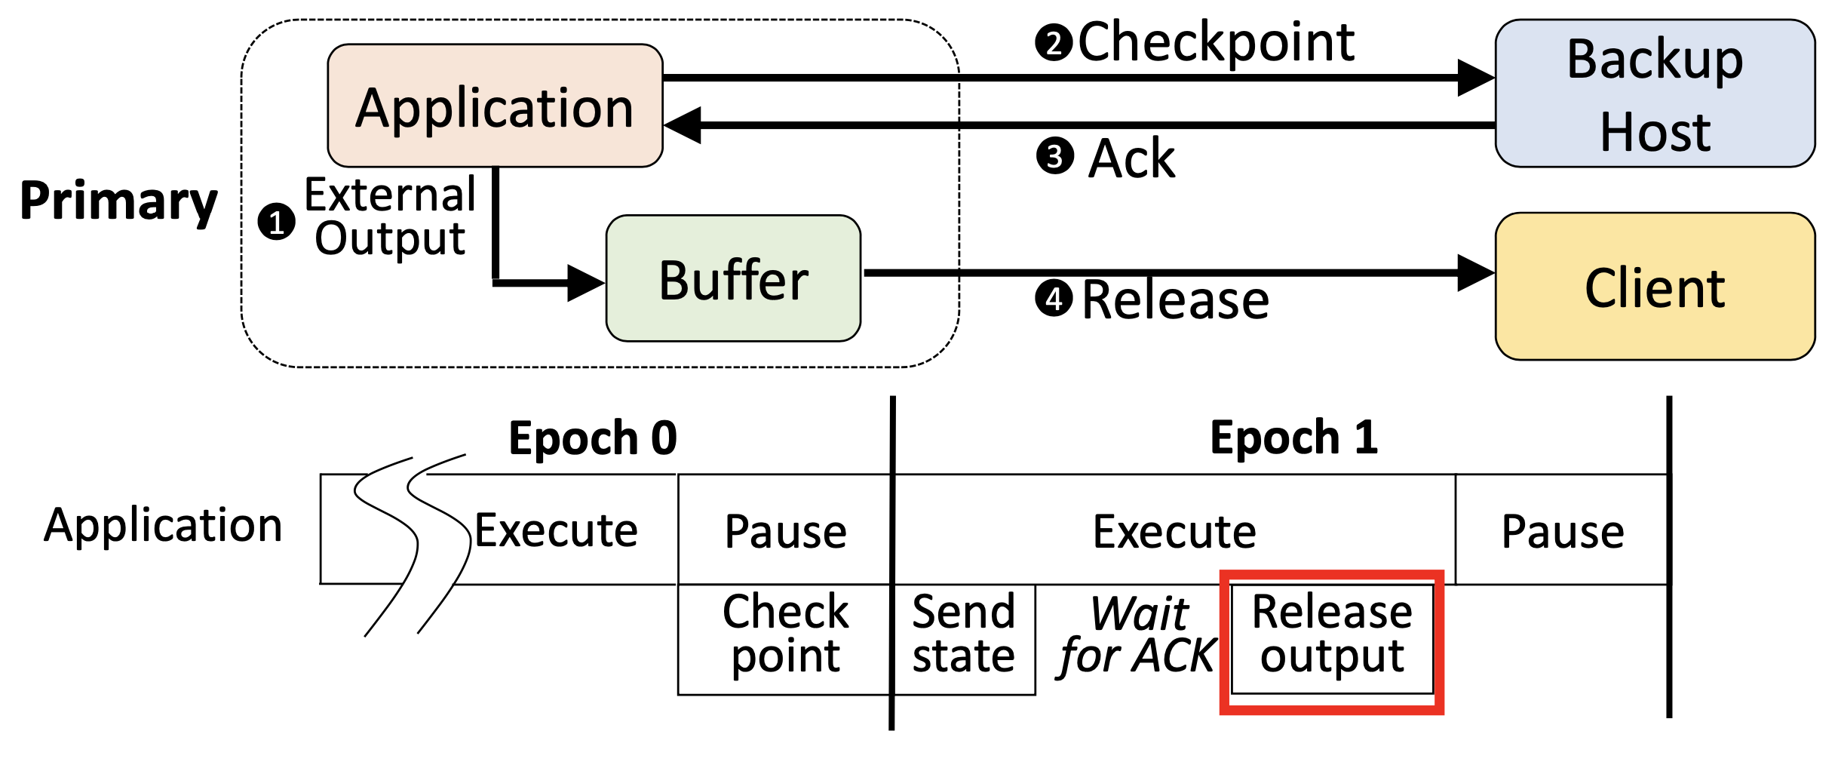
Checkpointing

Slide 13
Checkpointing
‒ Short interval, High throughput overhead, low latency overhead ‒ Long interval, Low throughput overhead, high latency overhead

Slide 14
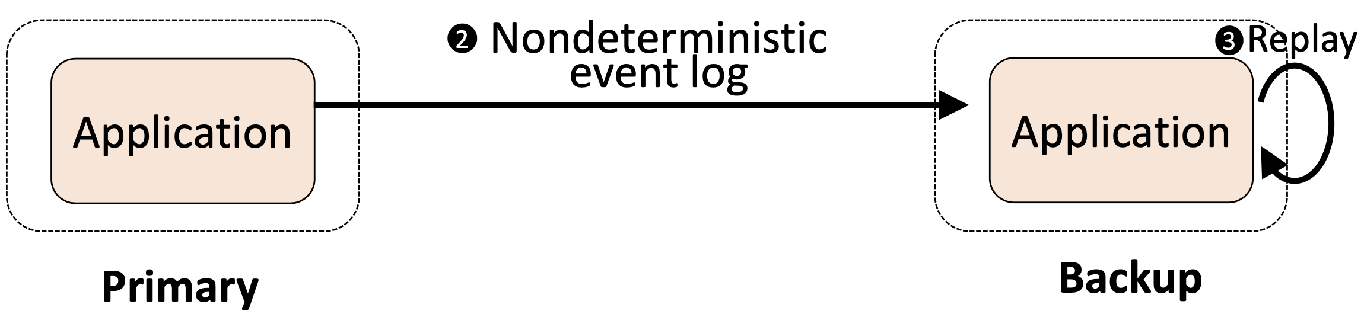
Event Logging
‒ Unprediced behavior with multithreading and race conditions ‒ Hight overhead and coupling between two servers

Slide 15
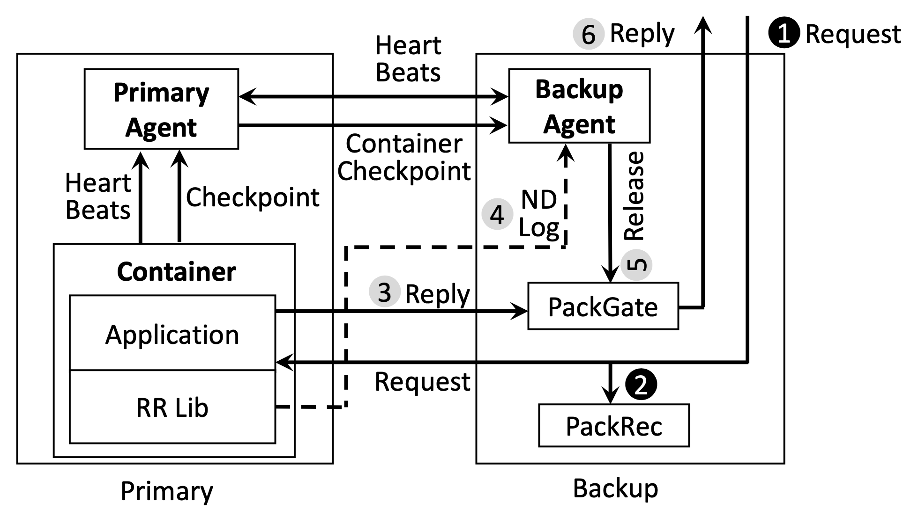
Solution: Hybrid Schema
On primary failure: ‒ Restore the last checkpoint on backup ‒ Backup replays primary execution up to the last released outputs

Slide 16
Some Implamentation Challenges
‒ Service pause during container checkpointing
Significant in-kernel container state must be checkpointed
Checkpointing requires saving a consistent state
Execution must pause during checkpointing
‒ Nondeterministic events and the challenge of data races
Vulnerability only to nondeterministic events occuring during the epoch of failure (Why?)
In multithreading memory access ordering is nondeterministic
We focus on infrequent data races (Why?)

Slide 17
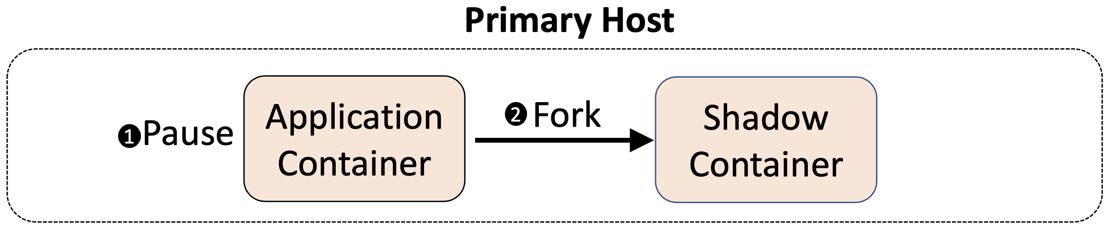
Reducing Service Pause Using Container Fork

Slide 18
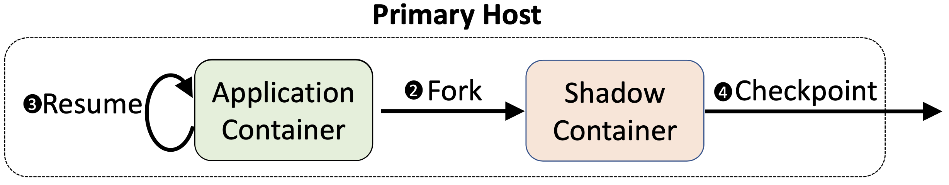
Reducing Service Pause Using Container Fork

Slide 19
Reducing Service Pause Using Container Fork
Result: Service Pause time [5.9ms - 42.9ms]→[0.5ms - 3.2ms]

Slide 20
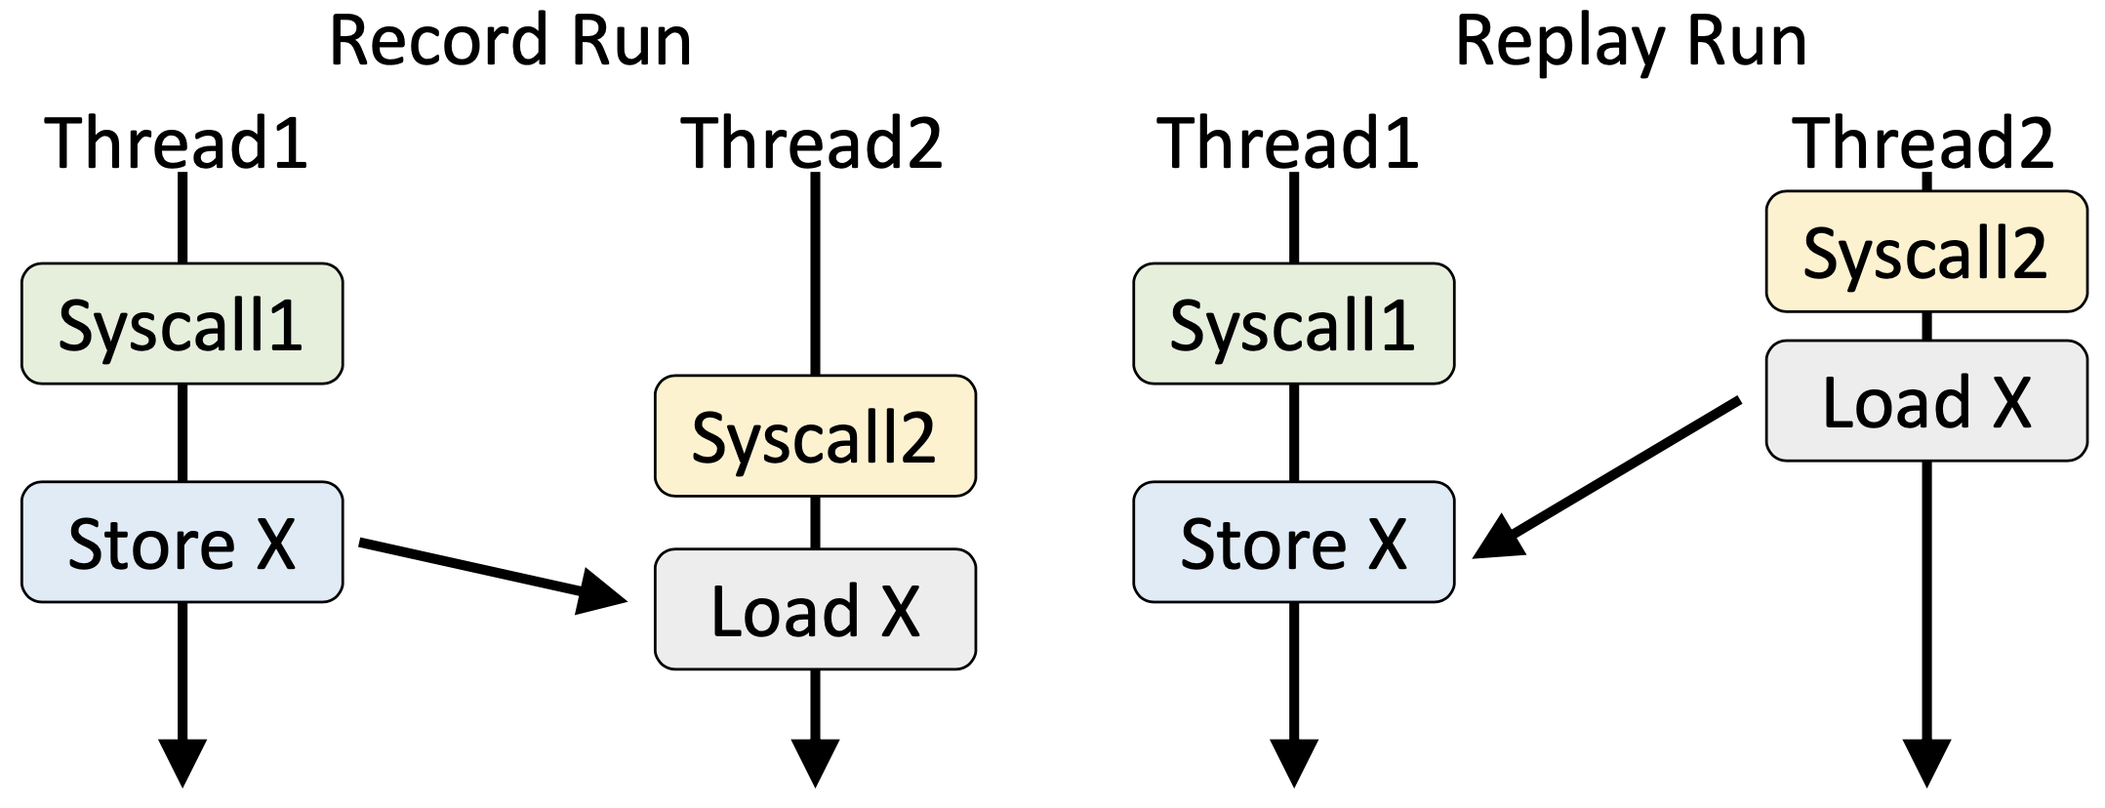
Challenge of Data Races
During replay on the backup, most of system calls are not actually called and executed
Different timing of thread execution may occur than record run

Slide 21
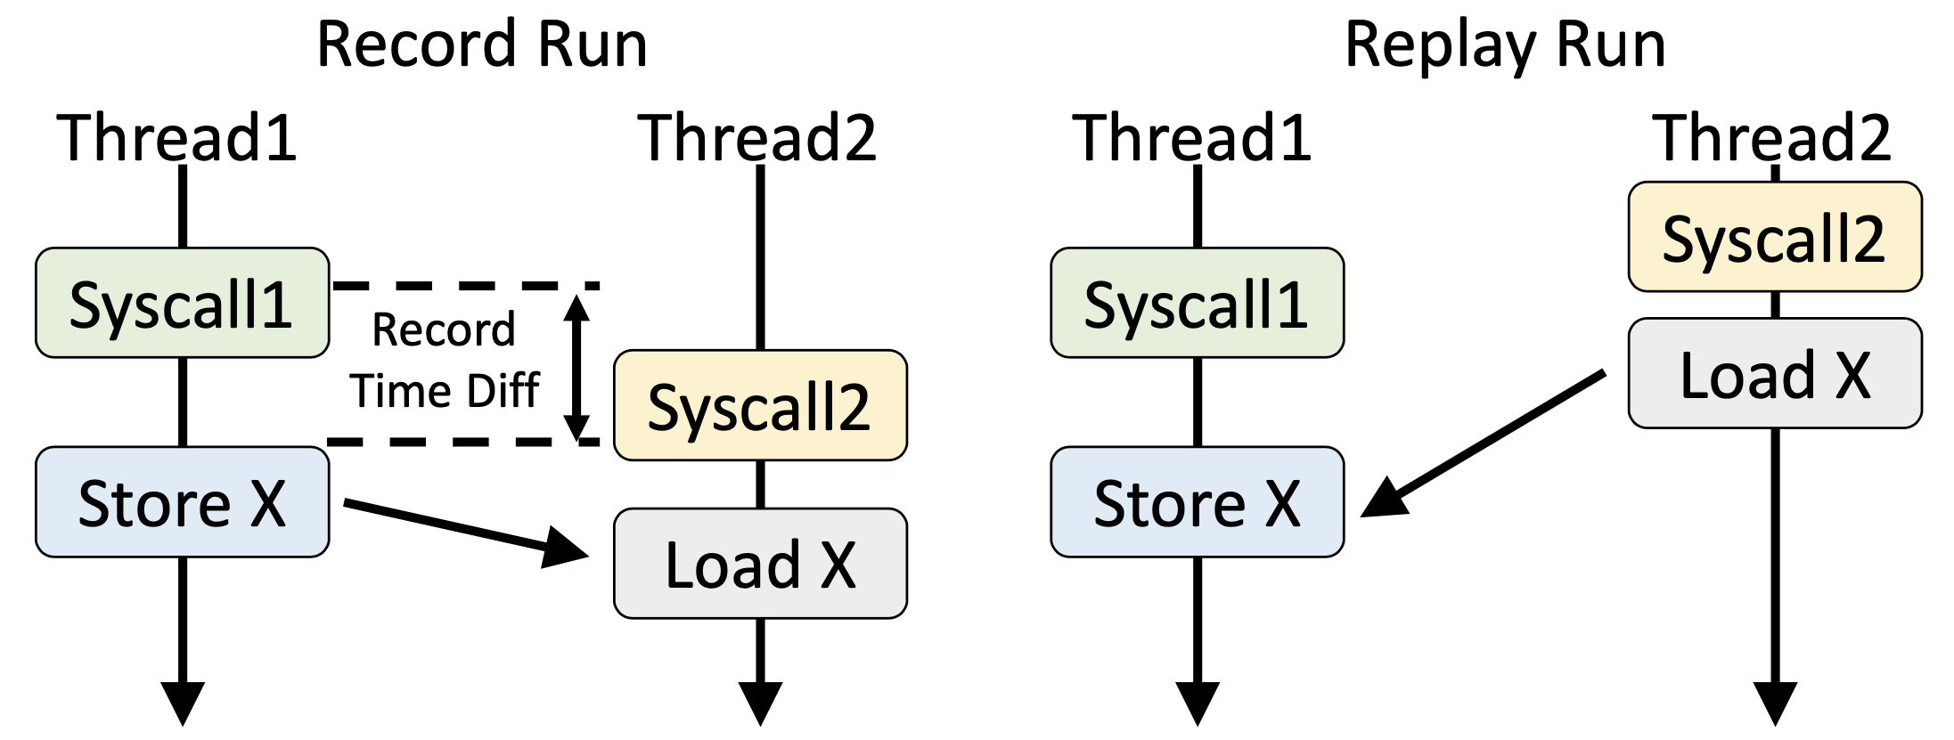
Solution: Record Time Diff during Record Run

Slide 22
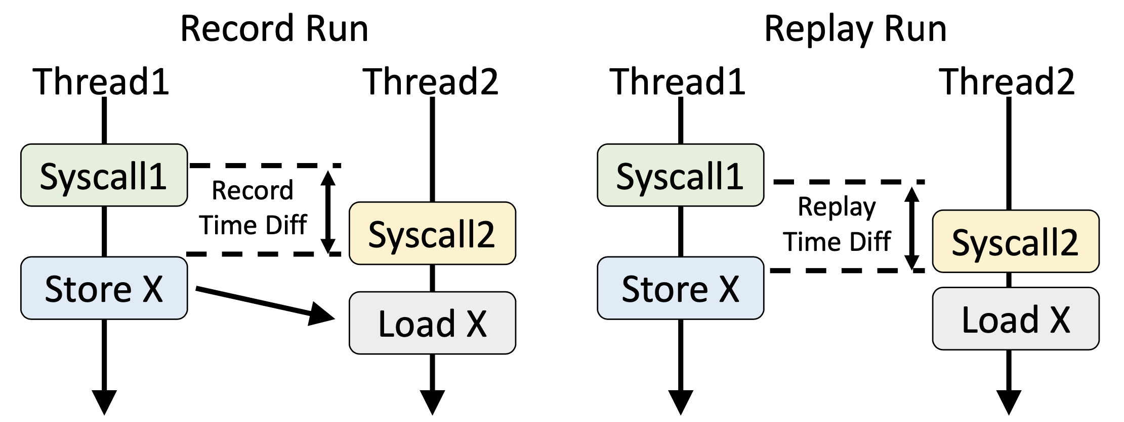
Solution: Record Time Diff during Record Run

Slide 23
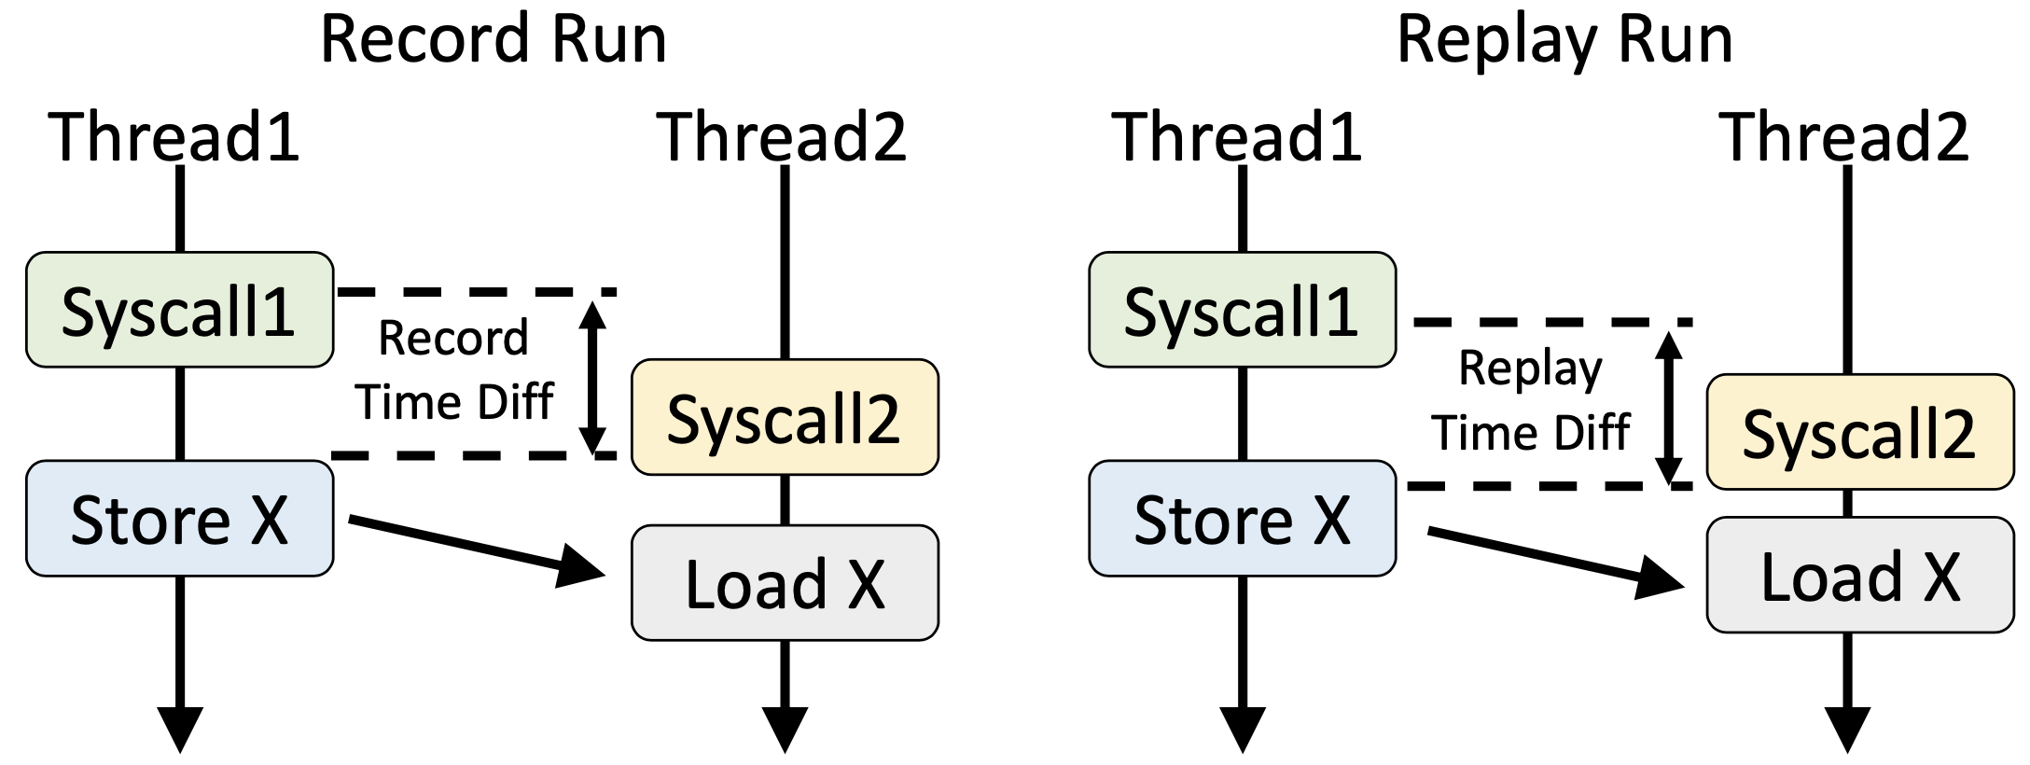
Solution: Record Time Diff during Record Run
Recovery success rate with infrequent data races: {35%, 51%}→> 99%

Slide 24
Evaluation
‒ Baseline
NiLiCon: Container replication, checkpointing to a passive backup
‒ Workloads
In-memory databases: Redis, Tarantool, SSDB, Memcached, Aerospike
Webserver: Lighttpd
‒ RRC configuration
100ms checkpointing interval

Slide 25
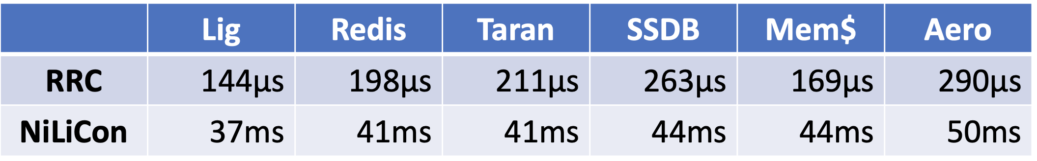
Average Latency Overhead
Average: RRC: 144us – 290μs NiLiCon: 37ms – 50ms
two orders of magnitude lower latency overhead

Slide 26
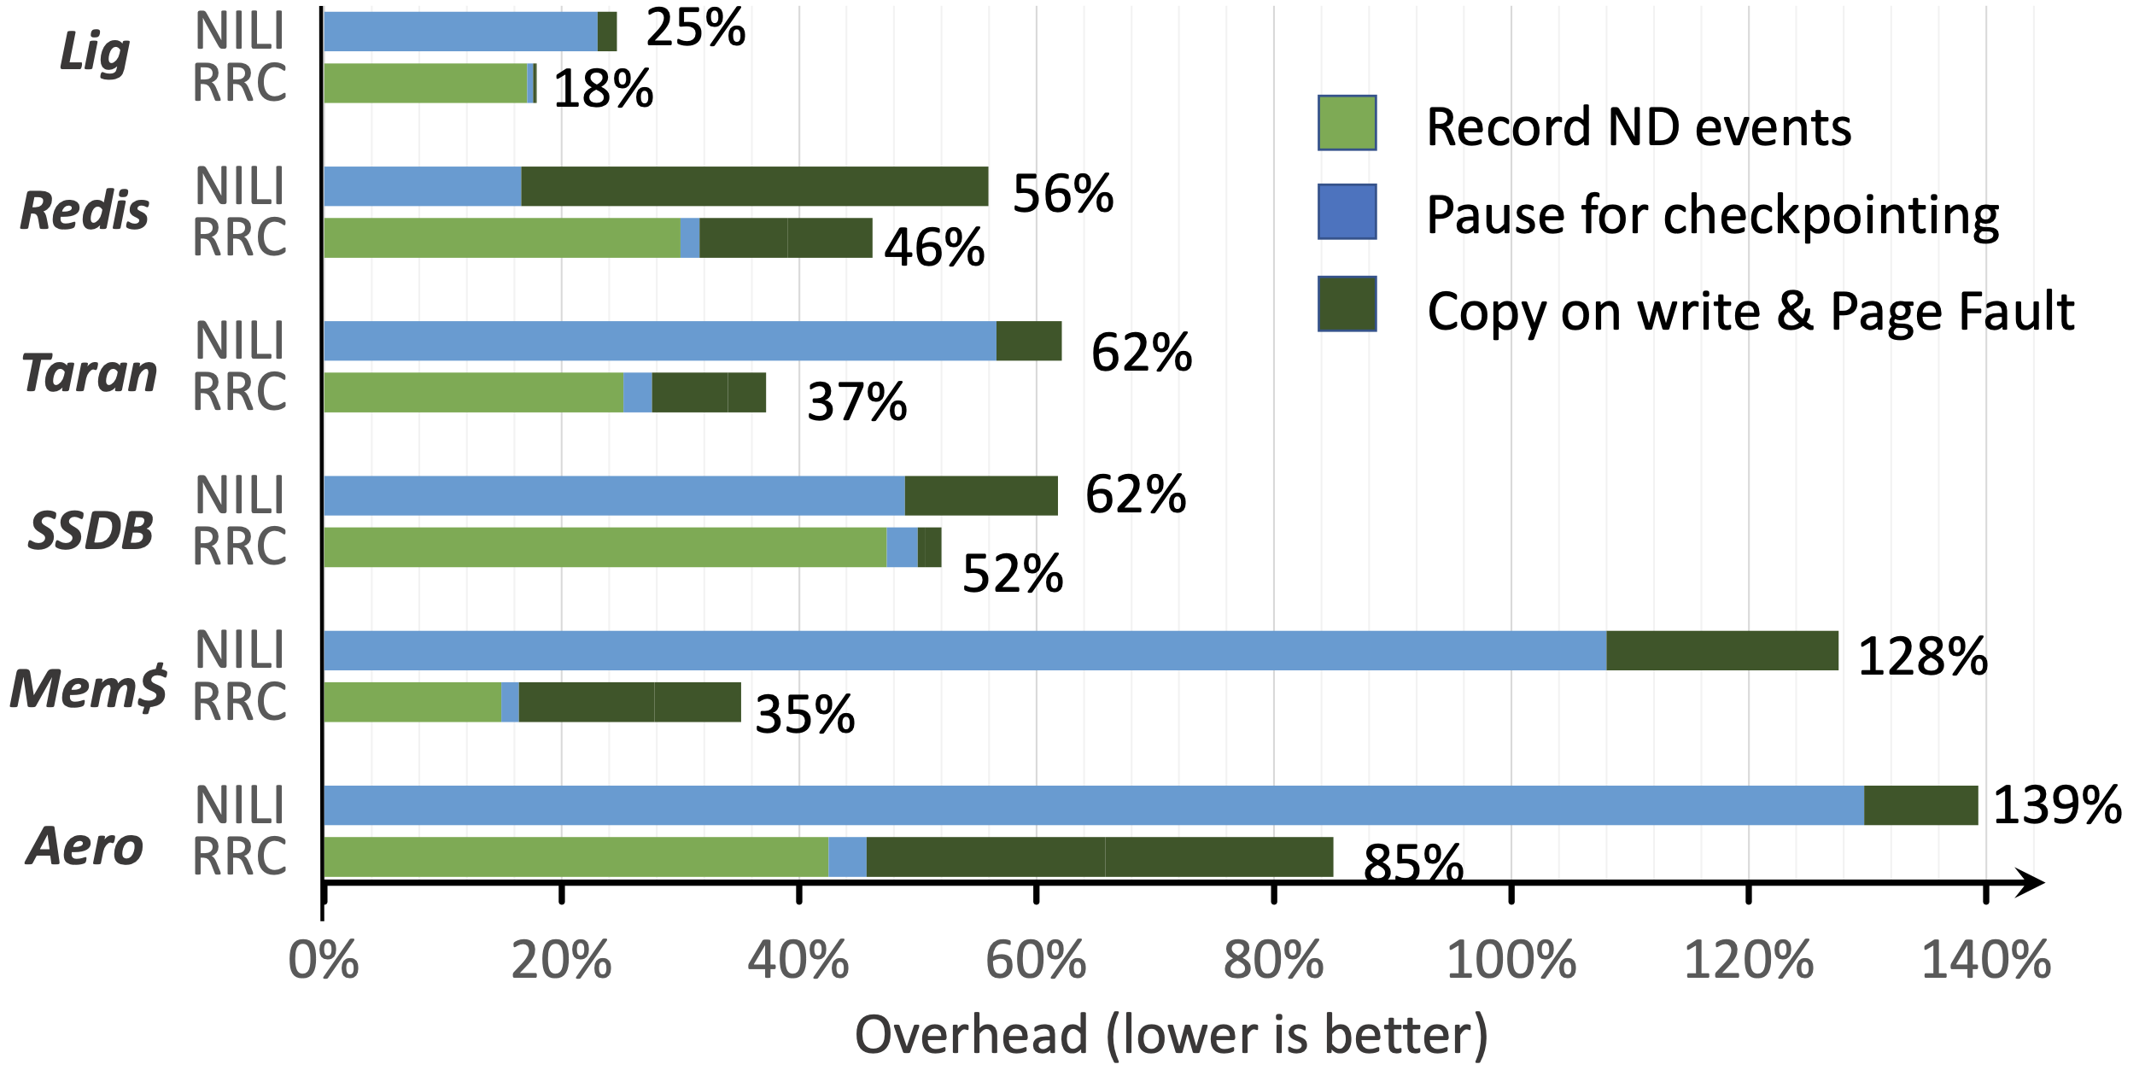
Average Throughput Overhead

Slide 27
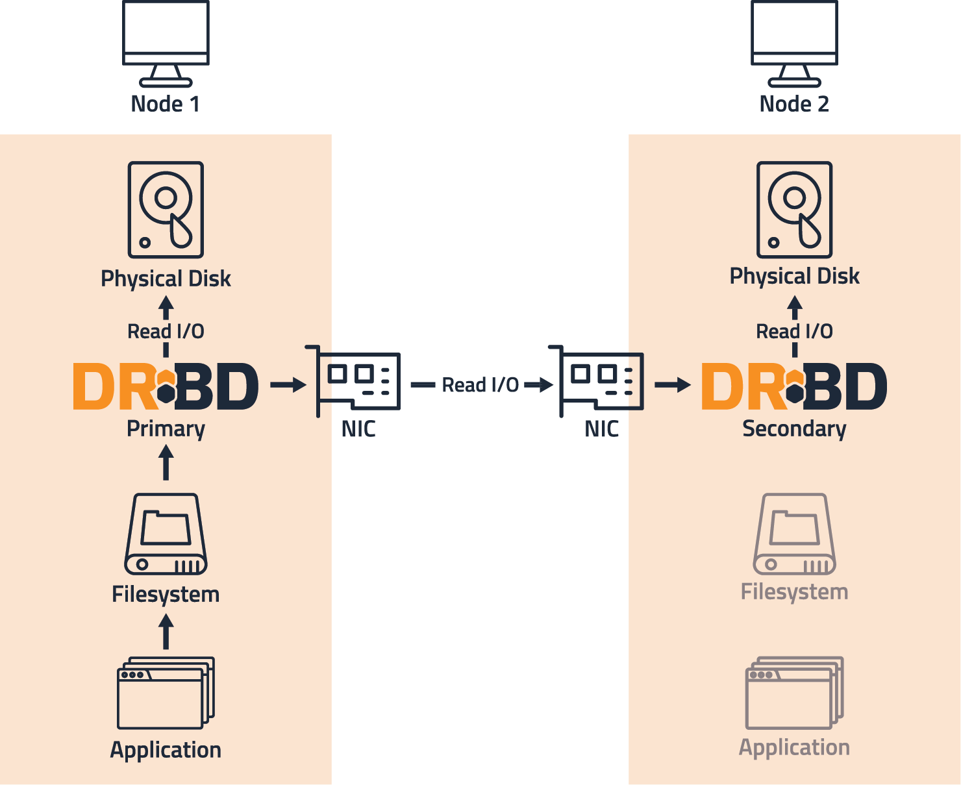
Distributed Replicated
Block Device
(DRBD)

Slide 28
Installation and configuration
global {
usage-count yes;
} common {
net {
protocol A; #(Asynchronous)
sndbuf-size 2M;
}
}
resource r0 {
net {
transport “rdma";
}
on alice {
device /dev/drbd1;
disk /dev/sda7;
address 10.1.1.31:7789;
meta-disk internal;
}
on bob {
device /dev/drbd1;
disk /dev/sda7;
address 10.1.1.32:7789;
meta-disk internal;
}
}
Distro | CentOS 7 | Ubuntu 18.04
Kernel | 5.4.200 | 5.4.0
DRBD | 9.1.7 | 9.1.15

Slide 29
Keeping alive options
connect-int
time between tries to connect.
ping-int
send keep-alive packet after that time.
timeout
if fail to ack after that time, partner node considered dead.
Tentative
abort the connection process after rsync handshake.

Slide 30
Transporting options
protocol
On the TCP/IP link the specified protocol is used.
sndbuf-size
When using protocol A, it might be necessary to increase the size of this data structure.
rcvbuf-size
Packets received from the network are stored in the socket receive buffer first.
transport
TCP or RDMA(Remote Direct Memory Access)

Slide 31
DRDB recommendations for Optimization
I/O subsystem throughput
Depends on number and type of storage units like disks, SSDs, Flash storage, … that can be written to in parallel
Throughput overhead expectations
DRBD throughput is limited by that of the raw I/O subsystem
Tuning recommendation
Setting max-buffers and max-epoch-size
DRBD throughput is limited by the available network bandwidth.
max-buffers is the maximum number of buffers DRBD allocates for writing data to disk
max-epoch-size is the maximum number of write requests permitted between two write barriers.
Tuning the TCP send buffer size
Tuning the Activity Log size
Disabling barriers and disk flushes

Slide 32
DRDB recommendations for Optimization
Optimizing DRBD latency
DRBD latency is affected by the latency of the underlying I/O subsystem and the latency of the replication network.
Latency overhead expectations
DRBD latency is bound by that of the raw I/O subsystem.
Tuning recommendation
Setting DRBD’s CPU mask:
DRBD latency is bound by the available network latency.
DRBD allows for setting an explicit CPU mask for its kernel threads. This is beneficial for apps which would compete with DRBD for CPU cycles.
Modifying the network MTU:
Enabling the deadline I/O scheduler:
Imposing a deadline on all I/O operations to prevent starvation of requests.
change the replication network’s maximum transmission unit (MTU) size to a value higher than the default.

Slide 33
Thank You

