Slide 1
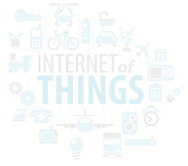
My IoT Platform
An IoT device Integration Platform

Slide 2
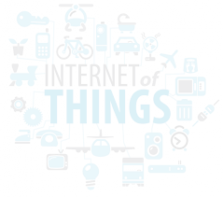
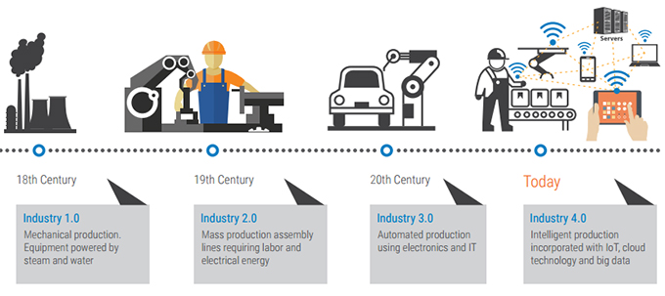
What is IoT ?
Any physical device that is connected to the internet
Why IoT ?
Data Capture — Big Data
Industrial Automation —Industry 4.0

Slide 3
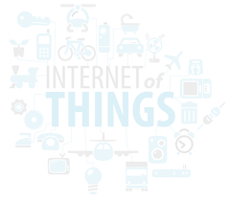
What is IoT Platform?
an IoT platform is just about enabling connectivity between all the IoT devices
Ideally What IoT Platform should offer?
Connectivity & normalisation
Device management
Data Persistent
Action management (Integration)
Visualisation

Slide 4
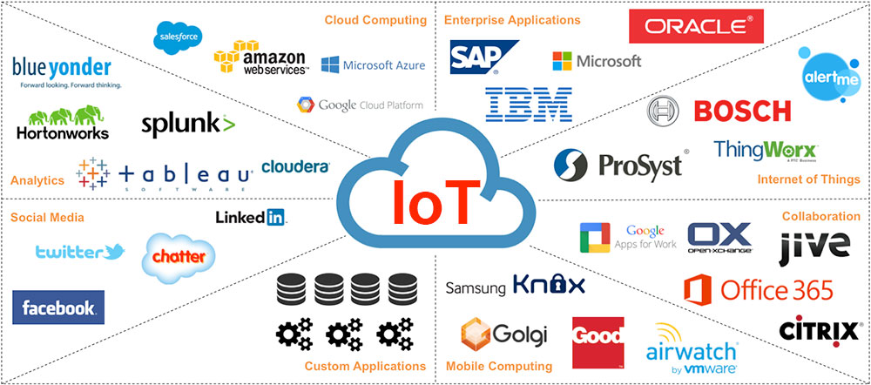
What is on the market ?
Commercial
Amazon WS
Google Could,
MS Azure IoT Pub
Open Source
ThingsBoard
What is missing?
Management of logic relationship among selected IoT device
Communication among selected IoT devices. (eg. machine-machine communication)

Slide 5
What is “My IoT Platform” aim for?
• Register/Deregister IoT device
• Subscribe real time data from registered IoT device (sensor)
• Publish command to registered IoT device (reactor).
• Create logic relationship among registered IoT device.
{
"description" : "Temp up light on",
"sensorIds" : [
"5af1c08f8697a9074c2fd4c9"
],
"reactorIds" : [
"5af1b8418697a906f59b78d4"
],
"sensorThreshold" : [
"20"
],
"sensorThresholdRelation" : [
"GT"
],
"reactorCommands" : [
"on"
],
}
When “My IoT Platform”
receives Temperature Data from
Temperature Sensor (id 5af1c08f8697a9074c2fd4c9)
If the data value is
Greater Than
20 degree
Then
Send Command (on) to
Reactor (id 5af1b8418697a906f59b78d4)

Slide 6
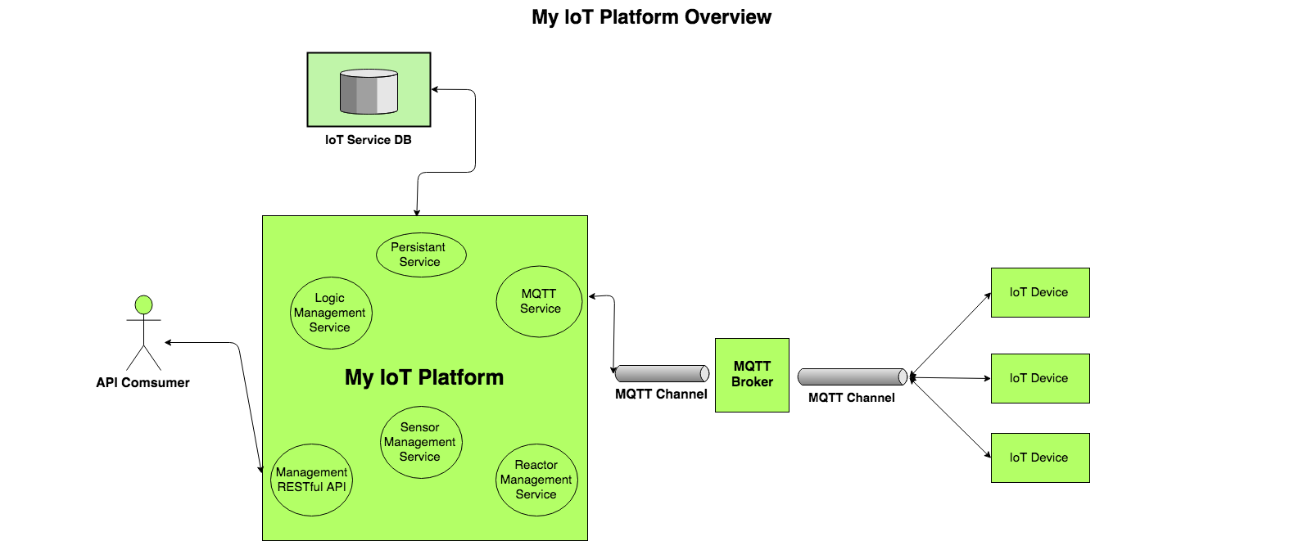
“My IoT Platform” Design and Implementation
Sensor & Reactor , MQTT Protocol, Arduino Micro-controller Board (Johnny-Five Library), Mango DB (NoSQL Database), ActiveMQ, RESTful API)

Slide 7
Application Design Pattern
Spring framework
MVC (Model-View-Controller)
Controller (HTTP Method Handler (API Interface))
Model (Domain — Service — Data access Object)
View (Test page)

Slide 8
DEMO

