Slide 1
Web Mining(6)
Web Crawler
杨光飞
系统工程研究所
大连理工大学
gfyang@dlut.edu.cn

Slide 2
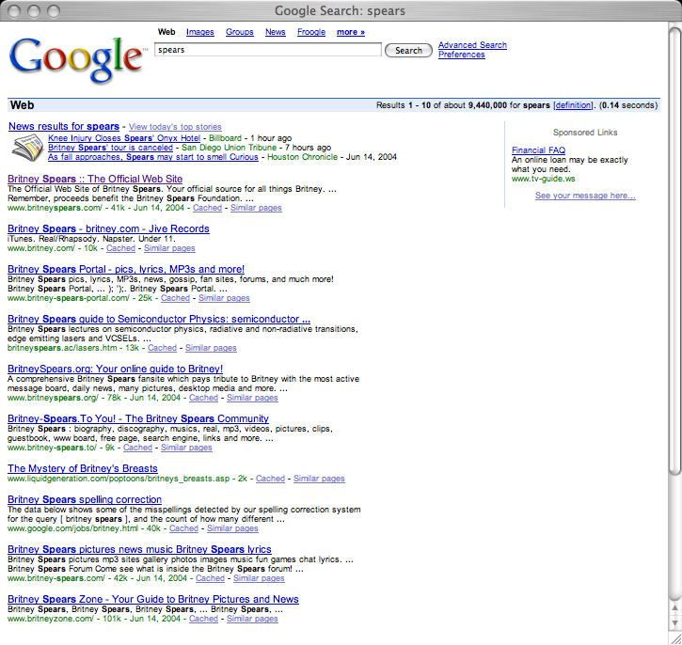
Q: How does a search engine know that all these pages contain the query terms?
A: Because all of those pages have been crawled

Slide 3
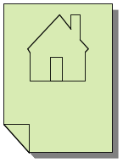

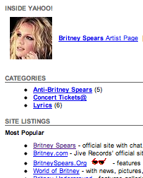
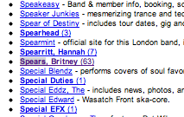
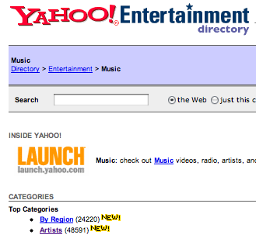

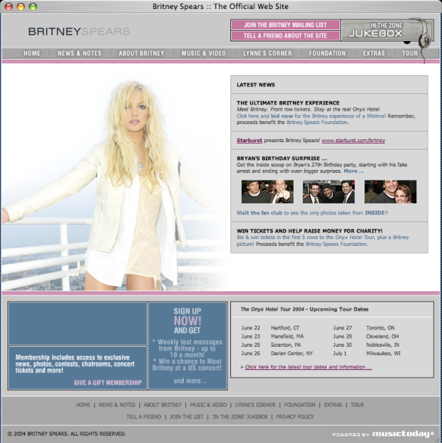
starting
pages
(seeds)
Crawler:
basic
idea

Slide 4
Many names
Crawler
Spider
Robot (or bot)
Web agent
Wanderer, worm, …
And famous instances: googlebot, scooter, slurp, msnbot, …

Slide 5
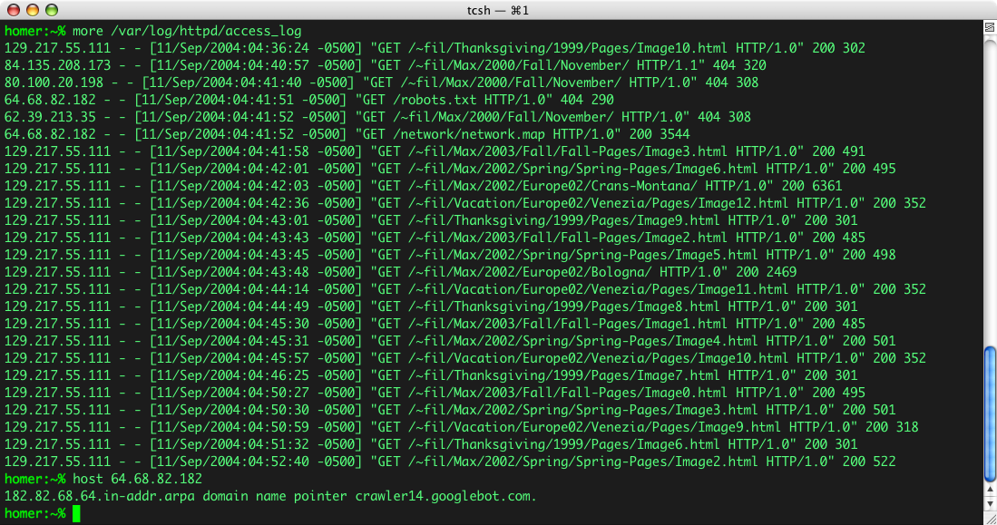
Googlebot & you

Slide 6
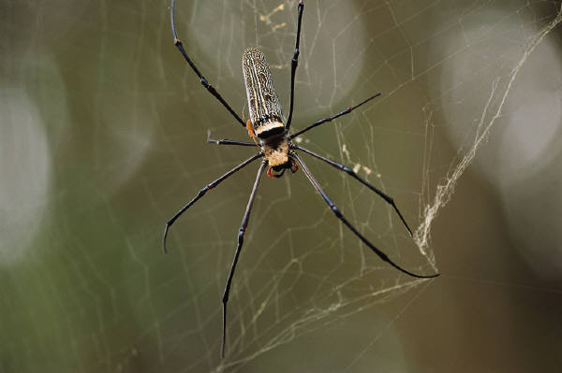
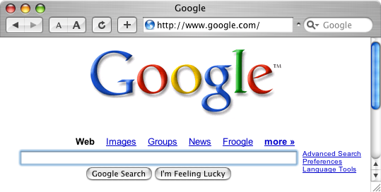
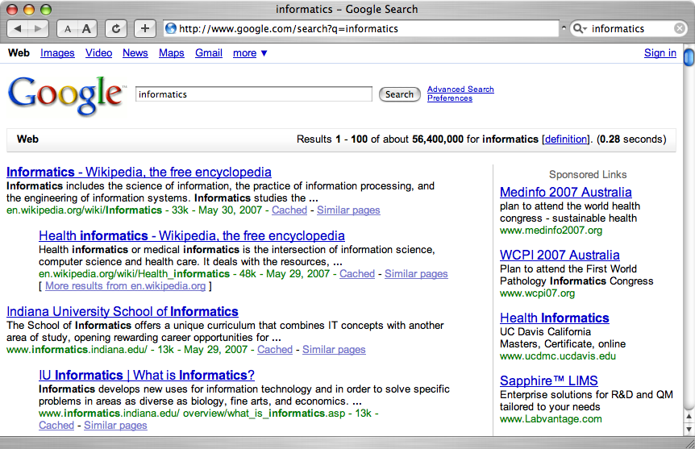
A crawler within a search engine
Web
Page repository
googlebot
Text & link analysis
Query
hits
Text index
PageRank
Ranker

Slide 7
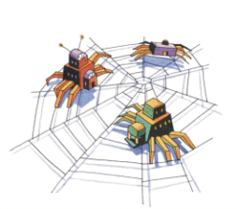
Web Crawlers/Spider
How do the web search engines get all of the items they index?
Main idea:
  Start with known sites
  Record information for these sites
  Follow the links from each site
  Record information found at new sites
  Repeat
Crawler
  To fetch the pages to the computer
  At the computer
    Automatic programs can analyze hypertext documents

Slide 8
Web Crawlers
How do the web search engines get all of the items they index?
More precisely:
  Put a set of known sites on a queue
  Repeat the following until the queue is empty:
    Take the first page off of the queue
    If this page has not yet been processed:
      Record the information found on this page
        Positions of words, links going out, etc
      Add each link on the current page to the queue
      Record that this page has been processed
In what order should the links be followed?

Slide 9
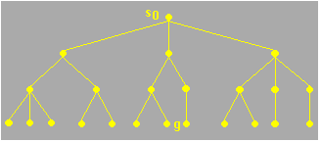
Page Visit Order
Animated examples of breadth-first vs depth-first search on trees:
http://www.rci.rutgers.edu/~cfs/472_html/AI_SEARCH/ExhaustiveSearch.html
Structure to be traversed

Slide 10

Page Visit Order
Animated examples of breadth-first vs depth-first search on trees:
  http://www.rci.rutgers.edu/~cfs/472_html/AI_SEARCH/ExhaustiveSearch.html
Breadth-first search
(must be in presentation mode to see this animation)

Slide 11
Page Visit Order
Animated examples of breadth-first vs depth-first search on trees:
  http://www.rci.rutgers.edu/~cfs/472_html/AI_SEARCH/ExhaustiveSearch.html
Depth-first search
(must be in presentation mode to see this animation)

Slide 12
Page Visit Order
Animated examples of breadth-first vs depth-first search on trees:
  http://www.rci.rutgers.edu/~cfs/472_html/AI_SEARCH/ExhaustiveSearch.html

Slide 13
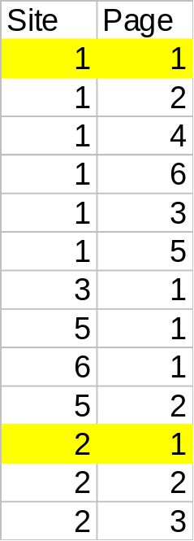
Depth-First Crawling
(more complex – graphs & sites)
Page 1
Page 1
Site 1
Site 2
Page 3
Page 2
Page 3
Page 2
Page 5
Page 1
Page 4
Page 1
Site 5
Page 6
Page 1
Page 2
Site 6
Site 3

Slide 14
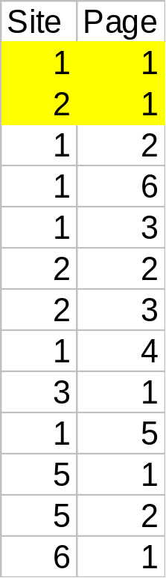
Breadth First Crawling
(more complex – graphs & sites)
Page 1
Page 1
Site 1
Site 2
Page 3
Page 2
Page 3
Page 2
Page 5
Page 1
Page 4
Page 1
Site 5
Page 6
Page 1
Page 2
Site 6
Site 3

Slide 15
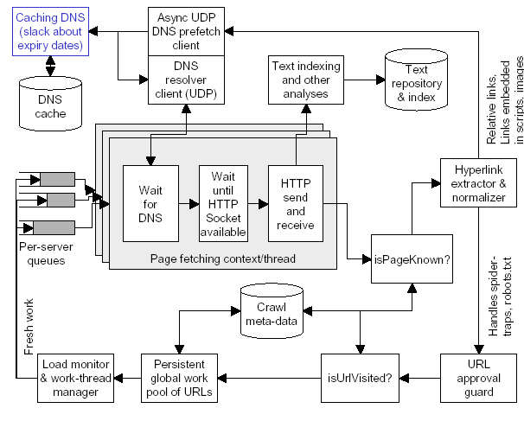
Typical anatomy of a large-scale crawler.

Slide 16
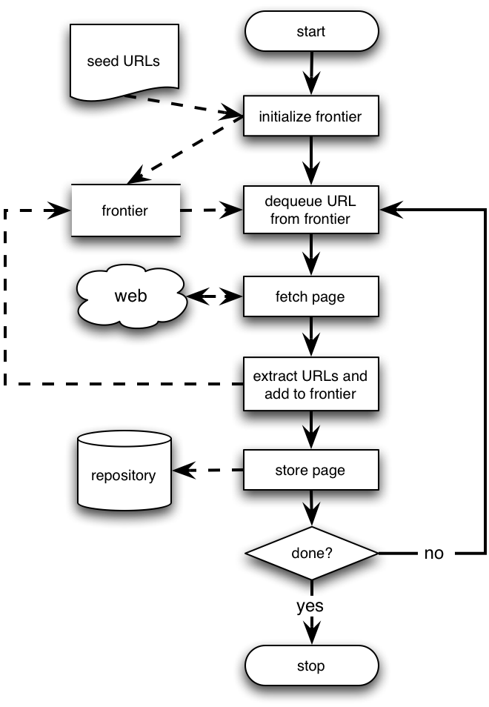
Basic crawlers
This is a sequential crawler
Seeds can be any list of starting URLs
Order of page visits is determined by frontier data structure
Stop criterion can be anything

Slide 17
Architecture of a crawler
Doc
Fingerprint
Robots
templates
URL
set
www
DNS
Parse
Fetch
Content
Seen?
URL
Filter
Dup
URL
Elim
URL Frontier

Slide 18
Architecture of a crawler (Cont’d)
Doc
Fingerprint
Robots
templates
URL
set
www
DNS
Parse
Fetch
Content
Seen?
URL
Filter
Dup
URL
Elim
URL Frontier
URL Frontier: containing URLs yet to be fetches in the current crawl. At first, a seed set is stored in URL Frontier, and a crawler begins by taking a URL from the seed set.
DNS: domain name service resolution. Look up IP address for domain names.
Fetch: generally use the http protocol to fetch the URL.
Parse: the page is parsed. Texts (images, videos, and etc.) and Links are extracted.

Slide 19
Architecture of a crawler (Cont’d)
Doc
Fingerprint
Robots
templates
URL
set
www
DNS
Parse
Fetch
Content
Seen?
URL
Filter
Dup
URL
Elim
URL Frontier
Content Seen?: test whether a web page with the same content has already been seen at another URL. Need to develop a way to measure the fingerprint of a web page.
URL Filter:
  Whether the extracted URL should be excluded from the frontier (robots.txt).
  URL should be normalized (relative encoding).
    en.wikipedia.org/wiki/Main_Page
    <a href="/wiki/Wikipedia:General_disclaimer" title="Wikipedia:General disclaimer">Disclaimers</a>
Dup URL Elim: the URL is checked for duplicate elimination.

Slide 20
Architecture of a crawler (Cont’d)
Other issues:
  Housekeeping tasks:
    Log crawl progress statistics: URLs crawled, frontier size, etc. (Every few seconds)
    Checkpointing: a snapshot of the crawler’s state (the URL frontier) is committed to disk. (Every few hours)
  Priority of URLs in URL frontier:
    Change rate.
    Quality.
  Politeness:
    Avoid repeated fetch requests to a host within a short time span.
    Otherwise: blocked ☹

Slide 21
Performance and reliability
Need to fetch many pages at same time
  utilize the network bandwidth
  single page fetch may involve several seconds of network latency
Highly concurrent and parallelized DNS lookups
Use of asynchronous sockets
  Explicit encoding of the state of a fetch context in a data structure
  Polling socket to check for completion of network transfers
  Multi-processing or multi-threading: Impractical
Care in URL extraction
  Eliminating duplicates to reduce redundant fetches
  Avoiding “spider traps”

Slide 22
Need crawling code?
Reference C implementation of HTTP, HTML parsing, etc
  w3c-libwww package from World-Wide Web Consortium: www.w3c.org/Library/
LWP (Perl)
  http://www.oreilly.com/catalog/perllwp/
  http://search.cpan.org/~gaas/libwww-perl-5.804/
Open source crawlers/search engines
  Nutch: http://www.nutch.org/ (Jakarta Lucene: jakarta.apache.org/lucene/)
  Heretrix: http://crawler.archive.org/
  WIRE: http://www.cwr.cl/projects/WIRE/
  Terrier: http://ir.dcs.gla.ac.uk/terrier/
Open source topical crawlers, Best-First-N (Java)
  http://informatics.indiana.edu/fil/IS/JavaCrawlers/
Evaluation framework for topical crawlers (Perl)
  http://informatics.indiana.edu/fil/IS/Framework/

Slide 23
Thank You !

