Slide 1
Agile Story Carding
prepared for @jaxcodecamp2009

Slide 2
Who am I?
Jim Remsik
Big Tiger
twitter: jremsikjr
Notes:
Most social media, No E

Slide 3
Who am I?
Jim Remsik
Big Tiger
gmail: jremsikjr
Notes:
Most social media

Slide 4
Who am I?
Jim Remsik
Big Tiger
flickr: jremsikjr
Notes:
Most social media

Slide 5



+
Notes:
I attend a Continuing Education Program called Hashrocket. Conveniently, they also pay me to attend. Constantly learning, and improving my skills and sharing what I know through co-location, pair programming, and passionately building software.
We love Ruby and Rails

Slide 6








Jacksonville
Ruby Ecosystem
Notes:
Refresh is a worldwide movement aimed at creative and technical types. The meetings are rewarding. In fact I just met three different web development companies that are operating in Jacksonville from our last meet up.
RubyJax is a local Ruby user meeting. If these things don’t exist in your technology start them up yourself.

Slide 7


What is this talk about?
Notes:
A single agile technique, story carding. What is it? How to use it?
If you noticed this is a Where’s Waldo picture
There he is...

Slide 8
민첩한?
Notes:
Agile? in Korean? A group of software development methodologies based on iterative development
opposed to Waterfall where all requirements are defined up front

Slide 9
Agile?
Notes:
Agile? in Korean? A group of software development methodologies based on iterative development
opposed to Waterfall where all requirements are defined up front

Slide 10
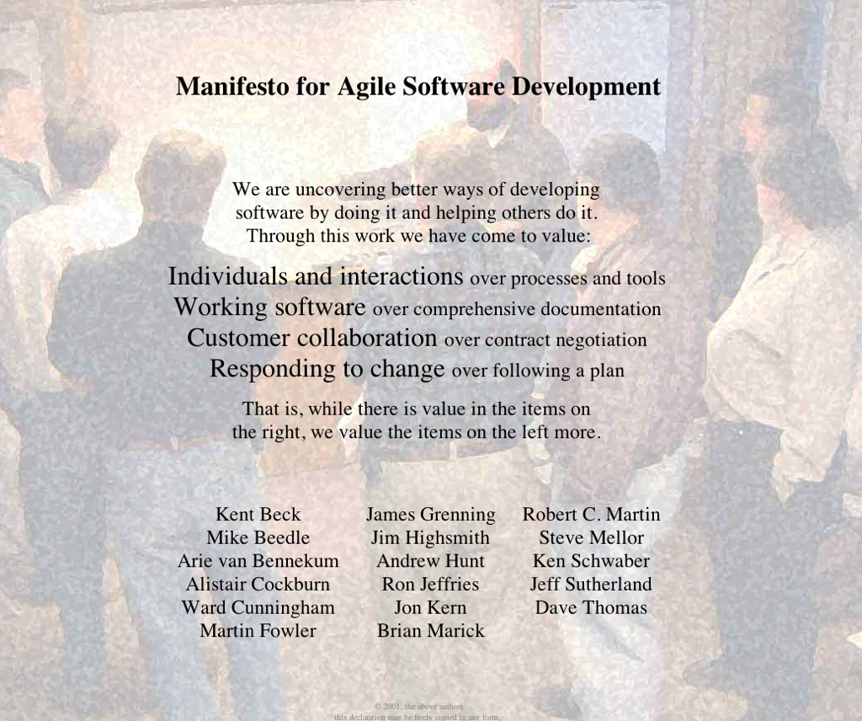
http://agilemanifesto.org
Notes:
Individuals and interactions over processes and tools
Working software over comprehensive documentation
Customer collaboration over contract negotiation
Responding to change over following a plan

Slide 11
Story Cards
Notes:
One way we communicate is through story cards, story cards describe features of an application, not a technical description of how to accomplish a thing but, why that thing is valuable.

Slide 12
Story Cards
are a placeholder for
Conversation
Notes:
Software Requirements are a communication problem

Slide 13
Story Cards
capture conversations
between the customer
and developer
Notes:
Software Requirements are a communication problem

Slide 14
Story Cards
include tests that indicate
successful completion of the task
Notes:
These are generally called acceptance criteria

Slide 15
Story Cards
are written in such a way
that the customer values them
Notes:
Hashrocket has a 100% retention rate of customers who have story carded with us. The value is so apparent at the end of the process that we’ve never had a customer walk away unhappy

Slide 16
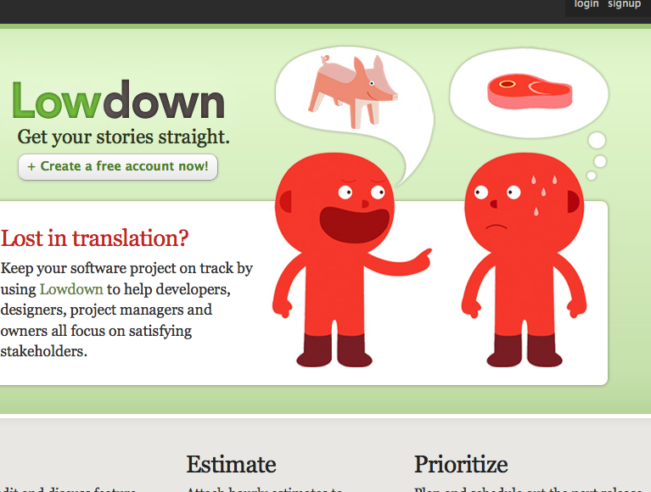
http://lowdownapp.com
Notes:
RailsRumble finalist 48 hour competition to build an Application
Kid’s game telephone, I write something down on paper, you read and interpret
Software requirements are a communication problem

Slide 17
An example
User reads a book before falling asleep
Notes:
albeit abstract

Slide 18
Story Template
As <role>
I want <goal>
So that <business value>
Notes:
Business value was often overlooked

Slide 19
Story Template
In order to <business value>
As <role>
I want <goal>

Slide 20
Story Template
In order to read a book at night
As <role>
I want <goal>

Slide 21
Story Template
In order to wind down from the day
As <role>
I want <goal>

Slide 22
Story Template
In order to wind down from the day
As person in bed trying to read
I want <goal>

Slide 23
Story Template
In order to wind down from the day
As person in bed trying to read
I want a light source I can control
that illuminates my book

Slide 24
Acceptance Criteria
Detail the conversations between developer and customer
Describe assumptions the customer may hold
Are to be written by the customer and augmented by criteria added by the developer
Are captured before solution is executed

Slide 25
In order to wind down from the day
As person in bed trying to read
I want a light source I can control
that illuminates my book
Acceptance Criteria
* Control does not require me to get out of bed
* Light source is safe to leave on overnight
* Light source is not so bright that keeps my wife up
* Light source is bright enough that I don’t have to strain my eyes to see the text

Slide 26
Acceptance Criteria
What happens when I click on a link?
User goes to the linked page
An AJAX for is displayed
User’s hard drive is formatted
Notes:
Of course you don’t want to format their hard drive, or do you? Customers occasionally ask for more than is capable. I’d link to click on this link and have it open my accounting package to that customer’s data
If the entire purpose of a development cycle is to provide this impossible task you can avoid the cost of the other development and move on to something more valuable.

Slide 27
We have a story card, now what?

Slide 28
Estimating
Relative effort, not time
Assign points or skittles or hot dogs
0, 1, 2, 4, 8

Slide 29
Prioritization
Customers can Negotiate relative priority
based on Estimates of Independent,
Small, Testable Stories and how much they Value the story

Slide 30
I.N.V.E.S.T.
Notes:
Memory trick to guide whether you’re going down the correct path
Not all your story cards will always meet these criteria. INVEST will generally drive you in the right direction

Slide 31
Independent
Notes:
Does this story stand on its own? Can I pick up this story with a basic understanding of what is being built and complete it. This is not always possible, but, it is something to strive for ...

Slide 32
Negotiable
Notes:
Stories represent desired behavior in the form of features. Of course to a client or perhaps your boss all features are non-negotiable. Autocomplete Drop-down, or checkboxes? Do you really need this feature to deploy? If so it is likely a chore.

Slide 33
Valuable
(To the purchaser)
Notes:
What value is this thing adding? Rotating logo example
Hard thing: Cards for back-end only non-visible benefit. Slow queries can be seen by a customer and the card is written to that.

Slide 34
Estimatable
Notes:
Can I ballpark this? A card that is difficult to estimate is a smell that perhaps your card is too complex or too vague

Slide 35
Common Reasons for un-estimatable stories include:
Lack of domain knowledge
Lack of technical knowledge
The story is just too big

Slide 36
Small
Notes:
Can I complete this task in a reasonable amount of time? Weekly iterations, break down stories, our point scale 0,1,2,4,8
Smaller stories usually have more well defined scope

Slide 37
The smaller the better, right?
Stories can be broken down
Stories can be combined

Slide 38
Testable
(Strive to automate)
Notes:
You should be able to create clearly defined acceptance criteria. If by the end of the story there is no measurable output how can you tell the task is complete? Developing acceptance criteria with a stakeholder requires them to describe the successful outcome and the value provided

Slide 39
I.N.V.E.S.T.
Notes:
Independent, Negotiable, Valuable, Estimable, Small, Testable
That’s a lot of *ables. What does a story look like?

Slide 40
Pivotal Tracker

