Slide 7


ML Libraries Used

Slide 8
Model setup
Lots of parameters you can set
< 25,000 rows, include all
> 25,000 rows, you pick the sample size

Slide 9
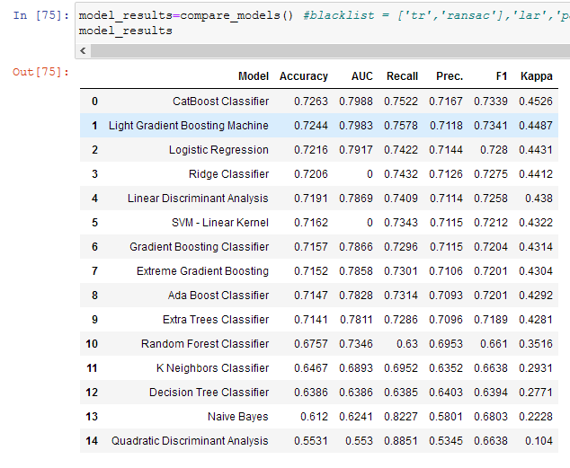
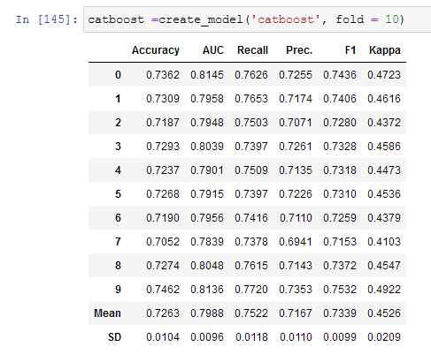
Creating the model

Slide 11
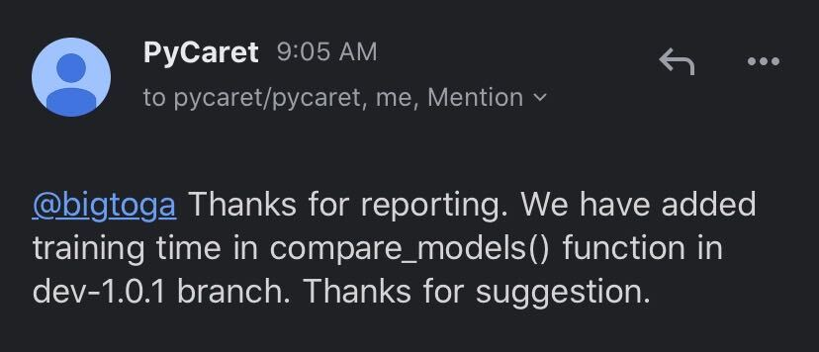
Improving Pycaret

