Slide 1



Architectural Support for Efficient Large-Scale Automata Processing
Hongyuan Liu, Mohamed Ibrahim (College of William & Mary),
Onur Kayiran (AMD),
Sreepathi Pai (University of Rochester),
and Adwait Jog (College of William & Mary)
Notes:
Hi, my name is Hongyuan Liu. Today, I will present our work “Architectural Support for Efficient Large-Scale Automata Processing”.
This work was jointly performed with my advisor and colleagues
at The College of William and Mary
and
our collaborators at AMD and University of Rochester.

Slide 2


Finite State Machine (Automata) Processing
Widely used in several areas
von Neumann architectures are not efficient at FSM processing
Irregular memory accesses
Limited Parallelism
Notes:
Finite state machines are widely used in different areas such as Bioinformatics, machine learning, networking intrusion detection, and XML parsing.
However, traditional von Neumann architectures are not efficient at FSM processing because of irregular memory accesses, and limited parallelism.

Slide 3

Automata Processor (AP)
In-memory Processing
Parallelism
FSMs
States
Figure from Micron website
Notes:
Automata Processor AP is a DRAM based domain specific architecture for accelerating finite state machine processing.
The automata processor performs orders of magnitude better than CPUs.
Generally, there are two reasons.
First, it exploit in-memory processing. This does not require expensive data movement.
Second, it has high amount of parallelism --- Multiple FSMs can run simultaneously, and multiple states can be activated simultaneously.

Slide 4
Applications are getting larger
ClamAV: Anti-virus database that identifies virus characteristics via FSMs
Snort: Network intrusion detection identifies many intrusion patterns via FSMs
Many more…
Notes:
However, there is sill a problem when we use AP to do the FSM processing.
For example, currently,
there are many emerging applications that consist of many FSM states.
For example, ClamAV is an anti-virus application. Each characterization of virus is stored as an FSM. Therefore, the database of virus is increasing over time.
Another example is Snort, where it uses FSM to represent each intrusion pattern.
We expect such applications will become more common in the future.

Slide 5

Applications are getting larger
AP Capacity is Limited
How do we accelerate large-scale FSM processing?
Notes:
As a result, there is a challenge to use AP efficiently.
On one side, the applications are getting larger.
On the other side, the AP capacity is limited.
In this research, we focus on how to accelerate large-scale FSM processing using automata processor.

Slide 6
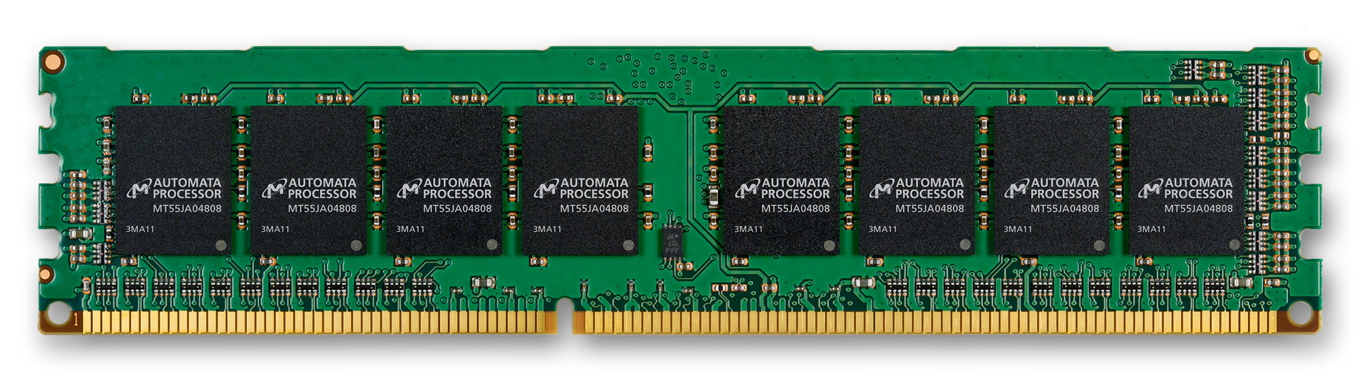
Current situation: Repeated Executions
Input Stream:
ORANGEAPPLEBANANAPEARPEACH….
Configure Batch 1
1st Execution
Application
Notes:
An application consists of many FSMs.
If the number of FSM states cannot fit in AP at one time, multiple batches are needed.
For example, we configure the first batch to the AP, and run the input stream on it.

Slide 7
Current situation: Repeated Executions
Input Stream:
ORANGEAPPLEBANANAPEARPEACH….
2nd Execution
Configure Batch 2
Application
Notes:
Then, we configure the second batch to the AP, and run the same input stream on it AGAIN.
This execution repeats until all batches are configured and executed on AP.
This repeated executions lead to inefficiencies.

Slide 8
Outline
Introduction
Background and Motivation
Challenges and Our Approach
Results
Conclusions
Notes:
This is the outline of this presentation.
In the previous a few slides, we were talking about the introduction of this work.
In the following parts, we will talk about background and motivation, challenges and our approach, results, and conclusions.

Slide 9
Input Stream
APPLEC
FSM
APPLE
APPLICATION
A
Match-set
Reporting state
Starting state
Enabled State
State
Activated State
S0
S1
S2
S3
S4
A
P
P
L
E
I
C
A
T
I
O
N
Starting State
(Always-enabled)
S5
S6
S7
S8
S9
S10
S11
Notes:
First, we show some backgrounds on the FSM processing.
Here is an FSM. It can identify two patterns, which are APPLE, and APPLICATION.
An FSM-based application contains multiple FSMs.
The matching process starts from the starting state, which is always enabled during the execution in our context.
The FSM-based application also requires an input stream. Here we show it as “APPLEC”.
We will show the example matching process in the following a few slides.

Slide 10
A
Match-set
Reporting state
Starting state
Enabled State
State
Activated State
APPLEC
S0
S1
S2
S3
S4
A
P
P
L
E
I
C
A
T
I
O
N
Active
S5
S6
S7
S8
S9
S10
S11
Notes:
Here we show the matching process.
In this example,
the first symbol is A. This activates the starting state S0.

Slide 11
A
Match-set
Reporting state
Starting state
Enabled State
State
Activated State
APPLEC
S0
S1
S2
S3
S4
A
P
P
L
E
Enabled
I
C
A
T
I
O
N
S5
S6
S7
S8
S9
S10
S11
Notes:
When S0 is activated, it enables its successor S1.

Slide 12
A
Match-set
Reporting state
Starting state
Enabled State
State
Activated State
APPLEC
S0
S1
S2
S3
S4
A
P
P
L
E
I
C
A
T
I
O
N
S5
S6
S7
S8
S9
S10
S11
Notes:
The second symbol is P. This activates S1.

Slide 13
A
Match-set
Reporting state
Starting state
Enabled State
State
Activated State
APPLEC
S0
S1
S2
S3
S4
A
P
P
L
E
I
C
A
T
I
O
N
S5
S6
S7
S8
S9
S10
S11
Notes:
The activated S1 enables its successor S2.

Slide 14
A
Match-set
Reporting state
Starting state
Enabled State
State
Activated State
APPLEC
Report generated
S0
S1
S2
S3
S4
A
P
P
L
E
I
C
A
T
I
O
N
S5
S6
S7
S8
S9
S10
S11
Notes:
This process continues. After several cycles, when E comes, reporting state S4 is activated.
A report is generated in this case.

Slide 15
A
Match-set
Reporting state
Starting state
Enabled State
State
Activated State
APPLEC
S0
S1
S2
S3
S4
A
P
P
L
E
I
C
A
T
I
O
N
S5
S6
S7
S8
S9
S10
S11
Notes:
The matching process continues until all symbols in the input stream are consumed.

Slide 16
After the execution
Some states are never enabled (cold)!
S0
S1
S2
S3
S4
A
P
P
L
E
Cold States
Hot States
S6
S7
S8
S9
S10
S11
I
C
A
T
I
O
N
S5
Notes:
To revisit the example we show before, we found there might be a number of states are configured to AP, but are never used.
We call them cold states in our work, while the enabled states are hot states in our work.
We found that, in the previous example, S6 to S11 are cold.

Slide 17
Underutilization of AP
Because of mismatch, there are many cold states configured to AP.
Notes:
Going forward, we evaluate all these real applications.
In this figure, the y-axis is the percentage of states.
We found that a large portion of states are cold. On average, there are 59% of cold states.
The reason of cold states is mismatch, where there are not enough interesting patterns occur in the input stream.

Slide 18
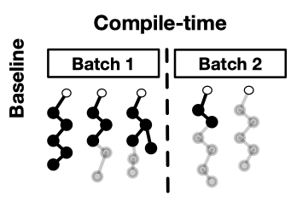
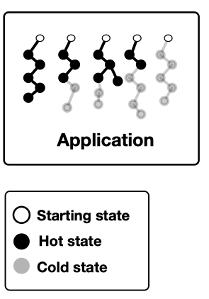
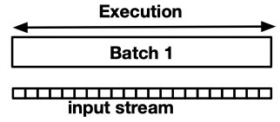
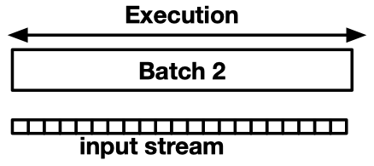
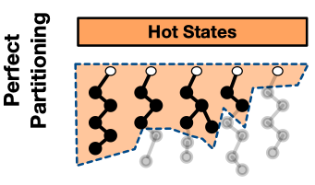
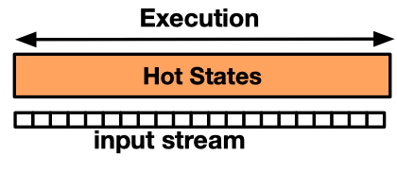

Benefits of only configuring hot states
Time
Notes:
So, ideally, if we can only configure the hot states, we can get performance benefits.
Here is an example illustrating the performance benefits of configuring only hot states.
In the baseline case,
the application is split to two batches.
At runtime, the AP needs to execute the same input stream for each batch.
On the contrary,
now suppose we have an oracular knowledge of cold states,
and in this case, the hot states could fit in one batch.
In comparison, at runtime, the AP only executes the input stream once, which leads to significant cycle savings.

Slide 19
Outline
Introduction
Background and Motivation
Challenges and Our Approach
Results
Conclusions
Notes:
Next, to realize the benefits as much as possible, we will discuss the challenges and our approach.

Slide 20
Challenges
How do we predict and partition?
How do we handle the mispredictions?
Notes:
However, to realize the benefits, we have two challenges.
First, how do we predict a state is cold or hot at compile time?
Second, how do we partition the FSMs in the application, and only configure the hot states?

Slide 21
Which states are more likely to be hot?
A
P
P
L
E
I
C
A
T
I
O
N
Shallow states ➔ Hot.
Deep states ➔ Cold (Details in the paper)
Notes:
First, we study which states are more likely to be hot.
Consider the previous example, we found the shallow states are hot.
This is because, the matching process is always from lower topological order to higher topological order.
---- We define a state is shallow or deep based on its topological order.
We study the hot states in these applications. We found that the shallow states are more likely to be hot.
Similarly, deep states are more likely to be cold.

Slide 22
How do we partition?
AP
We use a simple but effective offline profiling mechanism to determine the partition topological-order. (More details in the paper)
Partition via topological order makes transition unidirectional.
A
P
P
L
E
Topological Order
K = 5
N
I
C
A
T
I
O
Notes:
Based on this observation, we propose to use topological order to partition the FSMs.
Consider the previous example, we can partition it at topological order K = 5.
We only configure the states with topological orders no greater than 5 to the AP.
-----------------------------------------------
To determine the partitioning topological order for each FSM in the application, we use a simple offline profiling mechanism.
Second, partition via topological order makes transition unidirectional. Therefore, no back and forth transition will happen, which simplifies the misprediction handling. We will show it later.

Slide 23
How do we handle the mispredictions?
AP
APPLICATION
A
P
S2
S2
P
S3
K = 3
S3’
L
S4
S5
Intermediate
reporting state
A
P
P
L
E
I
C
A
T
I
O
N
Generated intermediate report
AP
A
P
S3; cycle 3
S2
P
S3’
L
Notes:
However, it is hard to predict the topological order correctly.
Now, suppose we have an imperfect partition at topological order k = 3.
In this partition,
--- S3, S4, S5 were partitioned out of AP, but they are actually hot. ----
In this case, a transition may go outside of the AP.
To notify the handler about the mispredictions, we add an intermediate reporting state for each cutting edge across the partition topological order.
In this case, the cutting edge is S2 to S3.
Then we attach S3’ to S2.
Therefore, in addition to the predicted hot states, the intermediate reporting states are also configured to AP.
-----------------------------------------------------
Consider current input steam is APPLICATION instead. The current symbol is L.
It makes the intermediate reporting state S3’ activated. So, an intermediate report is generated.
The report consists of two parts.
First, the state that to be continued in the misprediction handling.
Second, the cycle number where the report was generated.
In the following slides, we will show how to handle the list of generated intermediate reports.

Slide 24
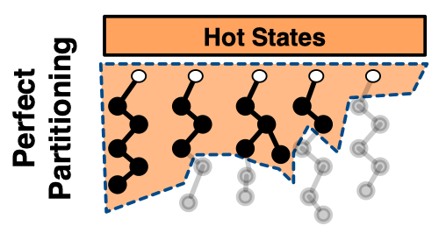
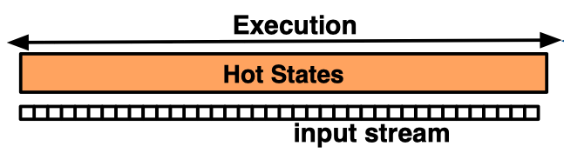
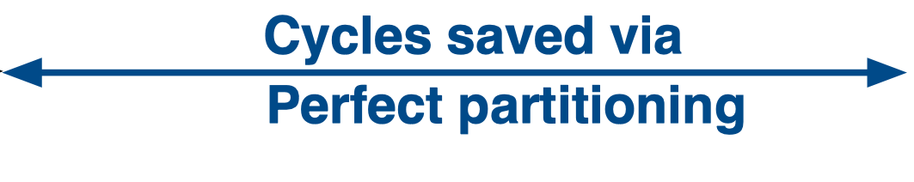
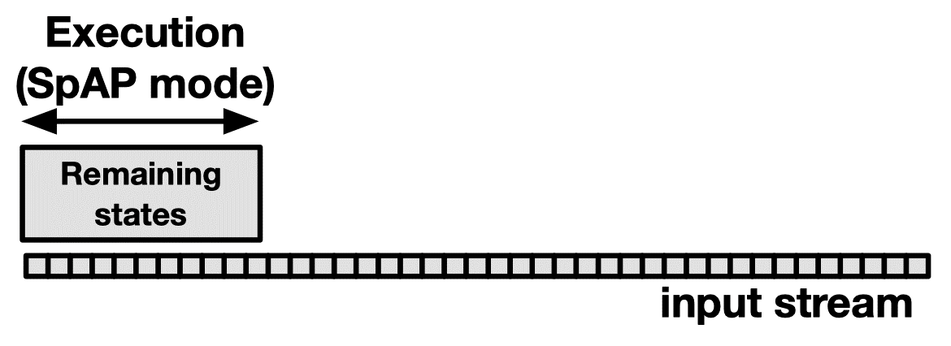
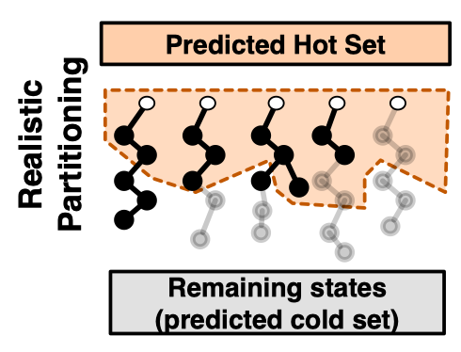
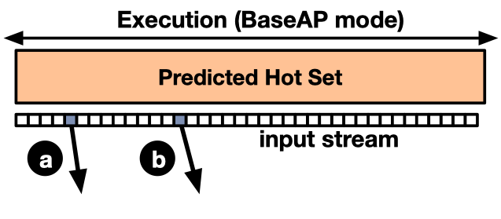
Handle the mispredictions --- SparseAP
Time
Cycle 5
Cycle 14
Notes:
To handle the intermediate reports caused by mispredictions, we propose SparseAP, which is an execution mode of AP.
It has two operations.
First, the enable operation enables the state to be continued in the matching process.
Second, the jump operation that jumps to a certain input position.
====
Here, we consider the realistic partition case. We partition the FSM states to predicted hot set, and predicted cold set.
We configure the predicted hot set to the BaseAP. During the BaseAP execution, transitions coming out the scope of predicted hot set are recorded in a list of intermediate reports.
In this example, the AP execution generates two intermediate reports, which are shown in (a) and (b).
After the AP execution, we handle the generated intermediate reports using SparseAP mode. We configure the predicted cold states to the SparseAP mode.

Slide 25
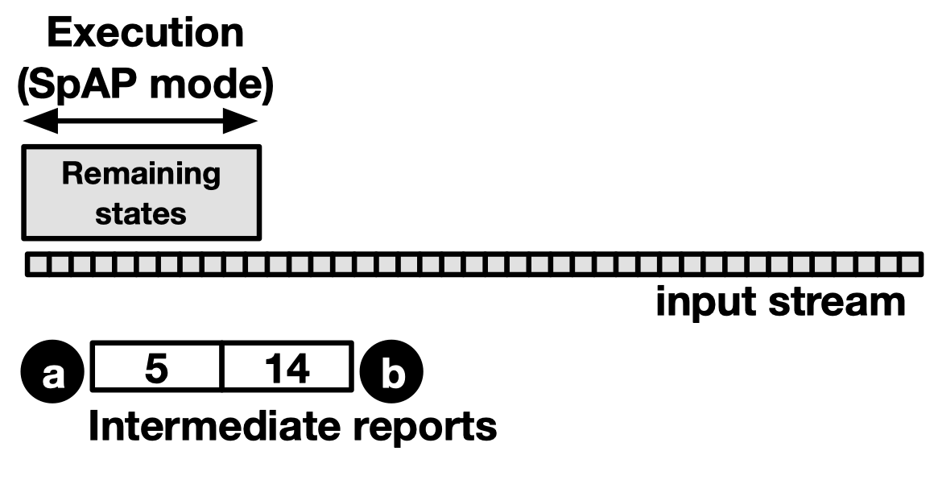
Handle the mispredictions --- SparseAP
Time
Notes:
Suppose the intermediate reports were generated at cycle 5 and cycle 14.

Slide 26
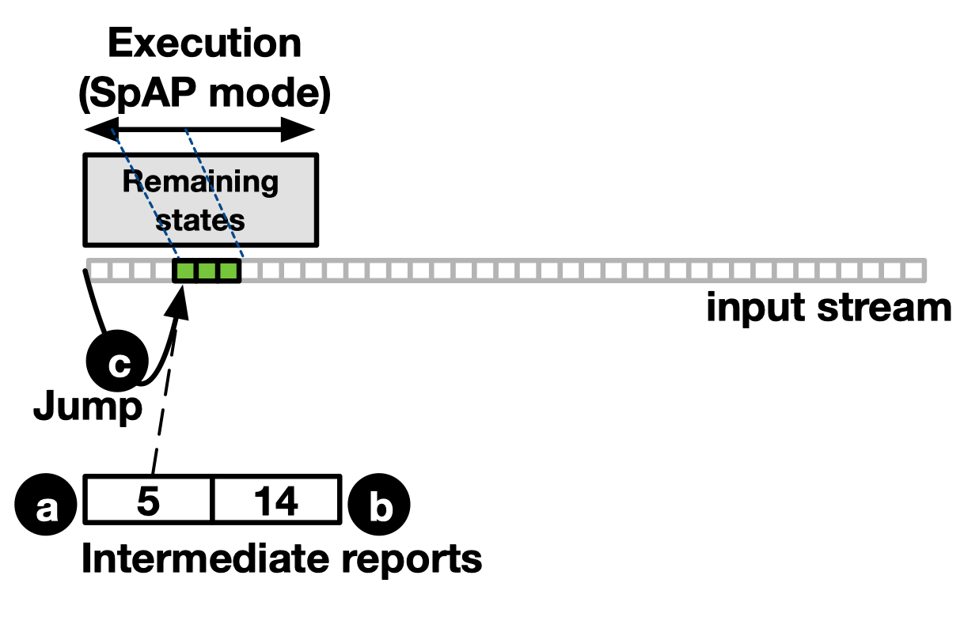
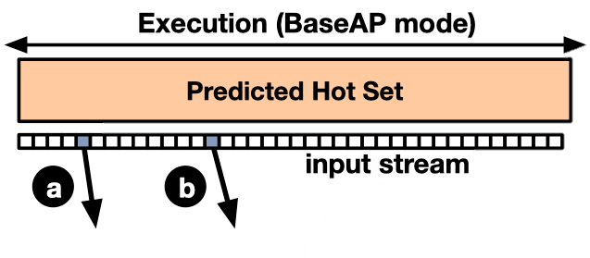
Handle the mispredictions --- SparseAP
Time
Notes:
At SparseAP mode, since there is no enabled state initially, we perform a jump operation to cycle 5 directly.
We enable the state that is to be continued.
After several cycles, there is no state enabled in SparseAP. This is either because of mismatch, or because a report is generated.

Slide 27
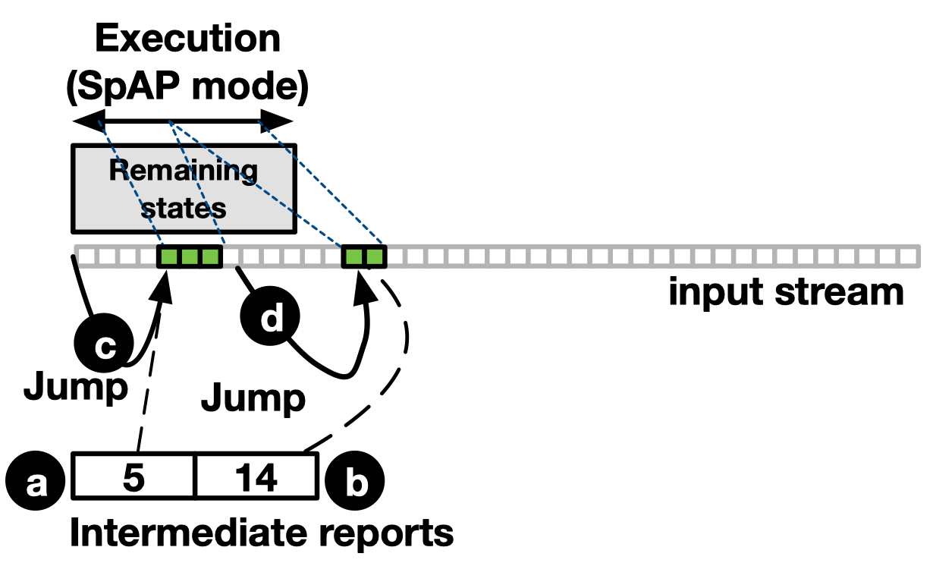
Handle the mispredictions --- SparseAP
Time
Notes:
Then the SparseAP performs a jump operation again. This jumps to the cycle where the second intermediate report was generated, which is 14.

Slide 28
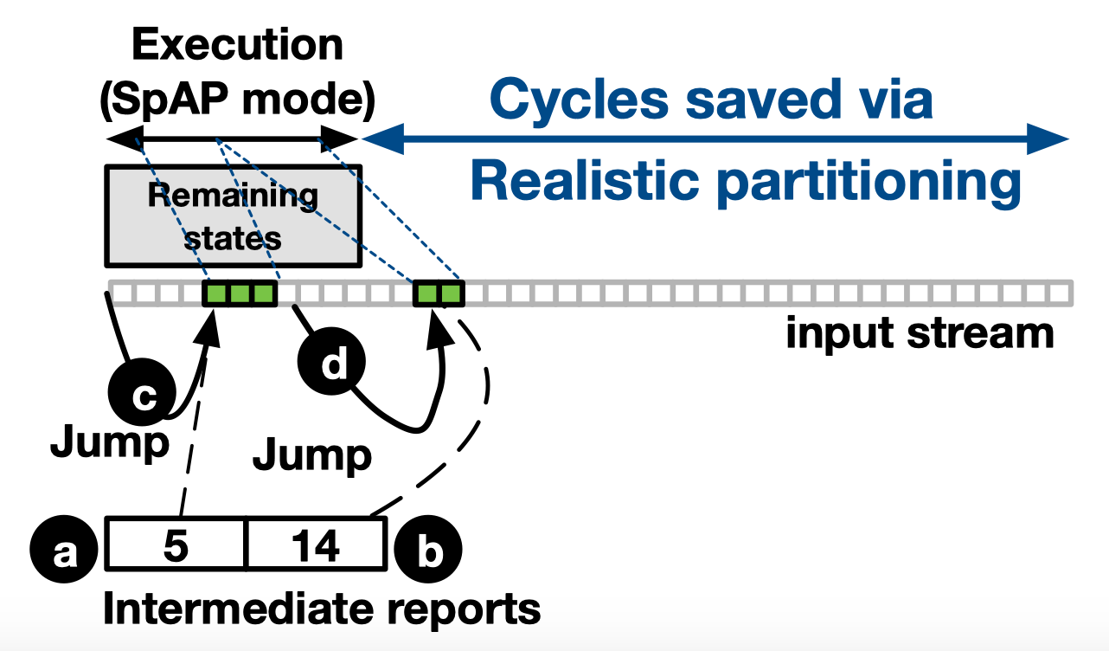
Handle the mispredictions --- SparseAP
Time
Notes:
After several cycles, there is no enabled state, and there is no intermediate reports to be handled. This finishes the SparseAP execution.

Slide 29
Outline
Introduction
Background and Motivation
Challenges and Our Approach
Results
Conclusions
Notes:
In the previous a few slides, we were talking about the introduction of our research.
This is the outline of this presentation. In the following parts, we will talked about background and motivation, challenges and our approach, results, and conclusions.

Slide 30
Evaluation Methodology
Our baseline AP
AP half-core
We build our evaluations on VASim
Benchmarks
ANMLZoo
RegEx
Offline profiling and testing input
0.1% and 1% of input as representative profiling input.
The rest is the testing input.
Notes:
We use an AP half-core as our baseline architecture.
We build our evaluations on VASim, which is a cycle-accurate simulator for automata processing.
We use two entire benchmark suites, ANMLZoo and Regex.
We use 0.1% and 1% of 1MB input as our representative input in the compiling time. We use the rest of input as our testing input.

Slide 31
Speedup
47x
2.1
1.8
Speedup is related to the underutilization of each application.
Notes:
Over the evaluated applications, our approach achieves up to 47x speedup.
Our approach achieves 1.8x and 2.1x speedup respectively on average using 0.1% and 1% profiling input.
The speedup is also related to the underutilization of each application.

Slide 32
Performance per area
32.1%
32.1% improvement of performance per area
More results are in the paper
Resource savings
Sensitivity to AP capacity
Effectiveness of SparseAP
…
Notes:
To measure the utilization efficiency of AP, we use a metric --- performance per area.
From this result, our approach achieves 32.1% improvement in terms of performance per STE.
More results are in the paper.

Slide 33
Conclusions
We show that many FSM states are cold (never-enabled) on AP leading to its underutilization.
We propose a novel topological-order based partitioning mechanism for FSMs that partitions only predicted hot states on AP.
We handle the mispredictions using a new execution mode (SparseAP) of AP.
Our low-overhead hardware/software approach achieves 2.1× geometric mean speedup (up to 47×) across 26 applications.

Slide 34
Thank You! Questions?
We acknowledge the support of the National Science Foundation (NSF) grants (#1657336, #1717532)
Notes:
Questions are welcome.
Thank you.

Slide 35
Architectural Support for Efficient Large-Scale Automata Processing
Hongyuan Liu, Mohamed Ibrahim (College of William & Mary),
Onur Kayiran (AMD),
Sreepathi Pai (University of Rochester),
and Adwait Jog (College of William & Mary)

Slide 36
Backup Slides

Slide 37
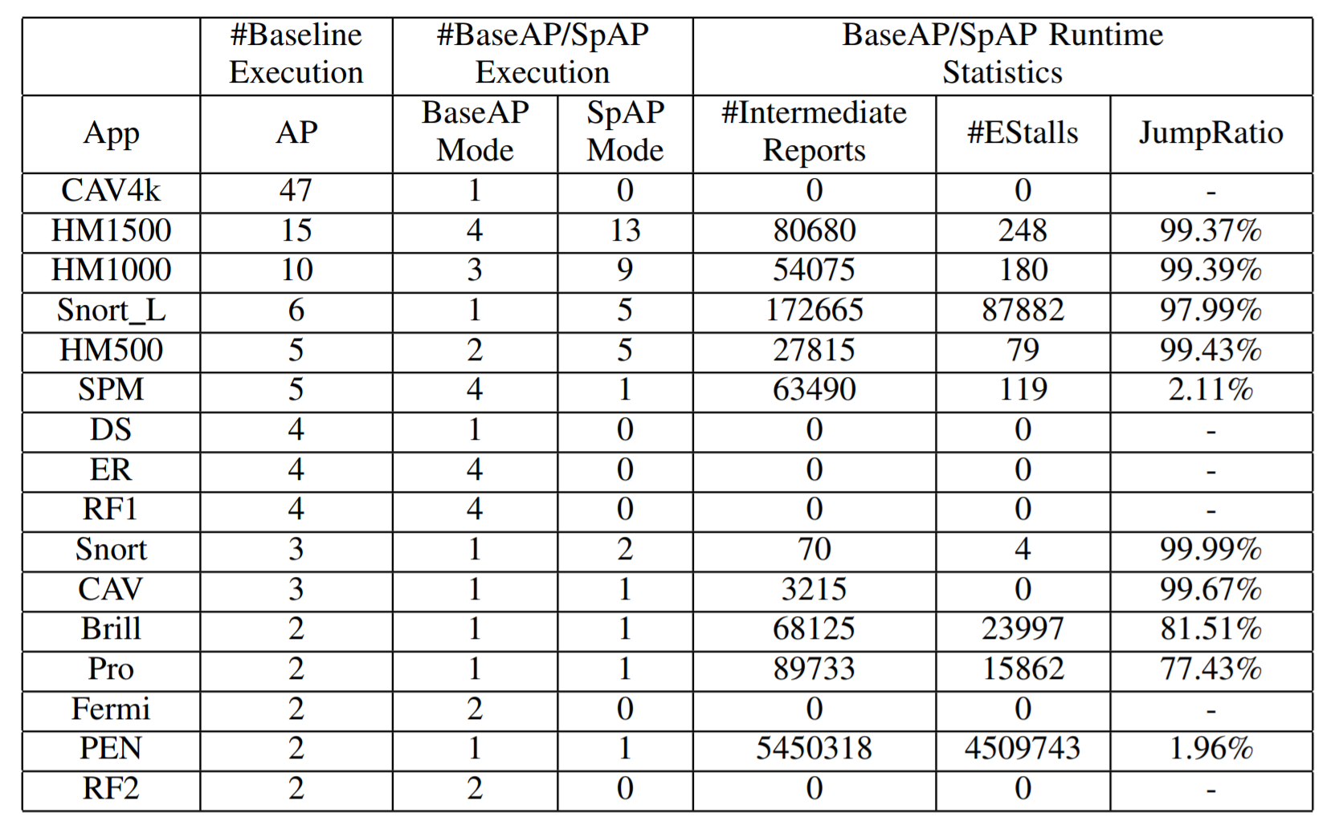
Jump Ratio

Slide 38
Sensitivity results: capacity = 49K
24x
2.1x
1.9x

Slide 39
Sensitivity results: capacity = 12K
29
54
7.5
8
2.2
1.9
If the AP size is smaller, more applications will have speedups.
Notes:
We also evaluate our results using a smaller AP, in which more applications have speedup.

Slide 40
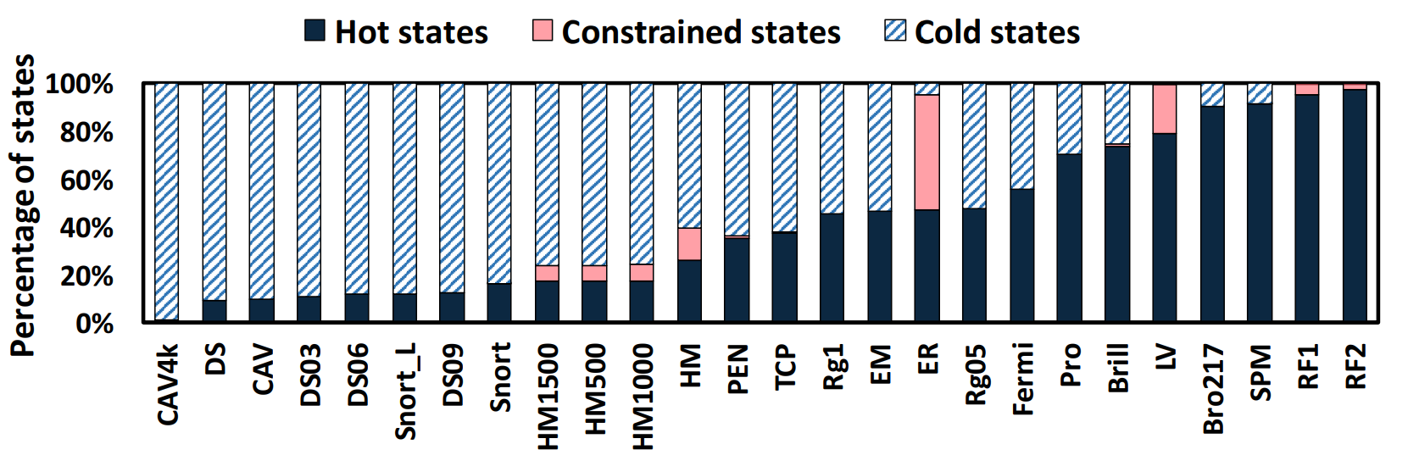
Topological-order-based Partition
Notes:
To

Slide 41
How to Predict Hot/Cold?
Use a small profiling input to predict the hot/cold states
Training
Testing
% from Input | 50% | 10% | 1% | 0.1%
% from Training | 100% | 20% | 2% | 0.2%
Accuracy | 97% | 93% | 90% | 87%
Notes:
First, we discuss how do we predict hot and cold states.
We use a simple profiling input to predict the hot and cold states.
To evaluate how a representative profiling input can predict the real situation in the execution, we evaluate the prediction in this methodology.
Each application has an 1MB input.
We split the input to two disjoint equal parts, which are training input and testing input.
We select different sizes of training input. We evaluate the accuracy of prediction by using different sizes of training input.
In our finial results, we use 1% and 0.1% of input.

