Slide 1


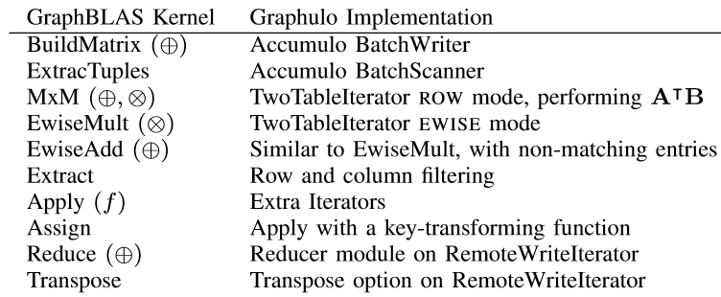
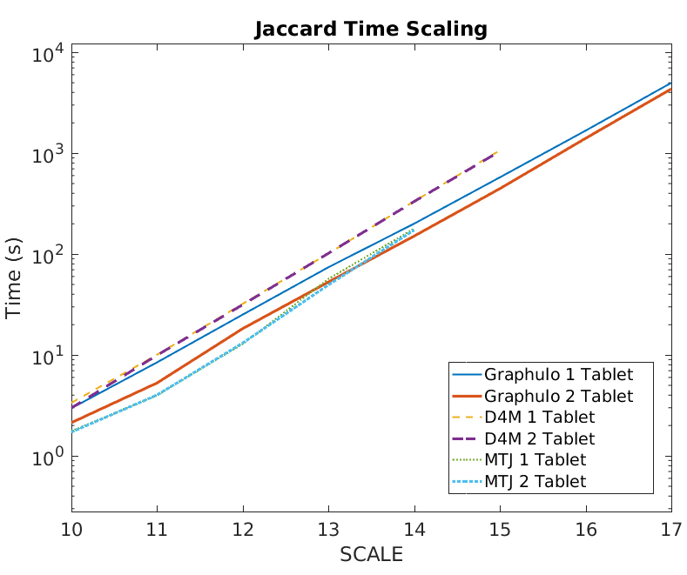
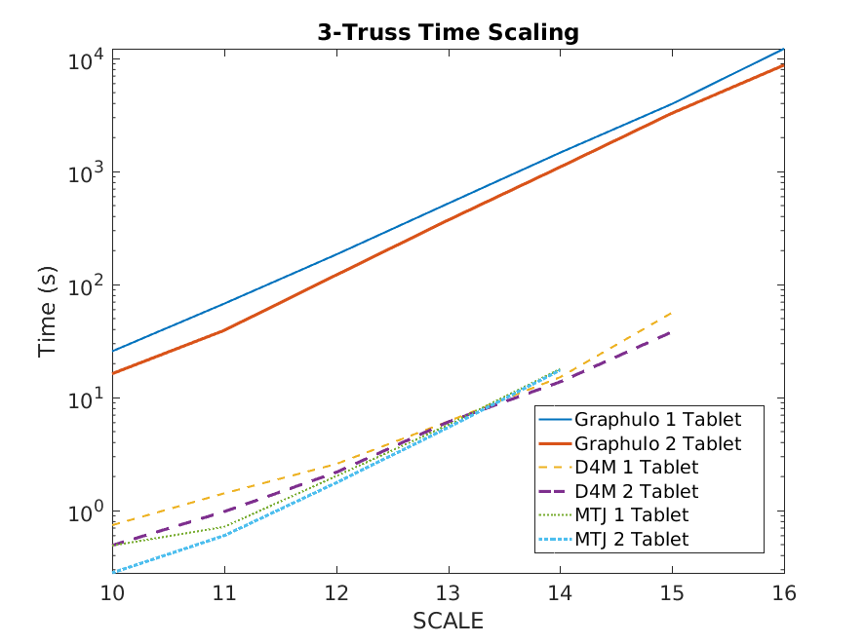
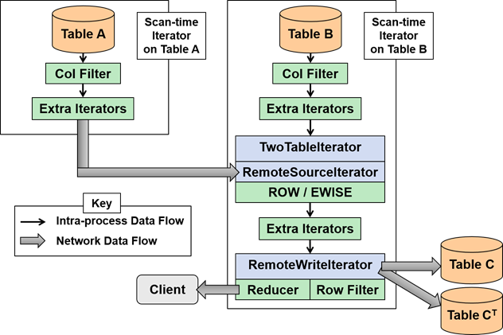
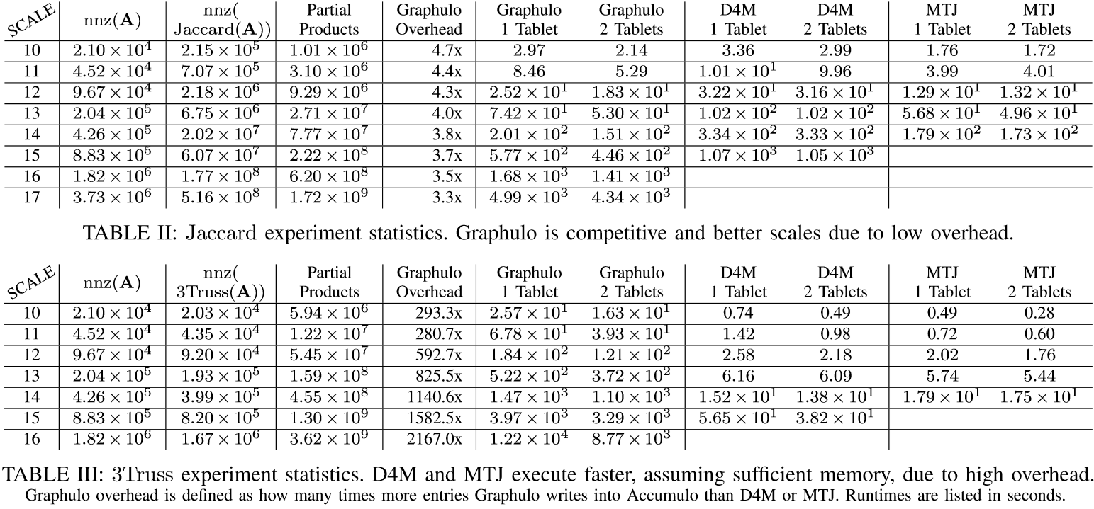
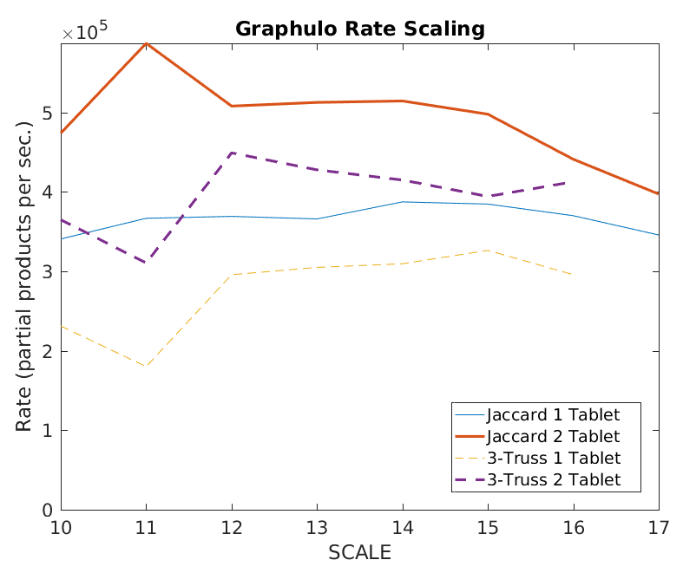
Graphulo: Native Linear Algebra in a NoSQL DB
Dylan Hutchison¹ Vijay Gadepally^{2,3} Jeremy Kepner^{2,3,4} Bill Howe¹
¹University of Washington ²MIT Lincoln Laboratory ³MIT CSAIL ⁴MIT Math Department
http://graphulo.mit.edu
GraphBLAS Matrix Math
Performance Comparison
D4M: Sparse Matrix Library for Matlab
MTJ: Dense Matrix Library for Java
An open source library to orchestrate server-side graph processing in the Apache Accumulo database
Example 3-truss
Jaccard: One Fused Matrix Multiply
k-Truss: Iterations of Matrix Multiplies
Problem: to analyze graph and matrix data stored in Accumulo
Non-solution: always pull data from the DB before processing
MapReduce or an in-memory matrix library
The Graphulo solution— A tighter coupling: reuse Accumulo’s native data access method, iterators, for query processing
Use Accumulo as a Big Index
Distribute with Accumulo’s tablet servers
Generalize to BigTable NoSQL design
Data model suits Sparse Matrices:
Graphulo’s TwoTable Iterator Stack
Competitive Graphulo benchmarks
Results
Future Work
Jaccard coefficient algorithm is ideal for Graphulo
k-Truss subgraph algorithm is better in an external matrix library, assuming sufficient memory
Use an in-DB solution when I/O is within an order of magnitude of alternative solutions
More multi-node evaluation
Expand to Relational Algebra
Use an Optimizer to choose the best implementation
Reference
Key |  |  |  |  | Value
Row | Column |  |  | Timestamp
 | Family | Qualifier | Visibility
IPDPS ‘15
HPEC ‘15
HPEC ’16 x2
Guideline

