Slide 1
Drone Mission Planning Software
David Klingenberg
Taylor Trabun

Slide 2
Overview
Problem Definition
Specific Component Design
Communications Design
Drone Design
Graphical User Interface Design
Timeline
Alternatives
Questions/Concerns

Slide 3
Problem Definition
The goal of this project is to design and develop a graphical user interface (GUI) for drone mission planning.
Requirements:
A user-friendly interface
Allow 3-dimensional mission planning
Upload the flight plan using XAPI and XBee
Allow manual override
Implement drone hardware for flight control

Slide 4
Overview
Problem Definition
Specific Component Design
Communications Design
Drone Design
Graphical User Interface Design
Timeline
Alternatives
Questions/Concerns

Slide 5
Communication Design
The communication system for this project must allow for commands to be sent from a computer to a drone.
Requirements:
XAPI and XBee hardware
Specific TUN packets:
Manual drone instructions (altitude, direction, takeoff, etc..)
Settings
Acknowledgement of packet received
Heartbeat/status updates
Override (manual, land)
Flight plan protocol
Initialize for upload
Get instructions
Echo instructions
Terminate upload

Slide 6
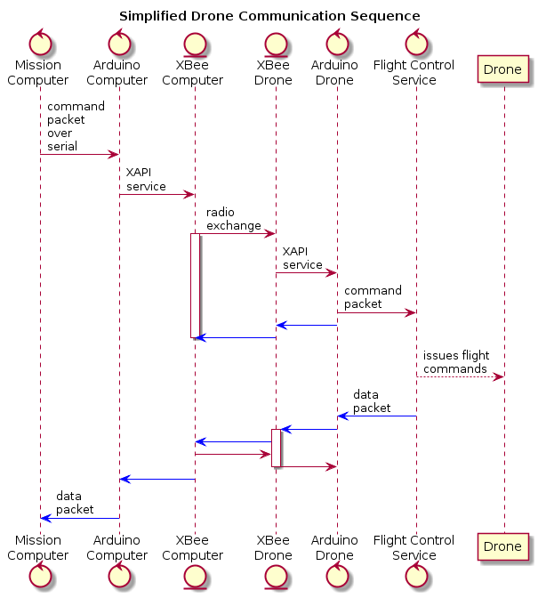

Slide 7
Overview
Problem Definition
Specific Component Design
Communications Design
Drone Design
Graphical User Interface Design
Timeline
Alternatives
Questions/Concerns

Slide 8
Drone Design

Slide 9
Overview
Problem Definition
Specific Component Design
Communications Design
Drone Design
Graphical User Interface Design
Timeline
Alternatives
Questions/Concerns

Slide 10
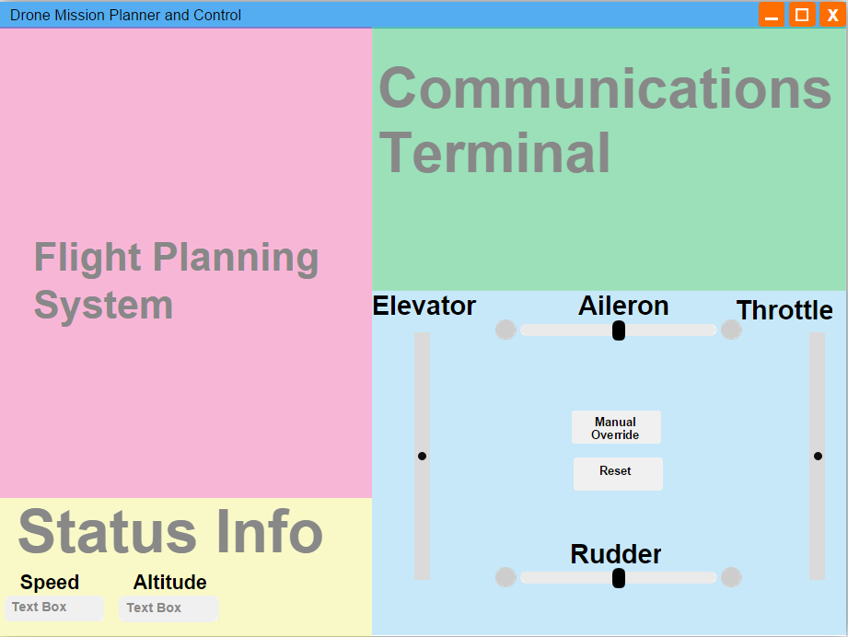
Graphical User Interface Design

Slide 11
Overview
Problem Definition
Specific Component Design
Communications Design
Drone Design
Graphical User Interface Design
Timeline
Alternatives
Questions/Concerns

Slide 12
Timeline
Re-design drone for reliable flight
Finish designing all needed packet types for drone control, status, ACK, and override.
Implement service on Arduino to send commands to flight computer
Finish implementing communications between two Arduino boards over XBee using XAPI
Finalize GUI design, implement communications system, design mission planning sub-system

Slide 13
Overview
Problem Definition
Specific Component Design
Communications Design
Drone Design
Graphical User Interface Design
Timeline
Alternatives
Questions/Concerns

Slide 14
Alternatives
Modify an already existing drone control system to use XAPI.
Pros:
Simplify development of flight system
Altitude hold
Drift compenstation
etc..
Allows for concentration on software tools
Cons:
Modification may prove to be more difficult
May be a dead end or require more work than current approach

Slide 15
Alternatives
The other alternative is to re-scope the project in order to focus on communications design and the flight planning tools by abstracting the hardware.
Pros:
More solid communication protocol
Solid planning tools (GUI)
Allow assembly for a more knowledgeable hardware team
Cons:
Abstract design that needs further implementation to be compatible with real-world hardware

Slide 16
Overview
Problem Definition
Specific Component Design
Communications Design
Drone Design
Graphical User Interface Design
Timeline
Alternatives
Questions/Concerns

Slide 17
Thank You
Questions or concerns?

